Slide 1
30 Years of USU in Space An exhibit celebrating the history and future of the GAS team
Curated by
Betty Rozum and
Andrew Wesolek
Merrill-Cazier Library
Summer 2012

Slide 2
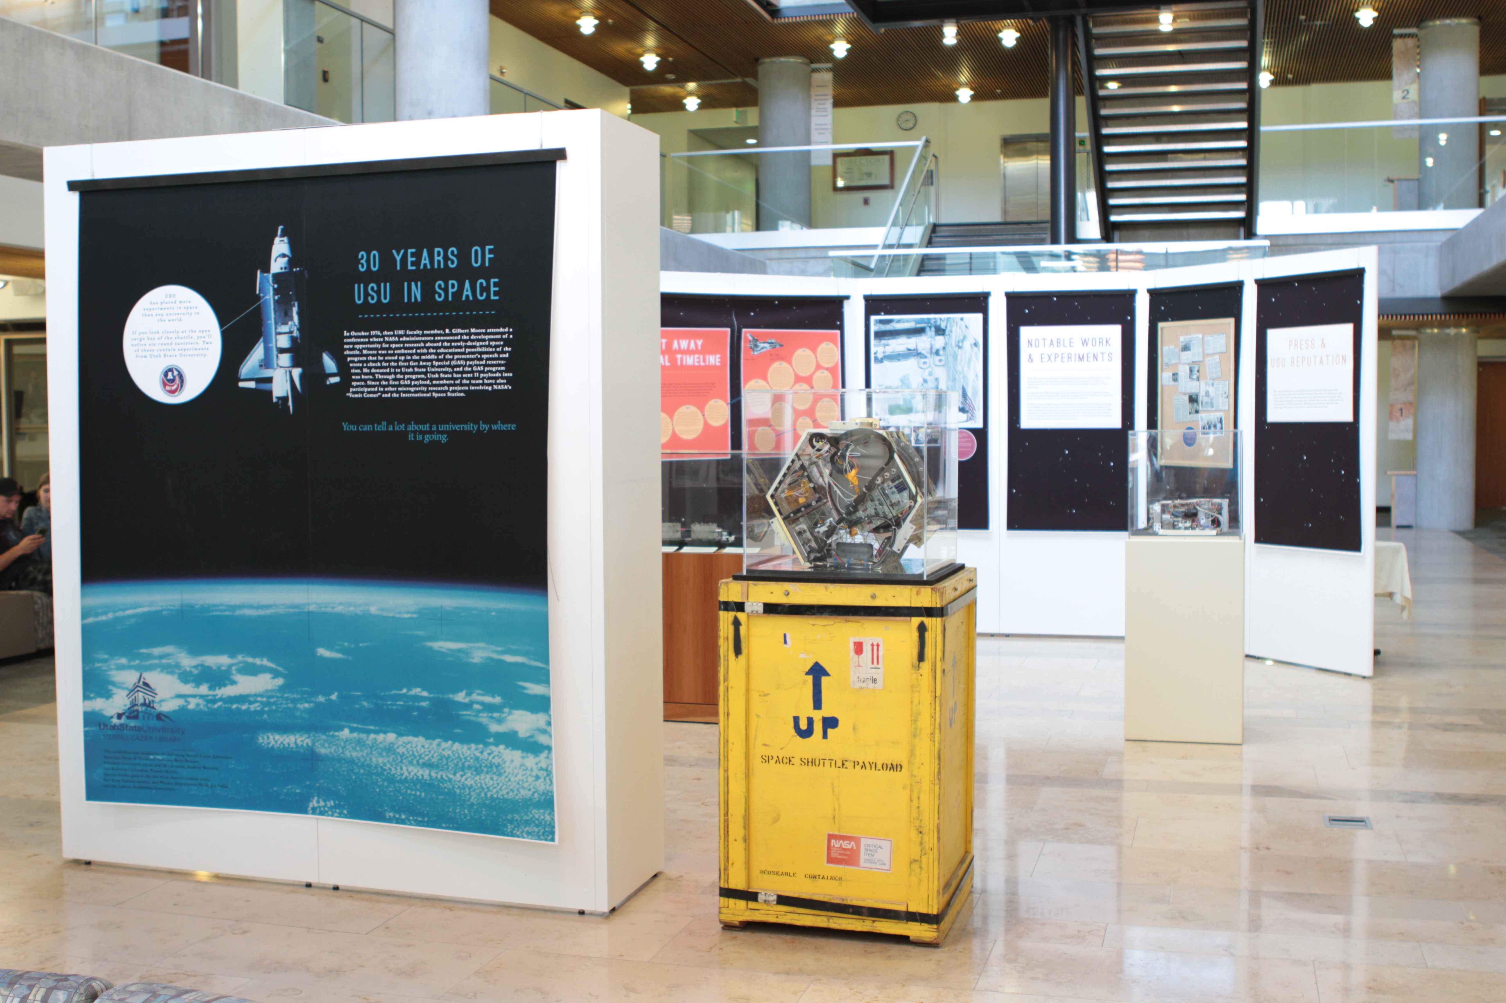
Notes:
30 Years of USU in Space
In October 1976, then USU faculty member, R. Gilbert Moore attended a conference where NASA administrators announced the development of a new opportunity for space research aboard the newly-designed space shuttle. Moore was so enthused with the educational possibilities of the program that he stood up in the middle of the presenter’s speech and wrote a check for the first Get Away Special (GAS) payload reservation. He donated it to Utah State University, and the GAS program was born. Through the program, Utah State has sent 11 payloads into space. Since the first GAS payload, members of the team have also participated in other microgravity research projects involving NASA’s “Vomit Comet” and the International Space Station.

Slide 3
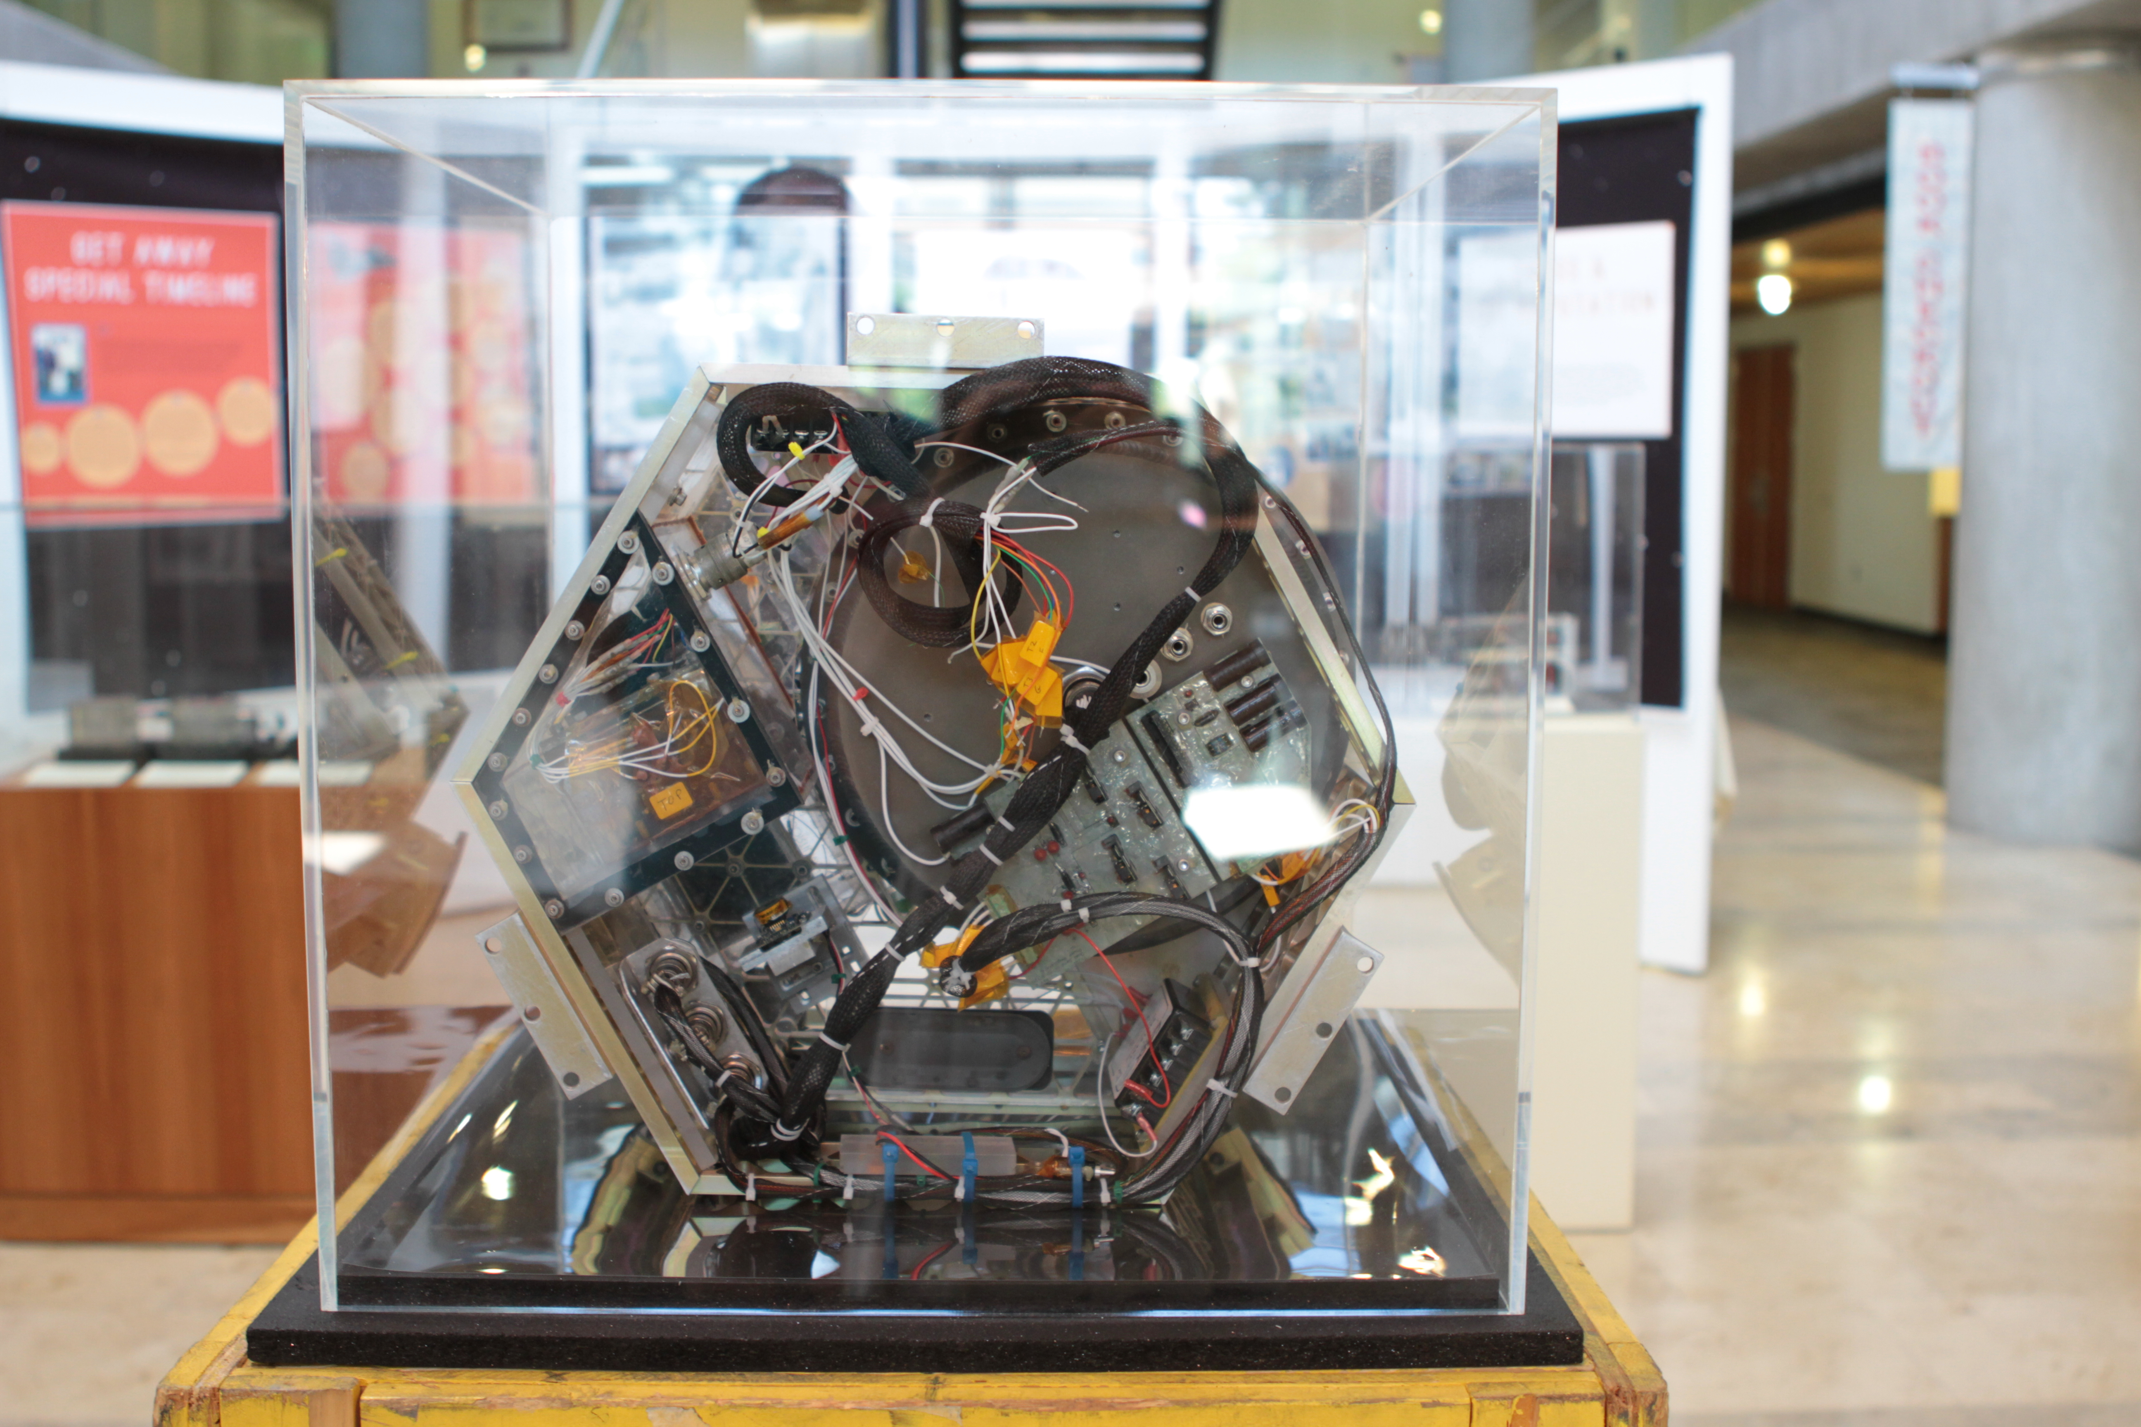
Notes:
This is USU's tenth payload, a joint effort with Box Elder High School, Moscow High School and Shoshone Bannock Jr./Sr. High School, flew on Space Shuttle STS-91.
Utah State University’s students at Logan Campus, designed the GAS payload G-090, as well as built the power supply and computer controls. The payload included three experiments conceptualized by high school students and built by USU GAS students.
G-090 gave high school students an opportunity to design experiments and work with USU students who acted as mentors then, coordinated the integration and building of the computer and power interfaces.
The first experiment, and the first GAS payload designed by Native American students (students at Shoshone-Bannock Junior/Senior High School on the Fort Hall Reservation, Idaho) was the Chemical Unit Process (CUP). Students wanted to learn how microgravity affected extracting phosphate ions, widely used as a fertilizer, from the phosphate ore that is mined on their reservation.
The second experiment, Nucleic Boiling, designed by Box Elder High School in Brigham City, Utah, studied the effects of microgravity on bubble formation and temperature gradients as water was heated to a boil during the flight. This process is affected on Earth by gravity, convection and liquid density.
Moscow (Idaho) High School and the University of Idaho formulated a crystal growth experiment to study the formation and growth of chemical crystals in a microgravity environment.
Lastly, the fourth experiment from St. Vincent Elementary School in Salt Lake City, compared traits of popcorn and radish seeds exposed to space with control seeds kept on Earth.

Slide 4
Notes:
The GAS team sent a number of notable components and experiments into space. In the early days, the GAS students built their own computers to control the experiments they sent into space. The computers were huge compared to those used today.
In addition, the GAS team engineered and produced its own isogrid structures, which maximize strength while minimizing weight, for their experiments. Much had to be created from scratch to meet the demands of NASA.
In recent work, the GAS team is exploring how water boils in microgravity through its FUNBOE experiments. These experiments could yield practical applications, such as using microchips to cool systems in zero gravity. During the first FUNBOE experiment, a number of students because sick, due to the effects of the “Vomit Comet.” This did not deter the GAS team, however, as it redesigned the experiment to avoid sickness while collecting even more data.

Slide 5
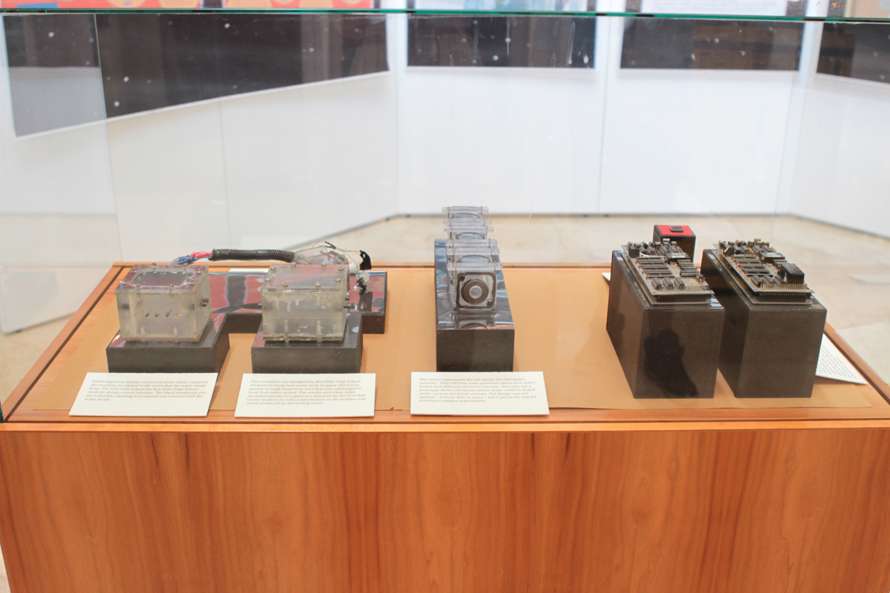

Slide 6
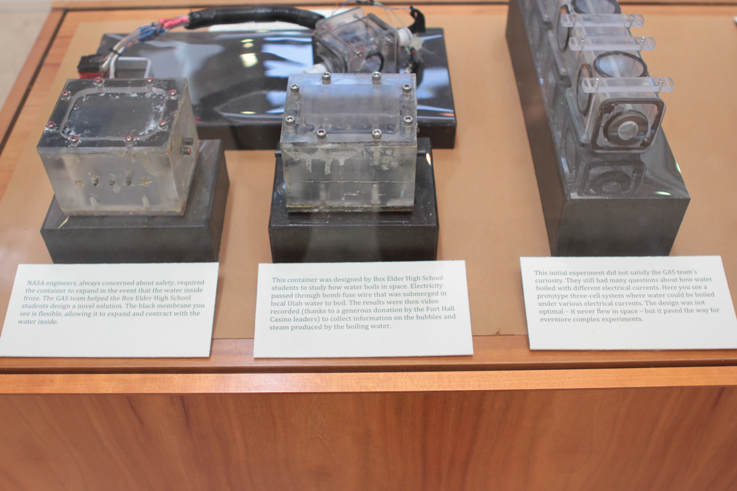
Notes:
(Right) NASA engineers, always concerned about safety, required the container to expand in the event that the water inside froze. The GAS team helped the Box Elder High School students design a novel solution. The black membrane you see is flexible, allowing it to expand and contract with the water inside.
This container (center) was designed by Box Elder High School students to study how water boils in space. Electricity passed through bomb fuse wire that was submerged in local Utah water to boil. The results were then video recorded (thanks to a generous donation by the Fort Hall Casino leaders) to collect information on the bubbles and steam produced by the boiling water.
(Left) This initial experiment did not satisfy the GAS team’s curiosity. They still had many questions about how water boiled with different electrical currents. Here you see a prototype three-cell system where water could be boiled under various electrical currents. The design was not optimal – it never flew in space – but it paved the way for evermore complex experiments.

Slide 7
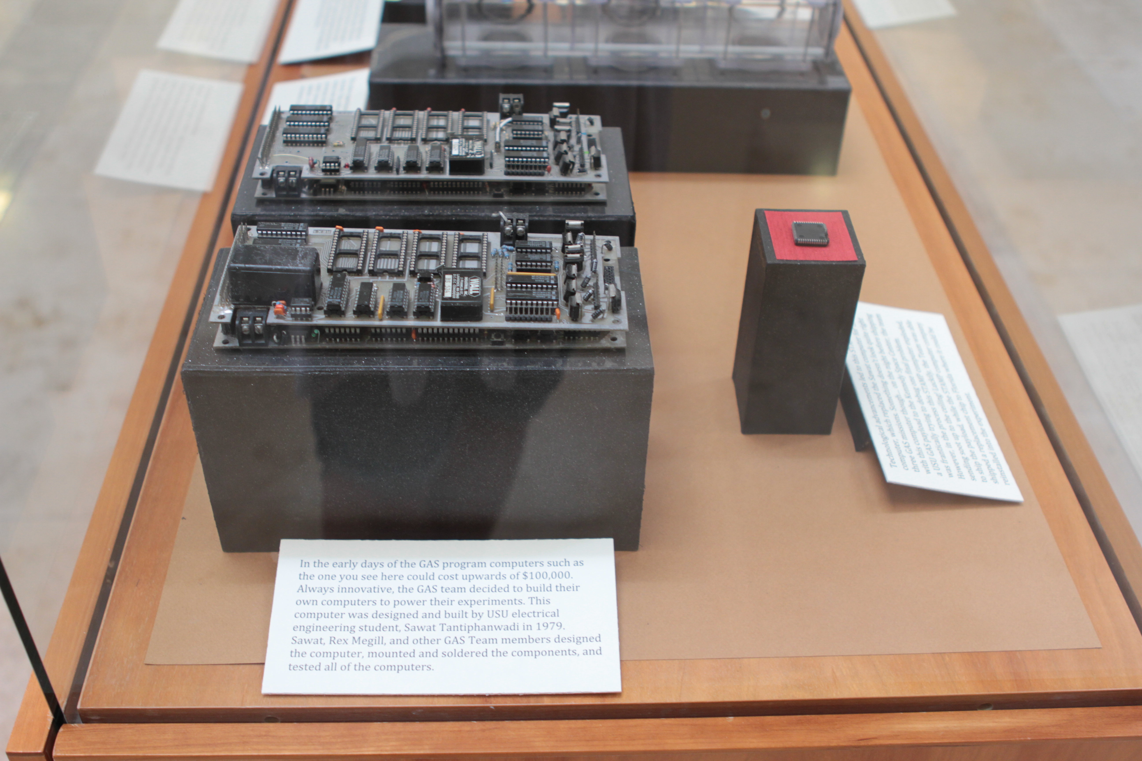
Notes:
In the early days of the GAS program computers such as the one you see here (left) could cost upwards of $100,000. Always innovative, the GAS team decided to build their own computers to power their experiments. This computer was designed and built by USU electrical engineering student, Sawat Tantiphanwadi in 1979. Sawat, Rex Megill, and other GAS Team members designed the computer, mounted and soldered the components, and tested all of the computers.
Technological advancements led to this STAMP type computer (right), which replaced the Sawat computer for the last three GAS missions. Something doesn’t look quite right with this computer though… on the night before shipping a USU GAS payload to the Kennedy Space Center, the team was frantically trying to debug one final problem. However, in the process this STAMP computer exploded, sending soot up to the ceiling! Luckily, the Team was able to ship the payload, while the STAMP computer company shipped a replacement chip to Florida where it could be reinstalled into the experiment.

Slide 8
Notes:
After learning from these initial designs, the GAS students now work with up to 30 compact stand-alone cells at one time! These experiments have flown on NASA’s Vomit Comet, most recently in July of 2012. In all, 18 GAS students have experienced zero gravity. Many of them also experienced the Vomit Comet’s titular ill-effects!

Slide 9
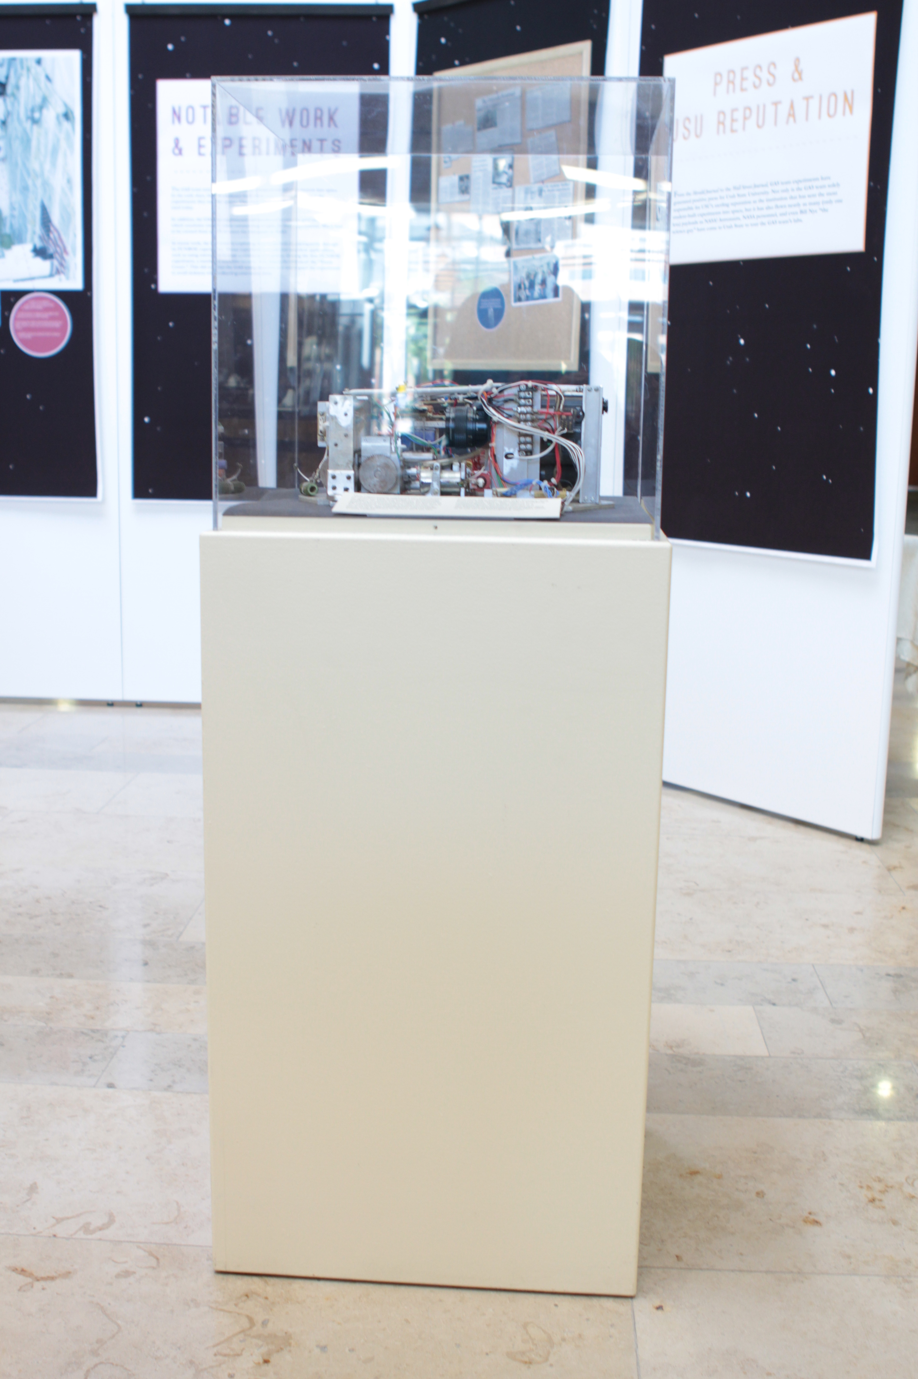

Slide 10
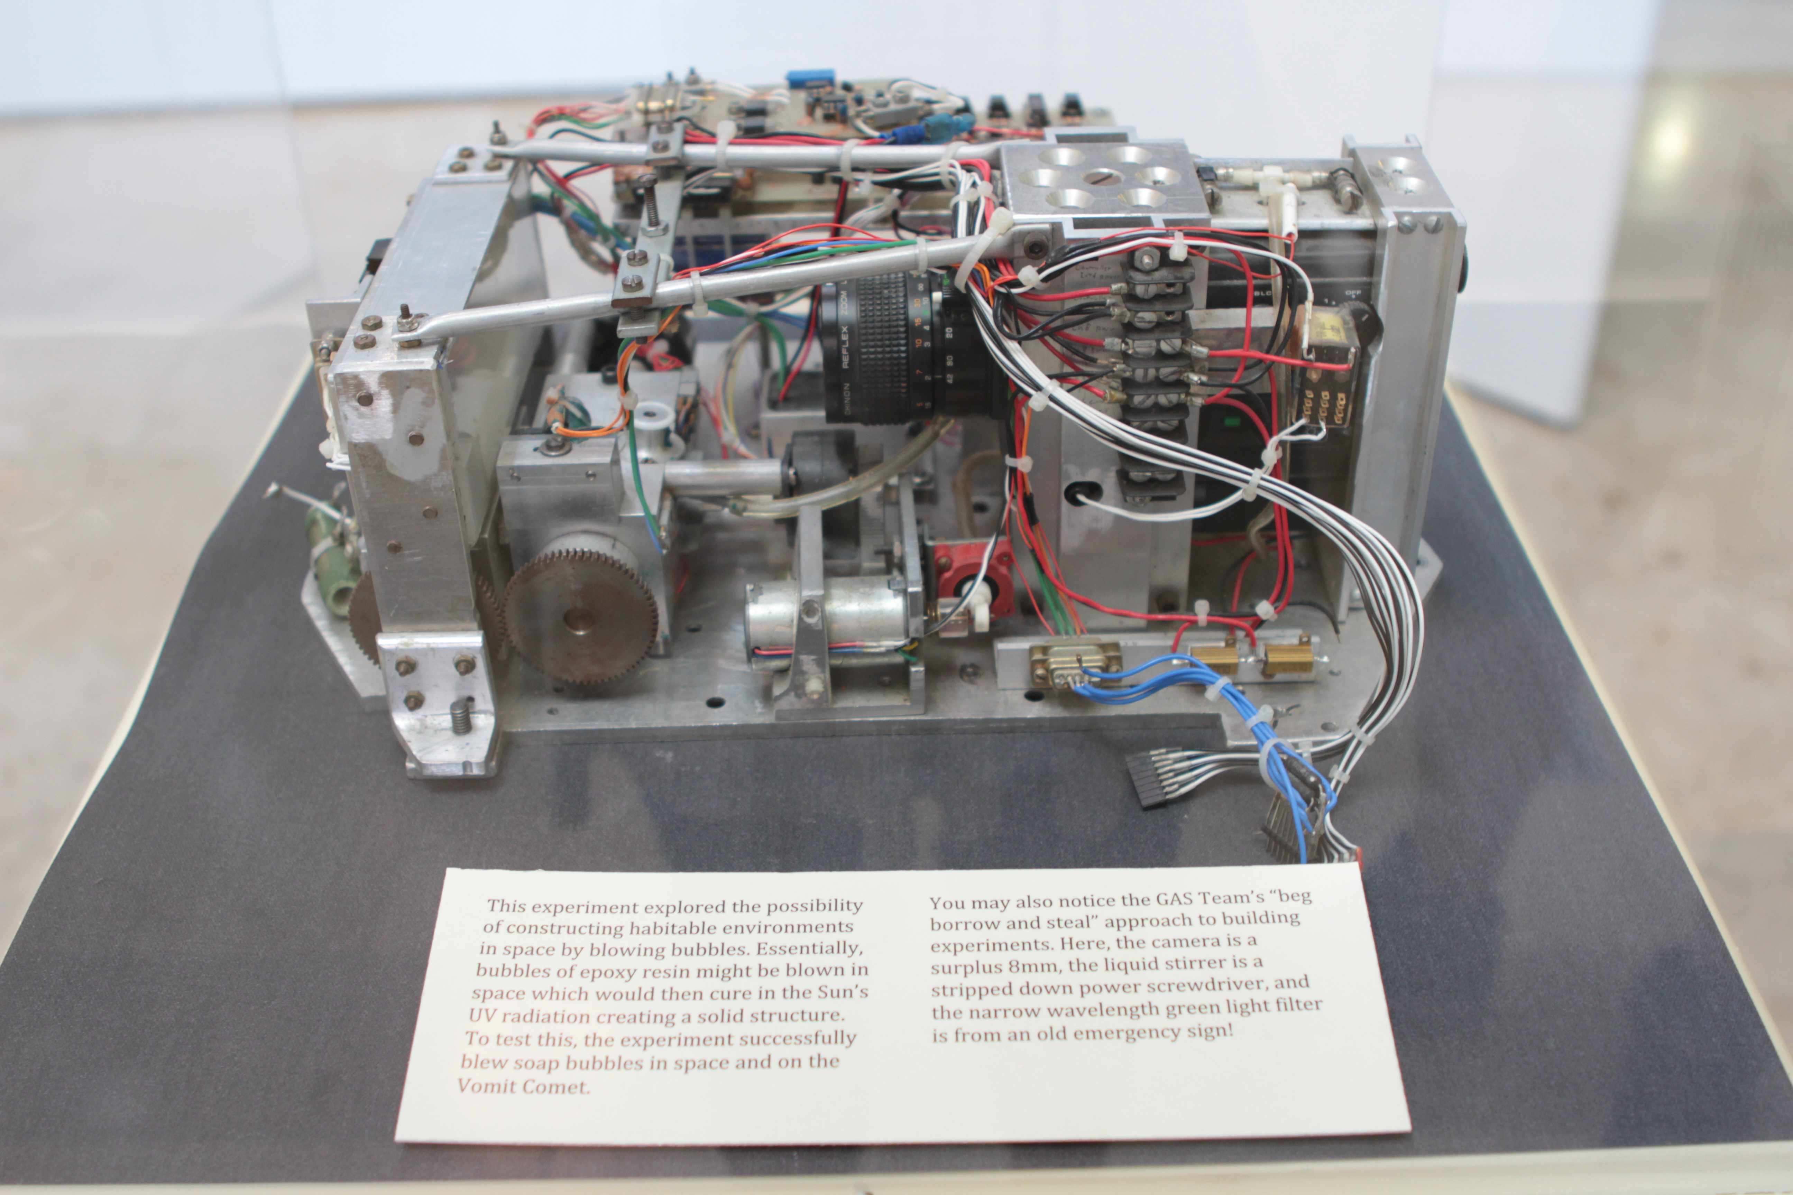
Notes:
This experiment explored the possibility of constructing habitable environments in space by blowing bubbles. Essentially, bubbles of epoxy resin might be blown in space which would then cure in the Sun’s UV radiation creating a solid structure. To test this, the experiment successfully blew soap bubbles in space and on the Vomit Comet.
You may also notice the GAS Team’s “beg borrow and steal” approach to building experiments. Here, the camera is a surplus 8mm, the liquid stirrer is a stripped down power screwdriver, and the narrow wavelength green light filter is from an old emergency sign!

Slide 11
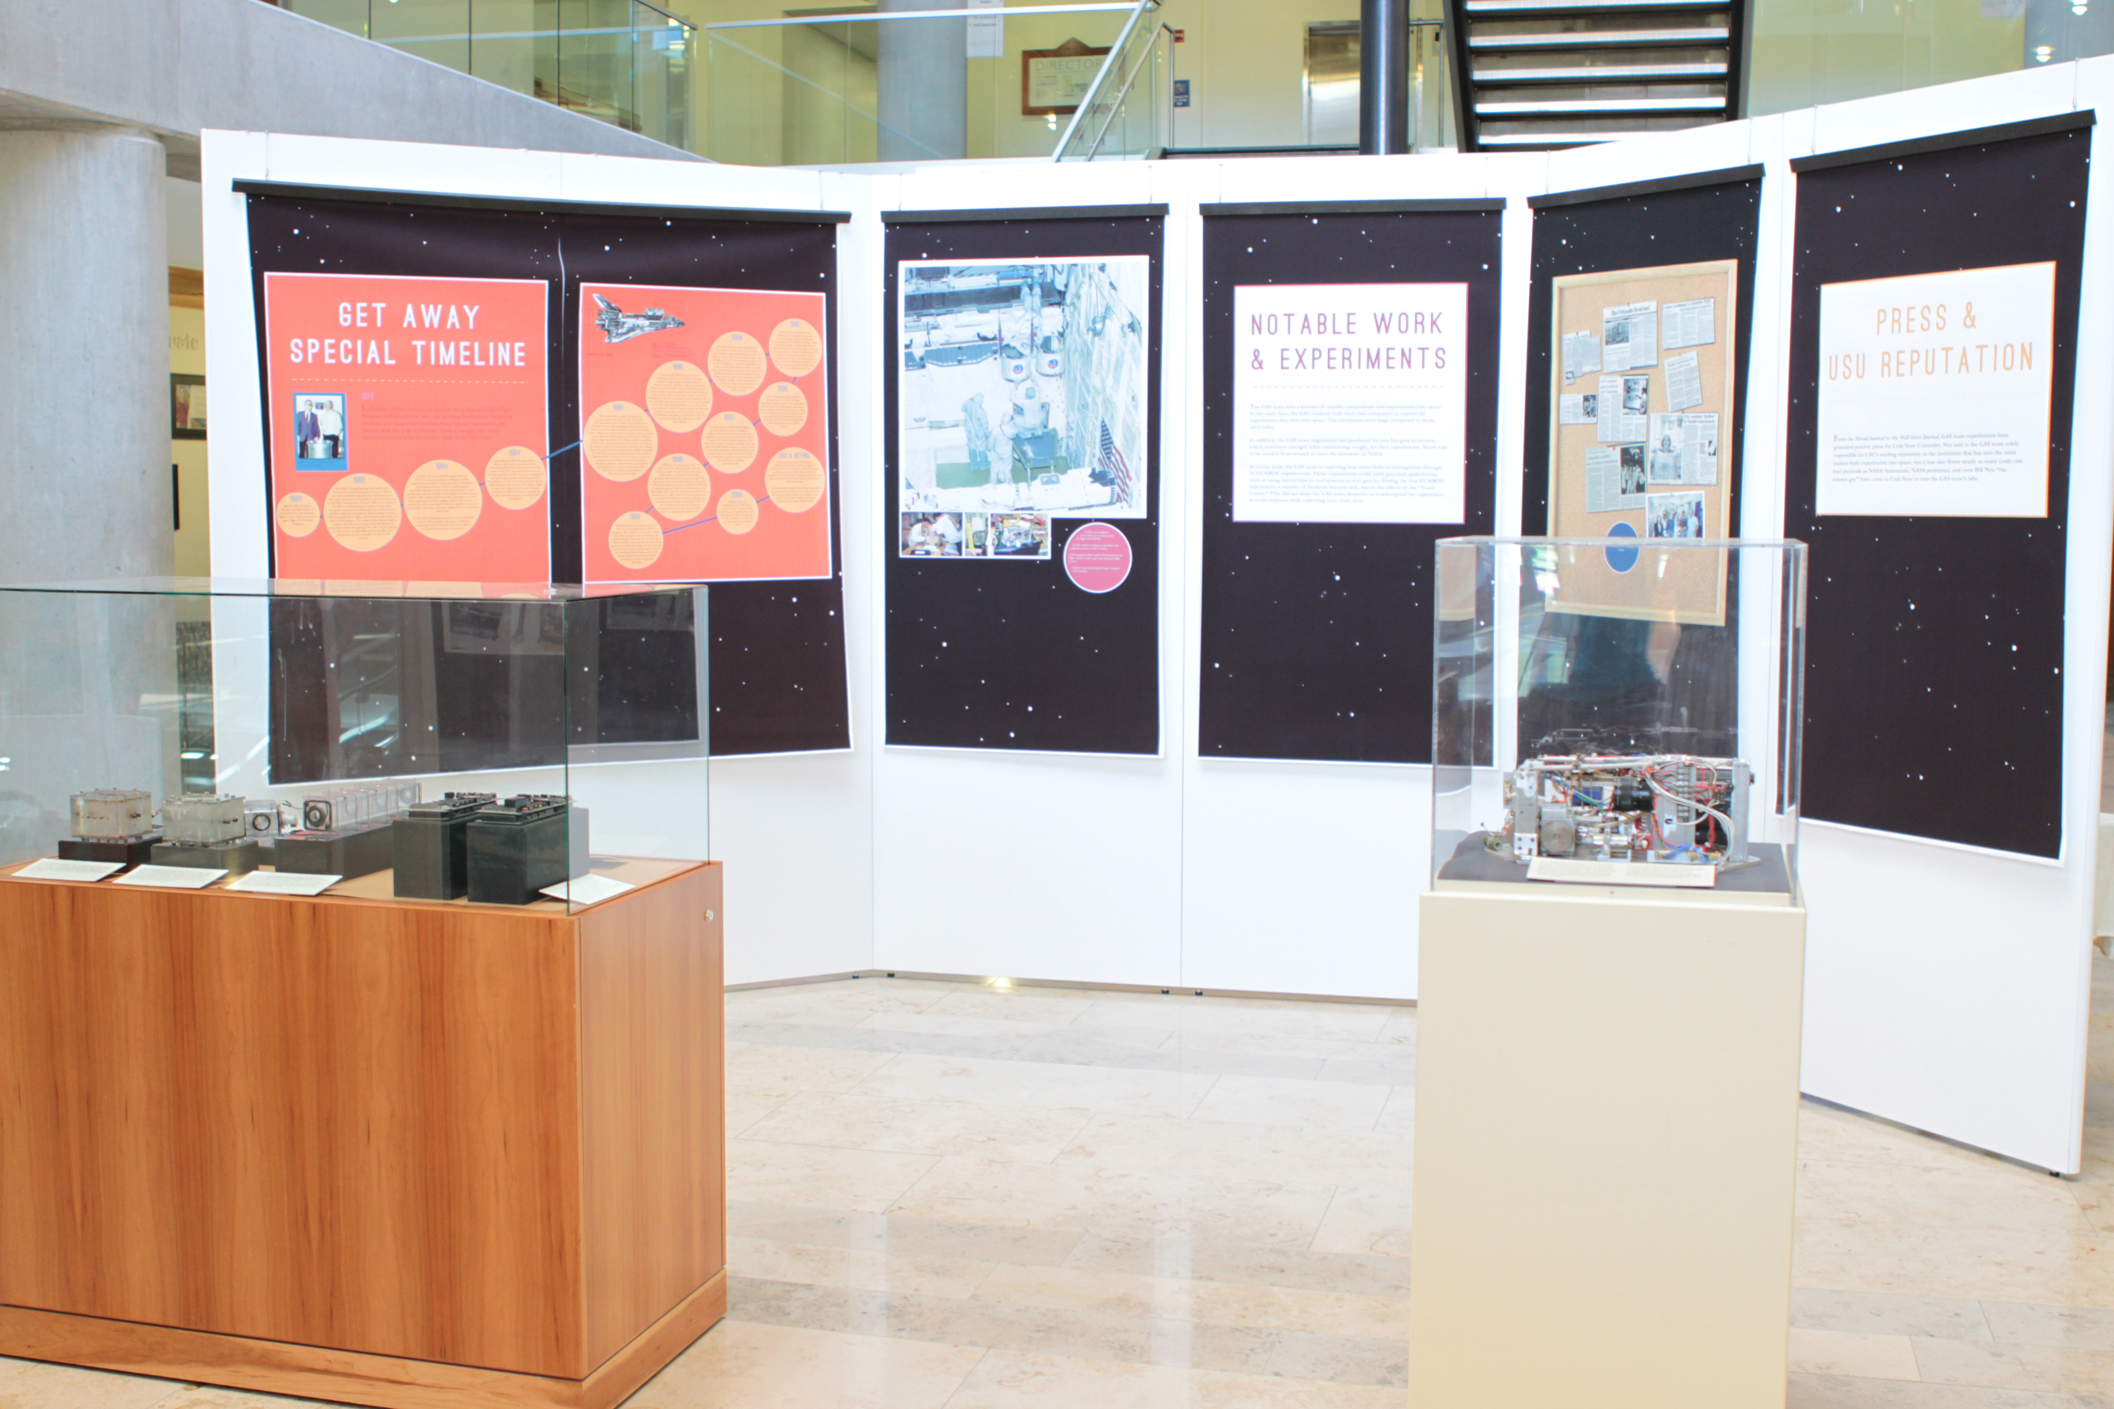

Slide 12
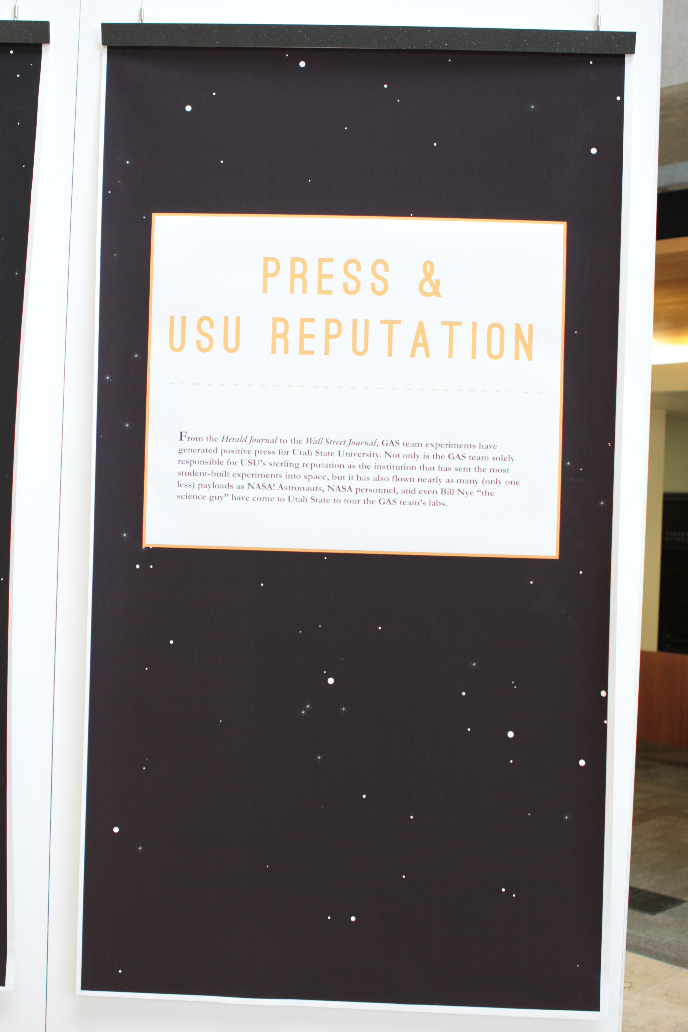
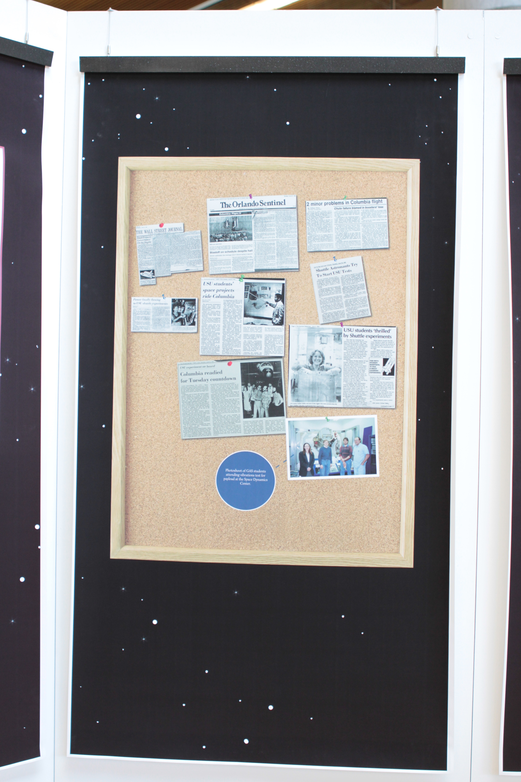
Notes:
Press and USU Reputation
From the Herald Journal to the Wall street Journal, GAS team experiments have generated of positive press for Utah State University. Not only is the GAS team solely responsible for USU’s sterling reputation as the institution that has sent the most student-built experiments into space, but it has also flown nearly as many (only one less) payloads as NASA! Astronauts, NASA personnel, and even Bill Nye “the science guy” have come to Utah State to tour the GAS Team’s labs.

Slide 13
Notes:
Gas Team Timeline:
1976 In October, NASA introduced the Get Away Special Flight Program. Gilbert Moore, who was working for Norton-Thiokol at the time, purchased the first Get Away Special reservation. Mr. Moore, with the help of Morton-Thiokol, bought nine more reservations that were donated to Utah State University.
1981 April 12, 1981, the Space Shuttle Columbia lifted off from Pad 39 at Kennedy Space Center. This was the first space flight of the Shuttle Program.
1982 USU’s first GAS payload, also the world’s first, flew on STS-4 which launched on June 27, 1982. It was a very ambitious payload. One experiment grew successive generations of fruit flies to see if microgravity on epoxy resin-graphite composite curing, brine-shrimp genetics, duckweed root growth, soldering, homogenous alloy formation, surface tension, growth rate of algae, and thermal conductivity of a water and oil mixture. Two students flew Masters degree projects. The first was a survey of the distribution of temperature within the payload. The other was in response to the need fore an affordable microcontroller. The student developed a controller for use in GAS canisters.
1984 G-004, Utah State University’s second GAS canister flew on STS-41-C which launched on February 3, 1984. Space Science students at the University of Aberdeen in Scotland used one of Utah State University’s newly designed SpacePaks. Aberdeen students flew experiments on spore growth, three dimensional Brownian motion, and dimensional stability. USU students filled two other SpacePaks in G-004. These experiments probed capillary action in the absence of gravity. One of the experiments looked at capillary waves on a water surface; the other, at thermo capillary flow in columns of melted wax.
G-008, Utah State University’s 3rd payload, also flew on the STS-41-B mission. Utah State University students redesigned a soldering experiment from G-001 and tested a heat pipe to be used in a future space experiment.
1984 The ability to refly GAS experiments within a short turn around period was demonstrated by Utah State University students on the G-518 payload. Four USU experiments flown as two different payloads on STS-41-B were reconfigured into this single payload, which flew just four months later on STS-41-G (launched October 5, 1984). The brief time between their flights might be one of the fastest turnarounds for space experiments in NASA history; it certainly was for any university program associated with the Shuttle.
1985 The pioneer GAS satellite sprang into a twenty-month orbit from G-010 aboard STS-51-B (launched April 29, 1985). The brainchild of a Federal Aviation Administration (FAA) engineer, the Northern Utah Satellite (NUSAT) was built as a Weber State College senior class project. Its purpose was to provide a safer and more efficient means for the FAA to calibrate airport radar equipment. The college students assembled NUSAT with components and technical back up from an all-volunteer team from Utah State University, New Mexico State University, the FAA, Goddard Space Flight Center, the U.S. Air Force, and more than 26 private corporations. Because NUSAT was the first-of-a-kind, as well as an example of extraordinary cooperation between education, industry, and government, the NUSAT structural text prototype became part of the Smithsonian Institution’s permanent collection in October, 1987.
1986 On January 28, 1986 the Space Shuttle Challenger and her crew, Francis R. Scobee, Michael J. Smith, Judith A. Resnik, Ellison S. Onizuka, Ronald E. McNair, Gregory B. Jarvis and Sharon Christa McAuliffe lifted off at 11:38 a.m. after a series of delays from the original launch date of January 22nd. Seventy three seconds after launch the orbiter, Challenger broke into several pieces and claimed the life of her crew. The explosion was traced to an o-ring that failed due to the cold weather in Florida that morning. This event stopped the Shuttle Program, and in turn the GAS program. It was more than a year before the next Shuttle flight, and eight years before the Utah State University Get Away Special flew any experiments on the Space Shuttle.
1994 The STS-64 mission was a landmark for the students involved with the Utah State University Get Away Special. A decade after the flight of G-010, USU was returning to space with the flight of G-254. The experiments explored the details of distillation, convective instabilities, the changes on the photosynthetic ability of a plant lichen, the interference patterns on the surface of a bubble in microgravity, and included the first flight of space popcorn for elementary school children. Another major component of G-254 was a flight test of a sample of the future experiment structure called iso-grid.
1995 The Utah State University Get Away Special expanded its horizons but participating in the first European Space Agency (ESA) Student Parabolic Flight Campaign. Raghu Tumkur and Thomas Gribovszki were fortunate enough to pretend to be astronauts for a day. The experiment they conducted studied properties of water in weightlessness. They were looking at thin films created with the water, much like the rainbow patterns that are created when there are oil slicks on the road.
1996 STS-77 launched on May 19, 1996 carrying with it G-200 Utah State University’s eighth payload. The experiments included the water polarization experiment, which explored the behavior of water in a large electric field, the Sound in Sand Experiment, which explored the properties of granular materials, and the Growth of Slime Mold, which attempted to grow mold in space.
1997 For the first time, NASA offered flights on their Reduced Gravity Airplane to college students. Utah State University was chosen as one of 34 teams to fly on the Vomit Comet. USU students Mike Anderson, Paul Hepworth, Morgan Davidson, and Mike Sorenson and USU media relations reporter Lynette Harris conducted an experiment that dealt with granular materials, in this case, glass beads. The results of their experiment may have repercussions for many industries, including pharmaceuticals.
1999 1999 turned out to be a slower year for USU’s Get Away Special than 1998. Six students, Mike Anderson, Zach Yates, Glenn Roth, Adam Margetts, Jamie Jorgensen, and Arlynda Wright Jorgensen, flew on the Vomit Comet with three new experiments. One of the experiments tested the design for future Shuttle experiments .The second experiment tested theories about the formation of the Solar System. The final experiment tested convection currents in granular materials.
2000 Because of lack of funding the year 2000 was a very slow year compared with the many accomplishments of the past six years. Work continued on G-221, a reflight of G-090, the outreach payload that flew in 1998.
2001 &
Beyond In the near future Get Away Special students are looking forward to a flight of G-221 on STS-108 in October of 2001. The team is also busy at work with G-192 another USU payload. G-192 will include a biology experiment and the two granular material experiments that flew on the Vomit Comet.
Activities that lie farther in the future may include opportunities for research to be conducted on the International Space Station, more flights on the Vomit Comet and of course a continued participation in Space Shuttle Flights.

Slide 14
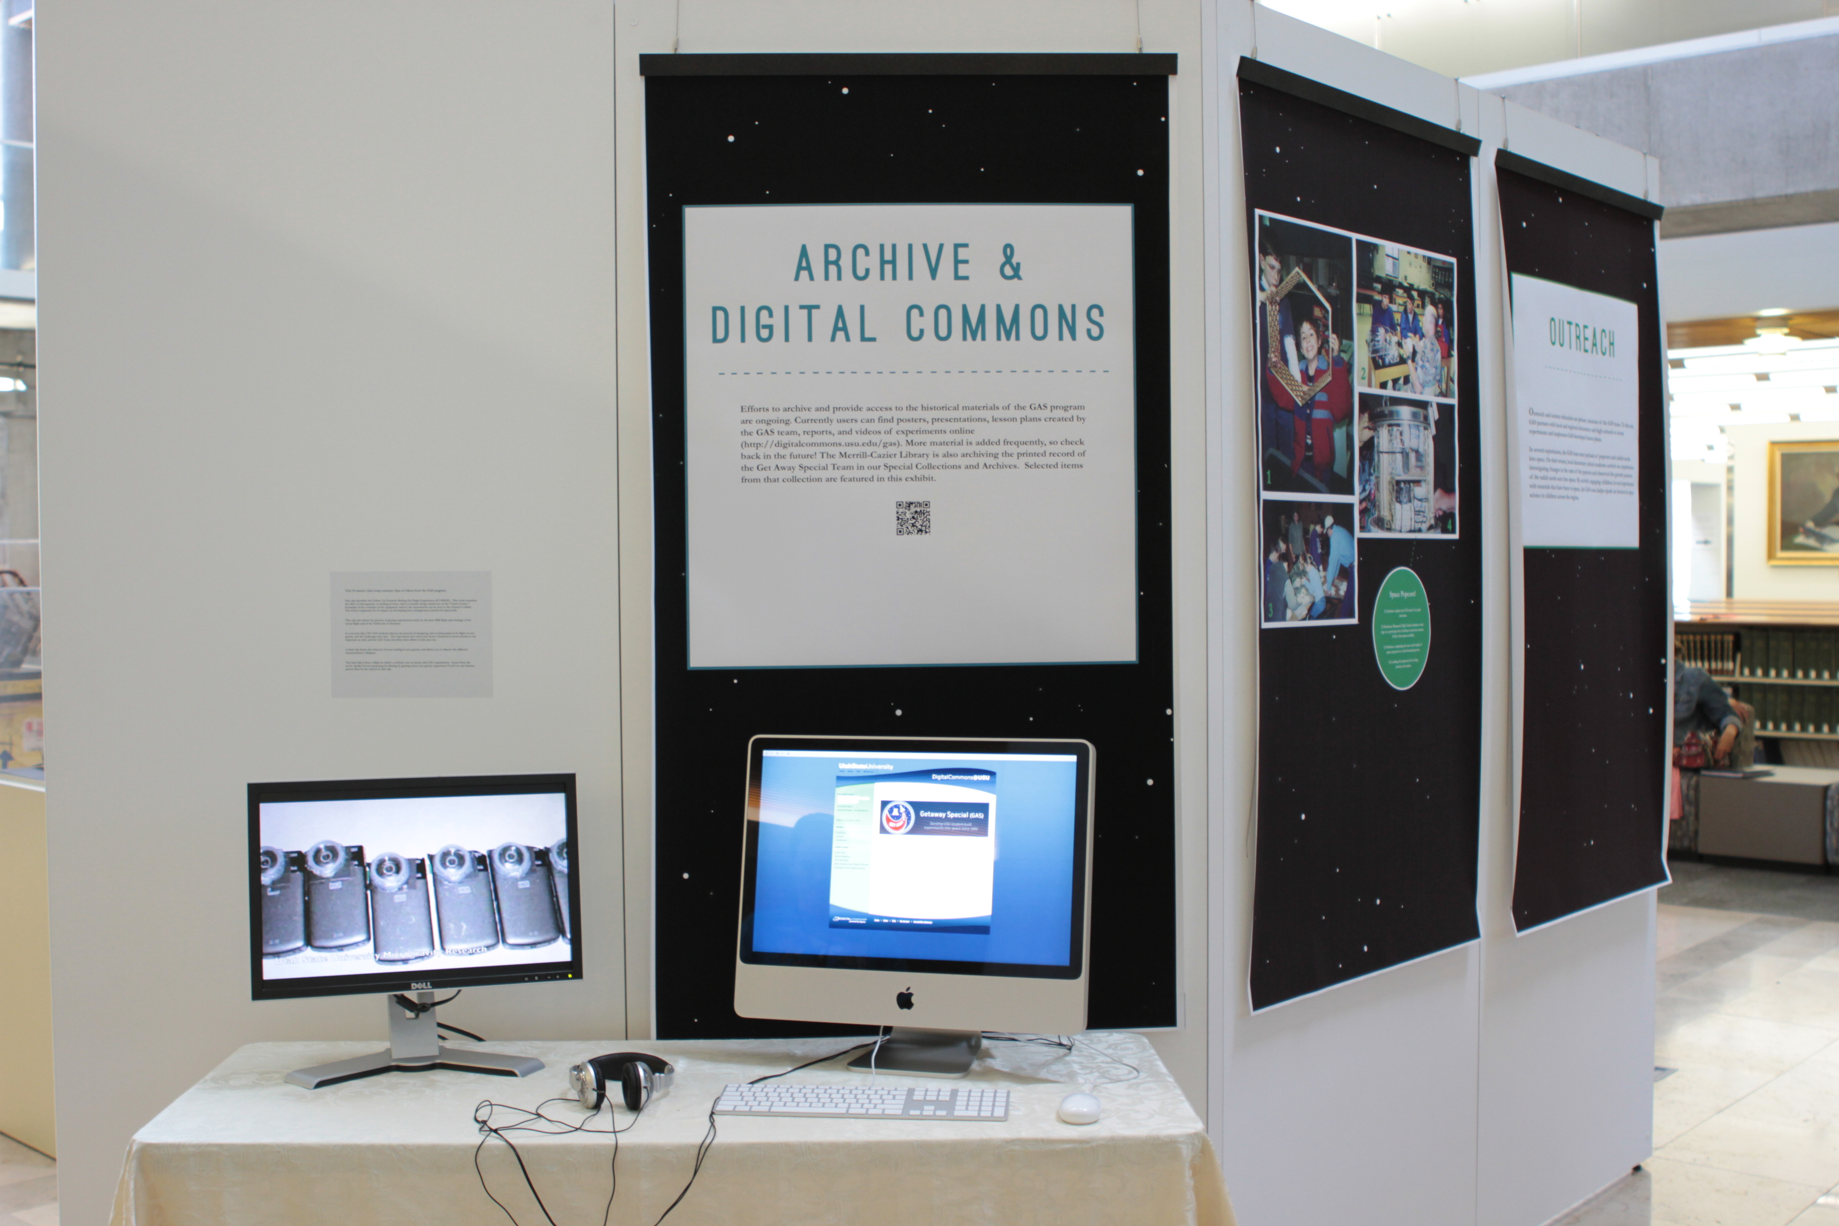
Notes:
Archive and Digital Commons
Efforts to archive and provide access to the historical materials of the GAS program are ongoing. Currently users can find posters, presentations, lesson plans created by the GAS team, reports, and videos of experiments online (http://digitalcommons.usu.edu/gas). More material is added frequently, so check back in the future! The Merrill-Cazier Library is also archiving the printed record of the Get Away Special Team in our Special Collections and Archives. Selected items from that collection are featured in this exhibit.
This 15 minute video loop contained clips of videos from the GAS program.
One clip describes the Follow Up Nucleate Boiling On-Flight Experiment (FUNBOE). This work examines the effect of microgravity on boiling of water, and is currently being carried out on the “Vomit Comet.” Examples of the evolution of the equipment used in the experiments can be seen in the Library’s exhibit. The work is important for its impact on developing heat management systems for spacecraft.
This clip also shows the process of getting experiments ready for the June 2010 flight, plus footage of the actual flight and of the NASA site in Houston.
In a second clip, USU GAS students discuss the process of designing and revising projects for flight in zero gravity and the challenges they face. The experiment isn’t their only focus! Outreach to local schools is very important as well, and the GAS Team describes their efforts in this area too.
A third clip shows the behavior of water boiling in zero gravity and allows you to observe the different characteristics it displays.
The final clip is from a flight in which a celebrity was on board with USU experiments. Actors from the movie Apollo 13 were preparing for filming by gaining some zero gravity experience! You’ll see one famous person float on by the camera in this clip.

Slide 15
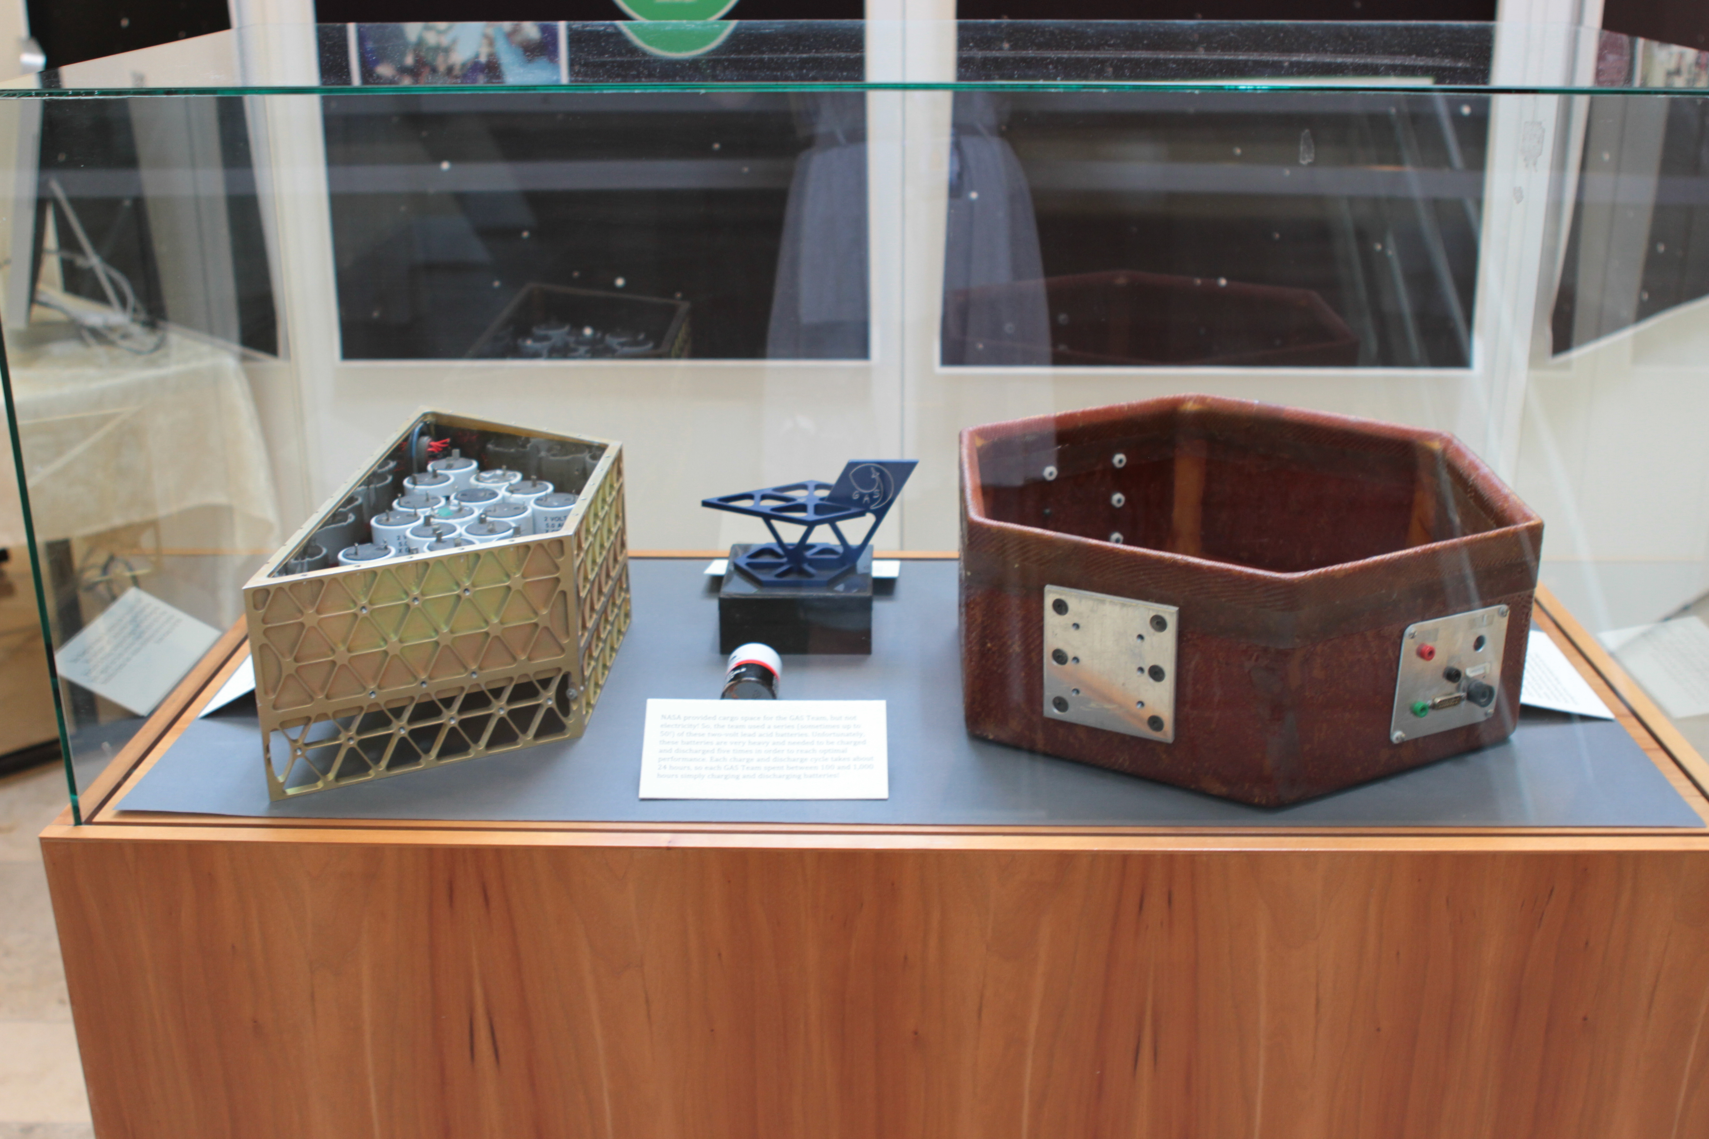
Notes:
(Center) NASA provided cargo space for the GAS Team, but not electricity! So, the team used a series (sometimes up to 50!) of these two-volt lead acid batteries. Unfortunately, these batteries are very heavy and needed to be charged and discharged five times in order to reach optimal performance. Each charge and discharge cycle takes about 24 hours, so each GAS Team spent between 100 and 1,000 hours simply charging and discharging batteries!
To house these batteries, the GAS team designed this (left) container. This container is also an example of student designed and machined Iso-grid Fabrication. The container was designed to fit the original hexagonal SpacePak structure and while NASA did have concerns about the design—they wanted it to be completely sealed—the battery container did fly in space once!
On the right, you see an early example of SpacePak technology. GAS payloads contained a number of experiments. Each GAS team was allotted one of the above SpacePaks, innovated by Rex Megill, which served as their “space real estate.” Early SpacePaks, such as this one, were constructed entirely of materials you might find at your local hardware store and subjected to a highly scientific strength test—being jumped on by Rex!

Slide 16
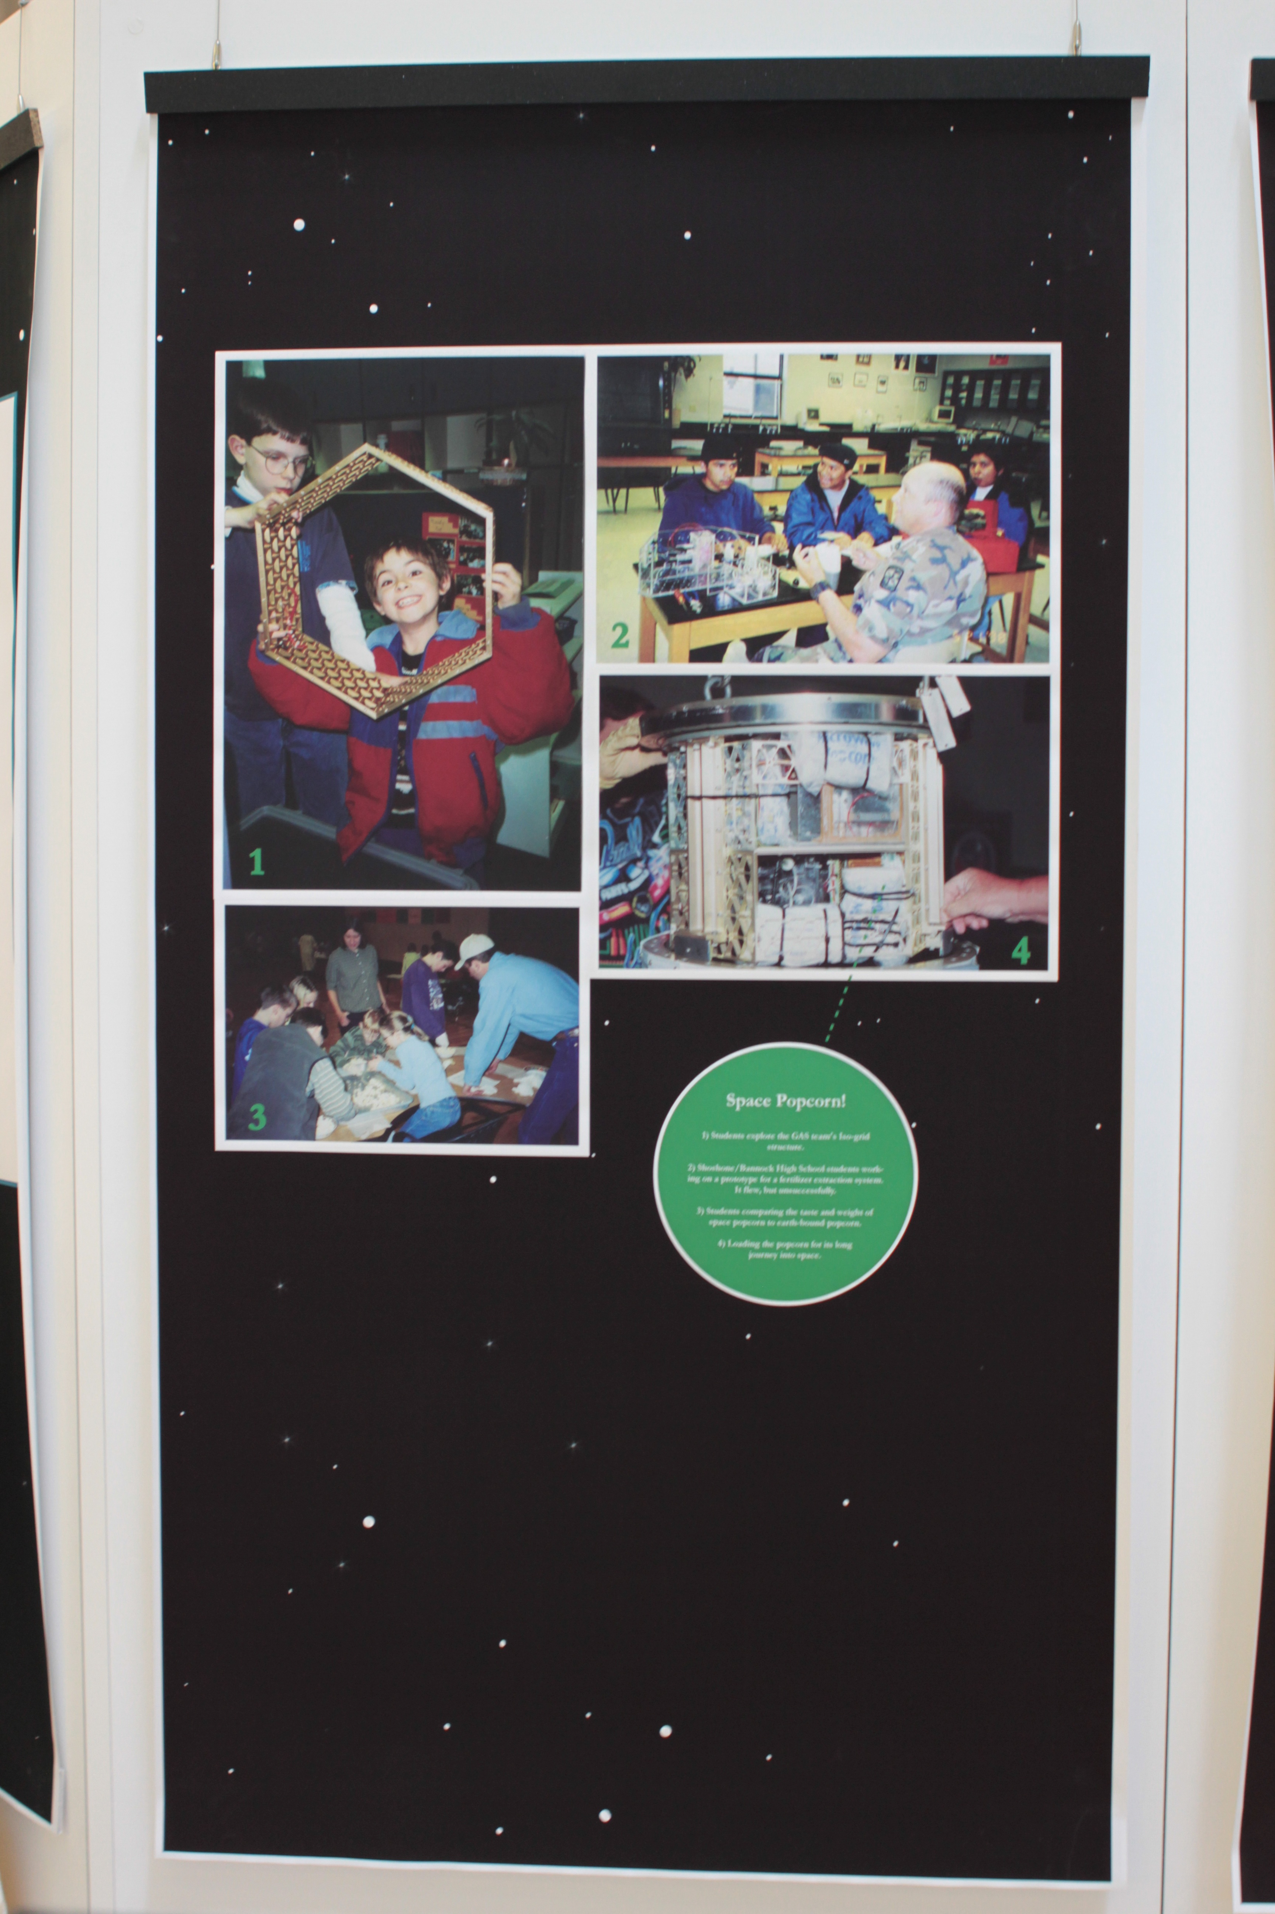
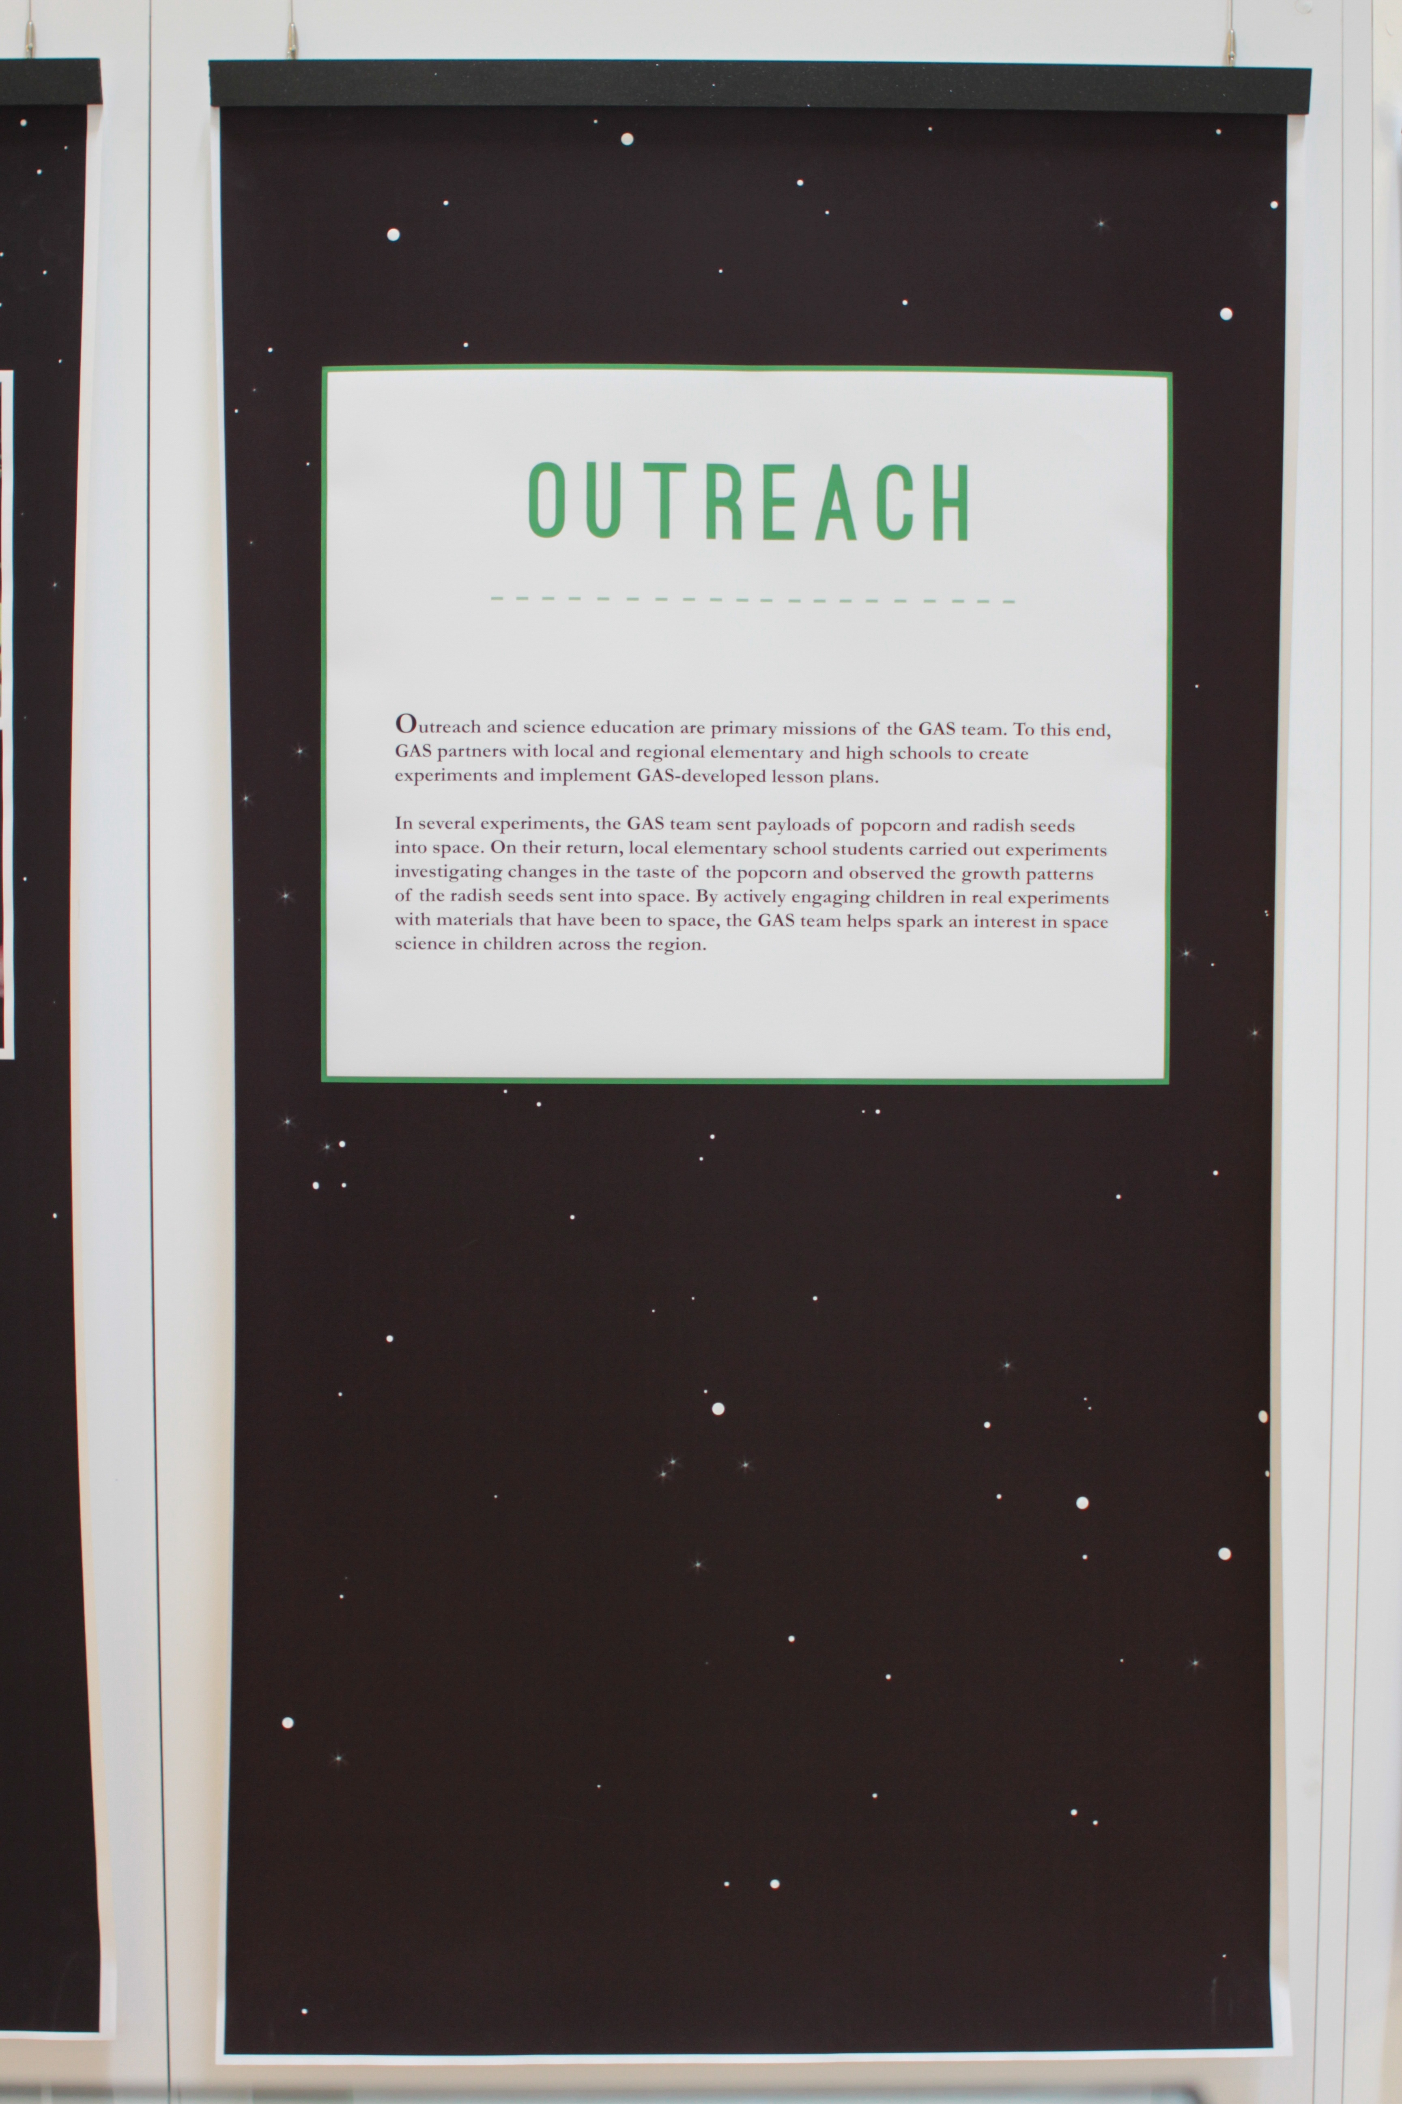
Notes:
Outreach and Science Education are primary missions of the GAS team. To this end, GAS partners with local and regional elementary and high schools to create experiments and implement GAS-developed lesson plans.
In several experiments, the GAS team sent payloads of popcorn and radish seeds into space. On their return, local elementary school students carried out experiments investigating changes in the taste of the popcorn and observed the growth patterns of the radish seeds sent into space. By actively engaging children in real experiments with materials that have been to space, the GAS team helps spark an interest in space science in children across the region.

Slide 17
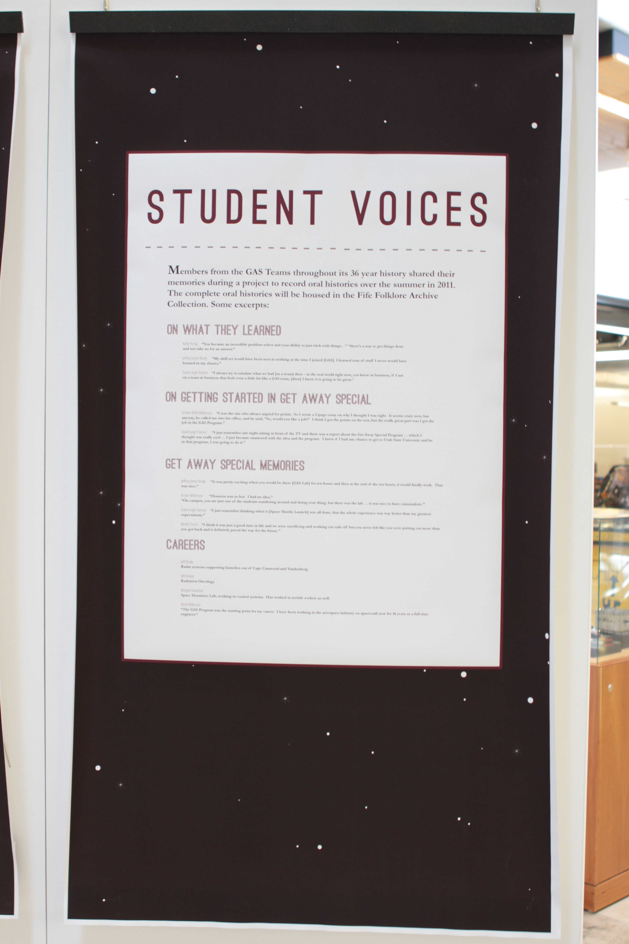
Notes:
Student Voices: Excerpts from GAS team Oral Histories
Members from the GAS Teams throughout the program’s 30 year history shared their memories during a project to record oral histories over the Summer 2011. The complete oral histories will be housed in the Fife Folklore collection. Some excerpts:
On what they learned
Kelly Persky
“You became an incredible problem solver and your ability to just stick with things…” “there’s a way to get things done and not take no for an answer.”
Jeffrey James Brady
“My skill set would have been next to nothing at the time I joined [GAS]. I learned tons of stuff I never would have learned in my classes.”
David Leigh Hansen
“I always try to emulate what we had [as a team] then – in the real work right now, you know in business, if I am on a team in business that feels even a little bit like a GAS team, [then] I know it is going to be great.’
On getting started in GAS
Kristen Redd Wilkenson
“I was the one who always argued for points. So I wrote a 2-page essay on why I thought I was right. It seems crazy now, but anyway he called me into his office, and he said, “So, would you like a job?” I think I got the points on the test, but the really great part was I got the job in the GAS Program.”
David Leigh Hanson
II just remember one night sitting in front of the TV and there was a report about the Get Away Special Program … which I thought was really cool … I just became enamored with the idea and program. I knew if I had any chance to get to Utah State University and be in that program I was going to do it.”
GAS Memories
Jeffery James Brady
“It was pretty exciting when you would be there for then hours and then at the end of the ten hours it would finally work. That was nice.”
Kristin Wilkenson
“Houston was so hot. I had no idea.”
“On campus, you are just one of the students wandering around and doing your thing, but there was the lab … it was nice to have camaraderie.”
David Leigh Hanson
(he has a great description of the launch)
“I just remember thinking when it was all done the whole experience was way better than my greatest expectation.”
Melvin Torrie
“I think it was just a good time in life and we were sacrificing and working our tails off but you never felt like you were putting out more than you got back and it definitely paved the way for the future.”
Careers
Jeff Brady
Radar systems supporting launches out of Cape Canaveral and Vandenberg
Bill Decker
Radiation Oncology
Morgan Davidson
Space Dynamics Lab working in control systems. Has worked in mobile rockets as well
Mark Wilkinson
“The GAS Program was the starting point for my career. I have been working in the aerospace industry on spacecraft now for 16 years as a full time engineer.”

Slide 18
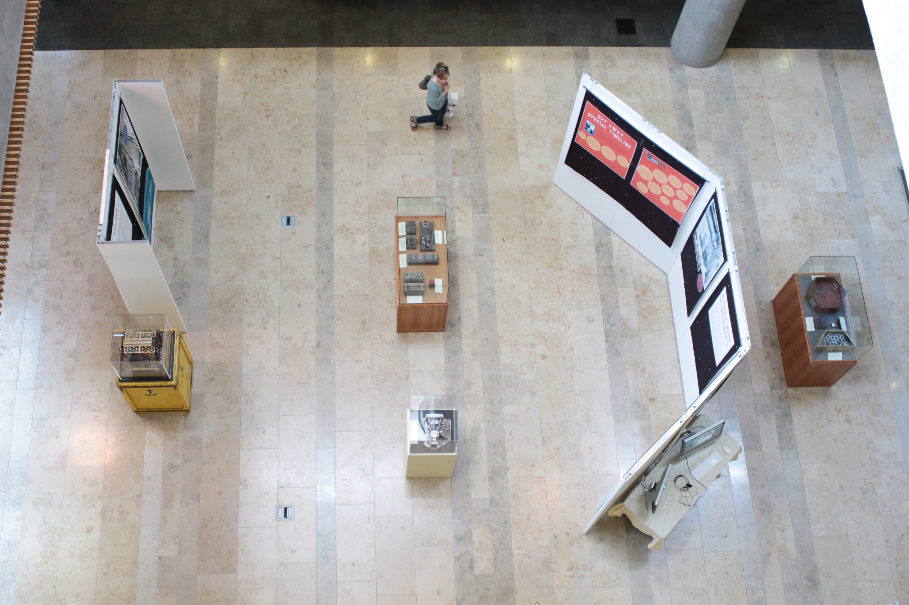

Slide 19
