Slide 1


Pre-breakdown Arcing in Dielectrics under Electric Field Stress
2013 APS 4 Corners
University of Denver, Denver, CO
Allen Andersen and JR Dennison
Physics Department
Utah State University, Logan, Utah

Slide 2

Experiment Analysis Conclusion
Outline
Instrumentation and Procedures
Determining material properties.
Analysis and Modeling
Understanding and comparing material behavior.
Conclusion
Quantitative descriptions of microscopic physics.
Notes:
My presentation will focus on What MISSE-6 is. The environment the samples were exposed to. Analyzing how that environment degraded materials. Simulating the space environment to get an idea of when things happened. And how this impacts future space component design.

Slide 3
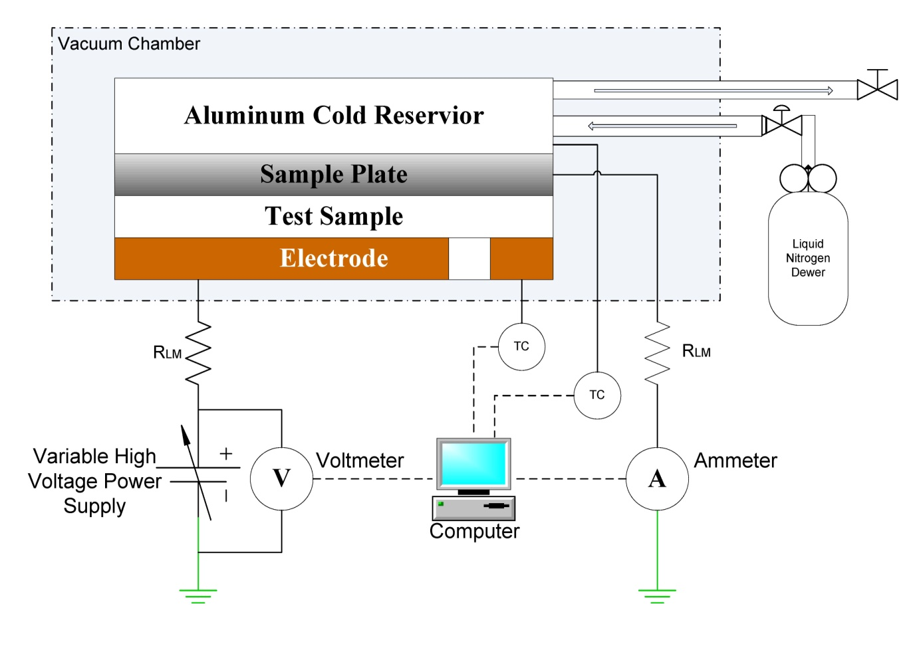
Experiment Analysis Conclusion
ESD SYSTEM
Simple parallel plate capacitor
Vacuum ~10⁻⁶ torr
Fully automated 0.25Hz system
Applies up to 30 kV
~150 K<T<300K with ℓ-N₂ reservoir
1.98 cm² sample electrodes
6 electrode carousel

Slide 4
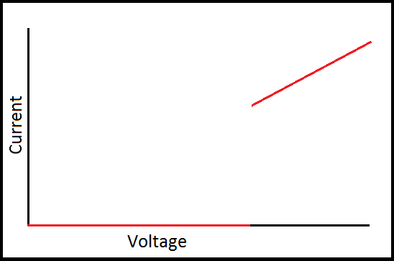
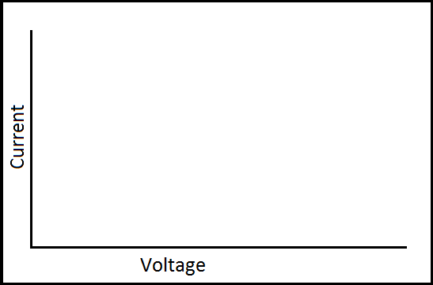
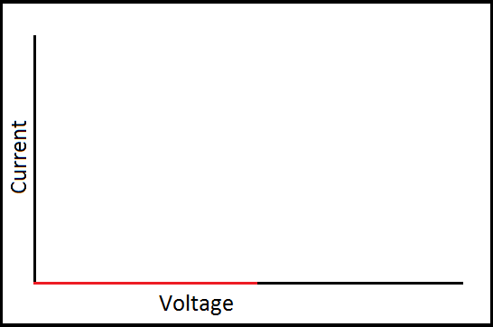
Experiment Analysis Conclusion
‘Typical’ Results
Once the critical voltage is reached the sample breaks down and current flows freely through the material. In general THIS IS VERY BAD!
The slope of the graph is just the inverse of the current limiting resistance in the circuit.
V=IR_{L}
I/V = R_{L}⁻¹
As voltage is first applied to the sample no current flows through it. The insulator is doing its job.
The discontinuity marks our breakdown voltage.
E_{esd}=V_{esd}/d

Slide 5
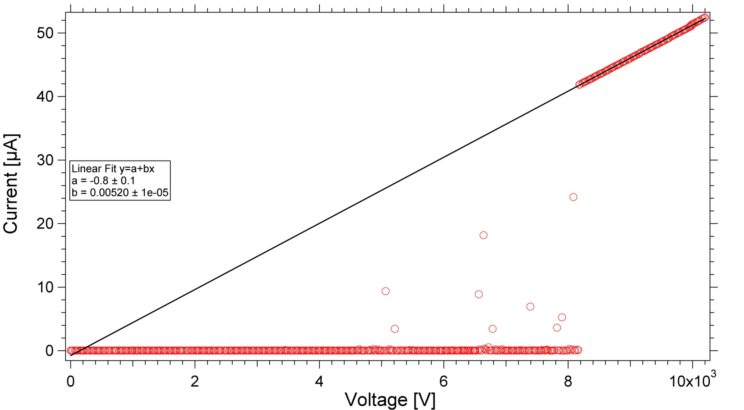
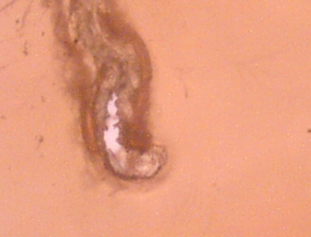
Experiment Analysis Conclusion
LDPE Data
Ohmic slope
I = V/R_{L}
x-intercept at origin
20 µm
25µm
Pre- breakdown arcing
V¹₀ ≈ 0V
Breakdown voltage
Notes:
Elliptical reflector designed to maximize the exposure of the samples by directing the light to a focal point where the samples can be placed. The bluish portion of the solid model on the right demonstrates the light cone and focal point of the reflector. The array on the left is an image of the deuterium lamp configuration that allows for even light exposure at the increased intensity.

Slide 6
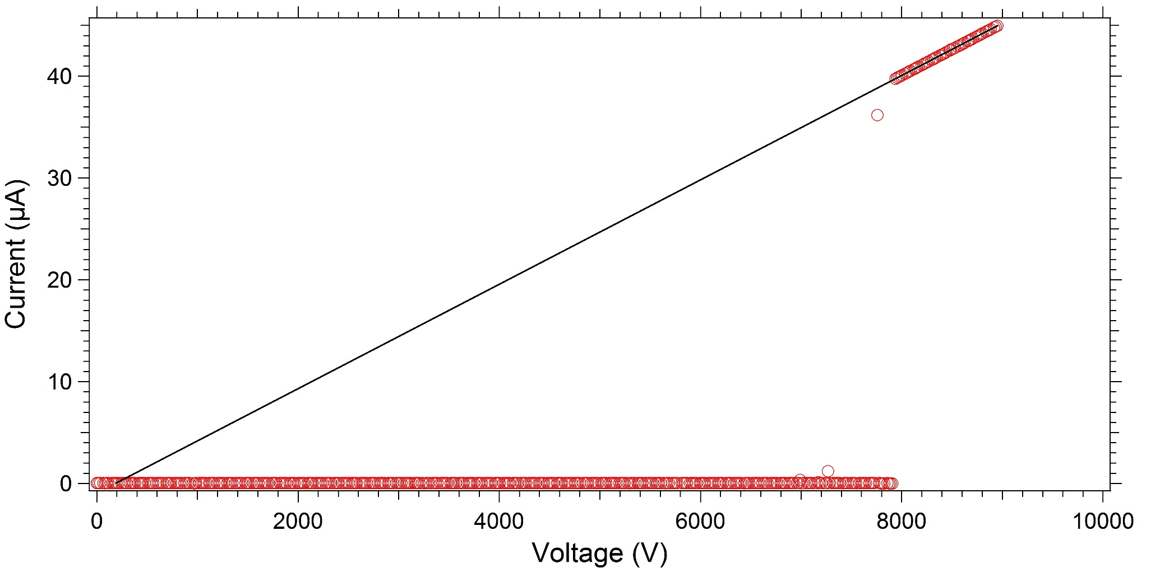
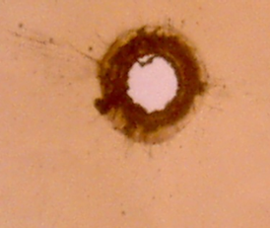
Experiment Analysis Conclusion
Polyimide Data
Ohmic slope
I = V/R_{L}
20 µm
25µm
V¹₀ ≈ 0V
Pre- breakdown arcing
Breakdown voltage
Notes:
Elliptical reflector designed to maximize the exposure of the samples by directing the light to a focal point where the samples can be placed. The bluish portion of the solid model on the right demonstrates the light cone and focal point of the reflector. The array on the left is an image of the deuterium lamp configuration that allows for even light exposure at the increased intensity.

Slide 7
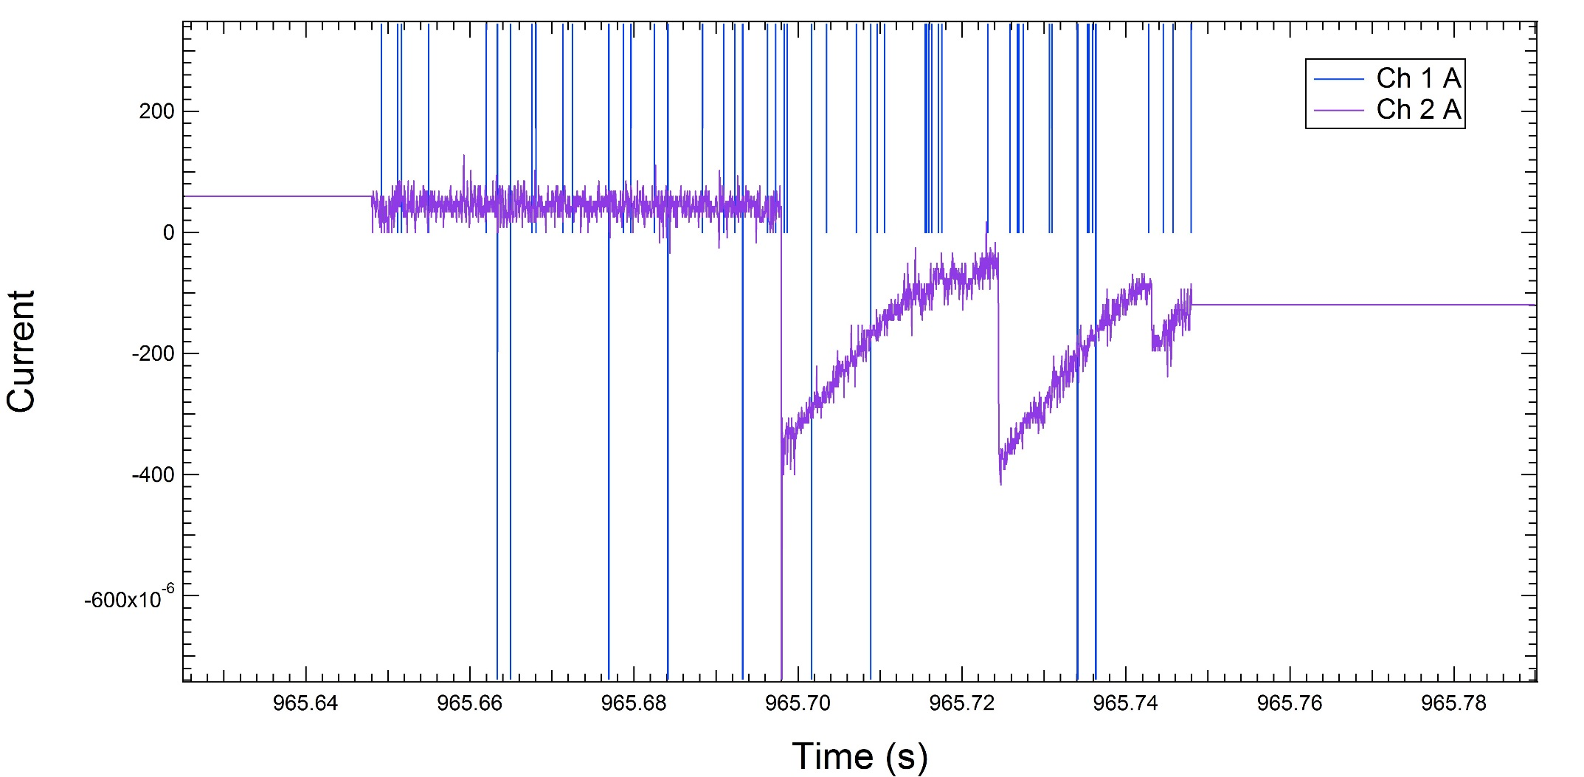
Experiment Analysis Conclusion
Pre-Breakdown Arcs–10kHz Oscilloscope
Pre- breakdown arcing
LDPE
Notes:
Elliptical reflector designed to maximize the exposure of the samples by directing the light to a focal point where the samples can be placed. The bluish portion of the solid model on the right demonstrates the light cone and focal point of the reflector. The array on the left is an image of the deuterium lamp configuration that allows for even light exposure at the increased intensity.

Slide 8
Experiment Analysis Conclusion
Pre-Breakdown Arc Field vs. Breakdown Field
The field where arcing begins marks the field where the material will eventually break down over time.
For LDPE the average electric field for the onset of arcing is (60 ± 15) % of its critical breakdown field.
For Polyimide the average electric field for the onset of arcing is (70 ± 15) % of its critical breakdown field.
Notes:
Elliptical reflector designed to maximize the exposure of the samples by directing the light to a focal point where the samples can be placed. The bluish portion of the solid model on the right demonstrates the light cone and focal point of the reflector. The array on the left is an image of the deuterium lamp configuration that allows for even light exposure at the increased intensity.

Slide 9
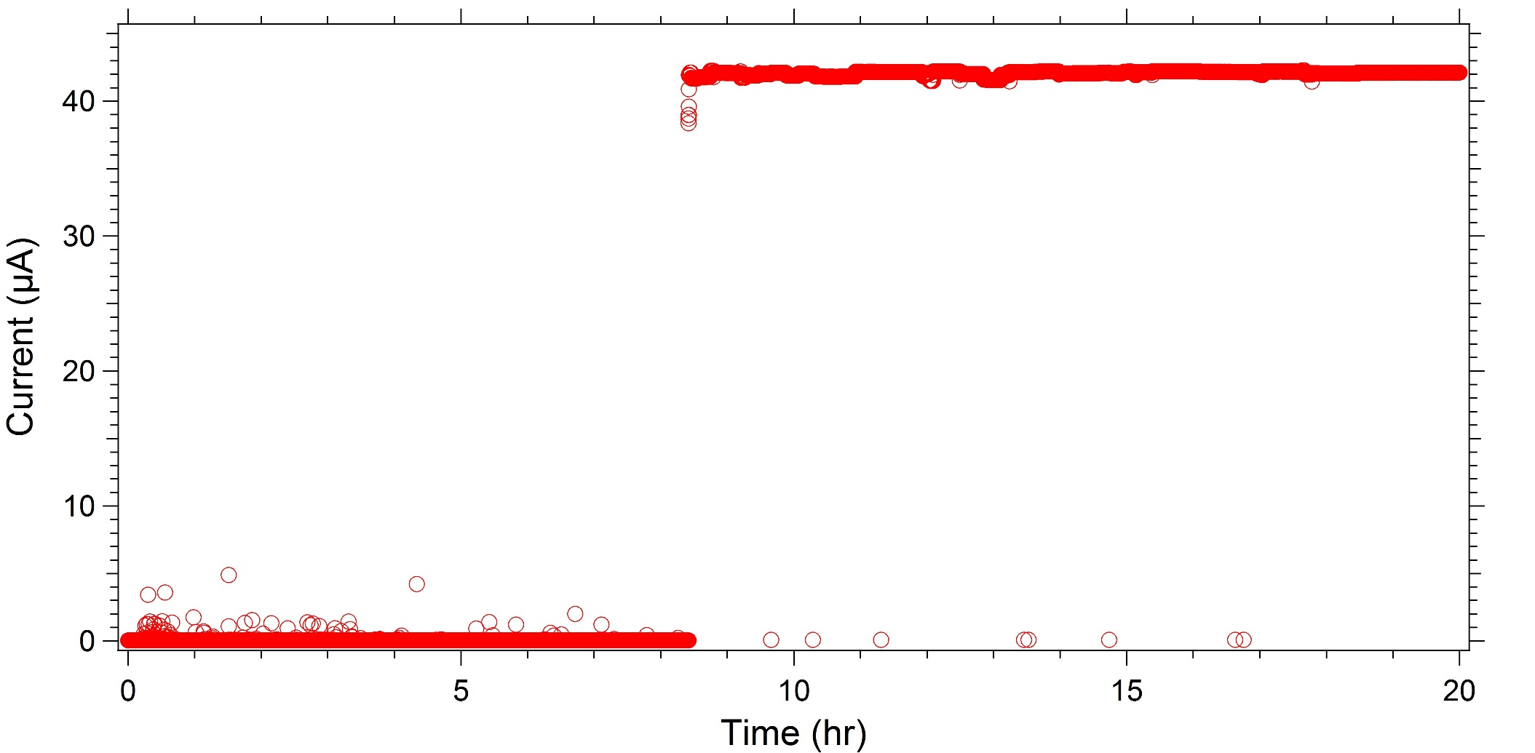
Experiment Analysis Conclusion
Time Endurance - LDPE
25µm
Pre-breakdown arcs
Breakdown time
~325 MV/m
Notes:
Elliptical reflector designed to maximize the exposure of the samples by directing the light to a focal point where the samples can be placed. The bluish portion of the solid model on the right demonstrates the light cone and focal point of the reflector. The array on the left is an image of the deuterium lamp configuration that allows for even light exposure at the increased intensity.

Slide 10
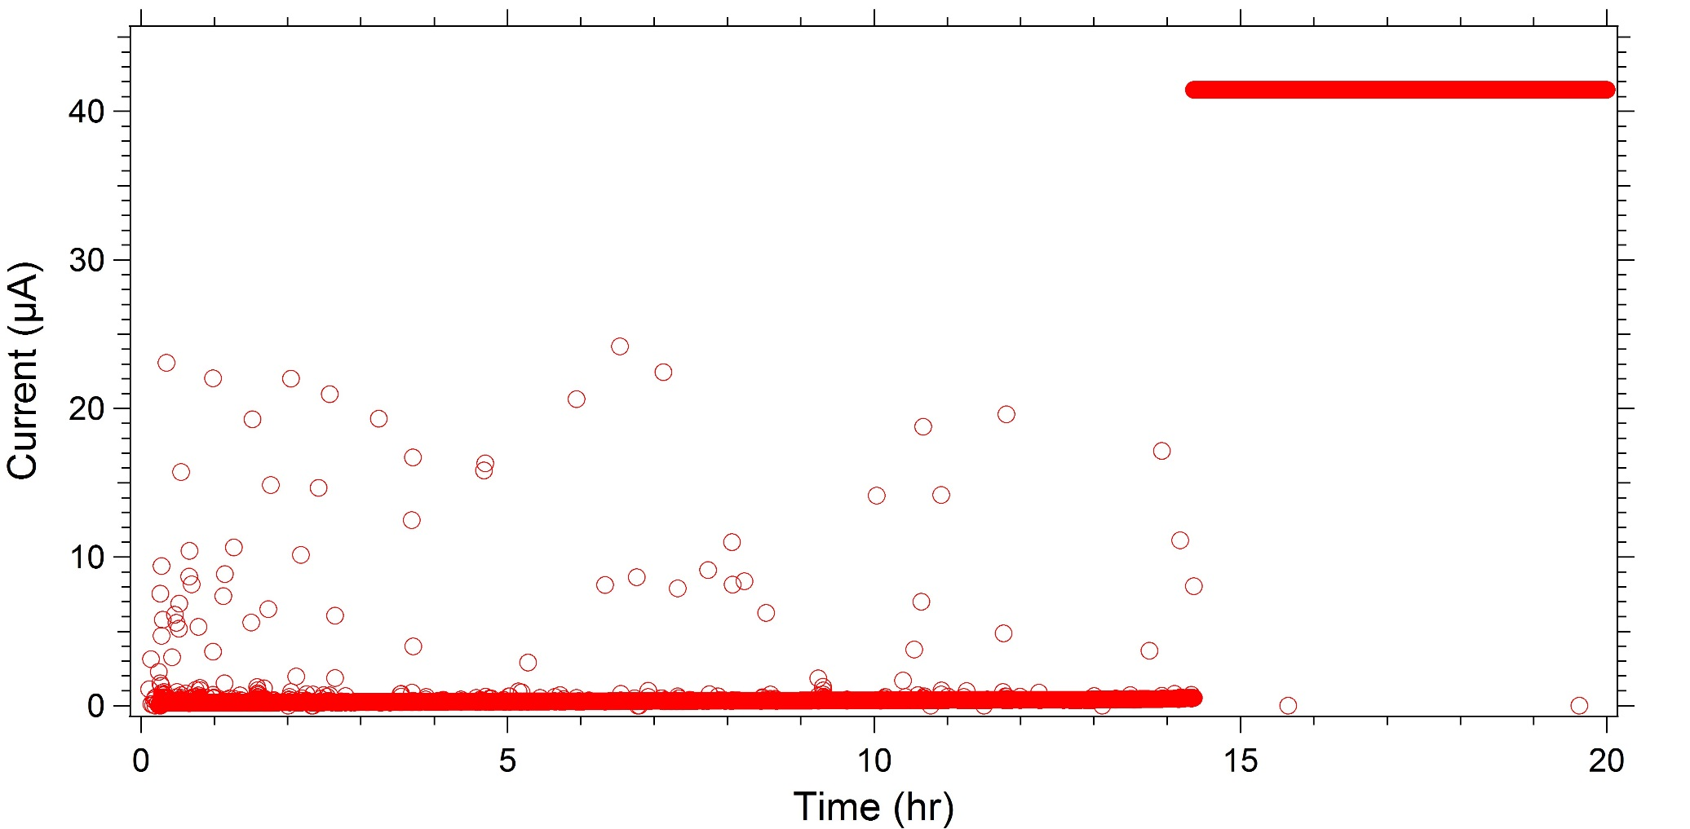
Experiment Analysis Conclusion
Time Endurance - Polyimide
25µm
Long wait time and higher current arcs indicate differences in defect populations.
~320 MV/m
Notes:
Elliptical reflector designed to maximize the exposure of the samples by directing the light to a focal point where the samples can be placed. The bluish portion of the solid model on the right demonstrates the light cone and focal point of the reflector. The array on the left is an image of the deuterium lamp configuration that allows for even light exposure at the increased intensity.

Slide 11
Experiment Analysis Conclusion
Pre-Breakdown Arcs
Energy
ΔG
Under an applied electric field, charge can ‘hop’ between defect sites. The probability of a transition in a given time step depends upon temperature, well depth, and applied field.
F
ΔG
ΔG+q_{e}a_{o}F
ΔG-q_{e}a_{o}F
q_{e}a_{o}F
a_{o}
Position
Notes:
Elliptical reflector designed to maximize the exposure of the samples by directing the light to a focal point where the samples can be placed. The bluish portion of the solid model on the right demonstrates the light cone and focal point of the reflector. The array on the left is an image of the deuterium lamp configuration that allows for even light exposure at the increased intensity.

Slide 12
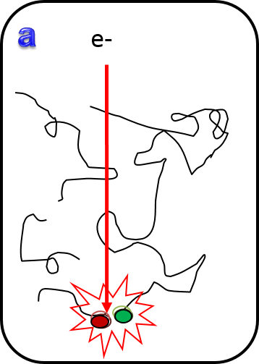
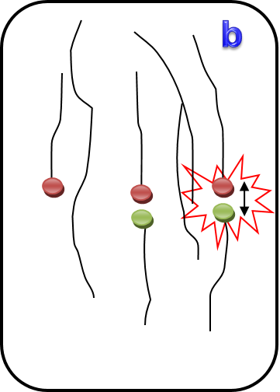
Experiment Analysis Conclusion
Pre-Breakdown Arcs
a) Defect sites can form in kinks of polymer chains. These low-energy defects can be thermally repaired since
ε_{kinks} ≥ k_{B}T_{RM}
b) At higher voltages, electrons have enough energy to break bonds, creating permanent defect sites.
ε_{bond} >> k_{B}T_{RM}
Notes:
Elliptical reflector designed to maximize the exposure of the samples by directing the light to a focal point where the samples can be placed. The bluish portion of the solid model on the right demonstrates the light cone and focal point of the reflector. The array on the left is an image of the deuterium lamp configuration that allows for even light exposure at the increased intensity.

Slide 13

Experiment Analysis Conclusion
Conductivity Model
Trap-to-trap Tunneling frequency
Well depth
Density of Defects
Tests lasting only days can predict decades of behavior!
Notes:
Elliptical reflector designed to maximize the exposure of the samples by directing the light to a focal point where the samples can be placed. The bluish portion of the solid model on the right demonstrates the light cone and focal point of the reflector. The array on the left is an image of the deuterium lamp configuration that allows for even light exposure at the increased intensity.

Slide 14
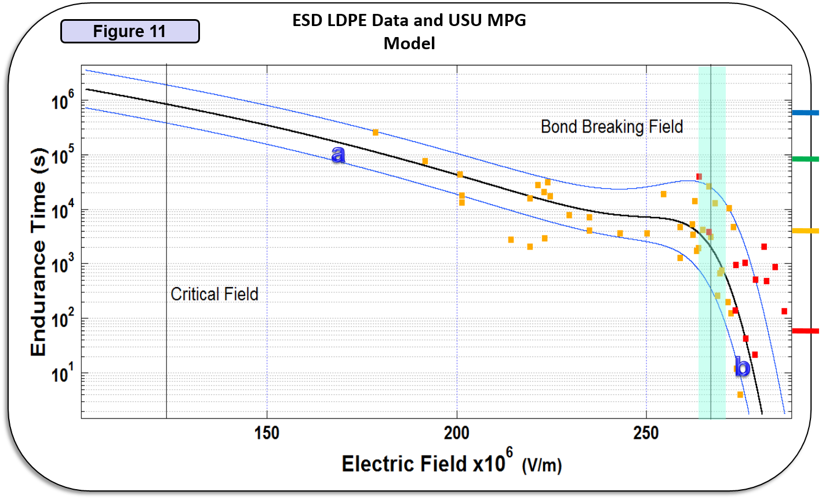
Experiment Analysis Conclusion
Time Endurance
1 week
1 day
1 hr.
1 min.
Notes:
Elliptical reflector designed to maximize the exposure of the samples by directing the light to a focal point where the samples can be placed. The bluish portion of the solid model on the right demonstrates the light cone and focal point of the reflector. The array on the left is an image of the deuterium lamp configuration that allows for even light exposure at the increased intensity.

Slide 15
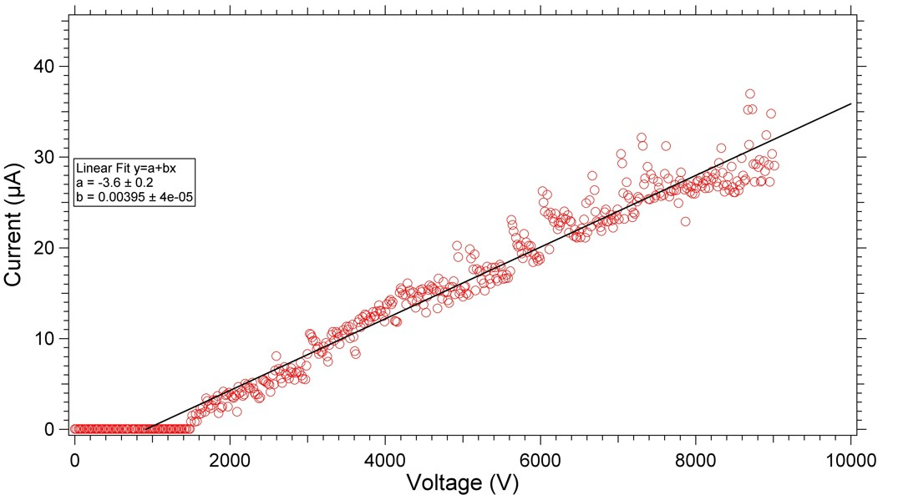
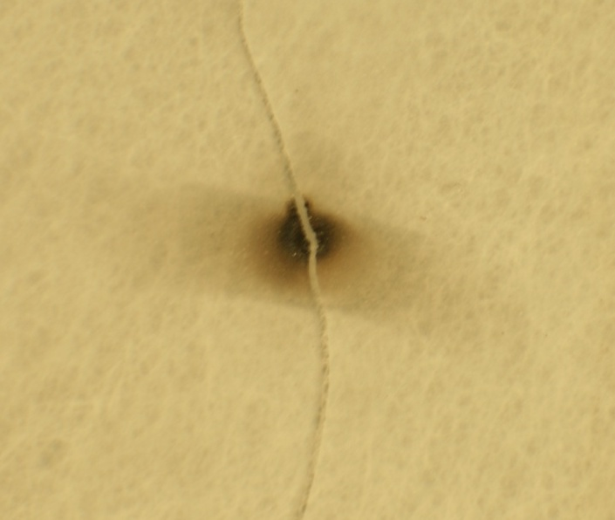
Experiment Analysis Conclusion
Fused Silica Data
Non-ohmic slope
80µm
Breakdown Voltage
V¹₀ ≈1000V
R¹>R_{L}
Notes:
Elliptical reflector designed to maximize the exposure of the samples by directing the light to a focal point where the samples can be placed. The bluish portion of the solid model on the right demonstrates the light cone and focal point of the reflector. The array on the left is an image of the deuterium lamp configuration that allows for even light exposure at the increased intensity.

Slide 16
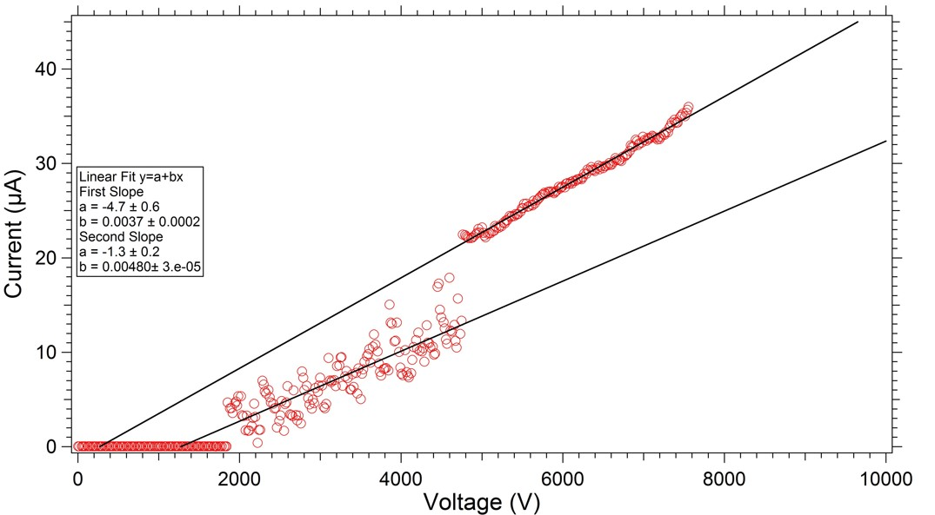
Experiment Analysis Conclusion
Fused Silica Data
2nd non-ohmic slope
80µm
Non-ohmic slope
R¹>R²>R_{L}
V²₀ ≈200V
V¹₀ ≈1000V
What is going on?!
Breakdown Voltage
Notes:
Elliptical reflector designed to maximize the exposure of the samples by directing the light to a focal point where the samples can be placed. The bluish portion of the solid model on the right demonstrates the light cone and focal point of the reflector. The array on the left is an image of the deuterium lamp configuration that allows for even light exposure at the increased intensity.

Slide 17
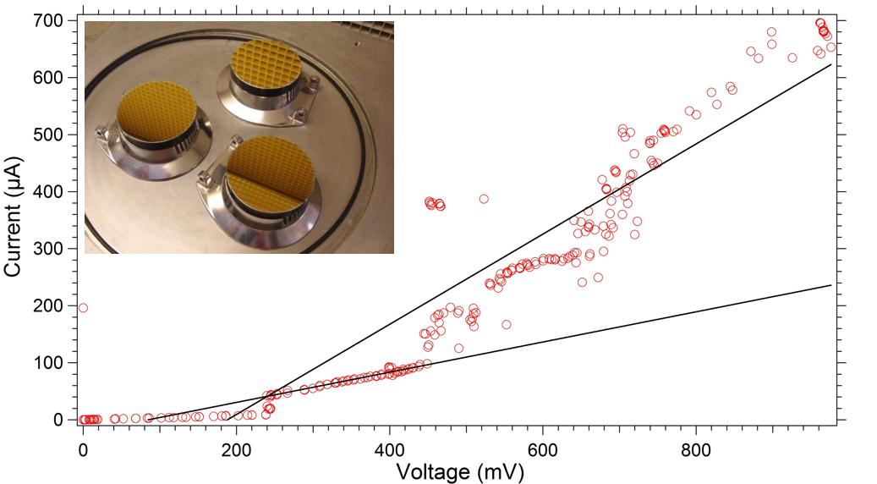
Experiment Analysis Conclusion
Fused Silica Data
65nm coating
V²₀ ≈80V
V¹₀ ≈200V
R¹>R²>R_{L}
Notes:
Elliptical reflector designed to maximize the exposure of the samples by directing the light to a focal point where the samples can be placed. The bluish portion of the solid model on the right demonstrates the light cone and focal point of the reflector. The array on the left is an image of the deuterium lamp configuration that allows for even light exposure at the increased intensity.

Slide 18
Experiment Analysis Conclusion
Fused Silica Data
Relatively low critical field – we can deal with that.
Tunneling current seems to be a bigger factor for thinner coatings
No noticeable pre-breakdown arcs – for SiO₂ we do not have polymer chains to “kink.”
Non-ohmic post breakdown slope – possibly only broken down part way through the sample.
Transitions to secondary slopes – marks increasing partial breakdowns
Notes:
Elliptical reflector designed to maximize the exposure of the samples by directing the light to a focal point where the samples can be placed. The bluish portion of the solid model on the right demonstrates the light cone and focal point of the reflector. The array on the left is an image of the deuterium lamp configuration that allows for even light exposure at the increased intensity.

Slide 19

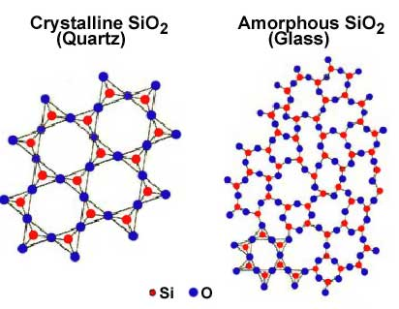
Experiment Analysis Conclusion
We shouldn’t expect the same behavior for different structures!
Notes:
Elliptical reflector designed to maximize the exposure of the samples by directing the light to a focal point where the samples can be placed. The bluish portion of the solid model on the right demonstrates the light cone and focal point of the reflector. The array on the left is an image of the deuterium lamp configuration that allows for even light exposure at the increased intensity.

Slide 20
Experiment Analysis Conclusion
Density of States
a) Delta function
b) Constant
c) Linear
d) Power law
e) Exponential
f) Gaussian
Each of these has
different transport properties.
LDPE – Linear
Polyimide – Exponential
SiO₂ – Exponential+Gaussian
Notes:
Elliptical reflector designed to maximize the exposure of the samples by directing the light to a focal point where the samples can be placed. The bluish portion of the solid model on the right demonstrates the light cone and focal point of the reflector. The array on the left is an image of the deuterium lamp configuration that allows for even light exposure at the increased intensity.

Slide 21
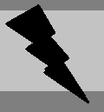
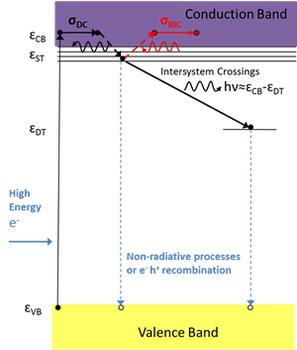
Experiment Analysis Conclusion
Complementary Responses to Radiation and Electric Field Stress
E
E
Modified Joblonski diagram
VB electrons excited into CB by the high energy incident electron radiation.
They relax into shallow trap (ST) states, then thermalize into lower available long-lived ST.
Four paths are possible:
relaxation to deep traps (DT), with concomitant photon emission;
radiation induced conductivity (RIC), with thermal re-excitation into the CB;
non-radiative transitions or e⁻-h⁺ recombination into VB holes; or
avalanche effect as CB electrons excite more VB electrons into the CB, causing ESD.
--24 meV
--41 meV
1.92 eV
_{eff}
E_{F}
2.48 eV
2.73 eV
4.51 eV
--8.9 eV

Slide 22

Experiment Analysis Conclusion
Conclusions
Polymer and glass structural differences are manifest in ESD measurements of pre-breakdown arcing and post-breakdown slopes.
Pre-breakdown arcing can be understood in terms of thermally recoverable and irrecoverable defect generation.
The onset, magnitude, and frequency of pre-breakdown arcing depends on the density of states for a given material.
The performance of insulating materials under electric field stress over time also depends on the density of defects.
Notes:
How long it takes for space suit to degrade and probabilities. What will happen and how serious it will be. Micro penetration vs astro penetration. Results.

