Slide 1
Charge Transport and Electrical Degradation Research for Power Grid Applications
2013 USU Graduate Student Research Symposium Utah State University, Logan, UT
Allen Andersen and JR Dennison
Physics Department
Utah State University, Logan, Utah

Slide 2
Motivation Procedure Analysis Conclusion
Outline
Power Grid Overview
Power grid problems and solutions.
USU Material Physics Group
Applying spacecraft charging science to the power grid.
Instrumentation
Determining material properties.
Analysis and Modeling
Using material properties to predict performance.
Impacts on Future Power Grid Development
Why we care.
Notes:
My presentation will focus on What MISSE-6 is. The environment the samples were exposed to. Analyzing how that environment degraded materials. Simulating the space environment to get an idea of when things happened. And how this impacts future space component design.

Slide 3
Motivation Procedure Analysis Conclusion
Motivation Procedure Analysis Conclusion
Motivation

Slide 4
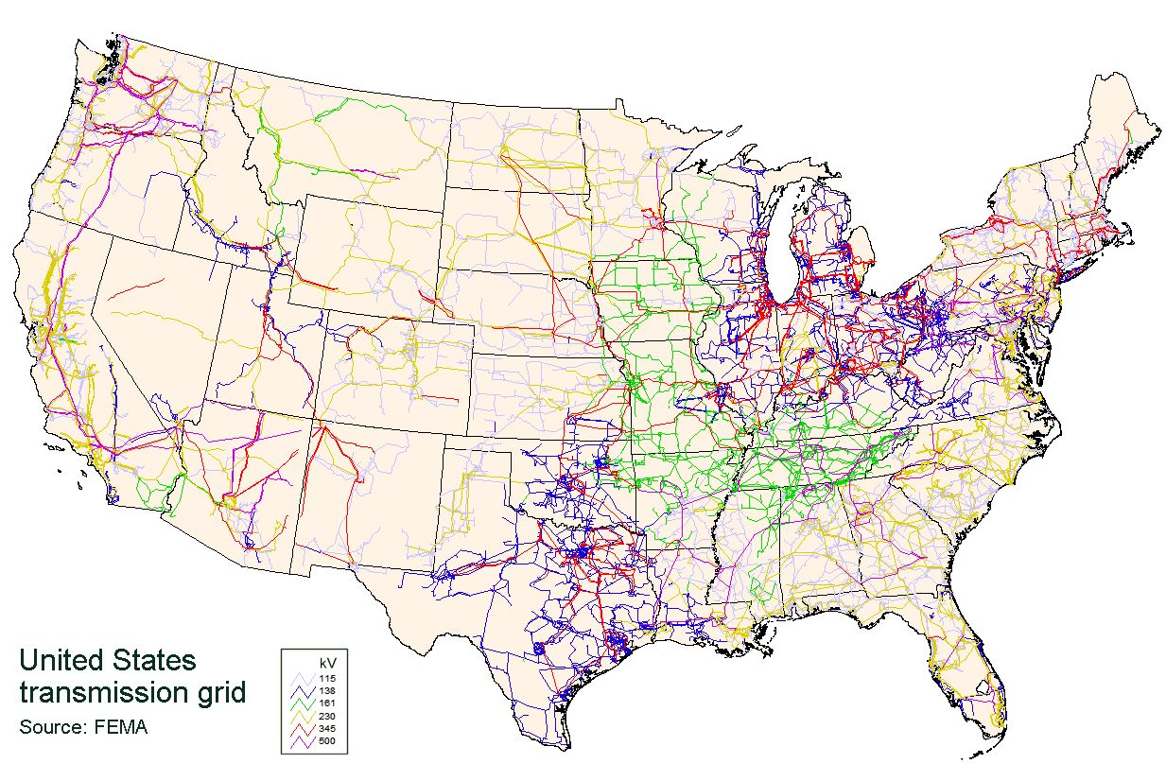
Motivation Procedure Analysis Conclusion
Motivation Procedure Analysis Conclusion
Problems with Existing Grid
1. >10 % Power loss in transmission due to radiation and heating .
2. The Nation uses several separate out of phase regional power grids.
3. Existing grids are ageing and already being pushed past their limits.
Notes:
The understanding gained from this analysis will allow for proper material choice to allow for space components with lengthened durability and less frequent repairs. James Webb Space Telescope, NASA’s current project, hoping to replace the Hubble, beyond repairable range. The two large blue panels here are each about the size of a tennis court and are made of metal coated polymers, like my sample of interest.
MISSE samples are also used in other space component designs such as astronaut’s space suits. 7 layers 3 are mylar.

Slide 5
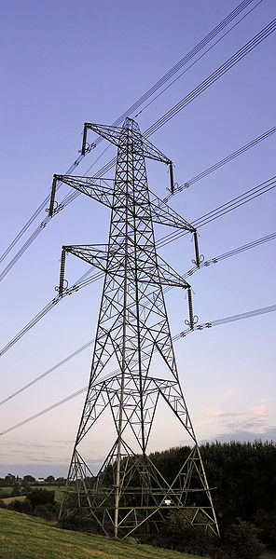
Motivation Procedure Analysis Conclusion
Motivation Procedure Analysis Conclusion
Possible Solutions
Operate at Higher Voltages
Currently HV wires operate at ~500kV.
Advantages
Much higher efficiency for MV transmission.
Disadvantages
Higher stress on insulating components resulting in leaks or failures.
Coronal discharge for AC lines.
Notes:
The understanding gained from this analysis will allow for proper material choice to allow for space components with lengthened durability and less frequent repairs. James Webb Space Telescope, NASA’s current project, hoping to replace the Hubble, beyond repairable range. The two large blue panels here are each about the size of a tennis court and are made of metal coated polymers, like my sample of interest.
MISSE samples are also used in other space component designs such as astronaut’s space suits. 7 layers 3 are mylar.

Slide 6
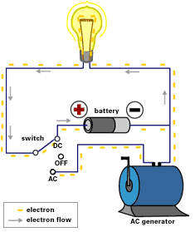
Motivation Procedure Analysis Conclusion
Motivation Procedure Analysis Conclusion
Possible Solutions
DC
Use DC Transmission
Advantages
Reduces radiation and thermal resistance.
More cost effective than AC over distances >350 miles.
Allows for high voltage transmission without coronal discharge at 1-3 MV.
Could connect the Nation’s out of phase power grids.
Disadvantages
Requires expensive DC/AC converter stations.
DC components in general are more expensive than AC.
Higher stress on materials.
Tradition – War of the Currents.
AC
Notes:
The understanding gained from this analysis will allow for proper material choice to allow for space components with lengthened durability and less frequent repairs. James Webb Space Telescope, NASA’s current project, hoping to replace the Hubble, beyond repairable range. The two large blue panels here are each about the size of a tennis court and are made of metal coated polymers, like my sample of interest.
MISSE samples are also used in other space component designs such as astronaut’s space suits. 7 layers 3 are mylar.

Slide 7
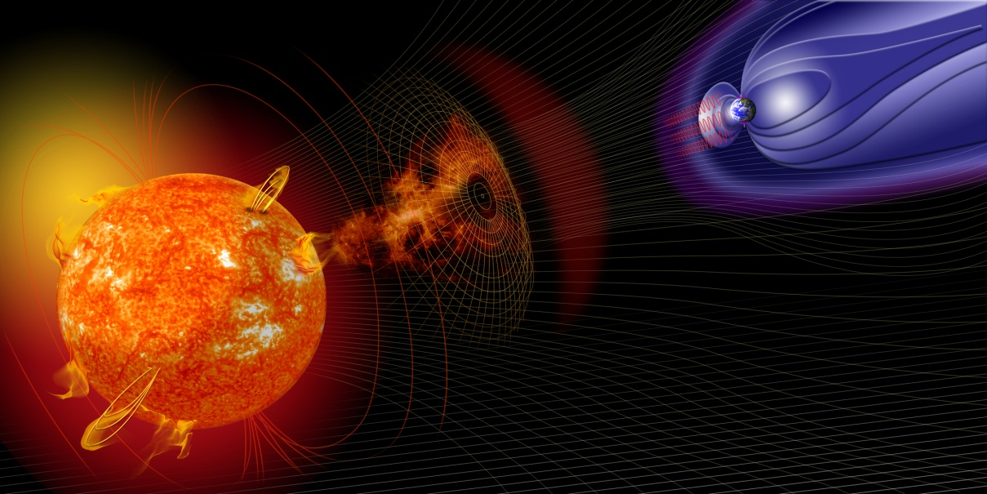
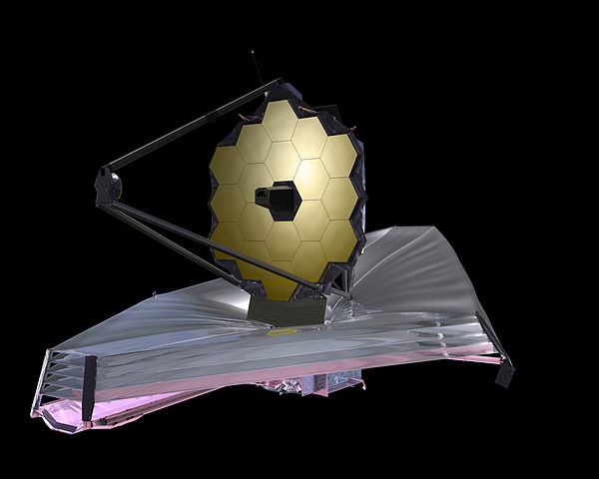
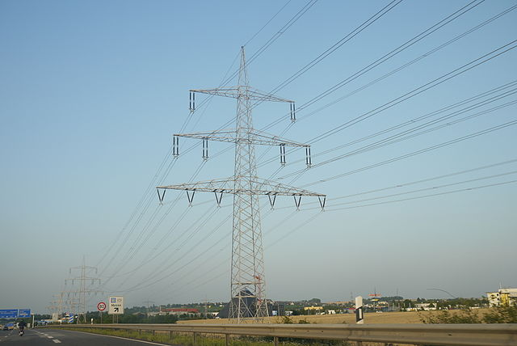
Motivation Procedure Analysis Conclusion
Motivation Procedure Analysis Conclusion
USU MPG
Environment Simulations
Physics Models
Spacecraft Charging
Charging of power grid components.
Notes:
The understanding gained from this analysis will allow for proper material choice to allow for space components with lengthened durability and less frequent repairs. James Webb Space Telescope, NASA’s current project, hoping to replace the Hubble, beyond repairable range. The two large blue panels here are each about the size of a tennis court and are made of metal coated polymers, like my sample of interest.
MISSE samples are also used in other space component designs such as astronaut’s space suits. 7 layers 3 are mylar.

Slide 8
Motivation Procedure Analysis Conclusion
Motivation Procedure Analysis Conclusion
Procedure

Slide 9
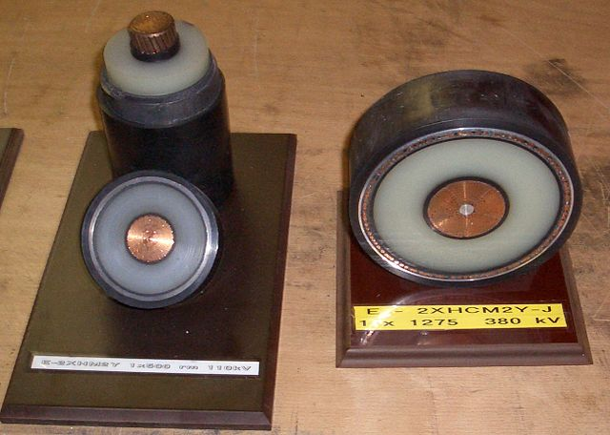
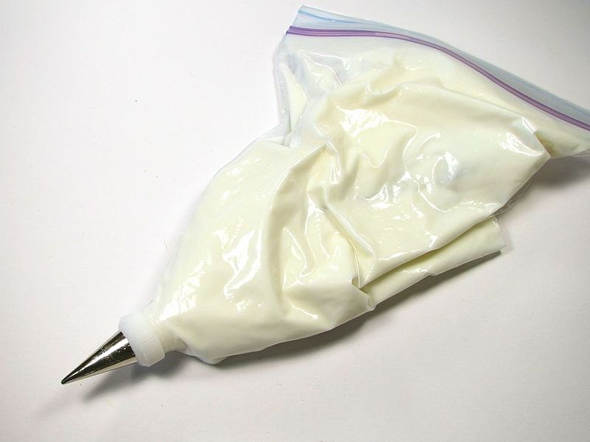
Motivation Procedure Analysis Conclusion
LDPE
Low Density Polyethylene – highly electrically insulating material.
Inexpensive and comes in many forms.
Common spacecraft insulator
Common power line insulator
Common everyday material.

Slide 10
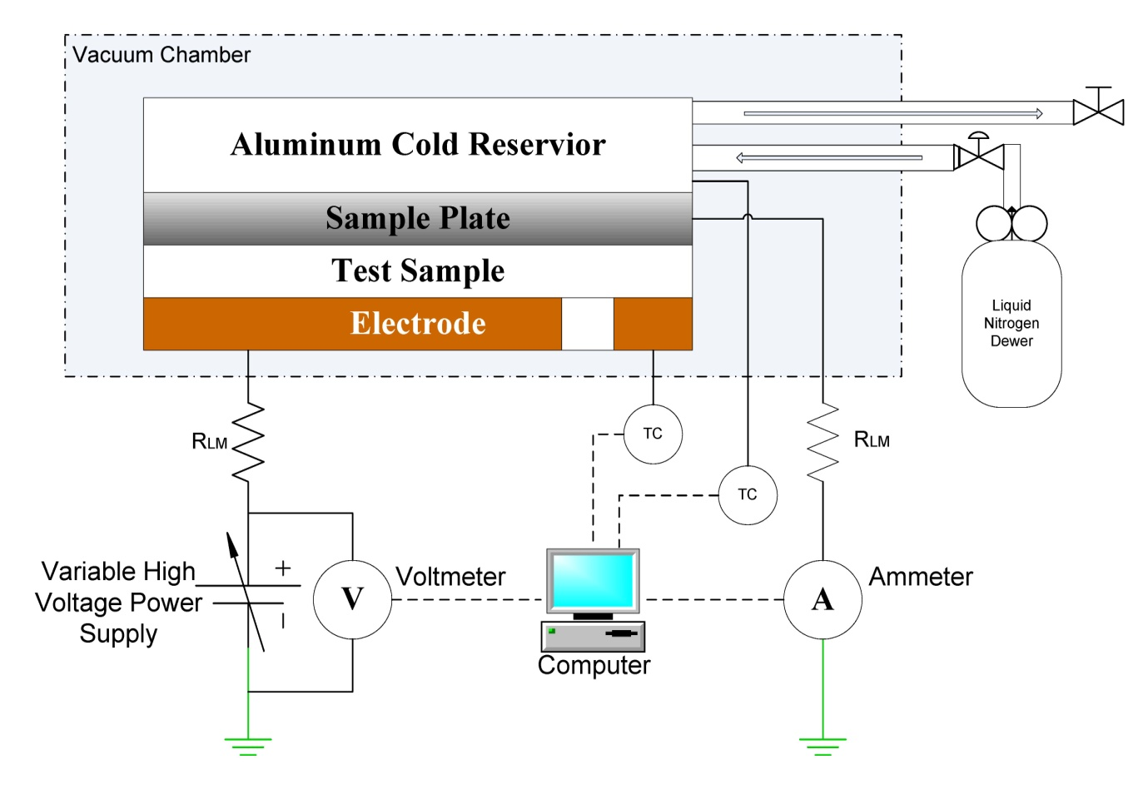
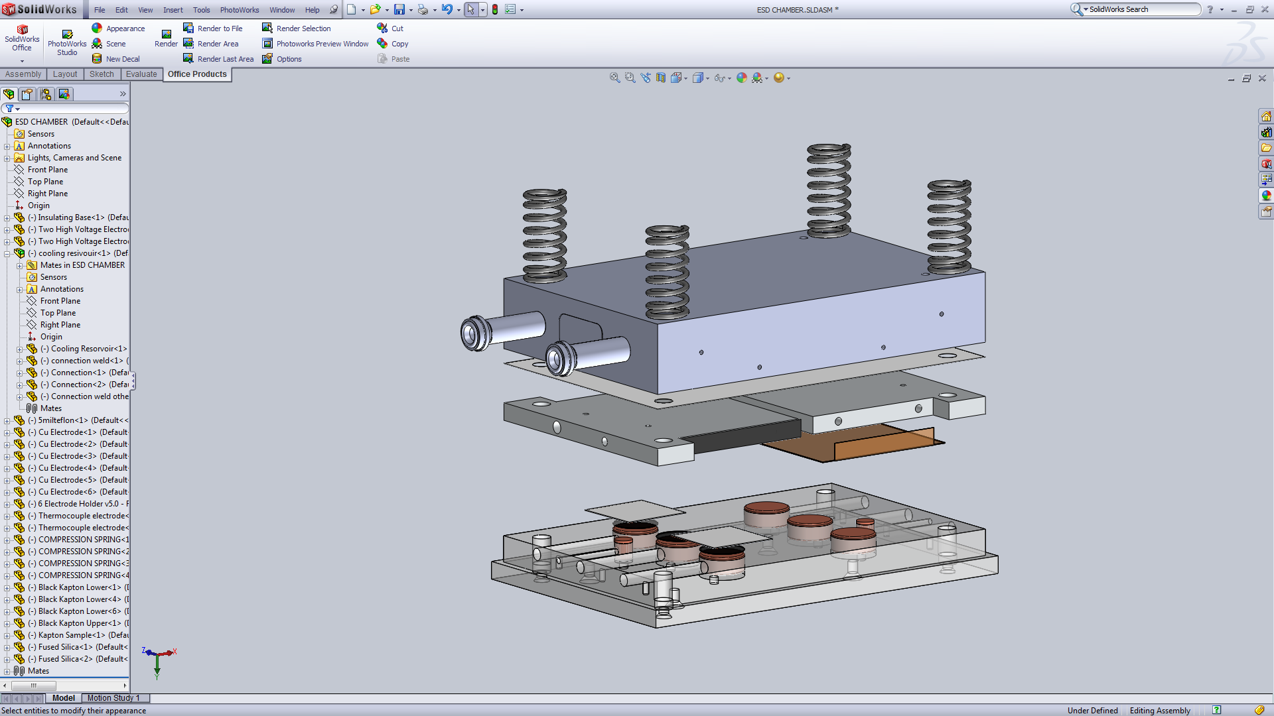
Motivation Procedure Analysis Conclusion
ESD SYSTEM
Simple parallel plate capacitor
Applies up to 30 kV
~150 K<T<300K with ℓ-N₂ reservoir

Slide 11
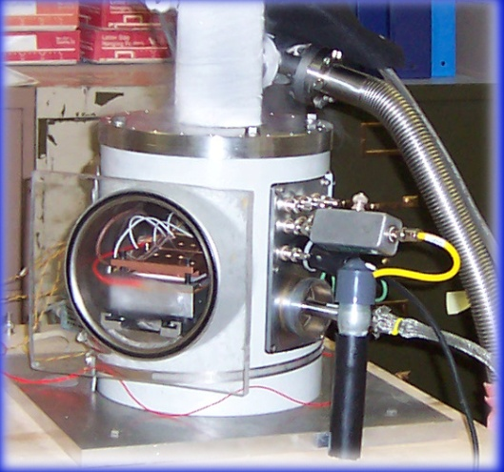
Motivation Procedure Analysis Conclusion
CVC SYSTEM
Same geometry as ESD system
Applied electric field well below critical breakdown field
Measures <200 aT at <8kV

Slide 12
Motivation Procedure Analysis Conclusion
Motivation Procedure Analysis Conclusion
Analysis

Slide 13
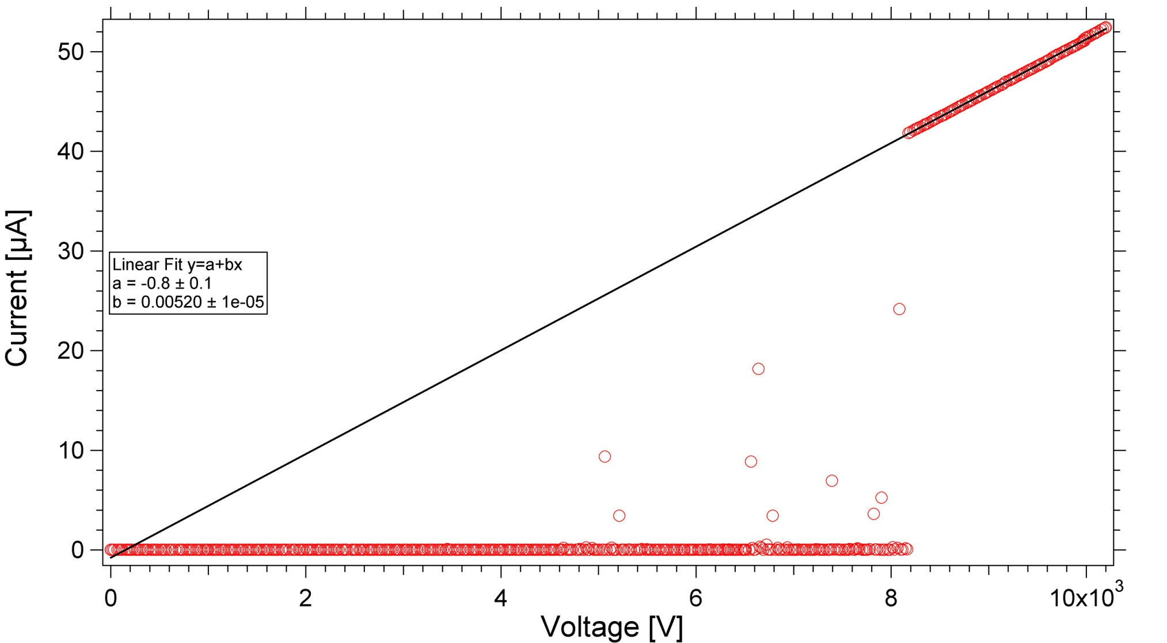
Motivation Procedure Analysis Conclusion
ESD Data
Ohmic slope
I = V/R
Pre- Breakdown Arcing
Breakdown voltage
Notes:
Elliptical reflector designed to maximize the exposure of the samples by directing the light to a focal point where the samples can be placed. The bluish portion of the solid model on the right demonstrates the light cone and focal point of the reflector. The array on the left is an image of the deuterium lamp configuration that allows for even light exposure at the increased intensity.

Slide 14
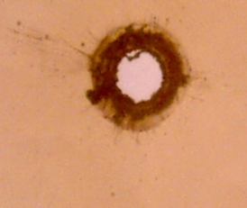
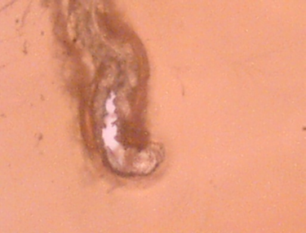
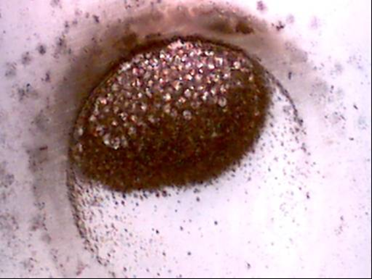
Motivation Procedure Analysis Conclusion
What ESD data tells us
Frequency of pre-breakdown current spikes corresponds to the rate of induced material defects.
The breakdown voltage corresponds to a critical electric field.
E_{esd}=V_{esd}/d
20 µm
20 µm
10 mm
Notes:
Elliptical reflector designed to maximize the exposure of the samples by directing the light to a focal point where the samples can be placed. The bluish portion of the solid model on the right demonstrates the light cone and focal point of the reflector. The array on the left is an image of the deuterium lamp configuration that allows for even light exposure at the increased intensity.

Slide 15
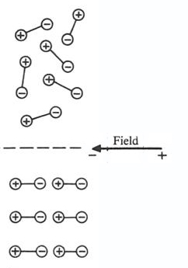
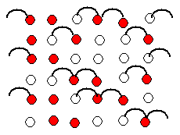
Motivation Procedure Analysis Conclusion
What CVC data tells us
Polarization – initial response of material to applied field.
Charge Transport – motion of charge across sample & charge rearrangement.
Defect Density – equilibrium ‘dark current’ proportional to density of defects in material.
Polarization
Dark Current
Notes:
Elliptical reflector designed to maximize the exposure of the samples by directing the light to a focal point where the samples can be placed. The bluish portion of the solid model on the right demonstrates the light cone and focal point of the reflector. The array on the left is an image of the deuterium lamp configuration that allows for even light exposure at the increased intensity.

Slide 16
Motivation Procedure Analysis Conclusion
Conductivity Model
Tunneling frequency
Well depth
Electric Field
Contribution
Tests lasting only days can predict decades of behavior!
Notes:
Elliptical reflector designed to maximize the exposure of the samples by directing the light to a focal point where the samples can be placed. The bluish portion of the solid model on the right demonstrates the light cone and focal point of the reflector. The array on the left is an image of the deuterium lamp configuration that allows for even light exposure at the increased intensity.

Slide 17
Motivation Procedure Analysis Conclusion
Motivation Procedure Analysis Conclusion
Conclusion

Slide 18
Motivation Procedure Analysis Conclusion
Motivation Procedure Analysis Conclusion
Conclusions
HVDC transmission improves efficiency.
Transmission loss effectively halved.
500kV/1000kV ≈ ½
High Voltage – High Stress
Electrons move through and pile up in permanent and recoverable defect sites until the material breaks down.
Physics helps predict long term behavior.
Measurements over reasonable time scales help us predict behavior over decades which allows testing and perfecting designer materials.
Impact on power grid
The energy saved if transmission losses were halved nationwide ~30 large coal burning power plants. Such reductions in loss are quite possible!
Notes:
How long it takes for space suit to degrade and probabilities. What will happen and how serious it will be. Micro penetration vs astro penetration. Results.

