Slide 1


The Next Information Literacy Challenge: Partnering to Promote Deeper Engagement with Information and Better Writing
Utah Library Association Annual Conference
May 2, 2013

Slide 2
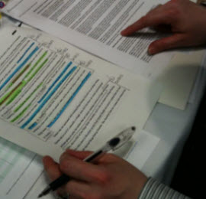
The Citation Project http://site.citationproject.net/
1,911 incidences of source use:
  42% copied and marked as quotation
  16% patchwritten
  32% paraphrased
  6% summaries¹
"96% worked with two or fewer sentences from the source"¹
46% of citations are to the first page of the source and 77% are to the first three pages²
Notes:
History of the project began with concerns about plagiarism:
“Although much has been written on this topic and many have expressed concerns, little empirical data is available to describe what students are actually doing with their sources. At present, therefore, educators must make policy decisions and pedagogy based on anecdote, personal observation, media reports, and the claims of corporations that sell “solutions.”(http://site.citationproject.net/)
biggest conversation starter I’ve had with faculty in entire career as an academic librarian
stories and anecdotes are useful; data can be really powerful in helping explain and deepen that narrative (“students doing superficial research” >>> heads nod >>> “the Citation Project tells me that 77% of the students are citing from only the first 3 pages of a source, not matter how long.” >>> Aha!
“If instructors know how shallowly students are engaging with their research source—and that is what the Citation Project research reveals—then they know what responsible pedagogy needs to address.”

Slide 3
Studying Teaching and Learning Information Synthesis
Anne R. Diekema and Sheri Haderlie, Instructional Technology & Learning Sciences, USU
Wendy Holliday and Kacy Lundstrom, Merrill-Cazier Library, USU
Heather Leary, University of Colorado - Boulder

Slide 4
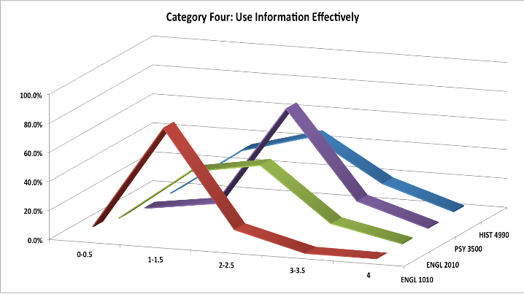
Library Assessments

Slide 5
Origin of synthesis intervention
Carolyn Johnson
  Librarian at Arizona State University West
  http://www.west.asu.edu/johnso/synthesis/synthesis.html³
Workshop materials adapted for
  UELMA 2012 presentation
  Several English Department presentations
  Study intervention lesson on synthesis

Slide 6
Synthesis Lesson
Met with 4 sections of ENG 2010 students
Brief introduction
Timed guided practice - in groups of 3-4
  individually read 2 articles
  shared with team members what they learned
  individually organized information on Post-Its
  team clustering of Post-Its
  team naming of clusters
  team review - too much, too little, just right
  team - define scope & decide sequence
  individually write a paragraph
    put articles aside
    use 1 cluster of Post-Its

Slide 7
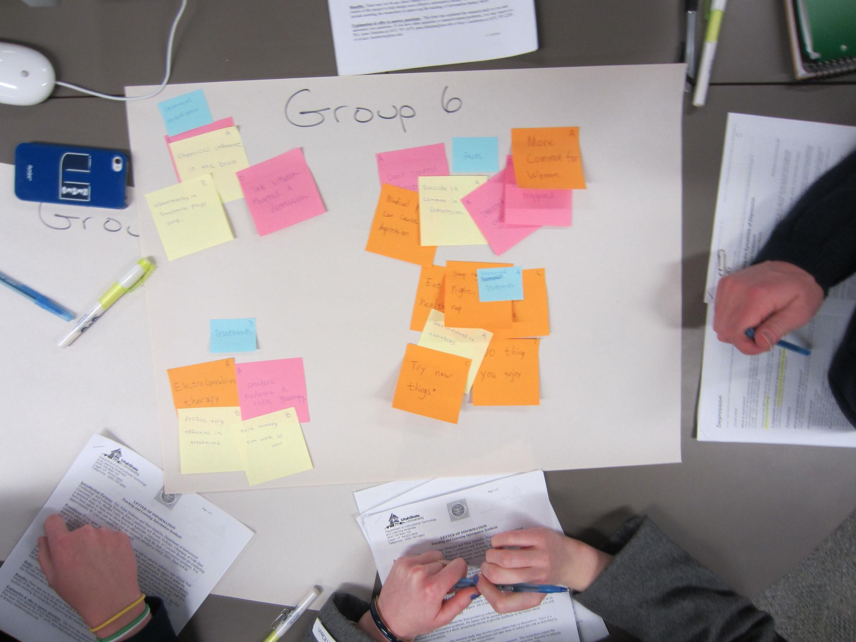
Research in action

Slide 8
Research Questions
1. Can information synthesis be broken down into steps that help identify and scaffold complex cognitive tasks for students?
2. Do students improve their information synthesis skills and apply it to their writing after participating in an in-class group-based synthesis lesson?
3. Can coding methods inspired by the Citation Project, such as number of sources cited per paragraph, effectively measure the level of synthesis in student writing?

Slide 9
Current status of project
All data collected
Working on how to capture synthesis
Quantitatively
  e.g. number of sources per paragraph
  e.g. number of connection between sources
Qualitatively
  Rubric
  Explore existing rubrics
  Create new items based on synthesis definition

Slide 10
Talk to us!
anne.diekema@usu.edu
heather.leary@gmail.com
kacy.lundstrom@usu.edu
sheri.haderlie@usu.edu
wendy.holliday@gmail.com
Our presentation can be downloaded here:
http://digitalcommons.usu.edu/itls_facpub/254

Slide 11
Works Cited
¹ Jamieson, S. & Howard, R.M. (2011). "Datasheet #1: Source use in the paper." The Citation Project. Retrieved from http://site.citationproject.net/wp-content/uploads/2011/08/Source-Use-in-the-Paper.pdf
² Jamieson, S. & Howard, R.M. (2011). "Datasheet # 2: Sources cited in the paper." The Citation Project. Retrieved from http://site.citationproject.net/wp-content/uploads/2011/08/Sources-Cited-in-the-Paper.pdf
³ Johnson, C. R. (2003). Synthesizing information. Unpublished workshop materials. Arizona State University West. Retrieved from http://www.west.asu.edu/johnso/synthesis/synthesis.html#examples

