Slide 1
Securing the scholarly record
This work is licensed under the Creative Commons Attribution 3.0 Unported License. To view a copy of this license, visit http://creativecommons.org/licenses/by/3.0/

Slide 2
Why Should You Care About Copyright?
Notes:
Image suggestions: question marks surrounding copyright symbol
You just published an article in Nature and want to post a copy of the article from the journal on your personal web site. Are you allowed to do this?
You published a book with Wiley, and you want to scan it in and add it to your class web site. Can you?
Whoever holds the copyright has the right to:
Reproduce the work
Prepare derivate work
Distribute copies of the work
If you signed your right away, you no longer have the right to do this and it is now your publisher’s exclusive right to these actions.
Do you want to have these rights, or do you want to give it away?

Slide 3
Know Your Contract
The Grant Clause
Notes:
What rights are you granting?
Copyright
It is very common in scholarly book contracts for copyright to be granted/transferred to the publisher. For articles and book chapters, it is not as common. If your copyright is transferred to your publisher, all is not lost; there are often good reasons to do this. And if you “retain” copyright, you may or may not be retaining secondary rights that allow you to do anything with it.
Language to look for: “author hereby grants, assigns, and transfers . . . all copyrights and the right to secure copyright in the name of the [author or publisher].”
Right to publish and sell
The right to publish is one of many rights included within copyright. Granting this right gives your publisher your clear permission to publish your work, even in cases where copyright is registered in your name.
Often, the contract will grant the publisher exclusive rights to publish. Sometimes, this grant is non-exclusive, meaning you are free to grant the same (non-exclusive) publishing rights to other publication venues, as well.
As a corollary of publishing rights, the contract will often grant the publisher the exclusive right to sell the work. That is, to protect the publisher’s investment in the work, the contract may disallow you from engaging others to sell the work, too, unless they have your publisher’s permission. For example, it might be a violation for you to sell copies of a PDF through your personal website, or to engage the local copyshop to print the work for sale to your students or family. Permission must be obtained from your publisher, because you have granted them the exclusive right to publish and sell the work.
Language to look for: “the exclusive right to publish, co-publish, or cause others to publish . . . and sell” vs “one-time, non-exclusive right to publish.”
Other rights
The contract often will also address other rights, called subsidiary rights. These might include rights to grant permission for others to use the work (as in reprints by other publishers, coursepacks, e-reserve, online “custom publications”), or the right to license translations or derivative works based on the publication.
Especially when your work is in a literary or other artistic genre, these might include performance rights, dramatization rights, serial rights, musical adaptations, even theme park rights.
With your grant of these rights, your publisher becomes your licensing agent, and they will handle correspondence, billing and collections, and income related to licensing these rights. In another clause, the contract will stipulate how any related income will be divided between you and your publisher.
Language to look for: “the full, sole, and exclusive right to grant, sell or license the following rights.”

Slide 4
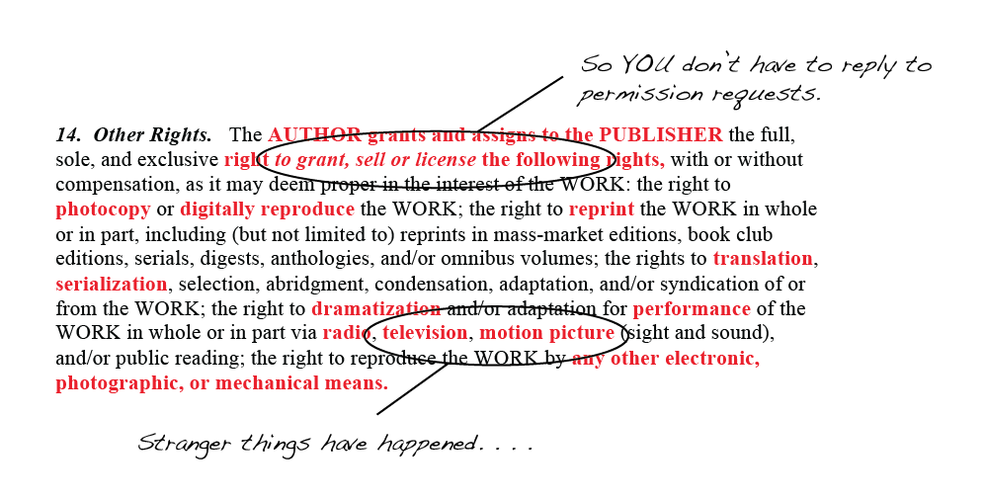
Know Your Contract
Other Rights
Notes:
Other rights
The contract often will also address other rights, called subsidiary rights. These might include rights to grant permission for others to use the work (as in reprints by other publishers, coursepacks, e-reserve, online “custom publications”), or the right to license translations or derivative works based on the publication.
Especially when your work is in a literary or other artistic genre, these might include performance rights, dramatization rights, serial rights, musical adaptations, even theme park rights.
With your grant of these rights, your publisher becomes your licensing agent, and they will handle correspondence, billing and collections, and income related to licensing these rights. In another clause, the contract will stipulate how any related income will be divided between you and your publisher.
Language to look for: “the full, sole, and exclusive right to grant, sell or license the following rights.”

Slide 5
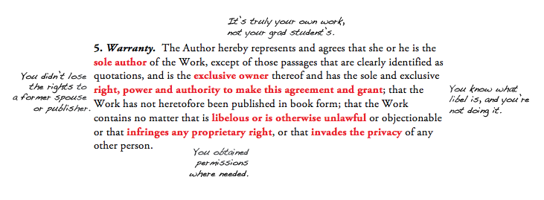
Know Your Contract
Warrants Clause
Notes:
What are you warranting?
Authorship
Normally, the contract will ask you to warrant that you are the true “sole and original” creator of the work. In case of a future dispute over rights, this shows that your publisher acted in a good-faith belief that you were the author/creator—because you warranted it was so.
Language to look for: “Author warrants that the Work is original with [you] . . . that [you are] the sole and original creator thereof”
Ownership
This is different from authorship, because sometimes ownership of a work is not held by the person who created it. A common example is a work made for hire, in which the author is only an employee or contractor of the copyright owner. Ownership likewise might have been sold, bequeathed, granted, or otherwise transferred to someone beside the creator—like another publisher. Warranting ownership again indicates to your publisher that they are contracting in good faith.
Language to look for: “that the Author is the sole owner of the rights granted herein”
Power/authority
By warranting that you have the authority and power to make the agreement (to grant the rights you are granting in the contract), you are assuring your publisher that the work is not bound by legal constraints—as it would be if there were a lien on it, or if it were currently the subject of a legal dispute, like an inheritance or divorce.
Language to look for: “that the Author has full power and authority to make this agreement . . . that no right in the work has been sold, mortgaged, or otherwise disposed of; that the work is free from all liens and claims”
Permissions
Many scholarly and some creative publications include or embed work that was created by someone else (including students). By warranting that you have permission to use the embedded work, you are assuring your publisher that you have cleared permissions with whoever controls the rights to reprint, or that you have not exceeded the bounds of fair use under the Copyright Act. Normally, you will need to provide originals or copies of written permissions during the editorial process.
Language to look for: “that the Work does not infringe any copyright or violate any proprietary rights”
Libel, unlawful, etc.
Often, the contract will include your formal warrant that your work contains nothing libelous or unlawful, that it does not infringe any rights belonging to others, and is not an invasion of privacy.
Exposure to a libel suit is one of the greater risks in publishing, so, in this clause, your publisher is asking for your formal warrant that what you have presented in the work as fact about other individuals or entities is indeed factual and documentable, and that where you are expressing opinions that might be objectionable, those are clearly represented as opinions.
Language to look for: “does not contain any scandalous or libelous matter, or invade the privacy of any person”

Slide 6
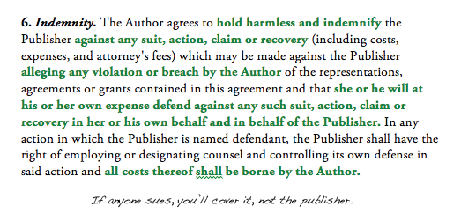
Know Your Contract
Indemnity clause
Notes:
Indemnity
Here you agree to take full legal responsibility for the content of the work. You agree that, should a legal action be filed, you will indemnify your publisher against negative judgments.
Language to look for: “agrees to defend, indemnify, and hold harmless the publisher against all claims, demands, suits, losses, damages, costs, and expenses incurred by reason of” etc.

Slide 7
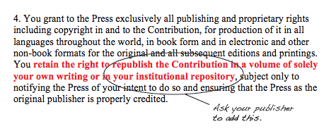
Know Your Contract
What RIGHTS are you retaining?
Notes:
What rights are you retaining?
Copyright
In some contracts—often in contracts on creative work—the author is said to retain copyright. This is achieved by registering copyright in the author’s name instead of the publisher’s, and it can be arranged by mutual consent in any publication contract. However, it is important not to over-interpret what this retains.
Copyright is essentially a cover term for a bundle of specific rights (publishing, licensing, selling, etc.). Without an exclusive transfer of most of those specific rights, the publisher will have little incentive to publish the work. But if those rights are transferred, then registering the copyright in the author’s name becomes a mere courtesy, and actually retains little power over the work for the author.
Language to look for: “secure copyright and renewals thereof in the United States . . . in the name of the Author”
Republication
Sometimes, the contract will retain republication rights for the author. This is often the case, for example, when the work is a short contribution included along with contributions by other authors/creators—an article, a poem, a photo, a chapter in a book. In these cases, you will not need formal permission from your publisher to submit the work for publication elsewhere in the future. With this right often comes the contractual duty to acknowledge your original publisher and copyright date in any republication.
Language to look for: “Author retains the right to republish . . . subject only to” etc.
Competitive/derivative work
Normally, a publisher will not agree to publish your work if you intend to release a competitive or derivative piece based on the same research, or an abridgement of the work. This is called “protection of the work,” because the second publication may reduce demand for the first.
However, occasionally, the contract will also allow this.
Language to look for: “Author retains the right to publish a work of similar character . . . subject only to” etc.
Institutional Repository
Newer publishing contracts increasingly are written to accommodate the need of academic authors to deposit their work with their local IR. Publishers sometimes see this as a risk to the work, especially where institutions have mutual access agreements with other institutions, or general open access policies. If language allowing this is not included in the contract, it is often possible to get the publisher to insert it or to include an addendum allowing deposit in the IR.
Language to look for: “author retains the right to deposit an electronic copy of the work in her/his institutional repository,” etc.

Slide 8
What Should You Keep?
Keep your own archive of your publications
Copy of contract
Copies of correspondence with the publisher
Versions of papers that are accepted (LOTS!)
Preprint (submitted final copy)
Final edited refereed copy (author’s post print)
Final proof (post print)
Notes:
Lost your contract? What to do?
Sherpa Romeo
Contact publisher
Contact us

Slide 9
What do these have in common?
Securing Your Rights
Creative Commons
Open Access
Author Rights!

Slide 10
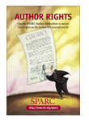
Securing your rights: SPARC author addendum
What is it?
How do you use it?
Complete the addendum
Print and attach to agreement
Note in cover letter
http://www.arl.org/sparc/author/
Notes:
The SPARC (Scholarly Publishing and Academic Resources Coalition—disseminates scholarly work and at the same time tries to alleviate the financial pressures on libraries—started in 1997—over 800 institutions worldwide who support) author addendum modifies the publisher’s agreement you receive when publishing. It empowers authors to retain specific rights with their work. It is easy to use, fill out the form online, print it and attach to your publishers agreement. Be sure to note you have done this in your cover letter to your publisher.

Slide 11
Creative Commons (CC)
For licensing all intellectual works
Posters
Power Point presentations
Conference works
Blogs
Webpages
http://creativecommons.org/about/licenses/
This work is licensed under the Creative Commons Attribution 3.0 Unported License. To view a copy of this license, visit http://creativecommons.org/licenses/by/3.0/
Notes:
Creative Commons is an organization built with the help of copyright attorneys that provides an alternative copyright license that allows a creator to choose how the work can be distributed, remixed, tweaked, and built upon (even for commercial work). It can be used on just about anything: posters, PP presentations, web pages, etc.

Slide 12
Open Access
“By open access, we mean its immediate, free availability on the public internet, permitting any users to read, download, copy, distribute, print, search or link to the full text of these articles, crawl them for indexing, pass them as data to software or use them for any other lawful purpose…” - The Budapest Open Access Initiative
Notes:
SPARC supports this definition of open access.

Slide 13
Open Access
Why should you care?
Open access materials are
Cited sooner
Cited more frequently
Move scholarship forward faster
Peer reviewed
http://www.arl.org/sparc/openaccess/
Notes:
Now that we know what Open Access means, why should you care? Open access materials are shown to be cited faster and more frequently allowing scholarship forward. For author rights it is important to know the licenses you are assigning to your works and how they are being distributed.
STATISTICS ABOUT THIS
IMPACT FACTORS
NOT EXCLUDING PEER REVIEW
From Norris, Oppenheim, Rowland, 2008:From sample of 4,633 articles 2,280 or 49% were OA with a mean citation count of 9.04; the rest, 2,353 or 51% required a fee with a mean citation count of 5.76. This varies among disciplines though.
From Davis et al., 2008:In the first six months after publication, OA articles had 89% more full-text downloads than subscription articles.
From Eysenbach, 2006:OA articles were twice as likely to be cited than non-OA articles. OA articles have a higher impact than self-archived articles.
From Hajjem, Harnad, Gingras, 2005:Comparing OA and non-OA articles in the same year/year, OA articles had more citations, that advantage varying from 36%-172% by discipline and year.
CITATION TO STUDY ABOUT THIS – OR AT VERY END

Slide 14
OA Studies
Norris, M., Oppenheim, C., Rowland, F. (2008). The Citation Advantage of Open-access Articles. Journal of the American Society for Information Science and Technology, 59(12), 1963–1972.
Davis, P. M., Lewenstein, B. V., Simon, D. H., Booth, J. G., Connolly, M. J. L. (2008). Open Access Publishing, Article Downloads, and Citations: Randomised Controlled Trial. British Medical Journal, 337, a568.
Eysenbach, G. (2006). Citation Advantage of Open Access Articles. PLoS Biol 4(5): e157. DOI: 10.1371/journal.pbio.0040157
Hajjem, C., Harnad, S. and Gingras, Y. (2005) Ten-Year Cross-Disciplinary Comparison of the Growth of Open Access and How it Increases Research Citation Impact. IEEE Data Engineering Bulletin, 28 (4). pp. 39-47.
Notes:
From Norris, Oppenheim, Rowland, 2008:From sample of 4,633 articles 2,280 or 49% were OA with a mean citation count of 9.04; the rest, 2,353 or 51% required a fee with a mean citation count of 5.76. This varies among disciplines though.
From Davis et al., 2008:In the first six months after publication, OA articles had 89% more full-text downloads than subscription articles.
From Eysenbach, 2006:OA articles were twice as likely to be cited than non-OA articles. OA articles have a higher impact than self-archived articles.
From Hajjem, Harnad, Gingras, 2005:Comparing OA and non-OA articles in the same year/year, OA articles had more citations, that advantage varying from 36%-172% by discipline and year.

Slide 15
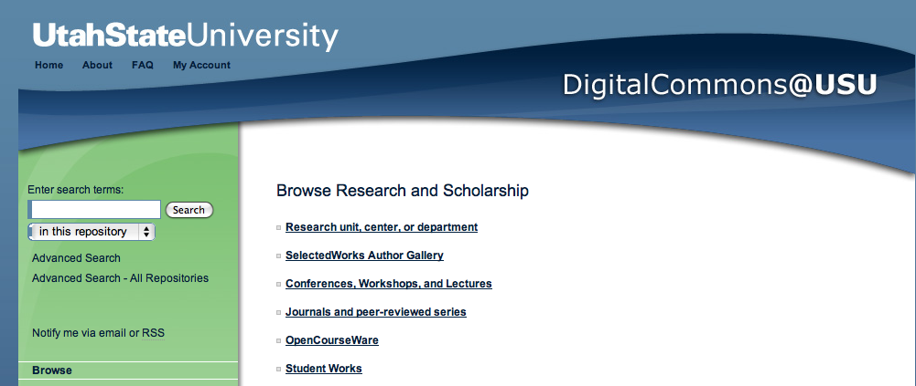
Promote Your Own Open Access
Contact the Library to deposit a copy of your paper in Digital Commons

Slide 16
Questions?
copyright@usu.edu

