Slide 1
Reaping a Rich Harvest from CONTENTdm:
Using Primo and a Dublin Core Application Profile
CONTENTdm Western Users Group Meeting
June 2010
Sandra McIntyre, Mountain West Digital Library
Cheryl Walters, Utah State University

Slide 2
Two efforts, same goal
  Improving Mountain West Digital Library’s search portal at http://mwdl.org
    Implementing Ex Libris Primo as the integrated discovery layer
    Implementing a new Dublin Core Application Profile to guide metadata assignment for MWDL partners

Slide 3
Mountain West Digital Library
Search portal at http://mwdl.org
  340 collections from 11 repositories
  50 partners
  300,000 records
  Rich metadata from a variety of sources standardized (up to now) on simple Dublin Core
A network of digitization projects in Utah, Nevada, and other places in the Mountain West
A program for increasing digital library efforts of the member libraries of the Utah Academic Library Consortium

Slide 4
Mountain West Digital Library
Old harvester: PKP Open Archives Harvester
  Inflexible – no incremental harvesting
  Inefficient reverse indexing
  Limits searching – a “memory hog”
  Little flexibility for the user in ordering search results
  Requires old-fashioned “Advanced Search” to tailor results

Slide 5
Mountain West Digital Library
text
Old metadata guidelines
  Shareable metadata issues, e.g.:
    Differences in date formatting and mapping
    Lack of common geographic data
    Lack of adequate preservation metadata
  Inadequate directions for partners

Slide 6
Goals set in 2009
Improving and expanding MWDL
  Aggregating more collections, including the large Utah Digital Newspapers collections
  Harvesting more frequently
  Providing more powerful searching

Slide 7
Ex Libris Primo
An integrated discovery layer tool
  Powerful search interface that “sits on top” of different silos of resources
    Bibliographic records
    Article databases
    E-journals
    Digital collections
  Sophisticated, rapid search features
  Powerful harvesting – aggregates primarily
  Powerful indexing

Slide 8
Primo: an opportunity…
Impact on searching and browsing
  More fields
  Larger data capacity
  Faceting the search process
  Qualified Dublin Core elements/refinements

Slide 9
Primo: …and a challenge
With larger numbers, need to give more specific search capability to users
Take advantage of the granularity that additional fields provide
More diverse partners and collections require better guidance

Slide 10
Parallel efforts
Application Profile
  Standardize and improve metadata ready for harvest
Primo
  Normalize metadata during the harvest
  Tailor the search interface to take advantage

Slide 11
Process of creating an Application Profile
text
[what is a Profile]
[Task Force and members]
Readings
List of current problems

Slide 12
How Profile is organized
Six sections:
  Best Practices for All Fields
  Explanation of Table Components
  Element Tables (in alphabetical order)
  Parsed Preservation Elements about Master Archival Files (Optional)
  Vocabulary Encoding Schemes
  Syntax Encoding Schemes

Slide 13
What’s new in this profile?
New structure provides a table for each element
More information about each element
  Repeatability
  How to use
  Harvesting implications, when needed
  Refines/Refinements
  Mapping for both Dublin Core and MARC
Major changes in date and identifier fields
digitizationSpecifications renamed conversionSpecifications

Slide 14
What’s new – part 2
To facilitate digital preservation, new optional preservation fields (Section IV) about archival master files
New optional Dublin Core elements included: abstract, alternative, extent, isPartOf, spatial, tableofContents, temporal
New role refinement for contributor
More specific temporal and spatial elements instead of coverage
More guidance on vocabularies and encoding schemes throughout, with tables for the major schemes provided in new sections (V and VI).

Slide 15
May add local fields
Collection managers/metadata creators may add other fields to their metadata records as needed to serve local needs. Some examples:
    fields for data specific to a particular discipline or user community
    tags needed for customized searching
    natural language date fields to display unformatted dates
    other optional Dublin Core elements such as audience or bibliographicCitation

Slide 16
Same field, multiple vocabularies
When an element uses two or more different controlled vocabularies (example: subject using both Library of Congress Subject Headings and Medical Subject Headings), use a different field for each vocabulary and identify the vocabulary in the field label
Examples:
  SubjectLCSH or Subject (LCSH)
  SubjectMeSH or Subject (MeSH)

Slide 17
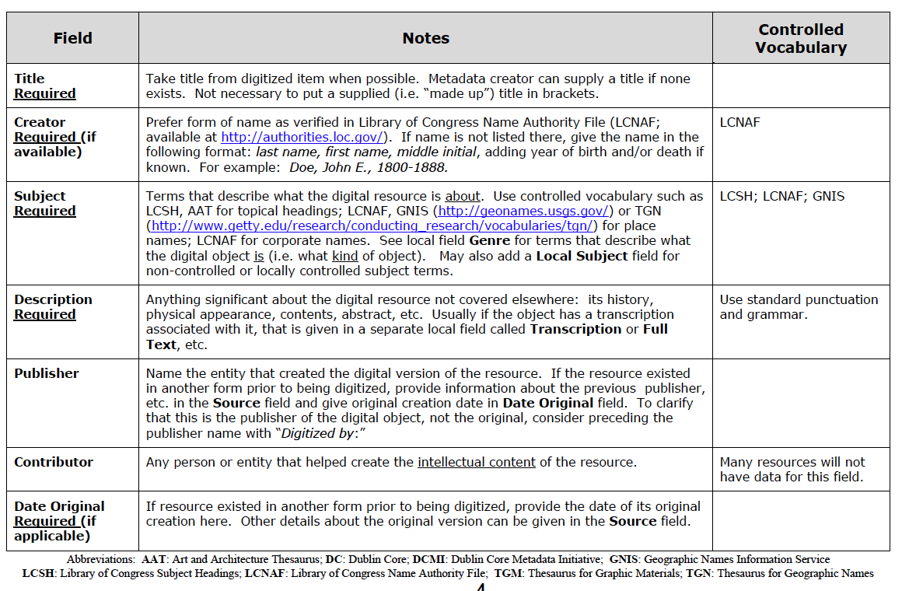
2006 MWDL Guidelines and Examples Used with CDP DC Metadata Best Practices

Slide 18
Each element described in a single row
Needed more instructions for how to use each element
Relied on CDP Dublin Core Metadata Best Practices for detail
No mappings provided for Dublin Core or MARC
Limited number of elements, mostly simple Dublin Core
Needed specific guidelines for using date and identifier elements to improve harvesting

Slide 19
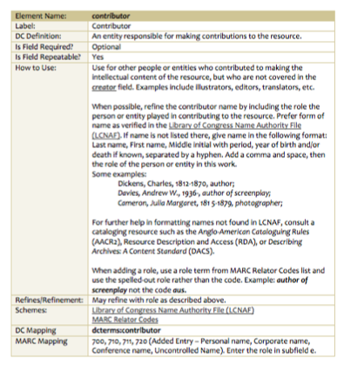
New 2010 profile: each element described in a table
From row to table in 2010 Profile
Contributor element in 2006
Contributor element in 2010

Slide 20
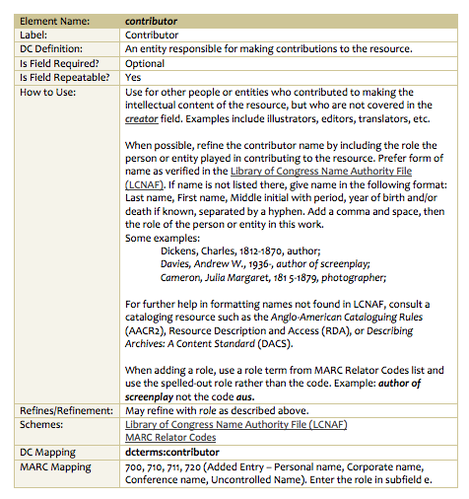
Contributor
“When possible, refine the contributor name by includ-ing the role the person or entity played in contribut-ing to the resource.”
Some examples:
Dickens, Charles, 1812-1870, author;
Davies, Andrew W., 1936-, author of screenplay;
Cameron, Julia Margaret,
1815-1879, photographer;

Slide 21
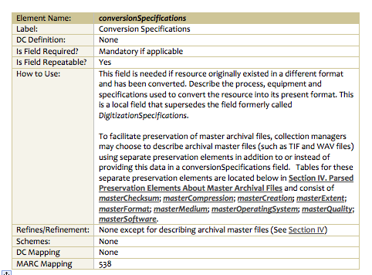
conversionSpecifications replaces digitizationSpecifications: renamed to clarify what to put in this field and when to use it…
Use “if resource originally existed in a different format and has been converted”

Slide 22

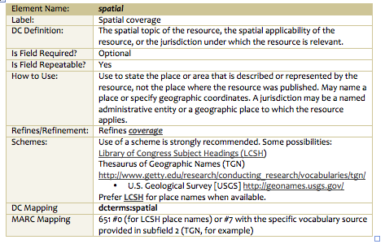
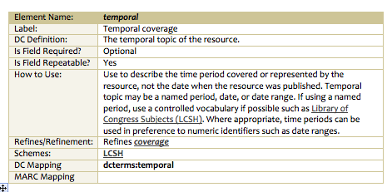
Adding specificity: Use Spatial or Temporal instead of Coverage

Slide 23
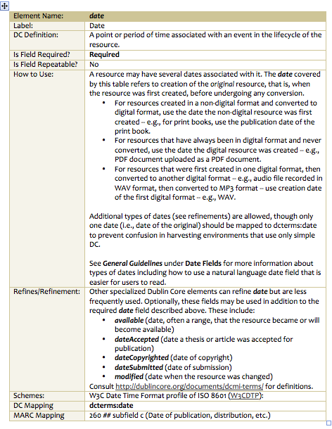
Lots of help with date element in profile… and general guidelines
(coming soon)

Slide 24
date
“…The date covered by this table refers to creation of the original resource, that is, when the resource was first created, before undergoing any conversion.”
  For resources created in a non-digital format and converted to digital format, use the date the non-digital resource was first created -- e.g., for print books, use the publication date of the print book.

Slide 25
date
  For resources that have always been in digital format and never converted, use the date the digital resource was created -- e.g., PDF document uploaded as a PDF document.
  For resources that were first created in one digital format, then converted to another digital format -- e.g., audio file recorded in WAV format, then converted to MP3 format -- use creation date of the first digital format -- e.g., WAV.

Slide 26
date
Additional types of dates (see refinements) are allowed, though only one date (i.e., date of the original) should be mapped to dcterms:date to prevent confusion in harvesting environments that use only simple DC.
See General Guidelines under Date Fields for more information about types of dates including how to use a natural language date field that is easier for users to read.

Slide 27
New sections
Parsed elements for archival master files to assist in tracking, managing & migrating files – Section IV: Parsed Preservation Elements
Tables for major controlled vocabularies – Section V: Vocabulary Encoding Schemes
Tables for major format conventions – Section VI: Syntax Encoding Schemes

Slide 28
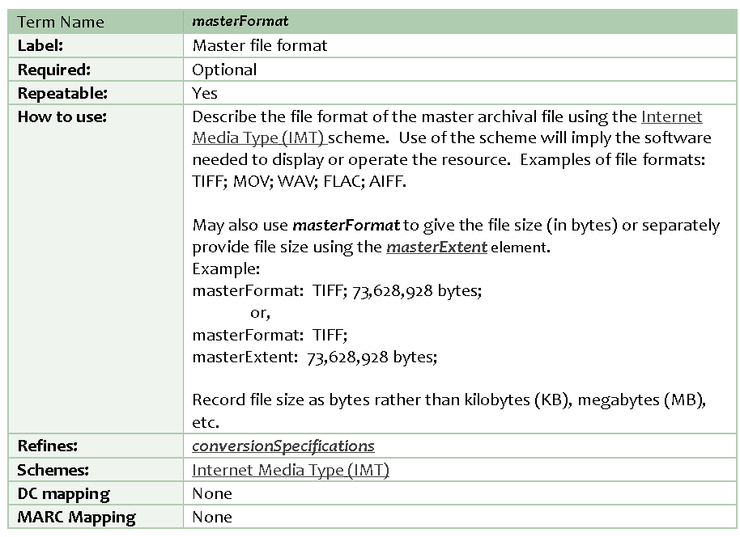
Preservation element

Slide 29
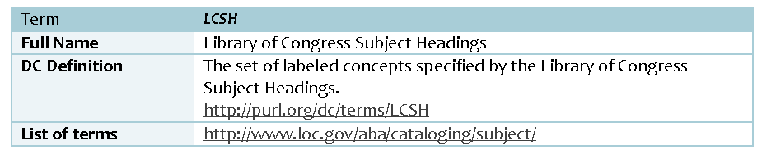
Vocabulary Encoding Scheme

Slide 30
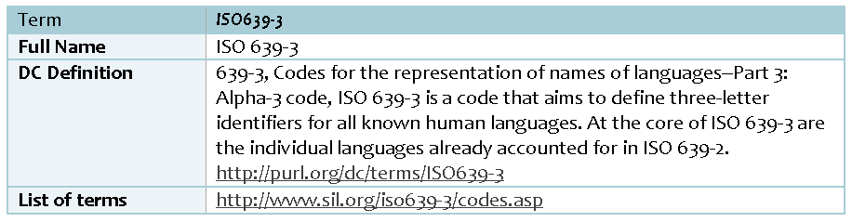
Syntax Encoding Scheme

Slide 31
Still in development
Guidelines
Examples
CONTENTdm Field Properties template
Recommended Readings

Slide 32
Future Revision
Over next six months, will collect comments and suggestions
December 2010 review and revision
Yearly reviews thereafter
Open invitation: Try it out and send us comments

Slide 33
Implementing the Profile in Primo
Writing normalization rules for metadata harvest into Primo – first pass is done
Customizing Primo’s front end to take advantage of the normalized records – under way now

Slide 34
Implementing the Profile in Primo
Piggybacking onto University of Utah implementation of Ex Libris Aleph and Primo
  Same instance of Primo
  Additional license for increased record count, up to 1 million (not including Digital Newspapers)
  Learning from that team’s experience
  Working with digital collections managers at the U of U re impacts of metadata standards

Slide 35
Step 1: Normalization rules
Manage the harvest and transformation of OAI metadata into Primo
Result: Primo Normalized XML (PNX)
  Display fields
  Search fields
  Facets
  Pre-filter facets
  Others: Scoping, Control fields, Links, Ranking

Slide 36
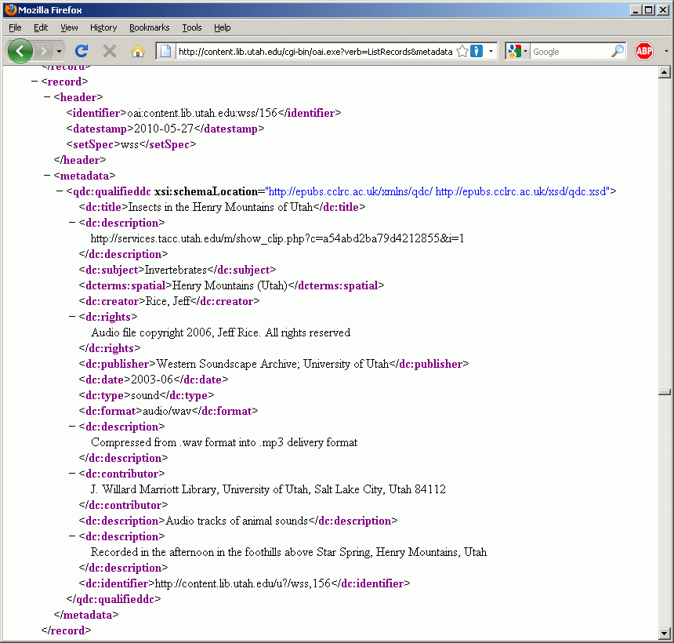
Dublin Core record via OAI

Slide 37
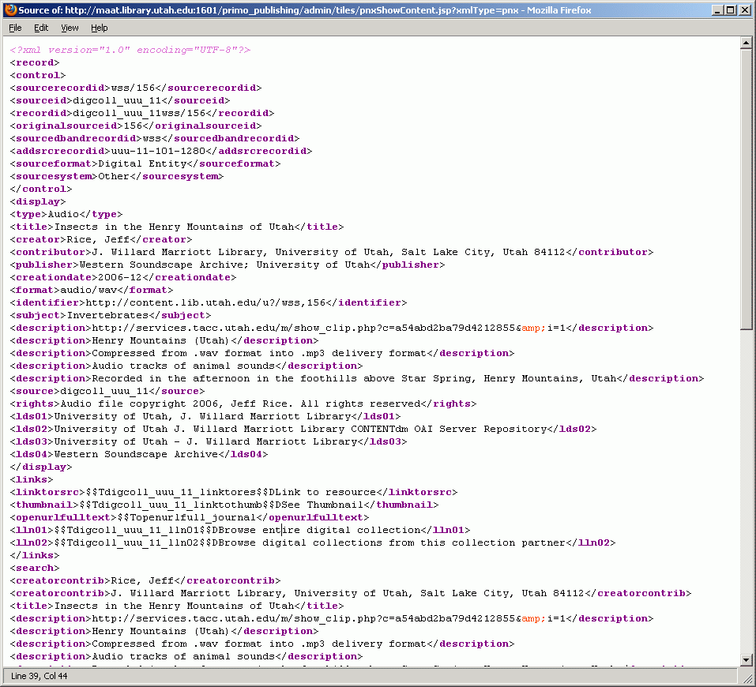
Primo Normalized XML

Slide 38
Normalization rules
Ex Libris offered default set of normalization rules for digital collections
We modified this, applying the Profile, element by element
Complication: one set of normalization rules for University of Utah and for all MWDL

Slide 39
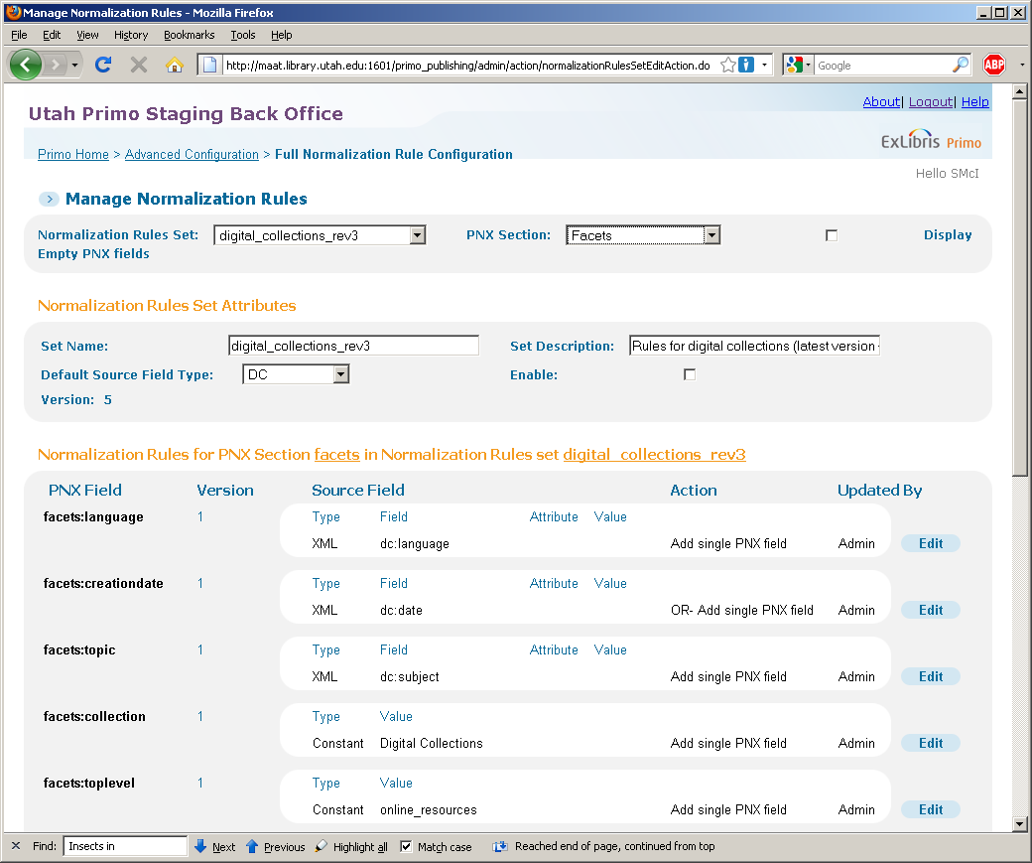
Normalization rules: Back Office

Slide 40
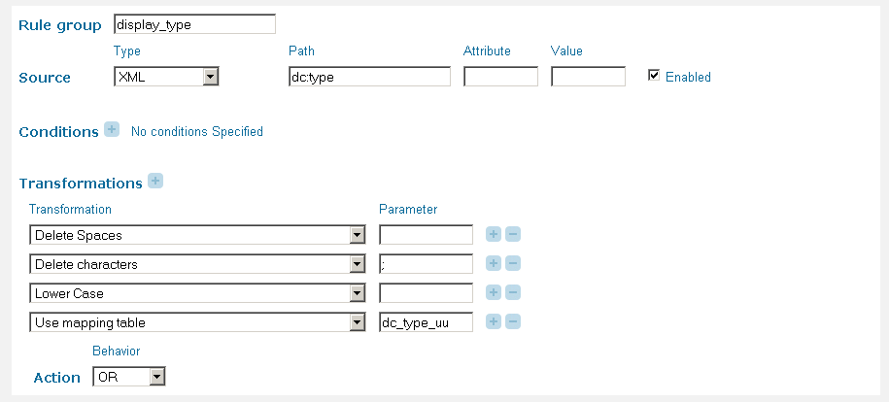
Normalization rules: Back Office

Slide 41
Normalization rules
Some of the things we can do:
  Select a specific dcterm from the OAI record
  Concatenate multiple iterations of one element or multiple elements
  Split a field by delimiter
  Add text at beginning or end
  Delete text
  Transform text, e.g., make upper-case
  Build in if/then conditions

Slide 42
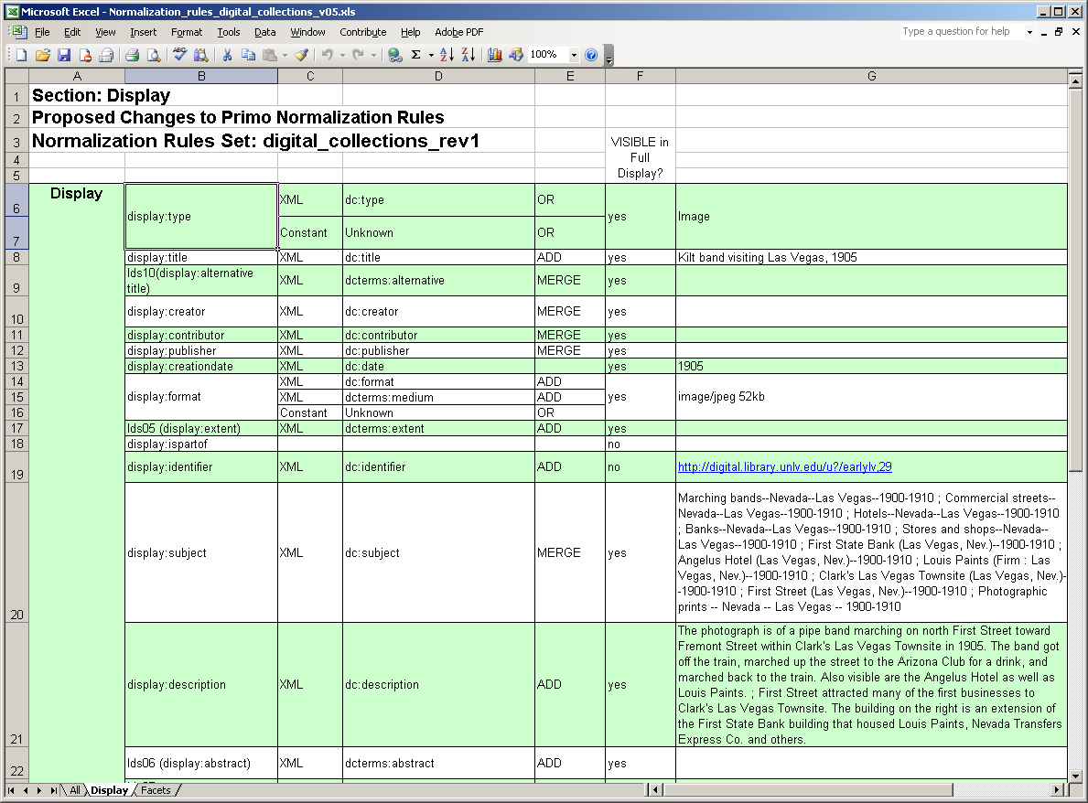
Normalization rules: tracking spreadsheet

Slide 43
Normalization rules: control
New control fields to reflect each item’s “membership” within the MWDL network
Example: Mendon City collection: usu-16-146-1536
  Hosting center: usu
  Utah State University, Merrill-Cazier Library
  Digital repository: 16
  Utah State University Digital Library
  Collection partner: 146
  Mendon (UT)
  Digital collection: 1536
  Mendon: A Page from the Past

Slide 44
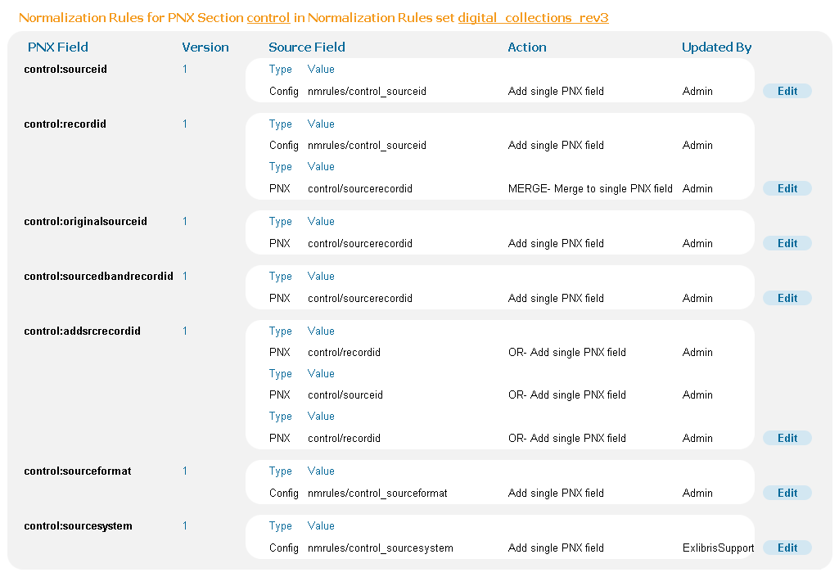
Normalization rules: control

Slide 45
Review and refinement
Four meetings of digital collections managers at 3 libraries – reviewed impact on University of Utah collections
Continuing refinements by that group in June and July
Review by UALC Metadata Task Force in June and July

Slide 46
Step 2: Customize Front End
Primo interface elements
  Facets
  Pre-filter facets
  Brief display
  Full display
  Links
  Scope

Slide 47
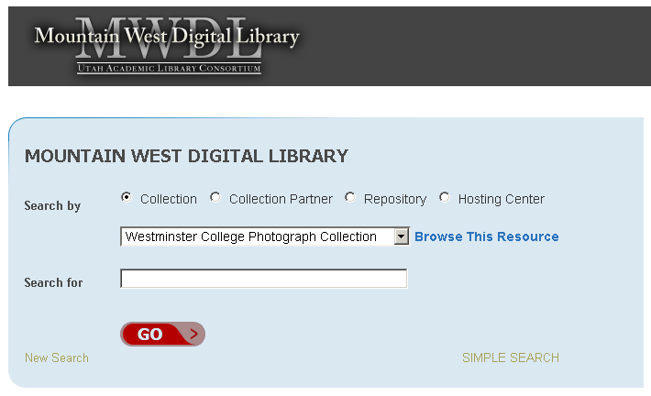
Customize Front End

Slide 48
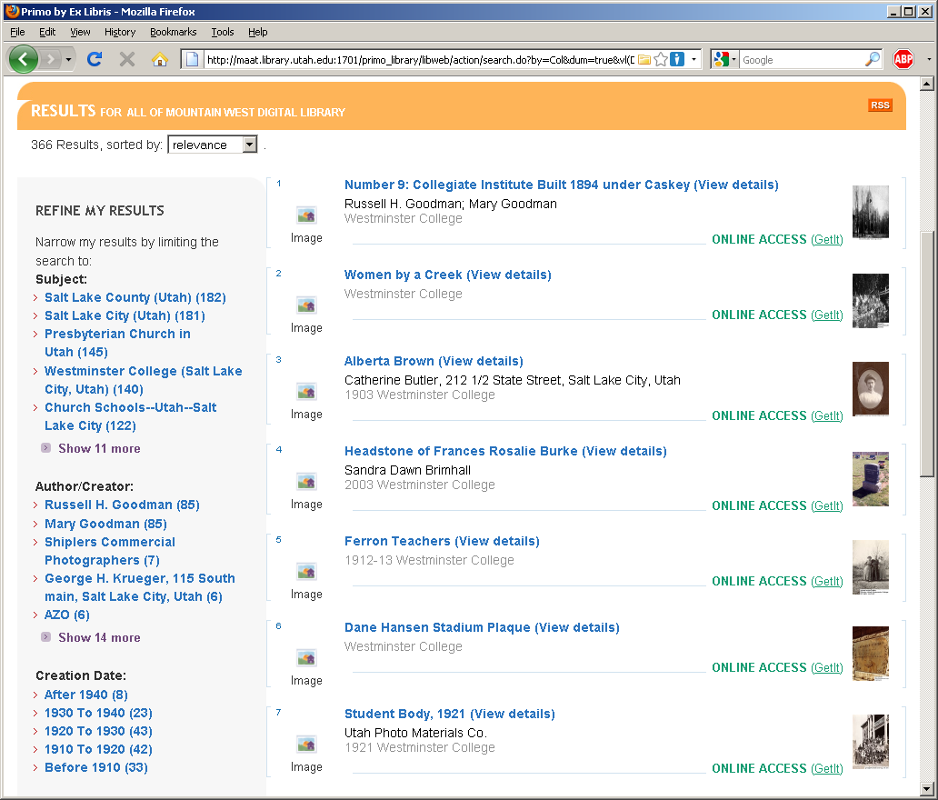
Customize Front End

Slide 49
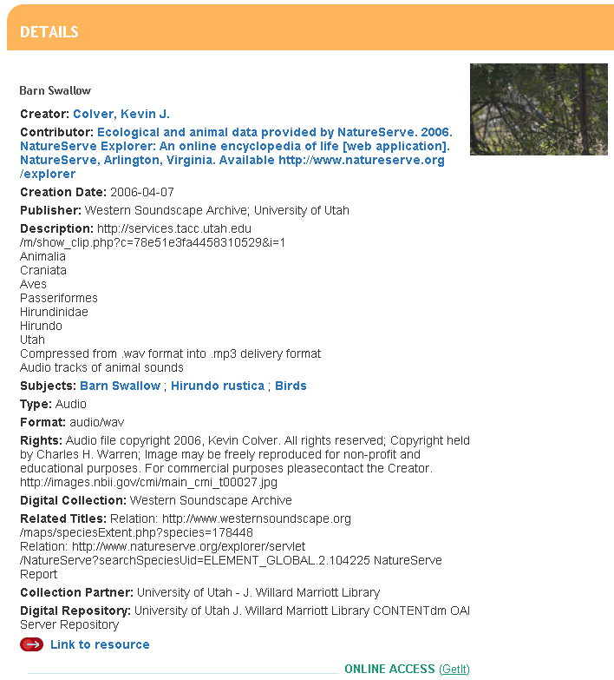
Customize Front End

Slide 50
Review and refinement
Review by UALC Website Development Task Force in June and July
CSS refinements by graphic designer; Javascript refinements by programmer
Possible modifications to Application Profile

Slide 51
Into the future
Tandem approach, with each effort reinforcing the other, has been productive
Proof in the pudding: evaluating users’ reactions
Theater into film analogy: We may not yet realize all the possibilities in Primo! What other opportunities await us?

Slide 52
Questions?
Sandra McIntyre
+1-801-585-0969
sandra.mcintyre@utah.edu
Cheryl Walters
+1-435-797-2623
cheryl.walters@usu.edu

