Slide 1
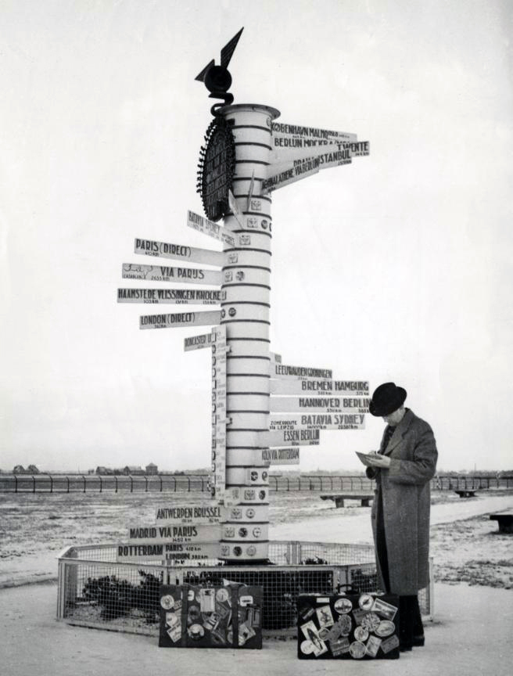
Resource Discoverability
Anne Diekema
Liz Woolcott
Cheryl Walters
ULA Annual Conference, St. George, May 2010

Slide 2
Stop moaning about the good old days. The card catalog sucked, and you thought so at the time, too.
Schneider (2006) – Free Range Librarian Blog

Slide 4
Introduction The New User Scenarios for Change The New Catalogs

Slide 5
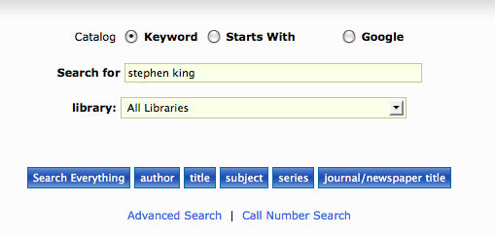
“Why does the Library catalog suck so bad?”-- Actual quote from a library patron, Spring 2010
What was he trying to do?
What did he get?
Leaders in animal behaviour : the second generation / Drickamer, Lee C.
Chapter: King Solomon's herring gull's world / Marian Stamp Dawkins
Chapter: Taking my cues from nature's clues / Stephen T. Emlen
Surviving field research : working in violent and difficult situations Sriram, Chandra Lekha, 1971-
Snakes : ecology and conservation Mullin, Stephen J., 1967-
Find books by Stephen King
He typed Stephen King into the search box and hit Enter.
What was he thinking?

Slide 6
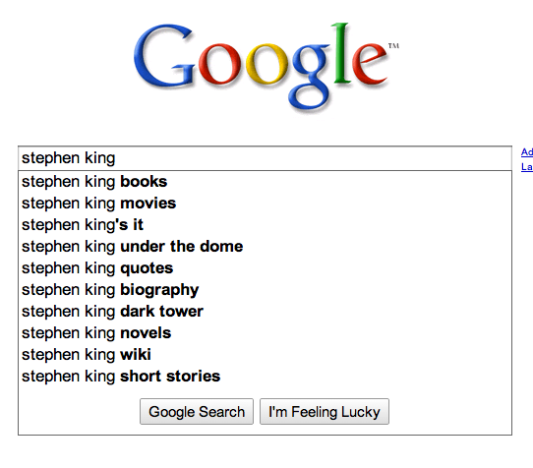
This!

Slide 7
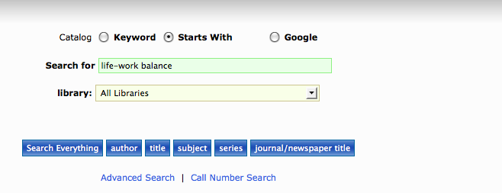
In the online catalog, a hyphen can make all the difference…
Life work balance
Or
Life-work balance
It shouldn’t matter whether user includes the hyphen or leaves it out.

Slide 8
The New User
Anne Diekema

Slide 9
That was then
Information appeared mostly in print in books and journal articles
Bibliographic databases with citations
Librarians information gatekeepers to databases
Library key to finding and obtaining information

Slide 10
This is now
The Internet
Subscription databases containing full text
Publishers are online with content
End-user searching (dis-intermediated environment)
Wide variety of free networking and search tools

Slide 11
Public Library Patron User Behavior
Patrons use online services at home
Streamline library visits
Informational searching at home
Library visit more entertainment oriented
From: Institute for Learning Innovation (2005)

Slide 12
College Student User Behavior
89 % of college students use search engines rather than library catalog to start search
93% are satisfied or very satisfied with search engine experience
84% are satisfied with librarian assisted search
College students use library less and are reading less
OCLC (2006)

Slide 13
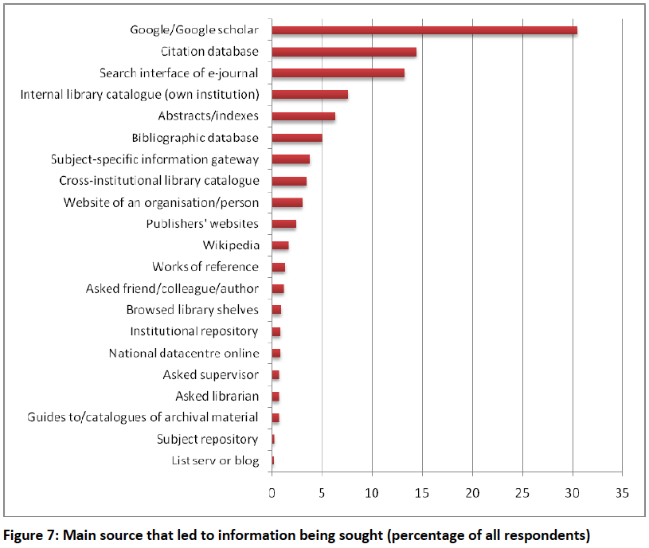
Researchers of Tomorrow (2009)

Slide 14
Young people’s information behavior - 1
Associate the Internet with Google
Have limited understanding of their information need => difficulty developing effective search strategies
Do not find library resources intuitive
Prefer using Natural Language versus keywords

Slide 15
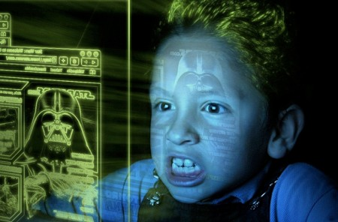
Young people’s information behavior - 2
Image search very popular
Rarely use Advanced Search
Spend little time evaluating information (for relevance, accuracy, or authority)
Spend little time reading
Image from Information Behaviour of the Researcher of the Future (2008)

Slide 16
Information Behavior in Virtual Libraries - 1
Horizontal Information Seeking
Skimming, viewing 1-2 pages, bouncing out
Navigation
Time spent finding bearings = time viewing content
Power browsing
New form of reading, title content, abstracts, quick wins;
Online to avoid having to read

Slide 17
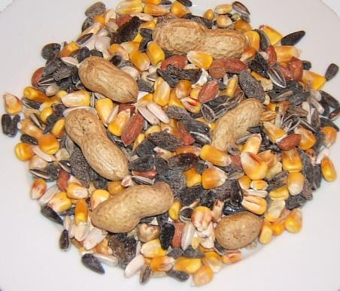
Information Behavior in Virtual Libraries - 2
Squirreling behavior
Download and store PDFs – no evidence of reading this content
Cross-checking
Dipping and cross-checking facts across trusted sites to assess authority
Image from Food 4 Wild Birds (http://www.food4wildbirds.co.uk)

Slide 18
Two roads diverged…?
Libraries
Users
Provide access to local physical collection through library catalog
Provide access to journal articles in subscription databases through library website
Provide trained reference librarians to help users find relevant content
Use Google or Google Scholar to find relevant content
Use library e-journal subscriptions but unaware of library
Avoid library visits because they are time consuming
Tend not to use librarians in their information search

Slide 19
Competition
Helping users “locate information for their research” has become a far more competitive endeavor than it was in the days of print… the library now competes with Google, publishers, aggregators, and other network-level services to service its constituents.
Schonfeld and Housewright (2010)

Slide 20
Information Consumers
“… library users have rapidly become information consumers who can switch instantly between commercial search engines, social networking sites, wikis, bookmarked resources and electronic services provided by their library to satisfy their information needs.”
The Researchers of Tomorrow (2009)

Slide 21
Low resource awareness
Many students expressed low levels of awareness of electronic resources, combined with a high use of Google.
Edwards-Waller (2009)

Slide 22
A rock and a hard place
“Libraries are increasingly between a rock and a hard place: the publisher or search engine gets the credit, they just pick up the tab.”
Information Behaviour of the Researcher of the Future (2008)

Slide 23
Scenarios for Change?
Liz Woolcott

Slide 24
Obstacles to change
Fear of change
Content-oriented rather than service-oriented
Job security
Perfectionism
Institutionalization of practice – the “We’ve always done it this way” mindset
Change is too complex.
Big change requires too many groups of people to be simple
Photo courtesy of flickr user Guilaume Lemoine
http://www.flickr.com/photos/guillaumelemoine/2491854144/

Slide 25
Two areas for change
Institutional structure
Resource delivery

Slide 26
Changes in… Institutional Structure
"Having services split up by subject area would be an improvement. Earlier SDUB (The University Library of Southern Denmark) had a special counter, ‘Social Sciences Information’, where I practically knew the librarians. I’d like to have that again.“
-patron recommendation
“The Hybrid Library: From the User’s Perspective”
Akselbo, et.al.
“ If the library wants to reach out to the users who don’t already know the library employees and their abilities, the observations suggest that signaling the employees’ individual areas of expertise can have a large effect. The users all demand employees who are knowledgeable about their subject, if they are to be involved in the phase where the users select literature.”

Slide 27
Changes in… Institutional Structure
Library structure
Move from department/collection oriented structure to services oriented structure
i.e. Subject areas vs. traditional departments
Advertise librarian qualifications (apart from library-specific qualifications).
i.e. Degrees in subject field

Slide 28
Changes in… Resource Delivery
“A serious flaw needing correction is the failure of the academic library Web site to invite the user community to, in simple ways, discover the full range of resources available for their research.”
“The future of the library Web site as information portal is bleak. But that’s good news. Libraries have grown too dependent on their Web sites as gateways to electronic scholarly content, and have invested too much time trying to fix what is broken.”
“Tabbed interfaces, simple search boxes and more personalization are a few of the new features site designers are employing in chasing better focus group responses. All of this change suggests rearranging the deck chairs on this Titanic. Now is the time to let this ship sink to its watery grave.”
Steven Bell
“Library Website of the Future”
http://www.insidehighered.com/views/2009/02/17/bell

Slide 29
Steven Bell Is the Library website defunct? http://www.insidehighered.com/views/2009/02/17/bell
Resource Delivery
Problem:
Library website = Titanic
Underused, non-intuitive
Not the primary portal for researchers, despite library misconceptions
Patrons have already grown accustomed to finding “work arounds” for accessing the information they need.
Faculty recommendation of resources is more influential to students
Solution:
Take resources to point of need
Integrate resources into online courseware
Partner with / educate faculty on available resources
Change purpose of website from access to resources to advertising the library place, library staff, and library services

Slide 30
Changes in… Resource Delivery
El-sherbini and Wilson asked two questions:
“Can libraries streamline their mechanisms used to deliver and access information?”
“Are libraries making the best use of today’s technology?”
In other words…
Can libraries deliver their content where the user already is?
Google

Slide 31
Landing Users
Library-sponsored content is shrinking in relative terms and it will become more difficult to find as users land where the search engines take them, not where librarians think they “ought” to land.
Information Behaviour of of the Future (2008)

Slide 32
El-Sherbini and Wilson Scenario 1: OPAC/Repository/Search Engines
Resource Delivery
Export OPAC bib records into repository to make accessible to search engines
Maintain local OPAC for in-house purposes

Slide 33
El-Sherbini and Wilson Scenario 2: Consortia/WorldCat/Search Engines
Resource Delivery
Eliminate local OPAC in favor of consortium-level OPAC
Use OCLC WorldCat to make records searchable on Internet

Slide 34
El-Sherbini and Wilson Scenario 3: WorldCat/Search Engines
Resource Delivery
Eliminate local OPAC in favor of WorldCat
Use OCLC WorldCat to make records searchable on Internet

Slide 35
El-Sherbini and Wilson Scenario 4: Local OPAC/Search Engines
Resource Delivery
Eliminate use of OCLC
Search Internet for records to download and edit for local OPAC

Slide 36
El-Sherbini and Wilson Scenario 5: OPACs/WorldCat/Search Engines-print materials/ Search Engines-digital material
Resource Delivery
Use OPAC for cataloging print material (holdings displayed in WorldCat); and use repositories for cataloging digital material
Eliminate duplication from one database to the other
Advantages?
Disadvantages?
Catalog digital material in the repository alone
Repository holdings and WorldCat holdings displayed through search engines.
Search Engines
Upload OPAC holdings to OCLC for display in WorldCat
Catalog print material in the OPAC

Slide 37
…. knowledge organization, the structure of information, and even basic library services are being fundamentally challenged by Web 2.0 technologies—whether our professional values are being changed as a result is perhaps the thornier question.
- Marta Mestrovic Deyrup, “Web 2.0 and the Academic Library”

Slide 38
The New Catalogs – open to the World
The question today is not how do we get users into the Library but how can we take the Library to the users…
Karen Coyle (2007). Managing Technology: The Library Catalog in a 2.0 World.
Cheryl Walters

Slide 39
It is necessary to be open to the world outside and to share standards and data with other sectors.
Lief Andresen (2004). After MARC – what then?

Slide 40
A future without OPACs? Without OCLC?
“Technology once again presents libraries with an opportunity to take the next leap. This time, the leap will take us fully into the Internet world, where most of our users already reside…
One of the key questions is whether libraries can envision a future without the OPACS, the consortia, and the bibliographic utilities, and embrace the major Internet search engines as the “Earth’s Largest Library.’”
Magda El-Sherbini and Amanda J. Wilson. New Strategies for Delivering Library Resources to Users…

Slide 41
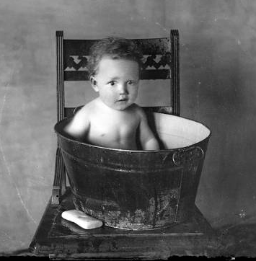
Let’s not throw out the baby with the bath water
Let’s change the water and get a bigger tub…
Change is needed… but we get that!
Libraries continue to change and adopt new tools to adjust to new users
Vendors like OCLC, Serials Solutions, EBSCO, III are building Next Gen catalogs with the features users want
Courtesy, L.Tom Perry Special Collections, Harold B. Lee Library,
Brigham Young University, Provo, UT 84602.

Slide 42
Transitioning from…
Old Catalog
New Catalog
Information = books
The online catalog is a very 1.0 Tool – only catalogers can add or edit
Passive users
Field searching on information in catalog record
Text-based
[Electronic resource]
Limited to what library has on its shelves
Walk to shelf, check out or copy
Information = Web
Online catalog is a Web 2.0 tool that includes reviews, tagging, recommendations, book covers
Users interact with content
Full-text searching & field searching
Icons and images
Full-text from anywhere on web or offered options to buy or borrow
Squirrel it (download & save), print it, order it, borrow it

Slide 43
WorldCat: going where the user lives
Google Toolbar: When an ISBN is detected, the Toolbar's AutoLink button converts to a Show Book Info button. Click links to get WorldCat results.
Firefox Search extension:
Enter a term in the Search Bar and select the WorldCat option from the dropdown menu.
Facebook application
Provides access to WorldCat searches and user-created lists from personalized pages within a Facebook account.

Slide 44
WorldCat: tutorials
Using WorldCat Lists featureshttp://www.youtube.com/watch?v=X8W7kWMrVNk
Using WorldCat Citation Tool
http://www.youtube.com/watch?v=X8W7kWMrVNk&feature=related

Slide 45
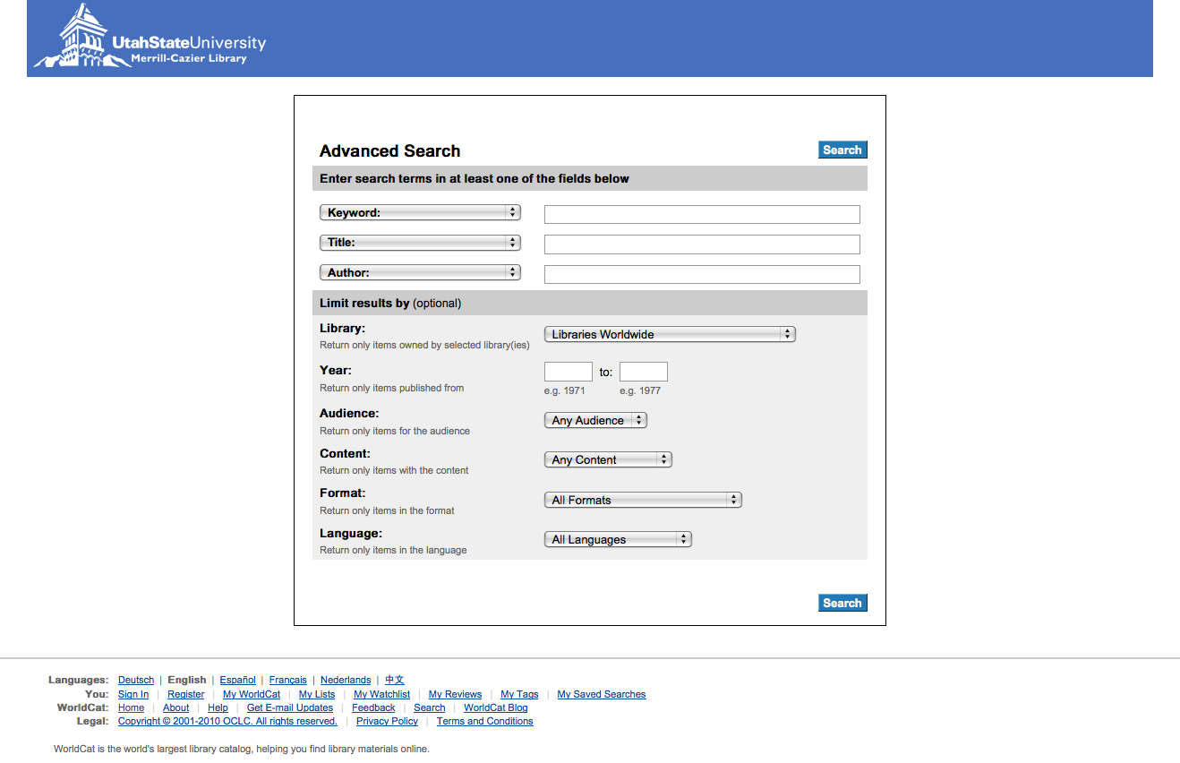
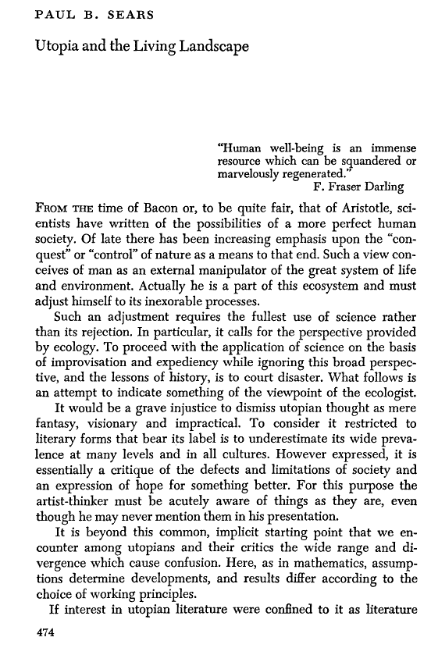
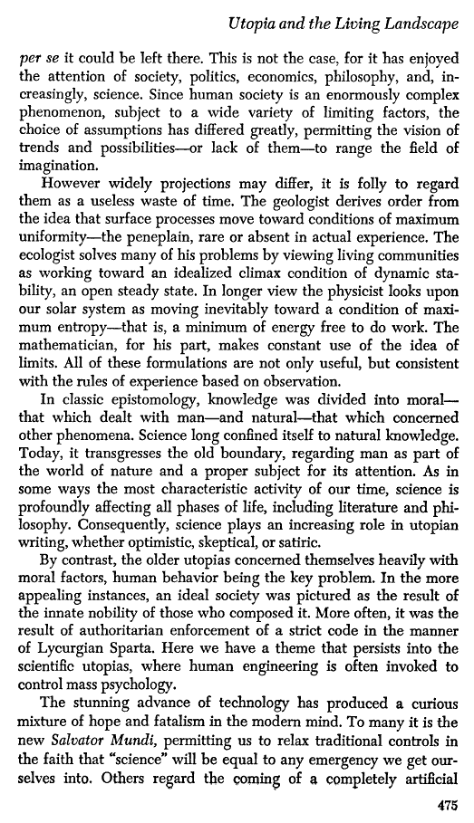
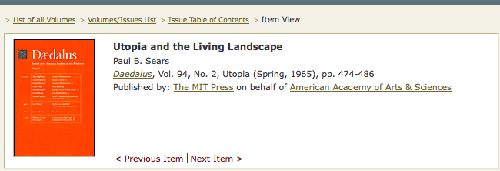
WorldCat Local
http://usu.worldcat.org/
Create an account
Add tags
Create Lists
Link to full text in ejournals owned by library

Slide 46
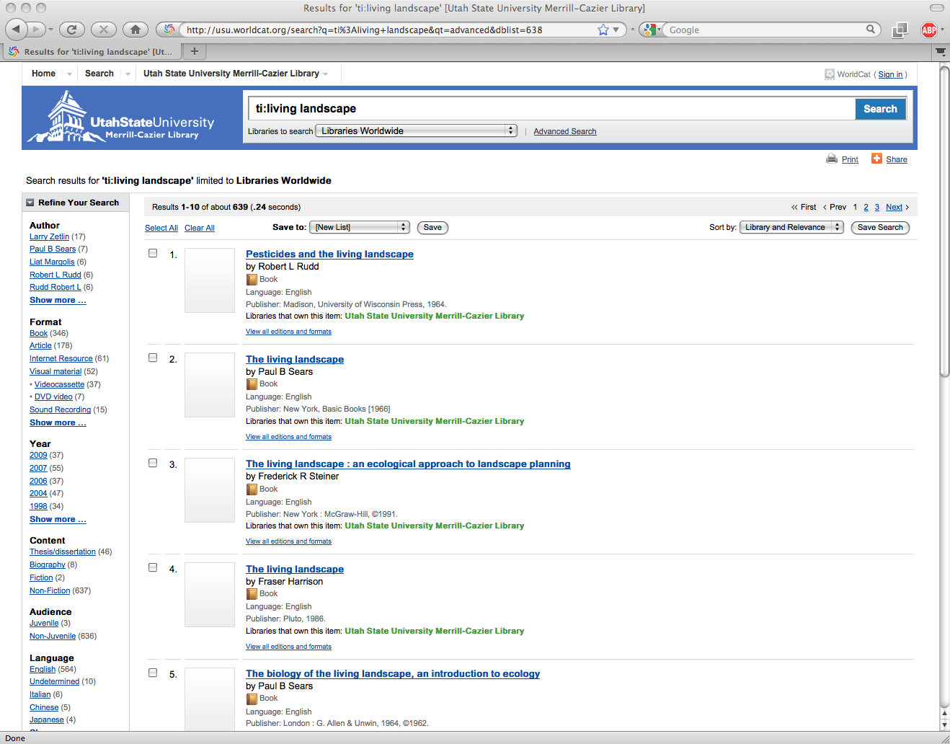
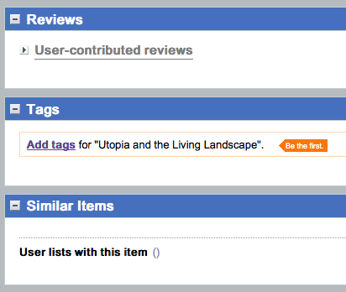
Offers Web 2.0 user interaction

Slide 47
Next Gen Catalogs: web discovery tools
Summon
Primo
Encore Discovery & Synergy
Ebsco Discovery Service

Slide 48
Discovery investments
…libraries need to consider very carefully the investments they make in search and discovery services.
Schonfeld and Housewright (2010)

Slide 49
http://www.serialssolutions.com/summon-features/

Slide 50
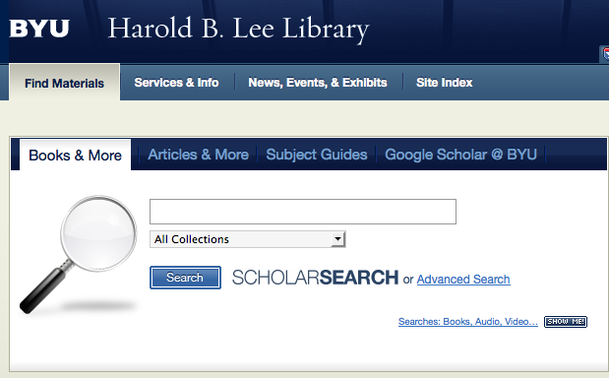
At BYU and soon to release at U of U and MWDL
http://www.exlibrisgroup.com/category/PrimoForYourLibrary

Slide 51
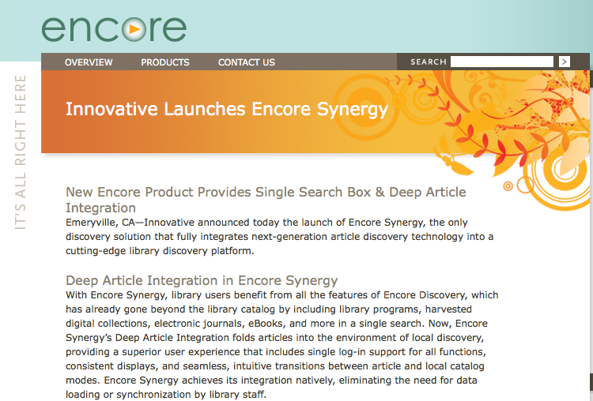
Encore Synergy
http://encoreforlibraries.com/2010/04/16/innovative-launches-encore-synergy

Slide 52
EBSCO Discovery Service
http://www.ebscohost.com/discovery/

Slide 53
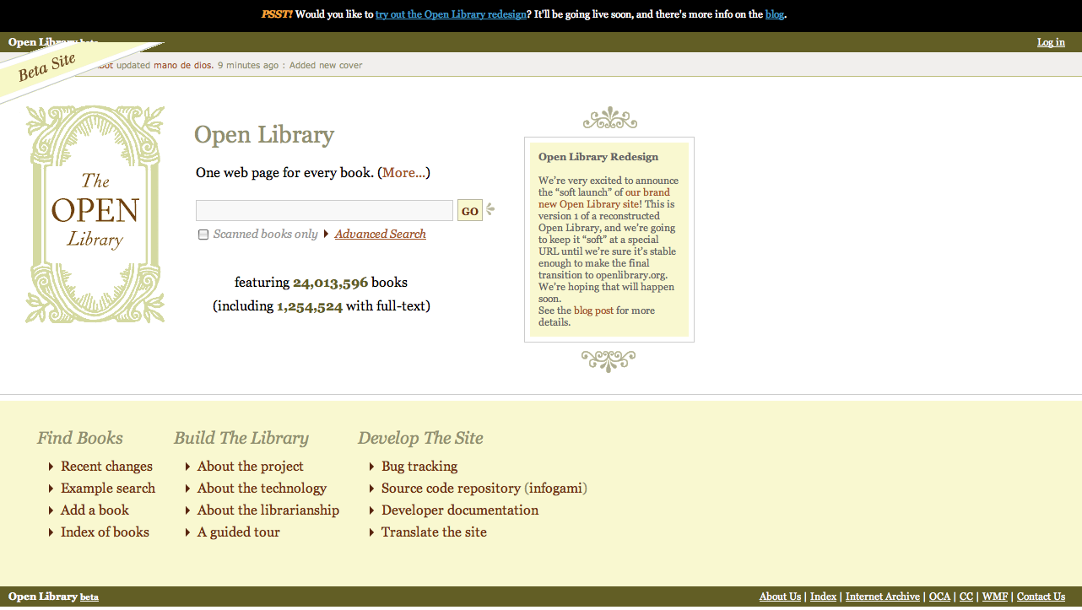
Web 2.0 + WorldCat + Wikipedia = Open Library
http://openlibrary.org

Slide 54
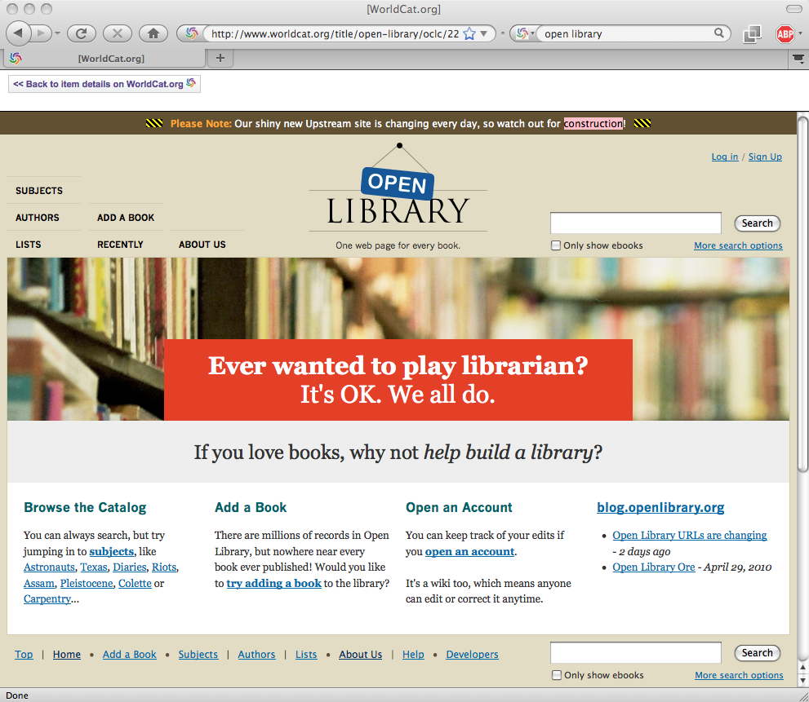
Its new look, still in beta…

Slide 55
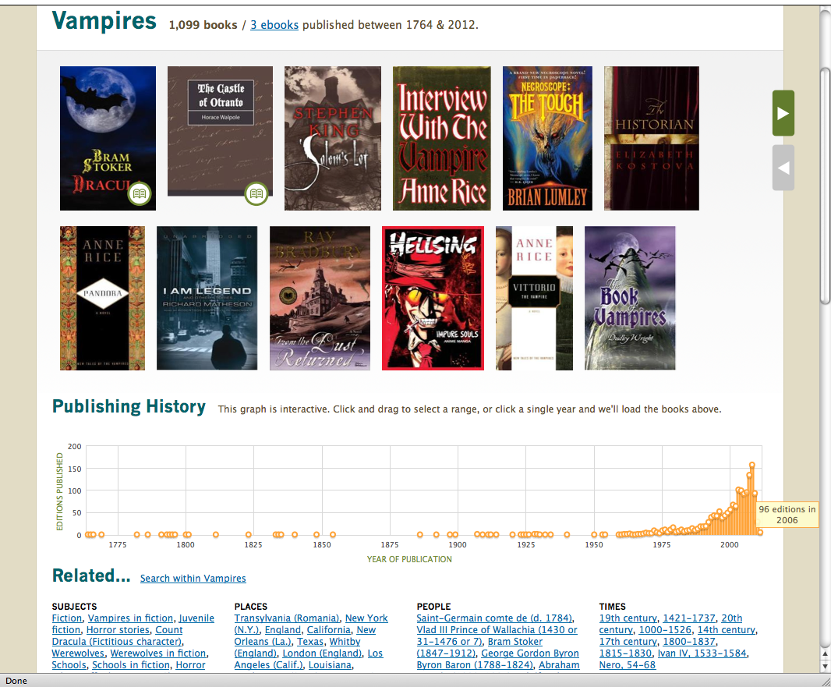
Each work, author & subject has a web page
Subject web page

Slide 56
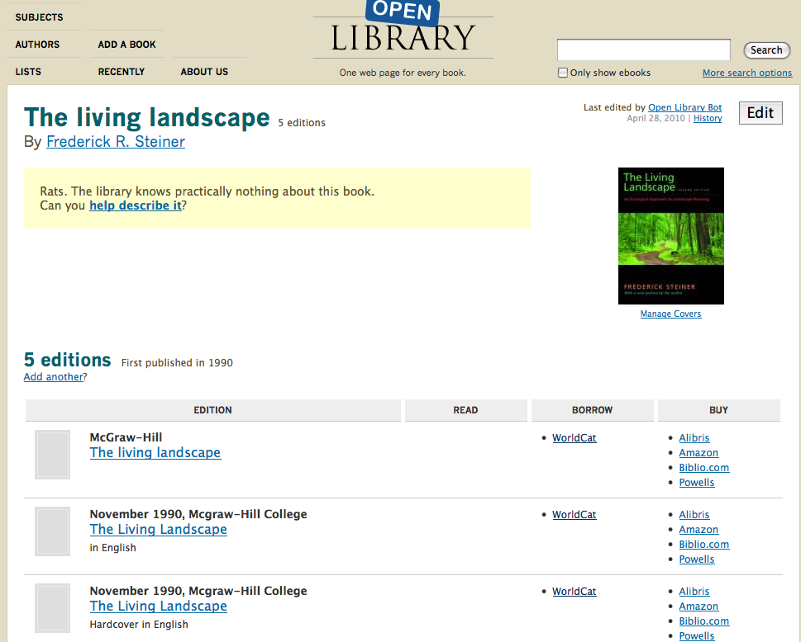
A FRBR-like record for the Work
Lists various editions
Click on WorldCat link

Slide 57
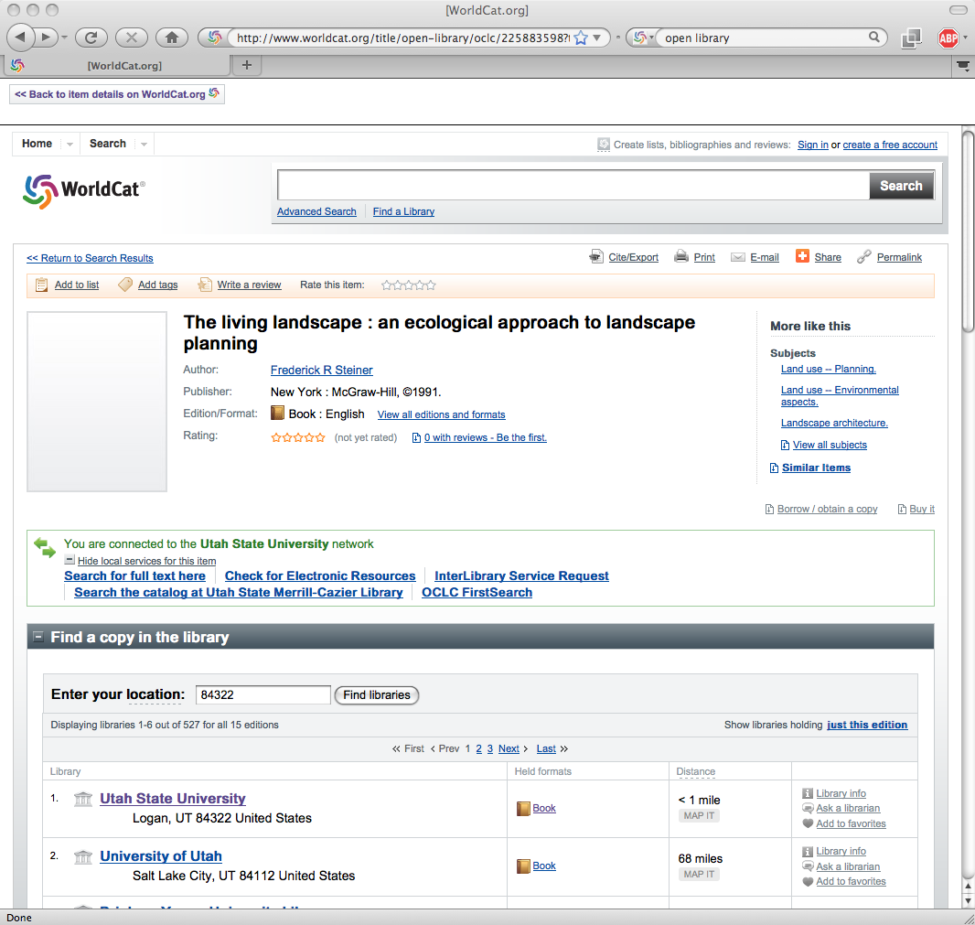
Nearest library that owns it is my library

Slide 58
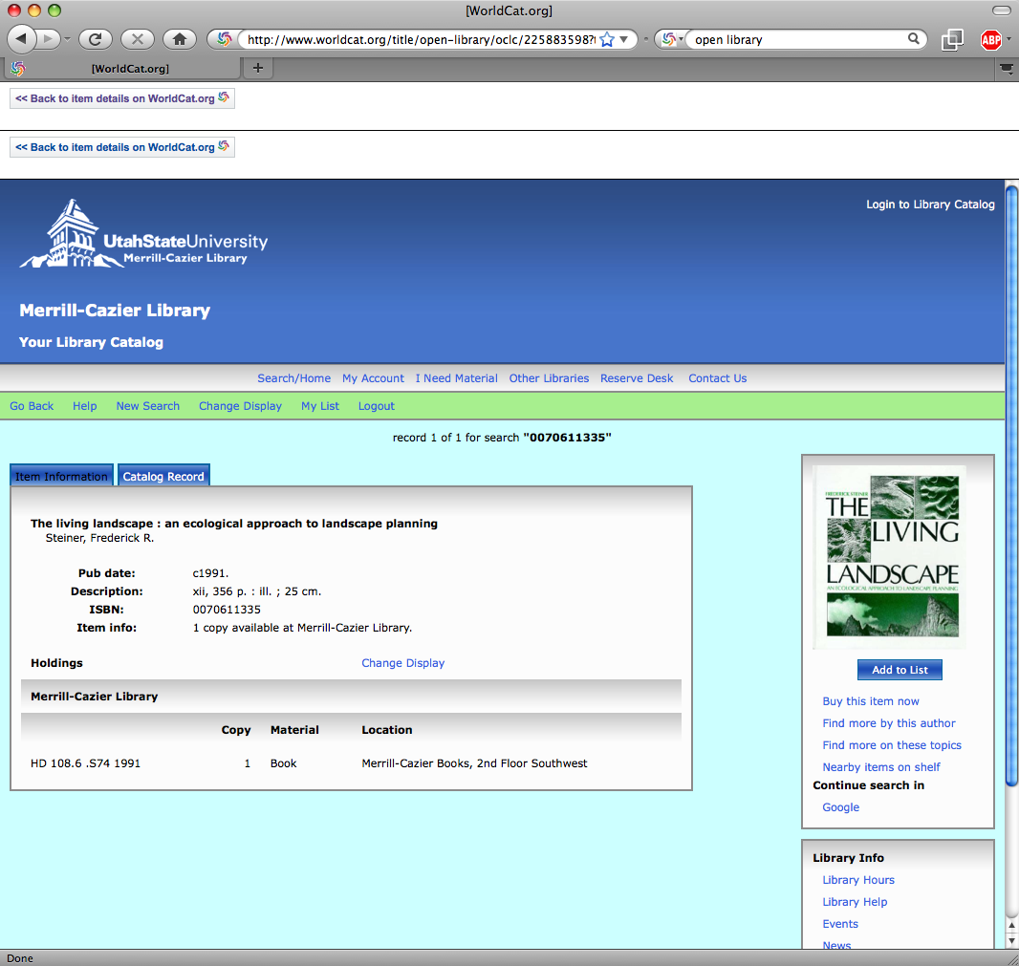
And here I am… at my own Library’s OPAC

Slide 59
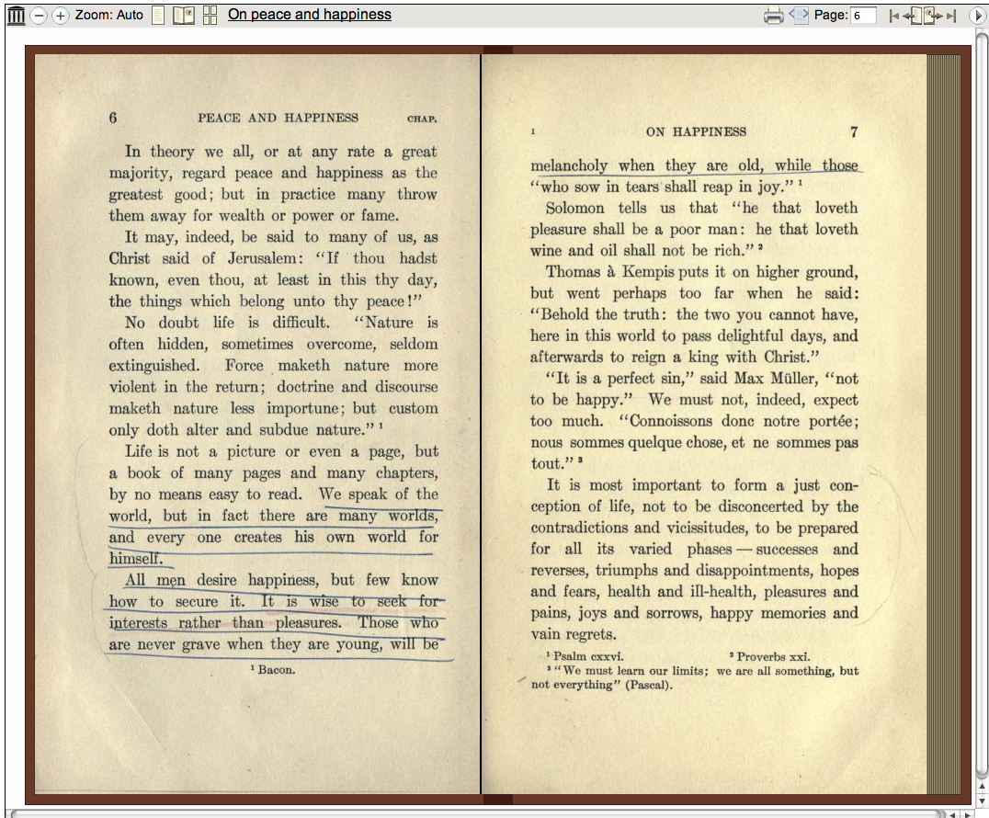
Read ebooks online

Slide 60
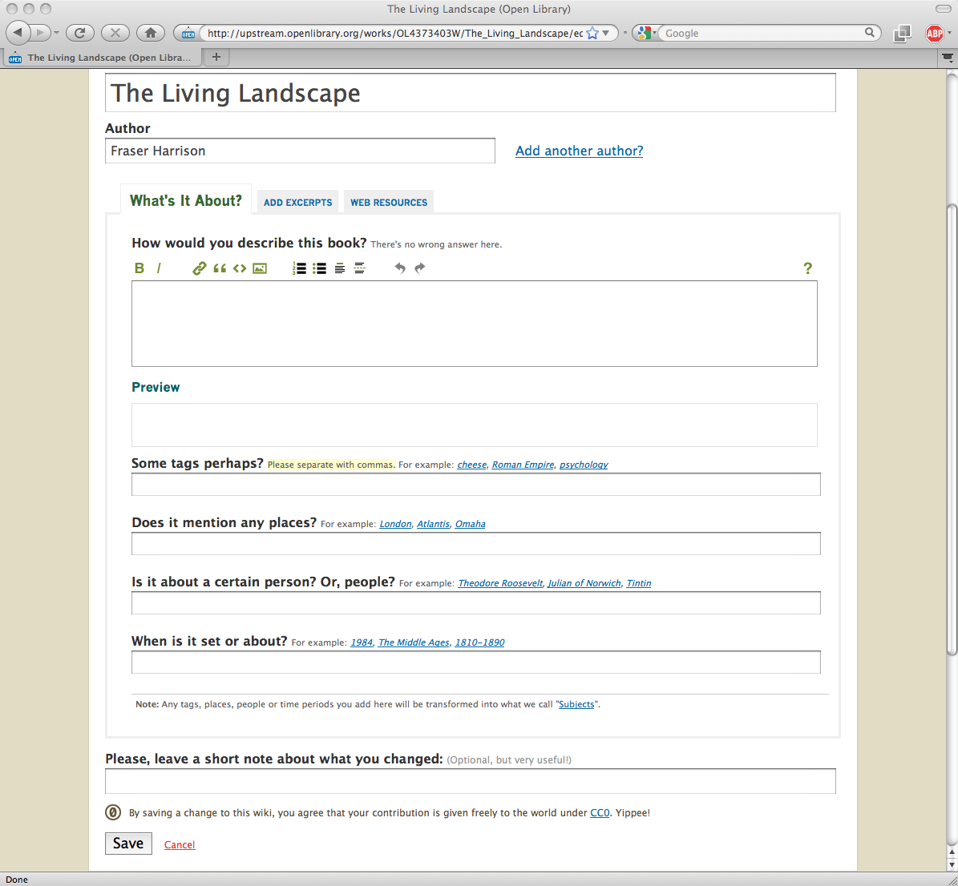
Edit an existing record

Slide 61
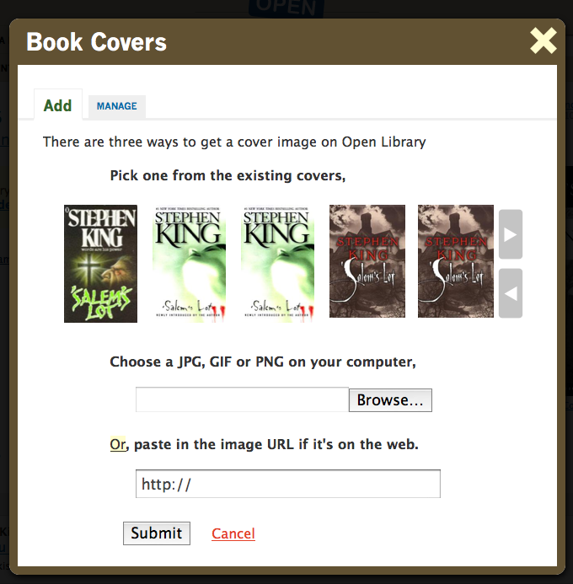
Add a book cover to your record
It would be awesome if we could start to collect excerpts from books.
George Oates, project leader for Open Library

Slide 62
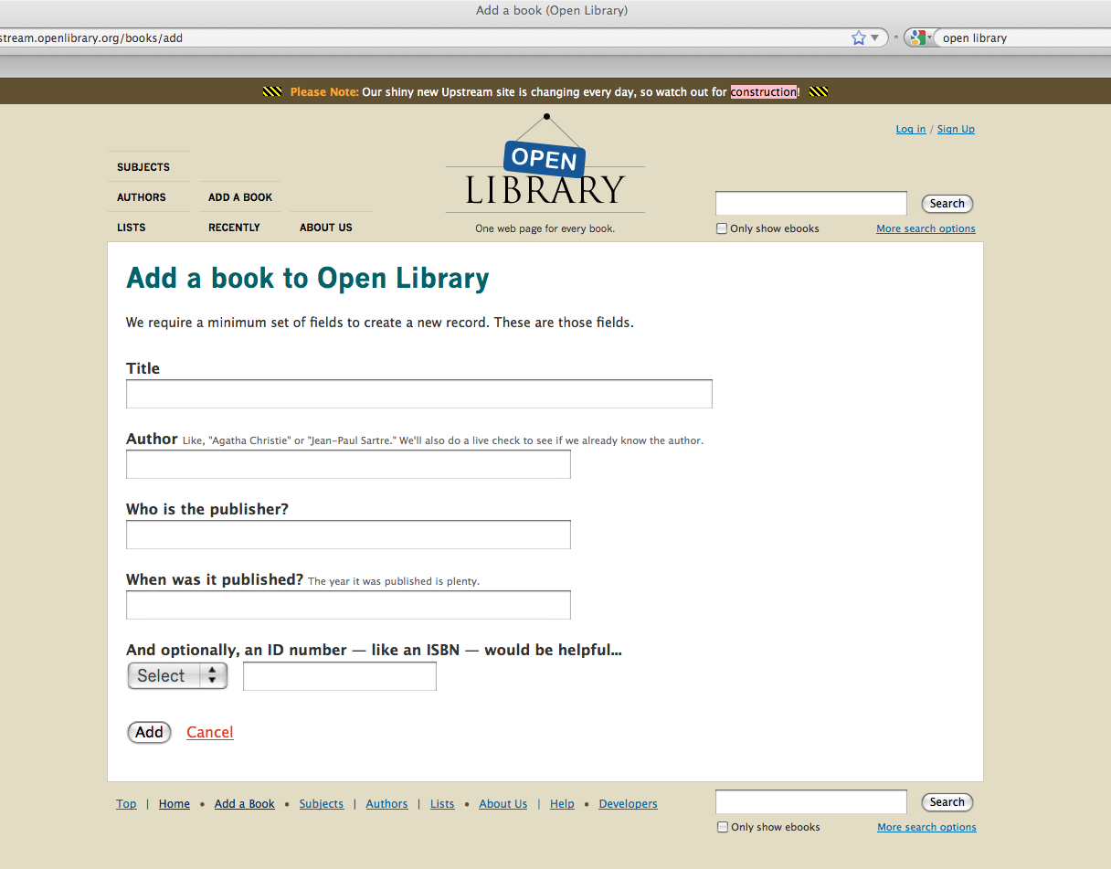
Add a brand new record

Slide 63
I don’t want Open Library to jettison librarianship or the brilliant hard work of librarians over the years…
George Oates, Project leader for Open Library
…if we get rid of all that machine readable gumpf, we start to have things that humans can parse as well…

Slide 64
Since librarianship is “diabolically rational of course, everything is in it’s place…
George Oates

Slide 65
Explore partnerships, connections
Reach into existing networks
George Oates
http://www.slideshare.net/george08/open-library-at-make-books-apparent

Slide 66
See what people do, provide tools to let people see what everyone else is doing….

Slide 67
And above all, participate! George Oates
For more information, go to our program wiki at: http://findability.wikispaces.org
It includes this powerpoint, recommended readings and citations for everything in this presentation
Anne.Diekema@usu.edu
Liz.Woolcott@usu.edu
Cheryl.Walters@usu.edu

Slide 68
Are Librarians Still Needed?
Consider it this way: if you believe that one reason why Libraries develop collections is in order to support discovery of proven quality resources, then the Library can still fulfill this role.
Hirst (2009) The Arcadia Project Blog

