Slide 1
LIRT Debate: For-Credit vs. Course Integrated: What is the best method to reach students?
Erin Davis, Utah State University, Merrill-Cazier Library
Kacy Lundstrom, Utah State University, Merrill-Cazier Library

Slide 2
Our backgrounds…
We’ve only taught COURSE INTEGRATED
We work in a highly integrated program
USU’s Numbers FY 2010:
959 sessions
19,511 contact hours with students
Reached 9,961 students

Slide 3
Course Integrated Information Literacy (IL)
“IL sessions that are tied directly to a course offered through the university and in which library instruction is delivered via multiple sessions.”
Examples:
Integration throughout general education classes
Subject-specific course integration

Slide 4
For-Credit IL
“Courses related specifically to IL, which grant students institutional course credit.”
Examples:
1 - 3 credit general credit class (required)
1 - 3 credit discipline-specific credit class (required)
1 - 3 credit class (elective)

Slide 5
Our Survey: Major Findings
There is an important relationship between the model of IL taught and librarians’ self-identification as teachers.
Librarians believe that teaching IL on campus is politically important to the library, regardless of the instruction model used.
Librarians have a preference towards the model they have experience using. (Perceived effectiveness of IL models)

Slide 6
Benefits of Course-Integrated
Caveat: It’s not necessarily either/or
Notes:
We’re not saying that there’s not a place for for-credit instruction on campuses, but if done well, course-integrated IL is a highly successful model you should consider implementing on your campus.

Slide 7
It’s Continuous
Starts with intro classes & spans through a student’s discipline
Allows for development and enhancement of skills
Notes:
(they don’t have to learn them all at once – it can be a progression)
But..compared to a for-credit class, you have a short time span to “dump” all of the skills at once
Faculty assume students are information experts once they take a credit-bearing class and they don’t have to deal with it anymore – students get little in the way of reinforcement of IL in their major courses

Slide 8
Point of Need Instruction
Real RELEVANCE to students’ disciplinary work
We’re there when they need us!
Notes:
The true power of the course-integrated model is its direct relevance to the student’s disciplinary work. Whether he or she is an english or business major, what they are learning about research skills is directly connected to their assignments – not ones constructed by librarians outside the subject major. You can meet students’ needs as they advance in their course work

Slide 9
Can be credible without credits
Higher education is expensive
Notes:
Many students already struggle to fit required credits in their schedule – we offer a solution that doesn’t require them to spend more $$$ or time achieving more credits.
By focusing on our common goals for student success, we’ll make more progress with faculty in the long run (david watt– found in steven bell’s blog)
Faculty have a hard time thinking of IL in deep ways without the context of disciplines. Credit courses tend to isolate IL as a generic skill outside of context.

Slide 10
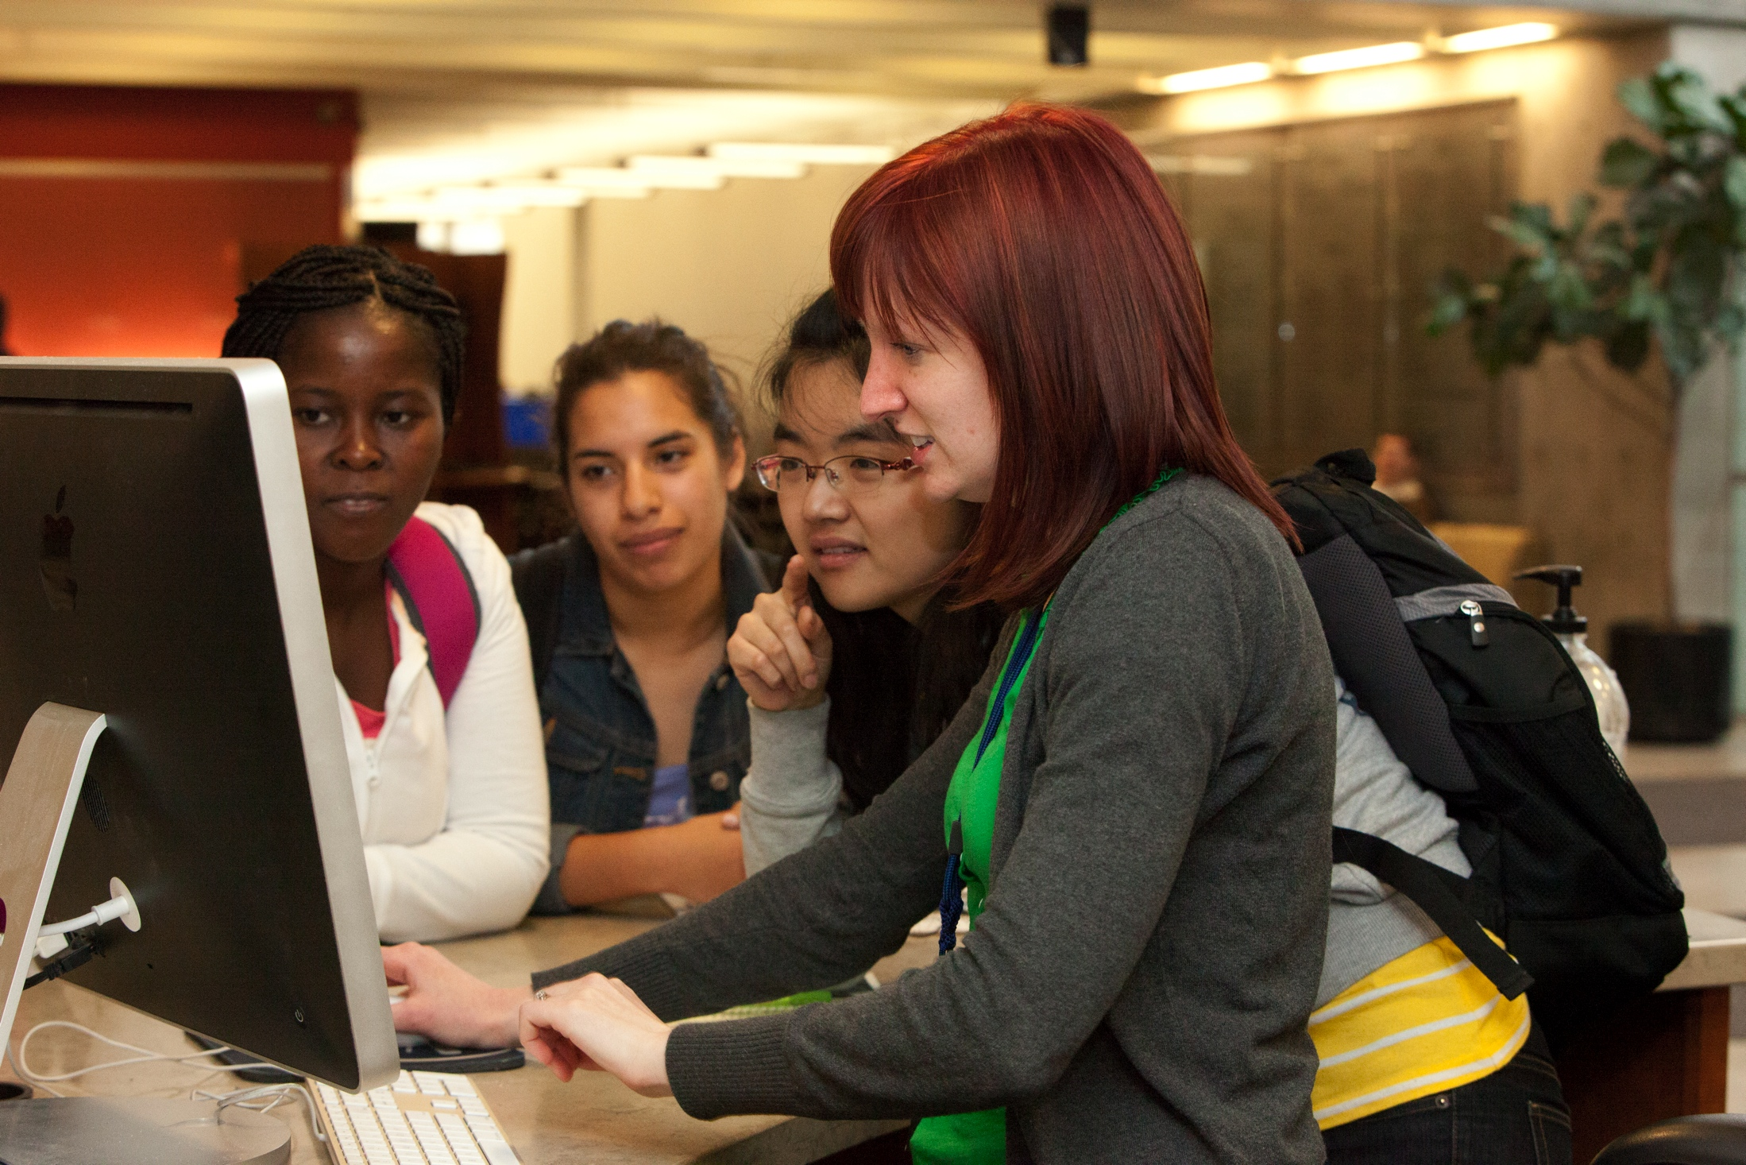
Allows for Authentic Learning
We incorporate hands-on, authentic student learning activities in each session
Students tend to retain skills better if it’s attached to a discipline
Notes:
Because we’re there when they need us, we’re able to do this kind of instruction. The content of our sessions aligns with the students' research projects to allow for authentic learning .
This facilitates real life learning, through authentic, project- or problem-based learning activities, students learn steps in the research process, make decisions, solve problems, and use technology or other tools to create products that demonstrate what they have learned

Slide 11
Relationships with students are possible
USU’s research consults have increased
Gives important 1-on-1 time and assistance
Leads to good rapport and deepened relationships with students
Notes:
For-credit does have the advantage of extended time with students, which can lead to deeper relationships.

Slide 12
Deeper Relationships with Faculty
Allows for faculty partnerships and ways to learn about faculty research needs, student needs, and to show them what we do (and can do for them)
According to our survey, more teaching librarians believed that course-integrated classes had increased political capital on campus.
Notes:
The rapport we build with faculty comes from the relationships in these classes..often snowballs into other instruction opportunities

