Slide 1
Who Uses this Stuff, Anyway?
An investigation into the end-users of the USU DigitalCommons
Prepared by:
Andrew Wesolek
June, 2012

Slide 2
About USU
Utah State University is the land grant institution of the state of Utah
We have about 28,000 students located both on our main Logan campus, as well as several regional campuses across the state
High research institution– particularly in Aerospace Engineering and Education.

Slide 3
About our Repository
Hosted Solution: bepress DigitalCommons platform
Goal: capture, preserve, and provide access to the research conducted at Utah State University
We are now in our fourth year of existence
Notes:
Benefits of hosting:
Bepress handles the nuts and bolts, freeing us to collect contend, promote the IR, and experiment with using it in new and novel ways.
Faculty members receive useful download statistics, so that they can see the value of adding their work in the IR. Many report new life being breathed in to older works that they thought were no longer relevant. This is very helpful ingenerating faculty buy-in
Search Engine Optimization
Free server space

Slide 4
Notes:
Here, I need to talk about 1. the types of things we collect in the Repository. 2. the statistics. It is important to point out here that we have reached a state of critical mass. We have extraordinary faculty support, with close to 20% participation. We also actively track down grey lit, and by word of mouth, some holders of grey lit have come to us. Also, our usage statistics show that the site is heavily trafficked, which helps to further increase faculty support. This is all well and good, but who is actually using this stuff?

Slide 5
Keys to our Success?
“We do it for you” model
Identify needs on campus. How can the IR fill them?
Be ever-present

Slide 6
Fresh Librarian, Maturing Repository
The DigitalCommons has reached the stage of critical mass.
Our success rests largely on the excellent foundation laid by Heather Leary, Cheryl Walters and our Dean, Richard Clement
We are beginning to shift our efforts from ingesting content and recruiting support to focusing our collection development efforts by targeting information that is in demand or inaccessible otherwise

Slide 7
The Survey
Created and initially implemented by my predecessor, Heather Leary
Survey remained accessible via the DigitalCommons for approximately 1 year– November 2010-January 2012
Good response rate: 202 participants
Notes:
“Implementation: I put together the survey because I had had several faculty members (and some of the librarians and I had talked about it as well) asking me about who was downloading their materials. Yes, they were impressed with the download numbers, but curious to know more about the type of people looking at their materials. I was curious to get a better understanding overall of the type of people looking at the site, why they were there, and what they thought. Plus, not a lot of people (at least sites with Digital Commons) had done a survey, so I thought it would an interesting experiment to see what we got.”
-Heather Leary

Slide 8
Survey Why and How
1 minute survey
Little is known about end-users
Faculty were impressed with download statistics, but curious about who was accessing their works
Survey only available on the records page from November 2010 to July 2011, then also added to the home screen.
Notes:
This boosted participation from about 83 over 8 months to 202 over the additional 6 months. This is interesting, because even though many users come to the repository directly to a record, the response rate increased dramatically after inclusion on the home page.

Slide 9
Homepage survey screenshot

Slide 12
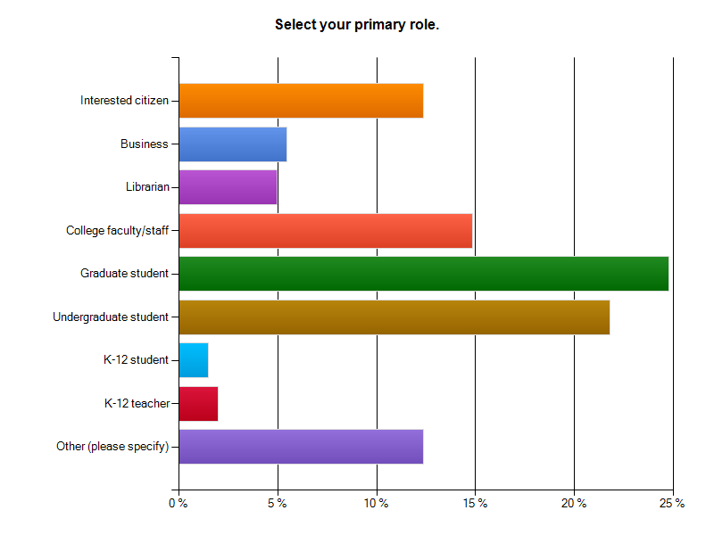
The Results
Notes:
Respondents were first asked to select their primary role. While it was expected that faculty/staff graduate/undergraduate students would account for the majority of the users of our Digital Commons, the large percentage (between 34 and 39 percent– “librarian” is unclear) of users outside of the academy are surprising.
We might also ask why they are using the repository. Due to our mandatory deposition of ETDs, we might suspect that a significant number of our graduate students are visiting the repository not for research but to access their thesis or dissertation.
Interested citizen12.4%
Business 5.4%
Librarian 5.0%
College faculty/staff 14.9%
Graduate student 24.8%
Undergraduate student 21.8%
K-12 student 1.5%
K-12 teacher 2.0%
Other (please specify) 12.4%25
Other is also an interesting category: some supplemental responses included “natural resource professional” “state Government” “public sector researcher” “wildlife management professional” “Family researcher” “K-12 parent”

Slide 13
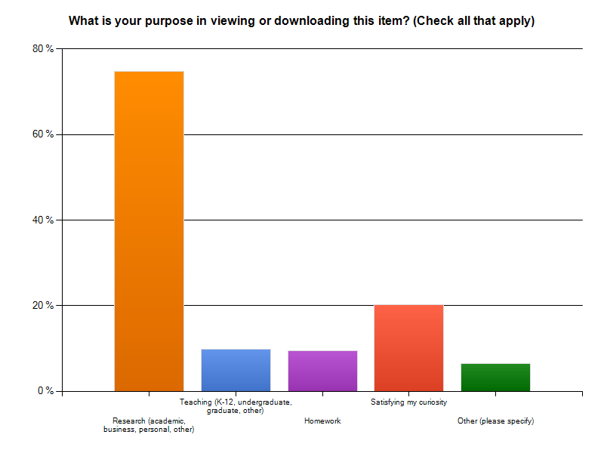
Notes:
Again, research is expected to be the major reason why our users are coming the the repository. However, it is interesting that 20% of our users are simply satisfying their curiosity. Also, this is very broad. To get at why users come to the repository, in the future, we will need to provide different possibilities under research to tease out the various types (academic, personal, business, etc) of research that users are conducting.
Research (academic, business, personal, other) 74.8%
Teaching (K-12, undergraduate, graduate, other) 9.9%
Homework 9.4%
Satisfying my curiosity 20.3%
Other (please specify) 6.4%
Other responses:
“we blog at our pr agency, I plan an article about resilience”
“Local high school & community needs course”
“Land management decisions”
“need a coiuple [sic] of beef processed”

Slide 14
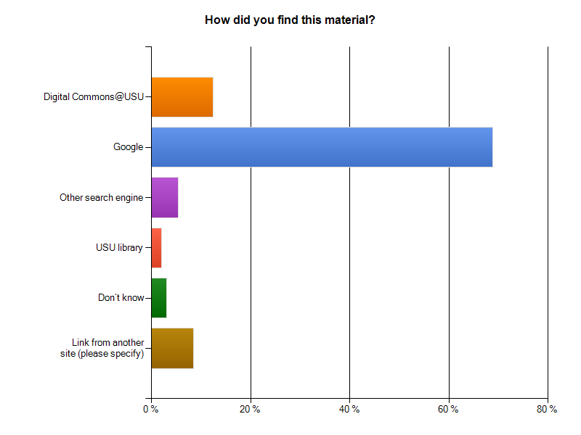
Notes:
This chart affirms the Google Analytics we run on the repository (61% over the life of the repository increasing to about 64% during the year this survey was conducted). Far from invisibility, the majority of our users find their way to the repository via Google or Google Scholar.
75% come to us via Google or some other search engine– slightly higher than reported by Google analytics
12% direct traffic (this is slightly lower than the 16% reported by Google analytics over the same period)
8% link from other site– the specified responses seem to indicate that these numbers are driven largely by word of mouth. Responses include “usu alum” “reference” “professional email list” “colleague” “referred by family member” And, we got 1 “www.nasig.org” response!

Slide 15
Take away?
The public are more interested in institutional repositories than we might suppose-- Both for public sector and personally-directed research as well as satisfying curiosity.
…and, of course, more research is necessary.

Slide 16
How have these results influenced our IR?
Collection Development
Public Outreach

Slide 17
Pilot Project: Joel Ricks
Prominent USU Professor in the 1920s through the 1950s
Research focus: Cache Valley history
Selected for potential potential public interest
Also, opportunity to blend the Digital Library and the Digital Commons

Slide 18
Takin’ it to the Streets
These data inspired a broader effort to market our open electronic resources to the people of Utah
Ricks is a good Starting point because of his focus on Cache Valley History
Presentations to Stevens-Henager College and the Cache Valley Library Association
Notes:
A survey of our end users suggests that nearly 40% of visitors to our repository are not affiliated with higher education. As the Land Grant Institution of Utah, it is important that we engage the citizenry and make our resources available to them.
It’s too early to judge the success of these presentations, but the number of daily visitors leapt from an average of about 615 to 865 the day of the Stevens-Henager presentation and 918 the day of the CVLA presentation.

Slide 19
Questions?
Email: Andrew.Wesolek@usu.edu
Office: 435.797.2650

