Slide 1
Preserving the Digital Past for the Next Hundred Years
Cheryl Walters
Tawnya Mosier Keller
Chris L. Erickson

Slide 2
Topics
1. Need for digital preservation
2. How to create a digital preservation plan
3. Six steps of digital preservation
4. Utah Digital Preservation Network

Slide 3
Need for Digital Preservation
“One of the great ironies of the information age is that, while the late twentieth century will undoubtedly have recorded more data than any other period in history, it will also almost certainly have lost more information than any previous era.”
      From: Alexander Stille, “Are We Losing Our Memory? Or The Museum of Obsolete Technology”, LOST Magazine, Feb (2006) no. 3, accessed 4/12/2012, http://www.lostmag.com/issue3/memory.php

Slide 4
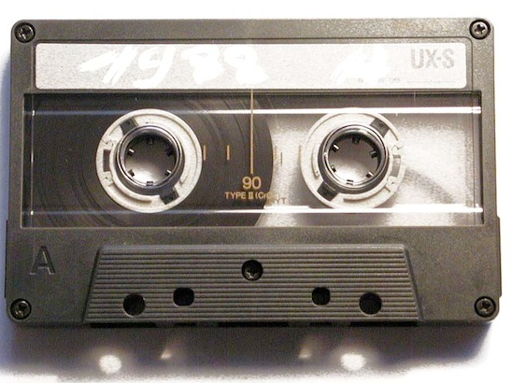
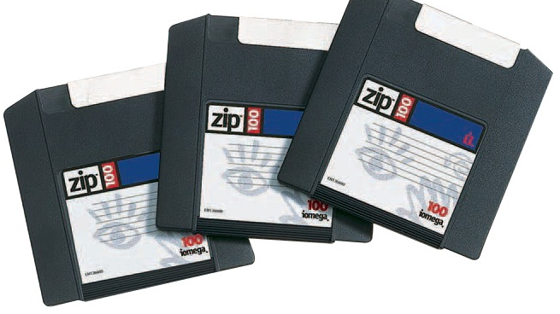
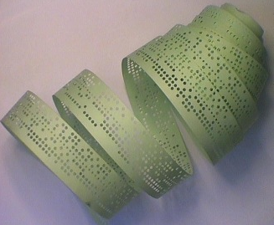
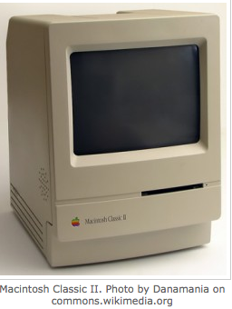
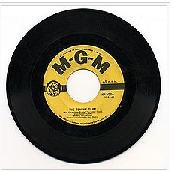
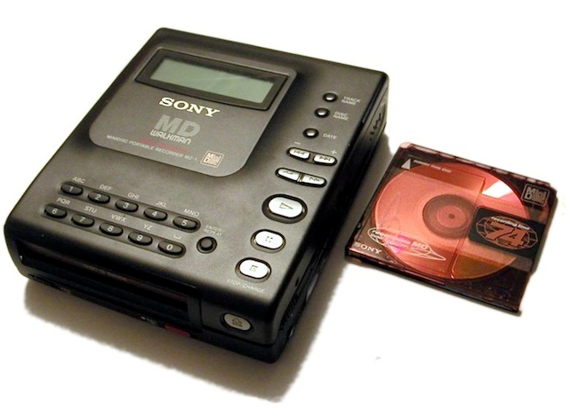
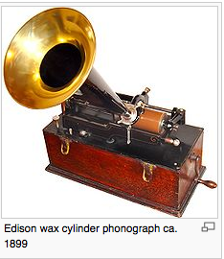
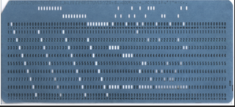
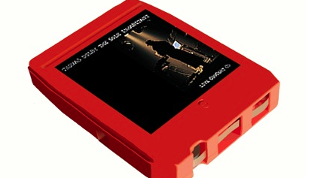
Remember these?

Slide 5
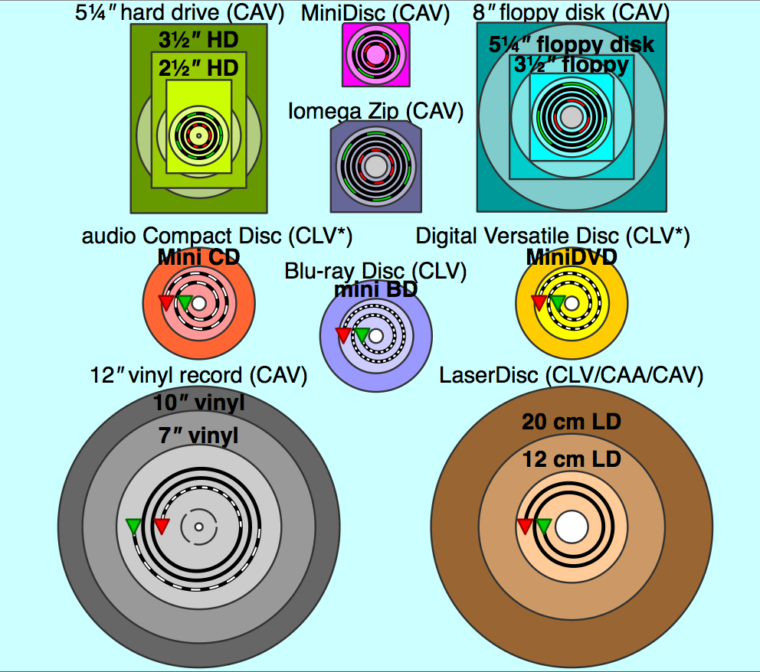
Digital Disasters
Consider just the round-shaped media:
Obsolence can lead to loss of important data.
It can affect file formats, software, and/or hardware
http://en.wikipedia.org/wiki/File:Comparison_disk_storage.svg

Slide 6
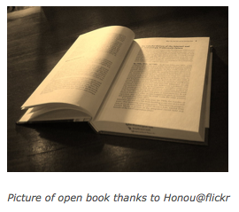
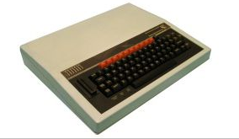
A cautionary example: book versus disc
  The 1980’s BBC Domesday Book project
    A snapshot of life in the U.K. compiled in 1980s and saved on interactive video discs.
      From: http://news.bbc.co.uk/2/hi/technology/2534391.stm

Slide 7
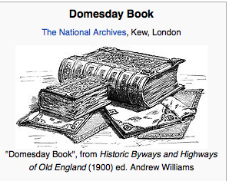
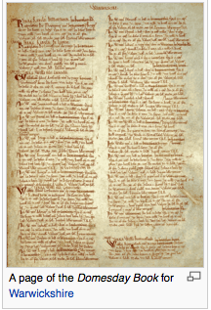
The first Domesday book, handwritten on parchment in the year 1086, is still readable after 900+ years.

Slide 8
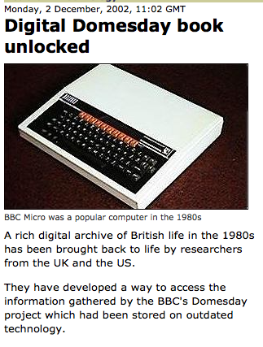
The 1980s Domesday book created using digital format became unreadable within a decade
It remained unreadable for 16 years until…
A team from Leeds University and the University of Michigan developed software that emulates the obsolete Acorn Microcomputer system and the video disc player.

Slide 9
Avoid disaster by planning and practicing digital preservation
Digital preservation encompasses a wide range of strategies and actions required over time to ensure continued & reliable access to authentic digital objects
“I have backups; isn’t that digital preservation?” Yes and no. Backups are just one digital preservation activity designed for short term data recovery
A digital preservation program anticipates, describes, and provides for all the activities needed to preserve digital assets

Slide 10
Do you need a digital preservation program?
Yes, if you have and want continued access to:
  Image files (jpgs, tiffs, etc.)
  Audio files (wav, mp3, etc.)
  Video files (mov, mp4, etc.)
  Office files (Excel, Word, PowerPoint, etc.)
  Emails (Outlook, Entourage, etc.)
  Databases

Slide 11
Where do you begin?
Develop a digital preservation policy

Slide 12

Cheryl Walters
Head, Digital Initiatives
Utah State University, University Libraries
cheryl.walters@usu.edu

Slide 13
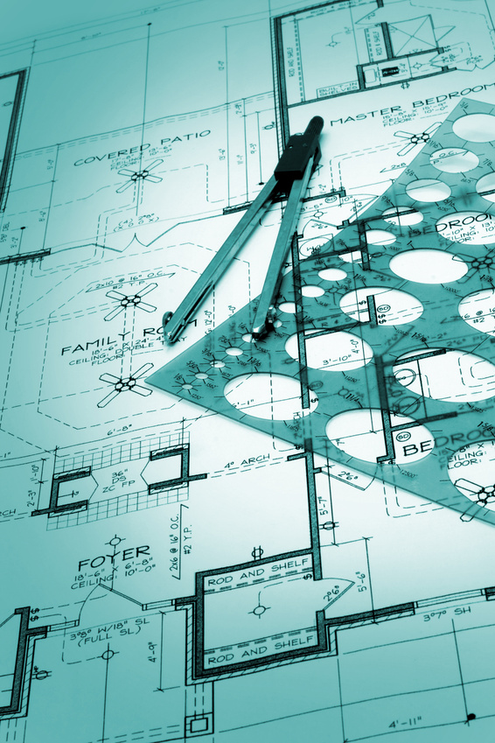
Digital Preservation Policy:
Blueprint for your Program

Slide 14
What’s the point of having a digital preservation policy?
  Documents your commitment to preserve content for future generations
  Specifies types of objects/collections to be preserved and at which preservation levels
  Ensures compliance with standards and best practices for digital stewardship
Notes:
No point in having a policy if your institution isn’t really committed to preserving digital content for the future.
Which file formats to maintain and at what preservation level. Some will be higher priority than others.
By agreeing to conform to best practices, you’re agreeing to aim at becoming a Trusted Digital Repository.

Slide 15
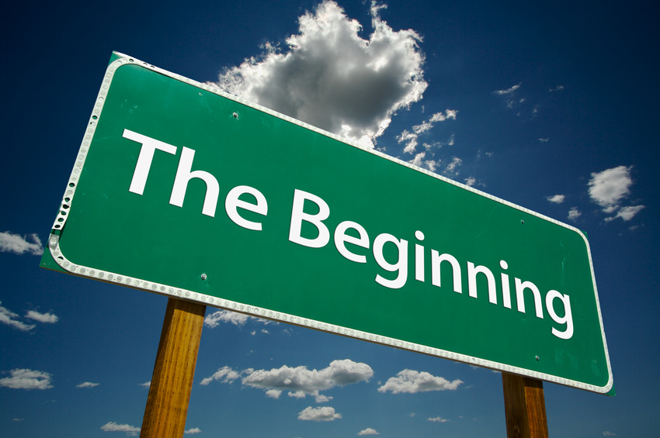
  Your policy will address content creation, integrity, and maintenance.
Notes:
Your policy will lay out the basics of Digital preservation strategies, especially those related to content creation, integrity and maintenance.

Slide 16
Content creation
Clear technical specifications
Production of reliable master files
Sufficient descriptive, administrative and structural metadata to ensure future access
Detailed quality control of processes
Notes:
What do we mean by “content creation”?
Clear…
Production…
Sufficient…
Metadata is the key to ensuring access for the future and shouldn’t be overlooked.
Quality control actions will also be needed if you want your files to be sustainable.

Slide 17

Content integrity
Documentation of policies, strategies & procedures
Use of persistent identifiers
Recorded provenance & change history for all objects
Verification mechanisms
Attention to security requirements
Routine audits
Notes:
Content integrity means that you have correctly documented all policies, strategies and procedures so you have your plan IN WRITING.
Integrity also includes the use of persistent identifiers to help with quality control of your files.
In digital libraries, an important use of metadata is to describe the content of the item, but in the digital archive, it’s also important to record the provenance of the digital object and any change history that it goes through over its lifecycle.
You’ll want your objects to be able to pass all verification mechanisms that you set up for it. You will need to make sure a file that ends with .tif is actually a tiff file and not a jpeg that’s been renamed something it’s not.
Security requirements are also important. Many organizations have requirements, but how many complete regular standard tests of those?
This is also where routine audits can come in to your workflow

Slide 18
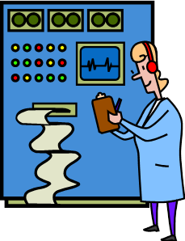
Content maintenance
Robust computing & networking infrastructure
Storage & synchronization at multiple sites
Monitoring & management of files
Refreshing, migration/emulation programs
Creation & testing of disaster prevention & recovery plans
Periodic review & updating of
policies & procedures
Notes:
Content maintenance refers partially to whatever Digital Preservation Software System you will be using to maintain your files and also to preservation planning activities that you will need to go through every so often. We’ve just purchased Ex Libris’ Rosetta…
A robust computing and networking infrastructure will require work from your department or institution IT group.
The same goes for the storage and synchronization of your files at multiple sites. Two sites is the minimum, but three is preferred, with more than three providing even more security. We’re aiming for two.
Another area that IT will be involved is when you’re investigating programs for refreshing, migrating, or emulating your files. We’re going with migration and even though our software will monitor our files, we will need to be responsible for migrating them when the time comes.
Disaster prevention and recovery plans are related to the security section on the last slide. These plans should be well documented and regularly tested.
Create a schedule for going over your policies and procedures and updating them. We just went through the process of updating our policy framework and are now updating our preferred formats chart and our digital preservation decision chart.

Slide 19
Creating your policy
Educate yourself
Research what others are doing
Start writing
Feedback: different perspectives
Edit
USE the finished framework
Notes:
You can follow some basic steps when creating your framework:

Slide 20
Educating yourself
ICPSR five-day digital preservation management workshop:
  http://www.icpsr.umich.edu/dpm/workshops/fiveday.html
ICPSR digital preservation management online tutorial:
  http://www.icpsr.umich.edu/dpm/index.html
Library of Congress digital preservation site:
  http://www.digitalpreservation.gov/

Slide 21
What are others doing?
  Regional Academic & Cultural Institutions (U of U, BYU, USU, WSU, LDS Church History Library)
  National Academic (Yale, Cornell, Harvard)
  National Libraries (Library of Congress)
  International (National Archives of the Netherlands, National Archives of England, Wales and the United Kingdom)
  Look at similar institutions to yours
  Look at collaborative projects

Slide 22
Scaling up/down for your needs
Don’t try to fit your program into someone else’s policy
You may need a robust policy if:
  You’re doing all work in-house
  Your institution will be preserving data for others
Not everyone needs a 25 page policy!
You could get by with 2-3 page policy if:
  You’re outsourcing preservation services
  You’re involved with a collaborative that already has a lot of documentation

Slide 23
Start writing!
Give yourself deadlines, even if you don’t get any from your boss
Follow a guide
Use other policies to inform yours
No need to re-invent anything

Slide 24
Feedback: different perspectives
Differences between sample documents & your program needs?
Which formats to commit to managing long-term & why?
Regular meetings with involved parties to make sure they’re represented in policy

Slide 25
Time to edit!
Which sections will stay in body of policy & which will move to appendices?
Body: High-level information that won’t likely need to be updated often
Appendices: Things that may change frequently like…
  Format best practices and/or requirements
  Technical specifications (hardware)
  Decision making tools
Notes:
Once you start writing your policy, you may find that it’s getting REALLY LONG, especially if you’re exceptionally wordy like me. Now’s the time to edit!...
I had a bunch of definitions all throughout the policy in the first draft and ended up moving them all to one appendix for reference. This makes the text of your document shorter, meaning that it will have a higher chance of actually getting read!
While your policy lays out the big picture, your appendices can create specific guidelines that you can use to help deciding which digital collections are truly archival and what to do in the case that someone wants to deposit a collection in a format you aren’t able to support.

Slide 26
Advertising your policy
Get your policy out there!
Website
Presentations
Papers
Face-to-face encounters within library/campus
Notes:
You can get your finished framework out in a number of ways…

Slide 27
Implementing your policy
How to make sure policy & accompanying documents are actually USED by collection owners/project managers?
Marriott Library plan:
  Technology Services and Knowledge Management Councils oversight
  Digital Collection Development Policy (draft)
  Digital Preservation Decision Flowchart (draft)
Notes:
We’re working on getting collection owners to think more strategically about which collections they might want preserved.
Part of the problem goes back to the confusion between a digital library and digital archive. People think if something’s digitized, the master is automatically preserved. On the other hand, if you set up a digital collection as NOT being archival, they think it will be lost completely. But the access files will be maintained as part of the digital library and whatever content management system you use (we use CONTENTdm). But the preservation of the master files is something we have to figure out on our own, which is why strategic decisions about which objects to preserve have to be made up front. There’s just too much data to preserve it all in any sort of accessible way.

Slide 28
Additional resources
Digital Preservation Management online tutorial
Library of Congress DP site
J. Willard Marriott Library Digital Preservation Policy

Slide 29
Tawnya Keller
Digital Preservation Archivist
J. Willard Marriott Library
801.581.8594
tawnya.keller@utah.edu

Slide 30

Six Steps of Digital Preservation
This is a Workshop created by the Library of Congress Digital Preservation Outreach and Education (DPOE) program.
Purpose: To encourage individuals and organizations to actively preserve their digital content, building on a collaborative network of instructors, contributors, and institutional partners.

Slide 31
Six Steps of Digital Preservation
Identify What digital content do you have?
Select What will you preserve?
Store How will you store your materials long term?
Protect How will you protect your digital content?
Manage How will you manage them long-term?
Provide How will you make them accessible?

Slide 32
Managing Content Over Time
manage
protect
store
1. identify
provide
select
Notes:
Identify and Select are in the center – repeat over time: identify new/additional content then select the portion to preserve
Store the selected content
Protect what is stored
Manage it over time (preserve it) – including policies/rules for identifying, selecting, storing, protecting and providing content
Providing preserved content over time (long-term access) relies upon good management over time

Slide 33
Why do we identify content?
Not all digital content will be preserved
Preservation – must commit resources
First step to making informed decisions
Effective planning is based on knowing what needs to be preserved now and in the future
A detailed inventory is the best way to identify content
Notes:
It’s really important to have an inventory to help with planning

Slide 34

How will an inventory help?
Good preservation decisions are based on an understanding of the possible content to be preserved
The Identify stage asks:
“what content do we have?”
Notes:
Inventorying content is a foundation step for digital preservation to identifying the extent of what you may need to preserve

Slide 35

Your Inventory Scope
Answers the questions:
What content are we already preserving?
Who has digital content?
What content MUST we keep?
  Types of records
  Format of files
  Location
Notes:
The inventory process will answer these and similar questions.

Slide 36
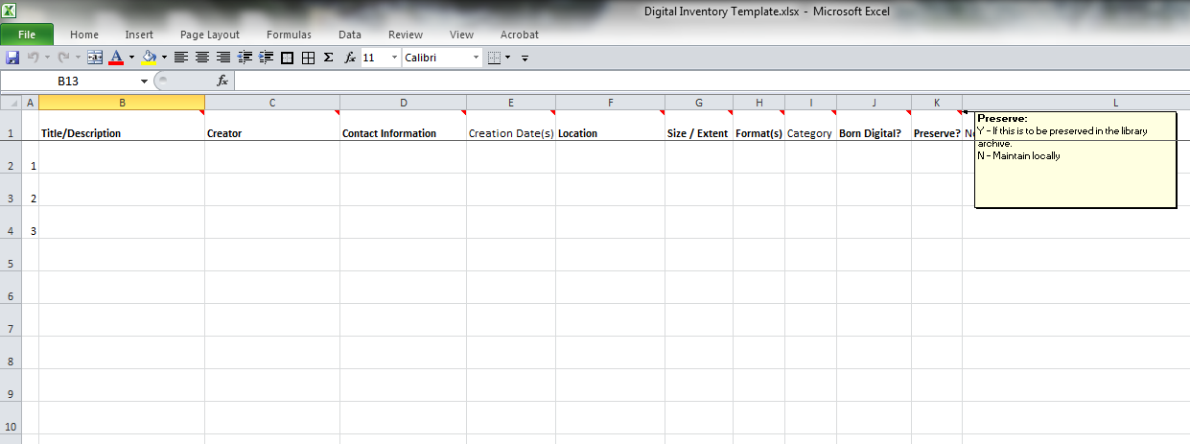
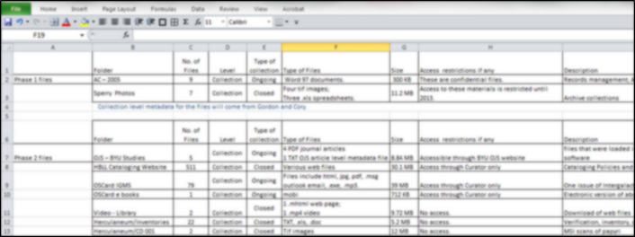
Your Inventory
Make it work for you!

Slide 37
Identify Outcomes
Identify potential digital content you may need to preserve
Treat the inventory as a management tool that grows as your program grows
Use it as a planning tool to prepare
  – e.g., staff, training, annual growth
Provides a basis for acquiring content, defining submission agreements, plans

Slide 38
Identifying Next Steps
Think about your current situation
Write down the top 2 or 3 things you think you most need to do
For each one, think through:
  Who you might work with
  How to address challenges you might face
  How much time you might need
  What the specific outcome will be
Choose one to start with
Notes:
Take concrete steps.

Slide 39
Utah Digital Preservation Network
What is it?
  Opportunities to talk about digital preservation
  Open to all institutions state-wide
  UALC digitalization task force – Tawnya Keller
  http://lib.byu.edu/sites/digitalpreservation/udpn_present/
When is it?
  June 22nd - Digital Preservation brownbag
  Others to be announced
Other training
  LC Digital Preservation workshop – Chris Erickson

Slide 40
Questions?
Chris Erickson
cle@byu.edu

