Slide 1
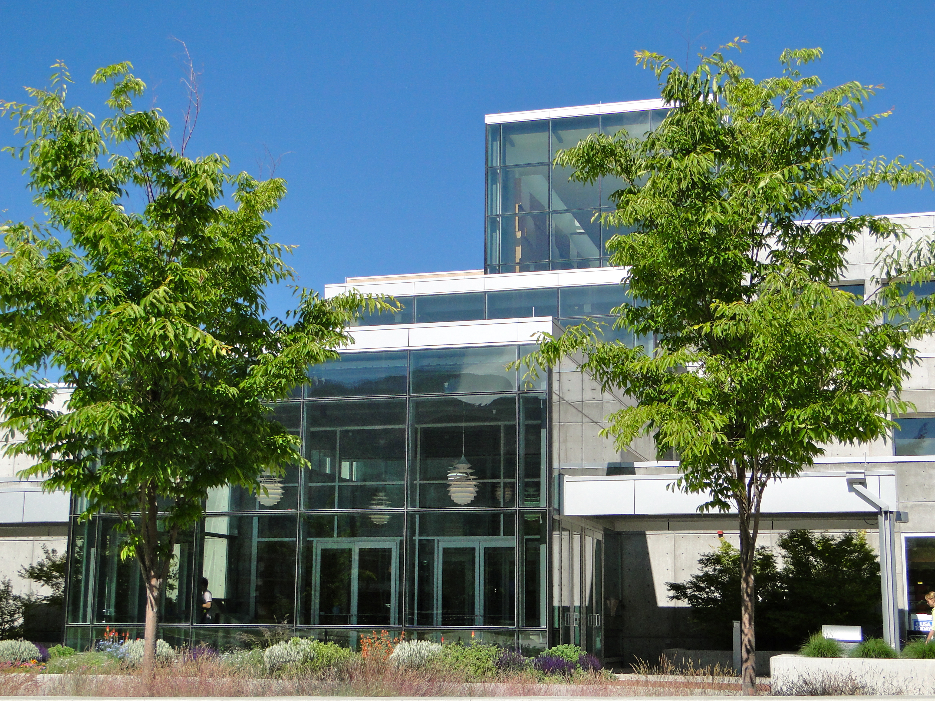
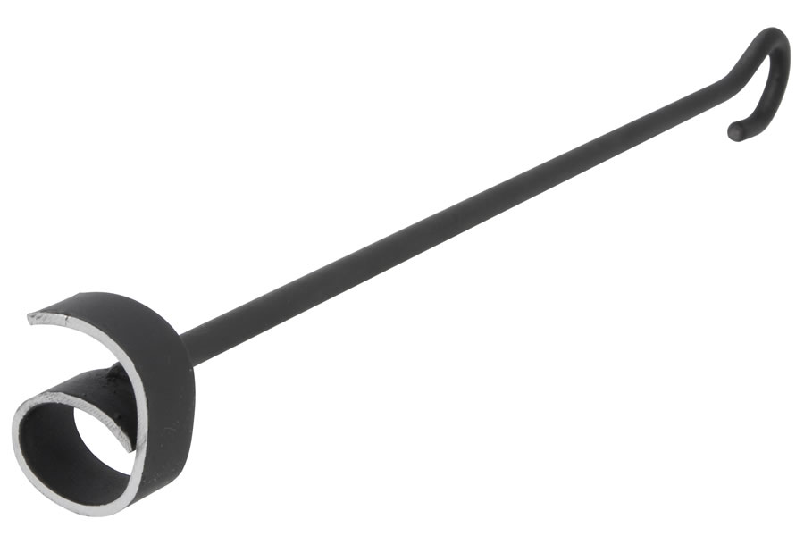
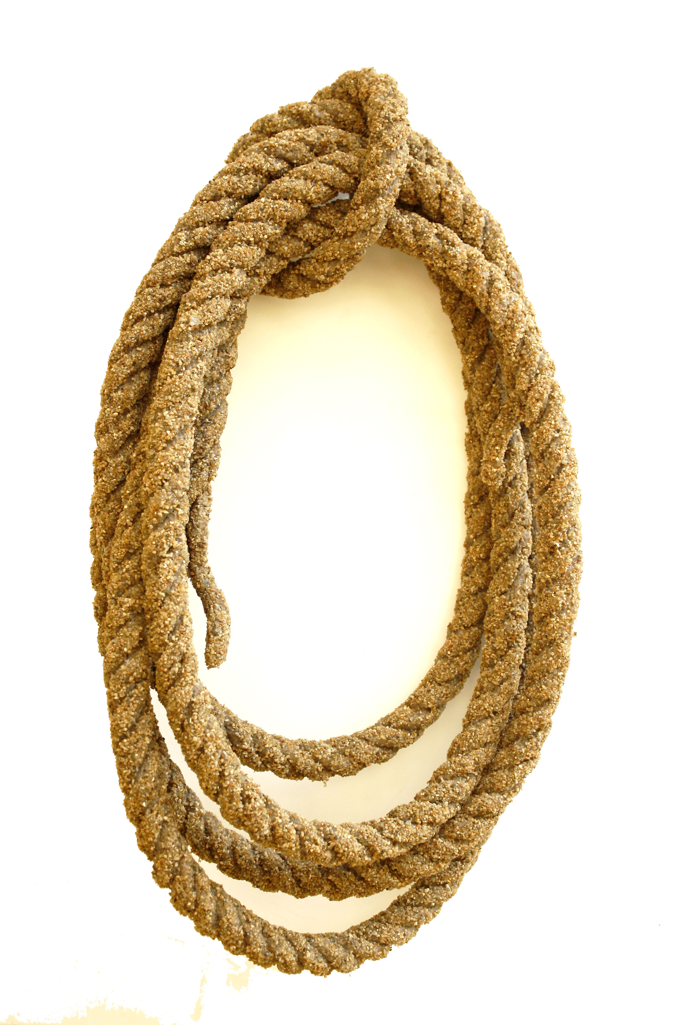
Riding, R ping, Corralling & Bran ing
Silos of Information:
Old West Techniques for a New World
Cheryl Walters
Randy Williams
Elizabeth Woolcott
Notes:
Randy

Slide 2
Riding
Riding (work) for the brand
  Must be a cowboy, not a “dude”
  “Aha moment”
    Folklorists great at collecting others’ oral histories, not so great at collecting from themselves!
  Ranch (organization) buy-in & involvement
    Utah State University SCA
    American Folklore Society
    American Folklife Center at the Library of Congress
  Plan
    Institutional Review Board
    Forms
      Letter
      Questions
      Release form
Notes:
Randy

Slide 3
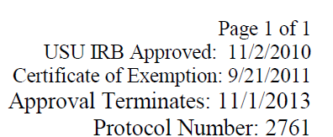
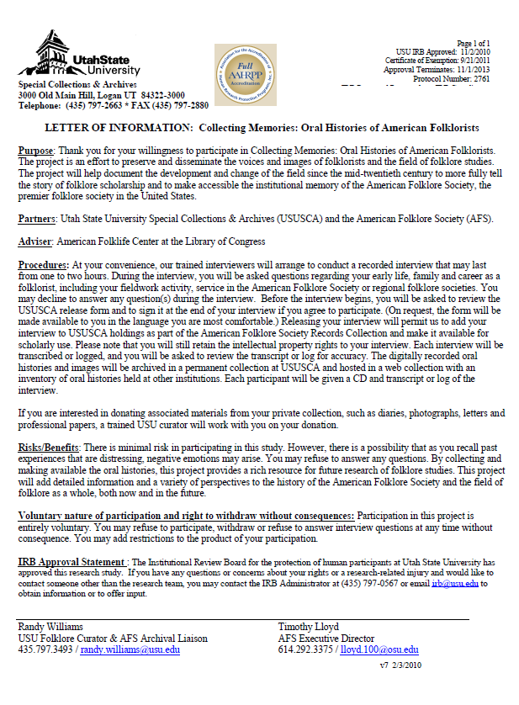
Letter of information (IRB)
Notes:
Randy

Slide 4
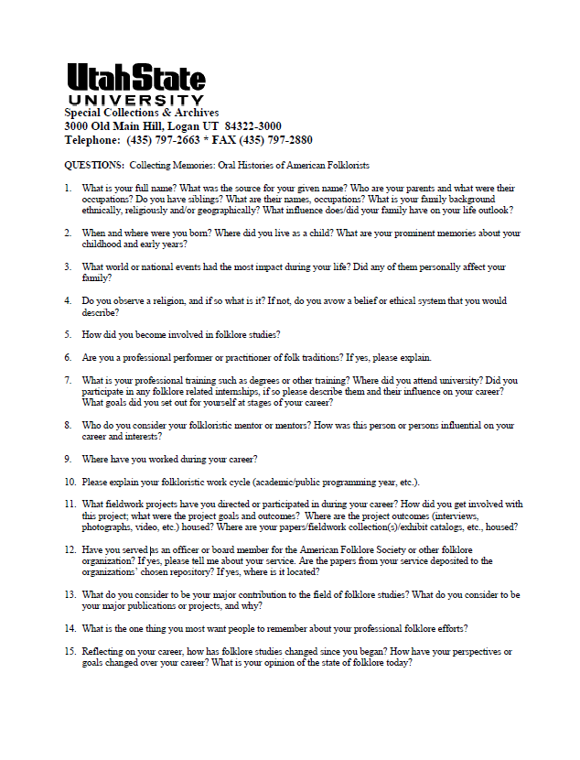
Questions
Notes:
Randy

Slide 5
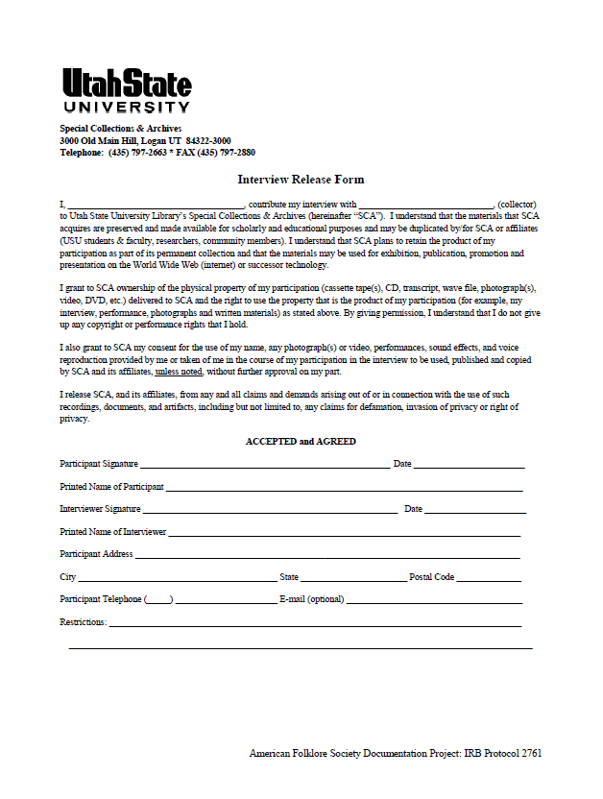
Release Form
Notes:
Randy

Slide 6
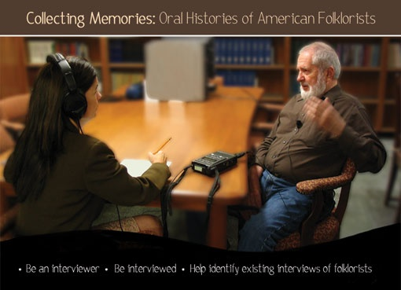




Branding
Organization brands: Logos
    American Folklore Society (History & Folklore Section)
    American Folklife Center at the Library of Congress
    USU Libraries Special Collections & Archives
PR
Notes:
Randy

Slide 7
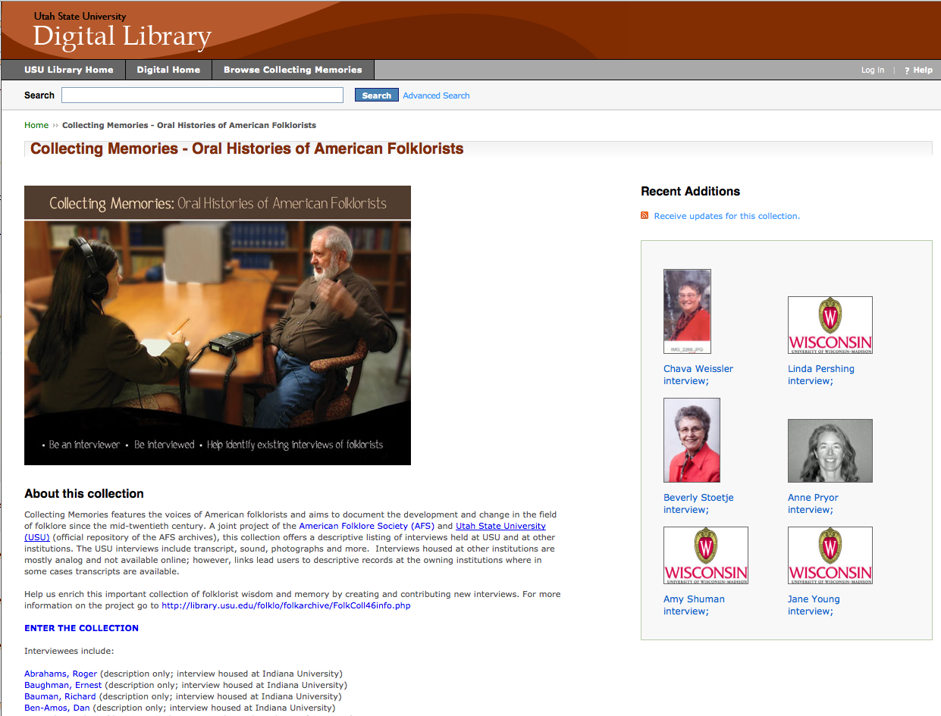
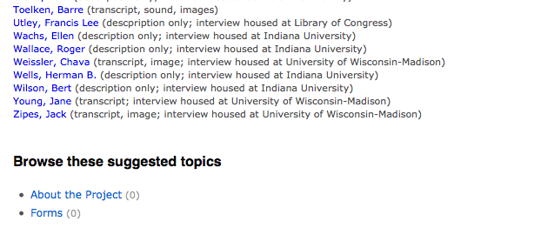
The website

Slide 8
Ways to search website:
Browse collection
Type keyword in search box
Click on a listed folklorist
Click on a recent addition

Slide 9
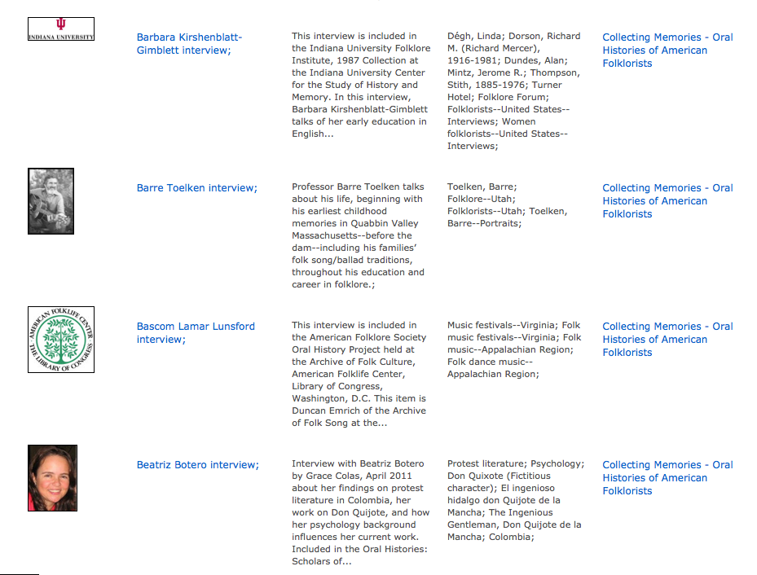
Browse List displays thumbnail (logo or photo) for each record

Slide 10
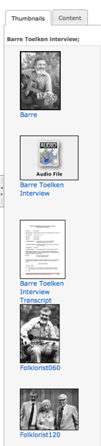
Each oral history was a compound object composed of several parts
Created compound object
Image
Audio file containing interview
Transcript (pdf)
When item actually owned by USU, included other images & documents

Slide 11
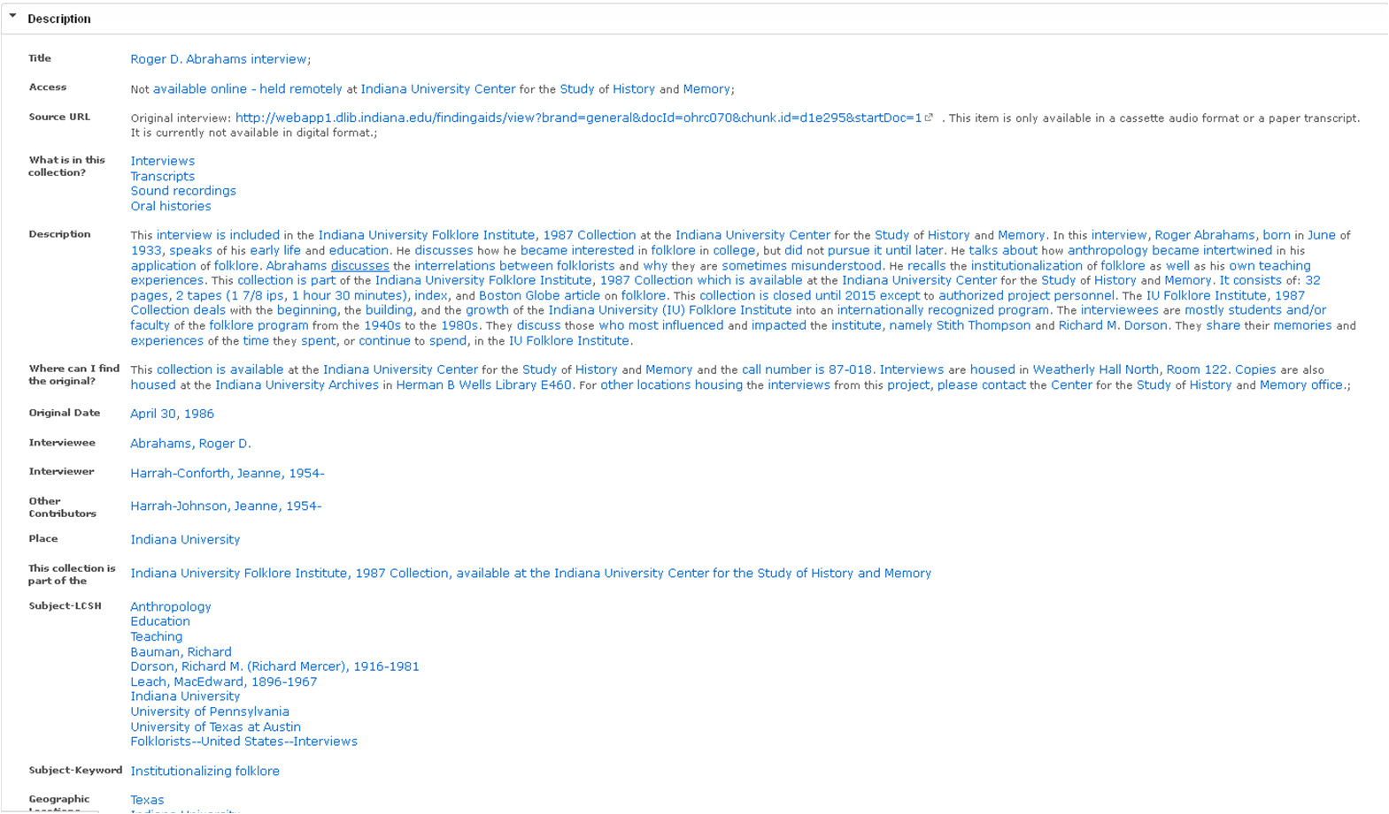
Record for physical item held at Indiana University in a closed collection – no online file available.

Slide 12
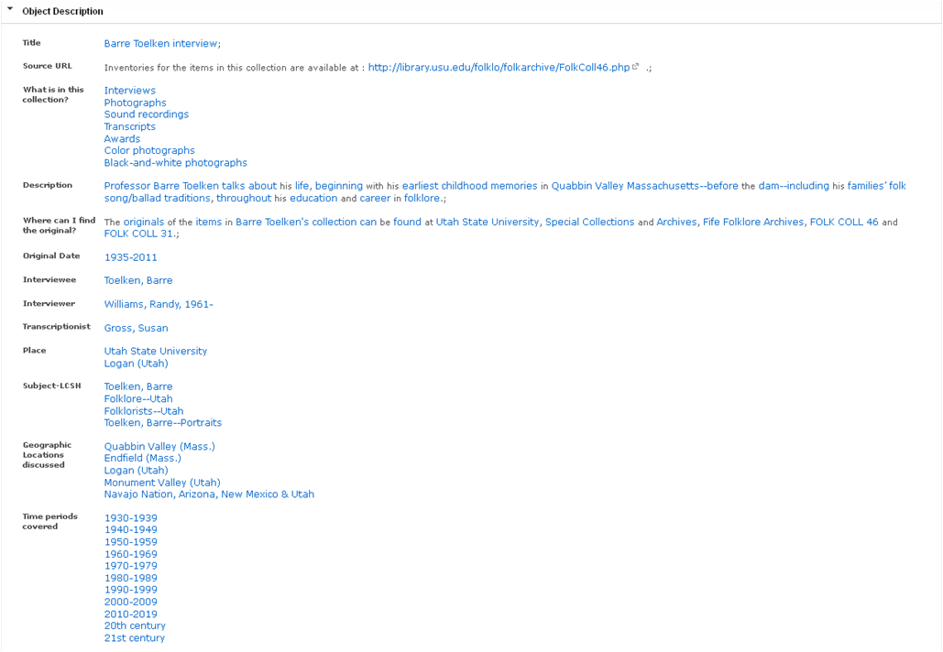
Record for item held at USU in open collection with digitized oral history immediately available online

Slide 13
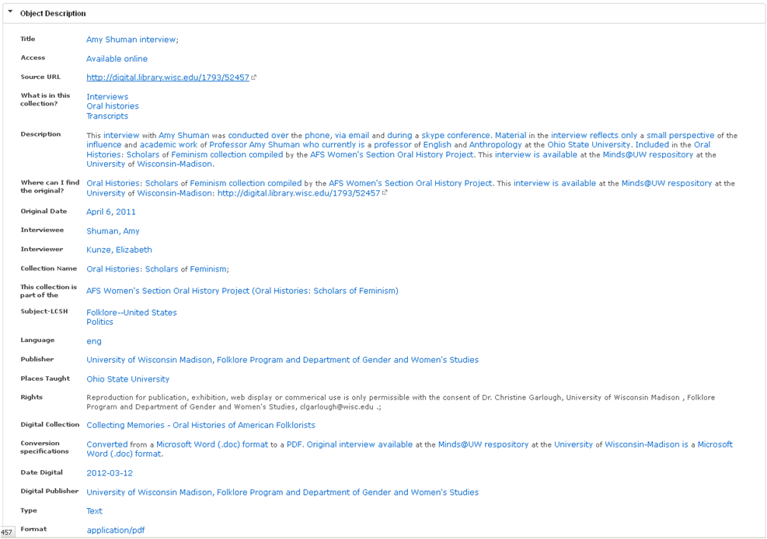
Record for digitized oral history from University of Wisconsin, immediately available online via provided link.

Slide 14
Roping/Corralling
Pulling existing oral histories from scattered silos into one website presented some challenges:
      Some in digital format, some analog
      Some open for use, some closed for set time period
      Some with minimal Dublin Core metadata, some with MARC cataloging records
      Mishmash of info – what to include, how to present
      Originals housed in different locations
      Types of items varied
Notes:
Purpose is to gather isolated silos of information into one panoptic collection where users can view all the options for the oral histories of folklorists in one spot.

Slide 15

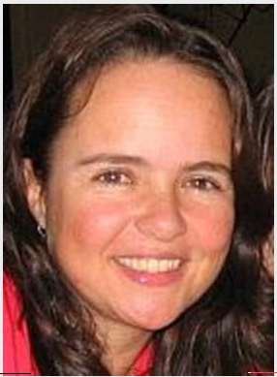



Image decisions
Use image if possible
Selected best representative image, not more
If none available, use logo of holding entity
Wanted to preserve individual branding for each holding institution

Slide 16
File format decisions
Included transcript where possible to improve discoverability
Goal is not to recreate but enhance discoverability and searchability of oral histories
Variety of text-based formats - converted all to pdfs

Slide 17
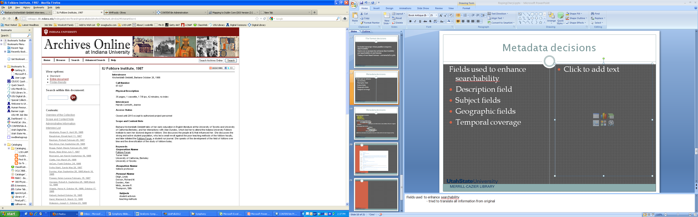
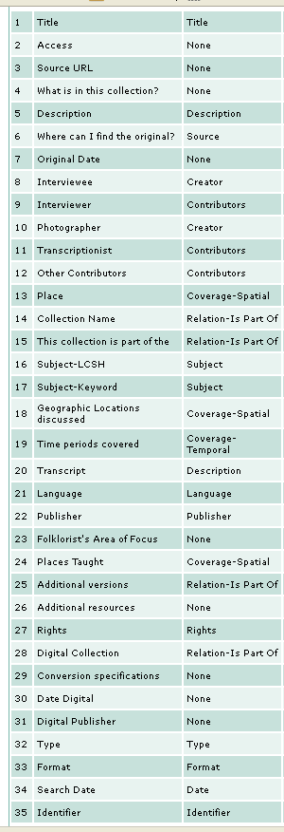
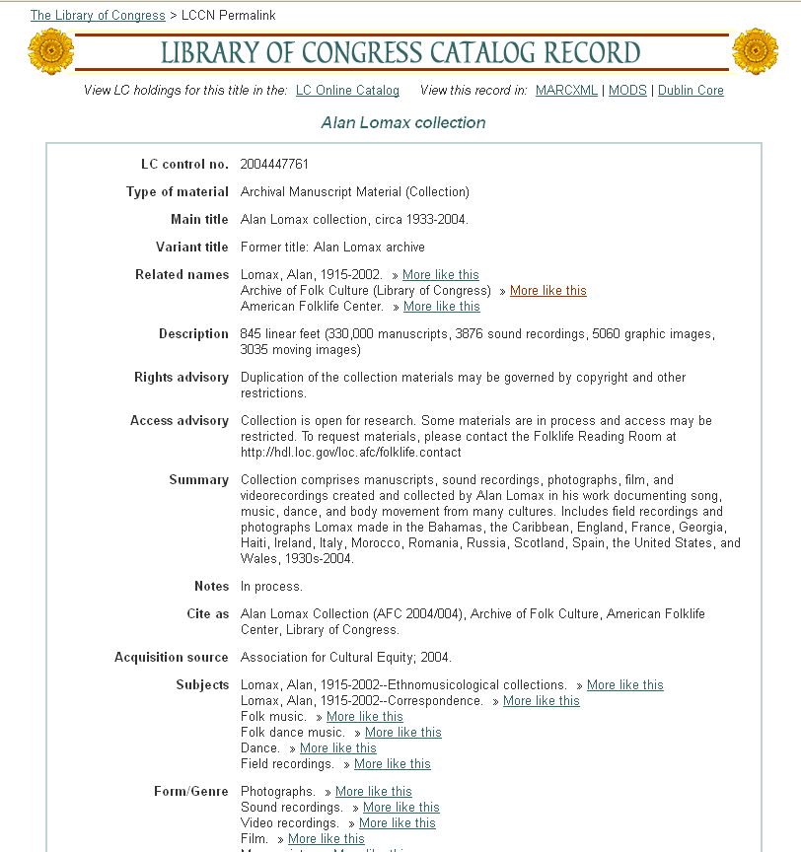
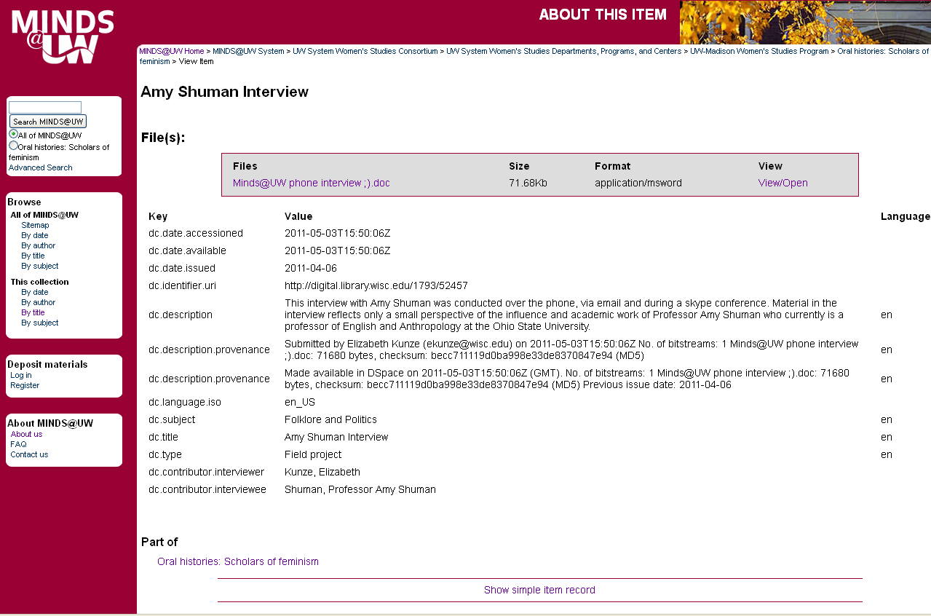
Metadata decisions
Translate field information from original finding aids, cataloging records, and metadata records
into
Dublin Core fields
Notes:
Fields used to enhance searchability
- tried to translate all information from original

Slide 18
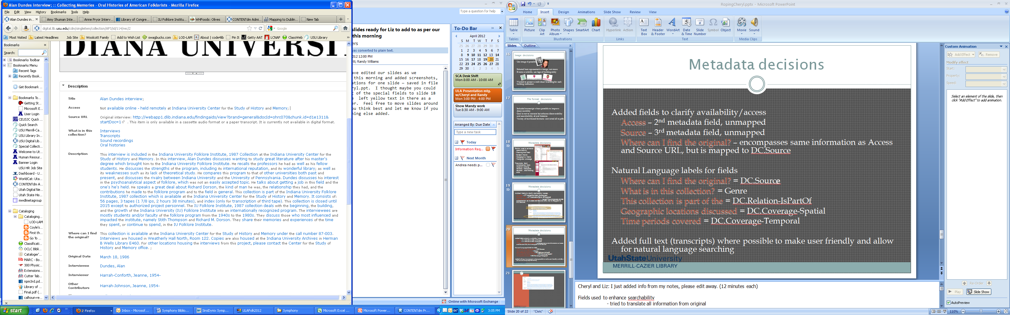
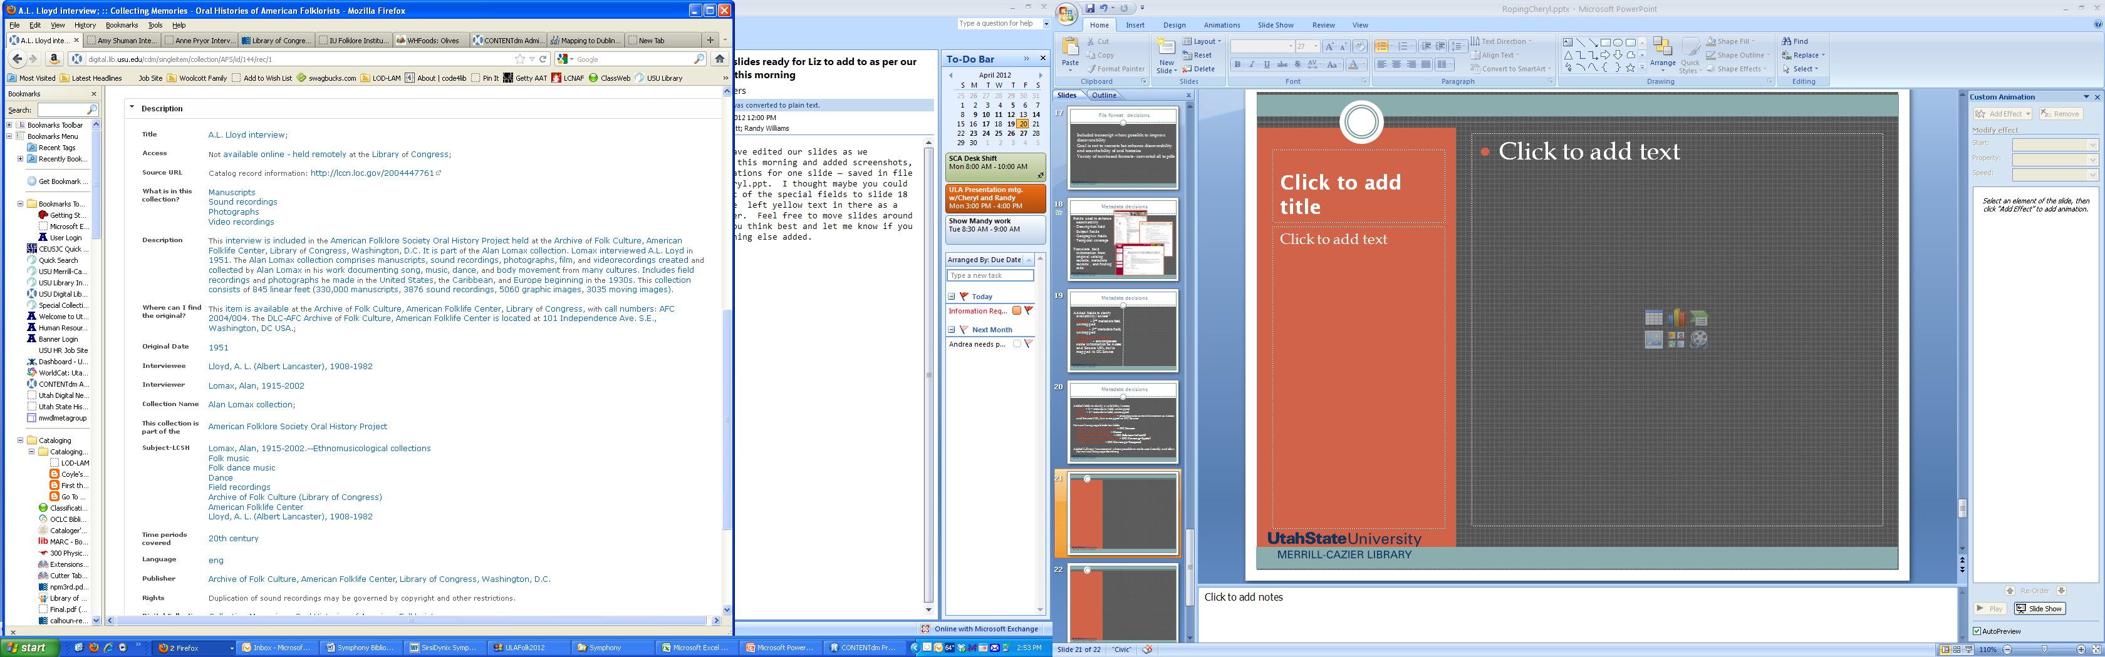
Metadata decisions
Added fields to clarify availability/access
Access – 2nd metadata field, unmapped
Source URL – 3rd metadata field, unmapped
Where can I find the original? – usually encompasses similar information as Access and Source URL, but is mapped to DC.Source
Notes:
Cheryl and Liz: I just added info from my notes, please edit away. (12 minutes each)
Needed user to know immediately that the resource
-was or was not available immediately
-where the information was taken from (or what the URL to get to the resource was)
-where the item could be found
Methodology:
What to include – how to provide consistent metadata with random information
Determine what the most basic information needed was and provide that consistently – and First!
Name of Folklorist
Location of collection
Accessibility of collection – and retrieval information
Extent of item (paper, photograph, interview, etc.)
Provide additional relevant data as available
Digitized interview
Subjects

Slide 19
Metadata decisions
“Natural language” labels for fields
  Where can I find the original? = DC.Source
  What is in this collection? = Genre
  This collection is part of the = DC.Relation-IsPartOf
  Geographic locations discussed = DC.Coverage-Spatial
  Time periods covered = DC.Coverage-Temporal
Use common controlled vocabularies wherever possible
  Geographic Locations - LCSH
  Subjects - LCSH
  Names – LCSH
  Genre – Getty AAT
  Time periods - Internal controlled vocabulary structure
Added full text (transcripts) where possible to make user friendly and allow for natural language searching
Notes:
Cheryl and Liz: I just added info from my notes, please edit away. (12 minutes each)
Fields used to enhance searchability
- tried to translate all information from original
Methodology:
What to include – how to provide consistent metadata with random information
Determine what the most basic information needed was and provide that consistently – and First!
Name of Folklorist
Location of collection
Accessibility of collection – and retrieval information
Extent of item (paper, photograph, interview, etc.)
Provide additional relevant data as available
Digitized interview
Subjects

Slide 20
Spurring the effort
2010 AFS Annual Meeting
2011 AFS Annual Meeting
“Introducing the AFS Oral History Project,” Randy Williams (USU), chair; Simon J. Bronner (Pennsylvania State University, Harrisburg), Timothy Lloyd (American Folklore Society), Jill T. Rudy (Brigham Young University), Nashville, TN, 13 October 2010.
Presentation at Archives and Libraries’ Section Meeting
Presentation at AFS conveners’ breakfast
“Happy Birthday: The AFS Oral History Project Turns One!” Randy Williams (Sponsored by the AFS Archives and Libraries Section), Bloomington, IN, 14 October 2011.
Meetings with key LOC staff
2012 plans . . .
  Session w/ high profile folklorist
  AFS funding for past president interview
Notes:
Randy

Slide 21
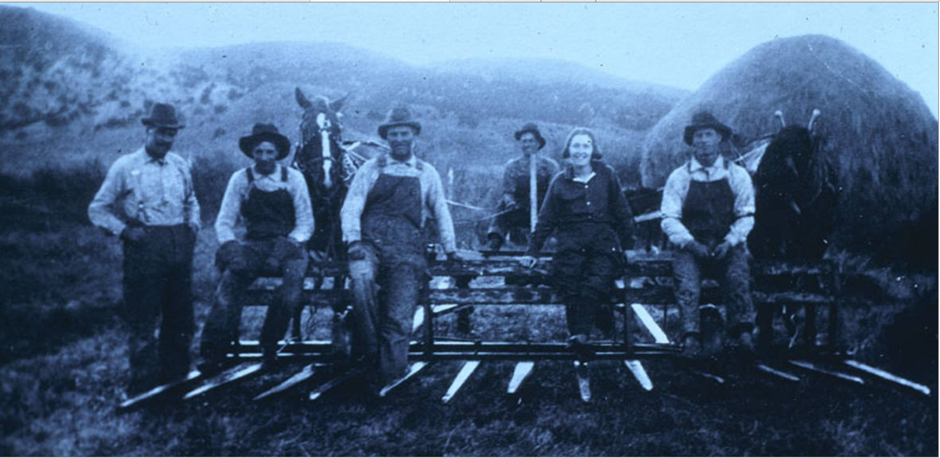
Century Collection
Sustaining the collection
  Continue working with American Folklore Society to garner support/collections
    And, continue to seek out “other” collections
  Established a pattern for continued development
  Following industry standards provides solid foundation to build on and sustain
Notes:
Randy

