Slide 1
The Changing Face of Scholarly Communication:
University Libraries and Presses Transform the Book
Richard W. Clement
Dean of Libraries, Utah State University
Cheryl Walters
Head of Digital Initiatives, Utah State University Libraries
Andrew Wesolek
Scholarly Communications and IR Librarian, Utah State University Libraries
Michael Spooner
Director, Utah State University Press
ETD 2012
Lima, Peru

Slide 2
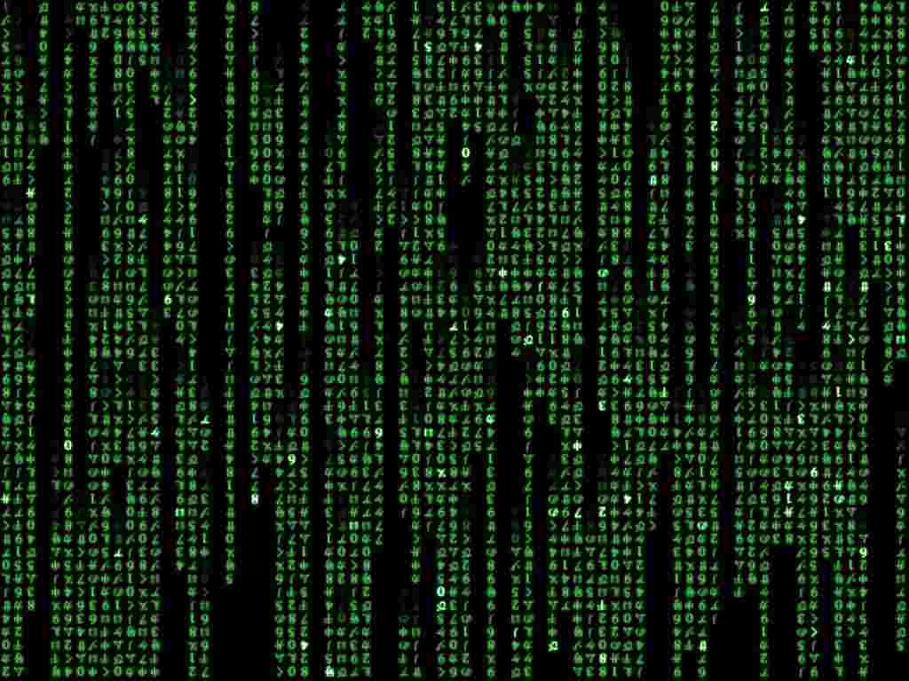

Introduction
Notes:
We stand at a notable moment in the history of human communication. We look back on a long history, and we look forward to an unknown future transformed by digital technology. And though we do not know what the future holds, we can look back through history and document how texts and books have changed, and perhaps find some indications of the tenor and significance of the change we are witnessing today.

Slide 3
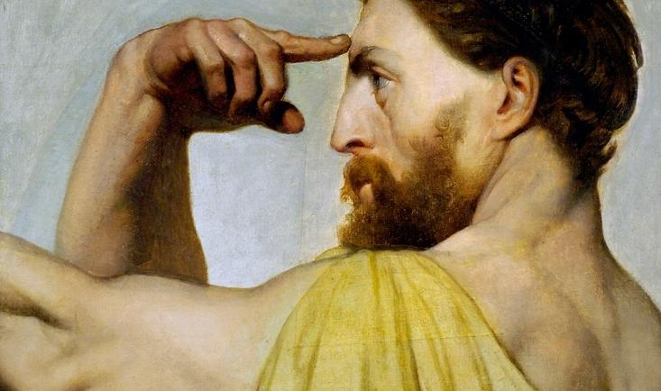
Text without Physical Form
= Language
Notes:
The first, and many would say the most significant event in the history of human communication, was the invention of language. This of course was an iterative process that took many centuries, and even millennia, to develop into the sophisticated system that we recognize as language. And with language comes the ability to create a “text,” that entity discussed by literary critics and historians divorced from any physical entity such as a book. Thus we might discuss “Hamlet” as a text that exists in some other intellectual space beyond the printed page. Text is a useful concept for us as we consider the transformation of the printed page. And so what of text in the period before writing, before the invention of the alphabet? Text existed in the mind, in memory. Homer composed his epics—the Iliad and the Odyssey— without the aid of writing, and these texts lived in human memory, passed down through generations. This was possible because the texts had poetic form that enabled and enhanced memorization. Poetry has its origin in this period of oral culture.

Slide 4
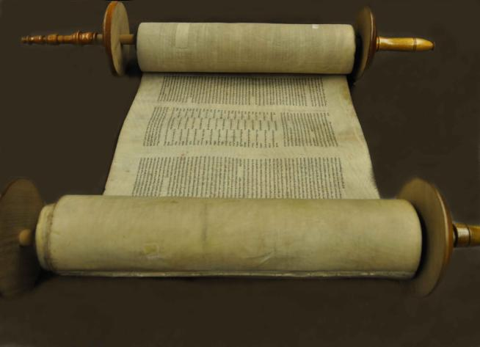


Text with Physical Form
= Book
Notes:
Writing represents language in a physical form, and for us in the West this is alphabetic. Now writing must take form on some surface, such as the clay of a cuneiform tablet. Writing in ancient Sumeria developed to record the most mundane things such as business and governmental records, and rarely the epic poems of authors like Homer. Prose had is origin in this period of the written text. As texts increased in length, new structures were developed to accommodate them. In the ancient world the scroll or roll was ubiquitous, but by the 4th century AD, the codex—what we know as the book—became the dominant form for recording written texts. And of course with the invention of printing in the 15th century, the text became fixed on the page and this form has remained dominant up until the present time.

Slide 5
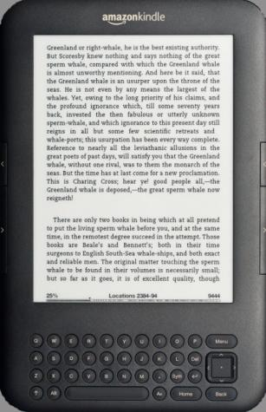
Text without Physical Form?
Notes:
Now with text in digital form have we returned in a way to the Homeric age of text divorced from a physical form? Yes and no. Text has become unfixed (as in the time before the invention of writing), but it can only exist with the appearance of printed text in a digital environment. There are those who would suggest that this is not an improvement, but there were those who said the same thing about the invention of writing. With each transformation we lose something, but gain more.

Slide 6
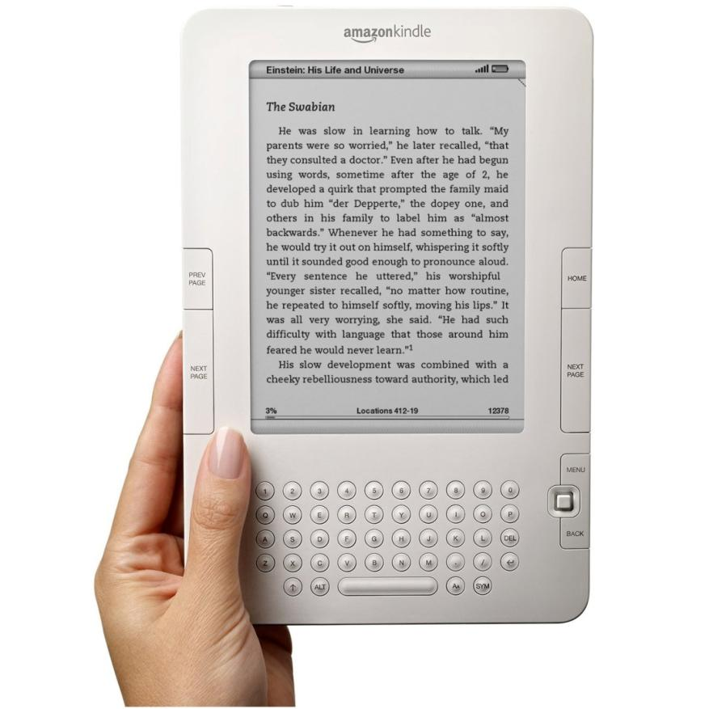
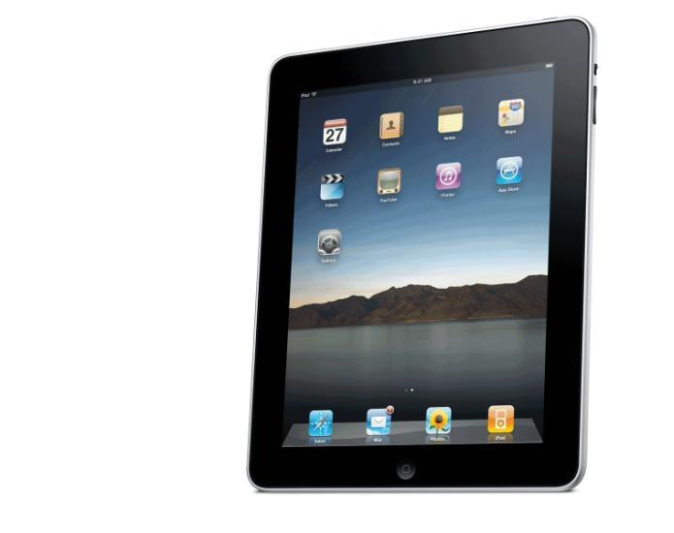
Text in a Dynamic Container
Notes:
What we have now is digital text in a container. It is a dynamic container that may be as limited as a Kindle e-reader (which simply repurposes printed text to a digital page) or an iPad tablet which has more capabilities, or a laptop computer which has even more potential. But in any case we haven’t yet seen the container that will hold the new digital book. It’s coming, but we just don’t know what it will look like yet.

Slide 7
What happens when the reading experience catches up with new technologies?
What happens when authorship catches up with new technologies?
Duane Bray, IDEO

Slide 8
The Evolving book
Attitudes and attributes
Cheryl D. Walters, Head of Digital Initiatives, Utah State University
Notes:
I will address Rick’s question about what happens when authorship catches up with the new technologies by telling you about some general attributes of the evolving book, what some authors and publishers have to say about it, and then showing you actual examples.

Slide 9
Attributes of the evolving book
Pushes the boundaries of the traditional book container, actively connecting authors, readers, researchers, and libraries
  Open-ended: easy to edit and expand with new content
  Multiple components in multiple formats: web-based, multimedia, interactive, mobile
  Links to related content
  Users are active, not passive
    Marginalia = Commenting in public forum
    Transcribe or translate text
    Identify & fill in missing information
    Add new content
  Use is easy, efficient
    Search, navigate, zoom, change font size
    Highlight, copy, paste, print, download, reformat, remix
Notes:
Let’s take a look at some of the ways the book is evolving in response to new technology, pushing the boundaries of the traditional book container to actively connect authors, readers, researchers, and libraries. Web-based books are dynamic and open-ended, easily edited and expanded with new content, composed of multiple components, often multimedia, interactive, and mobile. They can quickly link readers to related content. Digital books can engage users in many ways. Tapping the power of “Web 2.0” functionality, formerly passive consumers of information become creators and what Wikipedia calls “prosumers:”¹
Where once a reader’s marginalia consisted of a static comment scrawled on a page in a single copy of a work, now a reader can contribute marginalia to a web-based text by commenting, engaging other readers and perhaps the author in an ongoing conversation. Also, readers can enhance what they read by transcribing handwritten or illegible text, contributing searchable, readable text to a work thereby adding value for the benefit of other users. Experts and laypersons alike can help identify unknown people in photographs and fill in missing or supplementary information based on their personal experience and knowledge, adding context and depth to existing resources.
Besides enriching subsequent uses of material by others, readers can control their reading experience by altering font type and size, page views, text and background colors, zooming in/out, and more. Search capabilities permit use and analysis of text in amazing and fruitful ways unimagined just a few years ago. Using navigation aids, users nimbly jump to desired points in a work via a virtual table of contents, keyword searching an index, or by entering a specified page number. They can repurpose the content of “books” in digital format by highlighting, copying, and pasting text, images, or media clips into notes or even their own works. Depending on the application used to host the book, users may be allowed to download and/or print an entire work or some component of it, or even reformat and save it as a different kind of file.

Slide 10
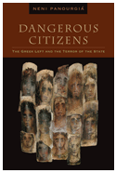
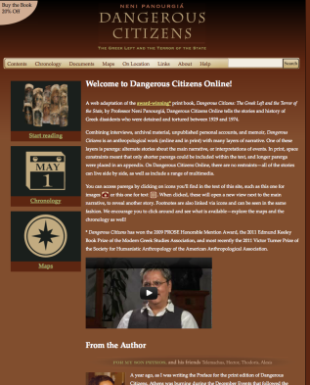
An author’s perspective:
A “Brave New Space”
Neni Panourgiá, author of Dangerous Citizens:
The Greek Left and the Terror of the State
This brave new space, where everything
And anything seems possible
  Anthropologist studying political dissent in Greece frustrated by her inability to include recent fast-breaking events in her print book. The electronic version of her work is allowing her to bypass the time and space constraints of the print book.
  “This is precisely the conundrum that the online book resolves,” she says. “It provides the author with infinite possibilities for the expansion of the text through ongoing research.”
Notes:
Neni Panourgia, author of Dangerous Citizens: the Greek Left and the Terror of the State calls the evolving book a “brave new space where everything and anything seems possible.” As an anthropologist studying political dissent in Greece, she was frustrated by her inability to include recent fast-breaking events in her print book being published by Fordham University Press. The electronic version of her work is allowing her to bypass the time and space constraints of the print book. “This is precisely the conundrum that the online book resolves,” she says in the About section of her online work. “It provides the author with infinite possibilities for the expansion of the text through ongoing research.”

Slide 11
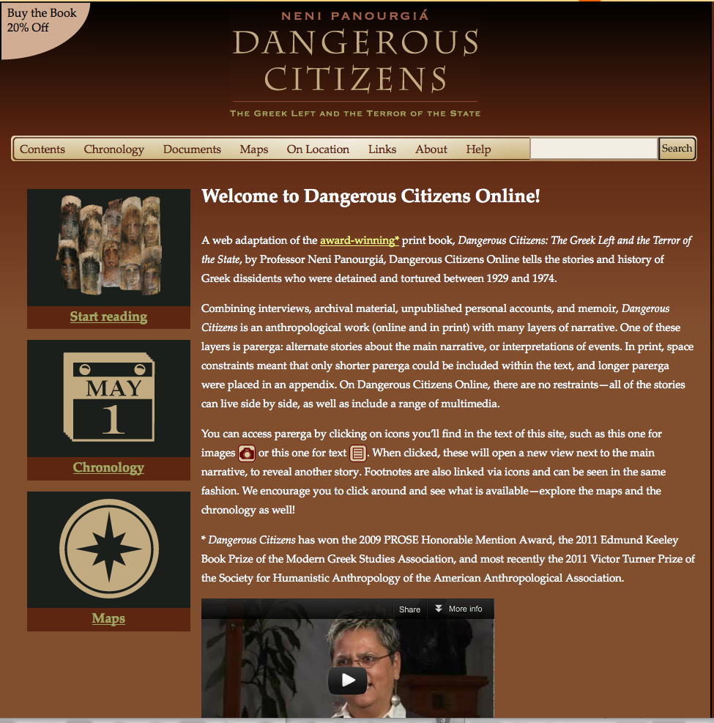
A web “book” that offers so much more than the print:
Website created by Columbia University Press complements the print book by Fordham University Press by providing:
Chronology of events
Digitized primary sources
Digitized maps, including one showing prisons and places of exile
Audio and text narratives describe uninhabited, desert islands used concentration camps for political dissidents from the 1920s - 1980s.
Clips from TV and radio broadcasts
http://dangerouscitizens.columbia.edu/
Notes:
The electronic version of Dangerous Citizens is a website created by Columbia University Press to complement the print book published by Fordham University Press. Elements offered by the web version include a chronology of events, immediate access to digitized primary sources, digitized maps such as the one showing prisons and other places where dissidents where exiled, audio and text narratives describing uninhabited, desert islands used concentration camps for political dissidents from the 1920s - 1980s, and clips from TV and radio broadcasts of the day.

Slide 12
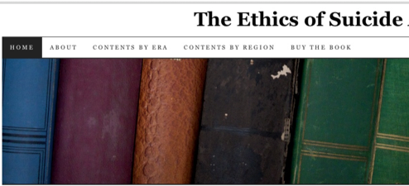
Another author’s perspective:
“An Author’s Dream”
Peggy Battin, author of
Ethics of Suicide,
  Book forthcoming from Oxford University Press
  Complimentary web version by University of Utah
“Elation”
“Nobody is telling me to make it shorter now.”
“The cooperation between Oxford University Press and the library [at University of Utah] has been amazing”
Allows her to publish print book of “reasonable size” via Oxford University Press while continuing to collect and add new material via online version of work hosted by University of Utah. “I always want to be able to add more material and allow anyone out there to suggest additions.”
Notes:
Another afficionado of the evolving book is Peggy Battin, author of the forthcoming book from Oxford University Press entitled “The Ethics of Suicide”. What are her feelings about this evolving book format? “Elation!” she enthuses. “Nobody is telling me to make it shorter now.” Long after passing the original deadline for her traditional print book, she found a way to publish a print book “of reasonable size” while continuing to collect and provide access new material via the online version of her work produced by a collaboration with University of Utah. “I always want to be able to add more material and allow anyone out there to suggest additions.”

Slide 13
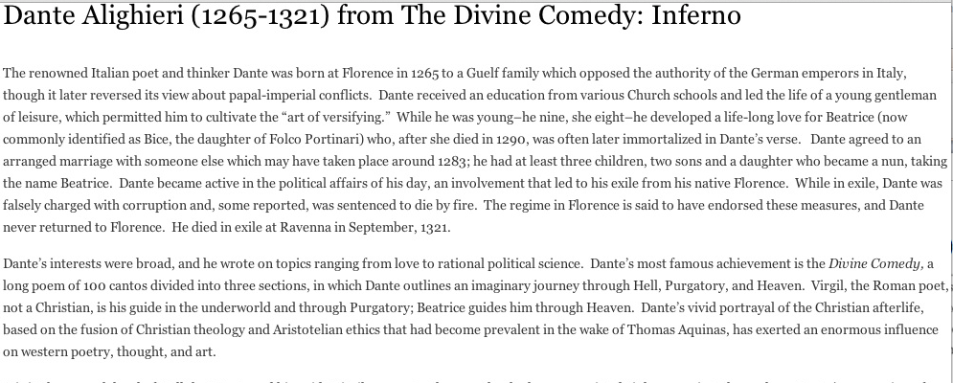
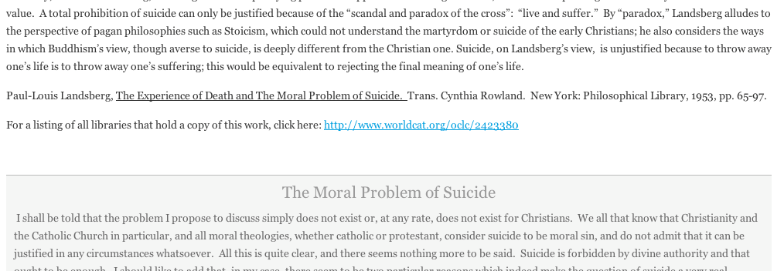
Entry describing subject’s views on suicide
Online version gives hyperlinks out to WorldCat records: full bibliographic info, libraries that own it
Online version offers fuller excerpts from works discussing ethics of suicide
Ethics of Suicide is a comprehensive look at how people throughout history have viewed the ethics of suicide. It consists of her in-depth analysis of authors and works that discuss suicide.
Notes:
Ethics of Suicide is a comprehensive look at how people throughout history have viewed the ethics of suicide. It consists of her in-depth analysis of authors and works that discuss suicide. The online version allows her to offer full excerpts from works, with links out to Worldcat entries where readers can find details on a cited work, see which libraries own it, and even link to their home library in some cases to check it out or borrow it via Interlibrary Loan.

Slide 14
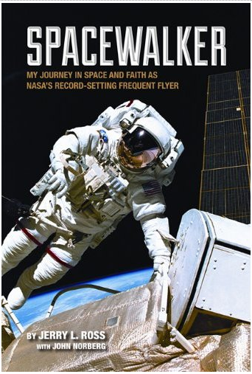
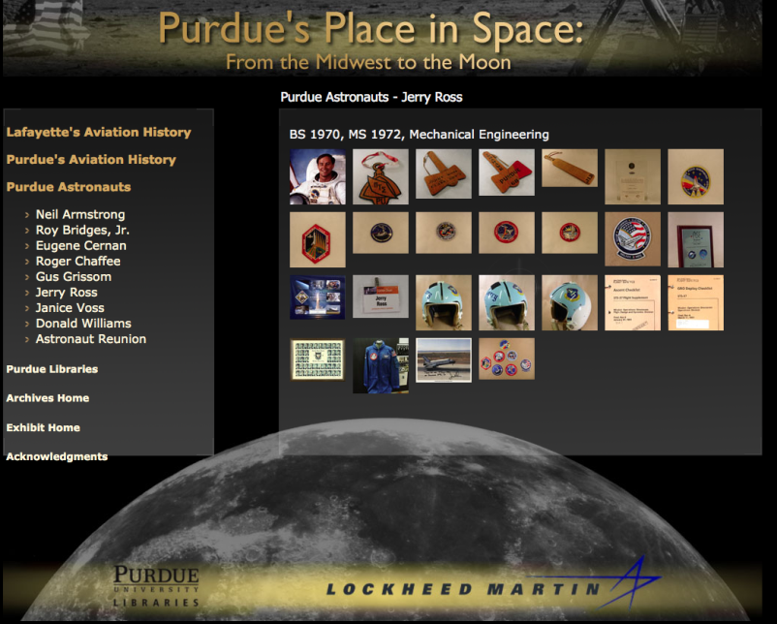
Transporting readers to archival sources
Coming Jan. 2013
Spacewalker: My Journey in Space and Faith as NASA’s Record-Setting Frequent Flyer
– Purdue University Press
Links to online archive of items from Purdue Libraries’ Barron Hilton Flight and Space Exploration Archives
Ebooks:
e-PDF, e-Pub on website
Kindle and Nook versions with video and audio links
iPAD app with interactive quizzes, timeline, and shuttle model.
Book & ebooks available soon
Notes:
Just as the evolving book is empowering authors and readers, so too is it allowing publishers to innovate. For example, libraries with publishing arms can use their products to benefit other parts of the library. Charles Watkinson, director of Purdue University Press and head of scholarly publishing services for Purdue Libraries, says that their forthcoming book/ebook Spacewalker: My Journey in Space and Faith as NASA's Record-Setting Frequent Flyer will link to and heighten the visibility of the Libraries’ Barron Hilton Flight and Space Exploration Archives containing the papers, photographs, and other items of NASA astronaut Jerry Ross. While the print book is limited to offering about 30 still images because of cost and space constraints, the ebook version will offer 80 still images, plus video and twenty 90-second commentaries, some from home videos never made public before. Purdue is also outsourcing an enhanced ebook version for iPad which will offer an extra interactive quiz, timeline, and cutaway model of the shuttle.

Slide 15

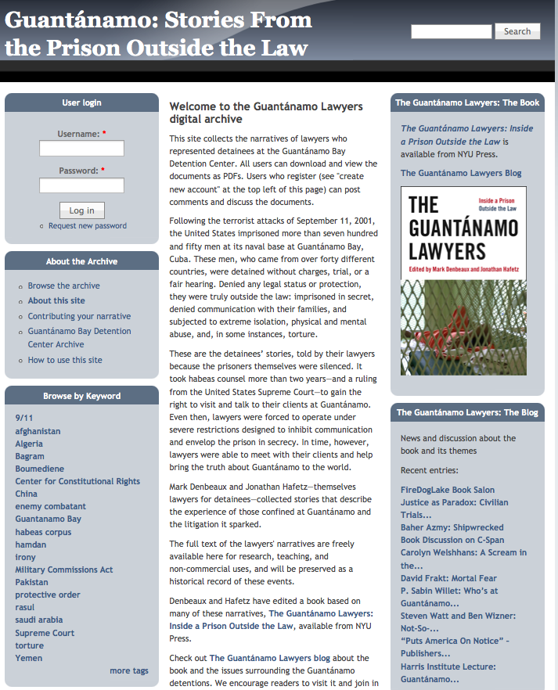
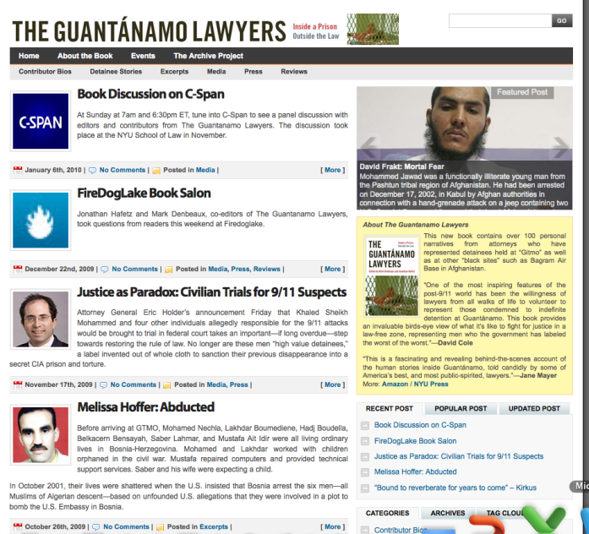
Many parts, connected & expanding
Website & online archive
Book
The book contains selective, edited interviews with the lawyers
A complementing website offers all the narratives in full at
http://dlib.nyu.edu/guantanamo
Online archive solicits other texts, images, and oral histories to add to the website.
A blog keeps the conversation going
The Guantánamo Bay Detention Center Archive is collecting records from attorneys who have defended Guantánamo detainees and other detainees held outside the law, including texts, visual documentation (photographs, film, and video), and oral histories from lawyers and former detainees. As these materials are gathered and processed, they will be integrated into this site.
Blog
http://dlib.nyu.edu/guantanamo
Notes:
Finally, I end with The Guantanamo Lawyers, a book published in 2009 with an established online presence that offers a blog as well as developing archive of narratives. New York University Press and the authors of this book are partnering with NYU’s Tamiment Library to document, preserve, and make accessible the legal records and human stories of the Guantanamo Bay Detention Center.
I have just shown you some interesting treatments of the book by some other university libraries and presses. Now we will talk a bit about what we are doing specifically at our own university.

Slide 16
Institutional Repositories:
Vehicles for change
Andrew Wesolek, Scholarly Communications and IR Librarian, Utah State University

Slide 17
Notes:
Institutional repositories (IRs) can, and indeed are, serving as hubs for library based publishing efforts. Utah State University hosts a thriving IR on a bepress Digital Commons platform. This repository, which aims to capture preserve and promote the intellectual output of the institution has coupled the innovative research conducted at USU, with highly efficient Search Engine Optimization, to yield nearly 1 million total full text downloads.
Now, many of the works in our repository are published via traditional avenues and hosted in Open Access (OA) forms in the IR. However, the repository also publishes grey literature, conference posters and presentations, among other academically interesting, works that may not find exposure through traditional publication

Slide 18
Traditional Text, New Vehicle:
Notes:
For the purposes of this presentation, we’ll focus on several ways that we have used the IR to produce intellectually interesting and potentially transformative texts. Our first example illustrates how the IR can give life to works that fall in the grey area between books and articles. Our IR does not offer any of the value added services provided by traditional publishers or university presses. This allows us to offer the repository as a vehicle for publication to those who may not have another outlet.
This text is both highly specialized and relatively short, making it economically unattractive to traditional publishers and university presses. By publishing through the IR, though, we can provide a specialized textbook by a recognized authority to the hundreds of graduate students worldwide who will use this text as part of an advanced course in Medieval manuscripts.

Slide 19
The Vehicle Shapes the Text:
Notes:
We are also able to use the IR to transform texts that were conceptualized in a traditional sense into highly dynamic and socially responsive works. In this example, we have taken a traditional (though un published) text, The Foundations of Wave Phenomena and reconceptualized it to draw on the strengths of the vehicle of publication—the IR. First, we give a brief introduction to the text, how it is to be used, and how it is to be navigated. However:

Slide 20
An Interconnected Web of Concepts:
The Book Becomes Social:
Notes:
Instead of presenting the text as one to be read linearly, we have structured the work such that each module (traditional chapter) stands independently, yet is deeply connected with the other modules. So, rather than a linear work to be read form start to finish, this transformed text exists as an interrelated web of concepts, where users can enter and exit at points of their choosing, as well as easily trace linked prerequisite concepts, supplemental materials, and practice problem sets.
In essence, the aim of a text is to transmit a complex concept from the author to the reader by way of a set of interrelated sub concepts. When confined to a traditional structure: IE a physical book, these sub concepts progress linearly. Here, though, we are able to present these subconcepts as a web—one in which the reader may enter and exit at points of his choosing, investigate supplemental materials where necessary or ignore them when they are not.
This approach has the added benefit of attracting Google and other search engine crawlers to the concepts outlined in each chapter (for example, Harmonic Oscillations) to a much greater degree than if those chapters remained part of a traditional book. So, rather than attracting users to the text as a whole, crawlers identify and make findable each of the subconcepts contained within that work.
Here we see the record page for each chapter. Notice that users are given the option to download helpful appendices, and problem sets to further their understanding of this chapter. Perhaps most interestingly, though, you’ll notice that through the IR we are able to add user-generated comments, thus allowing for the book to become a social space. In this instance, our faculty author monitors this comments field, so each reader is able to ask questions of the author, receive a response to them, while simultaneously creating a record of how the work is being used, and where gaps may exist. The book, then, becomes socially responsive dynamic learning space. Our faculty author is able to revise and update aspects of his work in direct response to the needs of users.

Slide 21
Looking Forward:
Notes:
Looking forward, the IR also allows us to integrate multimedia components. There is tremendous potential here to integrate these components with the nonlinear and socially negotiated transformed texts of the type discussed above. We have the potential to add animations, supplemental labs for use in large classrooms, lectures, etc. We are seeing these multimedia components make their way into journals (JoVE) and Open Courseware, but the potential for them to help transmit the ideas contained within texts, are as yet unrealized.

Slide 22
SUSTAINABLE INNOVATION
Digital Book Publishing at
Utah State University Press
Michael Spooner, Director
Utah State University Press
Associate Director
University Press of Colorado
Notes:
Innovation is not produced by isolated moments of genius. There is always an environment from which new ideas emerge, an ecosystem that supports them.

Slide 23
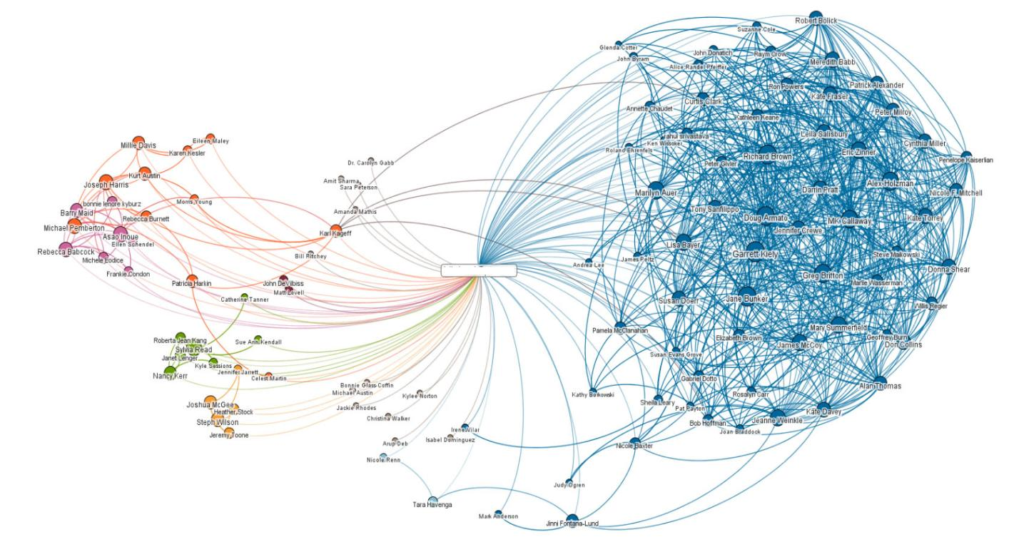
Sustainable Innovation
¡USU Press!
Notes:
Though America as a nation is wealthy, most American universities and their presses are not. Our budgets, like many others around the world, are tightly restricted, and we do not have the resources to invest in developing our own breakthrough ideas and products. Yet we also exist within the digital ecosystem.
As a small publisher, our path to sustainable innovation lies in creating relationships with others who have more resources.

Slide 24
Sustainable Innovation
Strategic Questions for a Scholarly Press
  Is the platform appropriate to our audience/readers?
  Longevity of the software/hardware?
  Longevity of the partner?
  Exclusivity or flexibility?
  Reaching which markets or readers?
  Business model?
Notes:
As we choose our partners in the digital publishing environment, we must face a bouquet of important questions: how will software address our readers’ specialized ways of reading? how long will this software or hardware or aggregator survive? Will this partnership be exclusive or flexible? How do we value different markets? For this ecosystem, what is the appropriate business model?

Slide 25
Sustainable Innovation
Strategic Answers
Multiple processes and partners
Simultaneous evolution
Versatility
Multimodality
Notes:
At least conceptually, the answer to that last question is simple. At our press, as at many others, we are investing in multiple processes, so that we may respond to simultaneously evolving formats, hardware, and delivery systems. In an environment where so many elements are developing at once, versatility and multimodality are key to sustainable innovation for us.
Here are some examples of how we use multimodal thinking in our unique situation.

Slide 26
Sustainable Innovation
Digital publishing partners
  University Press of Colorado
  Utah State University Digital Commons
  Bibliovault
  O’Reilly Media
  Univ Press Content Consortium
  Ebrary
  EBSCO/netLibrary
  Cengage/Questia
  Ebooks.com/ EBL
  Amazon
  BN.com
  Folletts
  Ingram
  HathiTrust
Notes:
The first USU Press digital books appeared in 1999 with a dot-com startup called netLibrary. Since then, we have engaged with a growing number of suppliers to academic libraries, to trade bookstores, and to individuals.
Today, we count among our partners a growing list of retail and library ebook vendors.

Slide 27
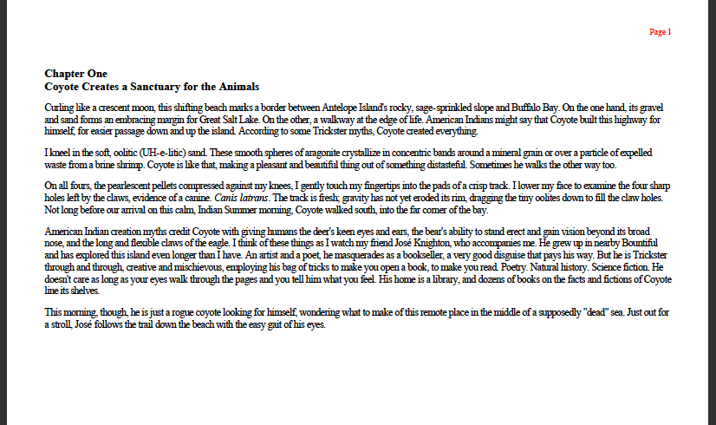
Sustainable Innovation
EBSCO Interface
Notes:
You’ll recognize the EBSCO/netLibrary interface here. I hear that libraries give this interface mixed reviews, but since EBSCO is one of the major aggregators for the library market, we distribute our content through them.

Slide 28
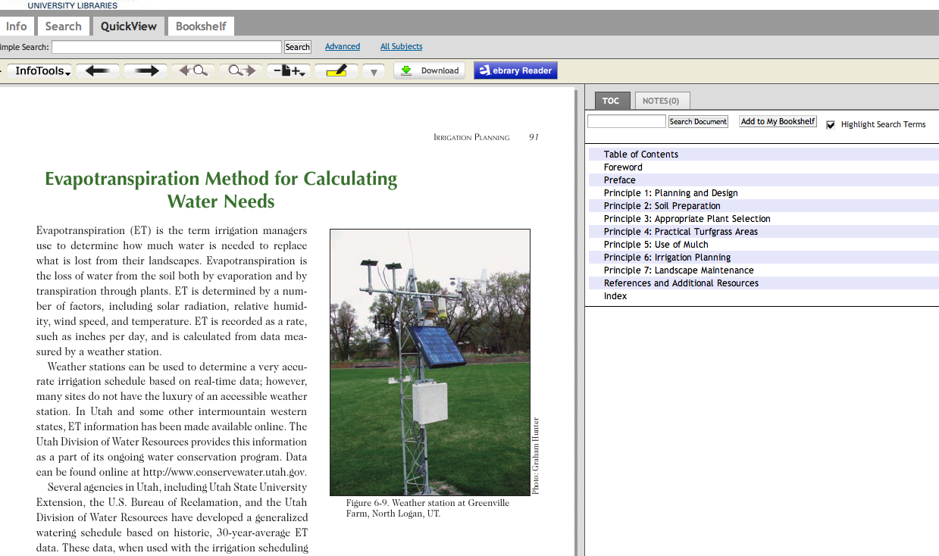
Sustainable Innovation
Ebrary’s Interface
Notes:
The Ebrary interface accommodates the original page design, so I like it a little better. In addition to EBSCO and Ebrary, as you know, there are many other aggregators around the world. We develop relationships with as many of them as we can.

Slide 29
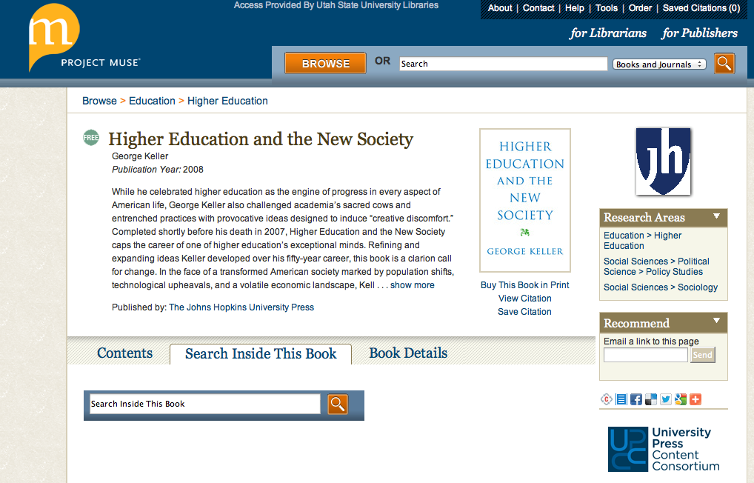
Sustainable Innovation
UPCC’s Interface
Notes:
We are also a member of the University Press Content Consortium (UPCC), an aggregator of monograph content that comes solely from university presses.
Books from aggregators like these are normally delivered through a library and are readable on the user’s desktop or laptop computer.

Slide 30
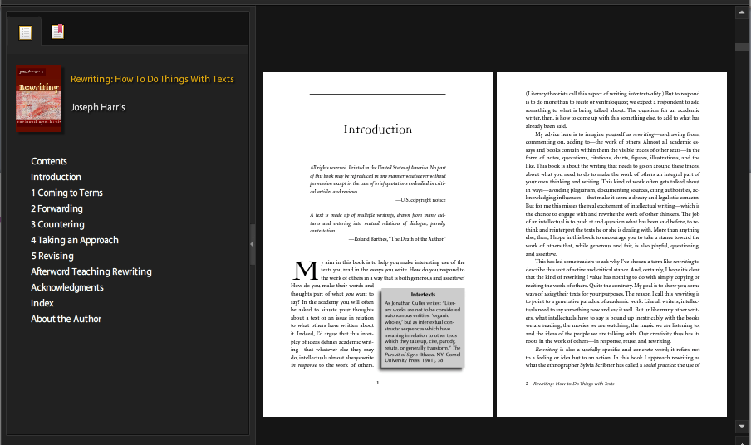
Sustainable Innovation
Adobe’s Digital Edition Interface
Notes:
In recent years, as personal ebook readers have improved, we began to release USU Press books in a couple of the most versatile formats. The Adobe Digital Editions reader is a free, cross-platform application, making ebooks deliverable from the shopping cart on our own website—instead of only through a library subscription.
These ebooks download easily to a desktop or laptop, and work well with free apps for mobile devices.

Slide 31
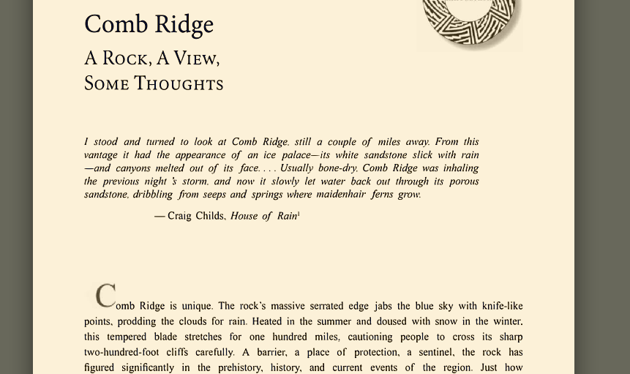
Sustainable Innovation
Amazon’s Kindle Interface
Notes:
We also convert our files to the epub/prc format, which is the basis for the Kindle book, the iBook, and others.
All of these downloadable formats allow an individual scholar to build a personal library on their own hardware in a manner not unlike the way we build a music library from iTunes. They are an especially good solution for international scholars.
One thing very evident here is that although there is a cutting edge of technology—as we see in what Cheryl and Andy have been showing us—those formats are not common yet. To create them requires skills that authors generally do not have, and an investment of time and capital that few scholarly publishers have access to. This is why, as Rick implied in his opening remarks, the vast majority of current ebooks are simply electronic editions of traditional page formats like we see here.

Slide 32
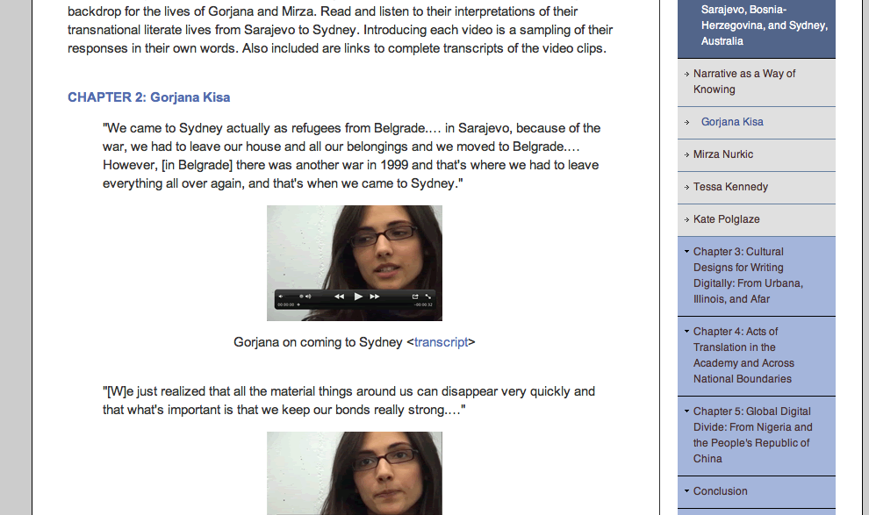
Sustainable Innovation
USUP/Computers and Composition Digital Press
Notes:
However, here is an example of a series that we created through a collaboration with several other institutions. This is the Computers & Composition Digital Press (CCDP). CCDP is dedicated to works that are native to the digital ecosystem—that is, they may include video, audio, database, and other elements not well suited for publication in print formats. These volumes are available open access.

Slide 33
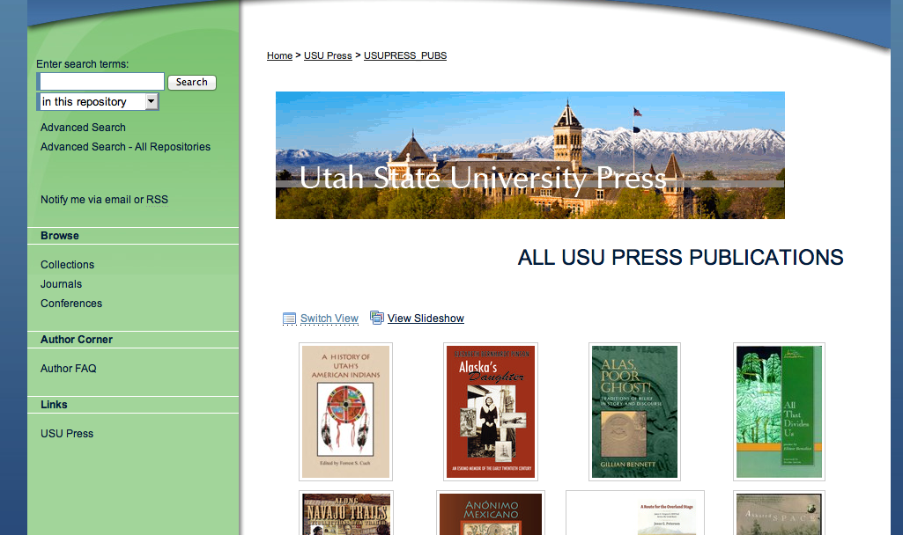
Sustainable Innovation
Digital Commons – Institutional Respository
Notes:
The USU Institutional Repository, which Andy has discussed, is a larger set of open access collections in ongoing development. Within the last year, USU Press publications in this collection (readable as PDFs) have been downloaded over 50,000 times.

Slide 34
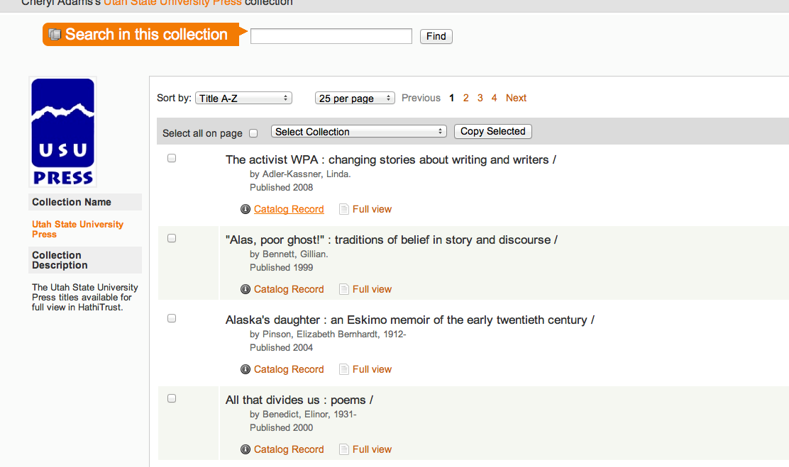
Sustainable Innovation
HathiTrust – Collective Repository
Notes:
Extending the repository idea, Utah State University is a partner of the HathiTrust, which is the first large-scale digital library in the US.
In addition, USU Libraries have joined with other partners in a project called OpenFolklore, an open-access resource for researchers in folkloristics.

Slide 35
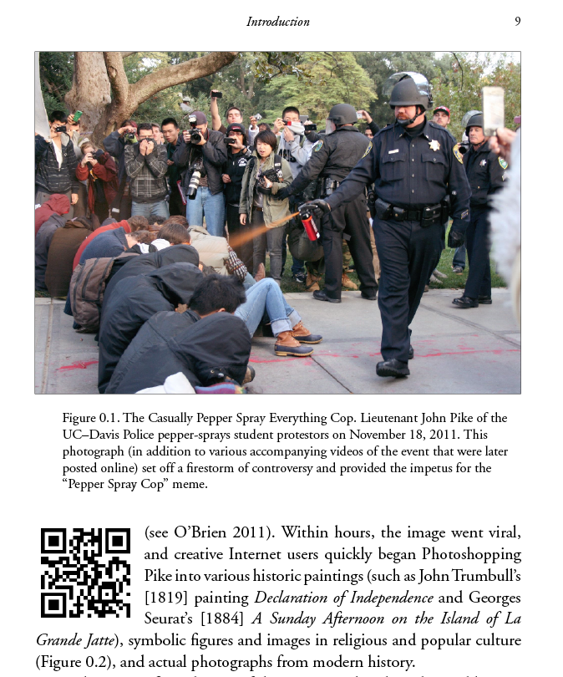
Sustainable Innovation
Traditional printed books
Notes:
We should not forget the role of traditional printed books, since—although the market for ebooks is growing, print remains the dominant format for published books today, at least in the US.
But even in producing print books, we employ multiple digital technologies. We have, for example, drawn on resources at the University of Toronto Press to initiate an XML-first production flow, making conversion to various ebook formats easier at the end of the process.
And, as you can see here, even the printed page can deliver electronic access—via QR codes in this case. In ebook editions of this volume, of course, the QR code becomes clickable.

Slide 36
Sustainable Innovation
Versatility and Multimodality
¡USU Press!
Notes:
Digital publishing is an idea in motion.
If our goal is not just innovation but sustainable innovation, then we who publish digital books need to maintain a versatile, multimodal approach. No university press has the resources alone to create and maintain a perfect product in such a fluid ecosystem. We must draw upon a network of connections, learning from one, delegating to another, contracting with another.
We have to do it all, and we have to do it all at once.
This approach allows us to address the fluctuating range of viable options, and allows us to stay flexible, open toward new developments and markets as they emerge.

Slide 37
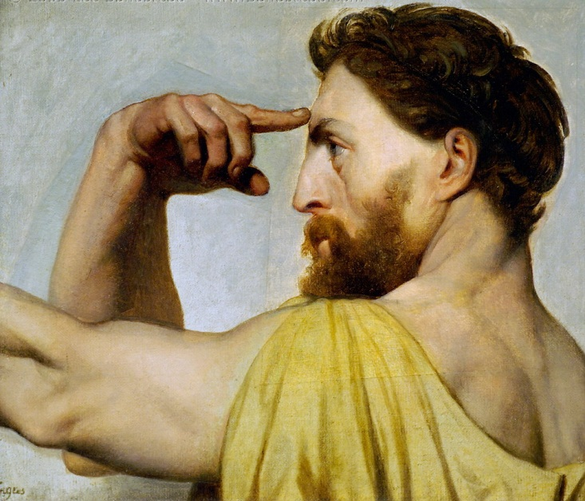
CONCLUSIONS
Notes:
We don’t know what form the book will ultimately take in the new digital age, and perhaps, given the dynamic nature of the digital medium, it will never take a fixed form analogous to the codex book we are so familiar with. But as university presses and libraries come together to experiment and explore possibilities in the creation and production of scholarly monographs, some things are already clear.
We are all aware that university presses in the US have long been at risk as scholarly monographs have become progressively less profitable. At the same time, the role of the scholarly monograph in the tenure and promotion system has become progressively more important. University presses have been trapped in a difficult situation and have often been marginalized in terms of local campus politics. And the result, as we have recently seen at the University of Missouri, has been to close the press. Our experience at Utah State University has been that bringing the press into the administrative structure of the library, has allowed the press to align its own mission to the library’s mission, and to move from the margin to the center.
Further, this administrative positioning of the press within the library has enabled both the press and the library to collaborate on experimentation on new forms of scholarly monographs, drawing on the strengths of both organizations. The collaborative structure has given the press and library a collective space for risk-taking and exploring new models. We don’t know where those new models may lead to, but we are actively exploring the possibilities and looking to the future with great anticipation.

