Slide 1
Northern Utah Speaks: USU’s Oral History Effort
Randy Williams
Fife Folklore Curator & Oral History Specialist
USU Libraries’ Special Collections & Archives Division
&
Elisaida Mendez
Latino Voices assistant director

Slide 2
What is Northern Utah Speaks?
Northern Utah Speaks is the aggregate of USU Special Collections & Archives’ rich oral history collections.
The Collection includes oral histories of Korean War veteran Shirley M. Adams and musician Dr. Irving Wassermann.
NUS is an ongoing effort to include the voices of all Northern Utah communities in USU Special Collections.

Slide 3
Mission
Identify and conduct oral history projects in areas critical to the people, environment and history of Northern Utah and subject interests of Utah State University.
Make oral histories available.
Teach oral history workshops & best practices.

Slide 4
Why oral history?
Oral histories add important information to our local, state and national story for present and future researchers.

Slide 5
What is oral history?
Oral history is a method of recording the memory and personal commentary from a person’s life to document an event, group, occupation, religious attitude, etc. by living survivors.

Slide 6

Is memory accurate?
A person’s memory is an amazing thing. During an oral history interview, many recollections are retrieved. However, one person’s perspective or vantage point on a topic may not complete the whole story. In our oral history projects we interview many individuals in order to elucidate the larger scope of an event. This allows researchers to review, compare and contrast data in an attempt to further understand human history.

Slide 7
What is an oral history interview?
An oral history interview consists of
  a well-prepared interviewer questioning an interviewee;
  an audio or video recording of the exchange;
  a transcript of the interview;
  a storage place for the interview media (tape, wave file, CD, etc.), transcript and associated materials (such as photographs, letters, diaries);
  a finding aid/cataloging record for the collection;
  a digital presence for the collection.

Slide 8
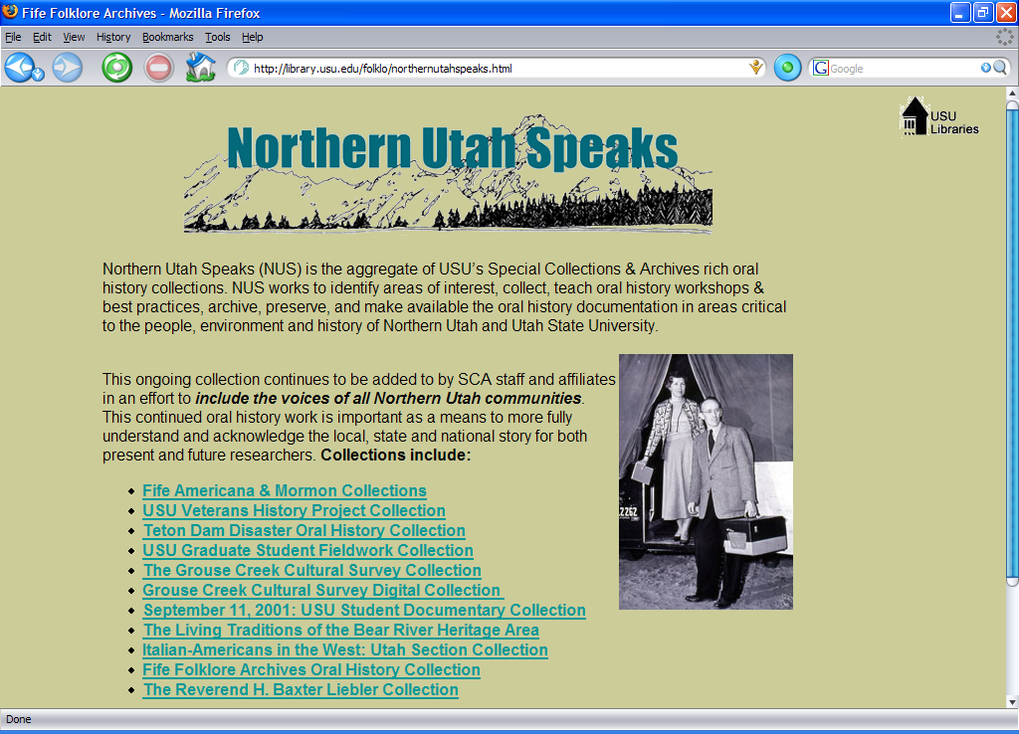

Slide 9
Northern Utah Speaks:
Sounds
Fife Mormon Collection
Grouse Creek Cultural Survey
Bear River Heritage Area Collection
Latino/a Voices Project

Slide 10
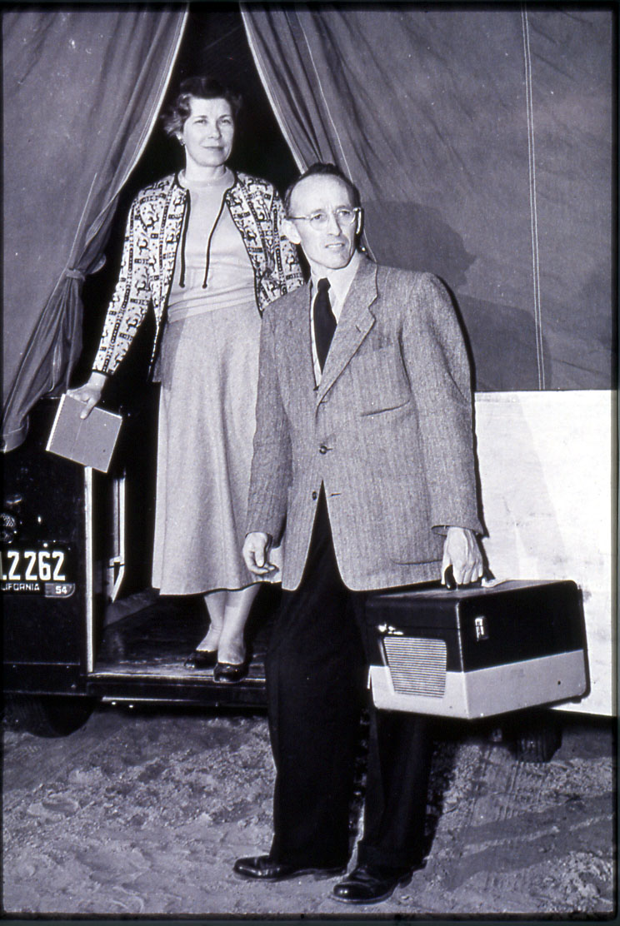
Fife Mormon Collection
Using summer vacations and weekends during the 1940s-1970s, Austin & Alta Fife traveled the west–most intensively in their native Utah–with a camping trailer, recording equipment, camera and stenographic materials to collect the folklife of the American West. This collection is comprised of Mormon folksongs and narratives.
Austin & Alta Fife on their way to an interview.

Slide 11

L. M. Hilton interview from FMT
Gospel News
The gospel news is sounding to nations
far and near,
Good people pay attention and to its
truth give ear.
For the Lord He hath commissioned
an angel from on high,
A message bearing through the land
and with it he did fly.
And with it he did fly, and with it he
did fly.
A message bearing through the land,
and with it he did fly
Saying, “Now give glory unto God
who made the sea and land.
Repent of all your wickedness, God’s
judgments are at hand.
And then go forth with contrite
hearts, believe in Jesus too.
And be baptized in His name and
you shall know it’s true.
And you shall know it’s true, and
you shall know it’s true
And be baptized in His name and
you shall know it’s true.

Slide 12
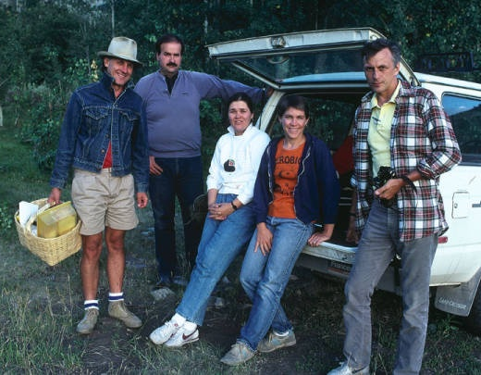
Grouse Creek Cultural Survey
In the summer of 1985 a team of folklife specialists (folklorists, architectural historians, & historians) from the Library of Congress and Utah spent a couple of weeks living in Grouse Creek, interviewing its people and recording its history and culture. This impressive collection is housed at USU SCA and is part of our digital library.
Research team: Tom Carter, Hal Cannon, Carol Edison, Debbie Randall and Carl Fleischhauer.

Slide 13
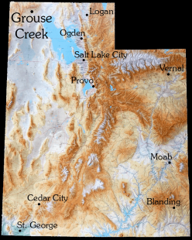
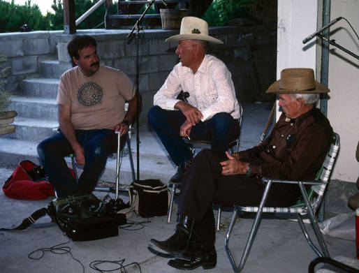
Max & Merlin Tanner interview from GCCS
Grouse Creek is in the North East corner of Utah
Ranch Life
Folklorist Hal Cannon interviewing Max and Merlin Tanner.

Slide 14
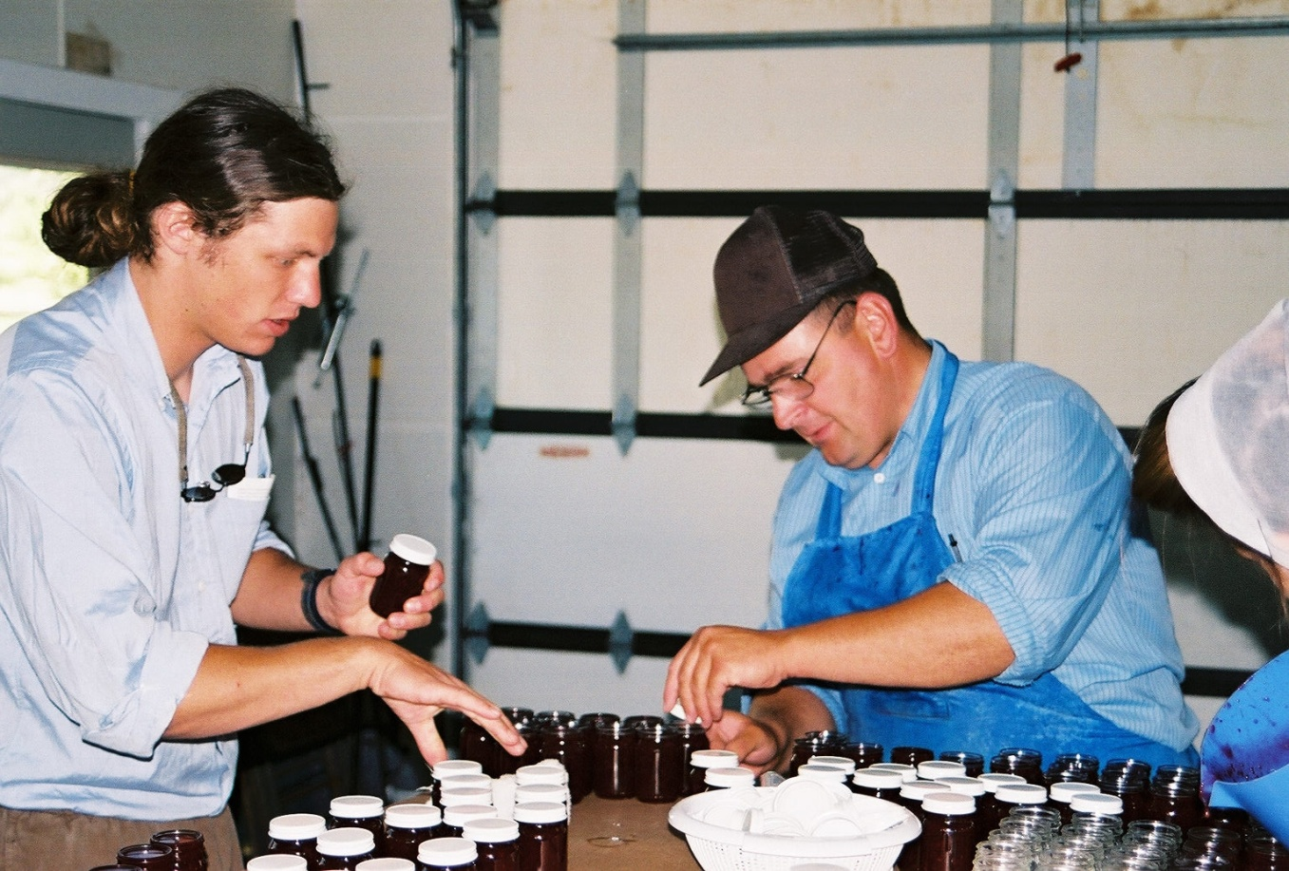
Living Traditions of the Bear River Heritage Area Collection
The collection documents the natural, cultural and economic heritage associated with the heritage of the Bear River area, which consists of three counties in northern Utah and four counties in southeastern Idaho that make up the Bear River drainage.
Michael Ward takes a break from interviewing Philip Lehman and helps him screw on lids of freshly made jam in Garland, Utah.

Slide 15
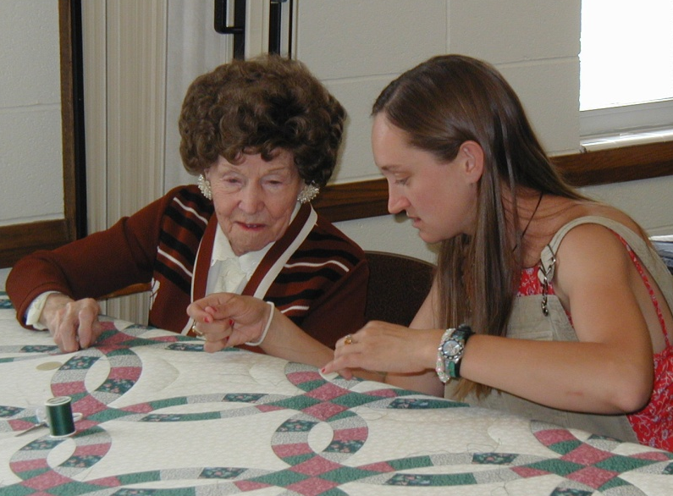
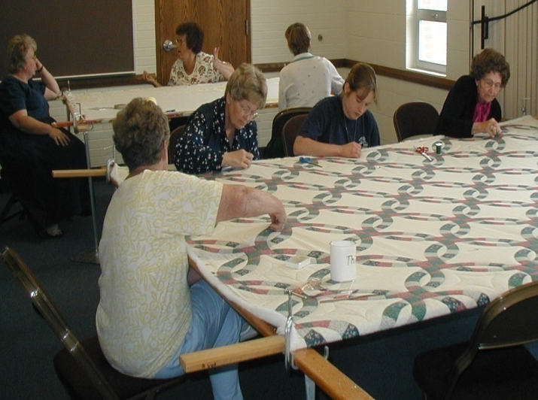
Fern Pope Interview from LTBRHA
Fern Pope teaching quilting to interviewer Sally Haueter.
Garden City quilting bee.

Slide 16
Elisaida Méndez
“As a member of this community, and as a direct contributor to the project’s fulfillment, I cannot think of a better way to bring the Latino community to light, with its qualities and strength of character that have helped us forge a present and a future in a western corner of a great nation. The Latino Voices Project is making justice as it enhances the quality of education, promotes further research and connects generations through the years.” Elisaida Méndez
Assistant Director of the Latino/a Voices Project & Doctoral Student in Combined Psychology at Utah State University. Ellie directed the ethics training at the oral history workshop, oversaw all the fieldworkers conducted interviews and was interviewed

Slide 17
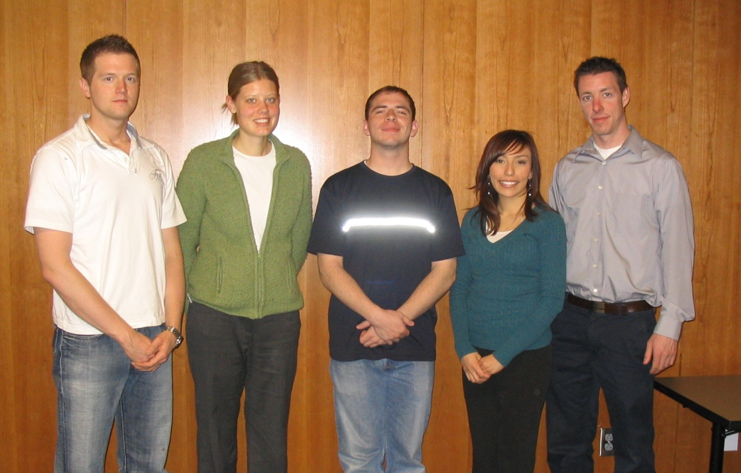
Latino/a Voices Project
The LVP is an effort to collect the oral histories of Cache Valley Latino/a citizens as a means to more fully represent this vibrant community in Utah State University's Special Collections. The collection will be preserved in a traditional archival collection and in a digital archive.
A few of the LVP interviewers: Nate Allred, Mary Gedge, Daniel McQuiston, Rubi Rodriquez and Shane Russell.

Slide 18
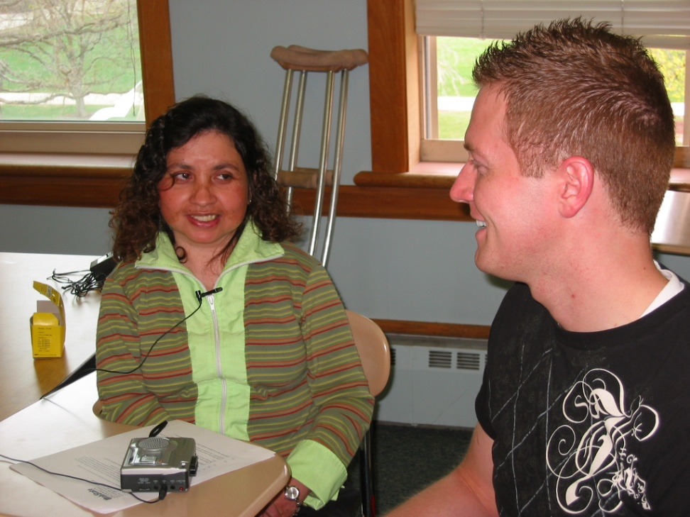
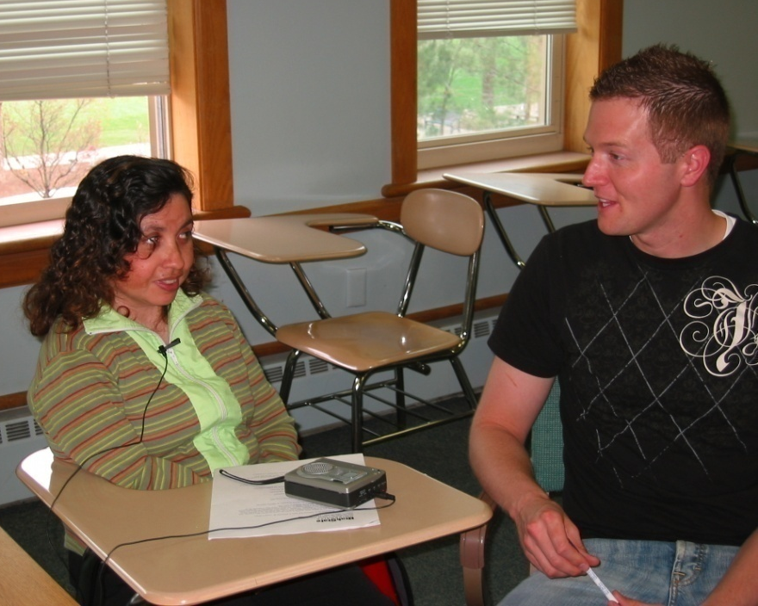
Clara Galeano interview from LVP
Clara Galeano being interviewed by Nathon Allred.

Slide 19
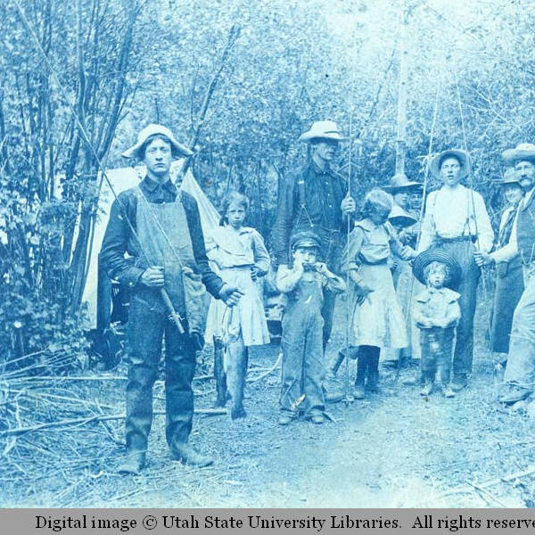
USU Land Use Management Oral History Project
This project will document, primarily through oral histories, aspects of land use and management in the Interior West, beginning with Logan Canyon and moving outward.
Fishermen in fishing gear holding their catch, circa 1920.

Slide 20
Target Groups
USU trained and/or faculty members of land use & management scientist.
.
Regional land managers and land users on both public and private lands:, such as Forest Service, National Park Services, Bureau of Land Management, Ranchers and farmers
Advocacy groups, including private or nonprofit conservation groups, wise use groups, such as Sierra Club, Audubon Society, snowmobilers associations, hunting groups
And, recreational and aesthetic land users, such as campers, hikers, kayakers, fishers, mountain bikers, skiers, hunters, trappers, snowcavers, etc.

Slide 21
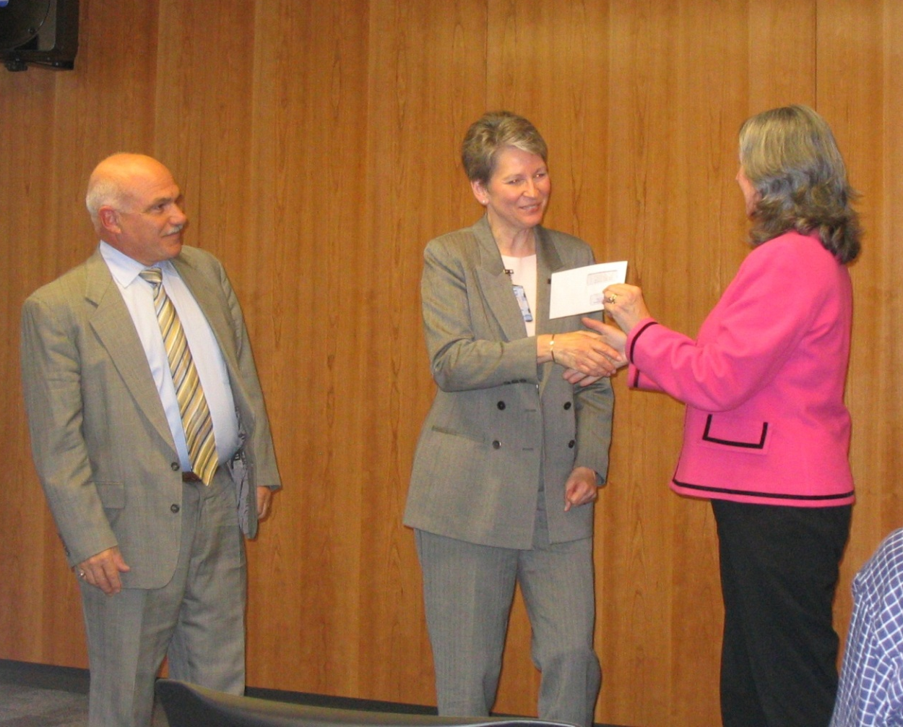
Our Generous Oral History Sponsors:
Marriner S. Eccles Foundation
Utah Humanities Council
Utah State Division of History
Mountain West Center for Regional Studies
Utah State Historical Records Advisory Board
Merrill-Cazier Library
Retired Vice Provost for Library Linda Wolcott (middle) receiving a check for $3,000 from Cynthia Buckingham, Director of the Utah Humanities Council and Phil Notarianni, Director of the Utah State Division of History, for the Latino Voices Project.

Slide 22
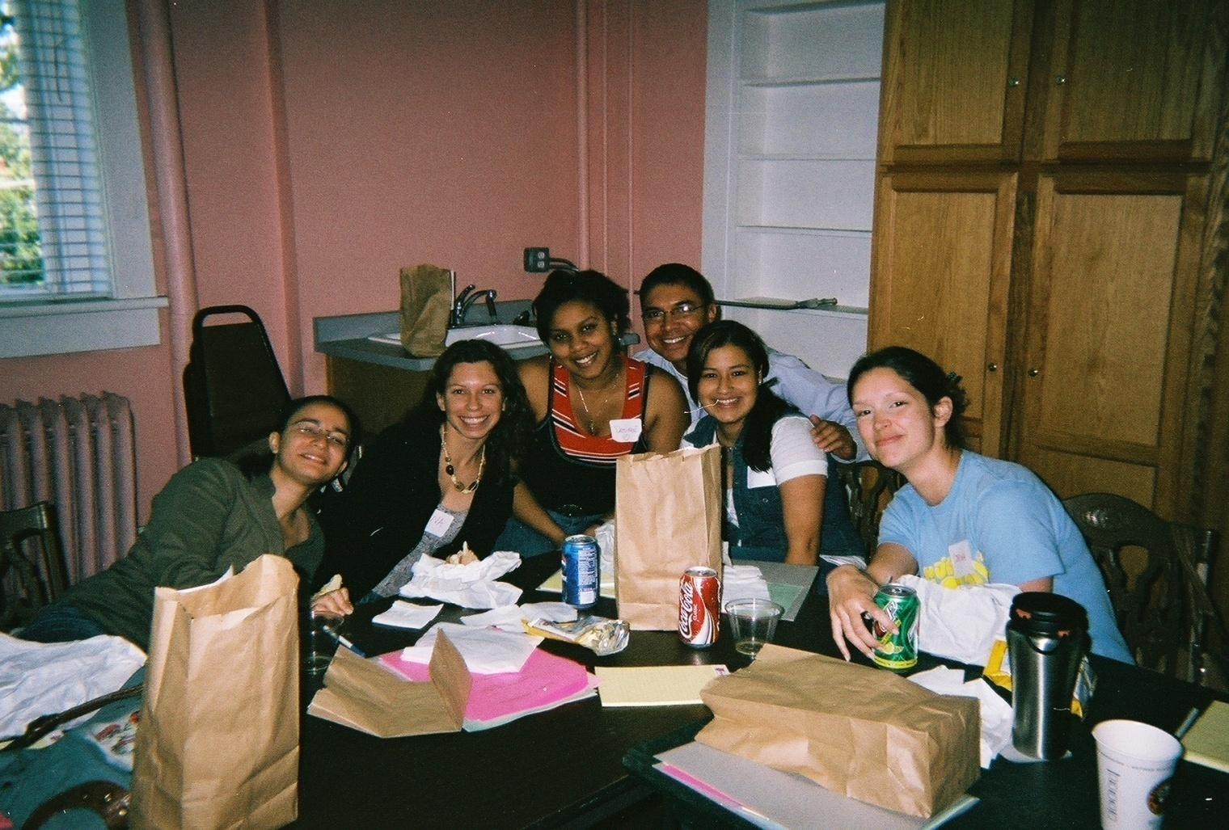
A few participants at the Latino Voices Oral History Workshop,
June 2007.
HOW CAN YOU HELP?
Participate in an oral history workshop and conduct oral histories
Be interviewed.
Donate money to USU’s Northern Utah Speaks projects.

