Slide 1
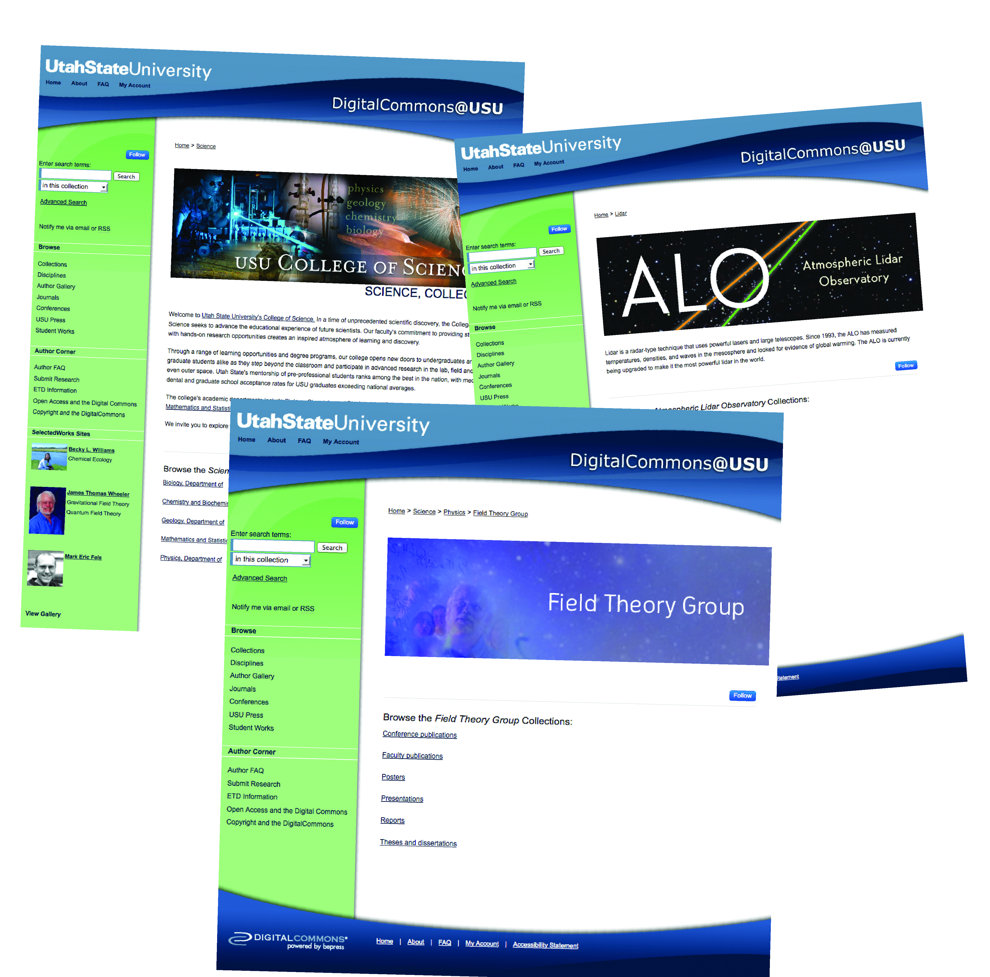
Ask for
a logo!
Promoting Physics Faculty, Students and Research through
the Library’s Institutional Repository
Ask for
a logo!
Betty Rozum and Andrew Wesolek, Merrill-Cazier Library, Utah State University
What is an Institutional Repository?
Focus on Students
scholarly works, research, reports, publications
Publication Pages for Students and Faculty
The DigitalCommons, the institutional repository at Utah State University, extends access to the scholarly works, research, reports, and publications of the faculty and students of USU by hosting these works freely online. In addition, the repository hosts numerous items that were previously unavailable outside of a researcher’s close group of colleagues.
Institutional repositories around the world, such as the DigitalCommons, increase access and impact of scholarly works through heightened exposure and free online access.
One of the Library’s goals has been to help student in the Physics Department establish online portfolios where they can present themselves to future employers or graduate schools. DigitalCommons uses a software product called Selected Works that allows the Library staff to create a site for each student. The student then maintains the site with publications, posters, classes taught, updated curricula vitae, etc. When the student graduates, the USU branding is removed, but the site is still active and remains so for them to use as long as they like. This provides a place for them to curate their publications and presentations.
For the Library, this provides an opportunity to educate students about the importance of copyright and author rights. Such efforts are of increasing importance as more of our research is shared, often freely, over the Internet.
“As a graduate student, I have found that working with the library to create and update my Selected Works site early in my career has been a very useful experience. Being able to send old professors, mentors and new colleagues one link to all of my academic work has made keeping people up-to-date on my current research efforts very simple.”
-Leda Sox, Ph.D. Candidate in Physics, Utah State University
“Within the DigitalCommons, things like posters that normally are not available, have now had exposure”
-Vincent Wickwar, Professor of Physics, Utah State University
Focus on Content
All Physics scholarship available in one location:
Journal articles, conference papers, etc.
Videos of lectures
Posters and presentations
Books
All materials organized by research group
Research groups provide links to all faculty and student Selected Works sites
Focus on Impact
Total content of DigitalCommons >32,000 records
Total full text downloads > 1.2 Million
Full text downloads of all physics publications: >20,000
Full text downloads of presentations, many of which were previously unavailable: >1,000
Full text downloads of previously unavailable posters from the Atmospheric Lidar Observatory Research Group >700
Full Text downloads the book Foundations of Wave Phenomena >750 in four months
Access via Google or another search engine: nearly 70%
Access from 147 different countries
Focus on Research Groups
Not content to utilize the repository as a simple “place to put stuff,” the Library and the Physics Department developed a partnership to transcend traditional repository structures and emphasize faculty research groups, including the key student researchers within the department.
While many academic institutions collect the theses and dissertations of their graduate students, it is less common to see the published papers and conference presentations from graduate students and undergraduates archived in the repository to represent the collected work of a research group.
This approach offers many benefits. For the research group, the body of work is in one location and they are able to showcase to potential students and faculty hires the work and research of their program, presumably making it easier to demonstrate why their program would be a good fit for a candidate. The department has a way to quickly hightlight the areas of active research of their faculty and students. For Utah State University, which has the second oldest undergraduate research program in the nation, this is an effective way to demonstrate student-faculty research involvement. Finally, making the outputs of the research process publicly and freely available for the community may be appealing to funding agencies that wish to make certain the research reaches the broadest audience possible.
Focus on Benefits
Increased exposure to research (optimized for Google, Google Scholar)
Secure, public, legal access to research
Student work is captured and archived
Research groups keep faculty and student work together for long term preservation
Research groups maintain a complete body of scholarship to highlight their work
Students build an online presence and archive of their scholarship
Setting up an IR
Generally, the Library manages the Institutional Repository, so check with your librarian to see if plans are underway to establish one. Basic requirements to launch an IR include software, such as DigitalCommons, Fedora, or Dspace, and staff with knowledge of copyright and publisher practices.

