Slide 1
Navigating the World of Copyright and Permissions, Part I: Authors’ Rights Initiatives
Jennifer Duncan, Head of Collections
Betty Rozum, Associate Dean for Technical Services
March 8, 2012

Slide 2
Introduction & Background
The problem
Online environment and copyright – easy to violate copyright
The solution
Easily accessible copyright resources
Create a Copyright Team

Slide 3
Our Approach
Create Campus Copyright Committee
Called upon people from various areas of library AND campus:
E-Resources
Interlibrary Loan
Licensing
Faculty assistance center
IT Security
Course Pack (Bookstore)
Course Management System
University Press
Student Government
Technology Commercialization

Slide 4
First things first…Training & Education (no JD’s here)
Members level of understanding of copyright varies
Purchased webinars, promoted to campus
Fair amount of self-education and peer education of committee members via meetings and discussions

Slide 5
Gaining Expertise
The Library sends a member of the Committee each year for Copyright Certification
University of Maryland University College, Center for Intellectual Property
http://www.umuc.edu/cip
Notes:
Jennifer

Slide 6
How Have We Reached Out to the Campus?
Webinars
Email
OA Week
Promotional Material
Copyright@USU Website
Presentation for the Faculty Assistance for Classroom Teaching (FACT) Series
Roadshows

Slide 8
SECURING THE SCHOLARLY RECORD
This work is licensed under the Creative Commons Attribution 3.0 Unported License. To view a copy of this license, visit http://creativecommons.org/licenses/by/3.0/
This work is licensed under the Creative Commons Attribution 3.0 Unported License. To view a copy of this license, visit http://creativecommons.org/licenses/by/3.0/

Slide 9
Securing the Scholarly Record
http://digitalcommons.usu.edu/lib_present/20/
Elements of a contract
Grants Clause
Warrants Clause
Indemnity Clause
Other Rights
SPARC Addendum
Open Access
Depositing in the Institutional Repository

Slide 10
Know Your Contract
The Grant Clause
This prevents you from contracting with multiple publishers … It may also prevent you from posting to your website or IR.
You may want the publisher to secure copyright in YOUR name.

Slide 11
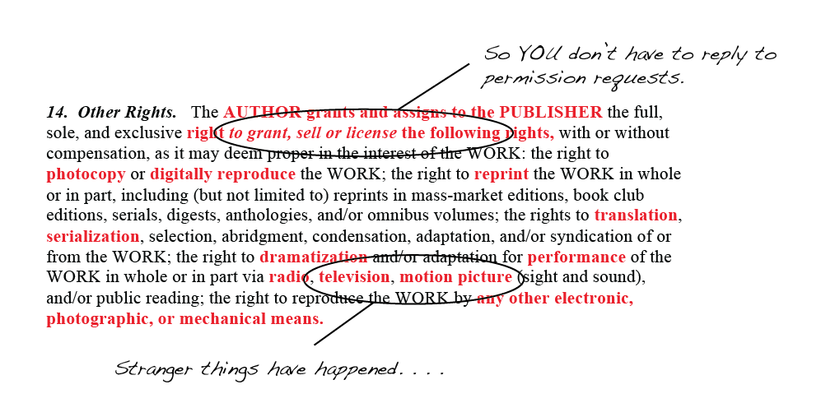
Know Your Contract
Other Rights
So YOU don’t have to reply to the permissions requests.
Stranger things have happened …

Slide 12
What Should You Keep?
Keep your own archive of your publications
Copy of contract
Copies of correspondence with the publisher
Versions of papers that are accepted (LOTS!)
Preprint (submitted final copy)
Final edited refereed copy (author’s post print)
Final proof (post print)

Slide 13
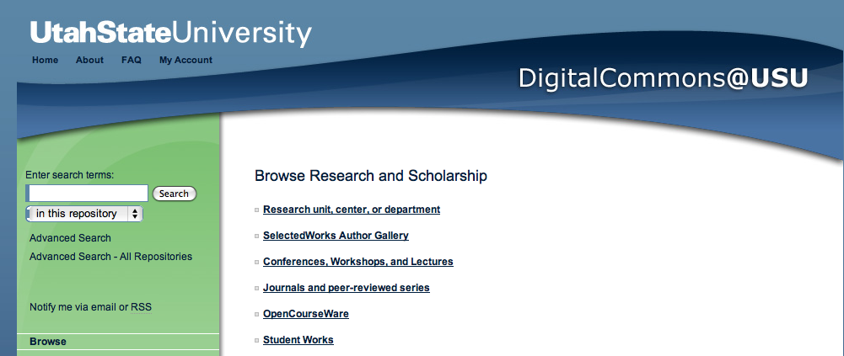
Promote Your Own Open Access
Contact the Library to deposit a copy of your paper in Digital Commons

Slide 14
FAIR USE IN TEACHING
(Or, How Not to Break the Law
In Your Classroom)
This work is licensed under the Creative Commons Attribution 3.0 Unported License. To view a copy of this license, visit http://creativecommons.org/licenses/by/3.0/

Slide 15
Fair Use in Teaching
http://digitalcommons.usu.edu/lib_present/19/
Four Factors of Fair Use
Face to Face and Online Instruction
TEACH Act
Format of materials used
Permissions
Gauging Risk

Slide 16
Linking is better
One of the best ways to avoid copyright infringement is…
to provide a link
instead of downloading and reposting.

Slide 17
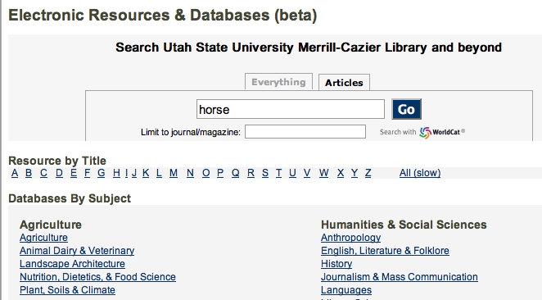
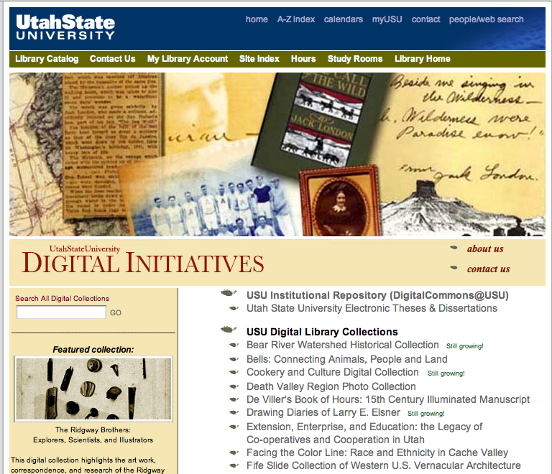
Other Library resources to link to…
Databases, digital objects, images, and more

Slide 18
The Roadshows
Roadshows
8 presenters (teams of 2)
15-min./presentation + 15-min. Q & A
21 out of 44 departments in 2 months (approx. 48%)
Fair Use: 11
Securing the Scholarly Record: 6
Both: 6
Very strong and positive feedback

Slide 19
Results We’ve Seen
Faculty appreciated the outreach and take advantage of the mail list to ask copyright related questions
Many faculty are genuinely surprised at the limitations imposed upon them by the copyright transfer agreements they have signed
Most faculty have been eager to participate in our IR. The Department of Special Education and Rehabilitation, immediately signed on and had us input all faculty vitas and publications

Slide 20
What We See Down the Road
We need to keep educating ourselves
We need to keep this in front of faculty, reminding them of scholarly communication issues
We need to work with undergrad and grad students to help them understand the importance of depositing their work in institutional repositories
We need to continue to educate our subject librarians so they are comfortable discussing these issues with their faculty members

Slide 21
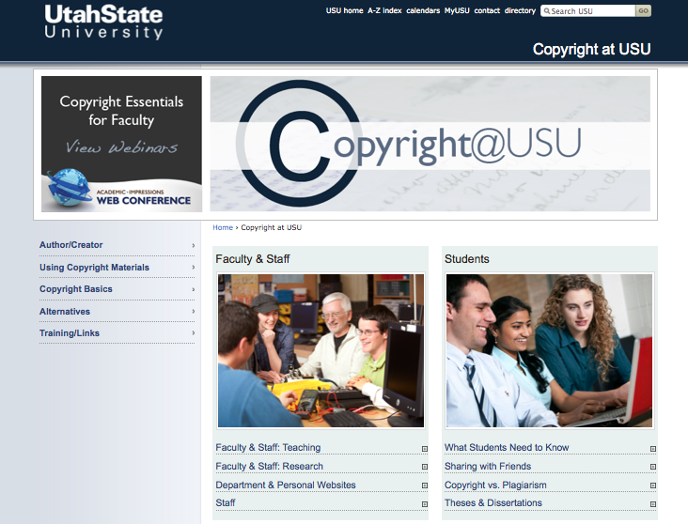
QUESTIONS
COPYRIGHT@USU.EDU

