Slide 1
Opening the Backlist at Utah State University
Richard W. Clement
Dean of Libraries
Utah State University

Slide 2
Utah’s land-grant university, founded in 1888 29,000 students; 1,000 faculty; six campuses 200 undergraduate, 90 masters, and 35 doctoral programs Open Access policy adopted 2012
Utah State University

Slide 3
Merrill-Cazier Library
New facility completed in 2005, 305,000 ft²
nearly 2 million volumes
Automated storage and retrieval system with the capacity for over 1.5 million new volumes
Information Commons with 150 workstations and 35 group-study rooms

Slide 4
USU Libraries
Three libraries on six campuses
Strong emphasis on e-content: 200 databases, 50,000 e-journals, 3 million ebooks
DigitalCommons, 31,000 items; over 1 million full-text downloads
USU Press is a department of the Library
Member of HathiTrust contributing USU Press backlist

Slide 5
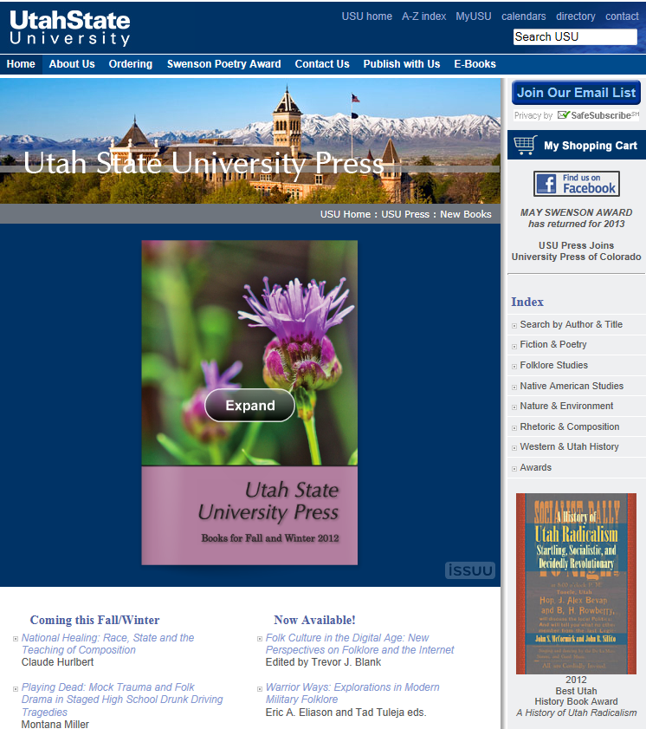
Founded 1972
Became part of the Library 2010
Joined the University Press of Colorado 2012
Publishes 20 books/year
Backlist Open Access in DigitalCommons and HathiTrust
One year embargo on frontlist before OA

Slide 6
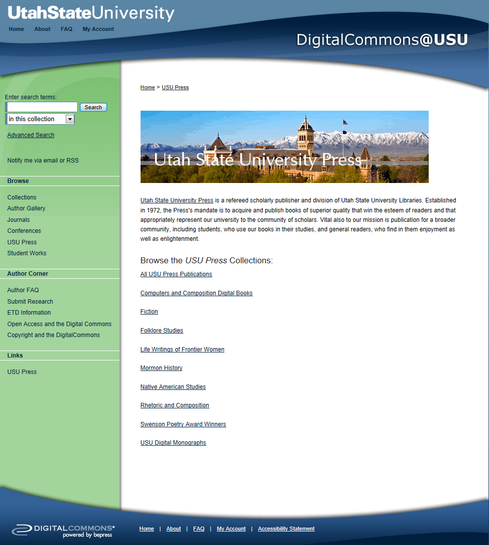
133 titles from the last 20 years

Slide 7
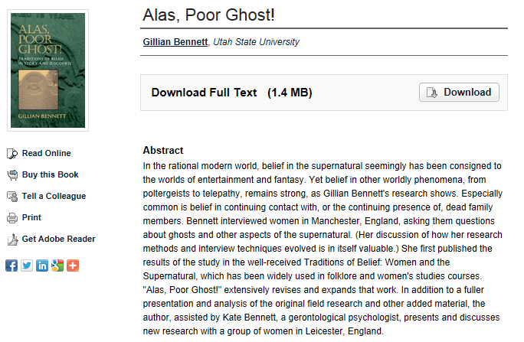

Slide 8
What Effect Does Open Access Have on Backlist Sales?
Does the availability of Open Access versions depress sales of backlist books?
OR
Does the availability of Open Access versions increase sales of backlist books?

Slide 9
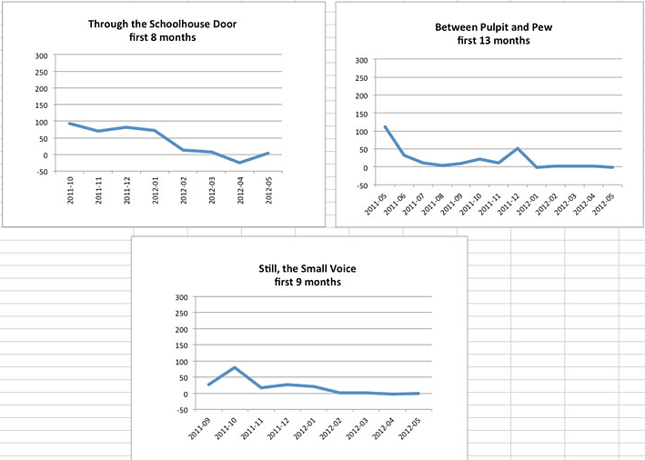
Typical Sales Patterns

Slide 10
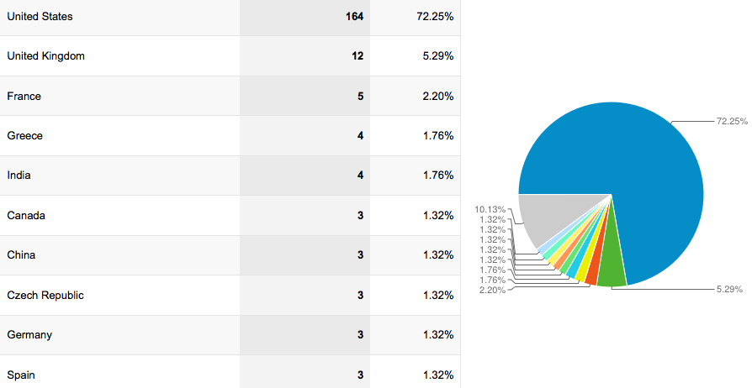
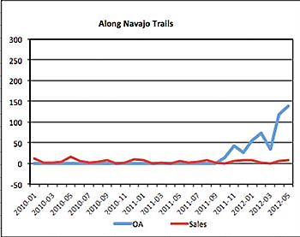
OA & Backlist Sales
27.75% International
2005

Slide 11
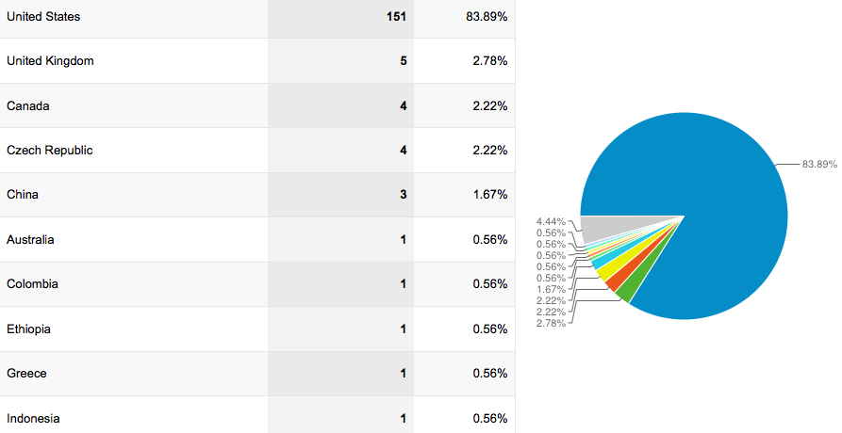
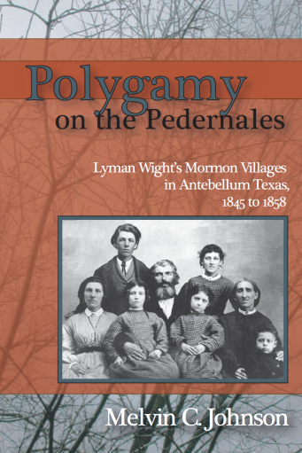
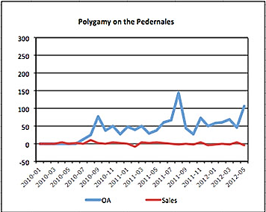
OA & Backlist Sales
16.11% International
2006

Slide 12
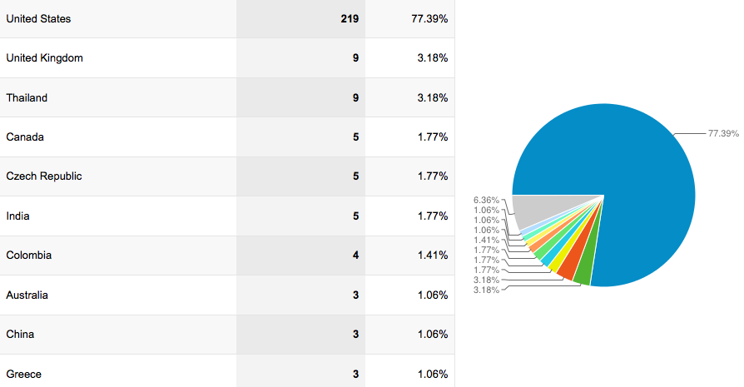
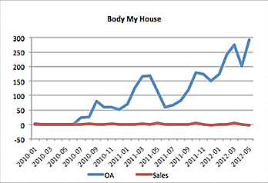
OA & Backlist Sales
22.61% International
2006

Slide 13
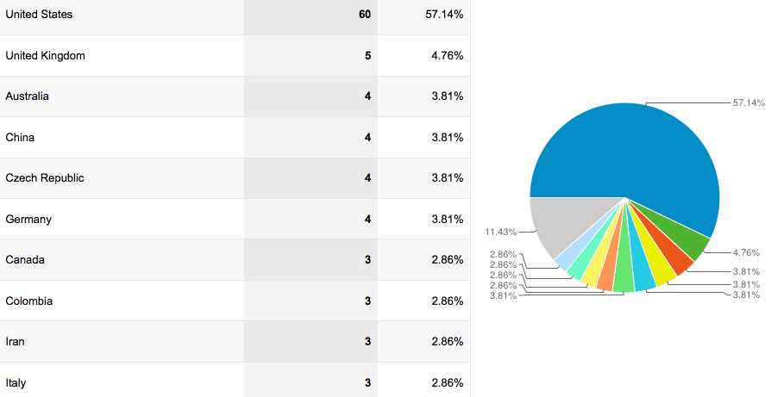
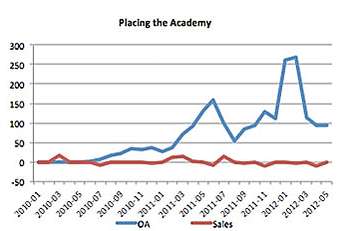
OA & Backlist Sales
42.86% International
2007

Slide 14
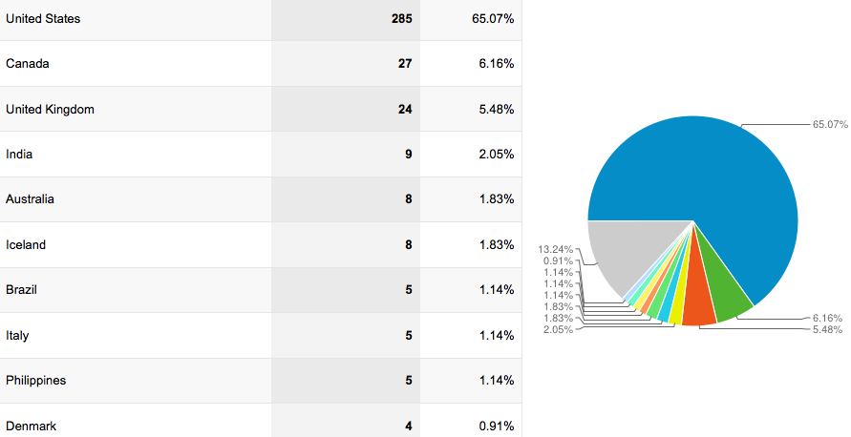
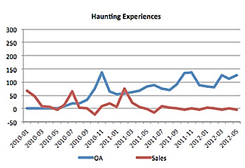
OA & Backlist Sales
34.93% International
2007

Slide 15
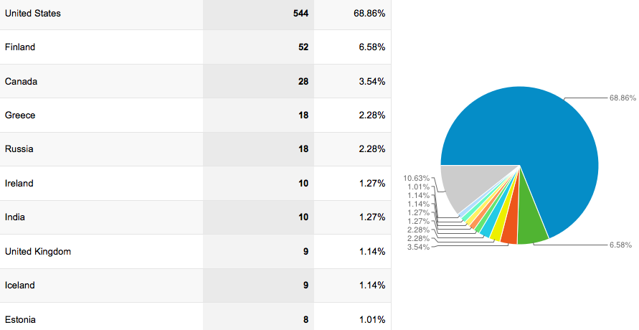
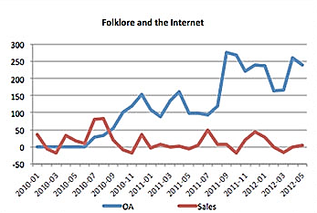
OA & Backlist Sales
31.14% International
2009

Slide 16
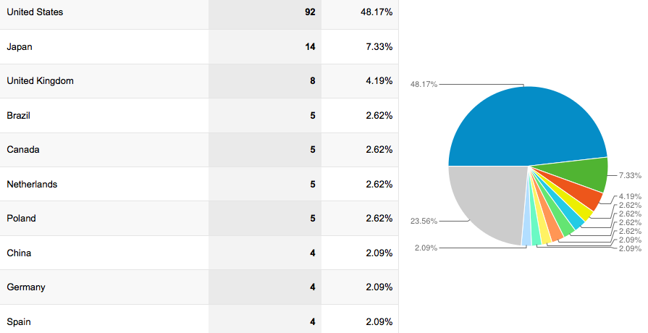
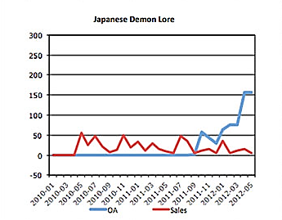
OA & Backlist Sales
51.83% International
2010

Slide 17
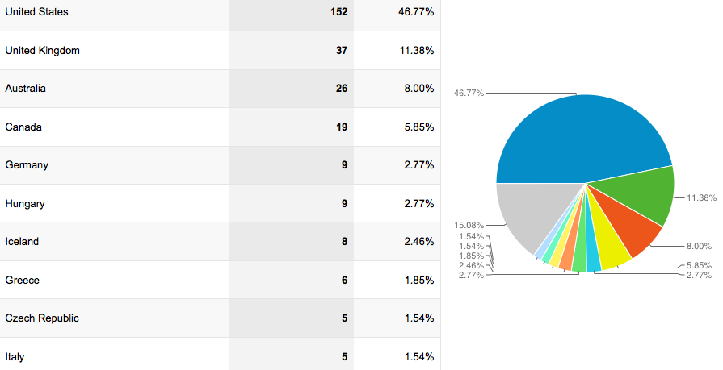
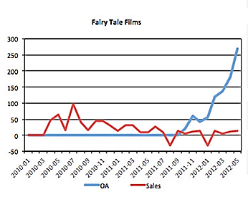
OA & Backlist Sales
53.23% International
2010

Slide 18
Tentative Answers
Does the availability of an Open Access version depress sales of backlist books? No, but we need more data…
Does the availability of Open Access versions increase sales of backlist books? Not in this study, but we need more data. This is still an open question.

Slide 20
Other Conclusions
Open Access gives new life to “dead” backlist titles.
Open Access significantly broadens the geographical distribution of titles.

Slide 21
Pending Questions
Can Open Access create a new revenue stream for backlist titles?
Can an Open Access version co-exist with a frontlist title without a negative impact on sales?
Can Open Access attract new customers to purchase both frontlist and backlist books?

