Slide 1
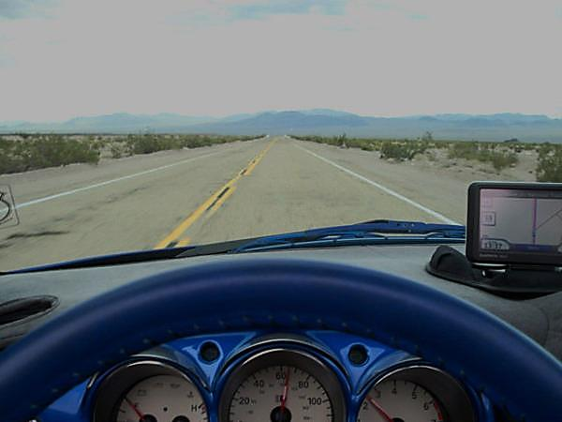
U.S. Highway 89 Cross Section of the West: A Collaborative Digital Exhibit- Looking at the Model of the NPS Route 66 Archives and Research Collaboration.
Joint Meeting of the Conference of Inter-Mountain Archivists and the Society of Rocky Mountain Archivists
May 22-25, 2013
Salt Lake City, UT
R. Sean Evans
Cline Library
Northern Arizona University

Slide 2
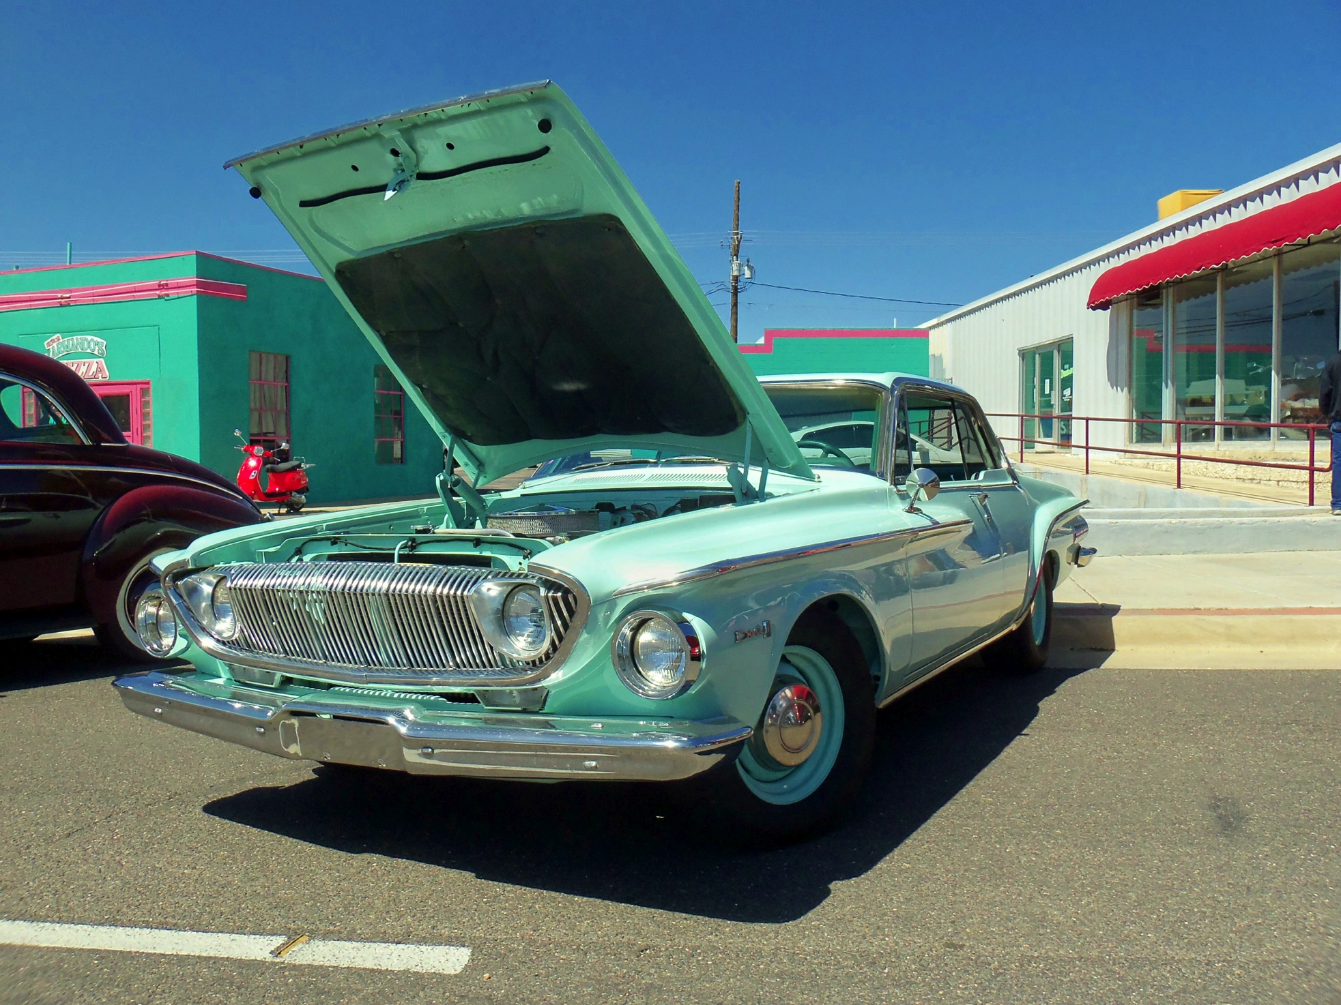
Route 66, archives, and the NPS
Congress passes: Public Law 106-45 “An Act To preserve the cultural resources of the Route 66 corridor and to authorize the Secretary of the Interior to provide assistance.” creating the Route 66 Corridor Preservation Program.
“The Program collaborates with property owners to identify, prioritize, and address Route 66 preservation needs. It provides cost-share grants to successful applicants for the preservation and restoration of the most significant and representative properties dating from the route’s period of outstanding historical significance, 1926 through 1970.”
To bring more attention to the historical record of Route 66, the National Park Service (NPS) is collaborating with archival institutions along the route to develop the Route 66 Archives and Research Collaborative, or “Route 66 ARC”. The mission of Route 66 ARC is to stimulate the collection and preservation of historical records, and increase their accessibility to the public.

Slide 3
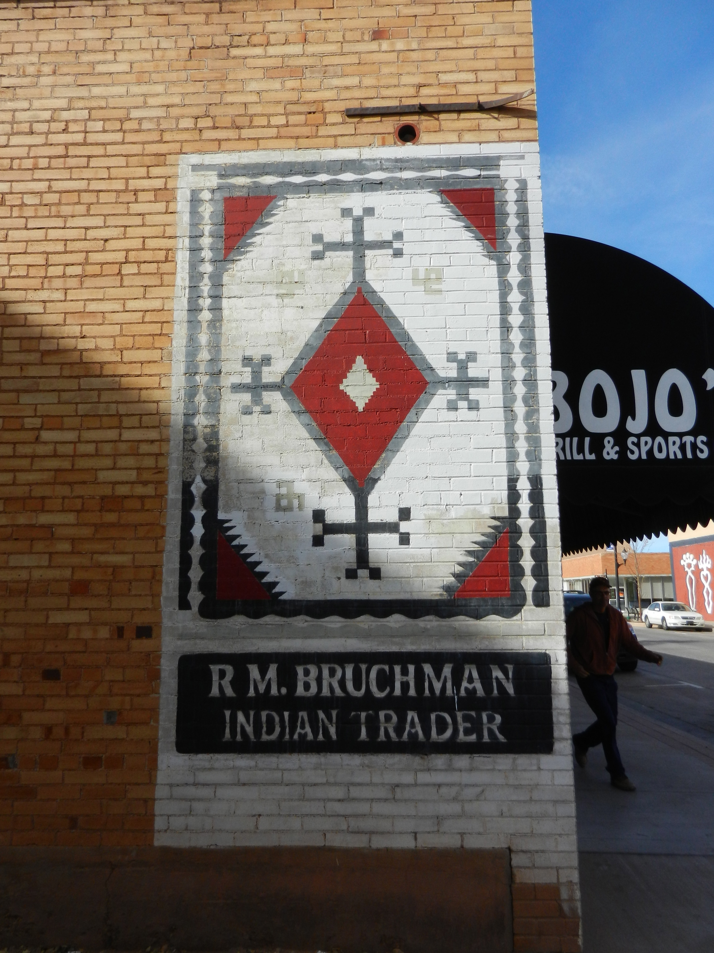
NPS Route 66 Archives and Research Collaborative
The NPS Route 66 ARC is the acknowledgement that “preservation” goes beyond the physicality of the road.
The 10 libraries, archives and museums that compose the ARC membership must:
Agree to the general goals of the ARC- providing unfettered public access; work on ARC agreed projects like conducting a state survey; actively collecting and promoting on Route 66; attending and hosting annual meetings
The relationship is formalized to the extent that the 10 facilities have signed an MOU with the NPS, and the NPS hosts the official NPS/Route 66 ARC website (http://www.nps.gov/rt66/ARC/index.htm). Each facility maintains their own materials; provides access (tangible and digital); provides reference service and engages in unique stand-alone and collaborative projects

Slide 4
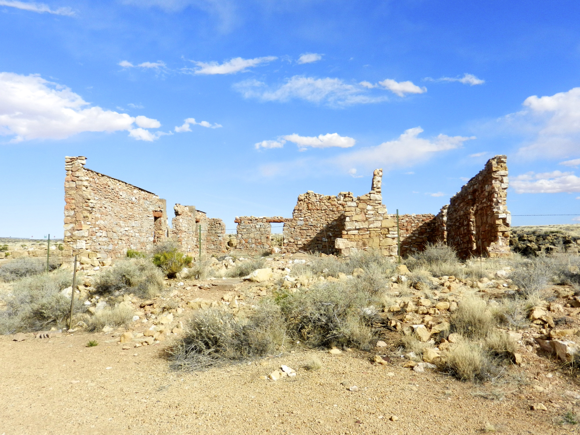
NPS Route 66 ARC realities
Ongoing discussion regarding ARC website and content
Dynamism of the mix of members
Sense of discovery and re-defining of what is Route 66
Development of curriculum around Route 66
Relative value of state-level surveys
Inability to share granting opportunities across ARC membership
Evolving ARC membership models
Inability to create a single web-based service point for researchers
Question remains about post- NPS Route 66
Corridor Preservation Office environment

Slide 5
What have we learned about Route 66 and archival work that may apply to U.S. HWY. 89?
Highways are a remarkably complex subject
66 has a nearly universal acclaim- with commercial authors in the U.S., Germany, Japan, the U.K., France and more
Researchers come in all stripes and proficiencies
NPS ARC members have begun to “create” content- themed web pages & pathfinders, oral history projects, exhibitions
Public displays and projects can be funding generators
Route 66 has helped to develop new curriculum, patrons, partnerships, outreach opportunities, and new material uses

Slide 6
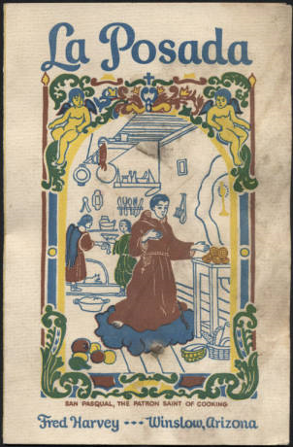
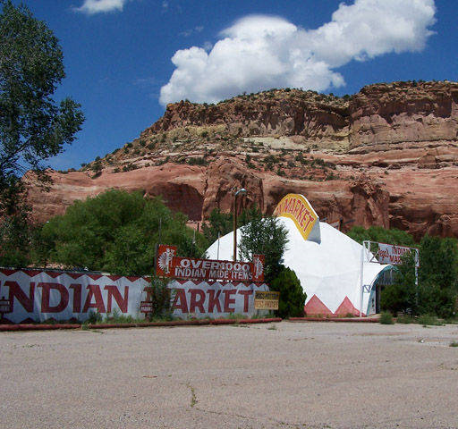
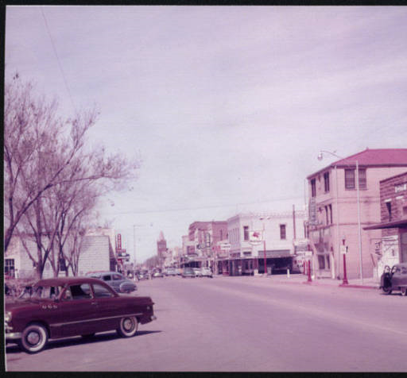
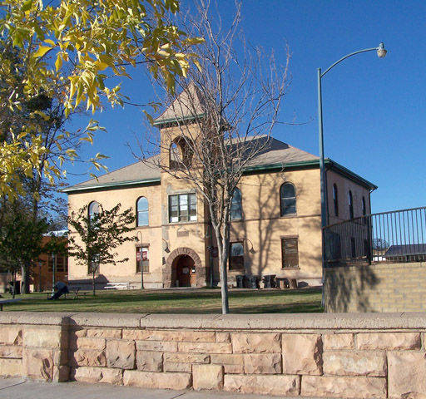
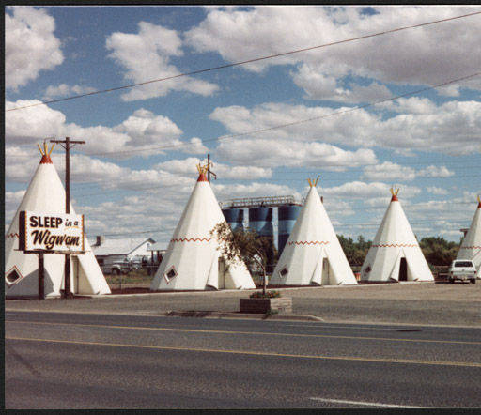
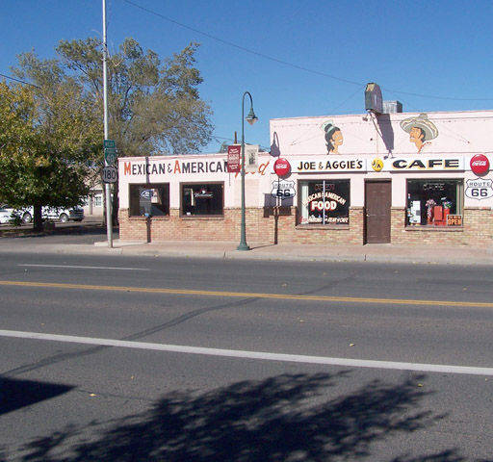
What else have we learned about Route 66 and archival work that may apply to U.S. HWY. 89?
NAU.PH.2013.4.1.10.0.88
NAU.PH.85.3.231.306
NAU.PH.2004.11.2.405
NAU.PH.2004.11.2.387
The most popular parts of Route 66 lie in the West. All of 89 is in the West.

Slide 7
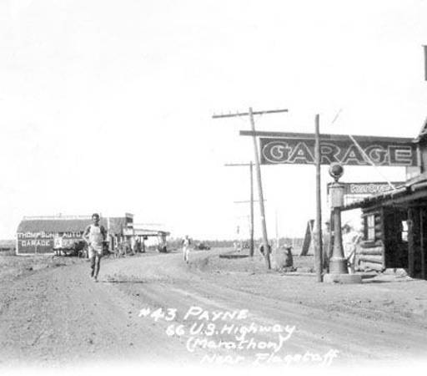
Route 66 & U.S. Highway 89
Questions?

Slide 8
U.S. Highway 89
Cross Section of the West
Notes:
Brief overview of (1) why Highway 89 is important and (2) history of the road

Slide 9
Notes:
*Highway stretches 1600 miles from Piegan, Montana to Nogales, Arizona. Passes through 5 states, Montana, Wyoming, Idaho, Utah, and Arizona.
*Designated by the Bureau of Public Roads in 1926, the highway initially stretched from Nogales to Spanish Fork, Utah, before officials extended the route north to Piegan in 1938. Routed through Ogden, Brigham City, Logan, and Montpelier, Idaho, though Wyoming lobbied heavily for a route through Evanston and Kemmerer (now U.S. 189)
*Major changes include:
*1959-1960: Rerouted through Page, Arizona to facilitate the construction of the Glen Canyon Dam. Original route now known as 89A. Road section on 89 collapsed in February, traffic back on 89A!
*1992: the Federal Highway Administration decommissioned the segment south of Flagstaff, Arizona. (I-17, I-19)
Big difference from Route 66: U.S. 89 remains remarkably intact. Only about 300 miles of its historic 1,600-mile length have been overlaid by interstate.

Slide 10
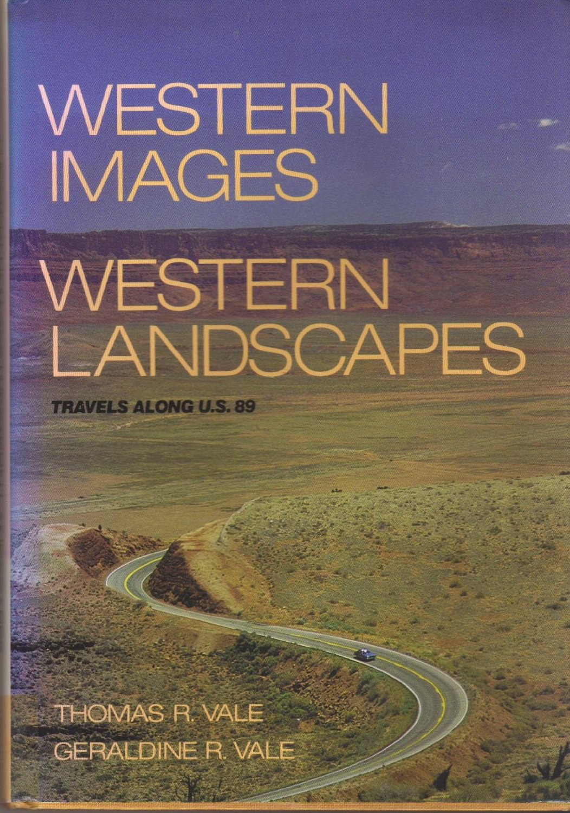
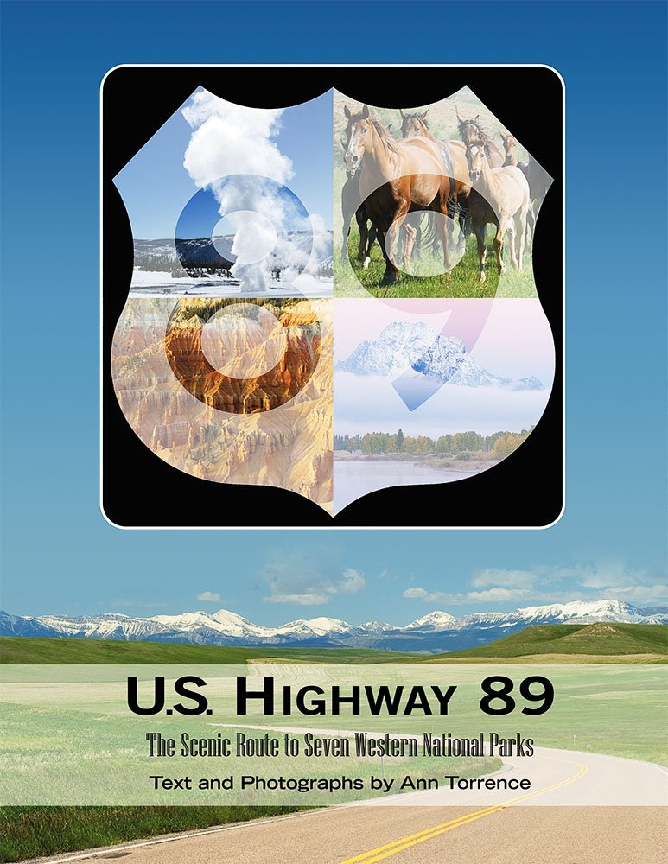
Literature
Notes:
Start out in a seemingly boring way only because it really drives home the two points I want to make here.
Two points:
*Highway 89 exemplifies the West
*Highway 89 deserves greater appreciation enjoyed by east-west routes like Lincoln Highway and Route 66

Slide 11
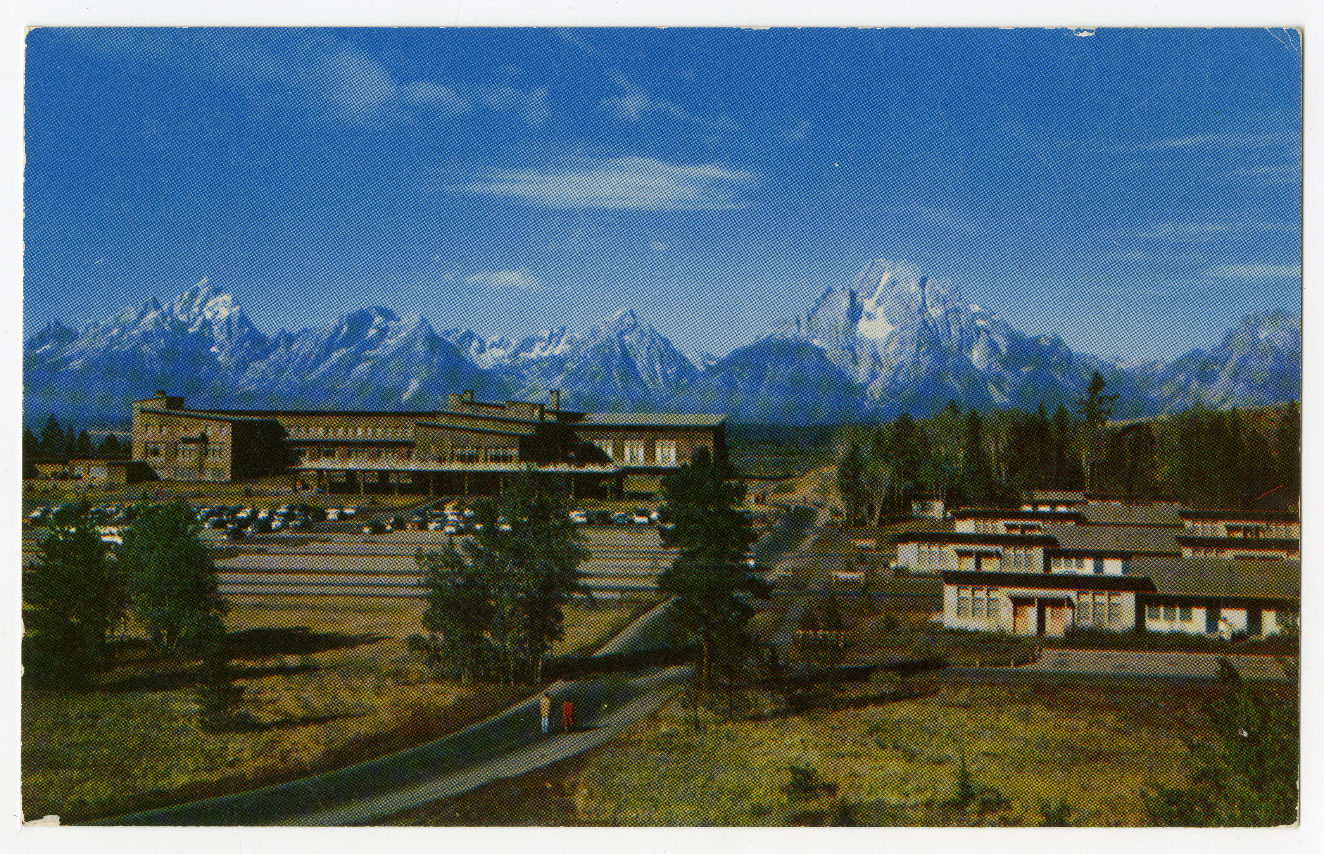
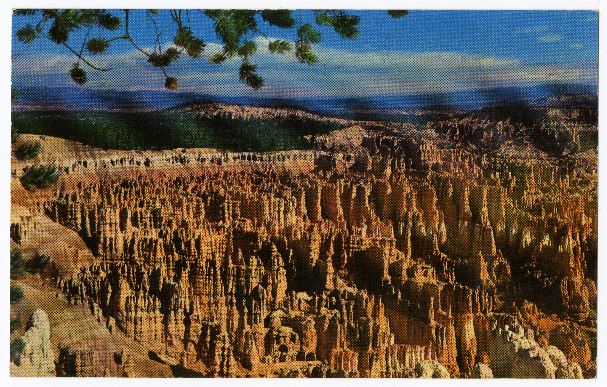
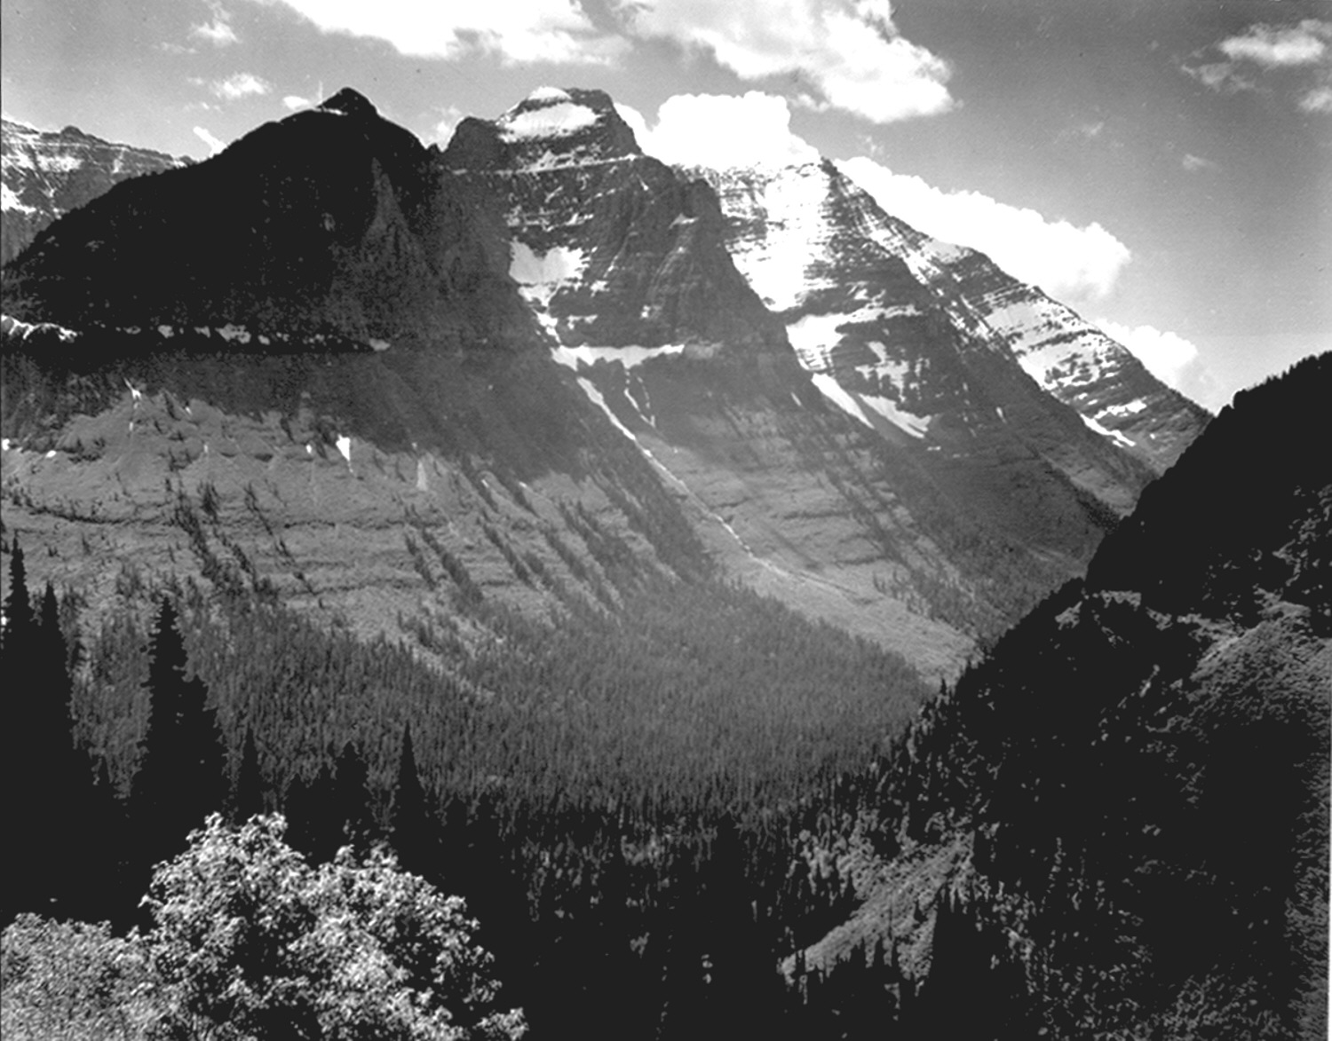
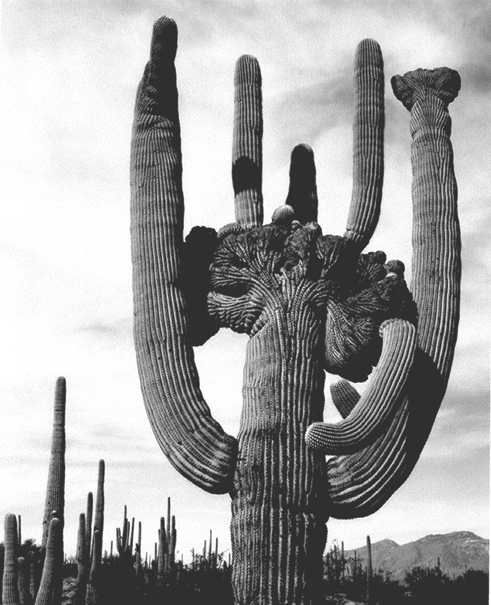
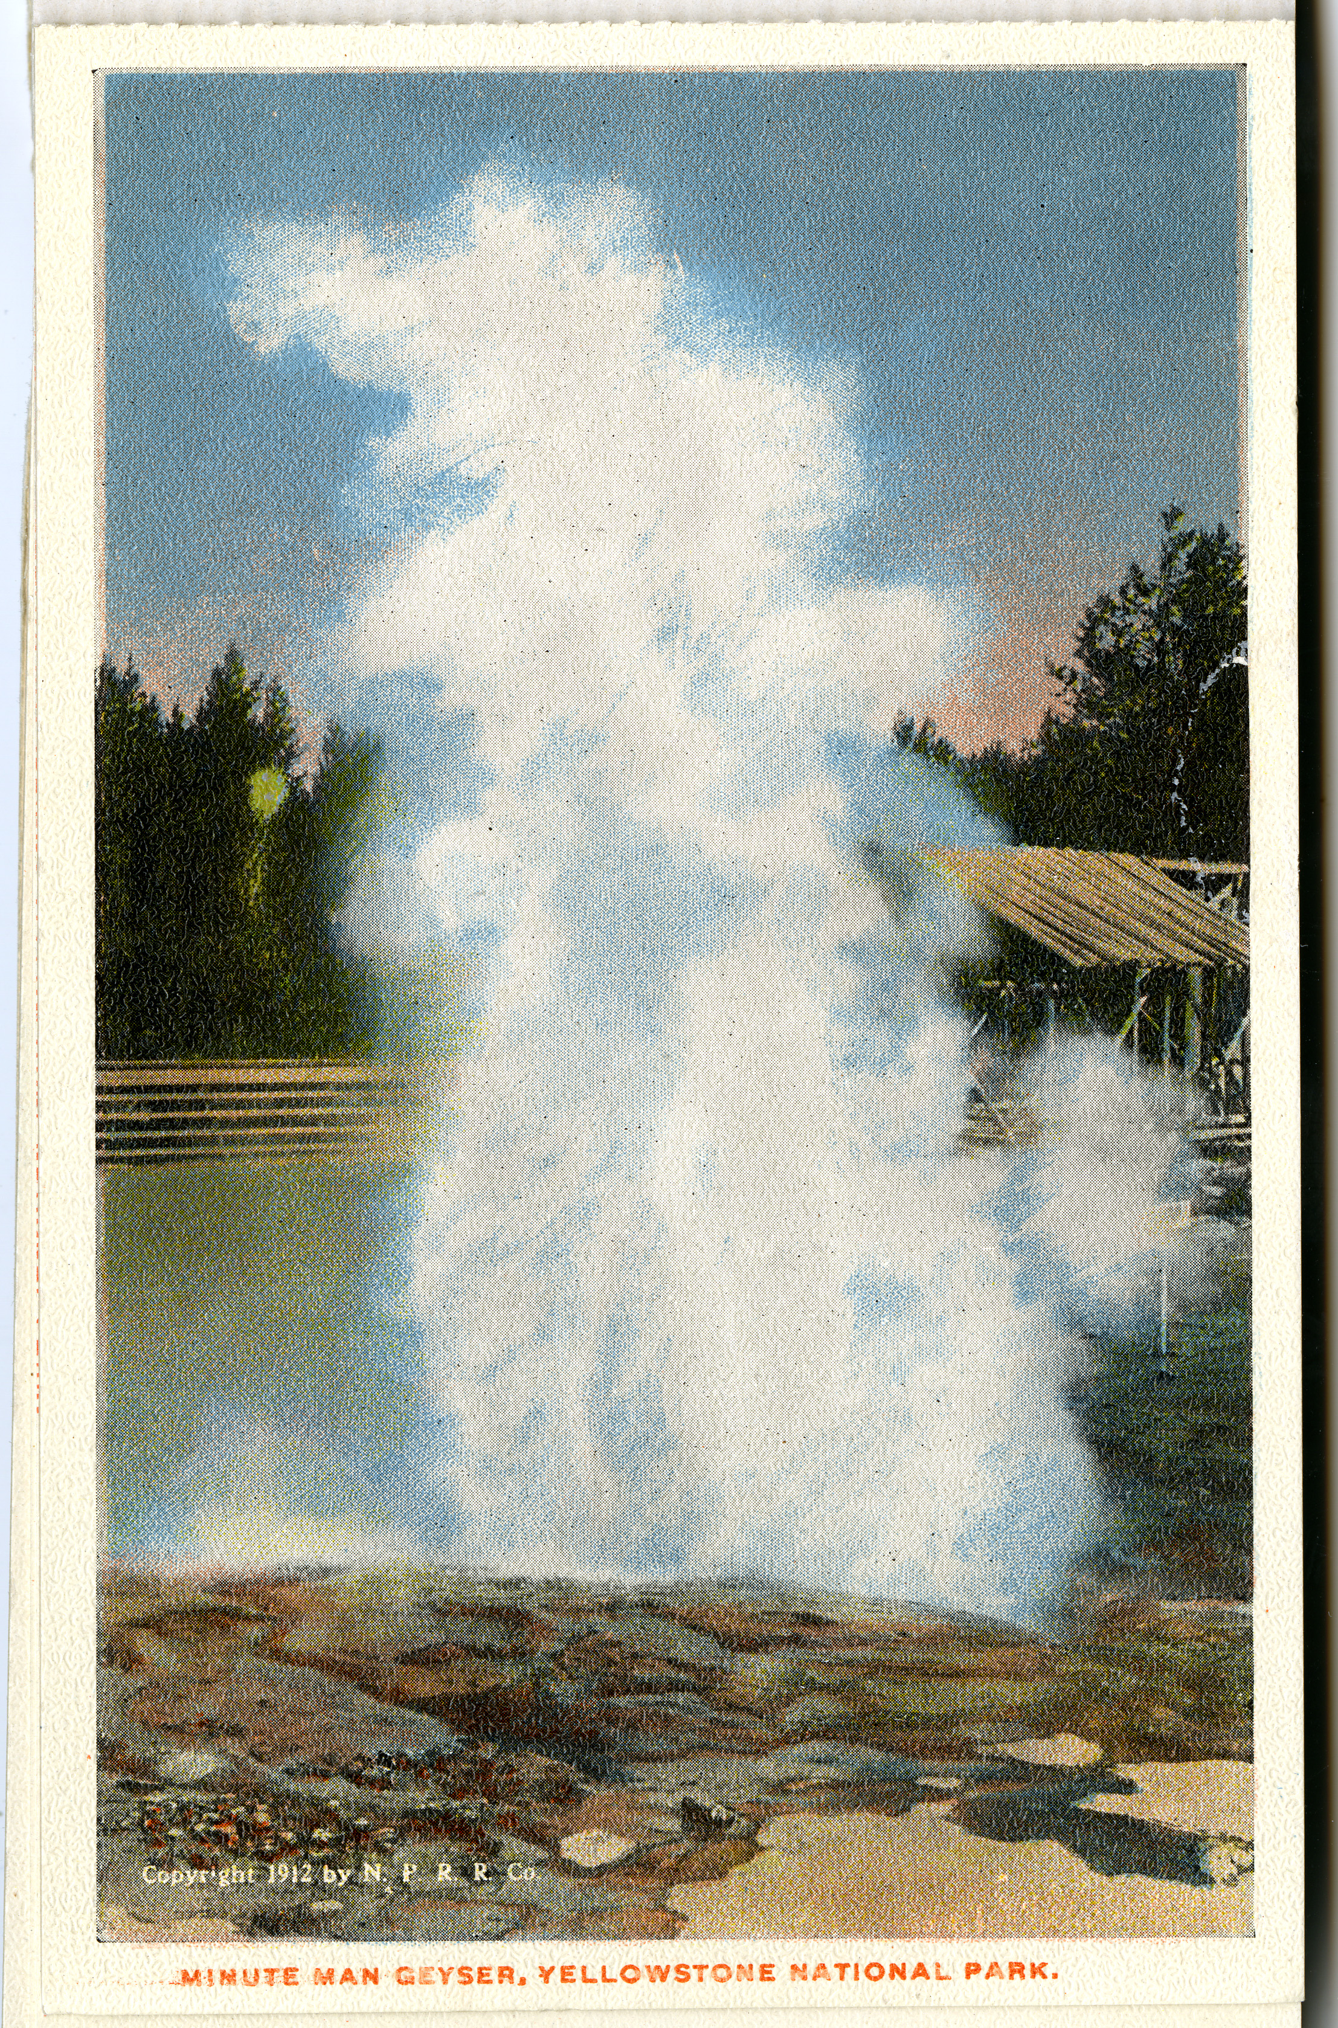
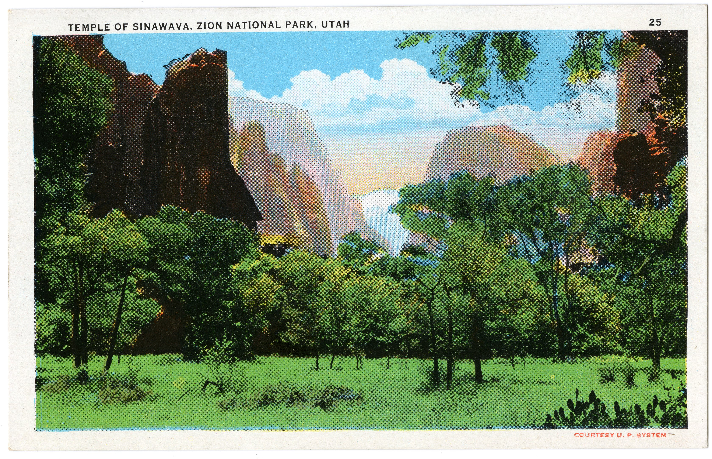
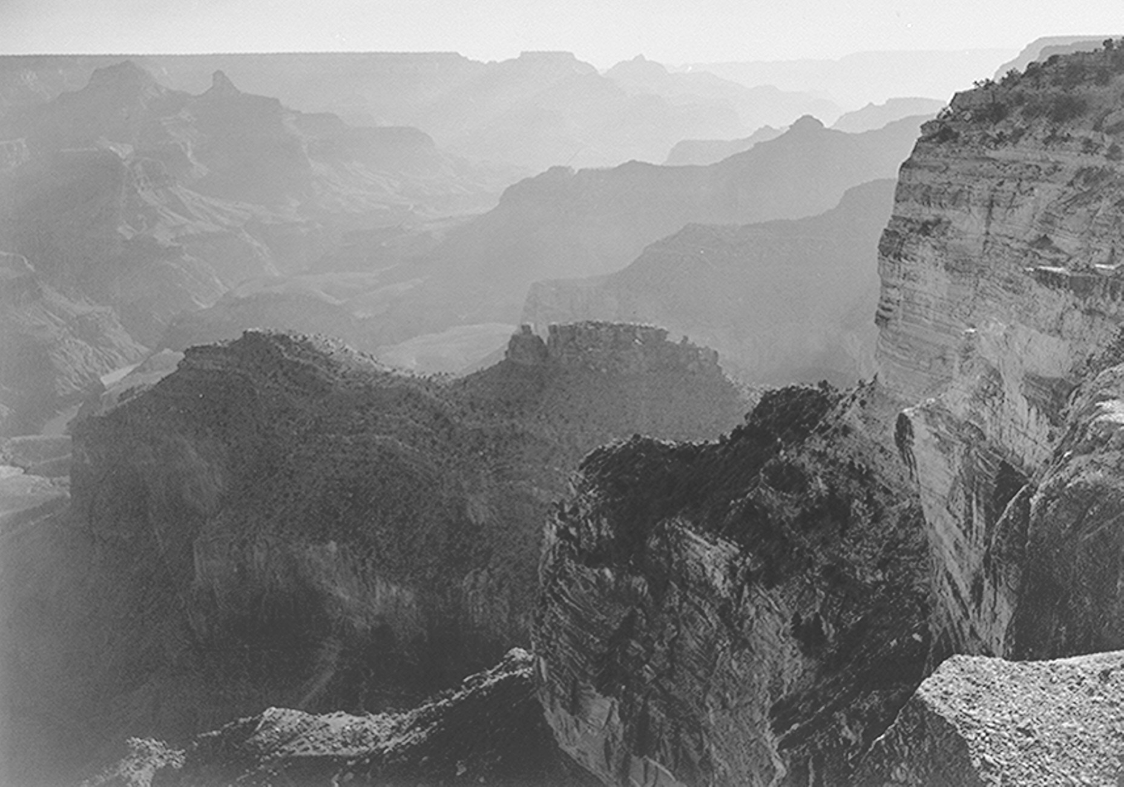
National Parks
Notes:
*“Cross Section of the West.” "Highway to Grandeur." "Fabulous Boulevard of National Parks." "The Scenic Route of Three Nations." "Treasure Trail."
*7 national parks: Glacier, Yellowstone, Teton, Bryce Canyon, Zion, Grand Canyon, and Saguaro
*It wasn’t planned this way: Not all of these were national parks when the highway was created and Saguaro wasn’t even part of the park service.

Slide 12
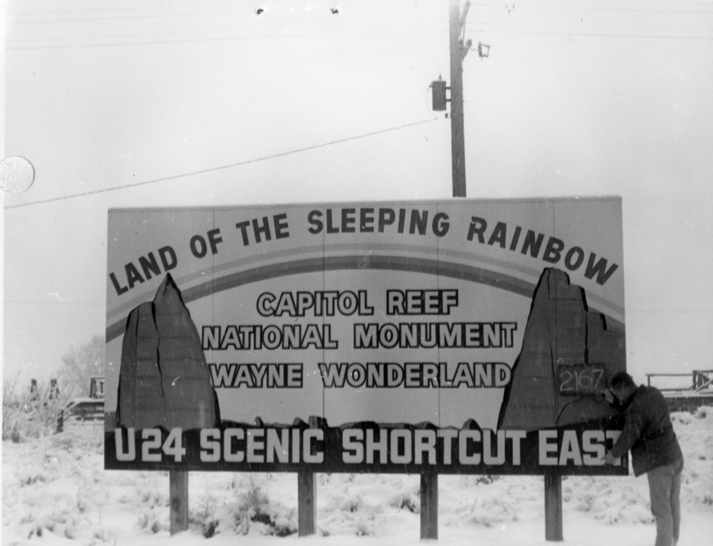
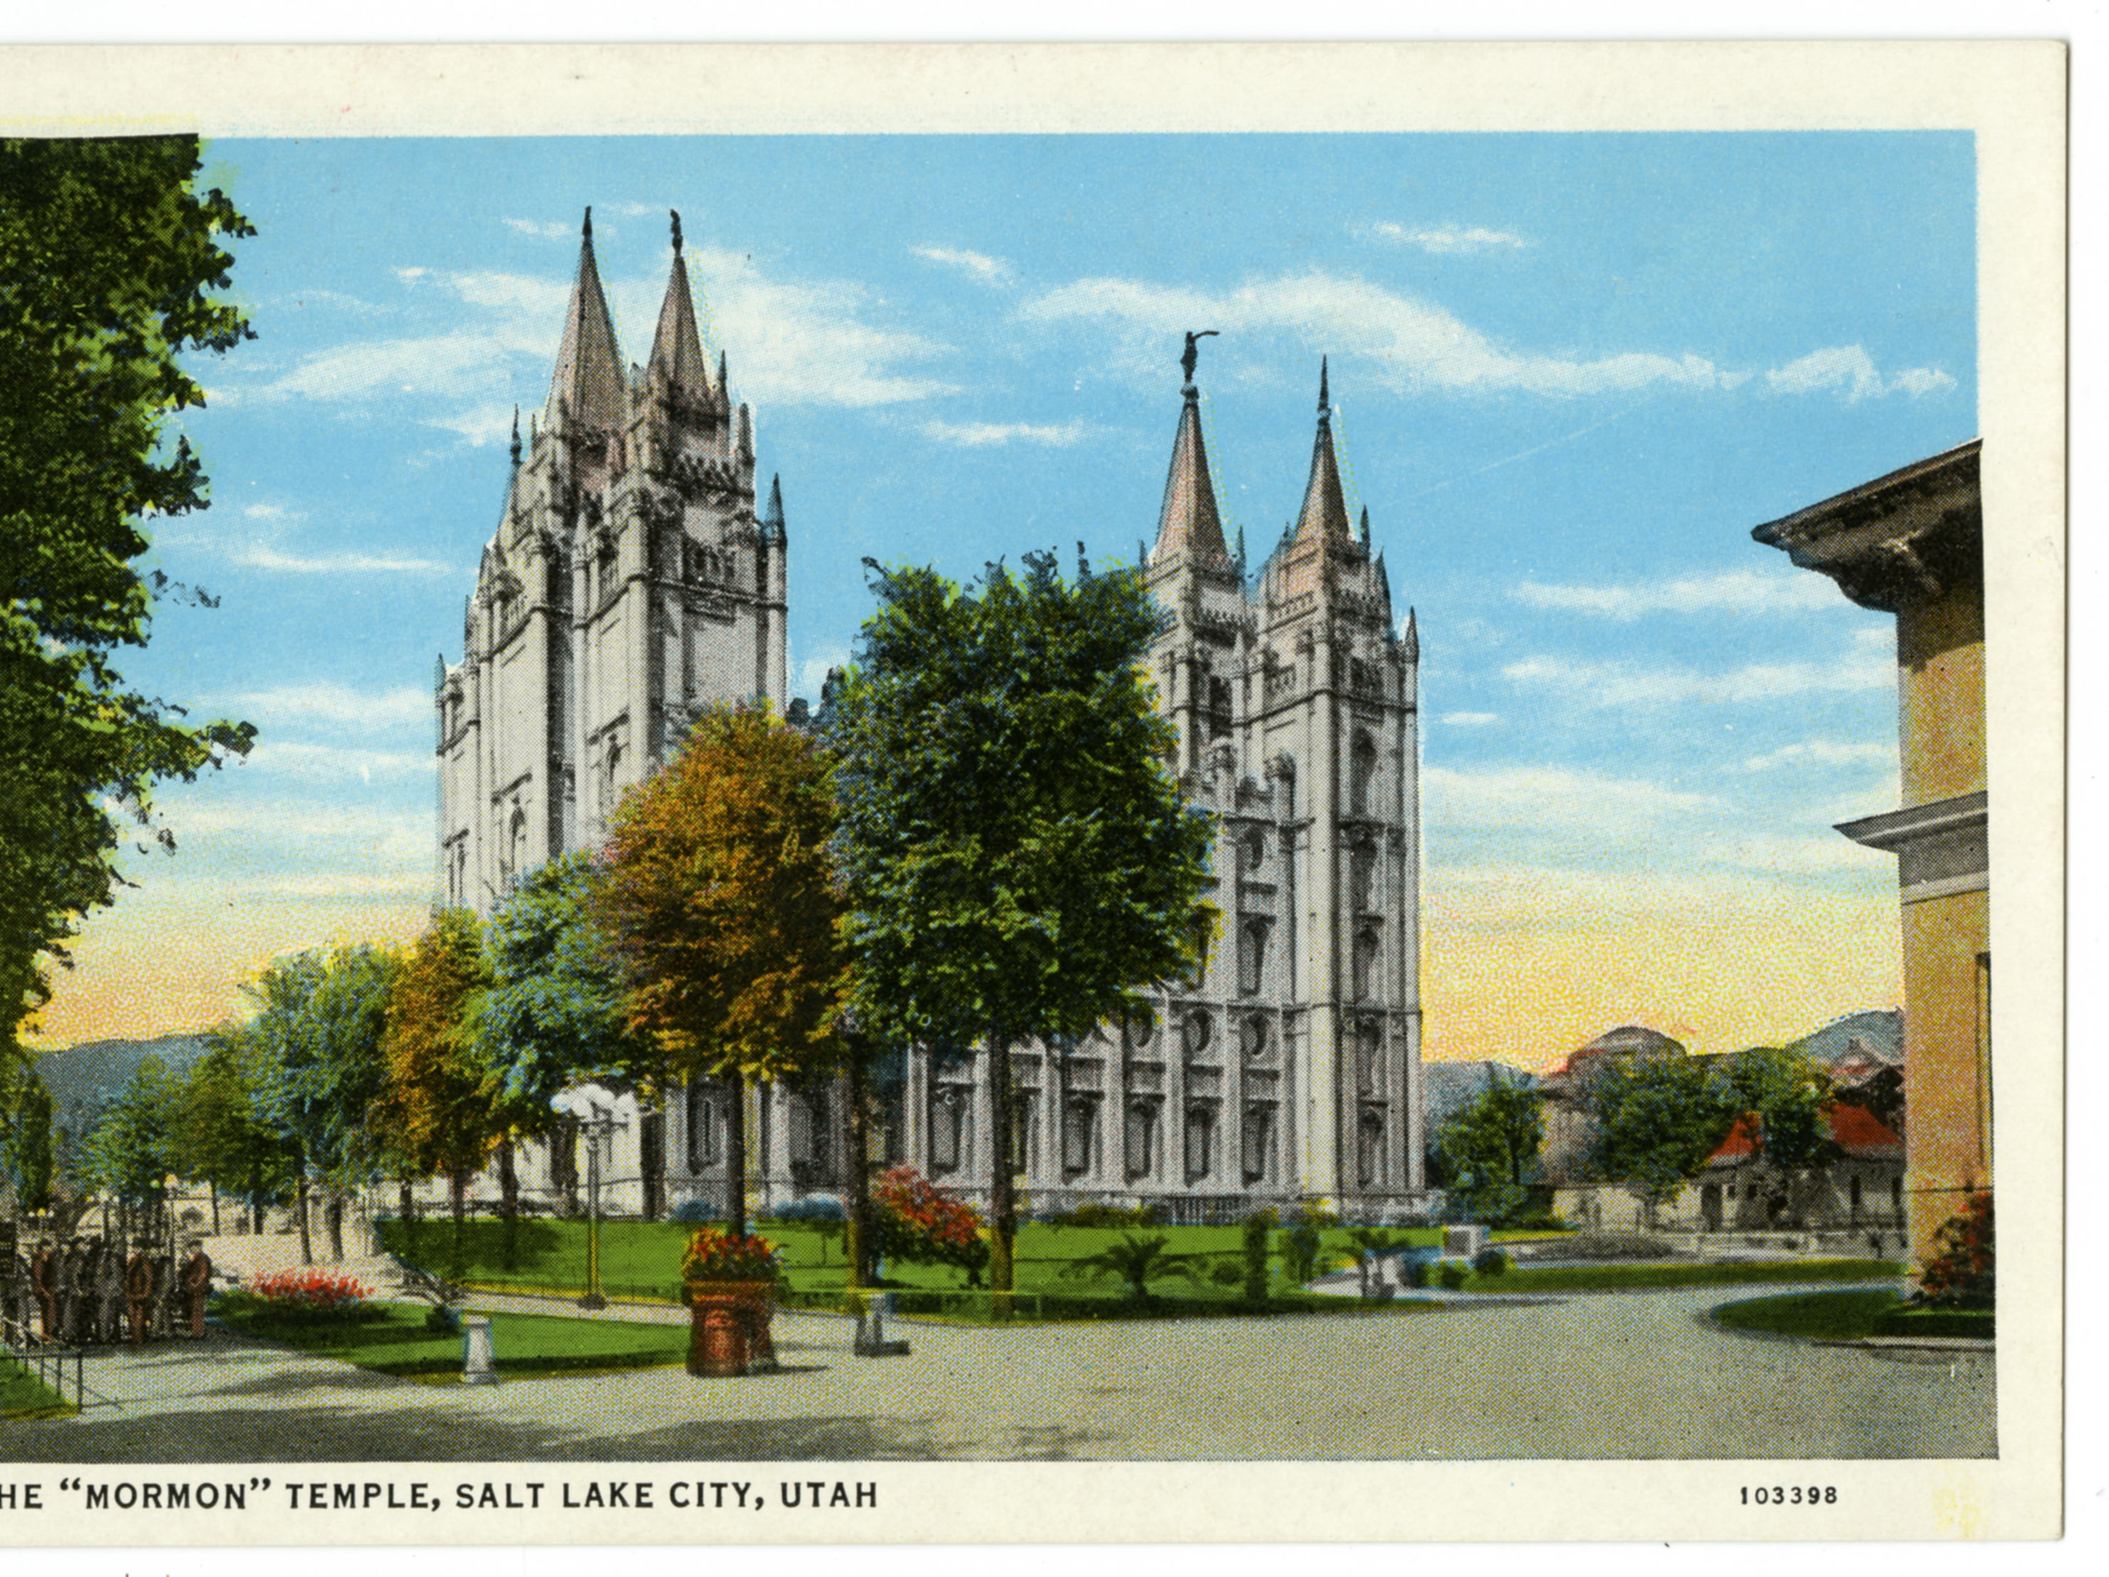
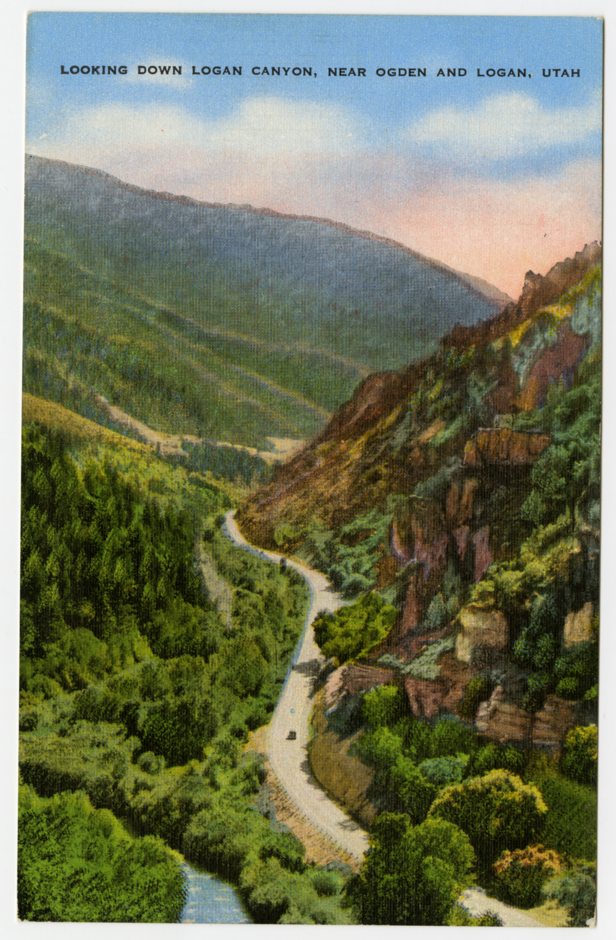
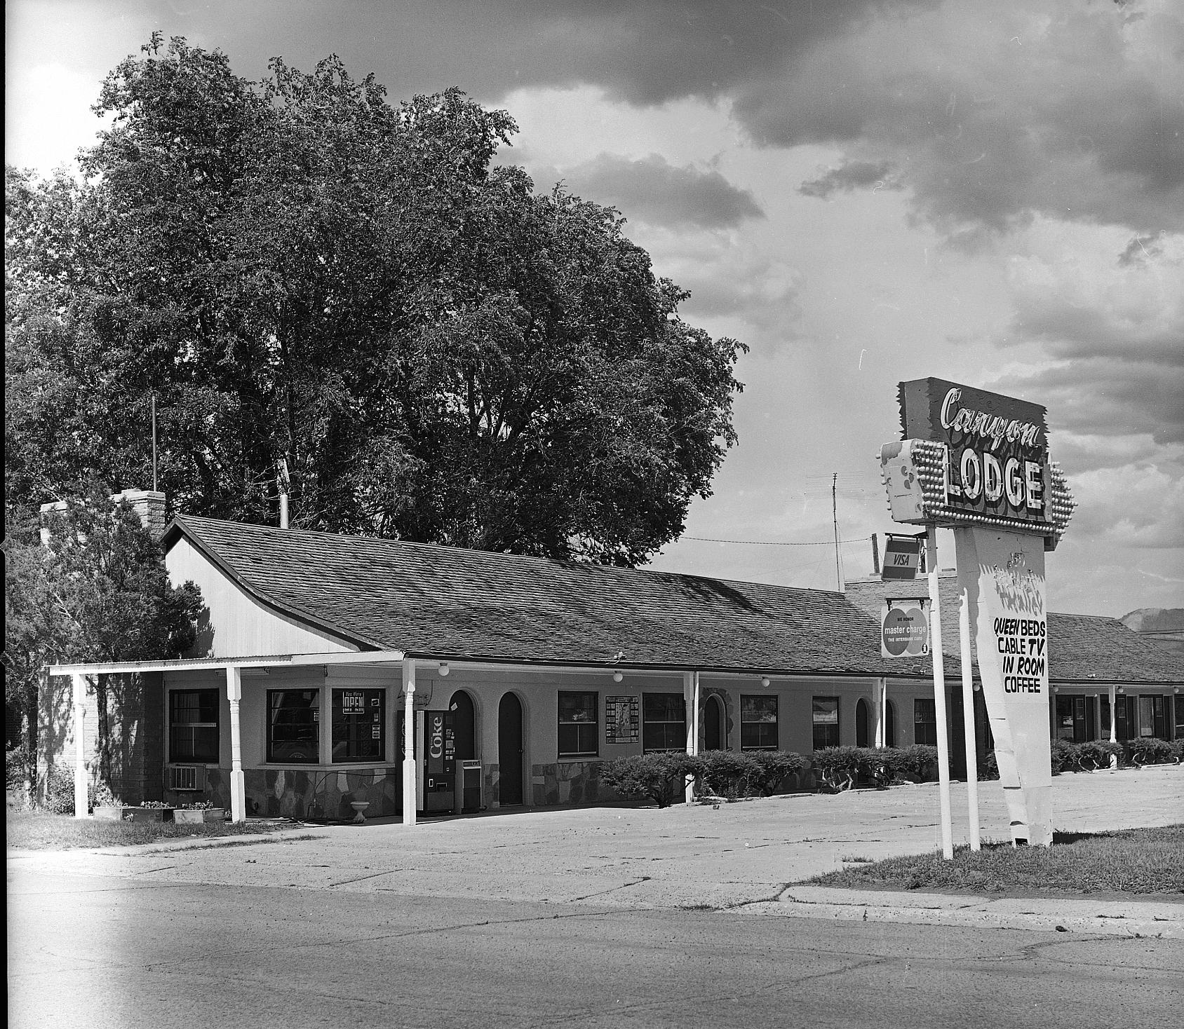
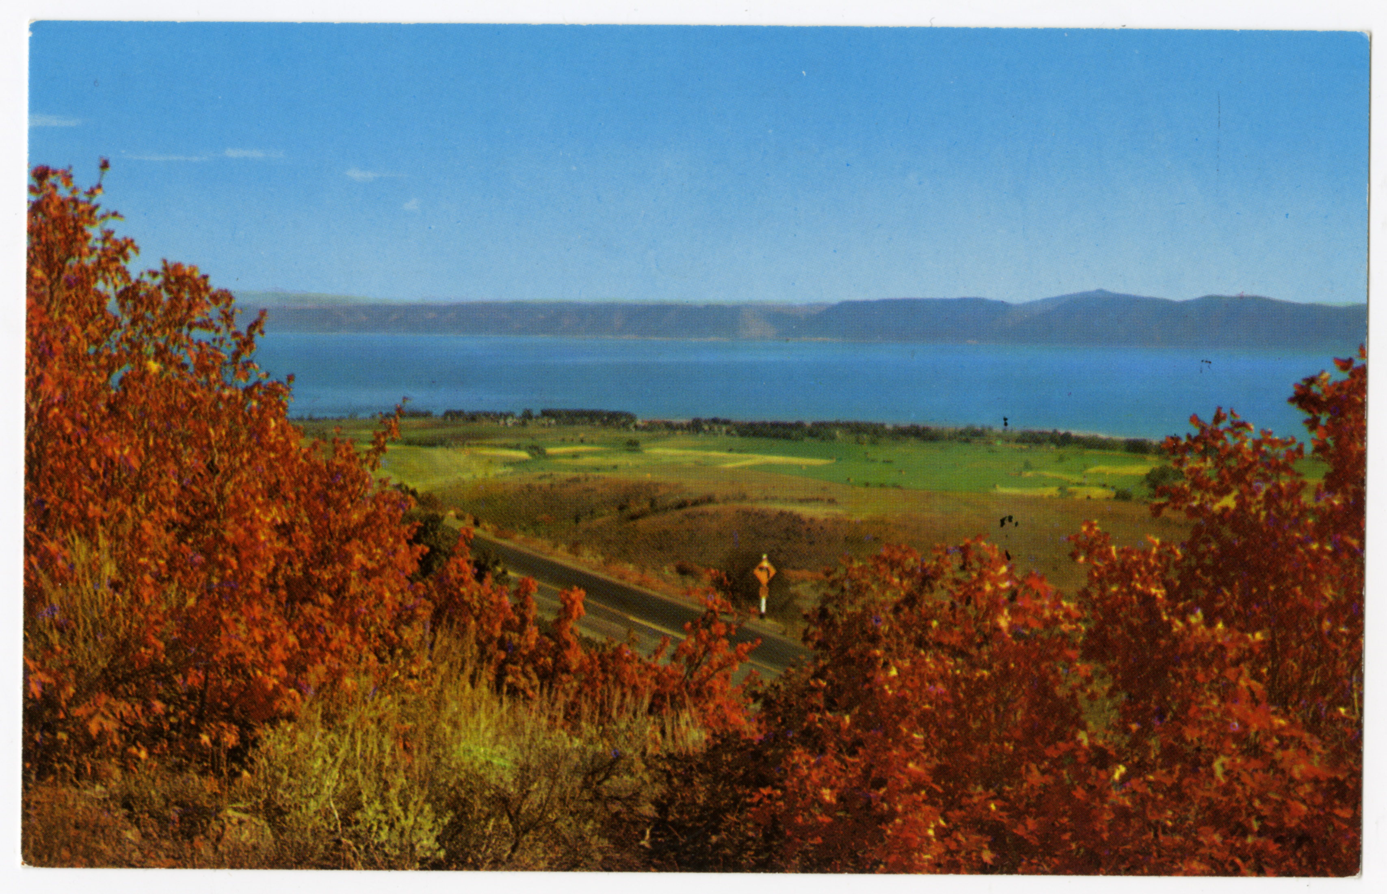
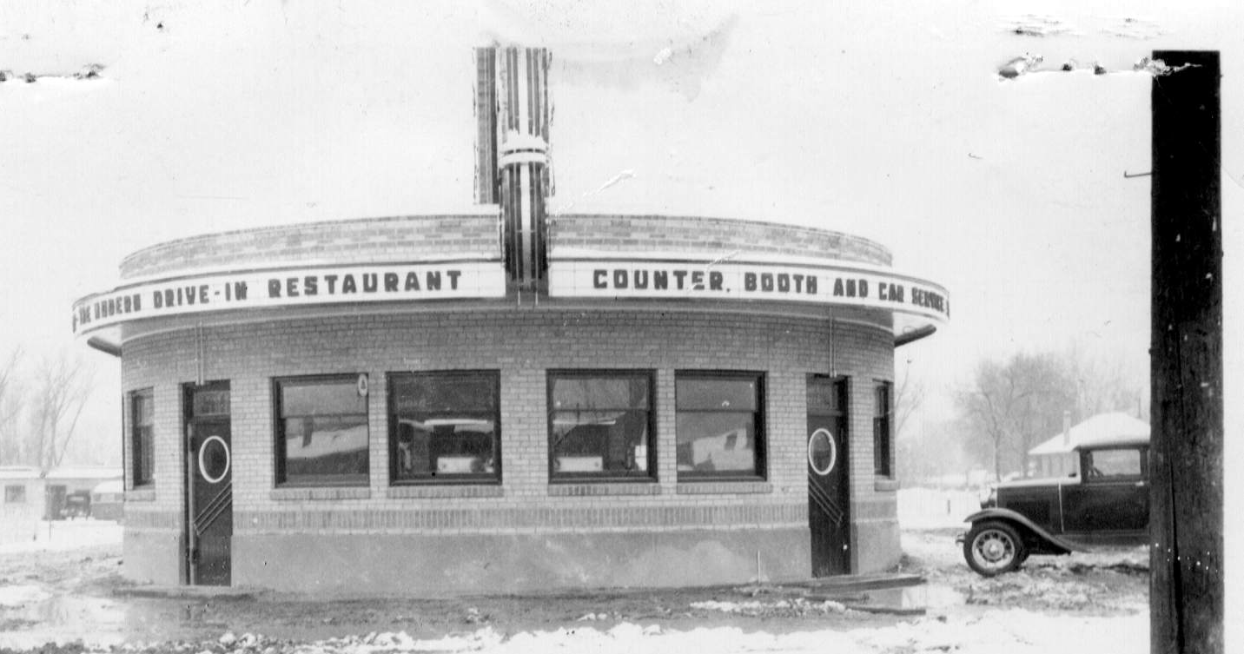
Other Attractions and Amenities

Slide 13
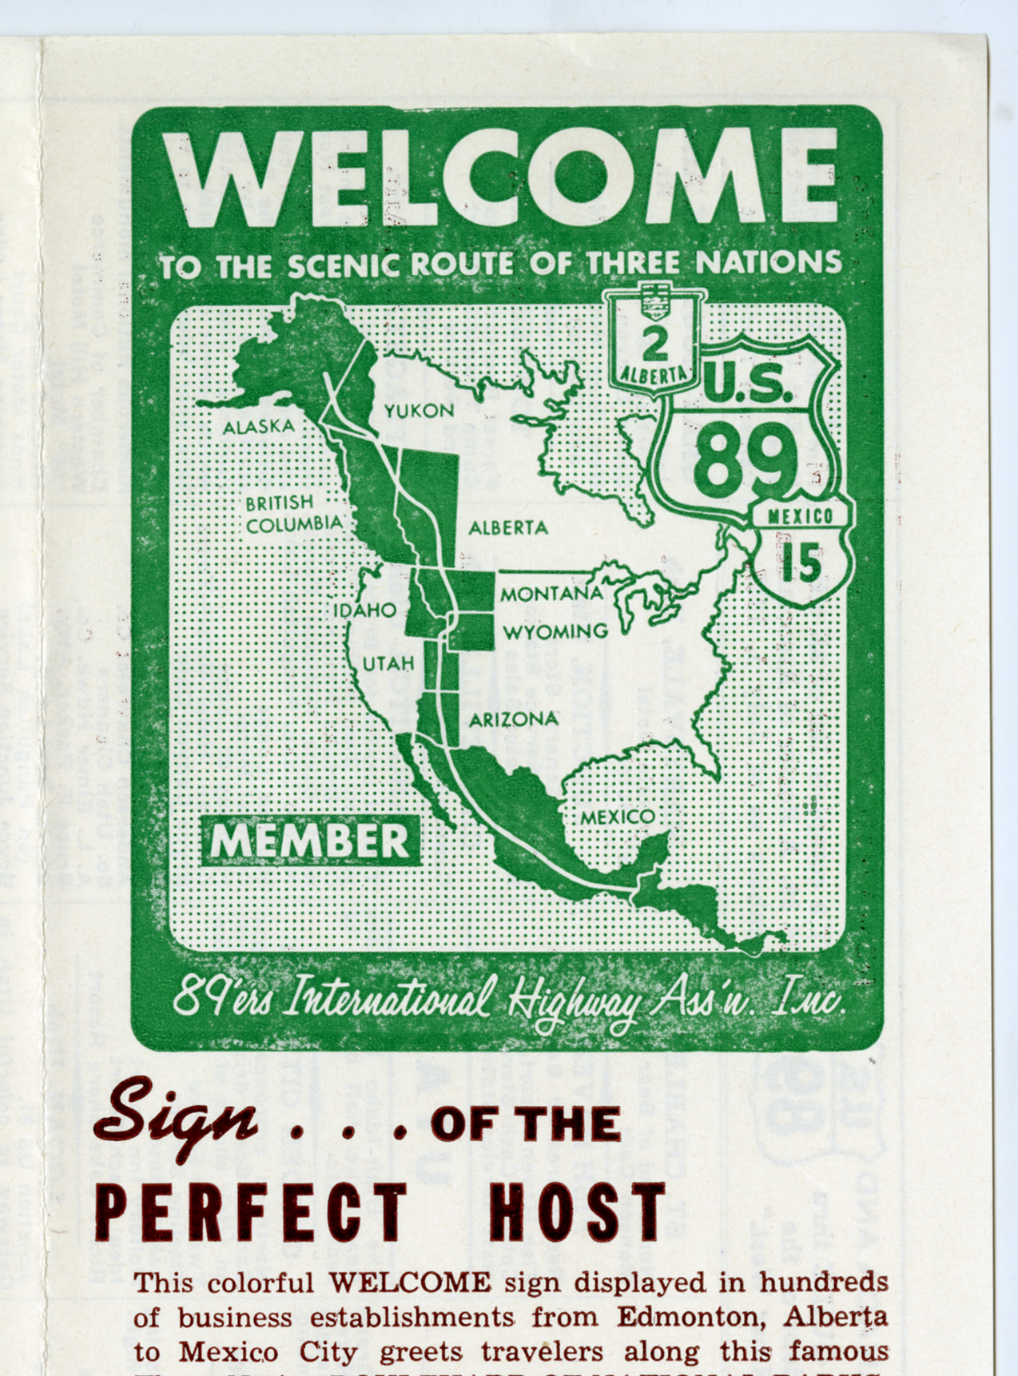
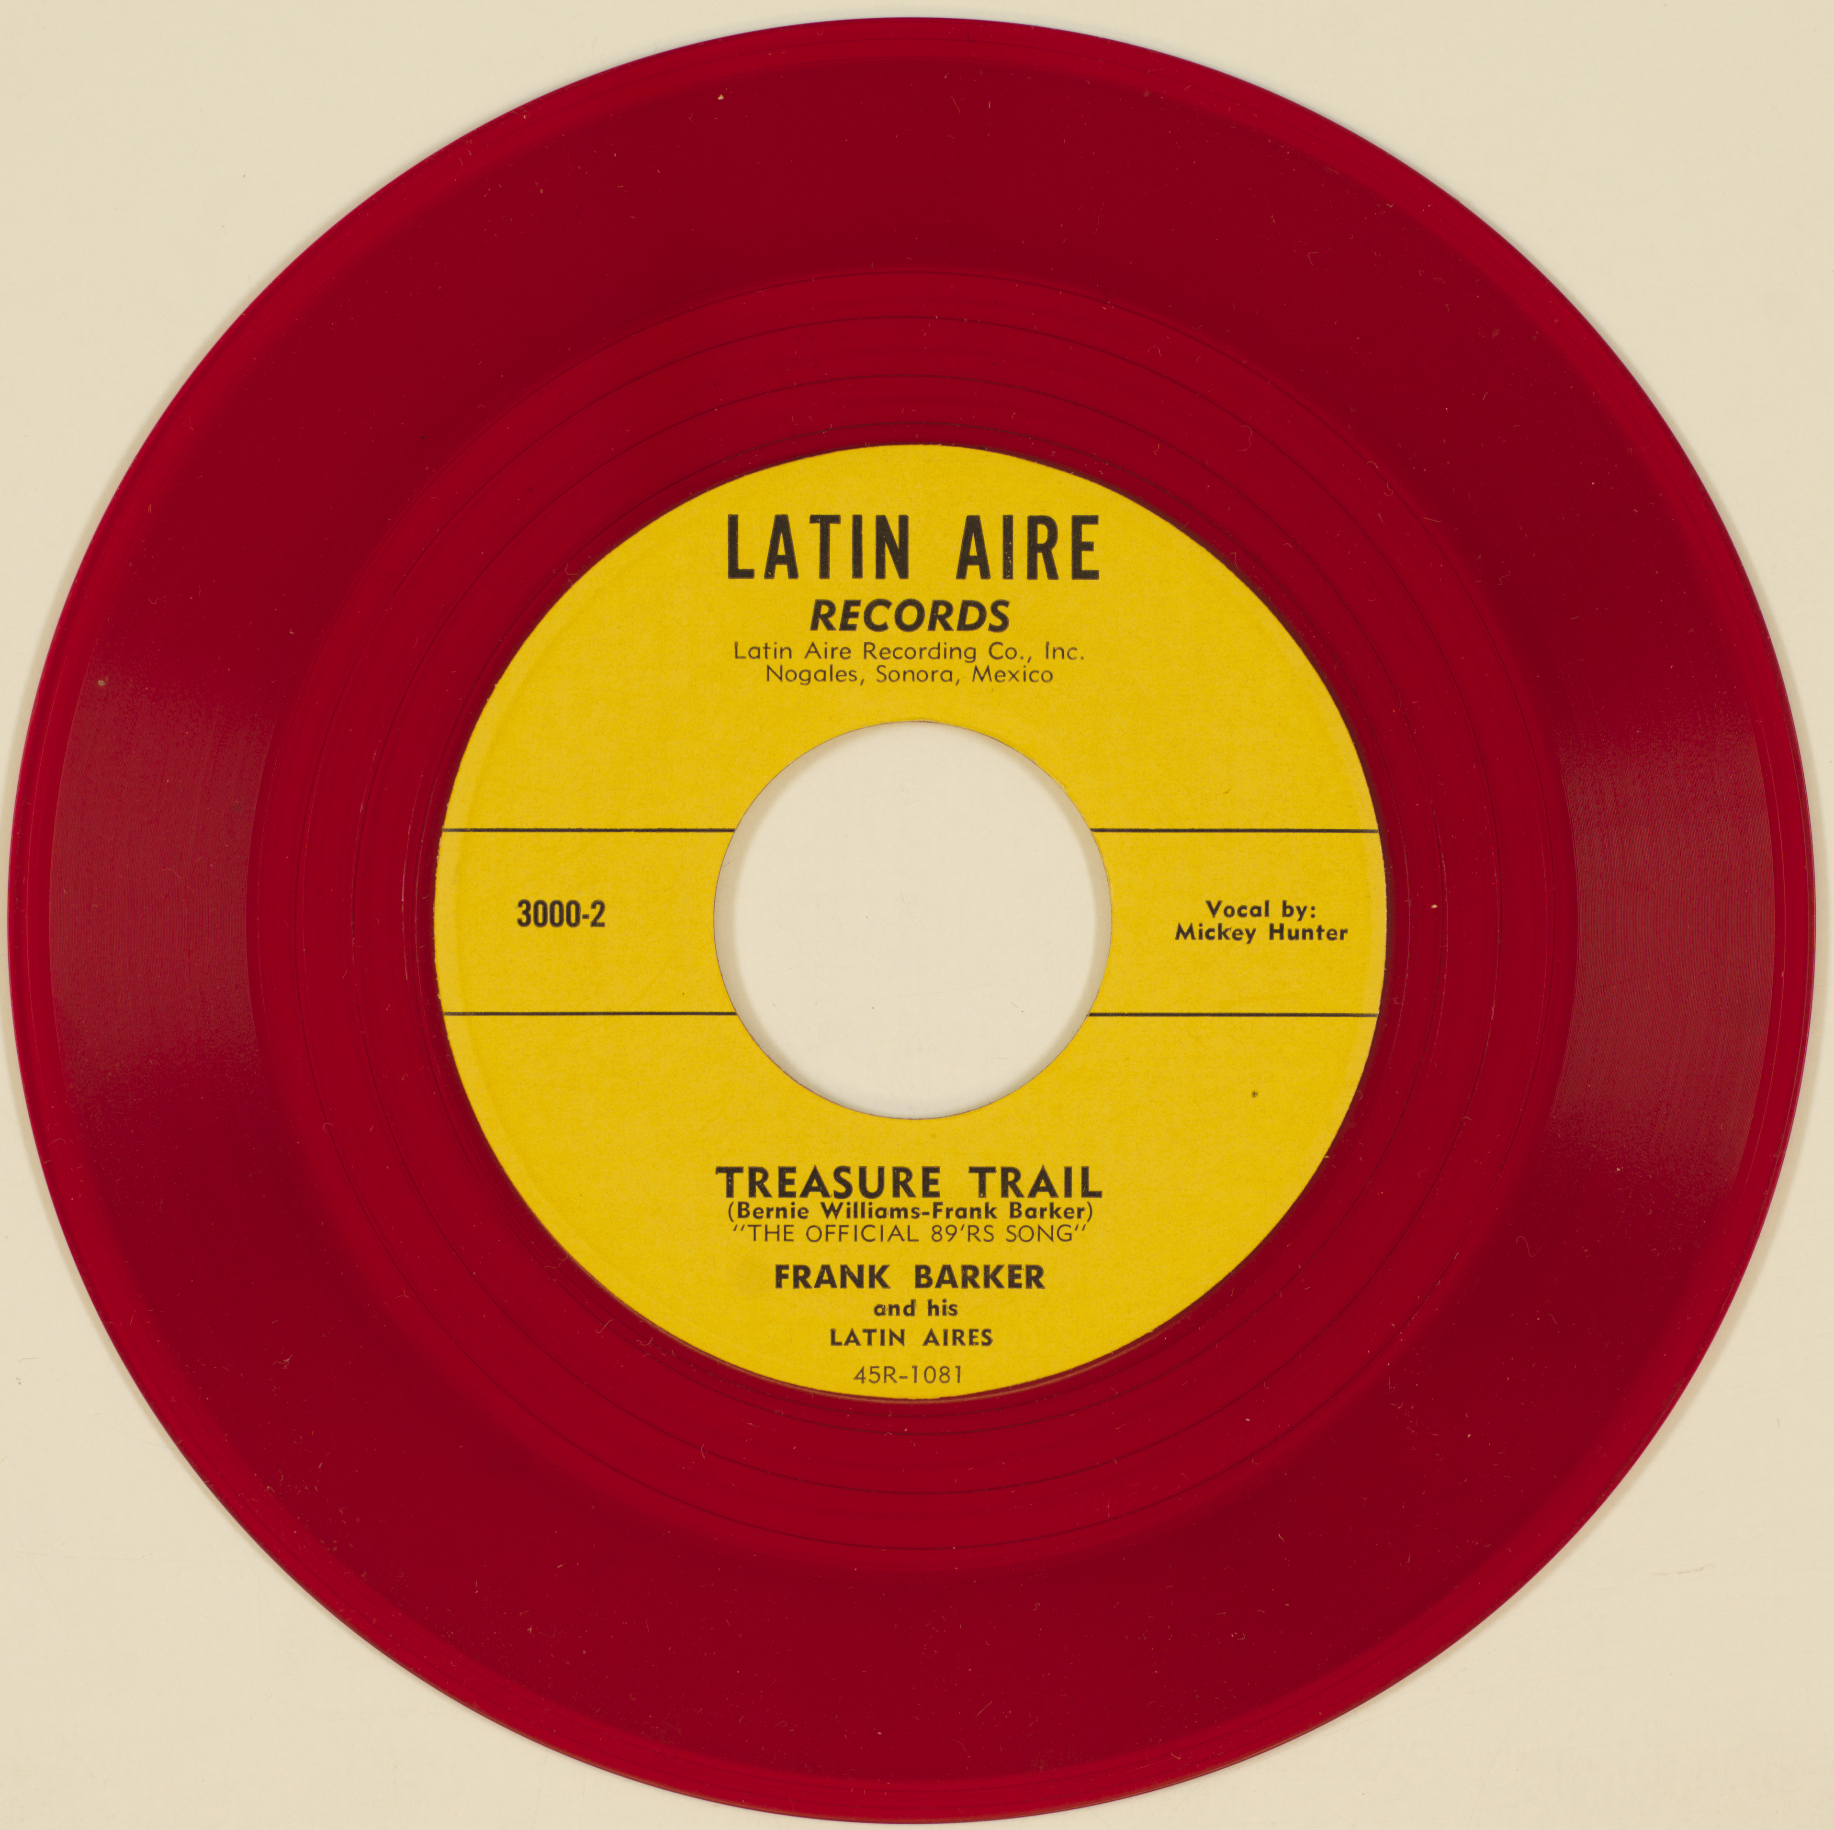
The 89’ers
Notes:
*Founded in 1955 by hotel other business owners to promote tourism along U.S. Highway 89
*We want to be like the 89’ers, except instead of promoting the attractions themselves, we want to promote the memory of how those attractions existed in the past through documents and photographs.

Slide 14
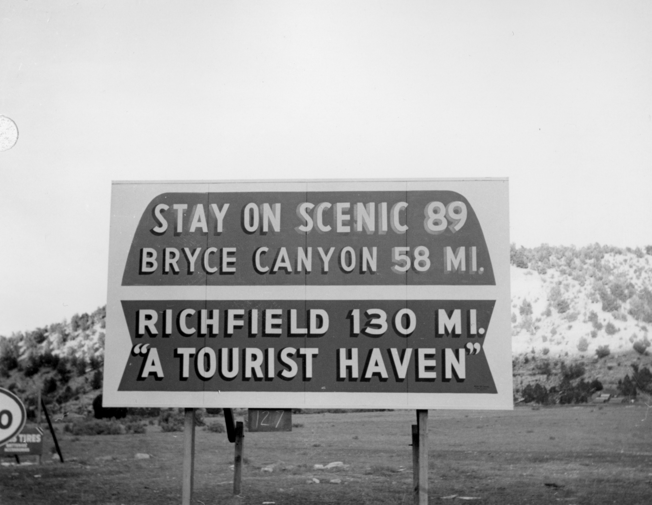
The ILEAD Project

Slide 15
Goals
Aggregate existing Collections
Locate and digitize new collections
Create an aesthetically pleasing user-interface
Design a site that is easily scalable
Provide opportunities for user-generated and contributed content

Slide 16
Structure
We will upload display JPEG and PDF only
Contributing institutions responsible for digital preservation
Loosely following MWDL metadata conventions
Currently consists of six founding institutions
Notes:
Start out in a seemingly boring way only because it really drives home the two points I want to make here.
Two points:
*Highway 89 exemplifies the West
*Highway 89 deserves greater appreciation enjoyed by east-west routes like Lincoln Highway and Route 66

Slide 17
Platform
Omeka 2.0 (out of the box)
1 Terabyte server housed at USU in Logan
Key Plugins:
Geolocation
Dropbox
CSV Import
COinS
Exhibit builder
Social Bookmarking
OAI-PMH Repository
Complete list of available plugins:
http://omeka.org/add-ons/plugins/
Notes:
Roy rosenweig center for history and new media

Slide 18
Challenges
We are running the newest version of Omeka
Not all plug-ins or themes are currently available.
1 terabyte of server space is not scalable
You may visit the test site at (temporary URL): http://rivendell.lib.usu.edu/
Notes:
Start out in a seemingly boring way only because it really drives home the two points I want to make here.
Two points:
*Highway 89 exemplifies the West
*Highway 89 deserves greater appreciation enjoyed by east-west routes like Lincoln Highway and Route 66

Slide 25
In Film
Film may be downloaded as a supplemental file here:
Notes:
Start out in a seemingly boring way only because it really drives home the two points I want to make here.
Two points:
*Highway 89 exemplifies the West
*Highway 89 deserves greater appreciation enjoyed by east-west routes like Lincoln Highway and Route 66

