Slide 1

Table Talk
Merrill-Cazier
Library
April 17, 2014
Presented by :
Melanie Shaw
Mavis Molto
Tim Olson
Liz Woolcott
Andrea Payant
Becky Skeen
Kurt Meyer

Slide 2
Authority Control
Overview
What is it?
Where is it?
How did we get the records?
How many catalog records were updated?
Are we getting further updates?
Notes:
Mavis

Slide 3
Authority Control
Overview
WHAT IS IT?
Authority control is “the establishment and maintenance of consistent forms of terms, as of names, subjects, and titles, to be used as headings in bibliographic records.” –dictionary.com
WHERE IS IT?
Authority records are found/used in all of our Innovative online catalogs, but are fully visible only in Sierra Desktop. The “see” & “see also” references are visible in WebPac, but not in Encore.
HOW DID WE GET THE RECORDS?
Marcive Inc. (San Antonio, TX)
Cost per record (backfile) = $0.024
BACKFILE UPDATE – 9/12/13
Bib records updated (headings, corrections, & RDA) =1,442,805
Bib records not updated = 463,691
  Temp/less important (Fast adds, Reserve, LMC,McNaughton)
  Leased online collections (e.g., Ebrary)
  Large collections (EEBO, ECCO)*
  Fluctuating records (e.g., Serials Solutions e-journals)
Name authority records added = 732,245
Subject authority records added = 239,069
ONGOING UPDATES – 9/19/13-present
Authority records updated/added = 3645/mon. (avg.)
  Many updates don’t affect the headings
Bib record headings updated = 1200-1500/mon.
ERRORS – for headings errors, report to Mavis or Melanie;
for RDA or format errors in records, report to Melanie____________
* EEBO=Online Early English Books, ECCO=Eighteenth Century Collections Online

Slide 4
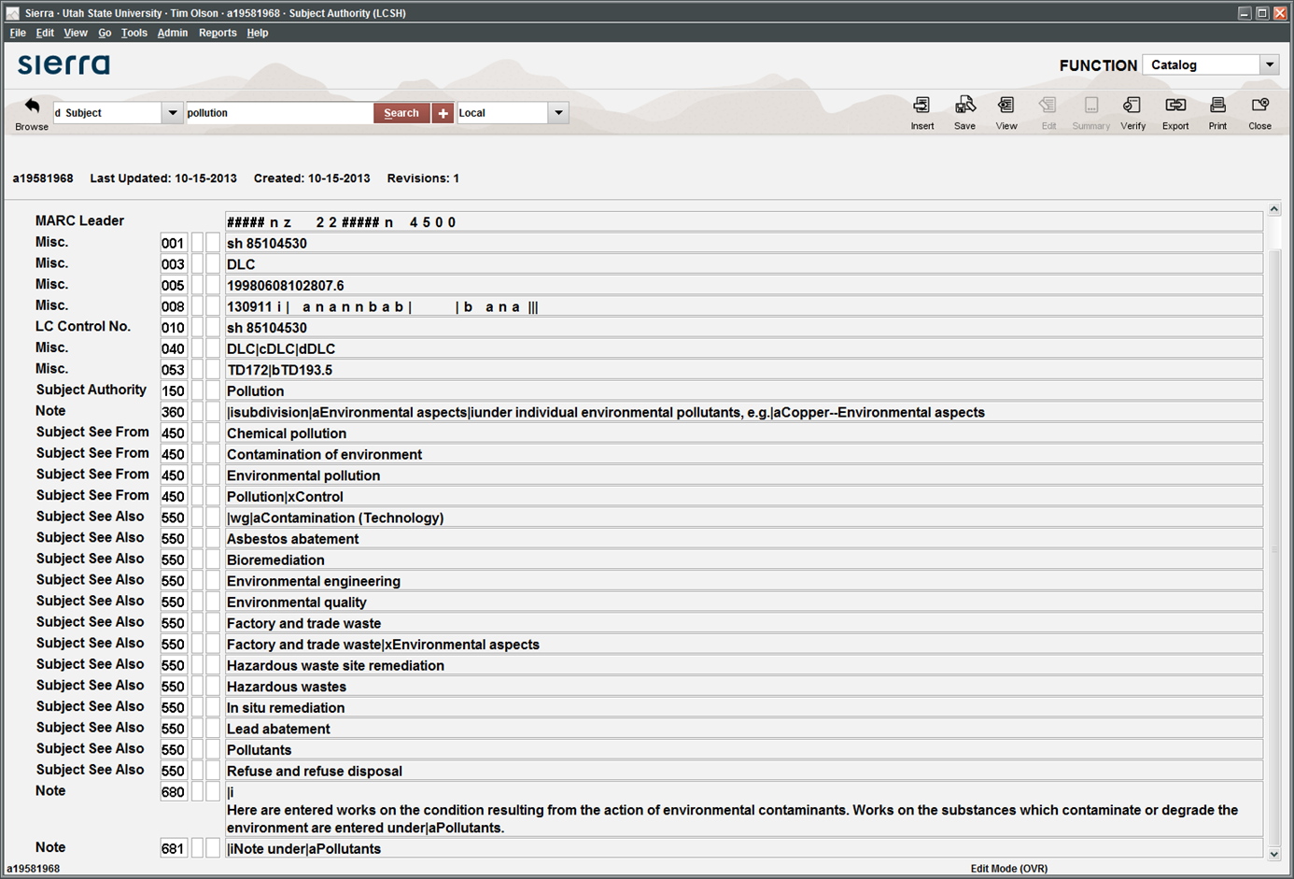
Examples & Purpose
Controlled subject term
Invalid search terms
Broader search term
Related search terms
Notes:
AHHHHH!!! Scary monster! What is it? Can we make it go away?
This is the MARC view of a subject authority record in Sierra. And yes, we can (sort of) make it go away. MARC was designed with machines in mind, so human readability is not a foremost concern (thus, the scariness). But if you know what you are looking for, you can see the controlled subject term, invalid references, and related references. Innovative, in its infinite wisdom, has made authority records primarily visible only through Sierra, which, in our library, is only available on Technical Services’ computers. They can be found through Webpac (as will be demonstrated later), but you have to want to see them.
I think we’ve seen enough of this particular view. Let’s make the bad (no, it’s not really that bad) go away.
Tim

Slide 5
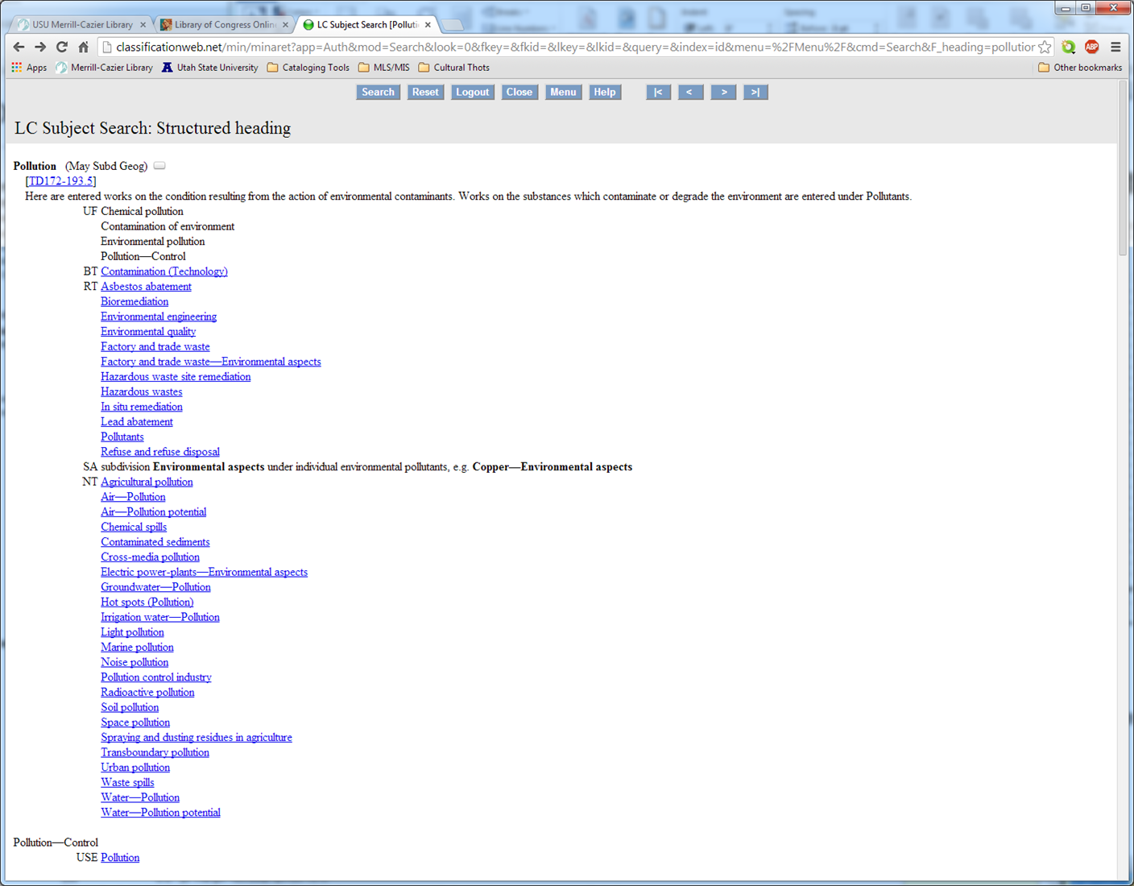
Notes:
Here is the same record displayed with human readability in mind. You can see that valid search terms display as links, grouped as Broader Term(s), Related Term(s) and Narrower Term(s). Invalid search terms are displayed as regular text under Use For.
To see how this record functions in the catalog, let’s go back to Sierra and do a Subject search on “chemical pollution”.

Slide 6
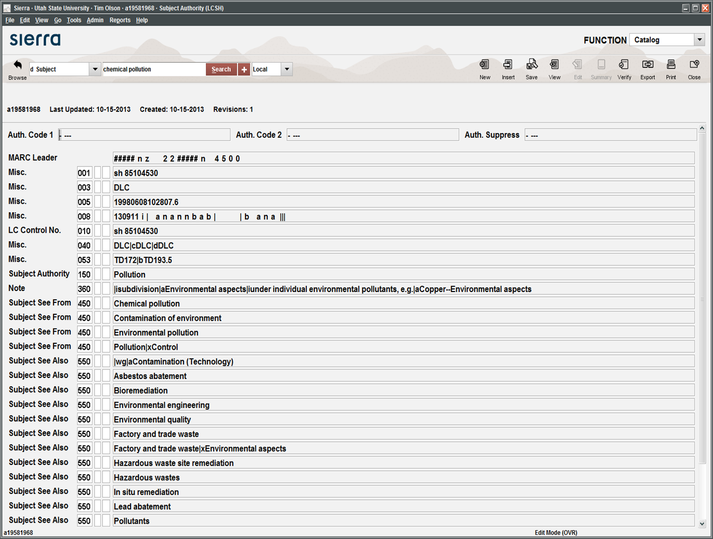
Notes:
What happened when we did a Subject search on “chemical pollution”? Sierra directed us back to “pollution,” since that is the controlled, or authorized, term. The authority record worked. Now, let’s try the same search in Encore.

Slide 7
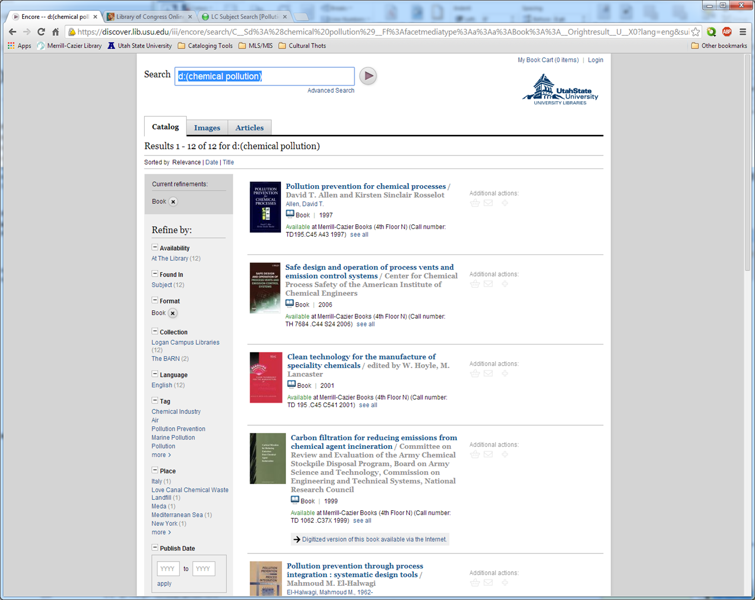
Notes:
Ummm… Well, that’s not what we expected. If Encore is using authority records, we would expect to have been redirected on our search, just as we were in Sierra. Instead, we have several results. Looking at the results, we can see multiple references to “pollution” or “chemical”, which would seem to suggest that Encore has performed a Keyword search, rather than a Subject search. And, as Melanie will explain later, that is indeed what has happened. Encore is trying to be helpful in bringing back any and every result possible, but in this case, that is not helpful. Thank you, Encore.
Ok, let’s try our search again, this time using Webpac.

Slide 8
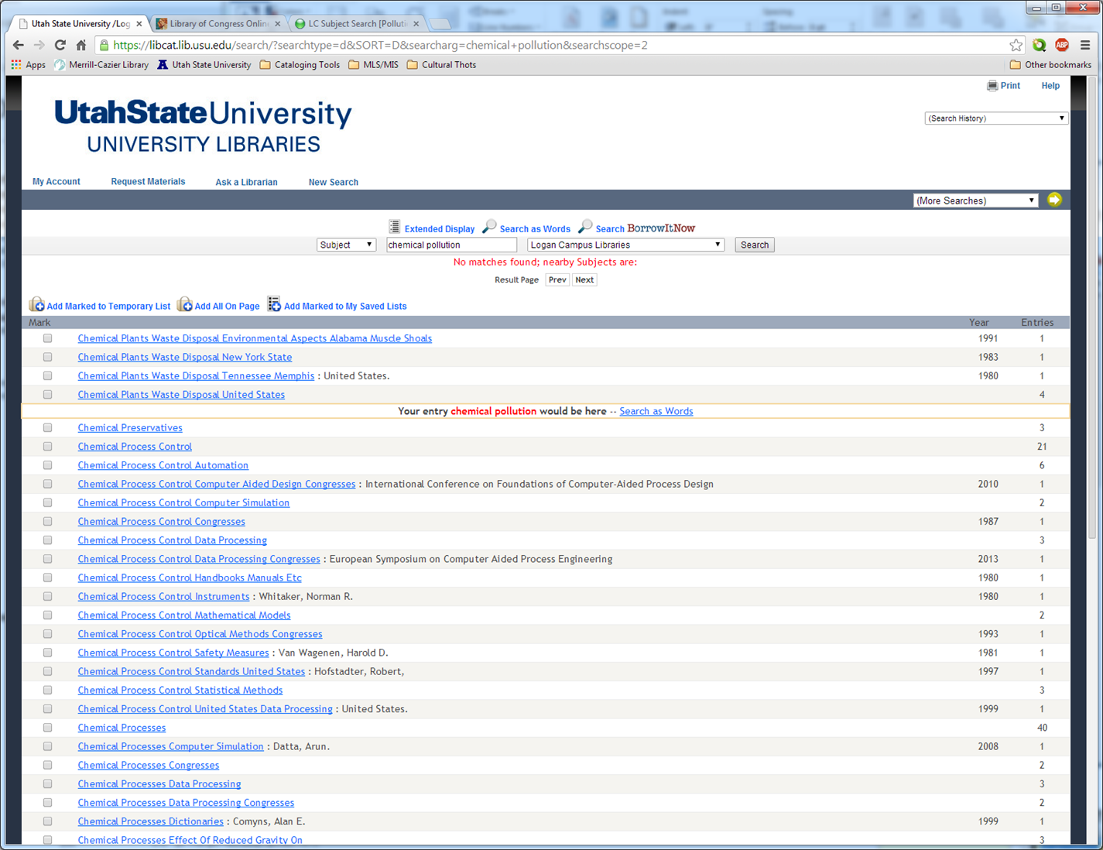
Notes:
Well. Then. So, we can see that something worked. Sort of. Our Subject search on “chemical pollution” failed, but instead of helpfully pointing us to “pollution”, it failed spectacularly and gives us nothing. Why?
The default “scope” setting for Webpac here is “Logan Campus Libraries” because, well, we’re at the Logan Campus. And Innovative, again in its infinite wisdom, has decided that authority records don’t need to show up in search results for any scope below “View Entire Collection”. They probably call it a feature. We call it a bug.
So, one more time, let’s do a Subject search on “chemical pollution,” this time setting our scope to “View Entire Collection”.

Slide 9
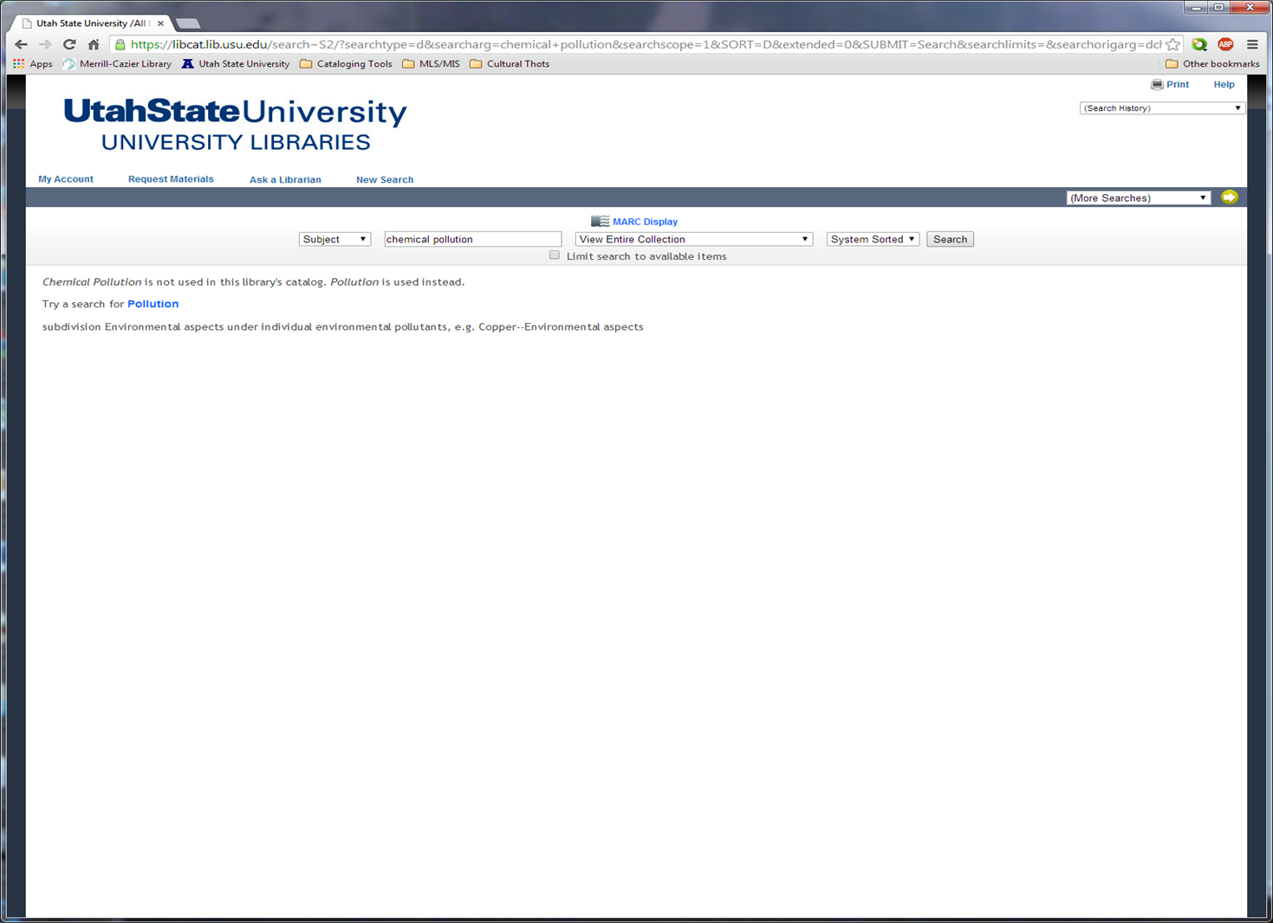
Notes:
Hey, hey, hey! We have a winner! We have a note indicating that “chemical pollution” is not a valid search term, and a reference to the valid form, “pollution”. Even better, “pollution” is a link, so we need only click on it to get where we want to go.

Slide 10
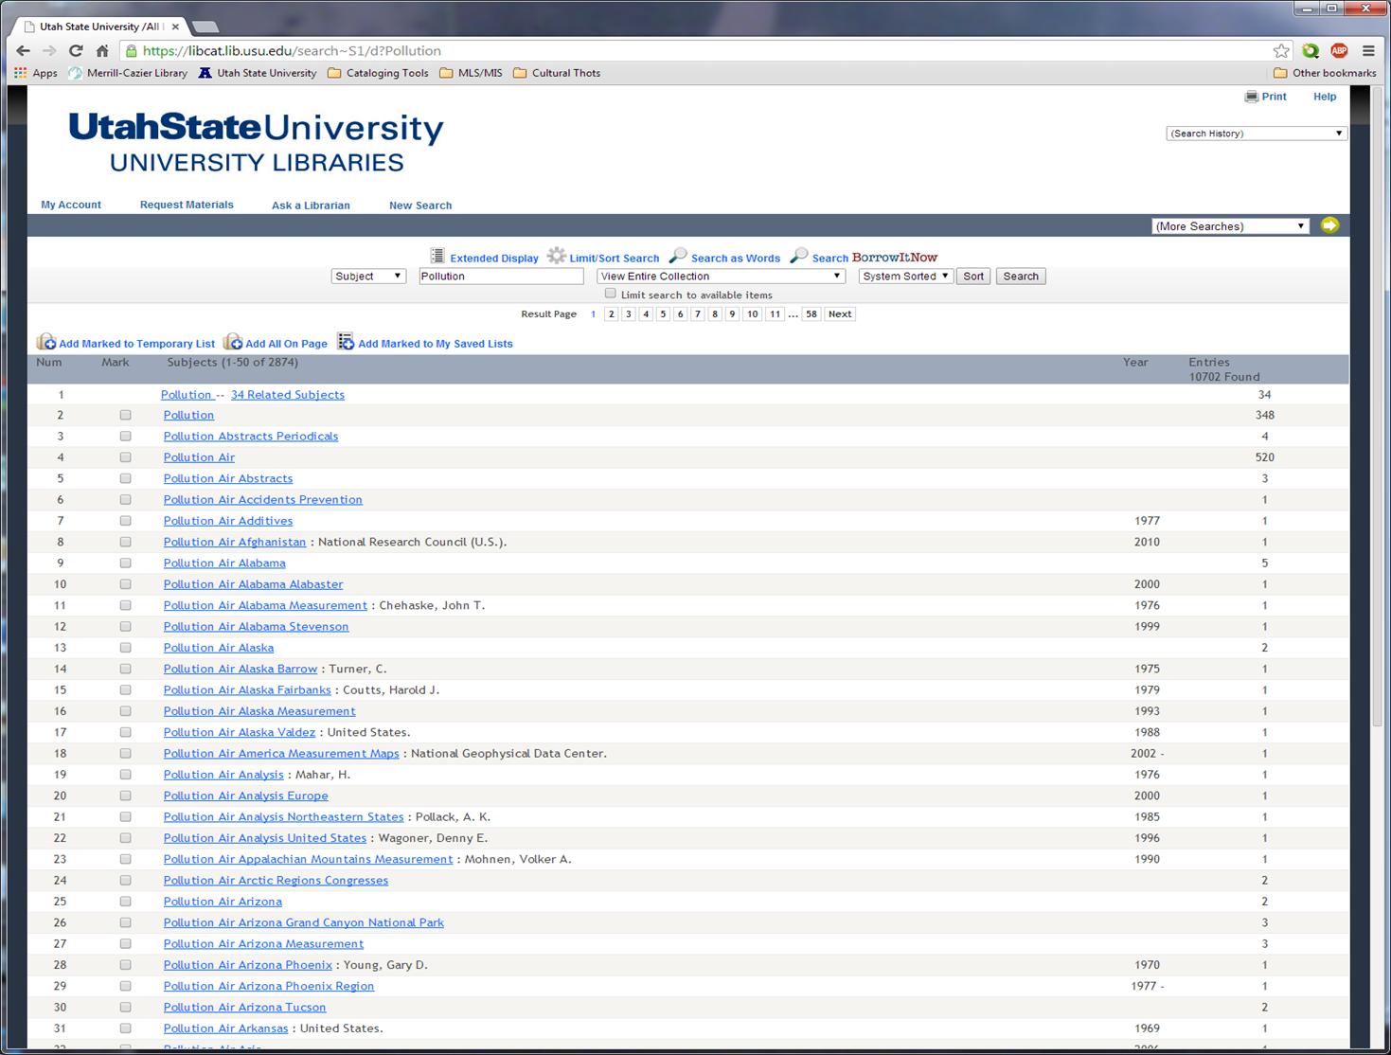
Notes:
Finally, here we have some results. On this screen we have a link to our related terms (in the red rectangle), a link to results for the primary search term (pollution – 348 results), and links to each of the valid subdivided subject terms. Let’s take a look at the related terms.

Slide 11
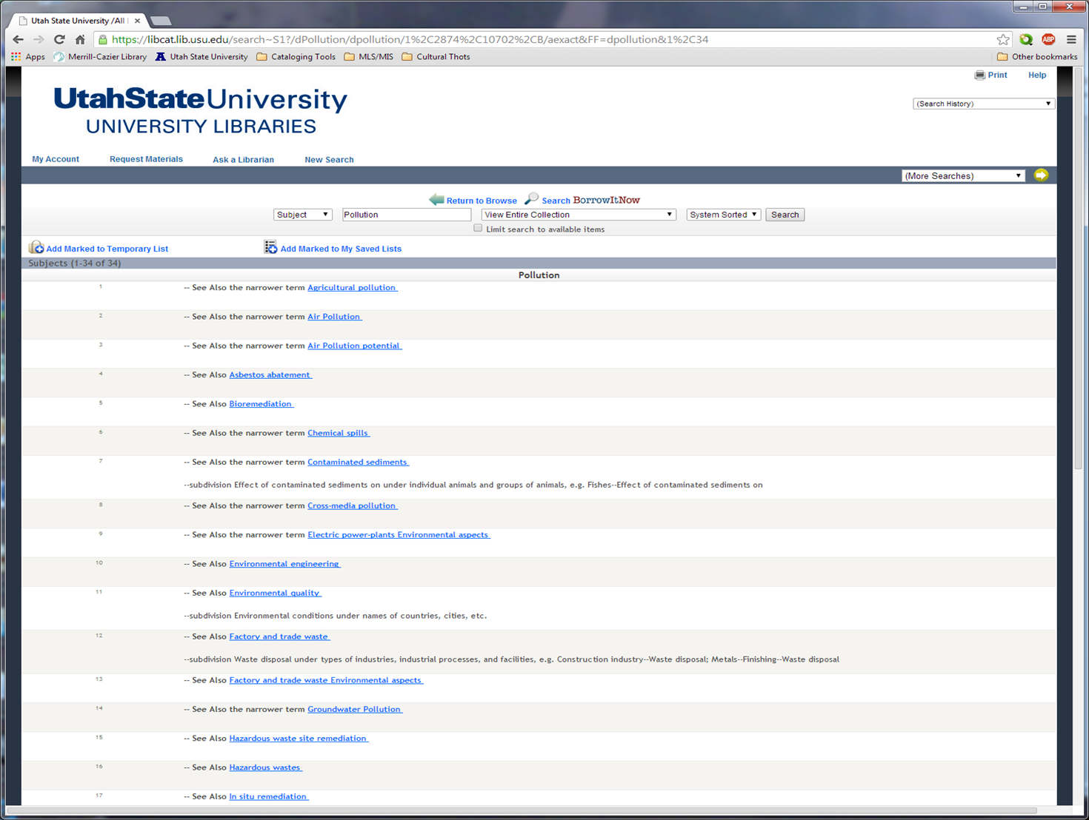
Notes:
Not only do we have the list of related subjects here, but the relation of each term back to our primary term is indicated (“See Also,” “See Also the narrower term,” and “subdivision” with explanation). Not only is our authority record finally working, it’s also helping to explain how various related authorized terms work together in this field of study. This kind of transparency (ok, maybe it’s more opaque. Right. Very opaque, but we’ll get to that later.) helps end users understand how information is organized in the catalog, which leads to more precisely formulated searches, allowing for more accurate results. And everybody likes more accurate results.

Slide 12
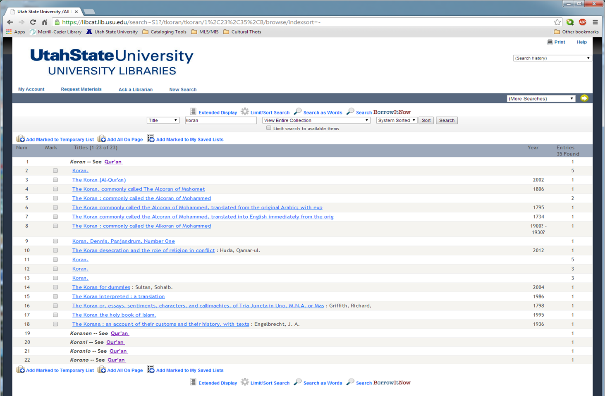
Notes:
So, one of the benefits of authority control is new or updated authorized terms. One example is the (relatively) recent change of the name of the Islamic scriptures from the very Anglo-centric “Koran” to the more closely Arabic form “Qur’an”.
If we do a Title search on the older term “Koran,” we get a few results, which is somewhat understandable. An authority update isn’t going to change the words that appear in the title field (245 for MARC enthusiasts) of a bib record. If the title of a book included the word “Koran” when it was published, that won’t be changed after an authority update. What will be changed is any Uniform Titles. Also, as Mavis mentioned in the introduction, we have several large collections of old books (EEBO, ECCO), eBooks and leased books/records, that were not effected by the update. So, while we can see the our first result is a reference to the new, authorized form, it’s not surprising to see several results under the old term. And, if we toggle to “Extended Display”…

Slide 13
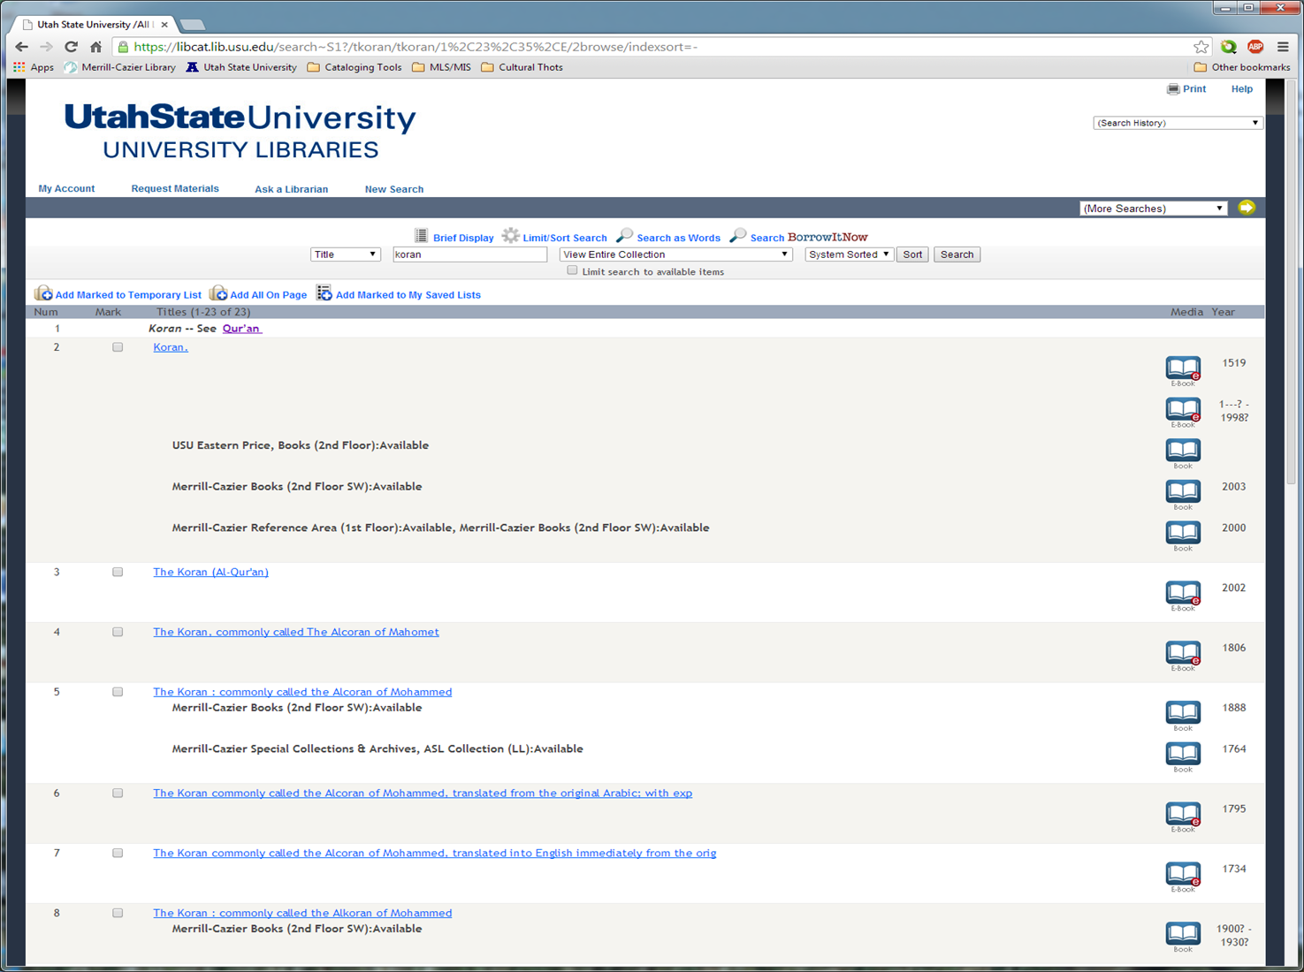
Notes:
… we find that several of these results are, indeed, eBooks.

Slide 14
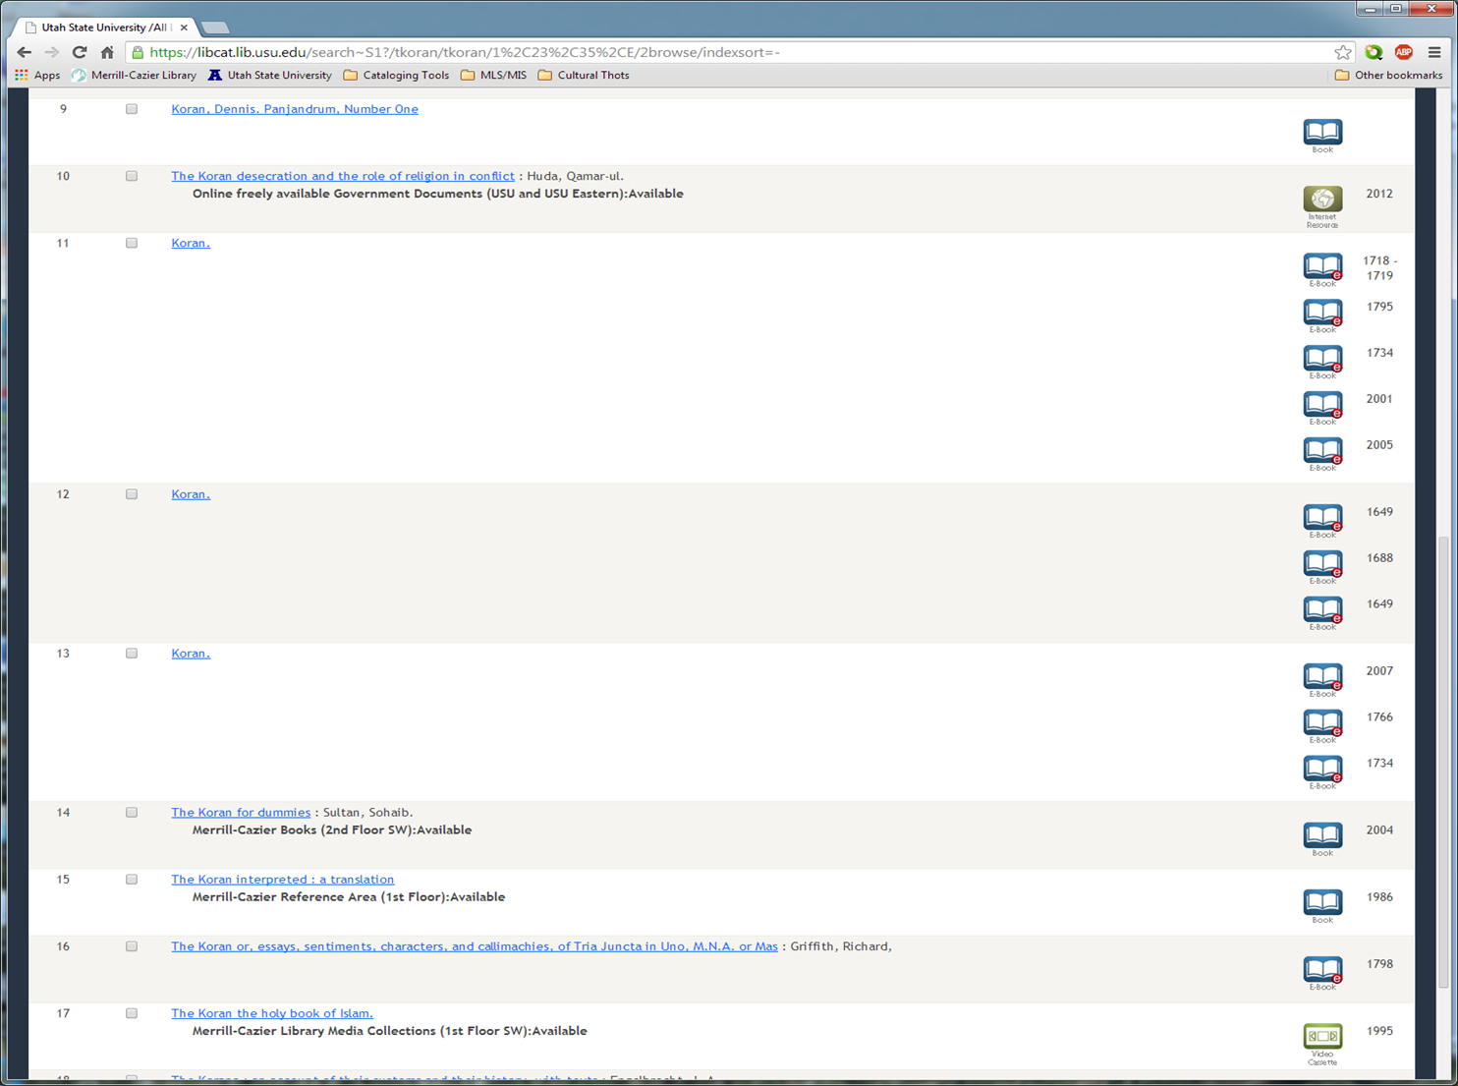
Notes:
And more eBooks.

Slide 15
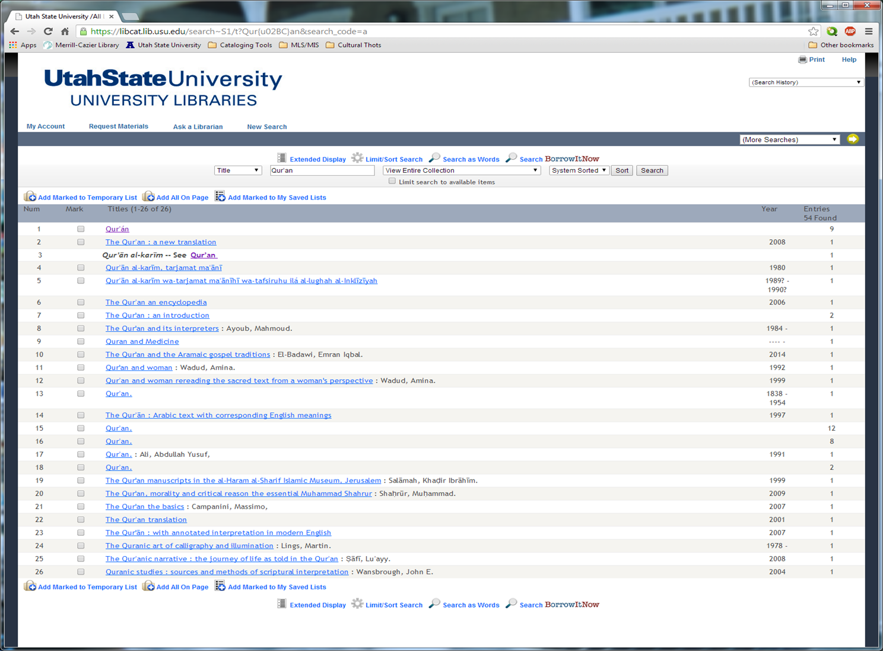
Notes:
Just for comparison’s sake, we can go back and do a Title search on “Qur’an” and see that most of the results are recent.

Slide 16
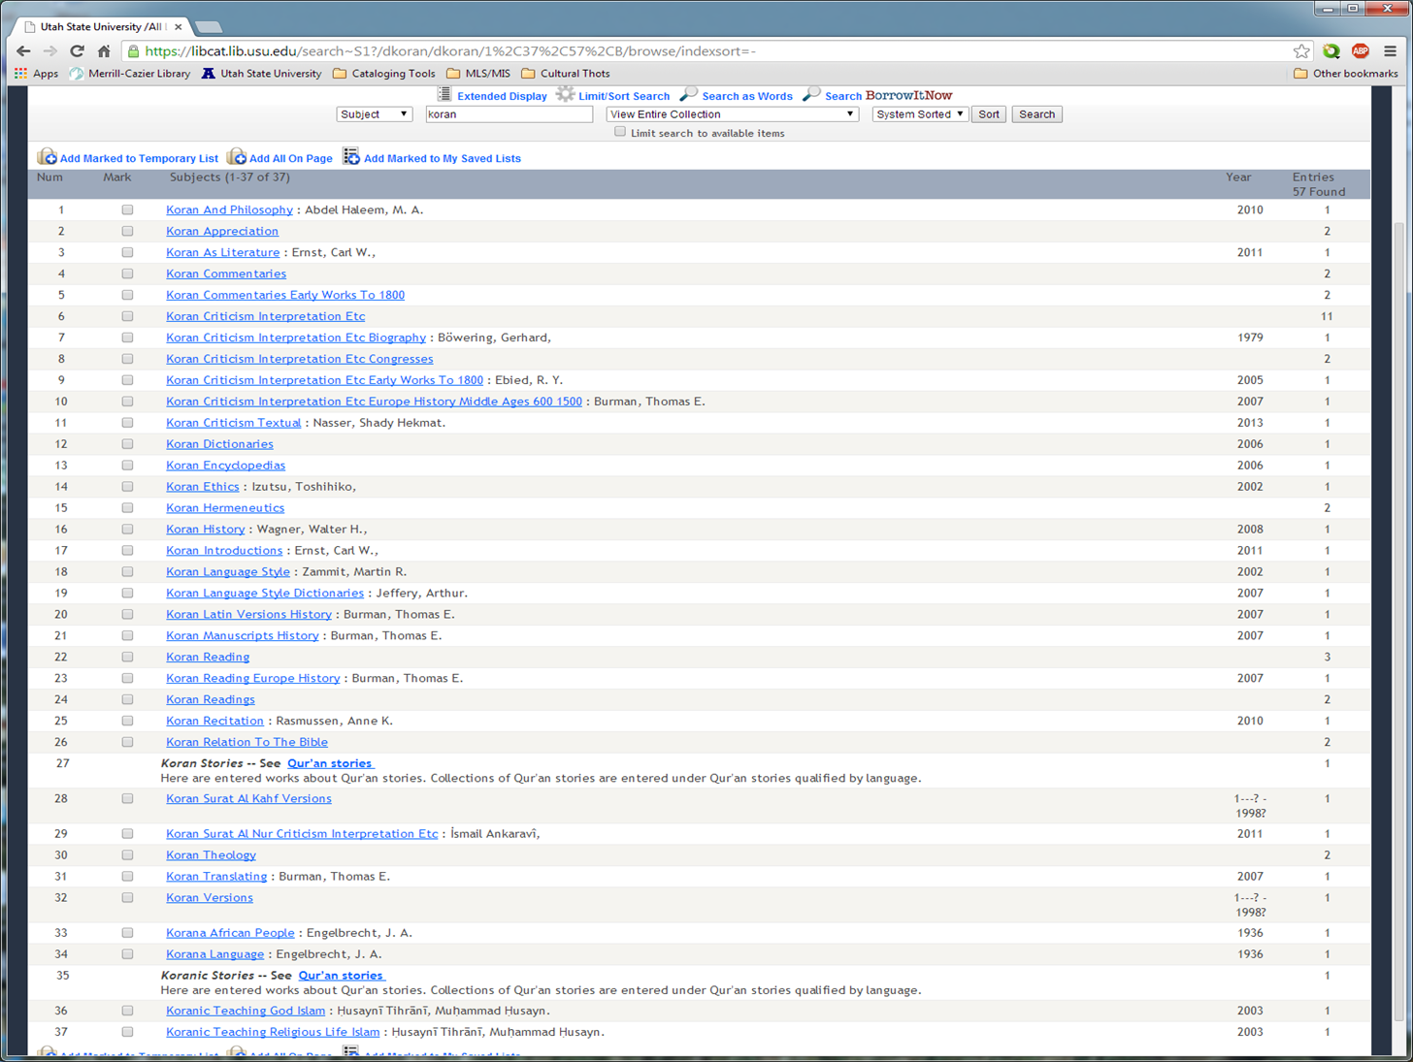
Notes:
Now, while the authority update didn’t change titles in bib records, it did change subject headings in bib records. After all, what’s the point of changing the authorized forms of subjects, place names, or personal names, if their corresponding references in bib records aren’t being changed? (Don’t ask Innovative. They’ll just come up with another way to hold our data hostage.) So, we would expect, if we did a Subject search on the old Anglo-cized term “Koran” to be referred directly to “Qur’an.” But we didn’t. We can see some references to headings that have changed. Why didn’t the other 30+ subject references change?

Slide 17
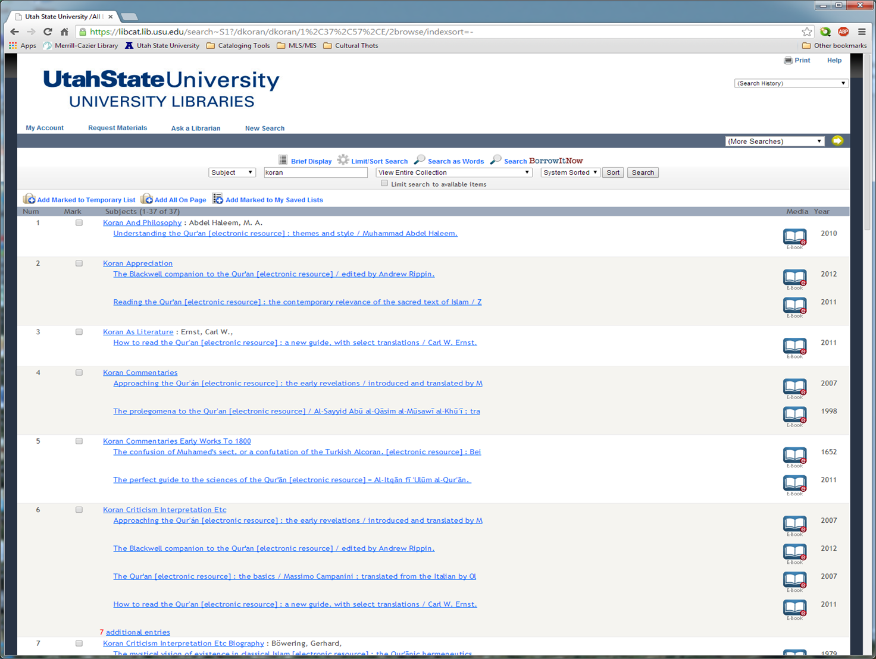
Notes:
Oh. Right. They’re ALL eBooks. And the subject references in eBooks didn’t change. Fabulous. So, if patrons are researching topics with subject headings that have changed recently (15 years is pretty recent for the Library of Congress…), they need to know that eBooks in our collections may still be using the old terms.

Slide 18
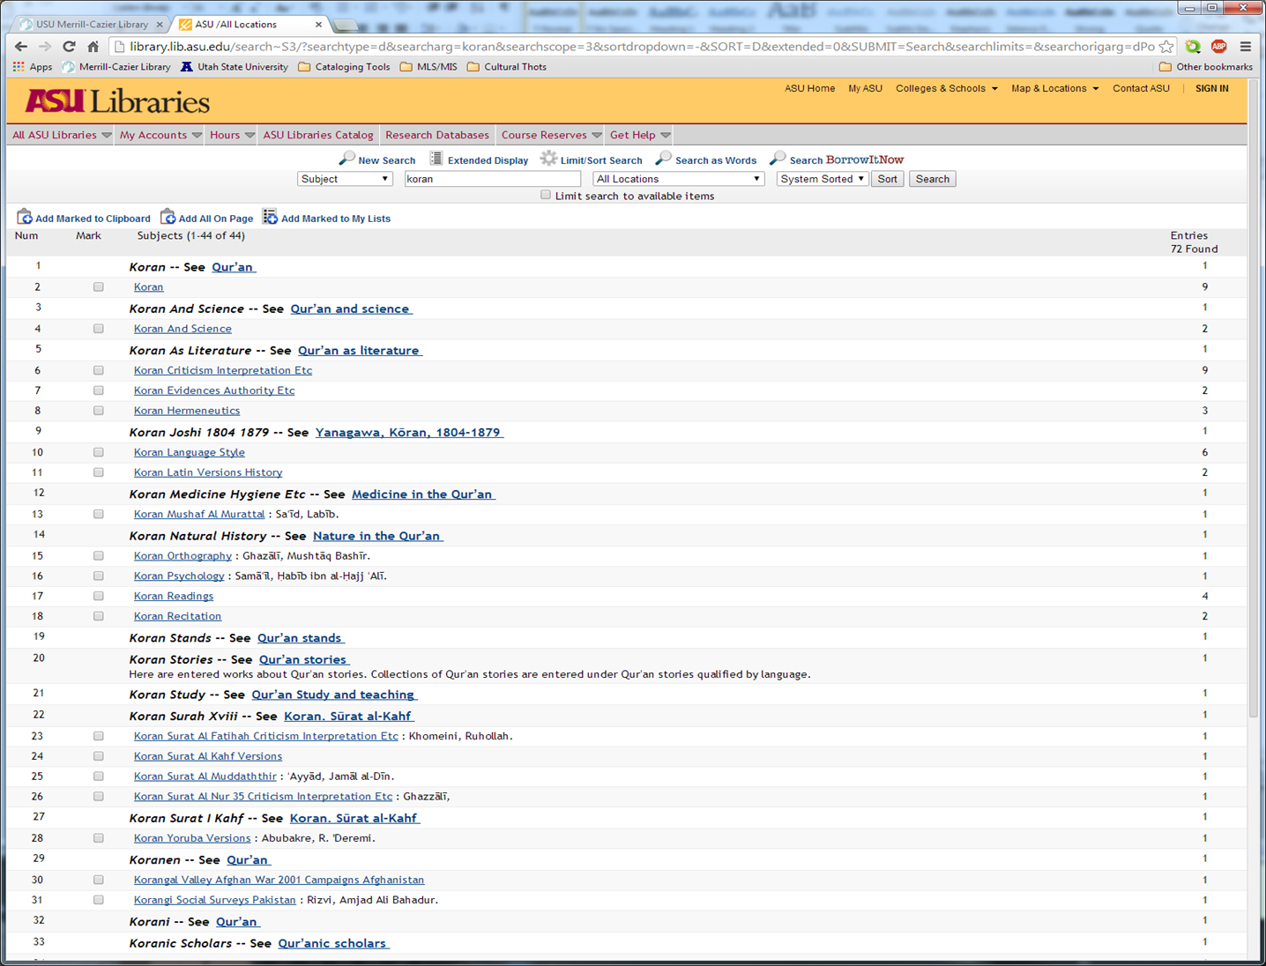
Notes:
Finally, one pretty example from another library. Arizona State University appears to be using Innovative’s software (notice the same tools at the top of the search window). However, when running a Subject search on “Koran” notice all the references generated to the new forms for subject headings using “Qur’an” instead of “Koran”. It’s so much more helpful (and pretty).
So, why the difference? Partially, the difference stems from having different works with different subjects. Only one subject heading with a reference to the new form is shared between the two catalogs (Koran Stories – See Qur’an stories), and three headings without references to new forms are shared. Those that remain behind appear to be subdivided headings (i.e., Koran—Criticism, Interpretation, Etc., or Koran—Orthography.). Such records DO exist in their new forms, and are in our catalog. So why don’t the references appear when “Koran” is searched instead of “Qur’an”? There are two reason: One, the new subject heading does not include a “Use For” reference back to the old heading, or Two, our catalog does not have an authority record for that subject heading. So, once again, we are left with searching for two versions of an authorized form, when one search should gives us all we want.

Slide 19
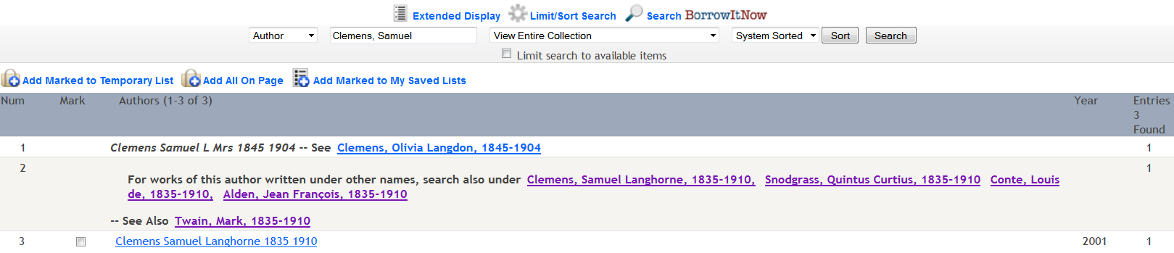
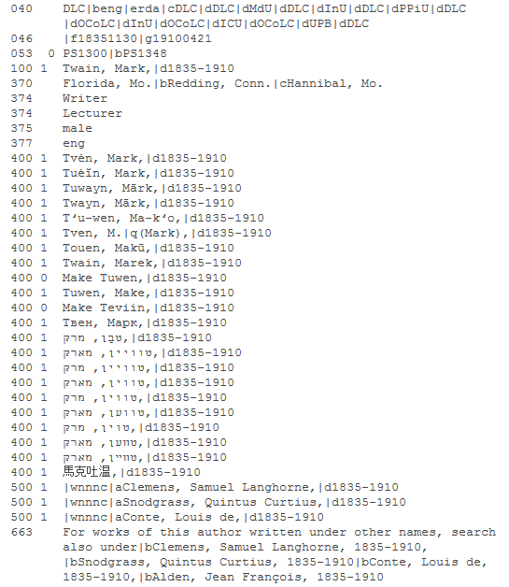
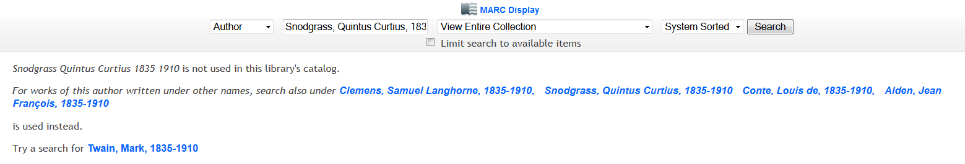
What will Patrons see? – Examples in Webpac
1. Search
2. Click on Reference
4. Click on MARC Display
3. View Record
5. View Authority Record
Notes:
We’re going to do an author (1) search in Webpac for Clemens, Samuel that brings up this list in the middle of the slide. We look at the list and see the note “For works of this author written under other names, search also Clemens, Samuel Langhorn, 1835-1910, Snodgrass, Quintus Curtius, 1835-1910, Conte Louis de, 1835-1910, Alden, Jean Francois, 1835-1910” and then a separate listing for “Twain, Mark, 1835-1910.”
Snodgras, Quintus Curtius is an interesting name so let’s (2) click on that name. Which then brings up a (3) message that reads “Snodgrass Quintus Curtius 1835-1910 is not used in this library’s catalog” and then the same message we received for our original Clemens, Samuel search: For works of this author written under other names…” and so on. And then it tells us to “Try a search for Twain, Mark 1835-1910.
Ok, but then at the top we see an icon and the words MARC Display. Now, granted most patrons are not going to know what that means or probably even really see it, but for us we’re power searchers so we’re going to (4) click on that and see what happens. Low and behold it brings up the (5) actual authority record for Twain, Mark, 1835-1910 that then lists the various forms of his name and other pseudonyms used by him.
It is important to note at this time that this option of MARC Display is not always available and, right now anyway, Webpac does not easily bring up the actual authority records for patrons to view.
Andrea

Slide 20
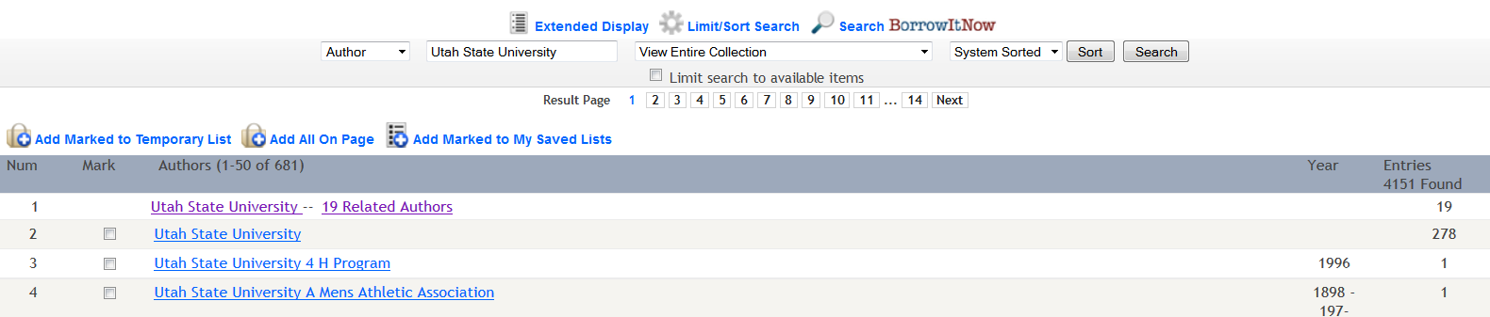
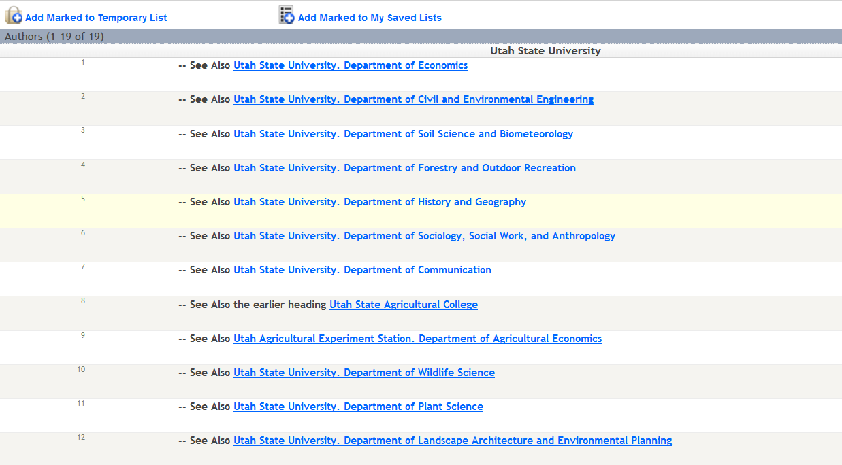
1. Search
2. Click
3. View Record
Related narrower terms
Earlier heading
Notes:
So, let’s do one more (1) search for Utah State University as an author.
As you can see in our search results list, it shows us that Utah State University has 19 related Authors. Now to actual look at bibliographic records that have Utah State University listed as an author that you would click on number two in the list. However, since we’re interested in the authority control aspect of Utah State University as an author we are going to (2) click on the reference given in the first line.
This (3) brings up a variation of an authority record that lists several related narrower terms for the university and then an earlier heading listing. The latter being important since the university has changed it’s name four times in its history.
Now we’re going to turn the time over to Melanie who is going to talk about how authority records work and show in Encore.

Slide 21
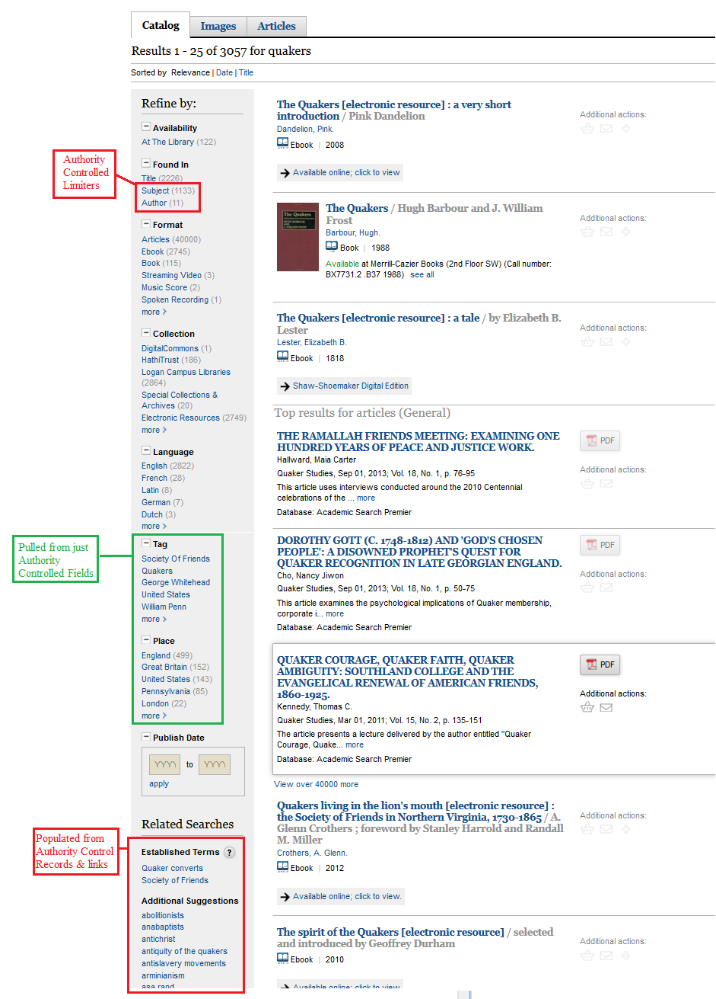
Initial Search:
(as keywords)
Found in:
Subject
Author
(as keywords)
Refine by:
Tags
Places
(as keywords)
Related Searches:
Established Terms Additional Suggestions
(as keywords)
ENCORE
and Authority Control
or,
How to make
a Salt Shaker
Disappear
Notes:
Encore doesn’t display authority records or Authority Control structure.
Searches all fields in its Search, including AC fields—but makes more use of AC fields in Encore’s Refine by sidebar in the results screen.
Found in Subject or Author limits to AC fields.
Tag and Place terms are pulled from AC fields, usually subjects.
Related Searches appear to be pulled from Authority Records themselves.
Melanie

Slide 22
1. Authority Records
2. More consistency in Authority Controlled fields
Authority Control
Improvements in Encore
Example: Joan Shaw, local author and editor, used three forms of her name in her career, and before authority control, she would need to be searched using all forms of her name in our catalog:
  Shaw, Joan, 1930-
  Shaw, Joan K.
  Shaw, Joan Katherine.
After the cleanup, all old forms of her name are updated to the authorized “Shaw, Joan, 1930-”

Slide 23
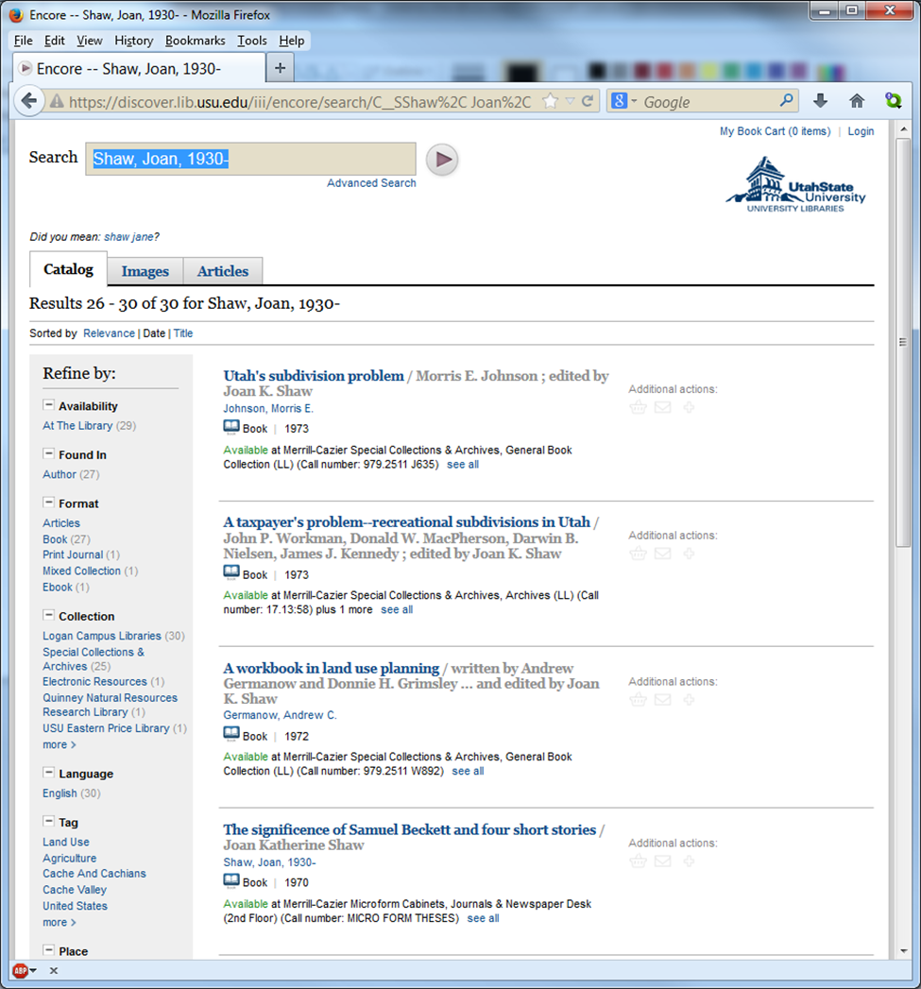
Notes:
1. AC shows up best with unique search words in Encore: such as “Shaw Joan 1930” or “Quakers”
2. For non-unique terms Encore can be frustrating.

Slide 24
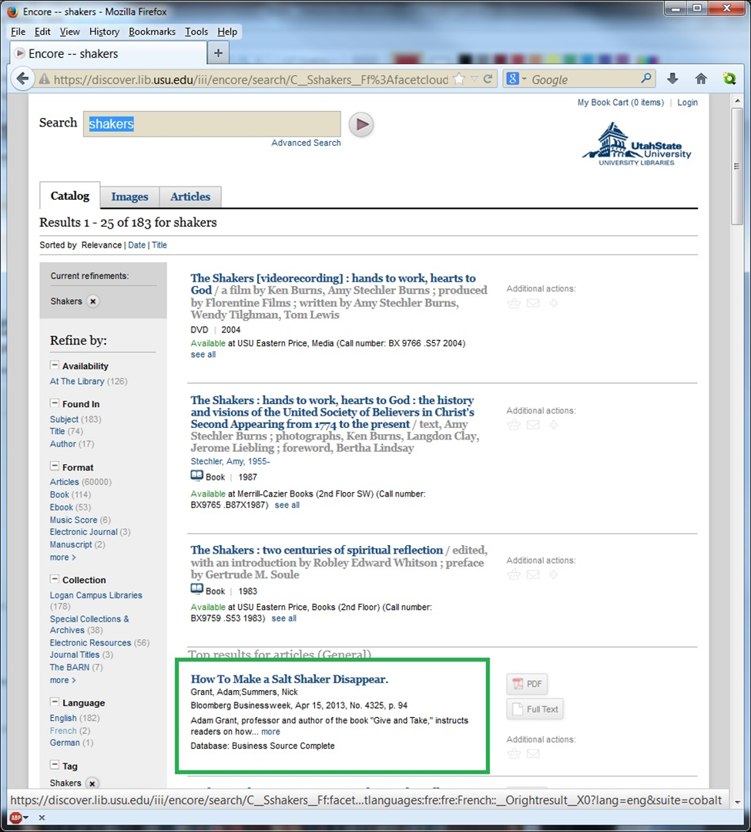
Notes:
Here I’m deliberatively testing Encore’s use of AC by searching for a term having many meanings in English: Shakers.
Naturally, I found, mixed in with my result, a lot of false drops,
including amusingly How to Make a Salt Shaker Disappear, plus 3 books on salt & pepper shakers, and a few books with “Movers and shakers” in the title….

Slide 25
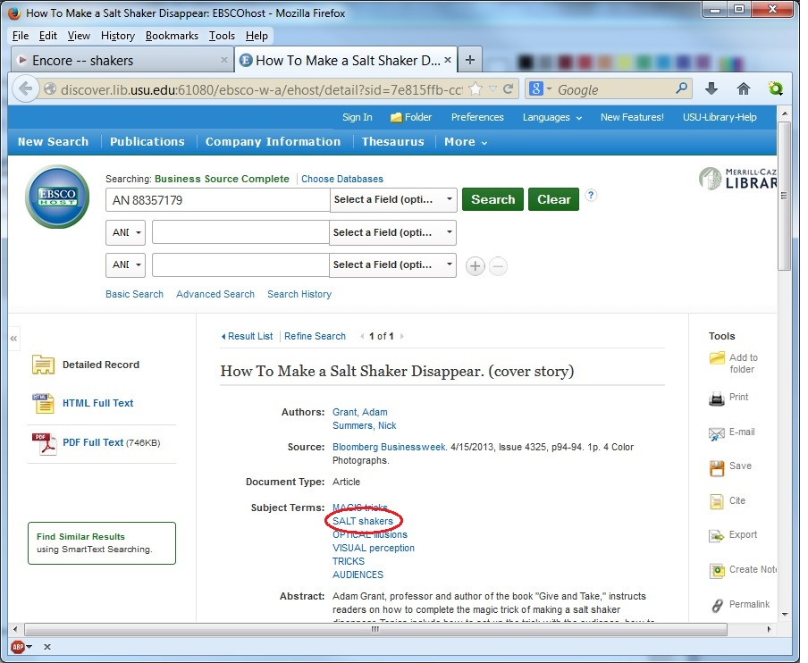
Notes:
2. I tried using Encore’s Found in Subject & then Encore’s Tag of “Shakers”, but this only got rid of the “Movers and shakers” titles. Encore’s uses all refinements as keywords, and here looking in the record for Making a Salt Shaker Disappear I see that “Salt shakers” is one of the subject headings.

Slide 26
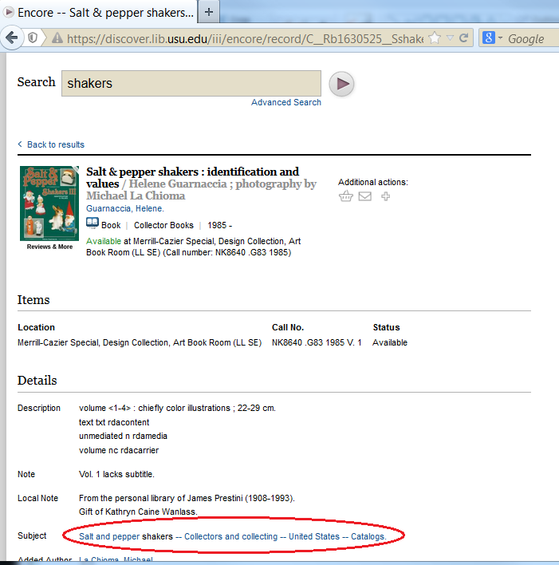
Notes:
…and the Salt and Pepper Shaker books have the subject heading of “Salt and pepper shakers”—
Encore doesn’t care where the word “Shakers” is, as long as it is in the chosen fields somewhere.

Slide 27
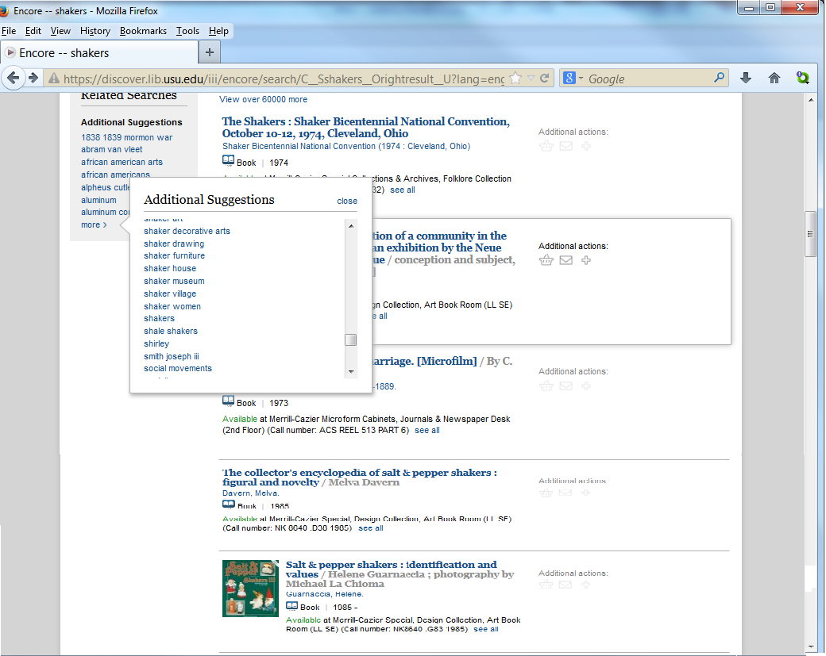
Notes:
3. How about Encore’s suggested searches. Here I tried the suggested search on the authorized term of Shakers.

Slide 28
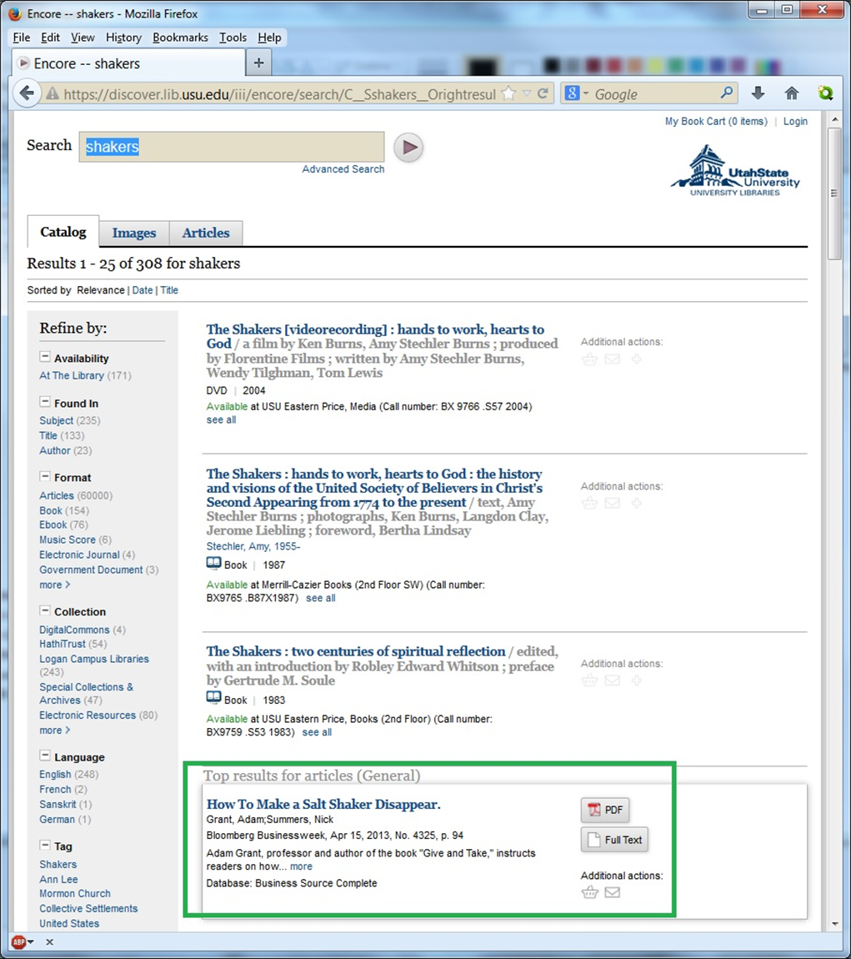
Notes:
This ran a new search: ….but the Salt Shaker article (and the salt shaker books) are still there. Why?
I asked Innovative, and it turns out the Additional Suggestions searches simply run a regular keyword search of the entire record, not just the AC fields.
This is apparently something only a cataloger would be surprised by.

Slide 29
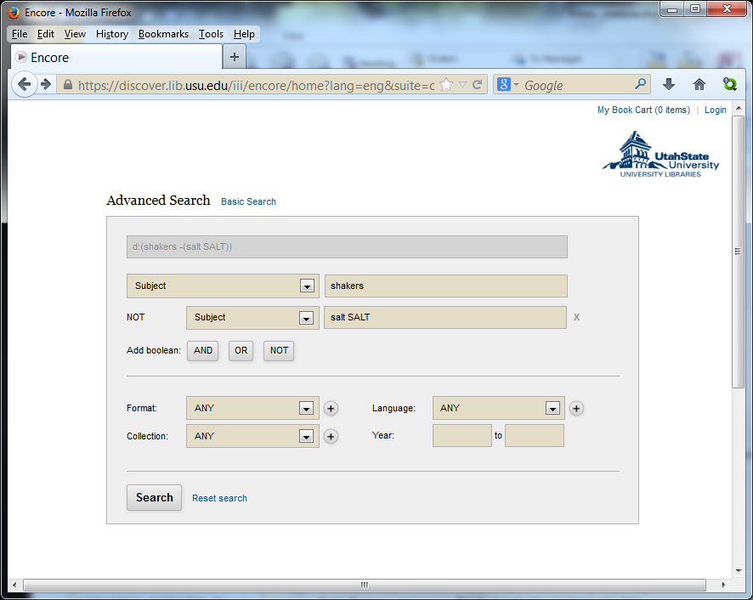
Notes:
So moving on to Encore’s Advanced Search: where I was able to restrict my search term of “Shakers” to subject, and a Boolean operator NOT (also limited to Subjects) to get rid of Salt in the subject fields.

Slide 30
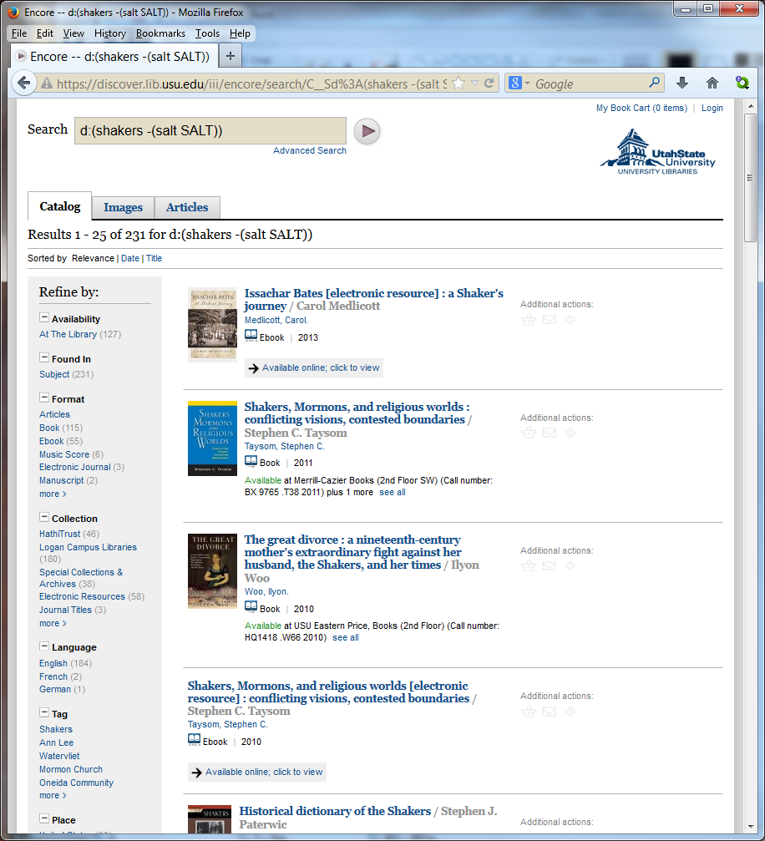

Notes:
Poof…And it works! The salt shakers are gone…and the results titles have been shifted around, but I found all the titles I want were still there in the list of titles, and the salt shakers are gone…But I suspect most folks would have given up about 4 screens ago.
I guess Encore use of AC can be sort of OK, with unique authority controlled terms, but for common words with multiple meaning, it’s messy and requires a lot of perseverance on the part of the searcher to get decent results.

Slide 31
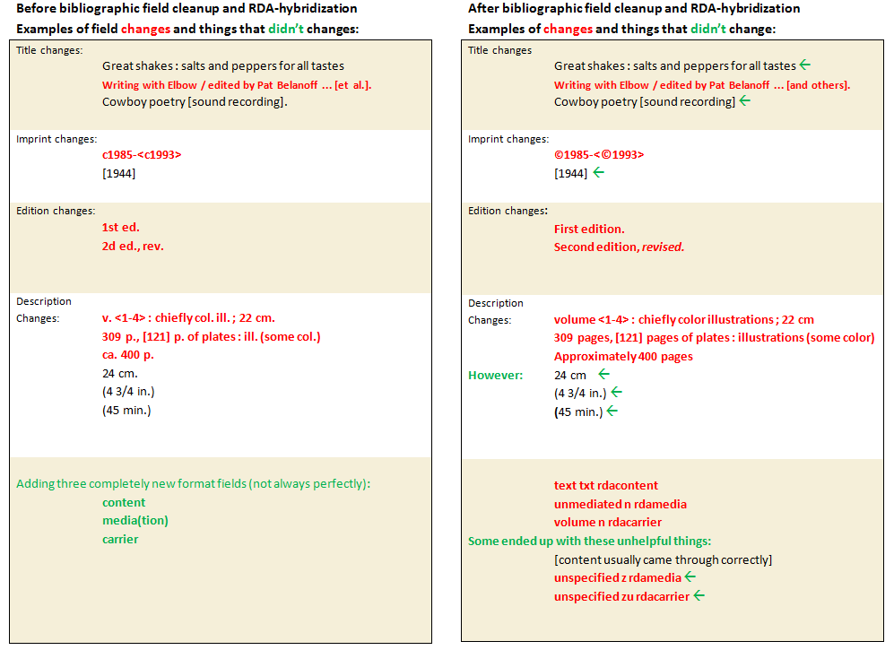
Rda bibliographic hybridization
Notes:
Along with all the work Marcive did on the Authority controlled headings and records; Marcive also did an update of our older bibliographic records, to make them more consistent with our new RDA cataloged bibliographic records. Here you can see, on the left, samples illustrating what we had Marcive hybridize, and what we did not.
All Latin abbreviations are converted to English phrases.
We did not have the bracketed format/general material designations removed.
We didn’t do much to the imprint or publisher fields—you will see c updated to the copyright symbol.
The largest changes are in the edition and descriptive fields: most abbreviations are now spelled out. However, note the few exceptions (in new RDA rules as well)—dimensions and time are still abbreviated.
All the older records now have the three new format fields: content, media (or mediation), and carrier. In most cases Marcive’s software was able to assign these without problems, but in some cases you’ll see the word “unspecified”—these were assigned when there was more than one possibility available, and the software (not being a human being) couldn’t make a choice between them. For instance music scores, which could be either a leaf (sheet, in RDAese) or several (volume, in RDAese). Email us if you find examples of “unspecified”s that particularly bug you (or a patron) and we’ll fix them.

Slide 32
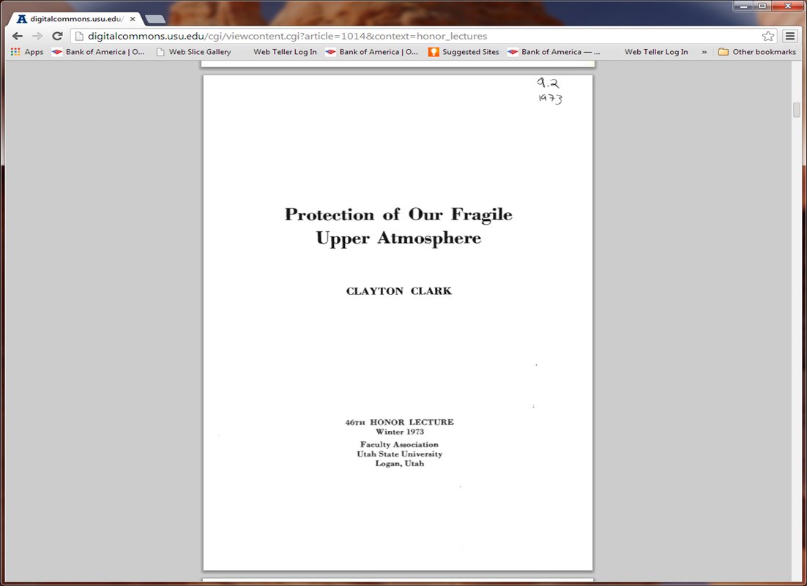
Authority Control
Mismatches
Notes:
Kurt

Slide 33
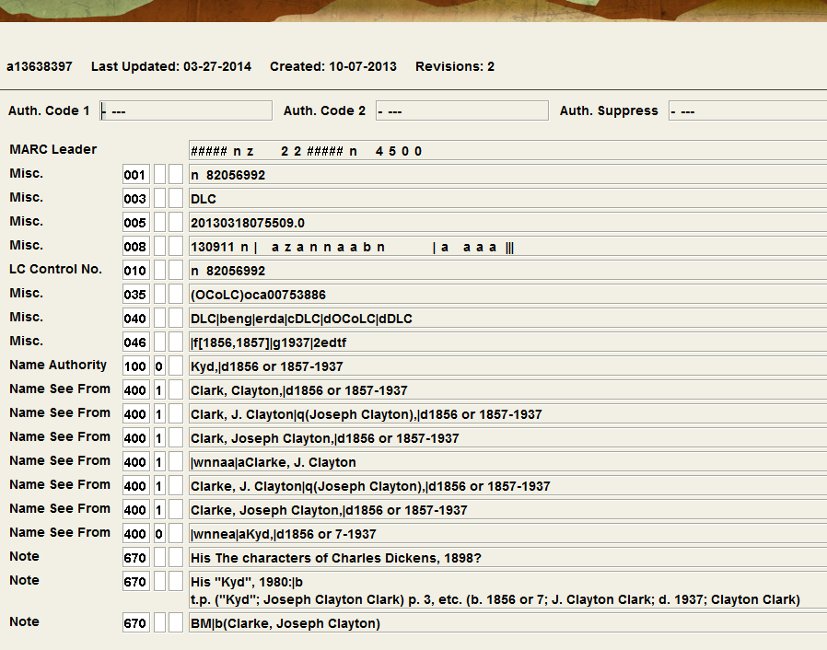

Slide 34
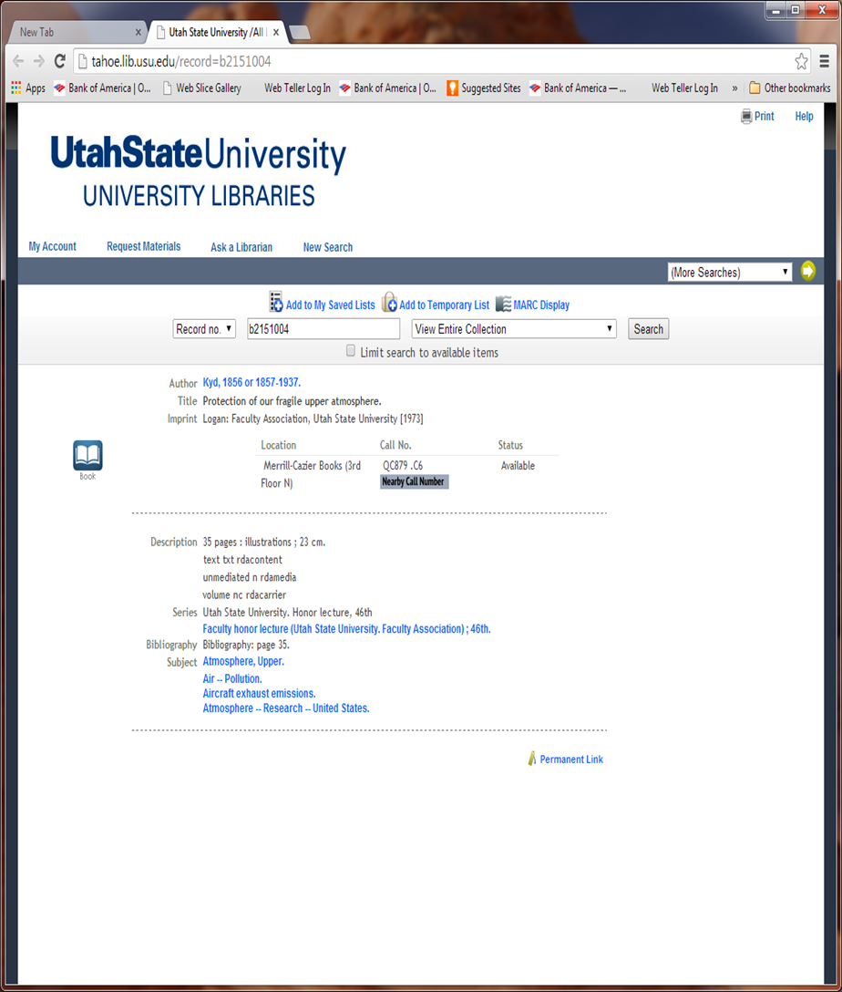

Slide 35
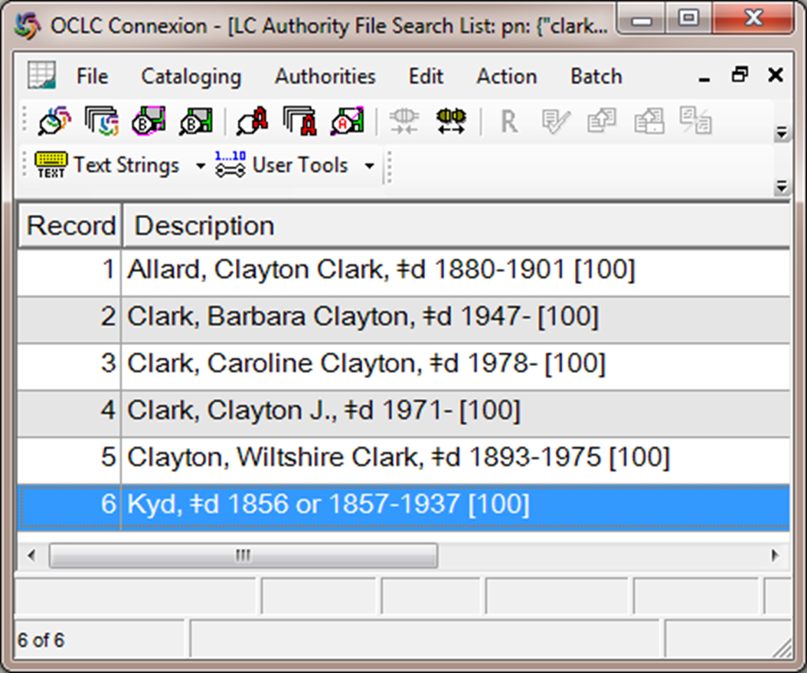

Slide 36
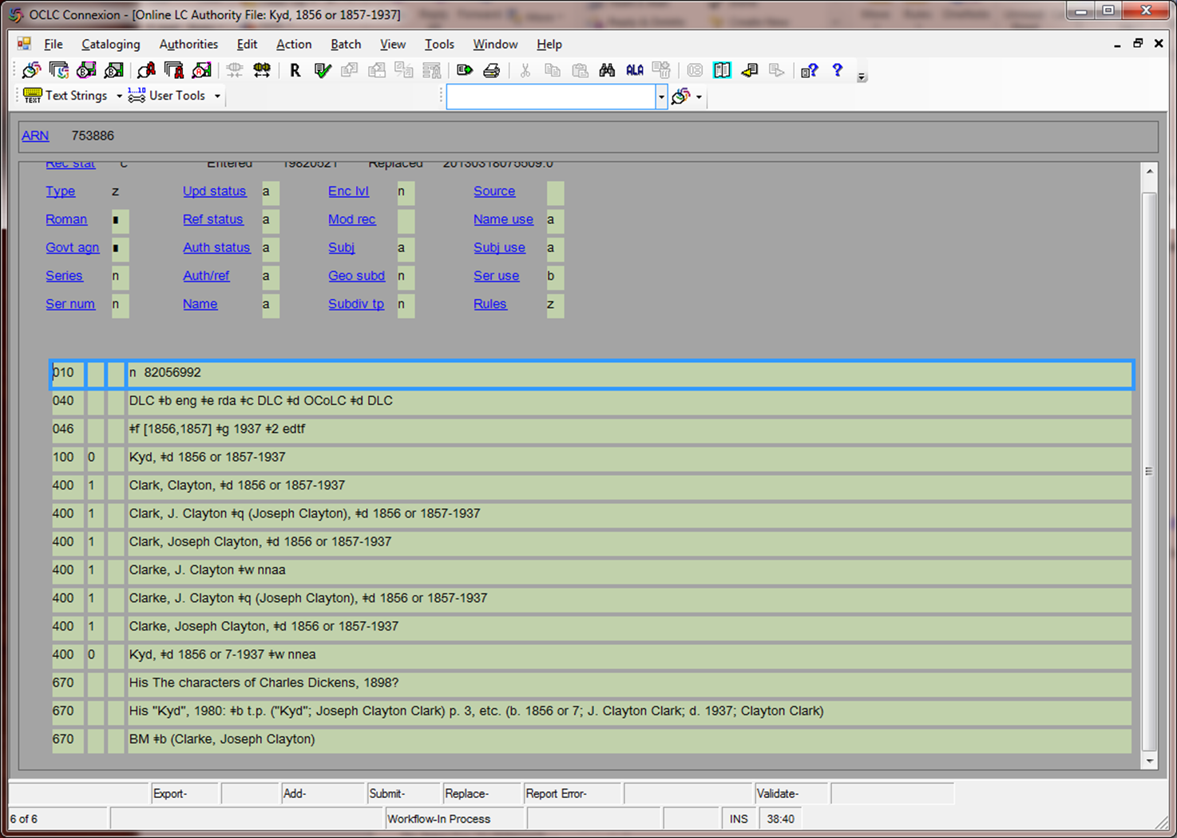

Slide 37
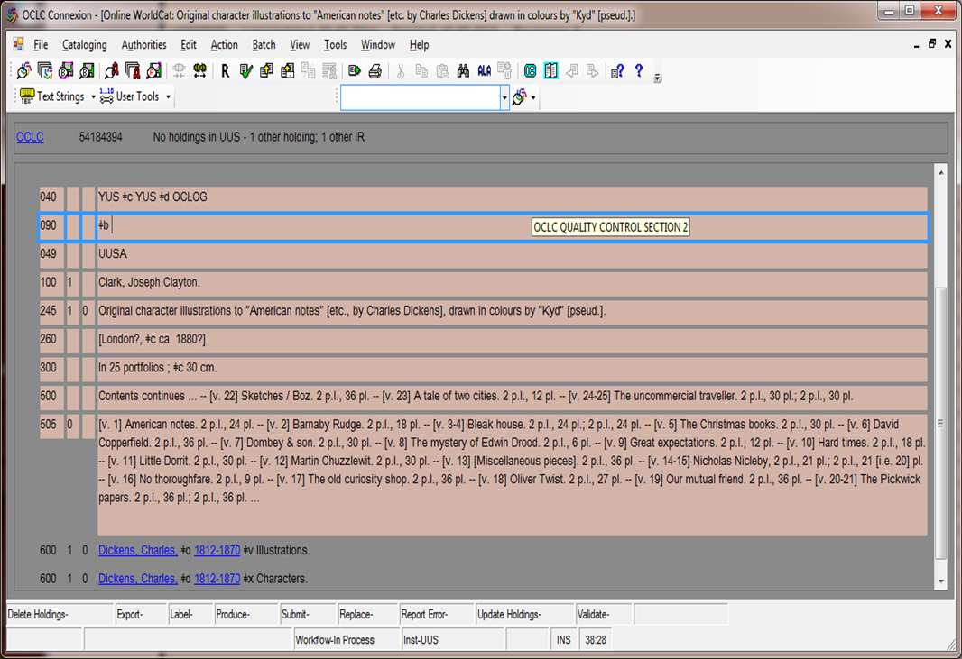

Slide 38
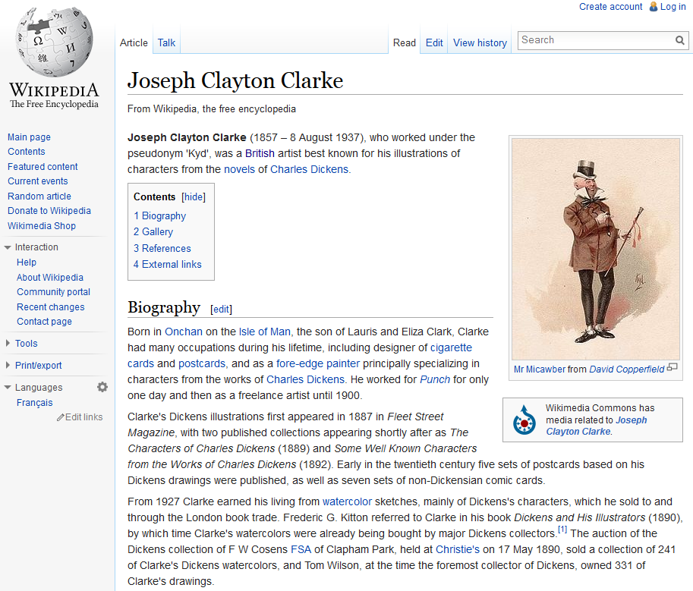

Slide 39
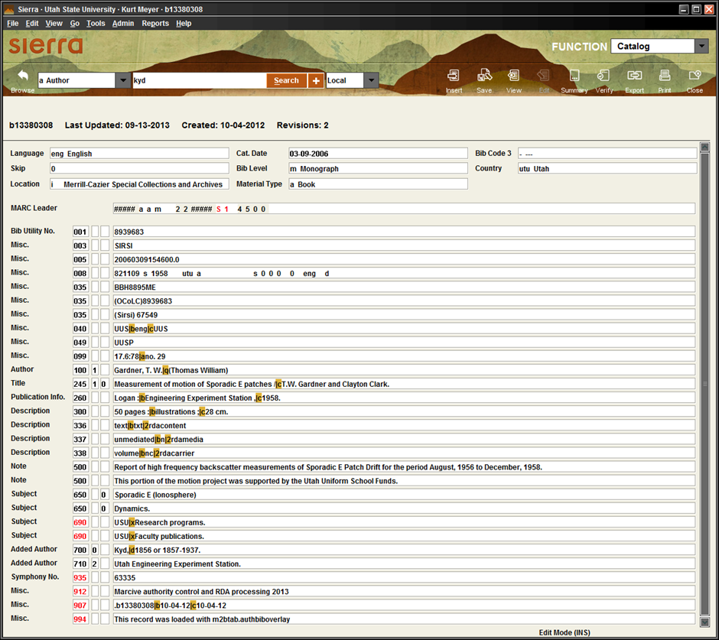
Not the same person as

Slide 40
Authority Control
Ongoing Updates
Monthly files loaded from MARCIVE
  Notification service – Updates previous authority records
  New match service – Finds authority records not found in original update
  Overnight service (current cataloging) (not done) – Finds authority records for new catalog records
Notes:
Mavis

Slide 41
Ongoing Updates
Costs
Original update (backfile) = $34, 681
Another big update in 5 years = $37,081
Ongoing updates over 5 years = $16,676

Slide 42
Ongoing updates
Do we need them?
Name changes – e.g. through marriage or divorce
RDA (Resource Description and Access) – rule changes
Undifferentiated names – guidelines changed

Slide 43
RDA
In 2012-2013 – LC reissued 640,000 authority records for RDA – 5% of NAF (Name Authority File)
Phase 1 – by July 2012
  313,000 records
  Added 667 field to indicate must update
Phase 2 – by March 31, 2013
  328,000 records
  Automatically updated
See: Backstage: Library of Congress to reissue 640,000 authority records for RDA
http://www.bslw.com/wordpress/2012/07/library-of-congress-to-reissue-640000-authority-records-for-rda-2/

Slide 44
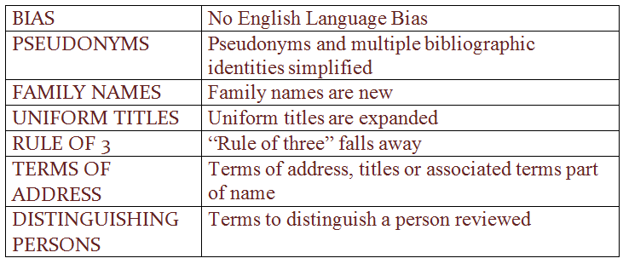
RDA vs AACR2
Changes

Slide 45
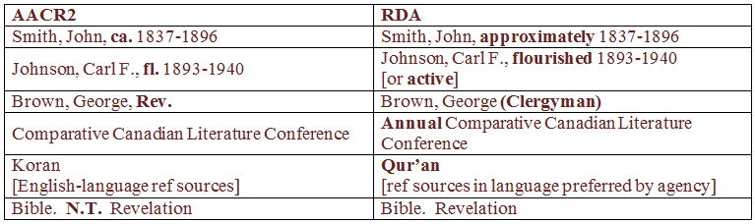
RDA vs AACR2
Examples
SEE: – Changes from AACR2 to RDA. Part 2: Access points, by Adam Schiff (PowerPoint)
http://faculty.washington.edu/aschiff/OCLCPresentation-Part2.ppt
EXAMPLES: Persons 19, 20, 22, Corp bodies 31, 32, Sacred works 37, 39

Slide 46
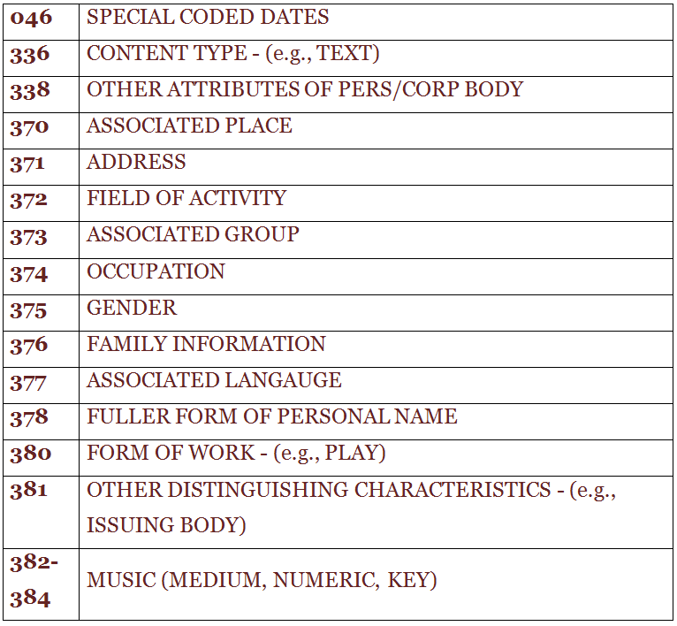
RDA
New MARC Fields

Slide 47
Undifferentiated Names
Past practice – used same record for multiple people – when insufficient information of correct type to distinguish
  See: The future of undifferentiated personal name authority record and other implications for PCC authority work, by John J. Riemer and Philip E., Schreur, Feb 14, 2012, updated May 8, 2012
  www.loc.gov/.../Undiff%20Personal%20NARs%20D [url not complete]
New guidelines (Nov. 2013, LC/PCC) – create a unique authorized access point for each person – using RDA attributes to distinguish
  See: Descriptive Cataloging Manual. Z1. 008/32 Undifferentiated Personal Name
  http://www.loc.gov/aba/pcc/rda/PCC%20RDA%20guidelines/Z01%20008%2032%202014rfeb.pdf

Slide 48
Differentiated Names Now Required
VIAF (Virtual International Authority File) – operated by OCLC, links national authority files
RDA MARC elements – e.g. place, occupation, field of activity, etc.
Synchronization – between headings in bibliographic records and authority records
Semantic Web – requires addressable authority data
See: The future of undifferentiated personal name authority record and other implications for PCC authority work, by John J. Riemer and Philip E., Schreur, Feb 14, 2012, updated May 8, 2012
  www.loc.gov/.../Undiff%20Personal%20NARs%20D [url not complete]

Slide 49
New Focus
From:
  Correct headings
To:
  Entity registration
  Storing identifying information in authority records
See: The future of undifferentiated personal name authority record and other implications for PCC authority work, by John J. Riemer and Philip E., Schreur, Feb 14, 2012, updated May 8, 2012
  www.loc.gov/.../Undiff%20Personal%20NARs%20D [url not complete]

Slide 50
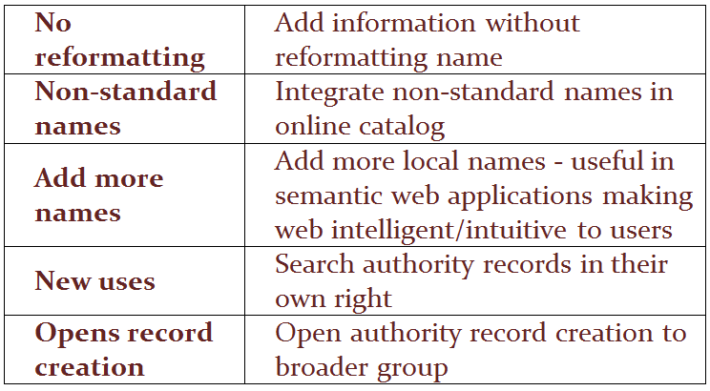
Advantages of New Focus

Slide 51

Linked
Data
Psst…. you’re already doing it.
Notes:
Liz

Slide 52
Linked Data
1st step: Create a URI
  EVERYTHING has a Unique Resource Identifier (URI)
    Functions like:
      Zip Codes
      Barcodes
      ISBN
      DOI
  URI is the ID #/address for the new authority record
    Current: Twain, Mark, 1835-1910
    Changing to: http://viaf.org/viaf/50566653

Slide 53
Linked Data
When humans search, we use this:
Twain, Mark, 1835-1910
Mark Twain
And that doesn’t even cover different languages:
Clemens, Samuel Langhorne, 1835-1910
But our records sometimes look like this:
توين، مارك،‏
Twain, Mark, 1830-1910
טוין, מרק,
Clamens, Samuel Langhorne, 1835-1910
Твен, Марк

Slide 54
Linked Data
Keyword searches were complicated by:
  Spelling errors, Typos
  Pseudonyms, Synonyms, etc.
  Language barriers
Humans can overlook many of these things, but machines function on absolutes, so we give them this:
    http://viaf.org/viaf/50566653

Slide 55
Linked Data
2nd step: Create connections
  Use RDF triples….
….. to show connections
Mark Twain is the author of The Adventures of
Huckleberry Finn
    http://viaf.org/viaf/50566653
dcterms:creator
http://viaf.org/viaf/178806136
…. to link authority different records
Logan (Utah) is the same as Logan
http://viaf.org/viaf/124340969
owl:sameAs
http://www.geonames.org/5777544

Slide 56
Future Systems
Will incorporate the URI/Linked Data behind the scenes
Will have Linked Data for just about every kind of entry that uses a controlled vocabulary, including:
  Names
  Titles
  Geographic Locations
  Material Types

Slide 57
Future Systems
Will use the standardized entries to:
  Create smoother interfaces
  Talk with other systems

Slide 58

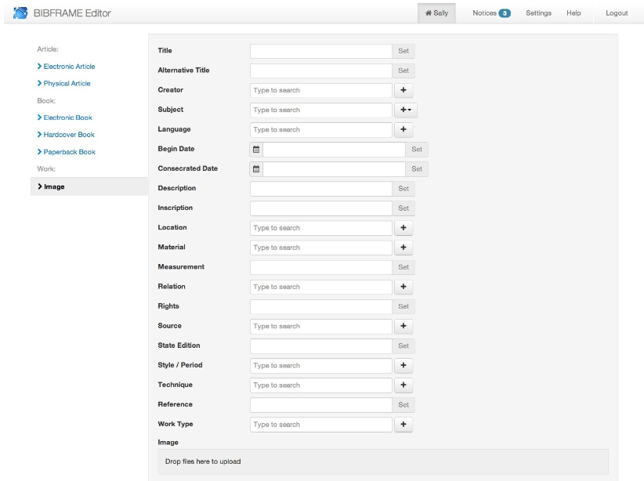
BIBFRAME

Slide 59
Want to learn more?
Check out these sites:
  Learning Linked Data: http://lld.ischool.uw.edu/wp/learning/
  A Skim-read Introduction to Linked Data: http://www.bbc.co.uk/blogs/legacy/radiolabs/s5/linked-data/s5.html
  BIBFRAME: http://bibframe.org or http://www.loc.gov/bibframe/

Slide 60

Questions?

