Slide 1
Let’s Get Digital!
Best practices in building digital collections for your community, by your community
Utah Library Association Conference
May 3, 2013
Liz Woolcott (Utah State University)
Paul Daybell (Broadview University)
Andrea Payant (Utah State University)
Becky Skeen (Utah State University)

Slide 2
Welcome to Mendon
Notes:
-Mendon – community in Cache Valley
-Community members donated a number of photographs and documents of town history to USU Special Collections
-Collection is being processed by community members during their free time, so it is slow
-Digitization began before processing was completed, so a large number of items have no identification

Slide 3
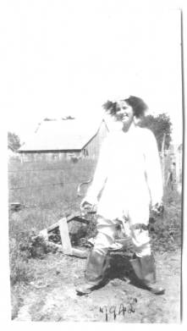
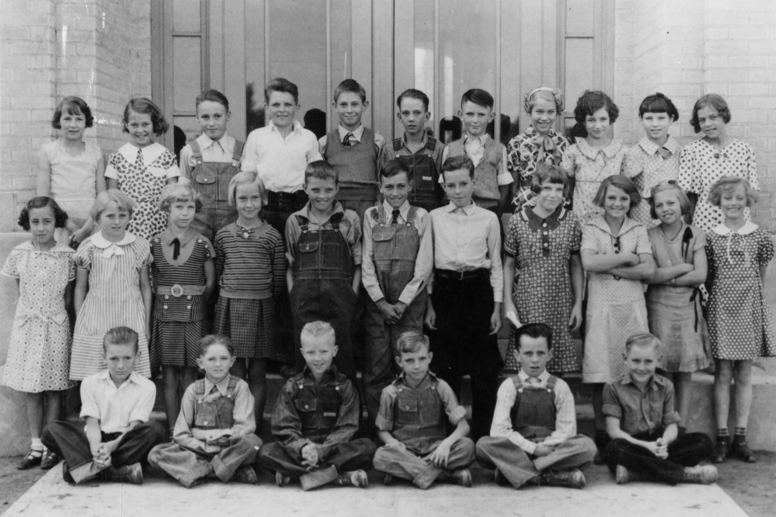
It’s not enough to just upload a scanned photo…
The problem:
Title: Woman standing in weeds with boots on, 1942
Title:
Students outside of schoolhouse, 1930’s
Notes:
The problem with just digitizing these images and putting them up with vague metadata is that they aren’t useful. Few people search for “Woman standing in weeds with boots” or “Students outside of schoolhouse”. But after some help from local Mendon residents, someone searching for “Carma Stauffer Bradshaw” could pull up both of these photos.

Slide 4
Crowdsourcing Strategy
2 point approach
In-person
Meetings with local groups
Individual interviews
On-line
Webforms
Comments/Tagging
Advertising
Community outreach
Partnering with other libraries

Slide 5
Strategy 1: In-Person
Local Groups
By Paul Daybell

Slide 6
Getting Started
Find your partners
Determine who the best people and organizations are in the community to help establish the project (i.e. local historical societies, historians, local leaders, etc.)
Know your audience
Who in the community will be the most likely to assist with your project?
Who in the community is most likely to have the most information?
Target the locals
Get a direct point person in the community to serve as your partner in crowdsourcing crime.
Meet with community leadership first to sell the project and get advice as to how best to proceed.

Slide 7
The Meeting
Initially met with small group of local historical societies and interested community members. Examples:
Daughters of the Utah Pioneers
Local history photographer
Cache Valley history collector
Mendon library representatives
Mendon city officials
Gave a short presentation describing USU’s:
Digital Work
Tour of Digital Library webpage
Tour of current Mendon Collection with an emphasis on the photo collection
Examples of webforms and how visitors can offer content suggestions to be added to the metadata.
Offered a few photographs to show how the community’s collective memory could benefit the collection.

Slide 8
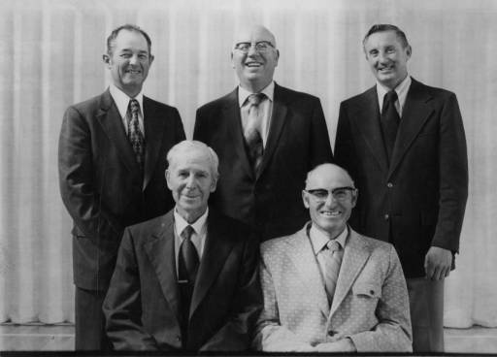
Example #1
Information Before:
Title: Group of five men, 1970’s (Mendon72)
Description: Group of five men, 1970’s
Information After:
Title: Past Bishops of Mendon Ward, 1973
Description: Photograph of past bishops of the Mendon Ward, Church of Jesus Christ of Latter-day Saints, 1970s. Includes (top row, left to right) Zeno H. Andersen, Fred W. Sorensen, and Stan S. Barrett, (bottom row, left to right) John O. Hughes, and Rulen C. Ladle. John O. Hughes was Bishop from 1952-1956, Rulen C. Ladle was Bishop from 1956-1962, Fred W. Sorensen was Bishop from 1962-1967, Zeno H. Andersen was Bishop from 1967-1973, and Stan S. Barrett was Bishop from 1973-1978.

Slide 9
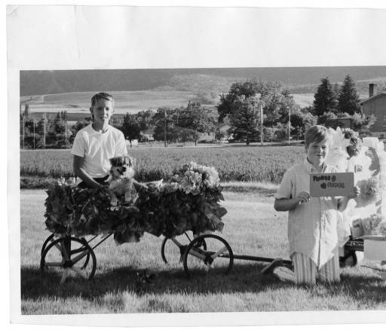
Example #2
Information Before:
Title: Two boys and a wagon
Description: Two boys and a wagon during a parade, possibly for May Day or the July 24th celebrations.
Information After:
Title: Tony Buist (in wagon) and another unidentified boy.
Description: Tony Buist (in wagon) and another unidentified boy. Sign reads “Flower Power.” The photograph was taken on Main Street in Mendon, Utah, looking west and slightly south across the town square. Identifying information for this photograph was generously provided by J. Watkins and Ed Buist.

Slide 10
Initial Lessons Learned
Keep organized!
The need to create and utilize a better way to gather information. (8 people talking and 1 person scribbling notes = Bad)
Community members were excited to contribute information. Felt like they were looking through an old family photo album.
The collective knowledge was invaluable for gathering metadata.
It is necessary to build strong relationships with community leaders.
The need to market the value of the collection and the value of their contribution. Make them feel ownership.

Slide 11
Strategy 1: In-Person
Individual Interviews
By Becky Skeen

Slide 12
Getting started
Review digital collection and originals
Add metadata found on original materials
Look for duplicate scans
If multiple interviews, go through information given in previous interviews and identify if further information is needed
Contact community point person
Decide who to interview
Setup interviews - If possible, get another family member or friend to come to the
interview
Materials and equipment
Decide what materials you want to show the individual for identification
Prepare material for identification
Reserve needed equipment (if any)
Perform the interview

Slide 13
The Interview
Who to interview
Decided older community members were more on par with the age of the photographs that needed identification
Met with 2 individuals so far
Community point person setup one interview
Through networking heard about another person to interview and set that appointment up ourselves
Introduction and goals
Introduced ourselves
Decided where to conduct the interview
Gave background information on the digital collection and what we were hoping to achieve through the interviews
Setup the recorder and pulled images for review
Identifying the images
Very receptive to the photographs
Kept talking about how fun it was to “stroll down memory lane”

Slide 14
Examples
Viewing Sheet
Documentation sheet

Slide 15
Interview in Progress

Slide 16
Lessons Learned
Very beneficial to have a point person or family member at the interview
One-on-one interview made discussion, identification, and documentation easier
Community members eager to help contribute information if they can
Be prepared - interviews can take a lot of initial preparation so it’s good to give yourself time to do it properly
Good to double check the address of where you are meeting for the interview

Slide 17
Strategy 2: On-line
Webforms &
Commenting
By Liz Woolcott

Slide 18
Getting Started
Recognizing target audience
Recognize that on-line information submission won’t appeal to everyone
One branch of a crowd-sourcing effort.
Need to accommodate as many levels and preferences of on-line users as possible (within tech and budget constraints)
Make the webform submission process simple for less-tech savvy patrons
Don’t require too much personal information from contributors – they may not necessarily trust you
Where possible, make comment/tagging features visible
Evaluating the need for Quality Control and Accountability of information
Determined it didn’t matter if users submitted their names and contact information
Quality control could be determined on a case by case basis but generally wouldn’t be needed. Trust patrons more.
How and where to document user-submitted information
Considered a separate metadata field
How to make the information harvestable outside of our local system?

Slide 19
Webforms
Notes:
When viewing an item, a patron see this link just below the image. They can click on it to bring them to a webform where they can give further information.

Slide 20
Webforms
Notes:
Example of our webform. Specifics we are looking at in particular are People, Dates, Locations, Events, Creators. All fields are optional except the last one “Is fire hot or cold?” as a way to prevent email spam. Patrons can leave their preferred contact information and whether or not they would like to be credited.
At bottom of page (cut off in the image) is further disclaimers reminding patrons that no personal names or information are required for submitting info and that our library did not collection personal information of any kind and would never distribute it in any way.

Slide 21
Webforms
Webform response information sent in an email.
Notes:
When a patron fills out a form, the information is emailed to us. Rather than have the patron record which item they were looking at, the ID information for the digital object is included (referenced by the link the patron clicked). Metadata catalogers can access it by the convenient URL generated by the webform.
We send the information to the person in charge of that digital collection and they update the data for the item and

Slide 22
Webforms
Notes:
Information from the webform is used to improve other fields like Subject, Date, Spatial Coverage, Temporal Coverage, etc. Respondents are credited in the Description field.

Slide 23
Webforms
Notes:
The metadata person in charge of the item will email the respondent back with a personal email and any follow up questions they might have (if the respondent indicated they would be amenable to that). Included in the email is a link back to the item they submitted information for, so that they can easily access it to see the results of their efforts (possibly even forward the link on to family or friends during that spontaneous “look what I just did” moment.)
In some cases, the email has encouraged a conversation with the respondent, where they email back more information that they have gathered from family and friends.

Slide 24
Commenting
Notes:
In CONTENTdm, users have the option of commenting on items. The “Comment” button is listed and will take you to the bottom of the page where you can leave information. Patrons can post with their names or anonymously.

Slide 25
Commenting
Notes:
Results show up in the comments at the bottom of the page. We incorporate as much information from the comments as possible in harvestable Dublin Core metadata fields, since the comments are not searchable in CONTENTdm. We also leave a thank you comment to let the patron know that their comments are appreciated (assuming they come back to check) and also to let other potential contributors know that we welcome input.

Slide 26
Initial Lessons Learned
Goal is to be APPROACHABLE
Create a conversation with your community
Thank respondents for their information
Email respondents (when possible) and thank them for their contributions
Do NOT use a form response. Making it personal goes a long way toward encouraging future use.
Respondents leaving comments should have a return comment
Again, do NOT use a form response. Make it personal and friendly
Comments have more visibility, so making a friendly and grateful reply can encourage others to contribute information, as well as the respondent.
Designate someone to monitor emails and comments, but the responsibility for replies can be spread out to more than just one person
Best if the person responsible for initially creating the metadata (or who knows the collection best) provides the response.

Slide 27
Advertising
By Andrea Payant

Slide 28
Getting Started
Recognize, create, or act upon opportunities
Take advantage of established relationships
Explore new networking options and make contact
Follow up
Consider potential advertising locations
What local businesses/organizations will likely allow your advertising to be placed in their establishments?

Slide 29
Creating the Advertisements
Target audience
Do you want to generate interest in a specific collection or are your advertising goals more broad?
What type of advertising is best?
How do you want to communicate the information? Online ads or Physical ads?
Posters – Flyers – Mailers

Slide 33
Lessons Learned
Consider all your options – you never know who will be interested
What may be seen as a lost opportunity may actually open up new possibilities = referrals
Generating interest on any level is progress

Slide 34
Plans for the future
By Paul Daybell

Slide 35
Plans for the future
Community wide event connected with traditional celebrations (ex. July 24th)
Provides forum for community discussion
Promote the use of the digital collection
Collaborate with new partners to advertise/promote crowd-sourced collections
Newspapers
Other libraries
Implement this process into other new/existing collections in need of metadata

Slide 36
Questions or Comments?

