Slide 1
Geospatial Metadata
How maps can help you find stuff
Liz Woolcott
Utah State University
Kristen Jensen
Utah Department of Heritage and Arts

Slide 2
Why do we need geospatial metadata?
The Only 22 Countries In The World that Britain Has Not Invaded
Andorra
Belarus
Bolivia
Burundi
Central African Republic
Chad
Congo, Republic of
Guatemala
Ivory Coast
Kyrgyzstan
Liechtenstein
Luxembourg
Mali
Marshall Islands
Monaco
Mongolia
Paraguay
Sao Tome and Principe
Sweden
Tajikistan
Uzbekistan
Vatican City
blah blah blah ...
Notes:
Kristen
So we can make maps

Slide 3
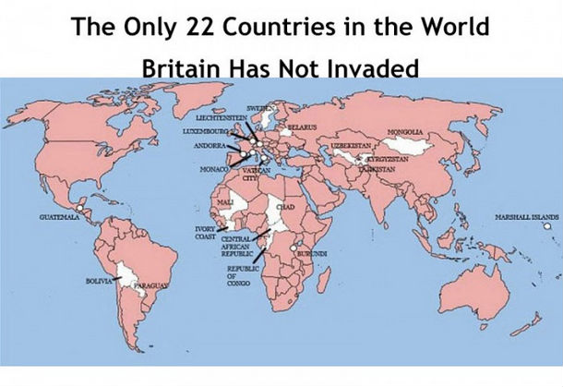
Why do we need maps?
Notes:
Kristen
More engaging. Link historical accounts to these countries

Slide 4
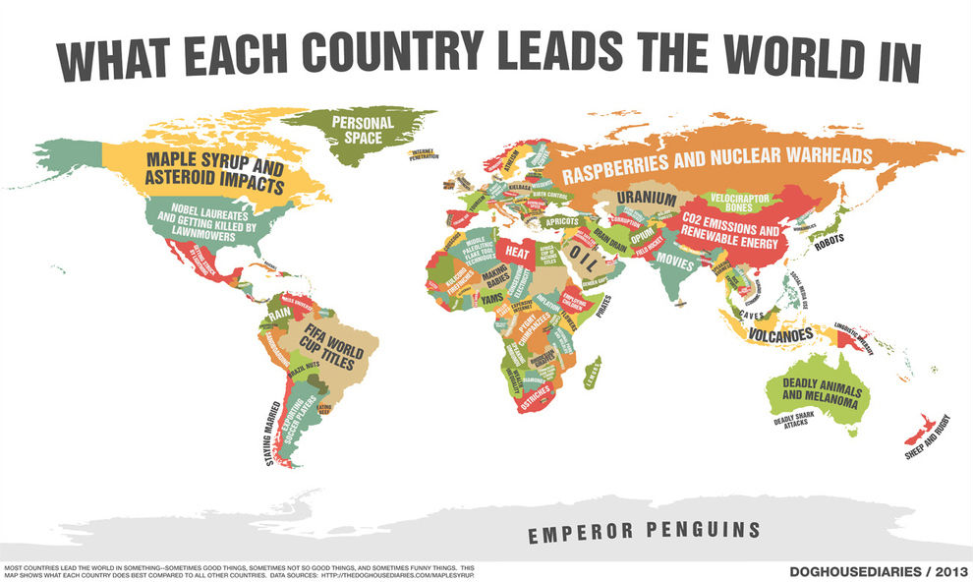
Why do we need maps?
Notes:
Kristen
Context, evokes conversation - users give back info

Slide 5
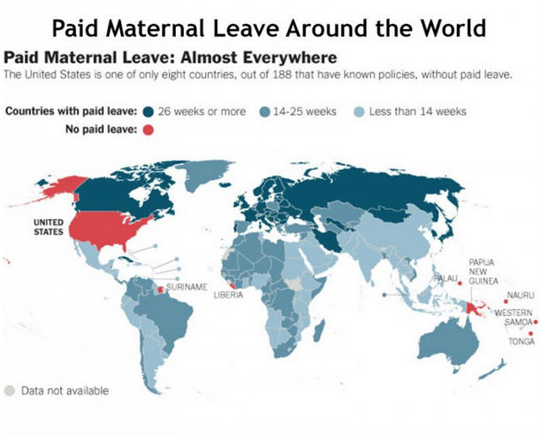
Tell stories
Notes:
Kristen
We could read a research paper about this. Or we could link the data and supporting documentation to places.

Slide 6
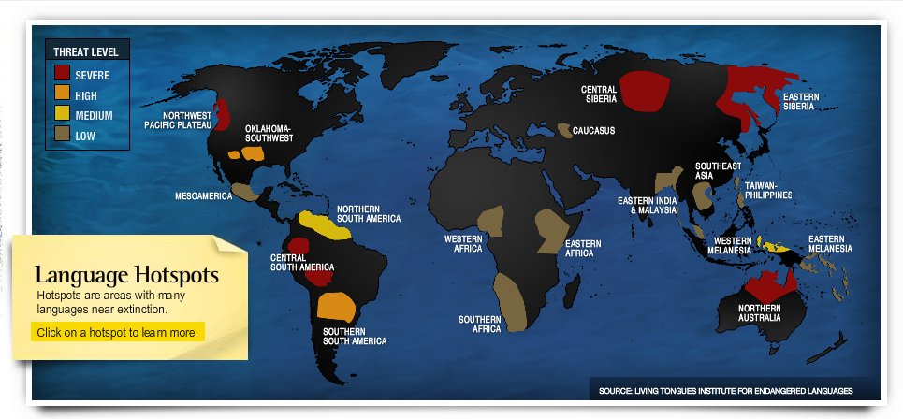
Interaction
Notes:
Kristen
Dynamic engagement with information
National Geographic

Slide 7
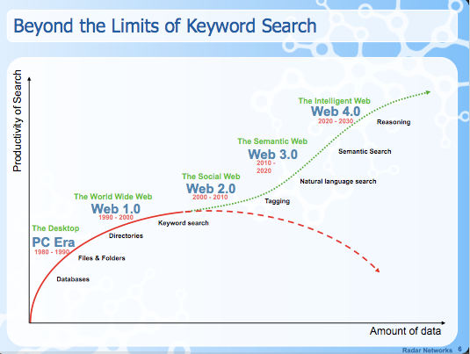
Keyword searches are so last century
Notes:
Kristen
Tech Crunch 2008
lack context, relationships to other info
Plug for the Linked Data Interest Group

Slide 8
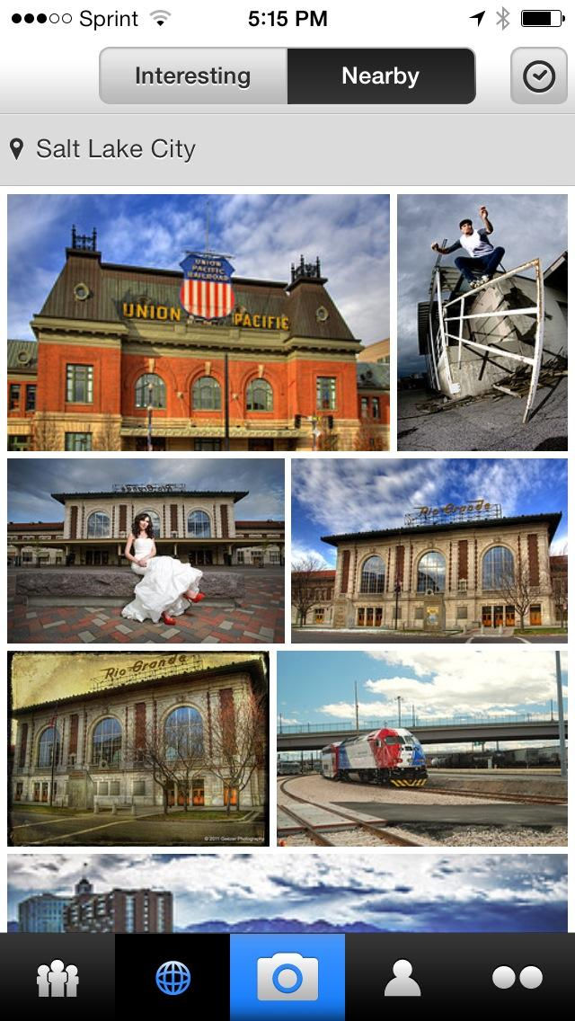
What if you could ...
Notes:
Liz
Flickr Nearby
Let’s take a minute and switch roles - from the creators of content or curators of collections - and look at it from a user’s standpoint
Here’s an interesting user app - called Flickr Nearby - lets you see not just images that people have uploaded to Flickr, but images of things nearby you - something in relation to YOU as the user.
What if you could….
See photos taken of places that were nearby you

Slide 9
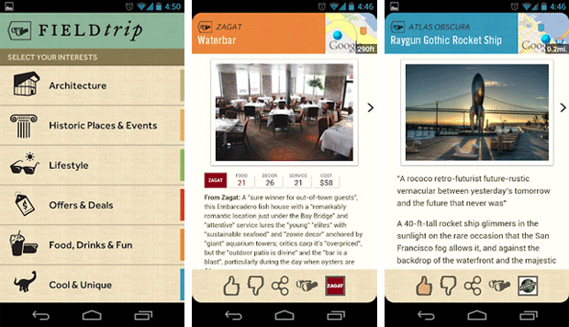
What if you could ...
Notes:
Liz
Here is something similar - the Fieldtrip app. Takes your GPS location and shows you interesting things near your location (historic places, interesting architecture, places to eat, etc.)
Once again - bringing content to the user based on the USER’s information (not necessarily keywords or overtly supplied information - users just have to have GPS turned on in order to get results).
Maybe a walking tour of a historic places.

Slide 10
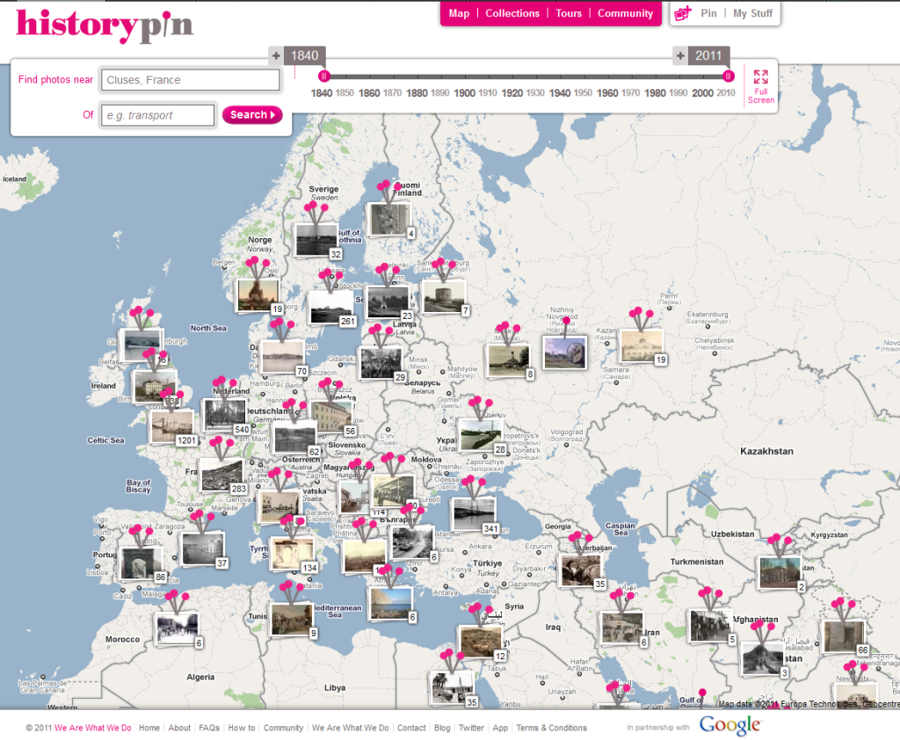
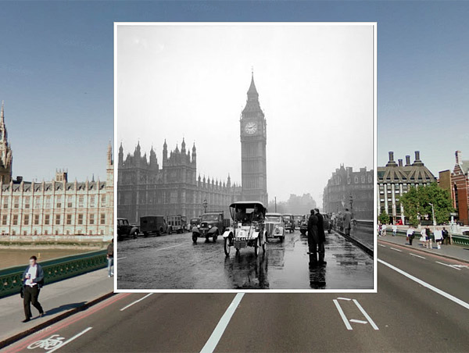
What if you could ...
Notes:
Liz
What if you could search for photos in a visual interface?
This opens up the possiblities of searching - using context, instead of text and seeing the relationship of photographs:
-Distance/Nearness
-Old/New (superimposed on each other)
The advent of semantic web technologies, the “app” model of content delivery, and even the new rules for creating metadata or cataloging records are starting to look at the relationships between items, instead of focusing purely on description (for one each item). Geospatial information is a easy way to connect related items.

Slide 11
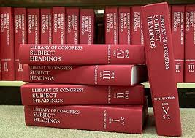
Why haven’t we done that?!!
Lots of standards/vocabularies to choose from
Notes:
Liz
How do we record the geospatial information?
- Coordinate data?
- Controlled vocabulary?
If so, which ones?
How do we have interoperabilty if everyone is using a different standard? What kind of cost and investment does this mean? How do we deal with legacy data and converting it to new formats? Or simply just supplying it in the first place?
How do we balance the need for local control with interoperability?

Slide 12
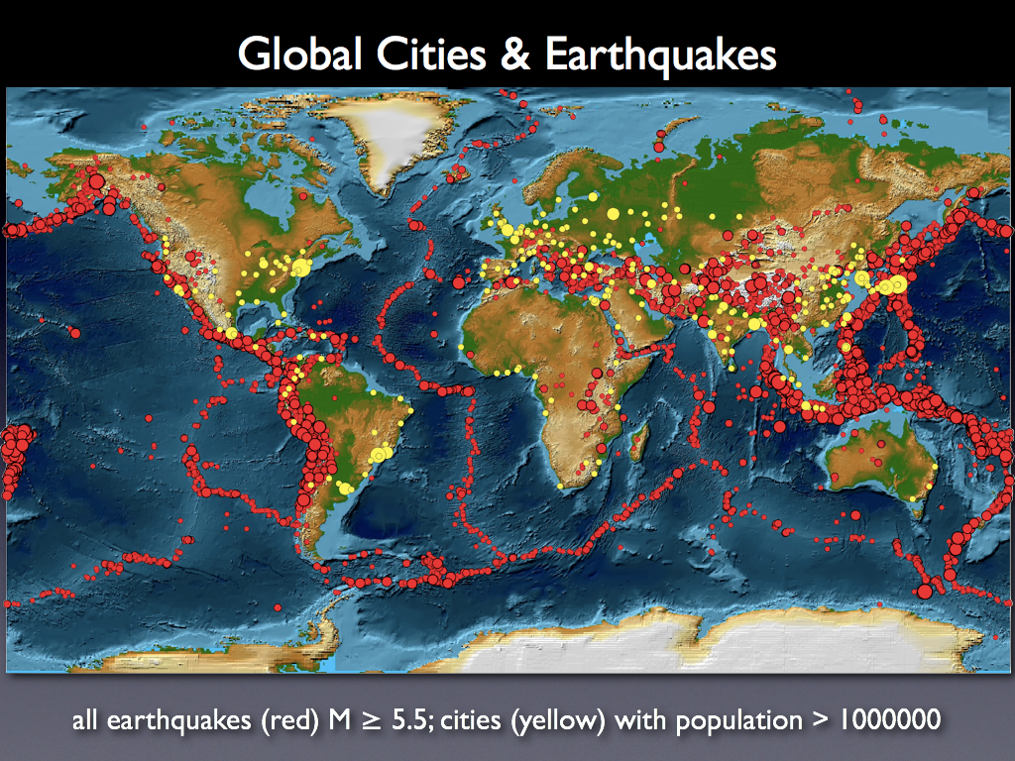
Why haven’t we done that?!!
Notes:
Liz
What level of specificity?
- “Salt Lake City, Utah” when looking for Intermountain West? (Example: water in the intermountain west)
What if you are searching for regions or nicknames, not political subdivisions.
Regions, not political divisions; eg Pacific Rim vs. specific city
What is users aren’t interested in a specific place, but rather in a geographic region - how do they search for or find those types of materials?

Slide 13
The location of what?
Notes:
Liz
Here is an example of a dilemma that Silvia (from UNLV) brought up - what does the geospatial location refer to?
Does it refer to the type of food/cuisine or to the location of the restaurant?
Dublin core indicates that spatial coverage refers to the spatial charcteristics of the intellectual content of the item. In this case, one might argue that if it is French cuisine, the spatial coverage should be France, but others might argue that the location of the restuarant that created the menu was just as important to the idea of the “intellectual content”.
Collection of paintings, done by French impressionist painters, who painted Norwegian landscapes, that are now part of an exhibit in Florida. The intellectual content could be “French impressionists” just as much as the “Norwegian landscapes” and in a Fieldtrip app, the exibit location is key.
What exactly is it that we are recording - and do our users understand that? There is a lot of geospatial information relevant to the items that users need that doesn’t fit simply within the traditional Dublin Core definition of dcterms:spatial.

Slide 14
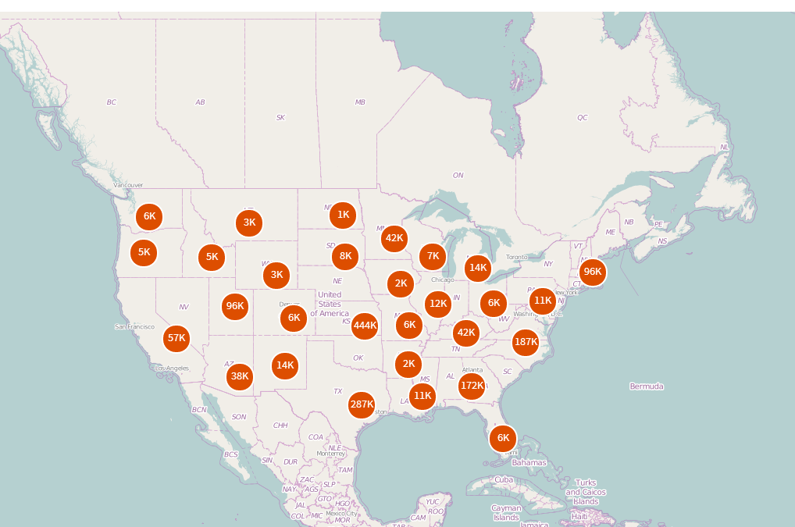
Which Washington?
Notes:
Liz
How do we deal with disambiguation?
Disambiguation - DPLA - Washington County / Washington State / Washington D.C.
What if there are names that are the same? What do we do when there are 31 Washington Counties (which there are) or 50 Greenville Cities? How do we differentiate?
If we were to create a field labeled “County” and map it to dcterms:spatial and populate it with the term “Washington”, we lose the contextual information (the field label of “county”) when we harvest metadata. If we were to even put in “Washington County”, which one of the 31 counties would it be referring to?
If conflicting or lacking information in our metadata, then it is difficult for consortias further up the chain (like MWDL or DPLA) to figure out which instance we are talking about - they have to default to algorithms, such as one that pairs the dcterms:spatial information with the location information of the contributing institution.
If no geospatial metadata, then those items are excluded from whatever map-based discovery tool is being used.

Slide 15
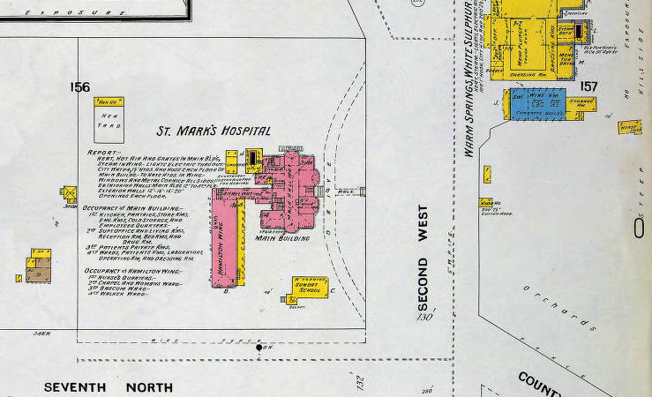
They moved the hospital?
Notes:
Kristen
Addresses change - second west is now third west

Slide 16
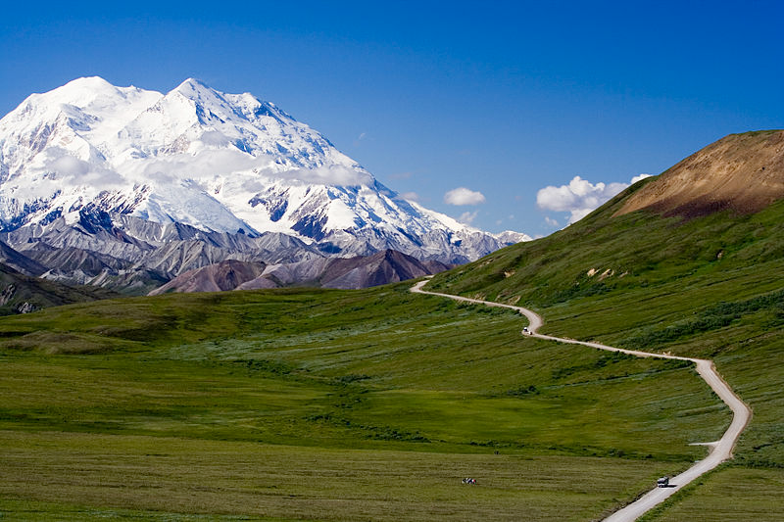
Where is Mount McKinley?
Notes:
Liz
Place names changes, or have naming disputes?
What do we do with places such as Mount McKinley which was known as Denali by indigenous populations and is recognized as Denali by the Alaska Board of Geographic Names, but is Mount McKinley to the U.S. Board on Geographic Names - mostly due to political disputes.
Now known as Denali
Squaw Peaks are gradually being renamed
“The Alaska Board of Geographic Names changed the name of the mountain to Denali, which is how it is referred to locally. However, a 1975 request by the Alaska state legislature to the United States Board on Geographic Names to do the same was blocked by Ohio congressman Ralph Regula, whose district includes McKinley's hometown of Canton.^{[22]} Members of the Ohio congressional delegation continue to protect the McKinley name, blocking attempts by the Alaska congressional delegation to get the Board of Geographic Names to change it to Denali. Thus, Denali is correct according to the Alaska state board, while McKinleyis correct according to the national board.” - Wikipedia

Slide 17
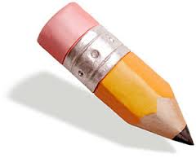
“Challenges”
Difficult to create map interfaces when:
Geospatial standards/vocabularies vary
Inconsistent metadata
Metadata is “keyword” dependent
How do we reflect changing names?
How do we accommodate regional information/non-political divisions?
What do you think?
Notes:
Liz?
Different types of items call for different types of geospatial data
not every item has geospatial data
not every location has a name
geospatial standards vary

Slide 18
Task Force Timeline
Notes:
Kristen
Called for volunteers at spring UALC digitization committee meeting
skip to the charge

Slide 19
Task Force Charge
1. Identify existing geospatial metadata practices
2. Develop guidelines for standardizing
3. Creating map-based search interfaces
4. Identify and share tools
https://sites.google.com/site/mwdlgeospatial/
Notes:
Kristen
ID key issues and problems
ID easily achievable practices that MWDL partners can implement in the interim before a final recommendation is made
ID examples of map-based search Interfaces, successful and unsuccessful
Suggest steps for addressing keys issues and problems
Recommend revisions to the MWDL Dublin Core Application profile to accommodate geospatial metadata

Slide 20
Task Force Deliverables
An online bibliography of resources
Guidelines for MWDL geospatial metadata practices
Recommendations & instructions for creating map-based search interfaces or search functionality
Final report on the task force’s activities, findings, and recommendations.
Notes:
Kristen

Slide 21
Task Force Timeline
Notes:
Kristen
Subgroups formed

Slide 22
What we think we know
“Recommendations for Geospatial Standards for Digital Collections in the Mountain West Digital Library”
by Dorotea Szkolar
Participants: THANK YOU!
Anna Neatrour (team lead)
Kristen Jensen
Silvia Southwick
Jeremy Myntti
Notes:
Kristen
Subgroup 1: Revised and updated recommendations based on the current environment

Slide 23
Low-hanging fruit
Identify strategies for short-term gain
Recommendations for next phase of Task Force
Participants: THANK YOU!
Liz Woolcott (team lead) Jeremy Myntti
Greta Bahnemann Sowmya Athithan
Sandra McIntyre
Notes:
Kristen
Subgroup 2

Slide 24
Some map-based interfaces
Webinar on March 18, 2014 @ 11:00 AM MST
“Geospatial Interfaces: How to Use Good Metadata Once We Have It”
Participants: THANK YOU!
Michelle Olsen (team lead) Paula Mitchell
Robyn Krohn Keeling Christian Sarason
Bert Granberg Ken Rockwell
Devin Becker
Notes:
Kristen
Subgroup 3

Slide 25
“I [we] recommend …”
Include dcterms:spatial in new records (if applicable)
Map existing geospatial metadata field(s) to the Dublin Core spatial refinement of coverage (dcterms:spatial)
Explicit hierarchy e.g. City; County; State; Country
If you’re going to abbreviate, be consistent!
Notes:
Kristen
tell them about the interactive part

Slide 26
Next Step
Form 3 more subgroups to
1. Evaluate Controlled vocabularies
2. How to convey coordinate data
Assess requirements of successful map-based interfaces
User-stories
Notes:
Liz

Slide 27
“Controlled Vocabs”
What do you think about …?
Geonames.org
LCSH
Getty TGN
Others?
Notes:
Liz
Invite participants in the subgroup

Slide 28
“x,y ???”
Evaluate options for conveying coordinate data or other standards in traditional GIS
Address data
Polygons
Lat long
GeoJSON
Notes:
Kristen
Open conversation - scribe or add thoughts to the document.
Guiding questions but add your thoughts free form

Slide 29
“User Stories” & “Cool maps”
How people might use geospatial metadata, to guide how we develop map-based interfaces.
As a Tourist, I want to be alerted to nearby attractions, so that I can visit them.
Please.
Notes:
Kristen
Two tabs

Slide 30
“Your turn!”
If you want to help, contact
Liz Woolcott Kristen Jensen
liz.woolcott@usu.edu kjensen@utah.gov
435-797-9458 801-245-7243
Notes:
Kristen and Liz

