Slide 1
Teaching Information Synthesis
Utah State University
Anne Diekema
Kacy Lundstrom
Connie Woxland

Slide 2
Introduction to Synthesis
Process of analyzing and evaluating information from various sources
Identifying conversations among information from different sources
Making connections between the information found
Organizing and presenting this information in a useful way
Notes:
Anne

Slide 3
Importance of synthesis
Allows us to derive new knowledge from large amounts of data
Assimilate information to make decisions
Vital in developing effective writing and communication skills to share new knowledge
Required to productively participate in and contribute to our information-rich society

Slide 4
Students struggle with synthesis
neglect to make connections between sources cited
summarized general information about topic
organize paper by source rather than idea
did not add their own voice to the conversation
organize information poorly, resulting in fragmented text
base entire papers on information taken from only one or two sources
Notes:
cited one research study or source per paragraph;
(utilization of large block quotes or irrelevant quotes)

Slide 5
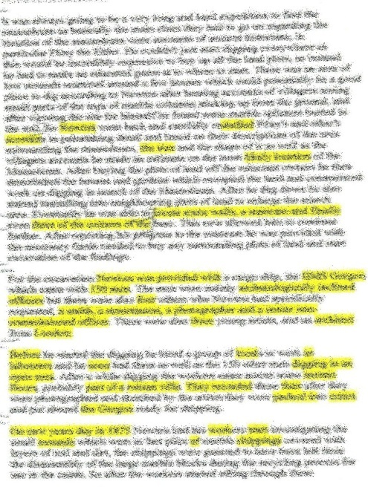
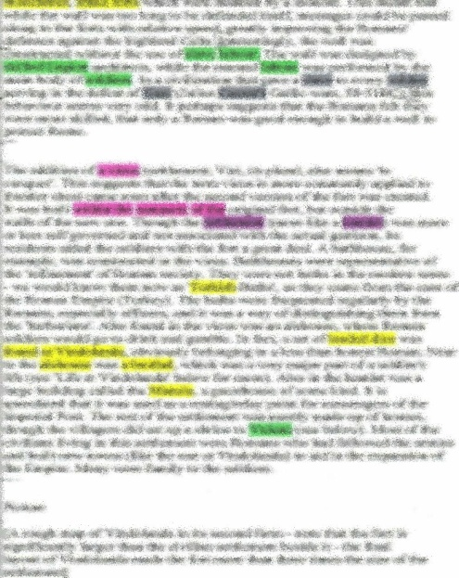
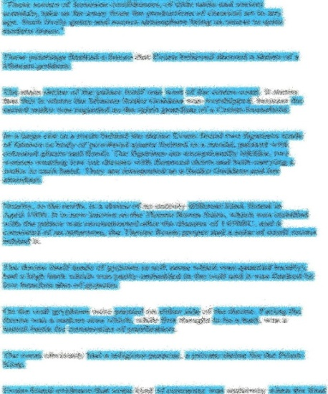
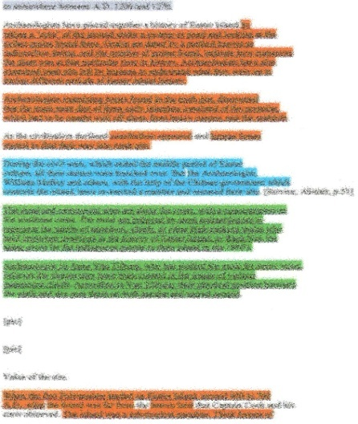
McGregor, J. (2011). A Visual Approach: Teaching Synthesis. School Library Monthly, 32(8), 5-7.
Student A
Student B
Student C
Student
D
© Joy McGregor 2004
Notes:
This slide allows for a direct comparison side-by-side, with an opportunity to elicit characteristics or attributes of synthesis. The examples of non-synthesis allow students to extrapolate characteristics such as the fact that using multiple sources is not sufficient.

Slide 6
Now what?
Change information literacy learning goals
Highlight skills students struggle with
Develop new lesson plans to teach synthesis

Slide 7
In Class Activity
Group

Slide 8
Post – It Activity
Beauty
Violence
Family Ties

Slide 9
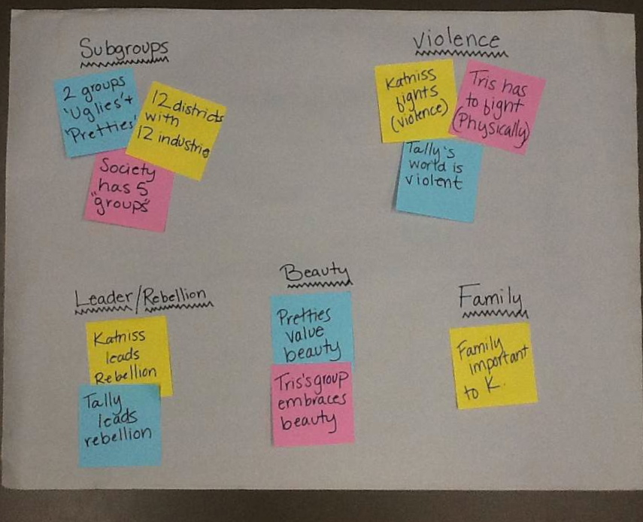
Final Product

Slide 10
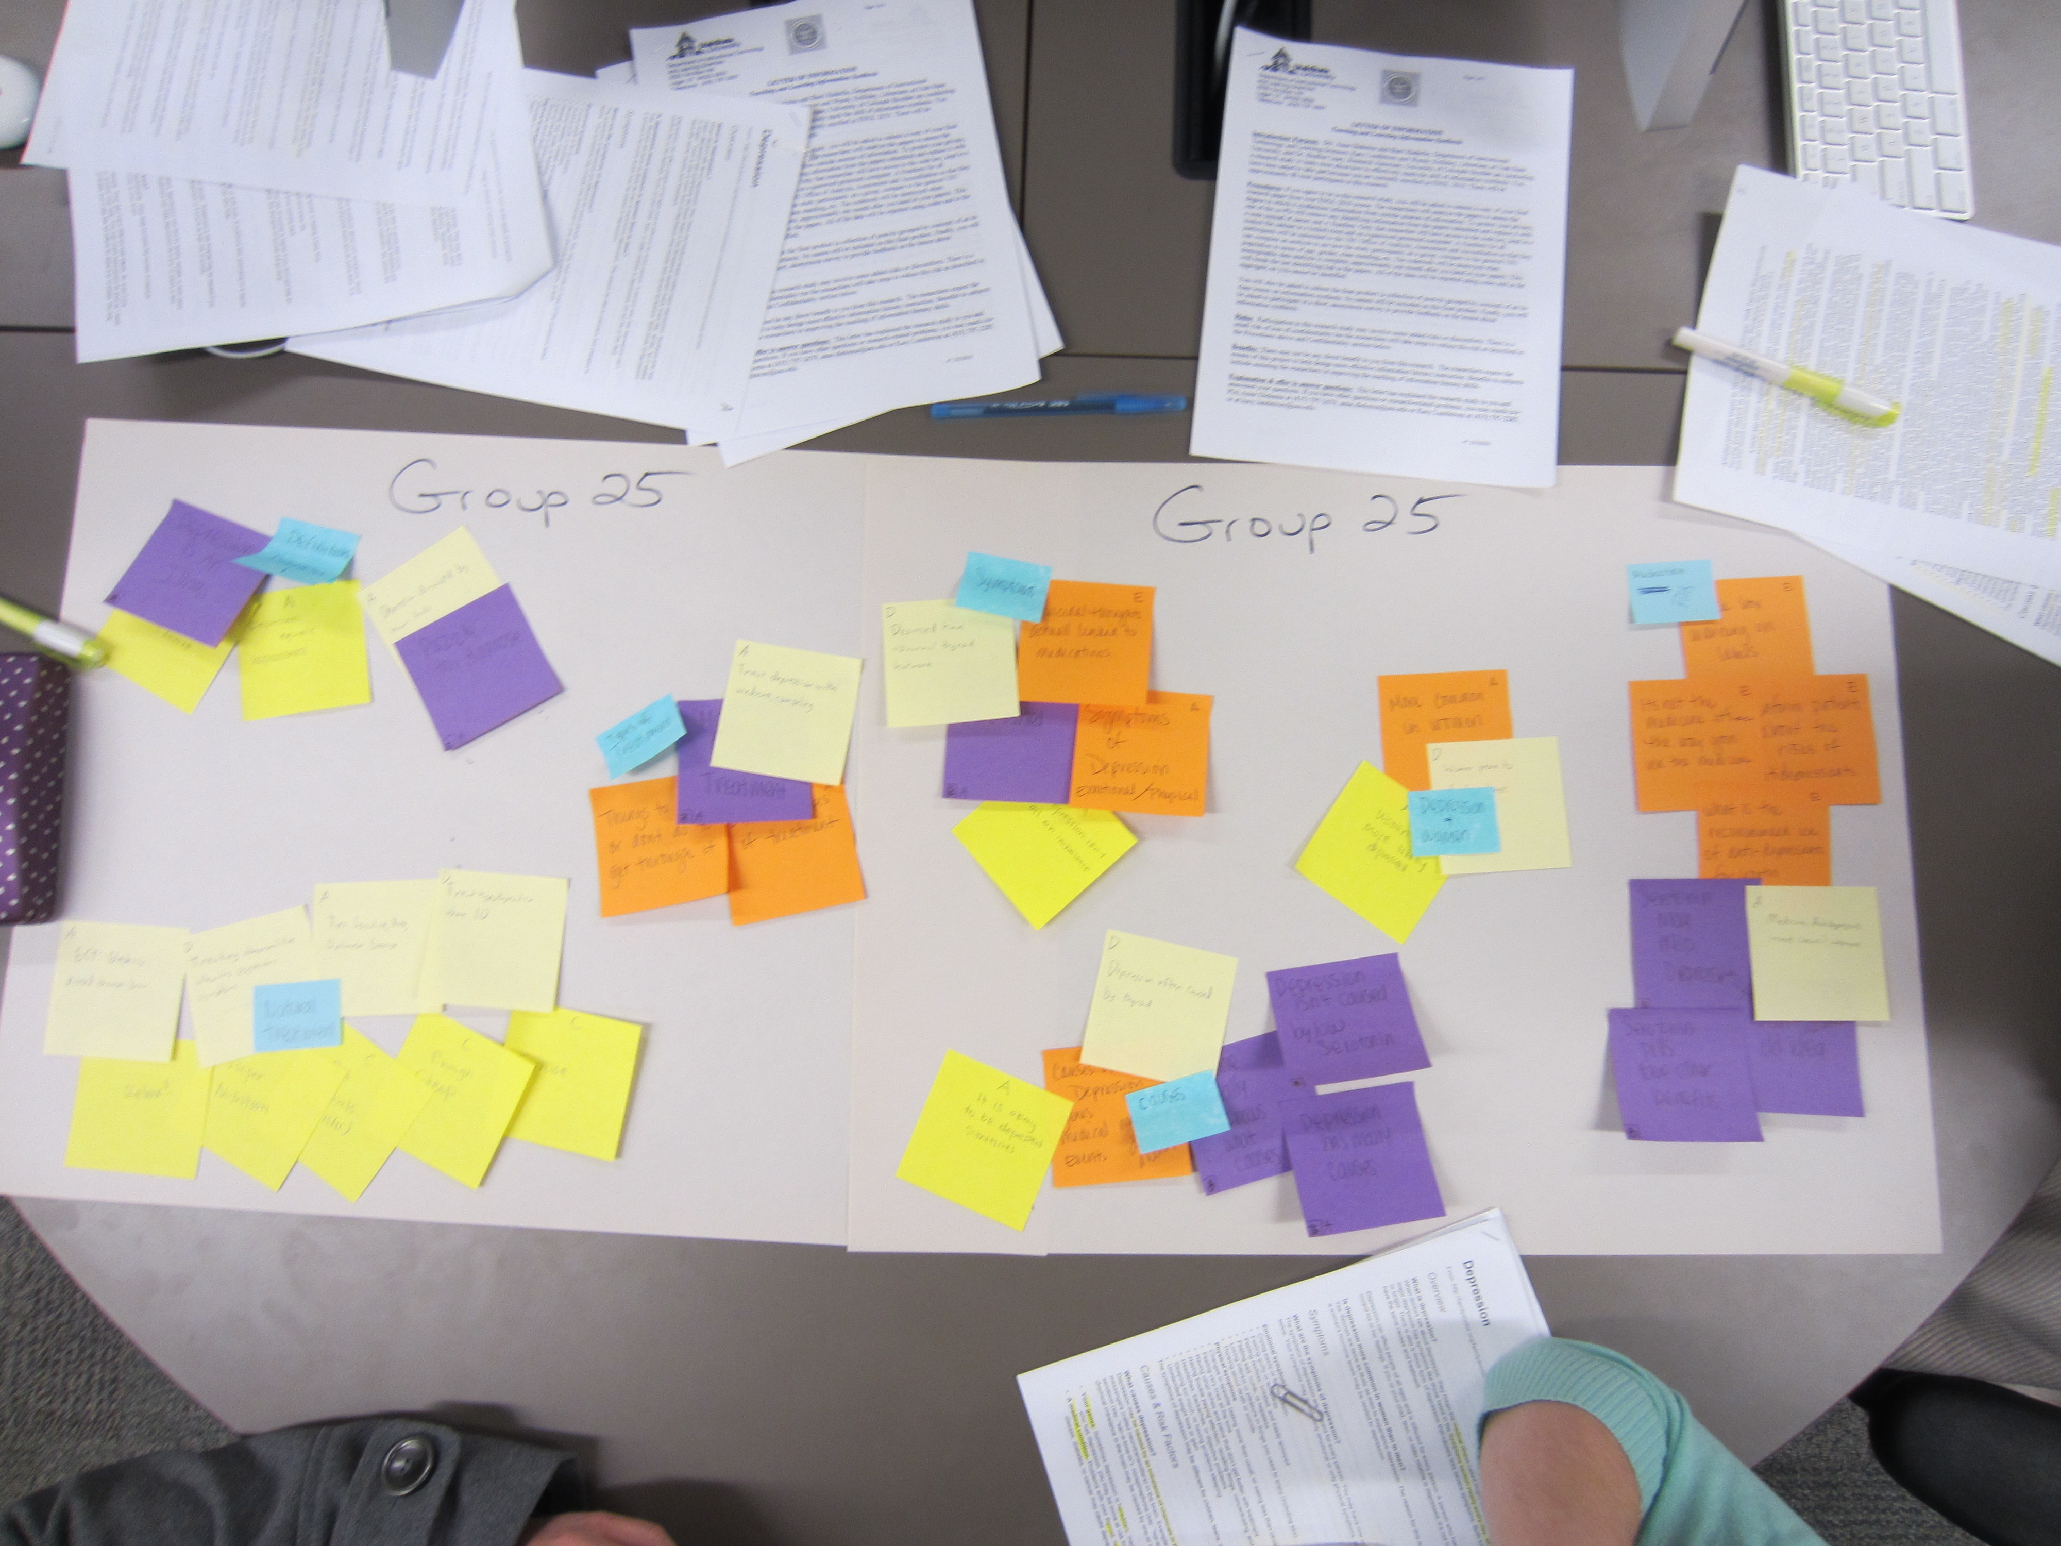
1010 Graphic Example
Notes:
Kacy – 1010 Cluster example (Small post-it = label)
Conversations that grow out of this: Outliers, too much of one color, Reconfiguring groups, relabeling, digging back into the research
Crop this photo
Maybe hold off on questions until this point?
Possible Discussion Points:
- Challenges and benefits we’ve seen in practice
- Why/how librarians can be helpful in teaching this
- Results of Anne and I’s rubric analysis showing that the lesson plan helped improve student’s ability to identify conversations among sources
- Adaptations, next steps

Slide 11
Adaptations
50 minutes vs. 75 minutes
ENGL1010 vs. ENGL2010
Superbugs vs. Hipsters
Large Paper vs. Wall vs. Whiteboard
Librarians vs. Writing Instructors
PowerPoint vs. Winging It
Small Group vs. Stadium Seating
Notes:
Kacy

Slide 12
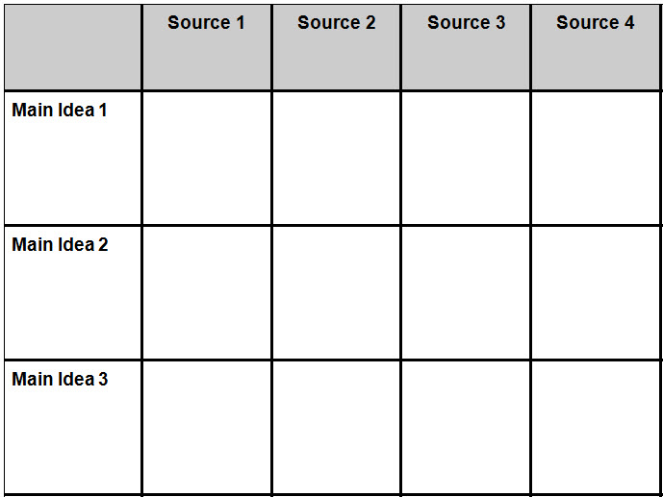
Synthesis Matrix
Adapted from NC State University Writing and Speaking Tutorial Service, Writing A Literature Review and
Using a Synthesis Matrix. 2006. Retrieved June 26, 2013 from http://www.ncsu.edu/tutorial_center/writespeak/download/Synthesis.pdf
Notes:
Kacy – Allows them to apply the process to their own research in a simpler form (but with a better understanding of what’s involved in the process)

Slide 13
Questions
ULA Libguide:
http://libguides.usu.edu/synthesis_ULA

