Slide 1
Current Recommendations from MWDL Geospatial Discovery Task Force
Liz Woolcott Utah State University, Merrill-Cazier Library Jeremy Myntti University of Utah, J. Willard Marriott Library Sandra McIntyre Mountain West Digital Library
Notes:
Sandra: slides 1-13
Jeremy: slides 14-25
Liz: slides 26-33

Slide 2
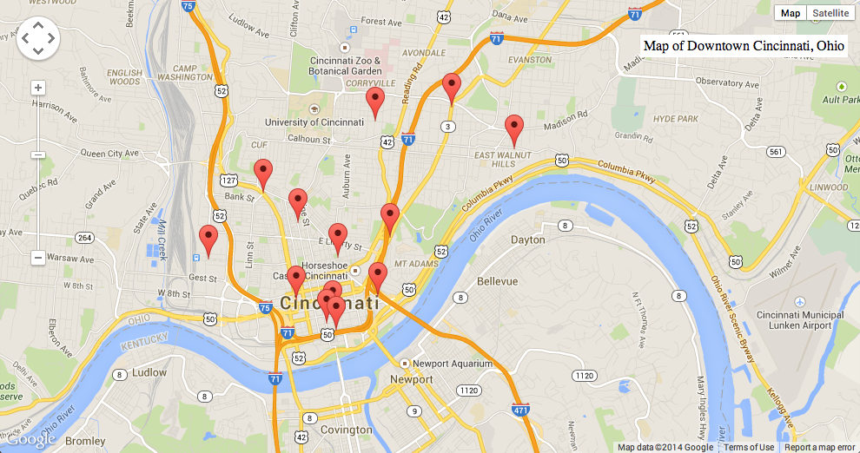
Ohio Memory Project, “Then and Now” maps
Notes:
Many of us who manage digital collections want to be able to provide access to the digitized resources via a map interface. Here are a few examples of different kinds of map interfaces.

Slide 3
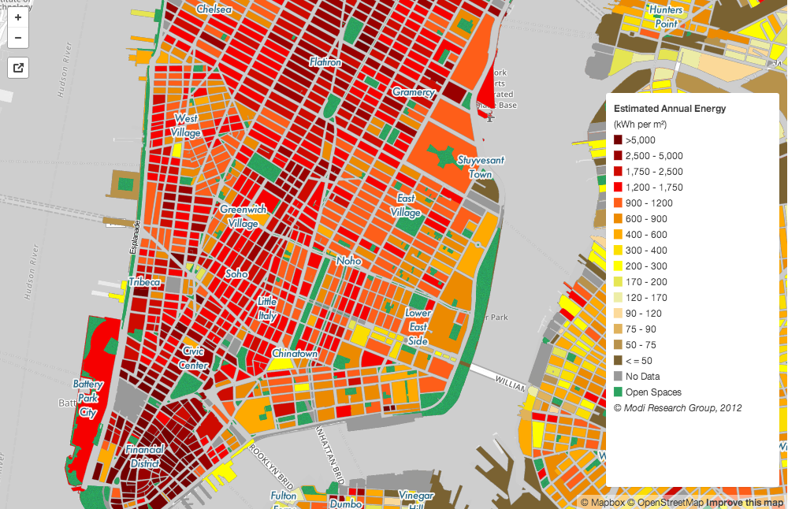
Estimated Total Annual Building Energy Consumption at the Block and Lot Level for NYC

Slide 4
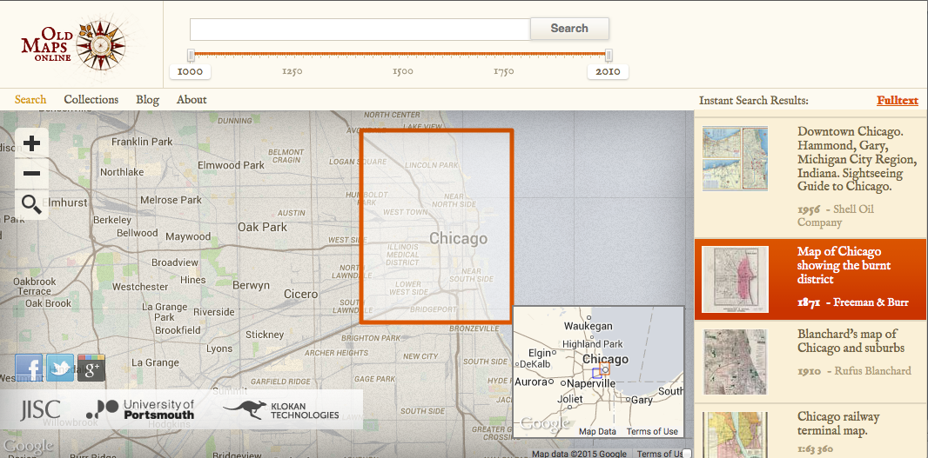
Old Maps Online, http://oldmapsonline.org
Notes:
Old Maps Online
Search for a place, select the area, and see what historical maps are available for that area.
Here I’ve found a map showing the burnt district following the Great Chicago Fire of 1871, a disaster that killed 300 people and left 100,000 more homeless.

Slide 5
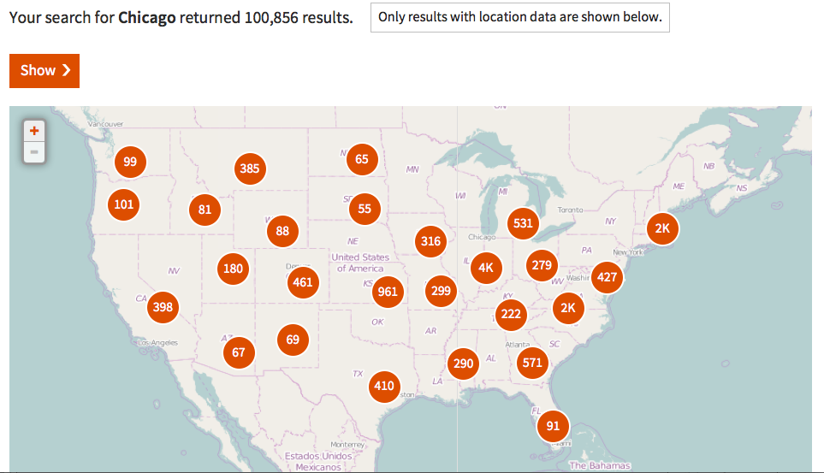
Digital Public Library of America, search on “Chicago”

Slide 6
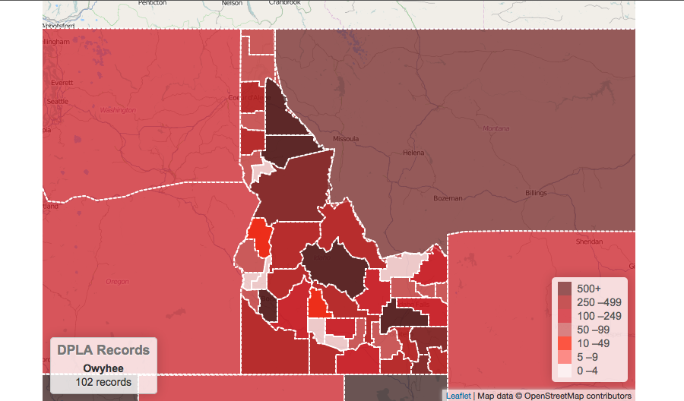
Digital Public Library of America, app: “DPLA State by State”

Slide 7
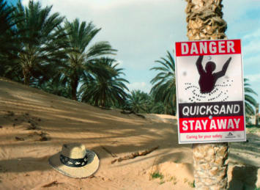
Geospatial Metadata Quicksand

Slide 8
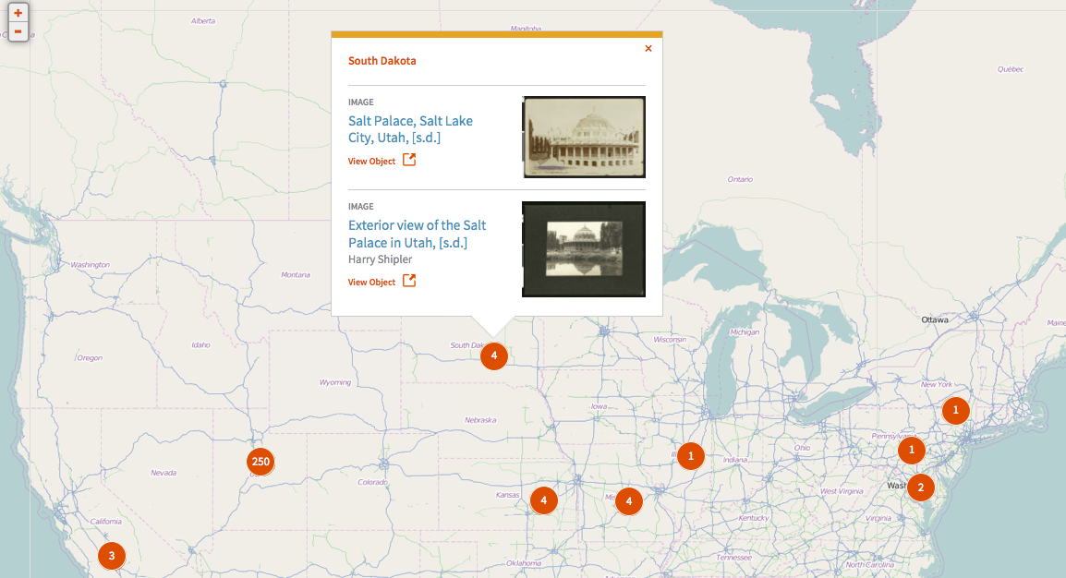
Misinterpreted location
A Salt Lake City landmark is placed in South Dakota

Slide 9
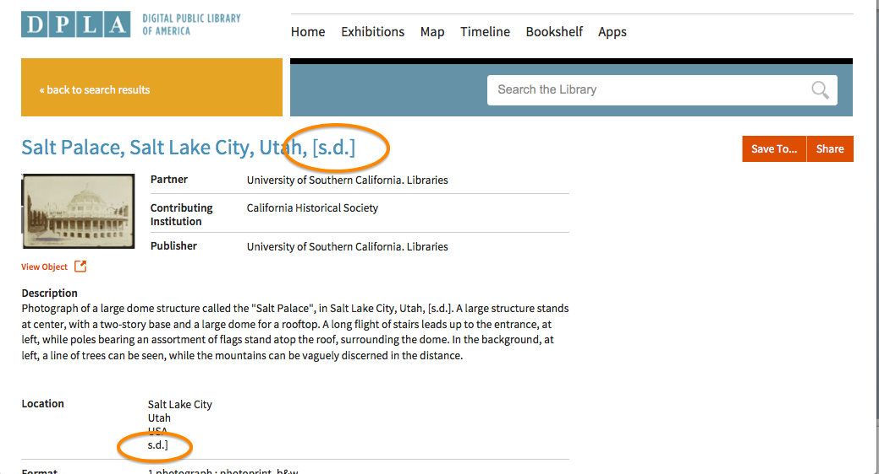
Location information or not?
Notes:
We can see why the location was misinterpreted, when we look at the metadata. The title includes the notation “[s.d.]” meaning “sans date” (in French). This was read erroneously to mean South Dakota.

Slide 10
Ambiguous place names
Boulder, CO
Boulder, MT
Boulder, UT
Boulder City, NV
Washington County, UT
Washington County, ID
Washington County, OH
Washington County, MD
Washington County, GA
Washington County, MS
Washington County, NC
Washington County, PA

Slide 11
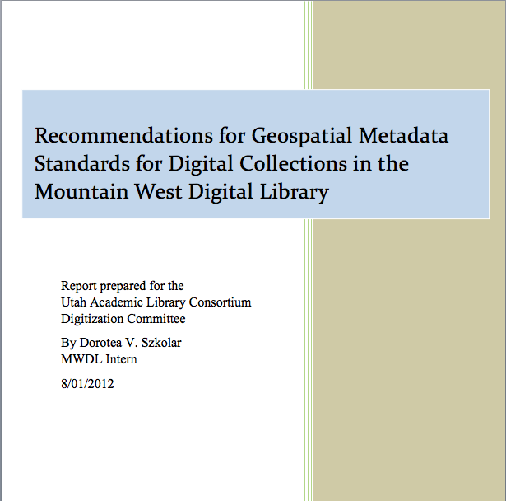
More problems
Report by MWDL metadata intern

Slide 12
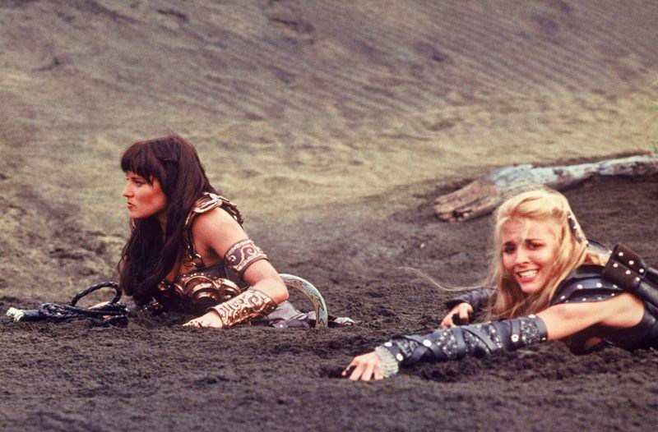
Variances in coordinate formats
Numbers:
decimal degrees
degrees/minutes/seconds
Directions:
(+) and -
W, N, E, and S
westlimit, northlimit, eastlimit, and southlimit
Placement:
In same field
In different fields
Xena and Callisto in quicksand

Slide 13
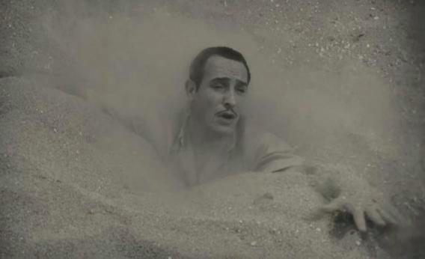
Variances in field mapping
Dublin Core
coverage
spatial
subject
Jean Dujardin sinks into quicksand in a still from The Artist.

Slide 14
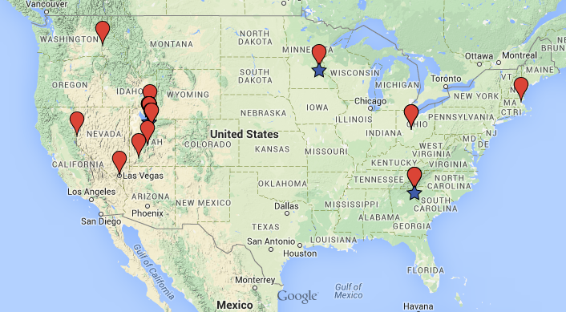
Geospatial Discovery Task Force
Notes:
Jeremy: slides 14-25

Slide 15
Task Force Charge
1. Identify existing geospatial metadata practices
2. Develop guidelines for standardizing
3. Creating map-based search interfaces
4. Identify and share tools
https://sites.google.com/site/mwdlgeospatial/

Slide 16
Phase 1
Three subgroups:
Review previous report
Identify low hanging fruit
Identify map-based interfaces
Notes:
Dates for this phase: July 2013 – December 2013

Slide 17
Phase 2
Three more subgroups:
Controlled vocabularies
Coordinate data and GIS perspectives
Map-based Interfaces
Notes:
Dates for this phase: March 2014- September 2014

Slide 18
Current Recommendation: 1
All standards and practices adopted by the metadata review board should be compliant with the ISO 19115:2003* Geographic Information--Metadata standard.
*Task Force will review the latest released standard ISO 19115-1:2014 in the coming months.

Slide 19
Current Recommendation: 2
Since MWDL contributors may need to use varied controlled vocabularies, we recommend that a geospatial metadata format and selected controlled vocabulary be highly recommended but not enforced.

Slide 20
Current Recommendation: 3
There is a clear preference for expressing coordinates in latitude-longitude as decimal degrees over the degrees-minutes-seconds format.
Ex. Mount McKinley:
Latitude: 63.540777
Longitude: -151.723614
Latitude: N 63° 32' 26.7972"
Longitude: W 151° 43' 25.0108"

Slide 21
Current Recommendation: 4
It is recommended that partners keep all the elements of a single term within a single iteration of the field. For example, don’t split latitude and longitude. Repeat spatial field for each new entity.

Slide 22
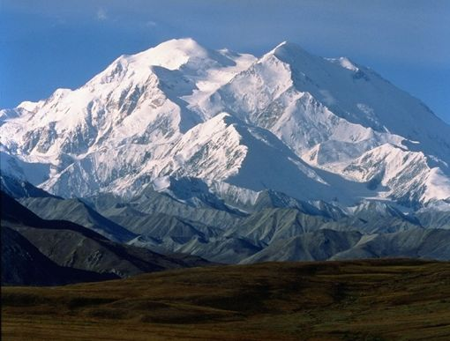
Current Recommendations: 4 example
For example: Mt. McKinley
Lat/Long expressed:
<dcterms:spatial>63.540777, -151.723614</dcterms:spatial>
Controlled Vocab expressed:
<dcterms:spatial>Mount McKinley, Denali National Park and
Preserve, Alaska, United States</dcterms:spatial>
URI expressed:
<dcterms:spatial>http://geonames.org/5868589</dcterms:spatial>
All together:
<dcterms:spatial>63.540777, -151.723614; Mount McKinley, Denali National Park and Preserve, Alaska, United States; http://geonames.org/5868589</dcterms:spatial>

Slide 23
Current Recommendation: 5
Partners should map geospatial metadata field(s) to the Dublin Core spatial refinement of coverage (dcterms:spatial), which can be done at the collection level. The OAI provider for the repository hosting the collection should support provision of qualified Dublin Core if possible.

Slide 24
Current Recommendation: 6
The spatial coverage refinement (dcterms:spatial) is highly recommended for all new collections harvested by MWDL.

Slide 25
Current Recommendation: 7
Where converting legacy data may be too difficult, partners can add an additional separate field mapped to the Dublin Core term spatial (dcterms:spatial) with basic, minimal geospatial metadata (at least at country and state level), in accordance with upcoming recommendations for controlled vocabulary.

Slide 26
Current Recommendations: Resources
To see a complete list of the current recommendations, visit: http://goo.gl/ZHMgtu
To see all the meeting minutes and reports created by the task force, please visit: https://sites.google.com/site/mwdlgeospatial/home/meeting-minutes

Slide 27
Use Case Scenarios
DLF Forum 2014 session: gathered and shared “user stories” of complicated geospatial metadata decisions
Groups formed then discussed scenarios, input selected in use case survey
Survey results available
Notes:
Liz: slides 26-33

Slide 28
Recurring Cases
Use of neighborhoods in geospatial metadata
Historical and informal
Immigrant neighborhood with multiple and changing ethnicities
Deciding when a location is “near enough” to add to metadata
Changing political boundaries: what to call an area
Distinguishing which geospatial metadata to include: about a specific location or from a specific location
Adding a geospatial layer to browse content by location subject matter
Location where photo taken or locations in the photo?

Slide 29
Infographic
Providing a visual overview of the work of the Controlled Vocabulary subgroup
http://my.visme.co/projects/mwdl-geospatial-task-f

Slide 30
Phase 3 – Next steps
Select a recommended controlled vocabulary.
Review the DCMI Box/Point Encoding Schemes:
DCMI Box Encoding Scheme at http://dublincore.org/documents/dcmi-box/
Example: name=Western Australia; northlimit=-13.5; southlimit=-35.5; westlimit=112.5; eastlimit=129
DCMI Point Encoding Scheme at http://dublincore.org/documents/dcmi-point/
Example: name=Perth, W.A.; east=115.85717; north=-31.95301
Example: east=148.26218; north=-36.45746; elevation=2228; name=Mt. Kosciusko

Slide 31
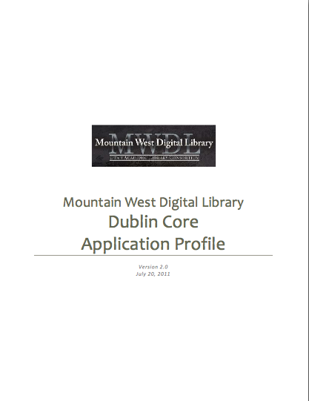
Phase 3 – Next steps
Make recommendations for modifying the MWDL Dublin Core Application Profile.
Finalize the infographic.

Slide 32
Phase 4 – Future plans
Develop regional gazetteer.
Develop actionable plans to deal with legacy data.

Slide 33
Want to stay informed?
Join the listserv: https://www.lists.utah.edu/wws/info/mwdl-geospatial
To subscribe, send an email message to sympa@lists.utah.edu with this subject: subscribe mwdl-geospatial firstname lastname
Note: replace “firstname” and “lastname” above with your first and last names. Do not put anything in the body of the message.
Contact Kristen Jensen (kjensen@utah.gov)
or
Liz Woolcott (liz.woolcott@usu.edu)
Want to get involved?

Slide 34
Questions?
Liz Woolcott Digital Discovery Librarian Utah State University, Merrill-Cazier Library liz.woolcott@usu.edu
Jeremy Myntti Head, Cataloging and Metadata Services University of Utah, J. Willard Marriott Library jeremy.myntti@utah.edu
Sandra McIntyre Director, Mountain West Digital Library sandra.mcintyre@utah.edu

