Slide 1


Transitioning to Open Educational Resources
Erin Davis, Library Coordinator of Regional Campuses
Becky Thoms, Head of Digital Initiatives
Utah State University, Merrill-Cazier Library

Slide 2

$1,249+ student budget per year for textbooks and supplies
Average Estimated Undergraduate Budgets College Board 2015-2016
Notes:
Textbook prices
UALC survey

Slide 3

87% of students have delayed purchasing a textbook due to price
39% have dropped a class because of textbook price
-Utah Academic Library Consortium Student Survey, 2016
Notes:
Probably nationally and here at USU, even if your class is not cost prohibitive, you have to look at the whole picture

Slide 4

Open – published under an open license to be shared for free
Educational – provides an alternative to textbooks
Resources – come in a variety of formats to be reused/adapted
Notes:
Definition--What sets these materials apart from traditional materials is that they are released under an open copyright license that grants blanket permission for open use. Raise your hand if you’ve heard of Creative Commons licenses.
So what exactly are Open educational resources? OER are high quality teaching, learning, and research resources that reside in the public domain or have been released under an intellectual property license that permits their free use and re-purposing by others. They are authored by faculty members and mostly come out of universities.
OER can include textbooks, videos, lecture notes, syllabi, exams, additional readings, and presentations to course shells/frameworks. What sets these materials apart from traditional materials is that they are released under an open copyright license that grants blanket permission for open use. Raise your hand if you’ve heard of Creative Commons licenses. These licenses support the 5 Rs which are Retain, Reuse, Revise, Remix, and Redistribute. They are essential for open access content.
What this all means for students is that OER...
are free for students to read and download digitally
can typically be printed at cost (for example, a hardcopy of an open textbook can be sold in the bookstore and costs $20-40).
What this all means for faculty is that OER...
allow for more academic and learning freedom.
can be curated and tailored by instructors to fit the needs of the course, so that YOU, the professor, not textbook publishers, decide what will be included in your curriculum
can be posted anywhere online or directly in Canvas

Slide 5


LICENSING
Distribute
Remix
Tweak
Build upon
Use commercially
Only attribution required
Distribute
Remix
Tweak
Build upon
Non-commercial
Share alike required
Attribution required

Slide 6



















OpenStax BOOKS THUS FAR
Notes:
OpenStax’s partnership program is designed to provide free consultation for schools wanting to increase the use of OER on campus and to build a community of institutions dedicated to lowering the cost of course materials using OER. Selected institutions were required to demonstrate their commitment to using OER to drive student success and graduation rates. - See more at: http://news.rice.edu/2016/07/06/11-schools-selected-for-national-openstax-partnership-program/#sthash.rJ6uc5Qn.dpuf

Slide 7
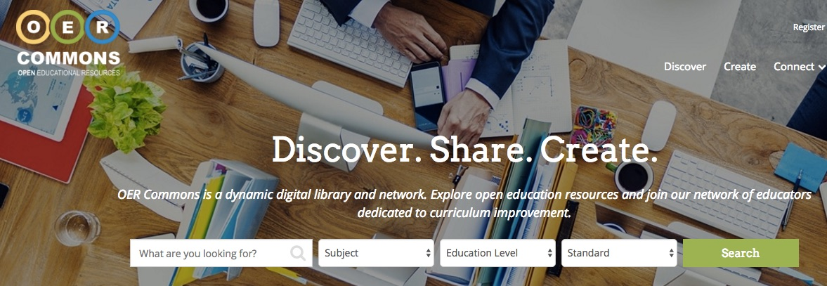
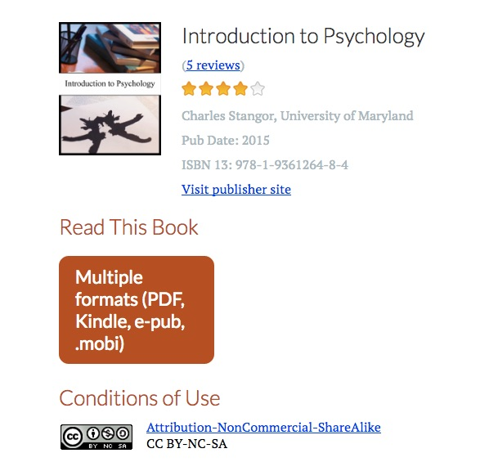


Slide 8










PARTNER & AFFILIATE SCHOOLS
Notes:
USU is not alone in getting on board with OER. Here's a sampling of the other institutions involved--University of Arizona, Ohio State, University of Connecticut.
Becky will do the first part of this slide - then, hand off

Slide 9
OER ENHANCES ACADEMIC FREEDOM
At the course level:
OER provides faculty with more choices for their courses
OER allows for permission free editing and adaptation
OER prevents faculty from being locked into a particular platform or system
In the market place:
OER should not be legislated or mandated
OER needs to stand on its own vis a vis publisher material
Notes:
publishers are trying to find a balance between adopting to this model while maintaining their bottom line

Slide 10
FULLY DEVELOPED MATERIALS
Written by content experts
Quality
Peer-reviewed
Go through a strict editorial process
Funded by universities, nonprofits, etc
Notes:
the format does not determine the quality

Slide 11
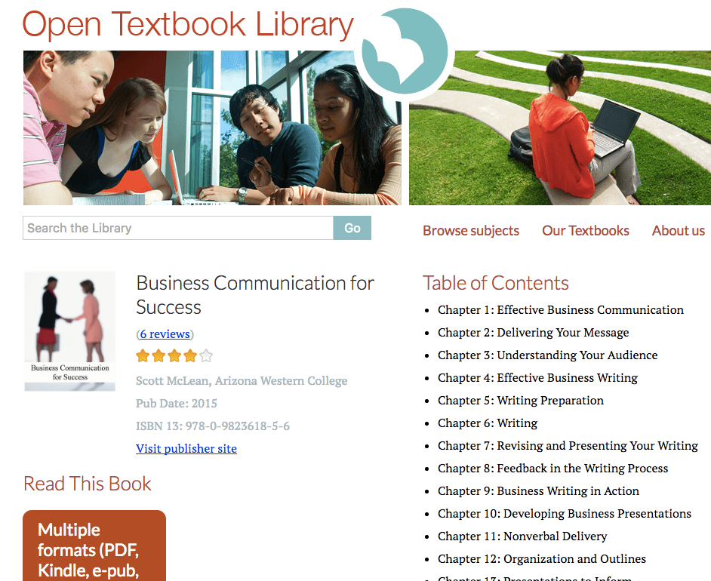
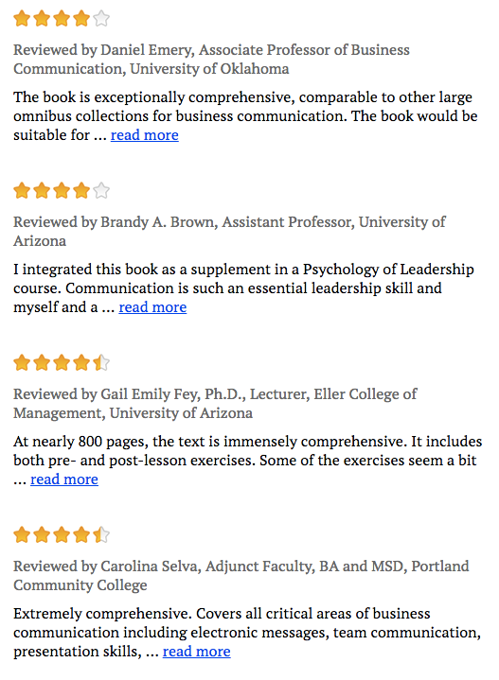

Slide 12
IMMEDIATE ACCESS, MANY FORMATS

Slide 13
ADDITIONAL RESOURCES
Online homework (from partners)
Online labs (from partners)
PowerPoint slides
Pronunciation guides
Solution Manuals
Test banks

Slide 14
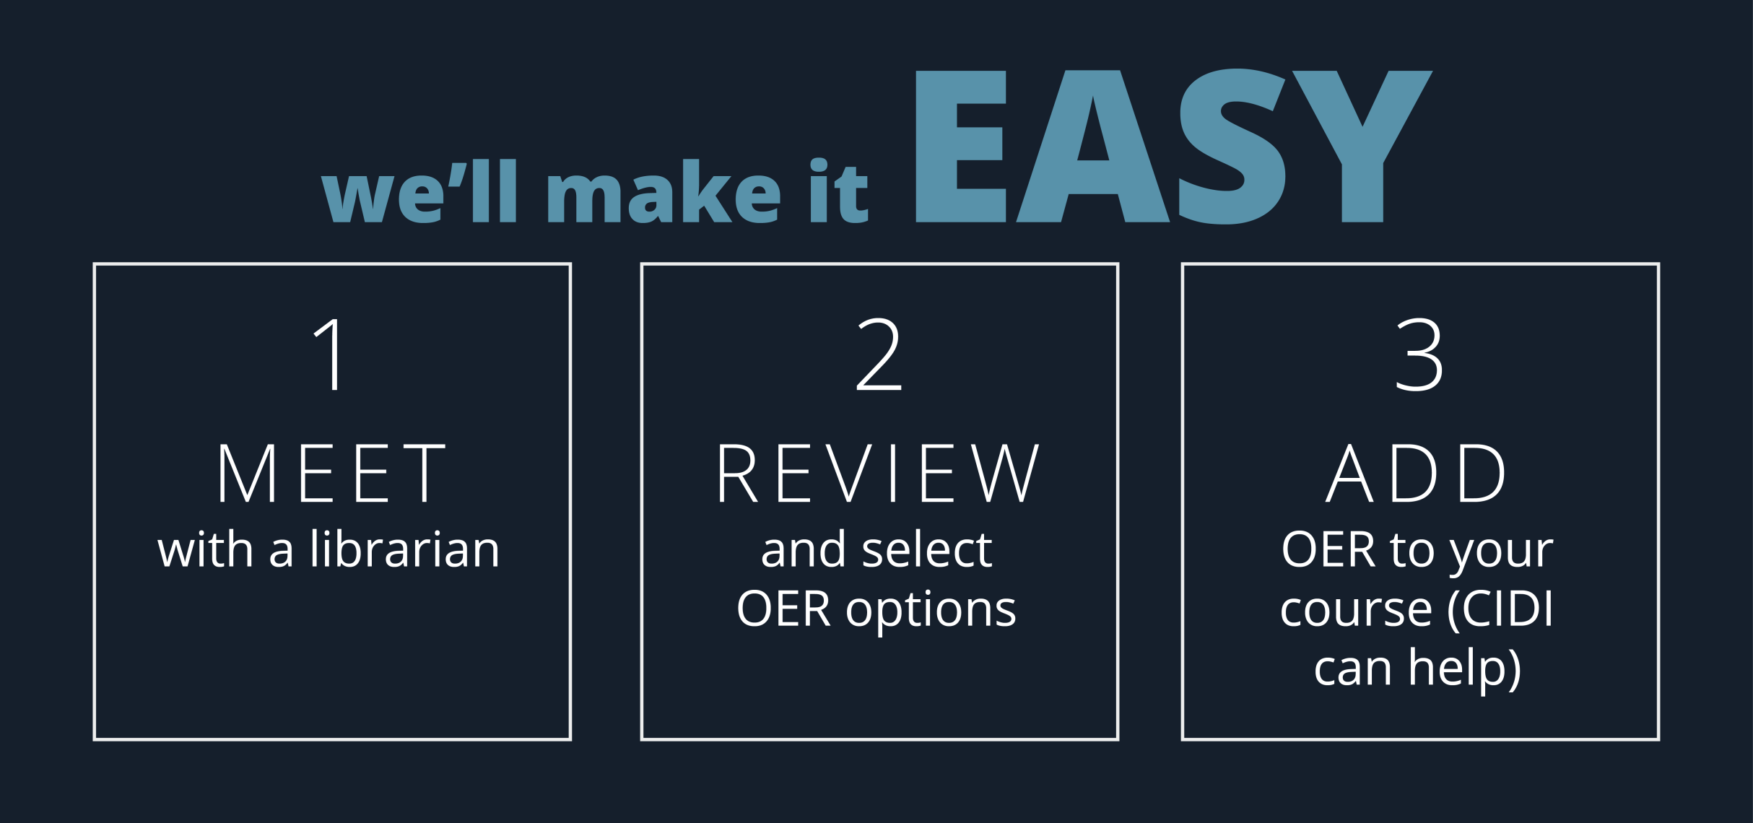
OER at USU
Notes:
Finding the right OER for your course may be challenging, but you don’t need to go it alone. The library’s OER support team can help!
Meet with your subject librarian and the library’s OER specialists
Identify potential textbook replacements
Evaluate promising textbooks
Announce change by bookstore deadline (Adoptions for Spring 2017 are due October 10th and for Fall semesters on March 10th.)
Integrate into syllabus and course materials
http://Oer.ou.usu.edu
There is campus support for OER - Mention campus level OER committee? Provost’s office

Slide 15
Questions? erin.davis@usu.edu becky.thoms@usu.edu
Visit: oer.usu.edu

Slide 16
FAQs
What’s the catch or obligation?
Do you plan on switching to a fee model?
“I don’t like X or you don’t have Y”
May I adapt and distribute without permission?

Slide 17
FAQs
With no sales reps, how do I get service?
What about sustainability? Revisions?
How do I report errors?
Can my bookstore order physical copies?
Notes:
you have to balance that out

