Slide 1
Paws and Breathe: How Pet Therapy Thrives in an Academic Library Presented by Pamela Martin, Andrea Krebs, and William Rozum

Slide 2
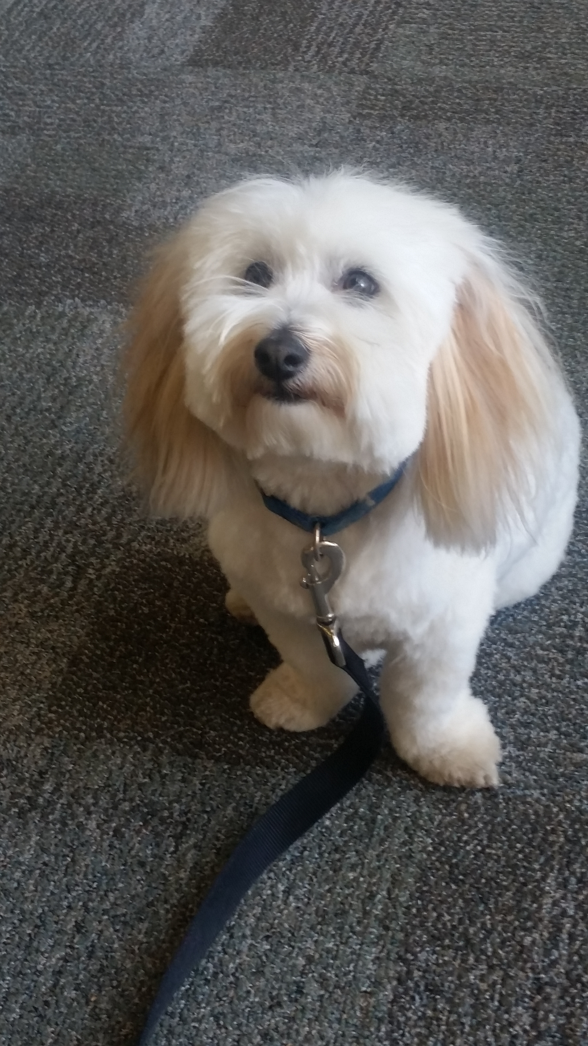
BACKGROUND
History: Dogs in libraries
Local Organizations: Therapy Animals of Utah and Intermountain Therapy Pets
Serendipity: volunteers on campus

Slide 3
Every Other Week
Finals Week
Every Week
Evolution

Slide 4
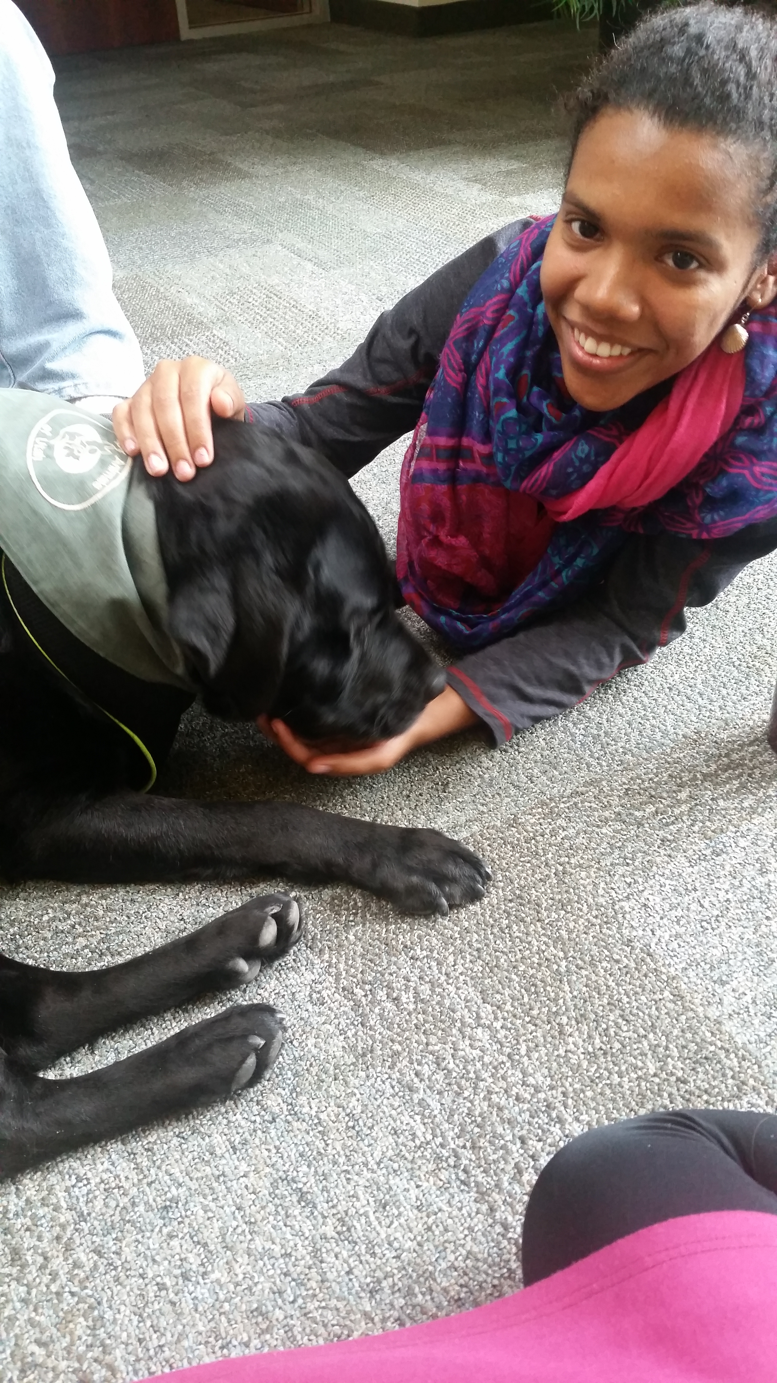
STUDENT RESPONSE
"KEEP THEM FOREVER!"
"I loved having the dogs here! Such a great stress relief"
“This is wonderful and necessary. I'm being incredibly serious right now. I need this in my life."

Slide 5
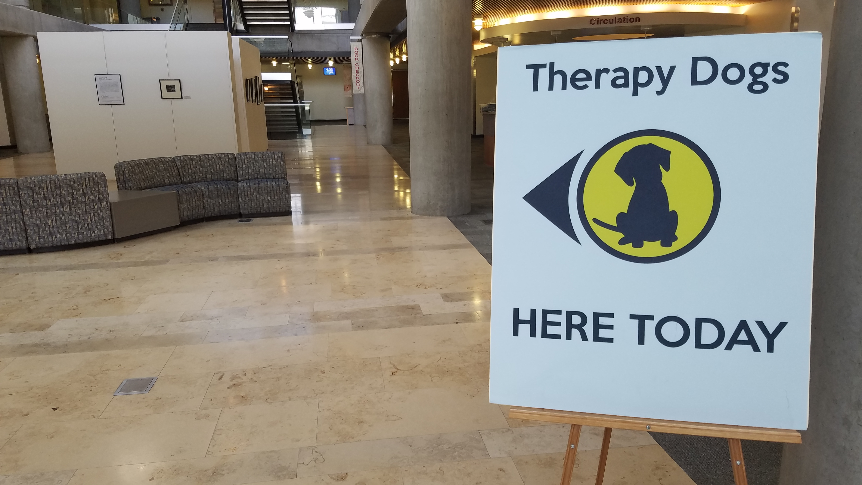
MARKETING
Signs in the library
Word of mouth
Don’t want to overwhelm the dogs

Slide 6
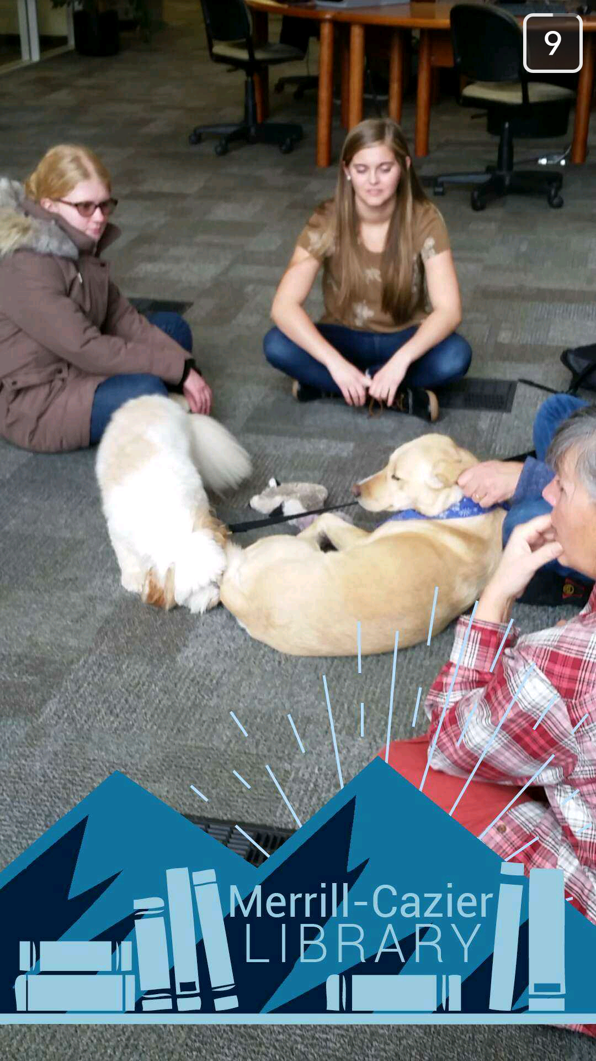
Social Media Marketing

Slide 7
HANDLER AND ANIMAL WELFARE
MAKING SURE EVERYONE FEELS HEARD

Slide 8
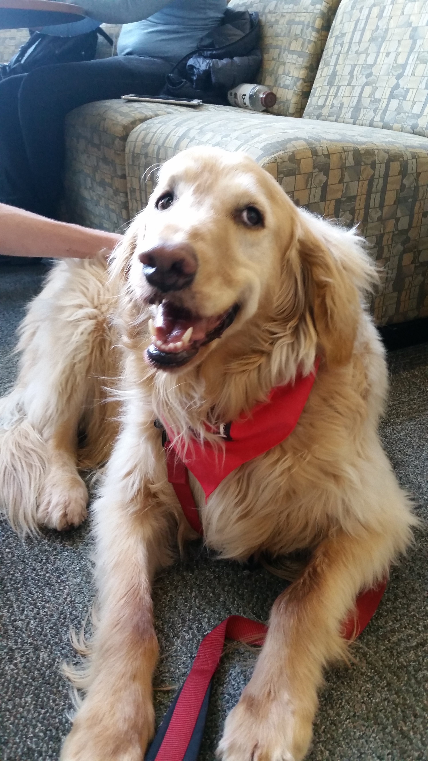
TIPS AND TRICKS
Cleaning supplies
Location, location, LOCATION!
Stay flexible!
Keep the volunteers comfortable!

Slide 9
FUTURE GOALS
T-Shirts
Dog Spotlights
Cats! (a variety of animals for a variety of people)
Anonymous handler survey

Slide 10
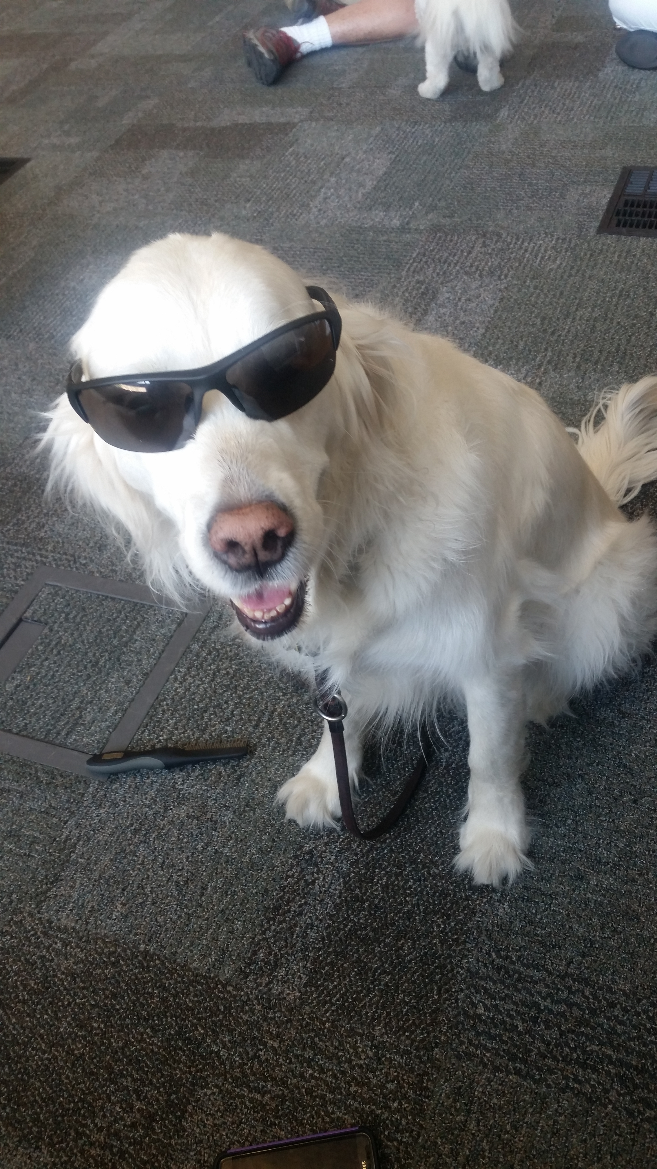
QUESTIONS?

Slide 11
