Slide 1
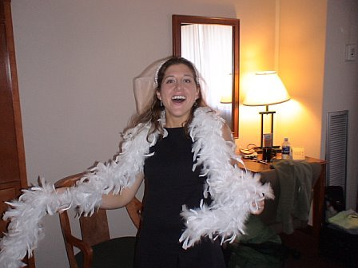

A Happy Employee
is a Productive Employee
Erin Dini Davis

Slide 2
Staff Development committee (SDC)
Mission:
SDC is dedicated to the training, education, and retention of all Library employees
Membership:
10 people representing all departments & all job classifications
Leadership opportunities for all!
NO ONE is safe from serving as the chair!
Notes:
Created SDC in 2002, committee’s goal is to enhance staff performance, thereby providing better experiences for our patrons.
Mission Statement: The Staff Development Committee is dedicated to the training, education, and retention of all Library employees. It promotes and aspires to gave a collegial environment for all Library employees individually and for the Library as a whole. Through its programs, the committee aspires to promote professional development and growth opportunities that enhance the performance of employees and increase the quality of service. The committee is charged with:
• Coordinating the review of issues and identifying needs related to training and development of Library employees
• Organizing and sponsoring continuing education programs (minimum 1 per semester) which may include workshops, seminars, and activities such as Staff Day, etc.
• Arranging panel discussions, brown bags, etc. where staff will report on recent conferences and continuing education sessions
• Arrange stress relieving activities for the betterment of the staff
• Evaluating the success of staff development activities
• Holding meeting twice a month, which is open to all Library employees
• Reporting annually to the Libraries Executive Council
Committee Membership: The committee shall consist of eager, willing, and positive people from all departments among the Library employees. The committee members will be volunteers. A member of the Executive Council will serve on the committee in an ex-officio capacity. Committee members will serve staggered two year terms that are renewable once. Lack of attendance at three consecutive meetings without prior report to the committee chair will result in termination from the committee. The committee will elect a chair from among its membership to serve for one year.

Slide 3
Our charge:
Identifying training needs
Organizing continuing education programs (workshops, seminars, Staff Day, etc.)
Promoting stress-relieving activities

Slide 4
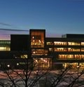
Staff Day – the main SDC event
An annual event for all library staff
Purpose is to learn about the library, strengthen relationships, and HAVE FUN!

Slide 5
Staff day
Offers diverse activities
Mixes fun and serious
Brings people together
Fosters conversations with colleagues
Features variety of speakers
Grassroots effort – planned by the people, for the people…
Notes:
Variety of activities, Mix of fun and serious Balance Unify, Highlighted a part of the library, Entertaining and educational, Bringing people together, Building community, Really got us talking,, No one person dominated
Productive, Got to know other staff that they don’t normally interact with, Mixed up the usual groups
Some criticisms:
Too long, Too drawn out, Stressful, Not everyone there, Too much time sitting
AGAIN, I THINK THIS SLIDE TITLE IS MISSLEADING. AREYOU TAKING ABOUT EVALUATIONS OF STAFF DAY? AND OUR DEAN IS AWESOME… MAYBE COMBINE THIS SLIDE WITH THE PREVIOUS ONE – CUT THE TEXT DOWN A LOT, THOUGH…

Slide 6
Recent staff day themes
  2005: Carnival
  2006: Strategic Planning (not popular)
  2007: Library Olympics
  2008: Folklore & Storytelling
  2009: Be Well, Be Safe, Be Happy
  2010: Giving Back to Our Community: Volunteer Projects

Slide 7
Staff Day 2006: Strategic Planning
By far it was our most unpopular!
We learned that Librarians Just Want to Have Fun!

Slide 8
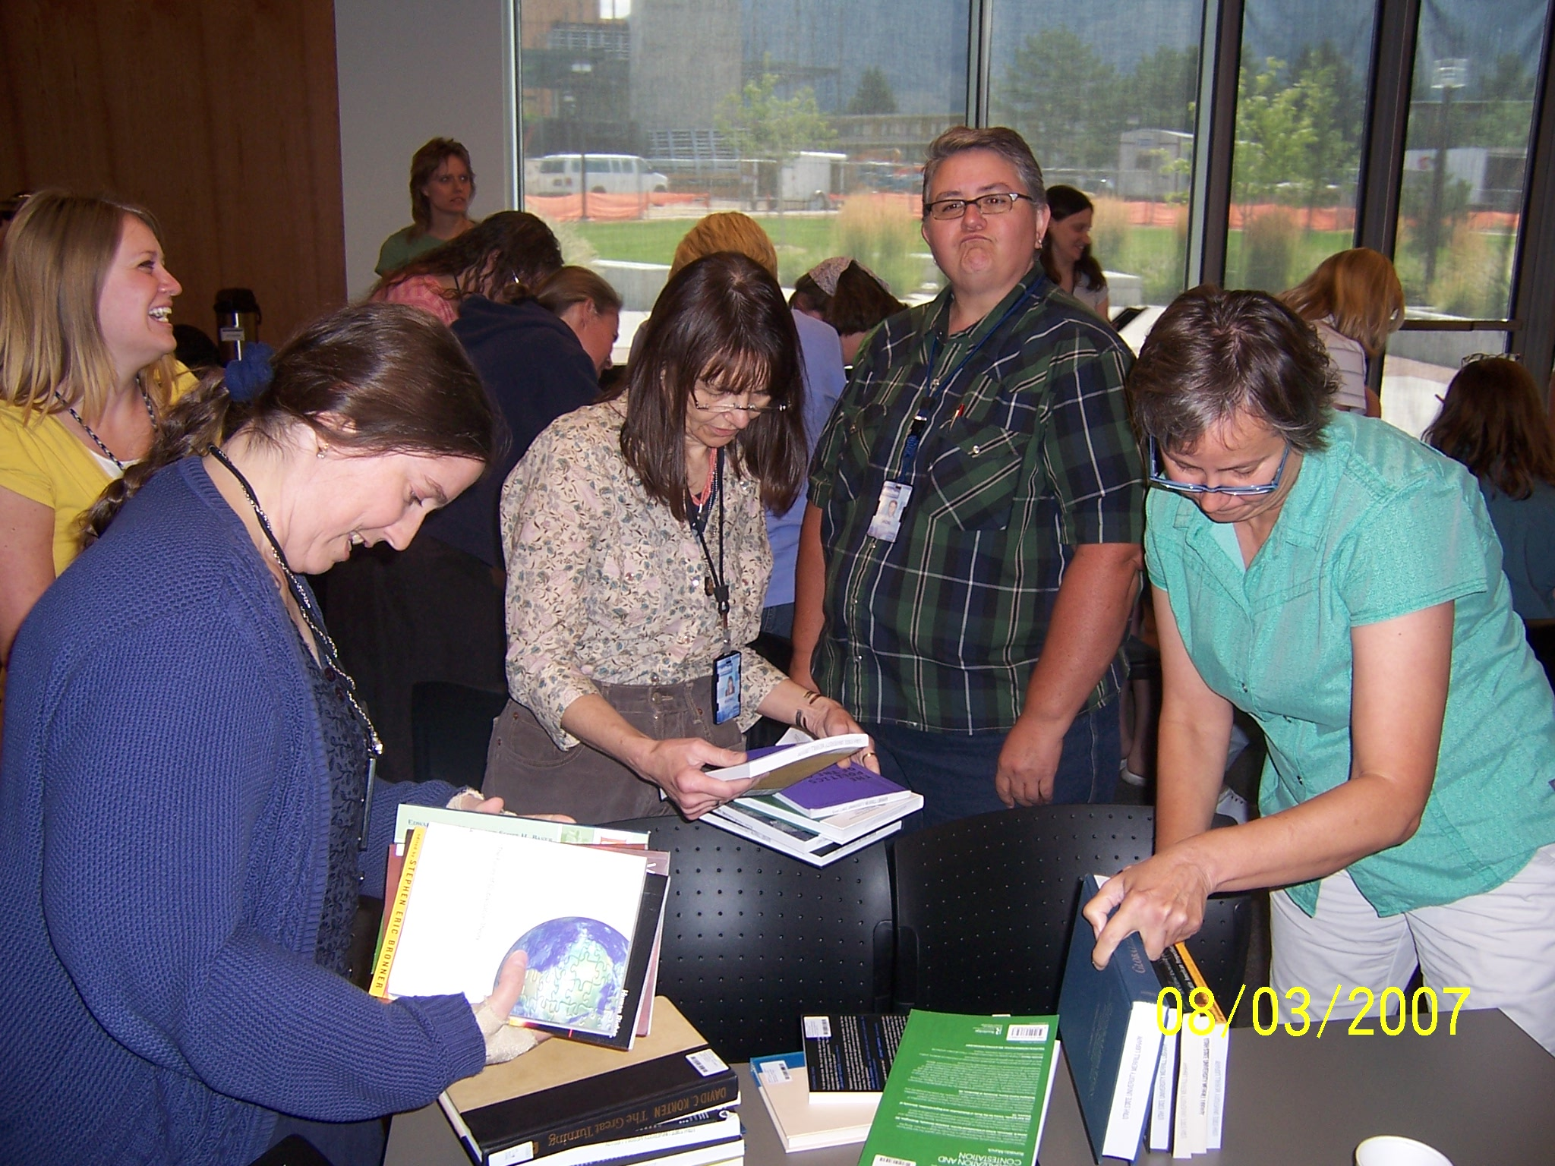
Staff Day 2007: Library Olympics
Notes:
Teams were created to combine people from various departments; here we have cataloging, serials, special collections, circulation, and interlibrary loan – all trying to put a cart of books in call number order.

Slide 9
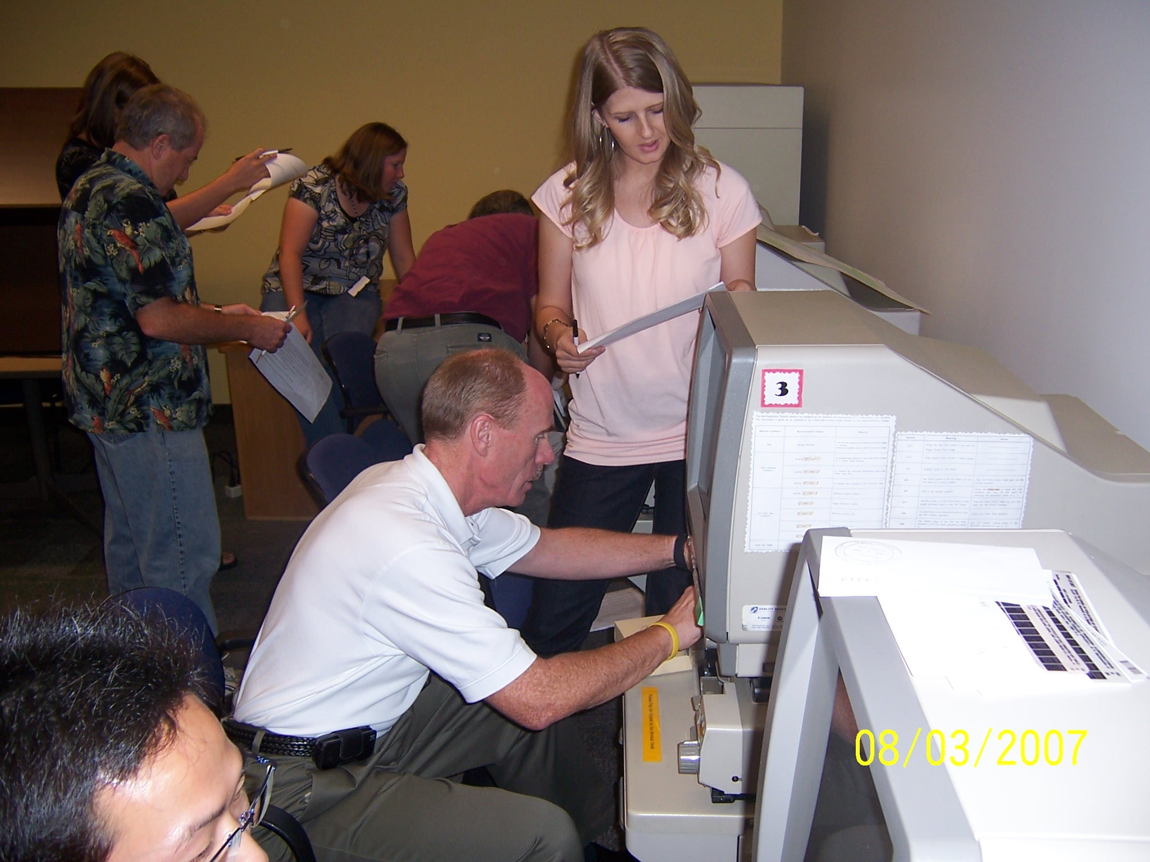
Staff Day 2007: Library Olympics
Notes:
Administration and Support Staff working together to figure out how to load microfilm.

Slide 10
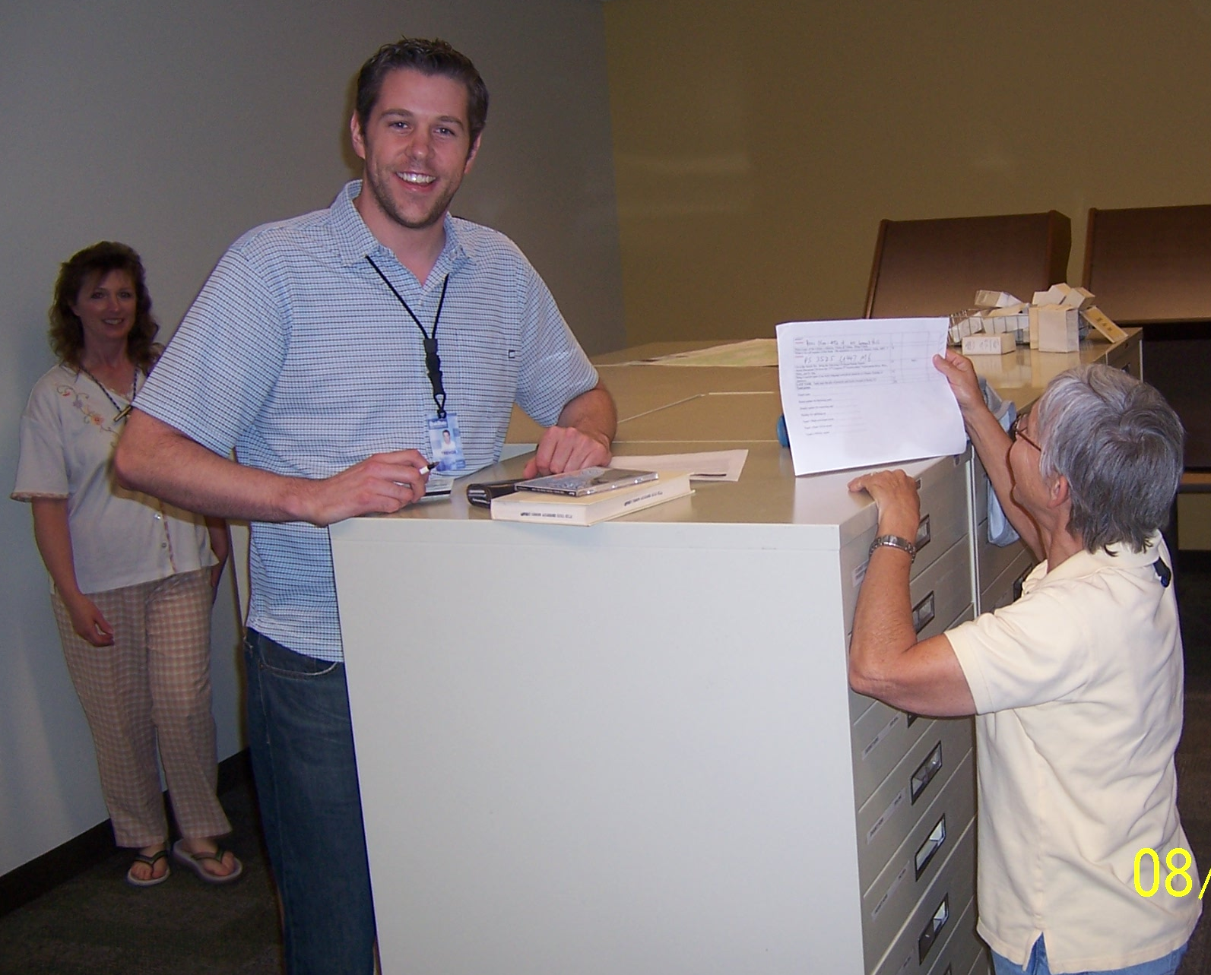
Staff Day 2007: Library Olympics
Notes:
Diversity (height), plus gov docs, circulation, reference on a team.

Slide 11
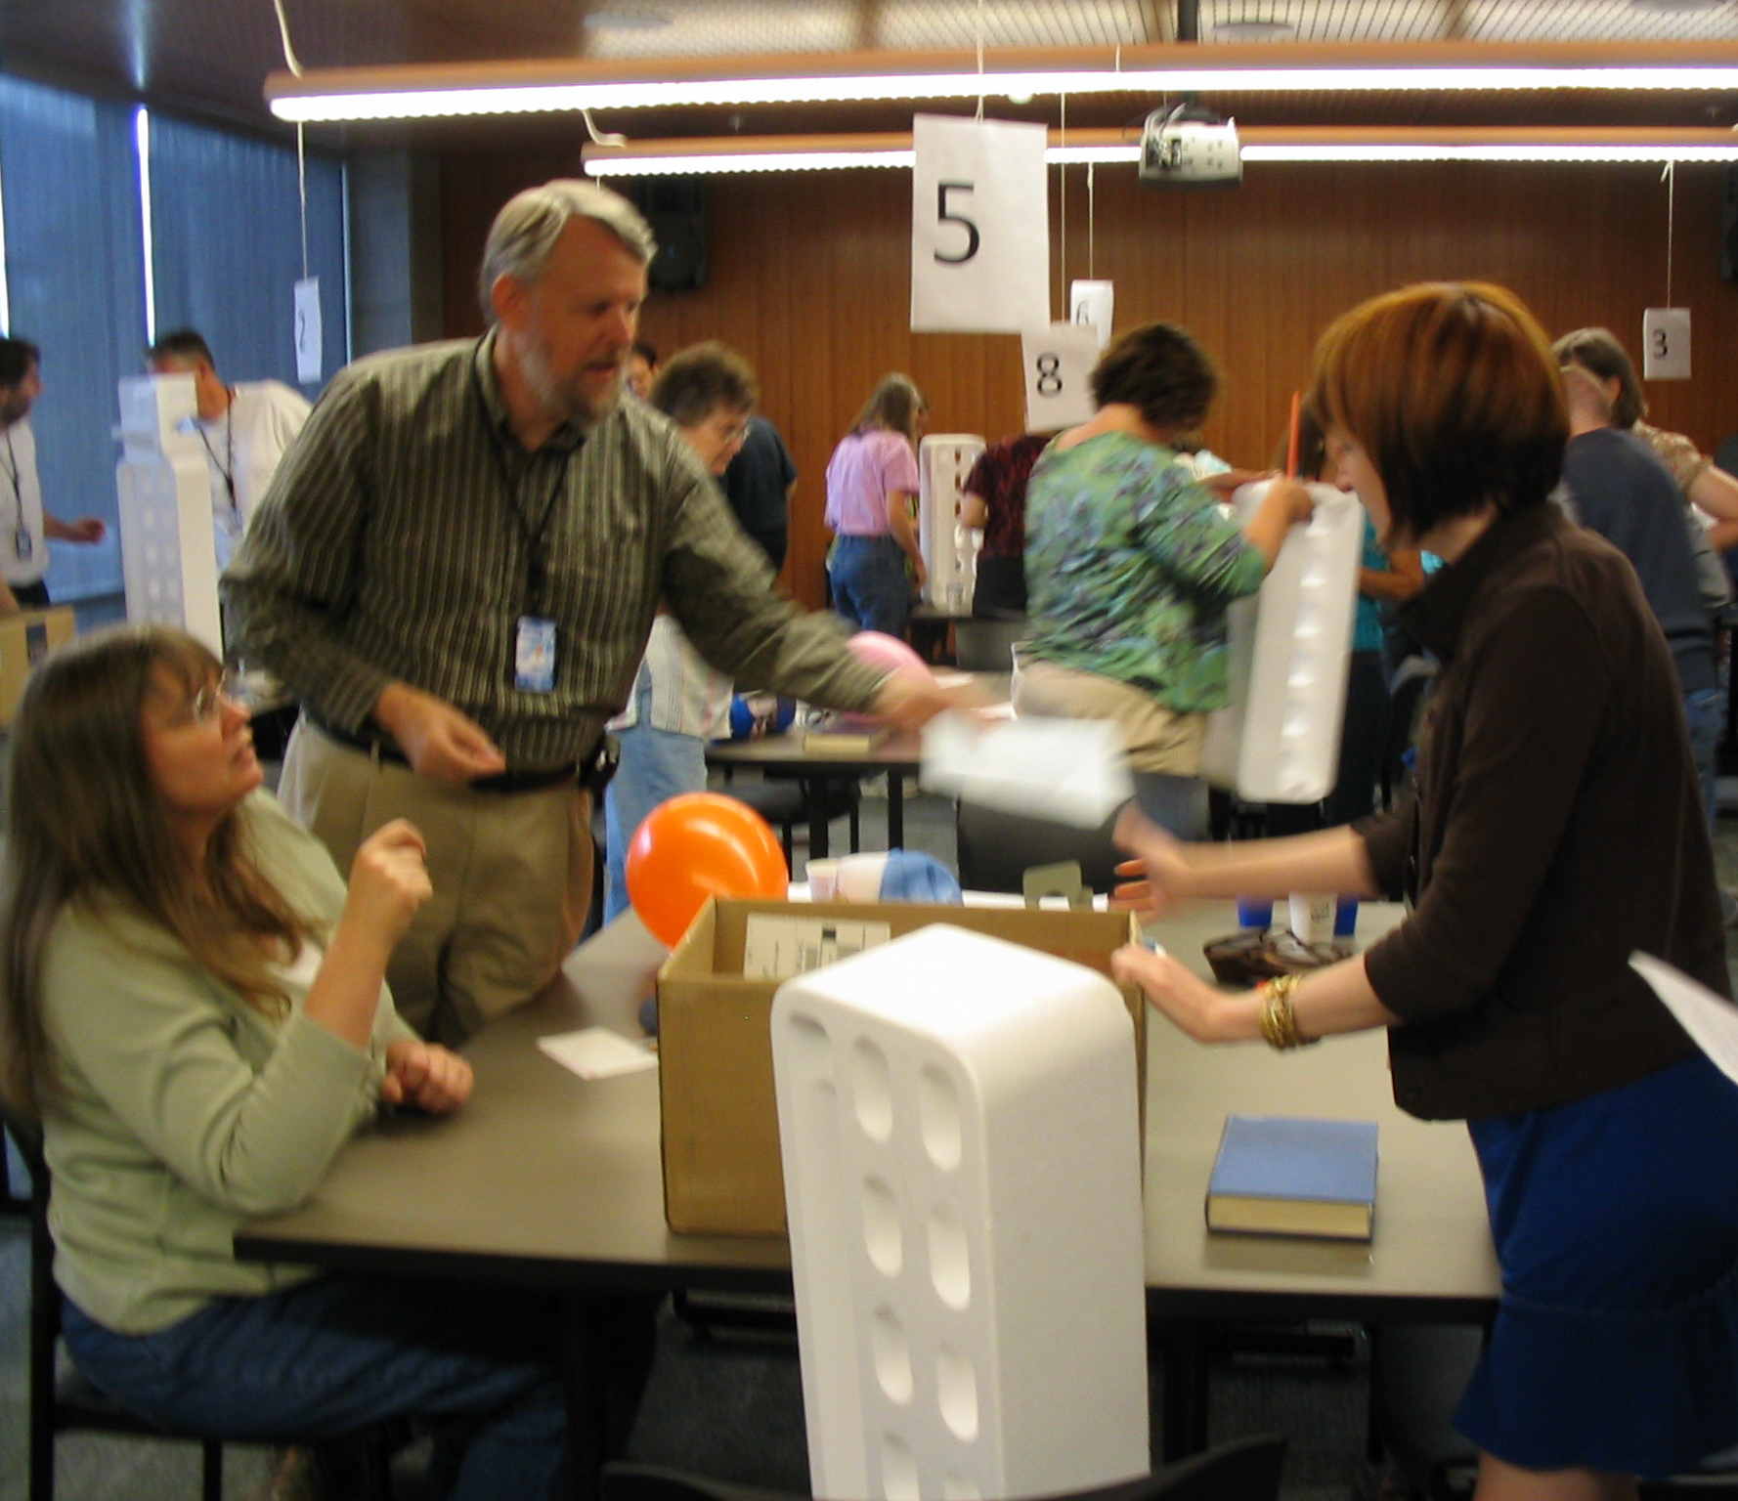
Staff Day 2008: Folklore
Notes:
This day focused on learning more about our history and about how our folklore program works. It included storytelling from a previous director, creation of pod casts, and team building exercises.
A team building exercise. Even our dean had to work.

Slide 12
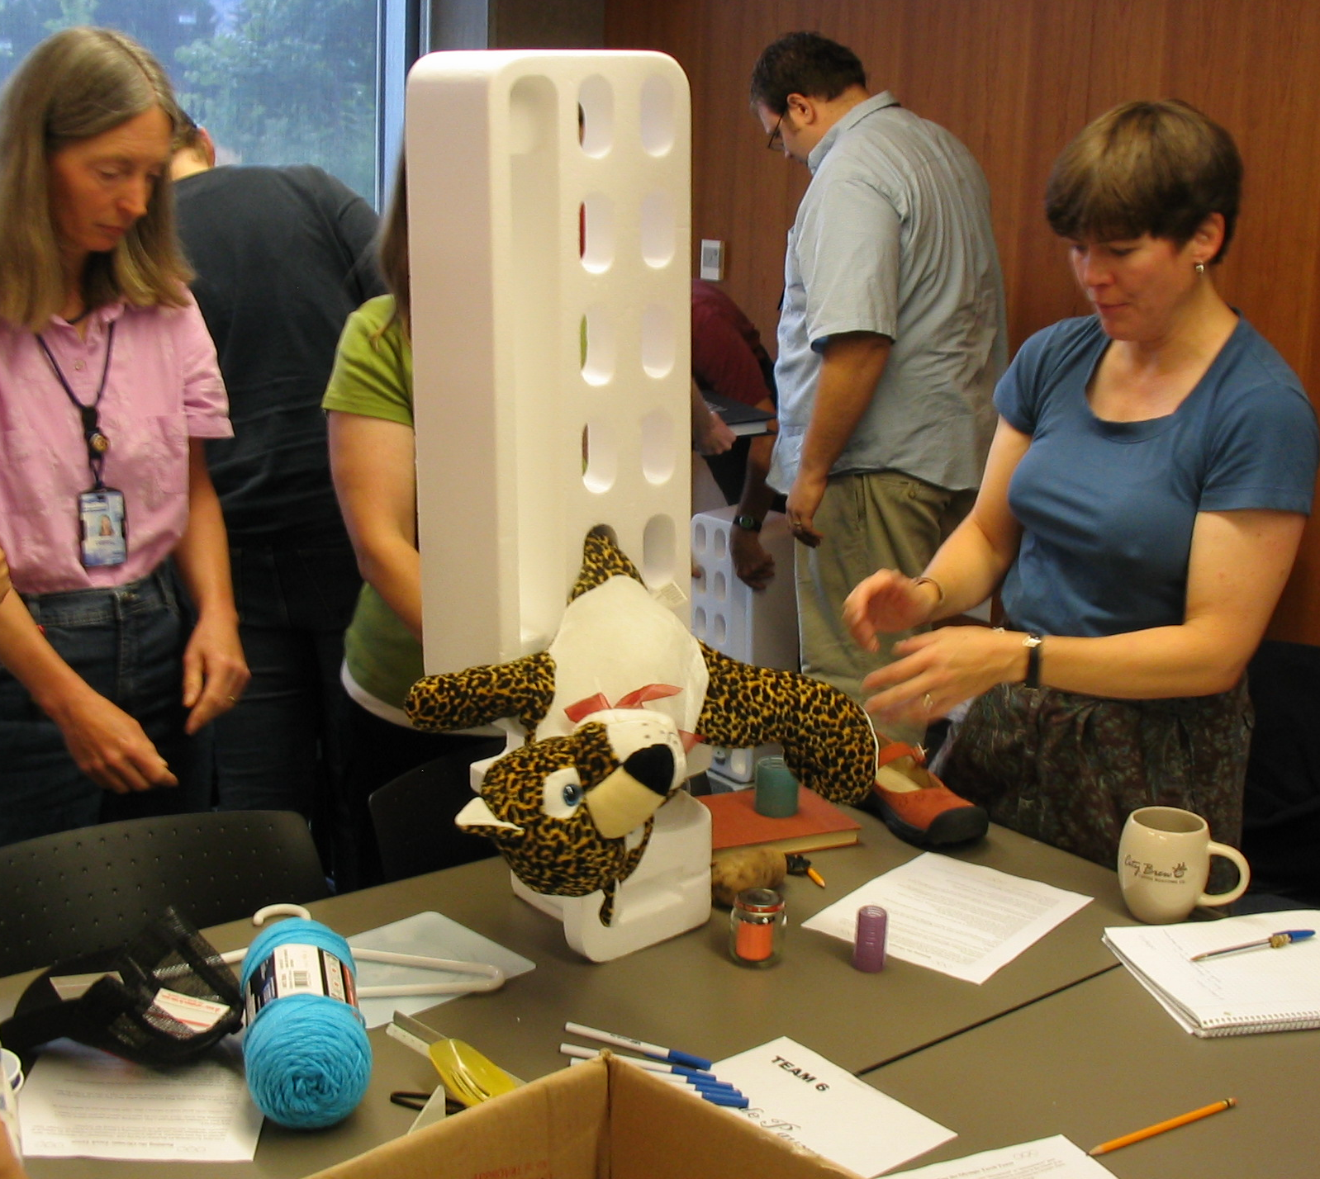
Staff Day 2008: Folklore
Notes:
We don’t know what they were thinking! Once again teams were created pulling people from various areas of the library.

Slide 13
Staff Day 2009: Be Well, Be Safe, Be Happy
Developed to complement a campus wide “Be Well” program
SDC members created training materials starring our very own talent, in order to keep the staff engaged
Staff Day launched a fitness challenge that culminated 30 days later with a “Be Well” lunch
Notes:
30 DAYS LATER? IT WAS ABOUT A MONTH LATER… GET RID OF HEALTHY LUNCH BULLET – NOT THE MOST IMPORTANT PART.

Slide 14
Staff Day Awards
Each year we honor an employee from each employee class: Classified, Professional, Faculty
Staff members submit nominations, describing the accomplishments of the nominee
The previous year’s winners serve as the judges
Winners receive a free day off
Notes:
Might ask our staff to send you’re their thoughts on this practice – might get a good quote to include.

Slide 15
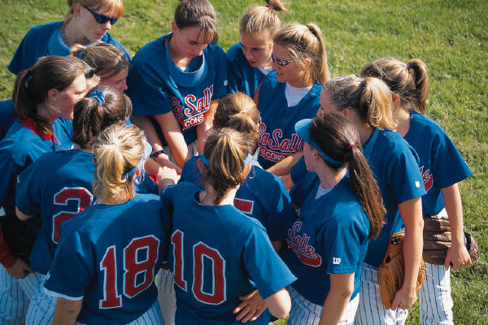
Other sdc Activities
Spotlight of the Week
Table Talks
Departmental Open Houses

Slide 16
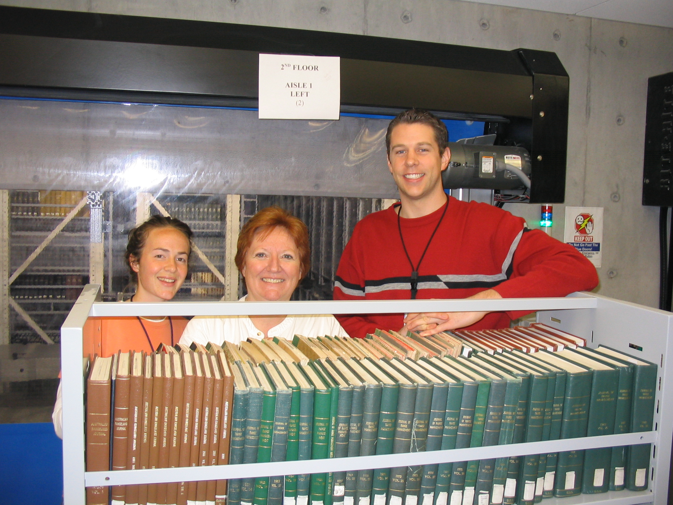
Spotlight of the week
Scholars on the Path to Enlightenment
Did you know that we have three scholars in library school! Trevor Young, Cindy Sherman, and Emily Burton are currently seeking true enlightenment through obtainment of that most revered of degrees, the MLS. Trevor and Cindy are attending Emporia State, and Emily is attending Clarion University.
One of the SDC’s Reporters on the Run, tracked down these talented employees for an in-depth, insightful, and highly professional interview. No frivolous questions were left unanswered. No library employees were intentionally injured during this interview.
All three appear to enjoy their calling to librarianship. The call came to them from different entities. For Cindy it was her landlord, to whom we will be forever indebted. Emily was influenced by Ronald Jenkins, Director of the Logan Public Library. Trevor simply heard voices in his head. Emily demonstrated wisdom beyond her years by indicating Cataloging was her favorite course. However, we must question her choice of least favorite course, since she cited the movies she was forced to watch as part of her Multicultural Sources & Services class! …

Slide 17
Table Talks
Anyone who has attended a conference, training, or workshop is asked to present a summary of their experience
Also features special training or current awareness:
  Web 2.0 technologies
  New Institutional Repository
Notes:
A great way for staff to find out what everyone else is doing, as well as an opportunity to learn from their travels

Slide 18
Departmental Open Houses
Offered every couple of years
Departments take turns hosting open houses
Departments plot and scheme creative ways to show what they do and who they are.
Activities have included:
  The Price is Right (Acquisitions)
  Baby Picture Matching (Digital)
  Mission Impossible Video (Systems)
  Circus (Cataloging)

Slide 19
eatin’ meetings
First Friday Lunch (monthly potlucks)
Holiday Treat Exchange
Recipe Exchanges

Slide 21




 | FRIDAY FEBRUARY LUNCH
 |  |  | Friday, February 13, 2009
 |  |  |  | 12:00 PM
 |  |  |  | ROMANTIC
 |  |  |  | ITALIAN
 |  |  |  | DINNER
 |  |  |  | The Menu:
 |  |  |  | Spaghetti and Meatballs
 |  |  |  | in a secret family recipe sauce
 |  |  |  | (artfully prepared by Chef Sandra)
 |  |  |  | Green Salad
 |  |  |  | Fresh Bread
 |  |  |  | Desserts
 |  |  |  |  | Drinks
 |  |  |  |  | Sign up on the blog to bring:
 |  |  |  |  |  | $3 towards the main dish ingredients
 |  |  |  |  |  | Spaghetti noodles
 |  |  |  |  |  | Salad Toppings & Dressing
 |  |  |  |  |  | Bread
 |  |  |  |  |  | Desserts
 |  |  |  |  |  | Drinks
 |  |  |  |  |  | Plates/cups/forks
 |  |  |  |  |  | Clean Up

Slide 22
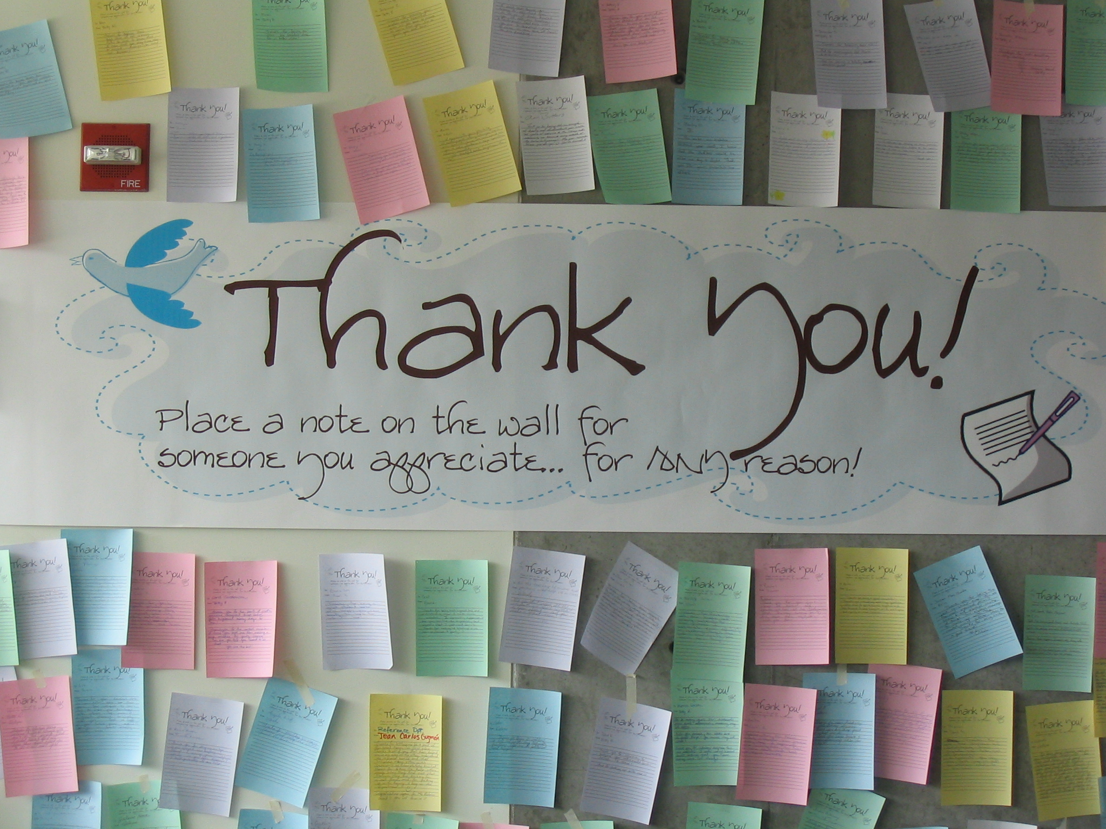
Wall of “Thanks!”
Notes:
Notes were written by staff to other staff… THERE ARE TREATS, TOO!

Slide 23
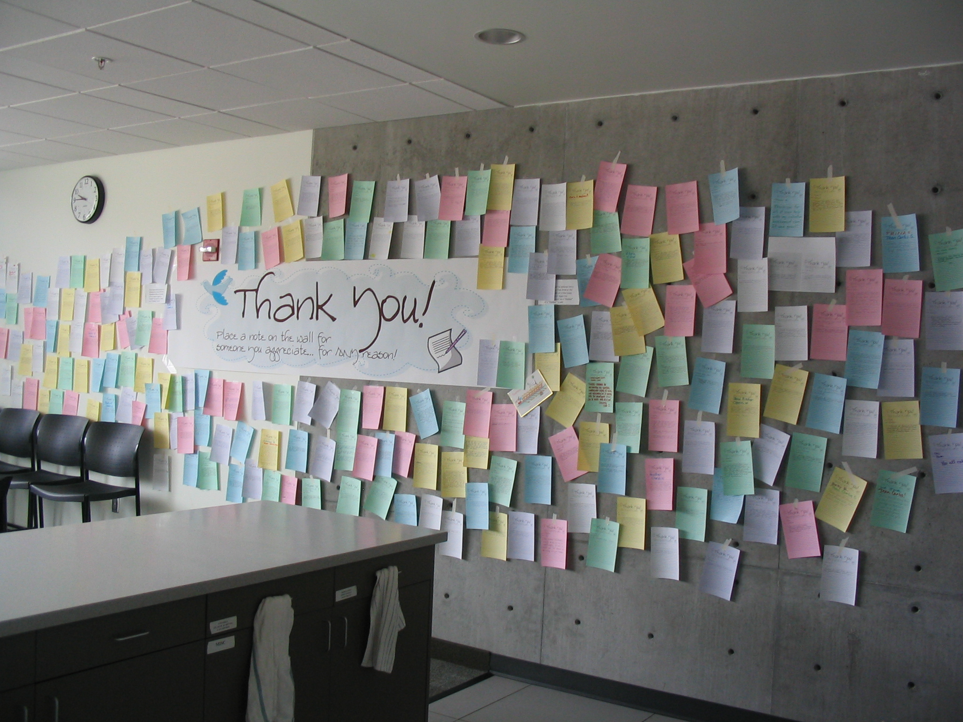

Slide 24
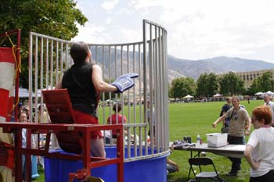
“A-DAY” Dunk Tank
SDC’s spirit inspires the entire library
We are even willing to get wet for a good cause
Notes:
Effort to shatter stereotypes of librarians.

Slide 25
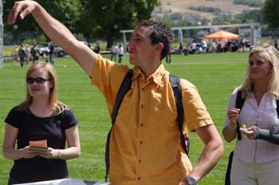
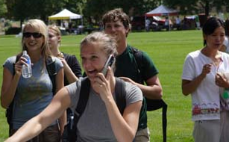
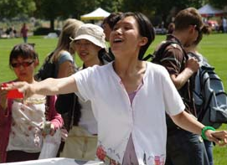
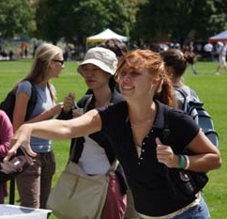
And students love dunking us!

Slide 26
Some final “FUN” things we do…
Halloween Costume Contest
Student and Staff Appreciation
  Doughnuts & Cider for Halloween
Employee Pet Contest (match the pet to their owner)
Photo contest: “People’s Choice”
Employee Film Contest
Notes:
I took out employee of the year since I added it elsewhere

Slide 27
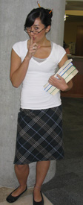
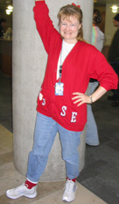
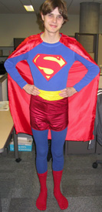
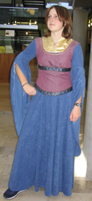
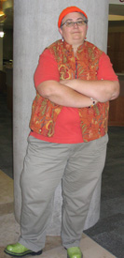
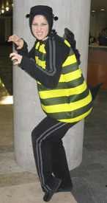
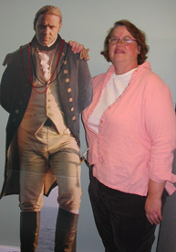

Slide 28
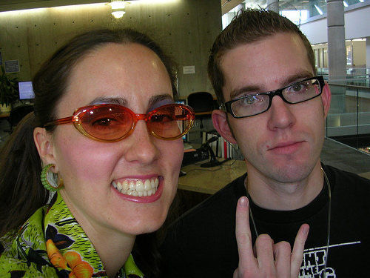
Halloween Costumes: Cool!

Slide 29
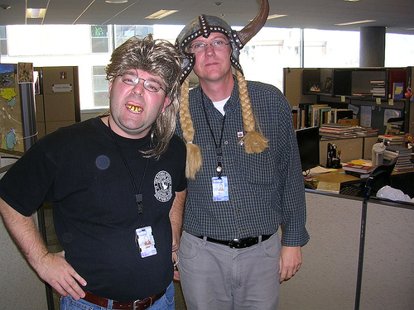
Halloween Costumes: Undignified!

Slide 30
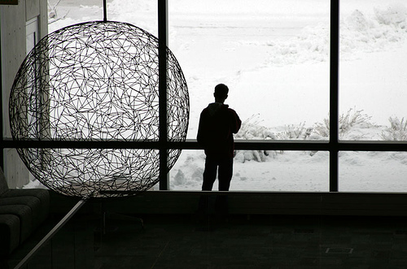
Staff photo contest

Slide 31
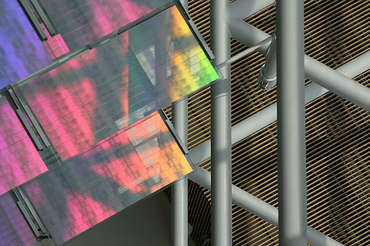
Employee Photo Contest

Slide 32
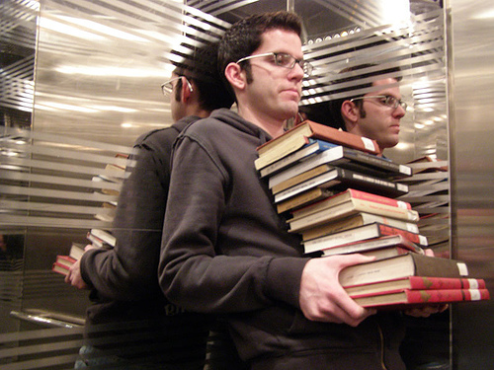
Employee Photo Contest

Slide 33
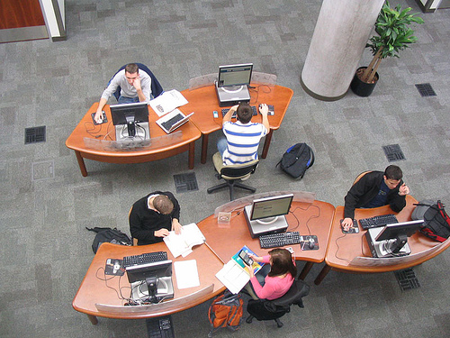
Employee Photo Contest

Slide 34
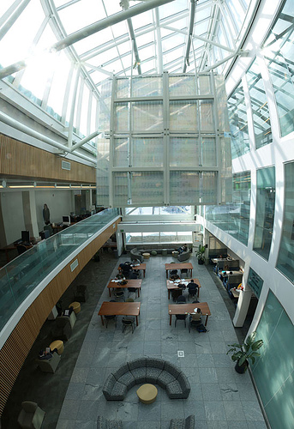
Employee Photo Contest

Slide 35
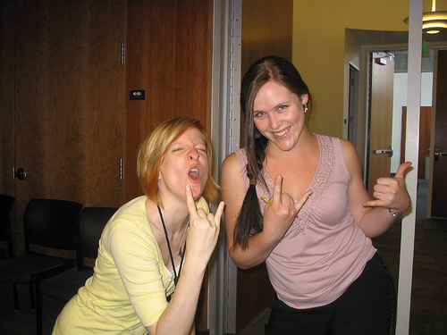
Why is SDC important to us?
Breaks down barriers between departments
Builds esprit de corps
Enhances reputation (other people want to work here!)
Happy workers = productive workers
Notes:
BEST ENDING PHOTO EVER!

