Slide 1

An Entrepreneurial Approach to Subject Librarianship
Jennifer Duncan, Head of Collections
Wendy Holliday, Coordinator of Library Instruction
Flora Shrode, Head of Reference
Merrill-Cazier Library, Utah State University
April 2010
Notes:
Intro: Welcome to our virtual poster, An Entrepreneurial Approach to Subject Librarianship. I’m Jennifer, Flora, and Wendy

Slide 2

Snapshot of Utah State University and Merrill-Cazier Library
15,612 students at main campus
11,207 students at regional campuses and in distance programs
1,647,042 volumes, 8,225 print journals, and 50,000 e-journals
24 faculty, 16 professional, and 26 classified staff
9,272 reference transactions in FY 2009
1,101 library instruction sessions in FY 2009
Notes:
WH
We wanted to give you a sense of the size and scope of our library, so we’ve provided some basic fact on this slide. We are a Carnegie Research Extensive institution and the land grant college in Utah.

Slide 3
Highly Centralized Collection Development Model
Decentralized Team-Based Subject Librarian Model with Functional Support
Notes:
WH
The USU Library has struggled to find a collection development model that works for our organization. This presentation tells the story of how we have transformed from having a highly centralized and tightly controlled system of collection development, focusing primarily on book selection, to developing a flat and decentralized model of integrated subject librarianship. This model allows our liaison librarians to focus on providing subject expertise in selection, specialized instruction, and outreach, while leaving administrative support and details to functional specialists. While this model is not necessarily a new innovation, we hope to share our process of moving from a hierarchical to a team-based approach.

Slide 4
Departmental Silos
Collection Development
Controlled by the CD Librarian
Reference/Instruction
Inconsistent focus on subject liaison areas
Notes:
JD
Ten years ago, the Library operated with a highly centralized CD model. The Head of Collection Development was quite heavy handed with material selection and instruction was not proactively coordinated. University priorities and programs had shifted and the delivery of instruction (specifically, the growth of distributed distance education) had evolved.

Slide 5
Problems With the Old Model
Collection development a low priority for liaison librarians
Difficulty in using and understanding resources for collection analysis
Lack of engagement with liaison departments
Neglect of online and distance education courses
Liaisons had no holistic vision for their work
Few librarians with formal education in their subject areas
Notes:
JD
We noted problems with prioritization; collection analysis; engagement; neglect of distance ed; lack of formal subject training; and lack of vision.
Our desire to develop a more holistic approach to subject librarianship compelled us to re-evaluate our organizational structure.

Slide 6
Collection Development Task Force
New Dean
Vacancy in Head of Collections
Opportunity to reconsider organization
Task Force created
Focus Groups
Survey
Town Hall Meetings
Notes:
FS
In 2007 the head of collection development left USU for another position, and the dean retired. A search for a new dean began immediately. We faced typical budget uncertainties, and we couldn’t anticipate what organizational model the new dean might prefer. At the same time we were dissatisfied with subject librarians’ performance.
These conditions inspired us to examine our organization, so we established a task force in the fall of 2008. Task force members conducted a survey and focus groups with subject librarians to learn about their needs and opinions.
We also held all-staff town hall meetings to seek input from throughout the library about how to adjust the way we organize and manage subject librarians’ work.

Slide 7
Organizational Culture
Competing Values Framework
Flexibility and Discretion
Clan
Concern for people
Adhocracy
Dynamic
Market
Results-oriented
Hierarchy
Coordination
Sensitive to customers
Nurturing
Participatory
Innovative and entrepreneurial
Risk taking
Competition
Achievement
Efficiency
Stability
Structure
Internal Focus
External Focus
Stability and Control
Cameron and Quinn, 2006
Notes:
WH
In 2007 I conducted a study of USU’s teaching librarians and our organizational culture, using the Competing Values Framework. This slide outlines the framework’s four cultures based on their focus (either internal or external) and their approach to flexibility and discretion and control and stability. We wanted to figure out how to best handle change and the hard decisions required to balance increasing demands for instruction during times of scarce resources.

Slide 8
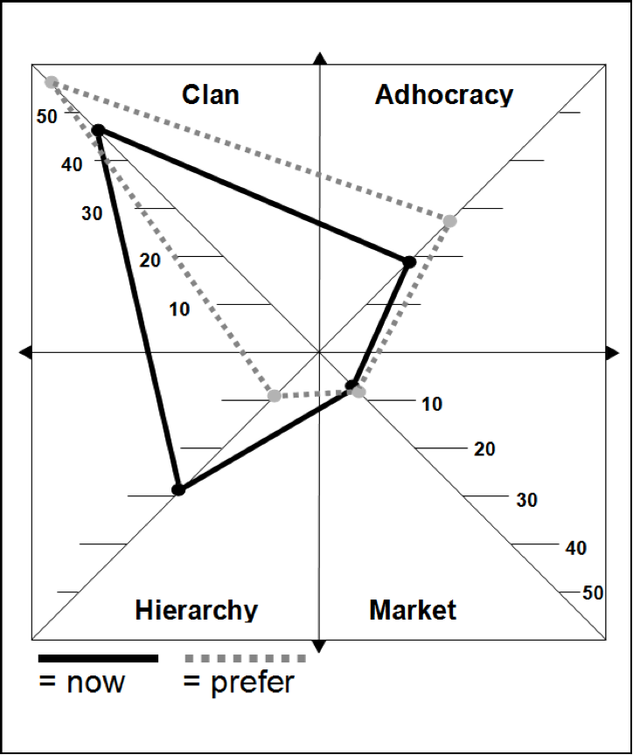
USU is a Clan Culture
Studied organizational culture in context of instruction in 2007
USU is a clan culture
Reference Department also had strong preferences for adhocracy
Bullard and Holliday, 2007
Notes:
WH
Among all of the teaching librarians there was a strong sense that we have a clan culture at USU and that is what we actually prefer. When looking only at Reference librarians, there was also an adhocracy element to our organizational culture, which values risk-taking. Both cultures favor flexibility and individual discretion. Understanding our library as a clan culture shaped the work of the CD Task Force because we knew that any recommendations that we made had to take into account how our librarians want to work.

Slide 9
Results of CD Task Force Study
Working Styles
Group/Individual
Need for support
Data
Deadlines
Targets/Accountability
Models/Templates
Barry and Shrode, 2003
Notes:
FS
Survey responses and focus groups with subject librarians revealed some new information about working styles and needs for support. Confirming our clan culture, many librarians indicated they would like to work with a partner or in a small group on collection development, collection management, and liaison activities.
They said that having partners would help them to be more accountable in their subject librarian roles – to stay on track with projects and budget expenditures.
Most of the support librarians need can come from department heads and coordinators. Like budget updates and reminders about spending targets; data about collections, and assistance with collection analysis, and subscription options for journals.
Subject librarians need guidance in reviewing curricula to identify courses ripe for information literacy instruction. They could also use templates for newsletters to tailor their promotion of library resources and services to individual colleges or departments.

Slide 10
Not Just a Selector Anymore!
Collection Development
Reference Desk Service
Subject Librarian
Library Instruction
Regional Campuses & Distance Education
Notes:
JD
In our new structure, the focus shifts from the individual processes of library instruction, material selection, reference desk service, or distance education service. Instead, our emphasis is on the subject librarian, integrating all of these processes into his or her work. Functional coordinators and department heads provide support by offering general guidance and generating the necessary data for the subject librarians to build a holistic picture of their departments.

Slide 11
Subject-based Team
Psychology Subject Librarian
Teacher Education and Special Education Subject Librarian
Instructional Technology Subject Librarian
Communication Disorders Subject Librarian
Family , Consumer, and Human Development Subject Librarian
College of Education Team
Notes:
JD
The subject librarians are divided into five subject-based teams that correspond to the colleges or pairings of colleges that make up our university. These teams include:
Business
Education
Agriculture & Natural Resources
Science & Engineering
AND Humanities, Arts, and Social Sciences
These groups capitalize on natural disciplinary relationships and similarities. Because many of our subject librarians do not have a background in their assigned areas, the group structure provides an added layer of support as those librarians are learning their fields.
The example on this slide indicates the composition of the Education team.
Each team has an assigned leader (in this example, the leader is Wendy) who is responsible for convening the group 2-3 times per year to discuss issues that might relate to all of the departments in a particular college.

Slide 12
Functional Coordinators
Subject Based Team
Coordinator for Regional Campuses and Distance Ed
Coordinator of Library Instruction
Reference
Head of Collections
Notes:
JD
Each subject based team draws upon the expertise of functional coordinators:
In addition to the subject-based team meetings, which occur only a few times a year, all subject librarians meet monthly and discuss joint concerns. Prior to our restructuring, we held three separate meetings for collection development, instruction, and reference. The new Subject Librarians meeting consolidates the three old meetings and is coordinated jointly by the four functional coordinators.

Slide 13
Subject Librarians Advisory Council (SLAC)
Library Administration
AD for Public Services
Reference & Instruction
Head of Reference
Collections and Acquisitions
Head of Collection Development
AD for Technical Services
AD for Special Collections & Archives
Library Instruction Coordinator
ILL Coordinator
Subject Librarian
Subject librarian selected at large to serve a two year term
Head of Acquisitions
Electronic Resources Librarian
Coordinator of RCDE Library Services
Notes:
JD
Finally, major policy questions are addressed in the Subject Librarians Advisory Council. This group replaced the former Collection Development Advisory Council to promulgate the message that the work of the subject librarian is multifaceted.. In order to reinforce balance, the chair of SLAC rotates among the Library’s associate deans, all three of whom sit on the committee.
This group has provided advice on large projects such as the creation of a patron-driven interlibrary loan acquisition program and the redesign of our e-resource access pages. These are the types of policies that could be driven and controlled by technical services, but whose design really benefits from the knowledge and expertise of the subject librarians.

Slide 14
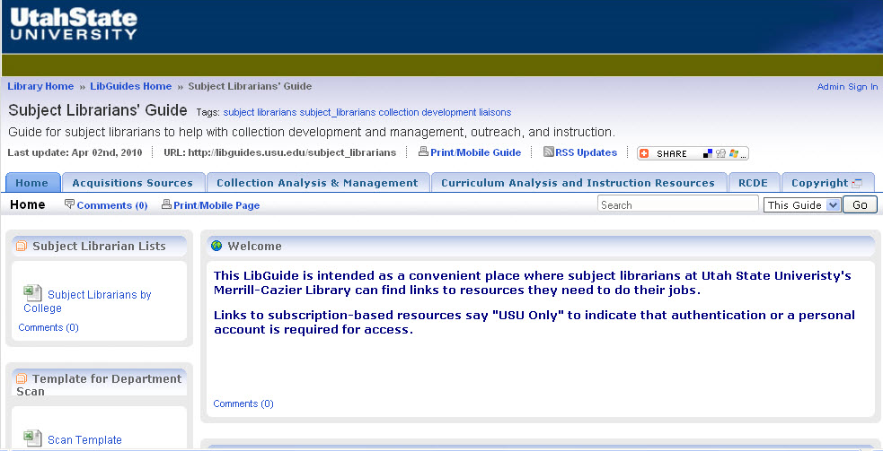
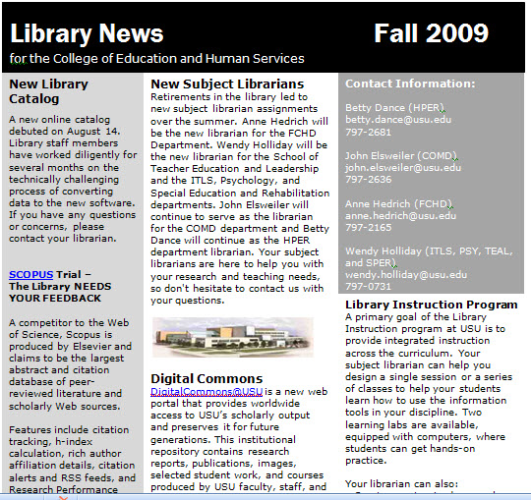
First Projects
Lib Guide http://libguides.usu.edu/subject_librarians
Newsletter
Notes:
FS
Two early projects that SLAC members collaborated on were creating a LibGuide web page for subject librarians and a template for newsletters to send to the colleges.
The LibGuide is openly accessible and serves as a central place where librarians can store and retrieve lots of data: for example, extensive reports of past acquisitions and library instruction by discipline, templates for departmental scans, and a template for newsletters with suggestions for content that librarians can adapt for a particular college or department.

Slide 15
Departmental Scans
Number of fulltime faculty
Program and Center descriptions
Number of majors
Number of minors
Majors graduated
MA degree seekers
PhD degree seekers
Graduate degrees granted
FTE taught at main campus (fall)
FTE taught at regional campuses (fall
Total student credit hours
General Education students taught
General Education classes taught
Notes:
JD
A significant project that we coordinated was a series of environmental scans of the academic departments, completed by the subject librarians. With input from the functional coordinators, we put together a list of data points that could potentially help the subject librarians in their work. This screen is text-heavy, but it lists the data points that we have found useful in guiding our subject librarians’ understanding of the departments with which they are working.

Slide 16
Approval Changes
Datapoints
Results
Circulation report
Approval statistics
Classification Web (LOC)
Departmental scans
Over 250 changes
In-depth understanding of the collection
Shift to shelf-ready approval
Notes:
JD
And more than just the subject librarians, the updated departmental scans also assist the functional coordinators in making decisions about their own areas of responsibility. The first major project that I undertook in terms of collection development was a complete revision of our print approval plan.
Each liaison received reports of circulation statistics, detailed information about approval books received in their areas, and detailed classification schedules. This is the type of data that the Task Force had found that subject librarians needed to have prepared for them in order to make informed decisions about material selection.
250 changes to the plan later, I shifted to shelf-ready approval and migrated several collecting areas to electronic preferred or patron driven e-acquisition.

Slide 17
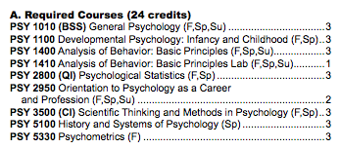
Curriculum Mapping
Major Requirements
Focus on required classes
List of Targeted Classes
Level (introduction or capstone)
Already teach library instruction?
Instructional Approach
Online tools
Formal in-class instruction
Identify “funnels”
Research component
Coaching/consultant model
Notes:
WH
Curriculum Mapping was another project.
Goal 1: Expand our integrated library instruction from general education into each major in a logical sequence.
Goal 2: Engage subject librarians in curriculum analysis to improve instruction and inform collection development.
We began by looking at the general catalog and identifying classes with a research component, especially those that students have to funnel through
Then we recorded whether a class was required and for what majors/degrees, and whether we already provide instruction for the class
Then we identified possible instructional approaches for each class, depending on their place in a major sequence and the kinds of skills to be taught.
We will collaborate with faculty to refine the plan and deliver instruction.

Slide 18
Psychology Instruction Plan
BS in Psychology | Already Teach? | Instructional Approach
PSYC 2950: Orientation to Psychology as a Career and Profession | yes | Formal instruction: Basic introduction to scholarly journals, the role of peer review, and PsycInfo as a disciplinary tool.
PSYC 3500: Scientific Thinking and Methods in Psychology | some sections | Formal instruction: Topic narrowing, PsycInfo refresher, and one-on-one assistance during class session.
PSYC 5300: Psychometrics | some sections | Online tools: LibGuide and tutorial on Mental Measurements Yearbook
MS and PhD
PSYC 6570: Introduction to Educational and Psychological Research | some sections | Formal instruction: Basic overview of library resources and services
PSYC 6970: Thesis | no | Informal: Reminder to consult with librarian
PSYC 7670: Literature Reviews in Education and Psychology | no | Check with faculty to determine best approach (consultant versus formal instruction)
Notes:
WH
This is an example of a skeleton plan for Psychology. You can see that is sequenced and combines formal instruction, a consulting model, and online teaching tools.

Slide 19
What is Working?
What Still Needs Work?
Engagement with Collections
Engagement with Instruction
On-site Business Reference
Enhanced Regional Campus Outreach
Takes time to implement change
Some entrenched habits
Accountability? Uncertainty
Notes:
FS
While a few librarians continue to operate with their old habits, for the most part we have seen a lot of progress. The subject group arrangement brings everyone to the table. We are fortunate at USU that communication is quite open among the members of our relatively small library faculty. Some uncertainly remains, however, from the fact that subject librarians report to many different departments so it’s not always clear who evaluates performance in collection development and related roles.
Progress we see is that many subject librarians now pay more active attention to their role in collection development. A coordinator of Library Services for Regional Campuses and Distance Education was appointed in spring 2009, and she has successfully raised awareness among all subject librarians about the importance of attending to distance ed students’ and faculty members’ needs.
Several subject librarians have met with their liaison departments to promote the library’s institutional repository and to invite researchers to set up profiles and share their publications.
Librarians are providing instruction in a wider range of departments and for increasing numbers of RCDE classes. The two subject librarians for business began offering reference service in the Business School building, where they find that interactions lean toward extensive research consultations rather than quick questions.

Slide 20
Questions?
Jennifer Duncan, Head of Collections
jennifer.duncan@usu.edu
Wendy Holliday, Coordinator of Library Instruction
wendy.holliday@usu.edu
Flora Shrode, Head of Reference
flora.shrode@usu.edu
References
Berry, T.U. &Shrode. F. (2004).“Collaborative reference: The Science and Technology Group at the University of Tennessee Libraries,” The Reference Librarian, 40(83/84), 145-155.
Bullard, K. & Holliday, W. (2009). Sailing off the map: Managing organizational change in the library instruction environment. Library Orientation Series No. 40.
Cameron, K. S., & Quinn, R. E. (2006). Diagnosing and changing organizational culture. San Francisco, CA: Jossey-Bass.
Notes:
FS
Thank you for viewing this presentation and listening to our story. Please contact us with any questions or comments.

