Slide 1
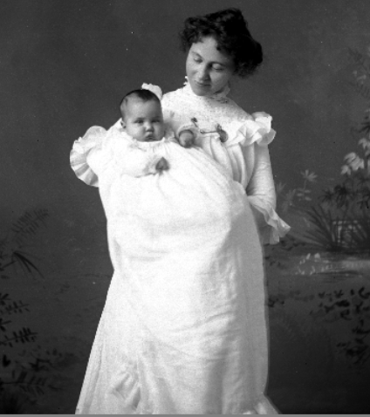
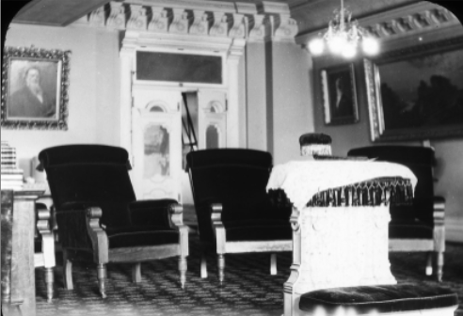
Mormon History Materials
Utah State University
Special Collections & Archives
Most images from USU Digital Library at
http://digital.lib.usu.edu
Powerpoint created by C. Walters

Slide 2
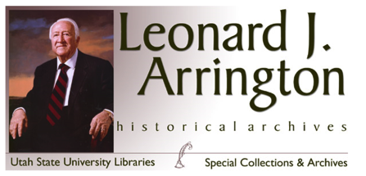
Leonard J. Arrington Historical Archive
Papers
Arrington’s professional life, both as educator and as Church Historian for the Church of Jesus Christ of Latter-day Saints from 1972 to 1982
His research interests: Women's history; Utah history; the Great Depression and the New Deal; and Mormon history
His writings
Photographs: mainly photographs Arrington collected for his numerous publications
Conway B. Sonne Papers

Slide 3
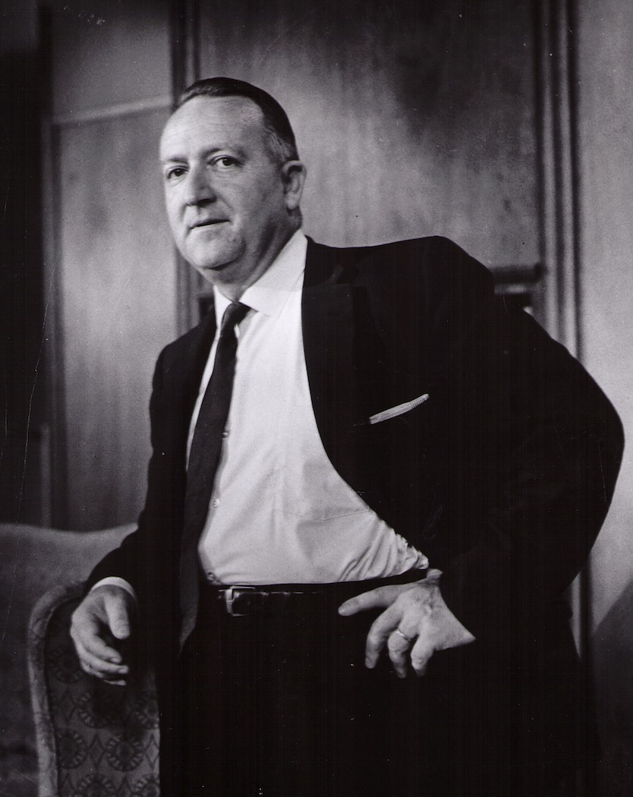
Leonard J. Arrington left behind a legacy of scholarship and mentoring that rightly earned him the title "Dean of Mormon History. “
His book Great Basin Kingdom: An Economic History of the Latter-day Saints is still considered to be one of the classic works of Mormon history.

Slide 4
The Arrington Archive includes:
Leonard J. Arrington's personal and professional papers
Historical materials and papers from other Arrington family members
Papers of other scholars in Mormon History.

Slide 5
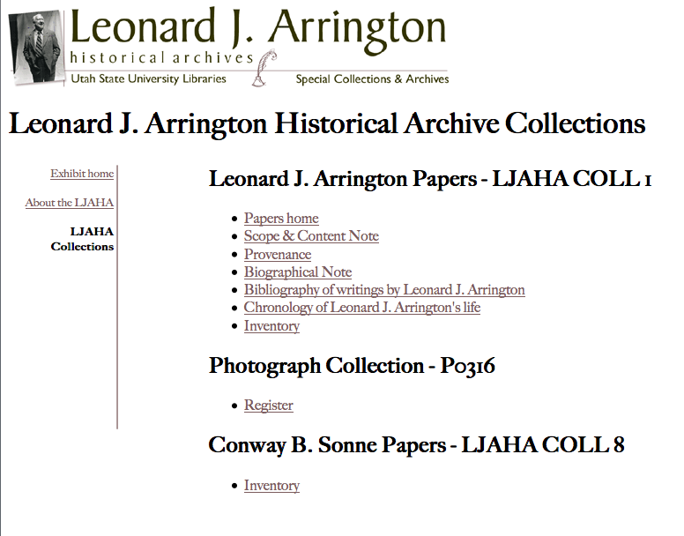
Arrington worked as Church Historian from 1972 to 1982… As the first (and only) professional academic to be named Church Historian, Arrington presided over a blossoming of Mormon history…
… he constantly combated a church hierarchy which did not regard the work of his department as "faith-promoting." Balancing his commitment to his profession and his loyalty to his church, Arrington frequently clashed with church authorities.

Slide 6
The Papers…

Slide 7
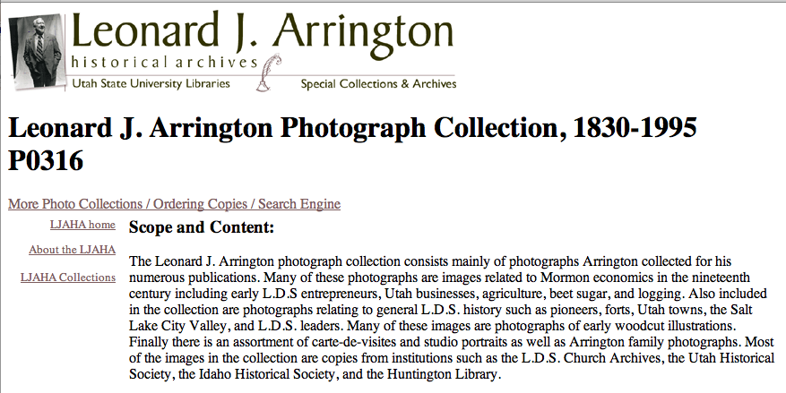
The Photographs…
Photos related to Mormon economics in the 19th century: early L.D.S entrepreneurs, Utah businesses, agriculture, beet sugar, and logging.
Photos on general L.D.S. history: pioneers, forts, Utah towns, Salt Lake City Valley, and L.D.S. leaders.

Slide 8
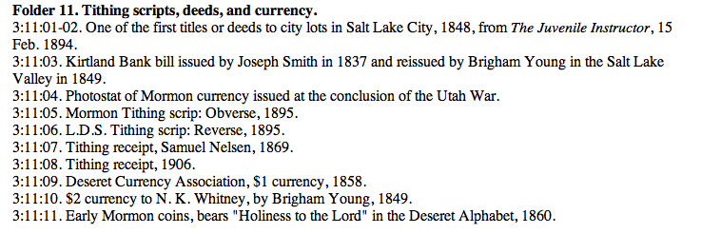
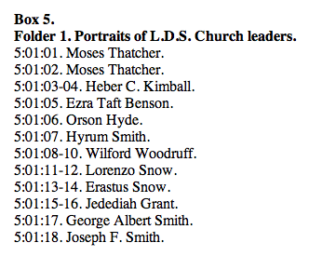
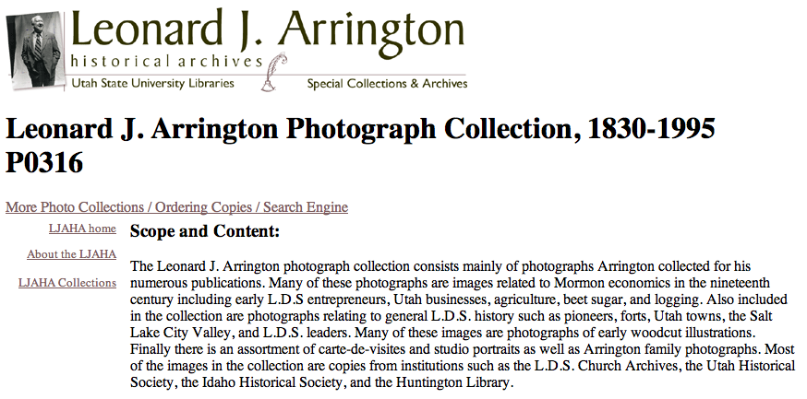
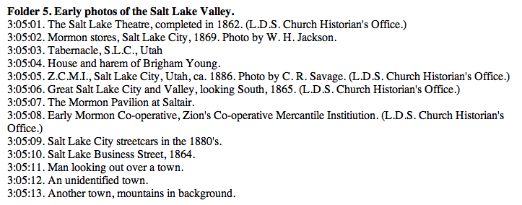
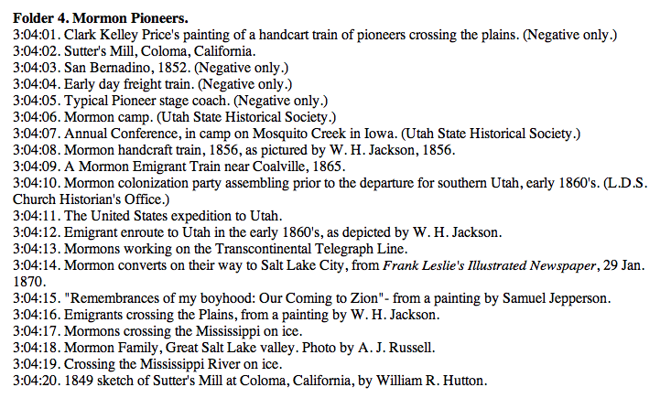

Slide 9
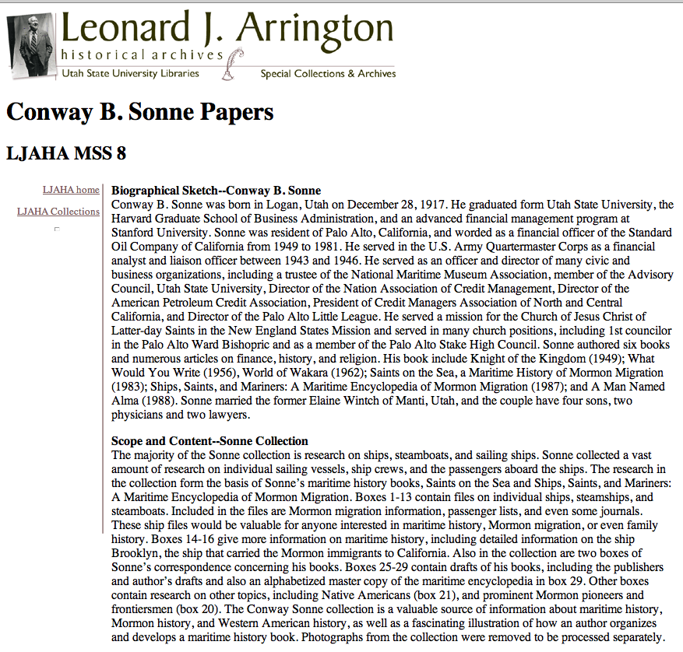
The Sonne Papers…
The research from Sonne’s maritime history books:
Saints on the Sea
Ships, Saints, and Mariners: A Maritime Encyclopedia of Mormon Migration.
Files on individual ships contain Mormon migration information, passenger lists, and even some journals.

Slide 10
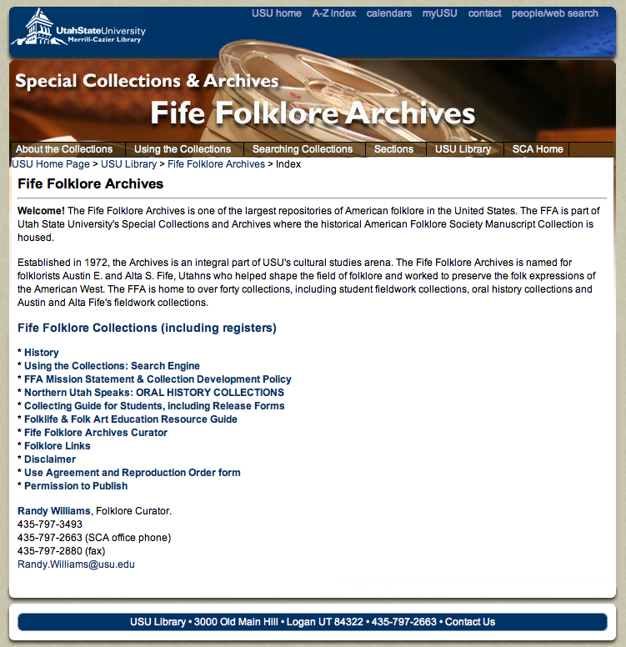
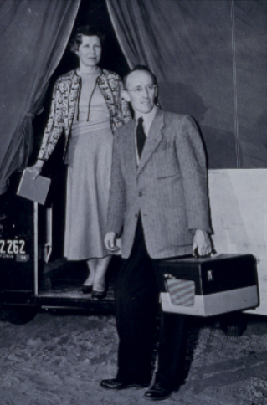
Fife Folklore Collections
Austin and Alta Fife: traveling folklorists

Slide 11
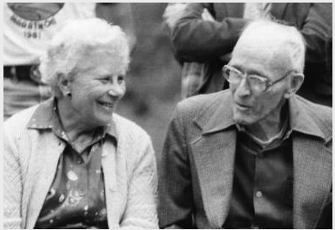
Folklore materials related to Mormons and Utah
Folk Collection 4: Austin and Alta Fife Fieldwork
4a: The Fife Mormon Collection
Folk Collection 11: Cowboy poetry
Folk Collection 17: Historic cookbooks and foodways
Folk Collection 21: Grouse Creek Cultural Survey
Folk Collection 27: Teton Dam disaster; letters and interviews from people who experienced the June 5, 1976 disaster
Folk Collection 29: Living Traditions of the Bear River Heritage Area
The Fifes documented the Mormon Intermountain West. Their 40+ years of fieldwork forms the heart of the Fife Folklore Collection which began with collecting Mormon folklore and continues today.

Slide 12
Fife Slide Collection of Western U.S. Vernacular Architecture
Old LDS bishop’s storehouse, used as residence in Ephraim, UT
Monument to seagulls

Slide 13
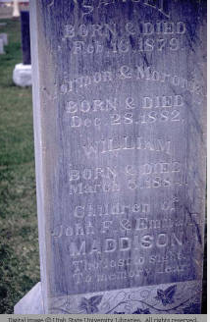
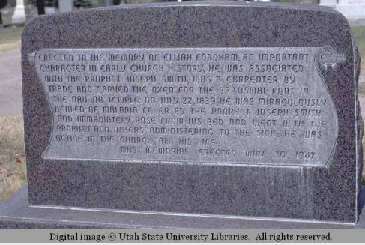

Slide 14
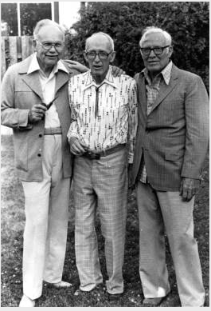
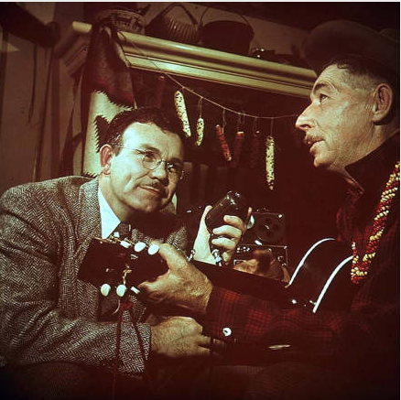
Hector Lee Fieldwork Recording Collection
Hector Lee, Austin Fife, and Wayland Hand – affectionately known as the “Three Nephites” in Mormon Folklore circles.
Hector Lee recorded the vernacular voice of Mormon Utah in songs and anecdotes.

Slide 15
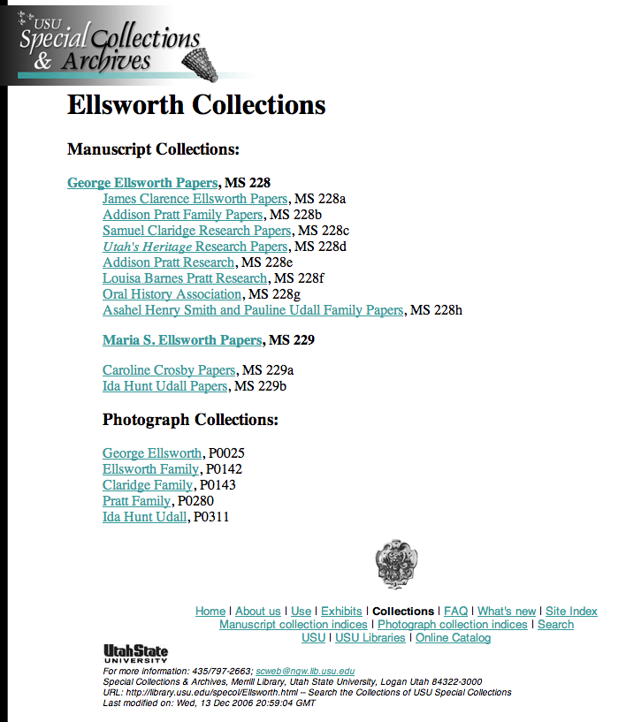
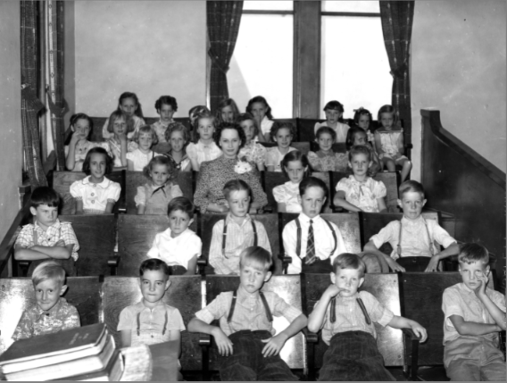
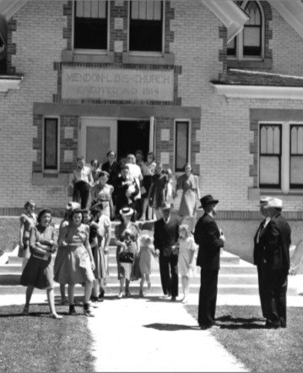

Slide 16
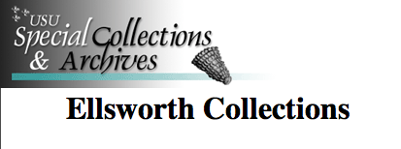
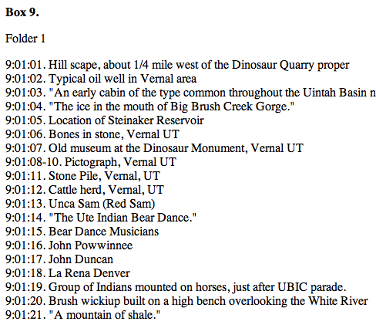
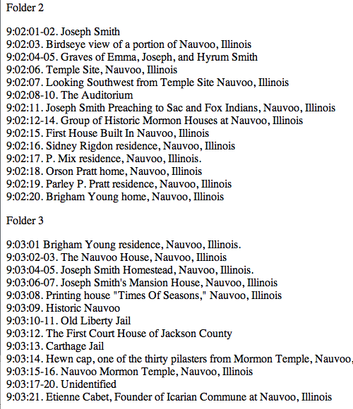
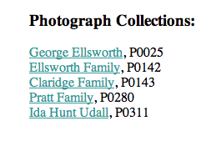
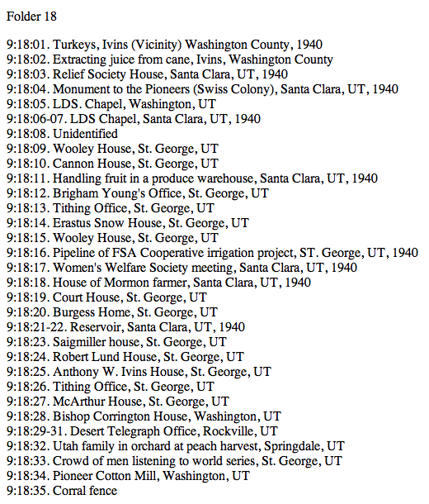

Slide 17
Compton Photograph Studio Archive, 1884-1952

Slide 18
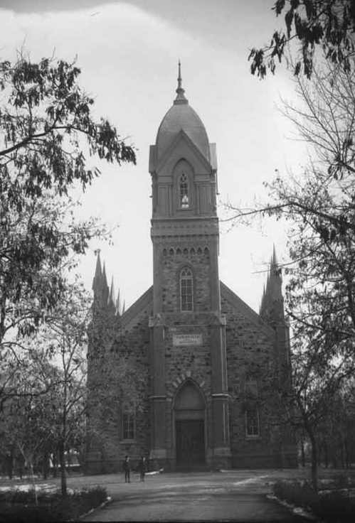
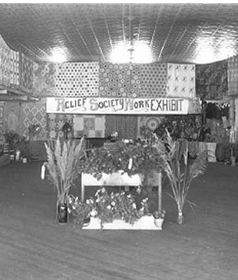

Slide 20
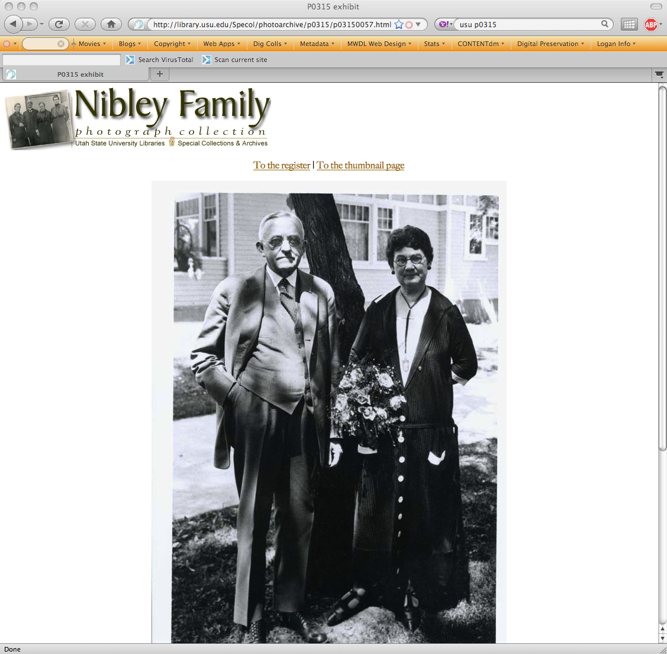

Slide 21
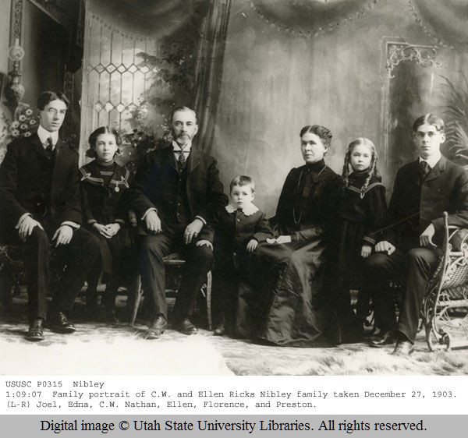

Slide 22
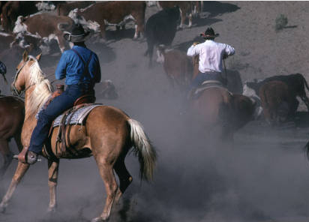
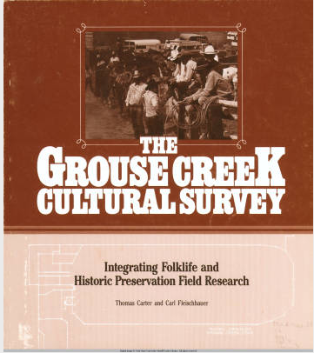
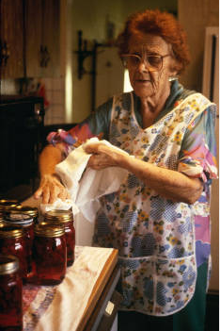
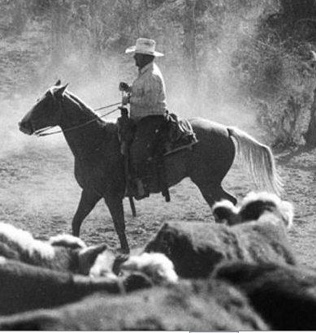
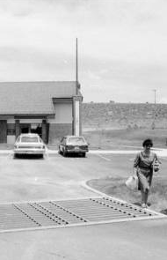
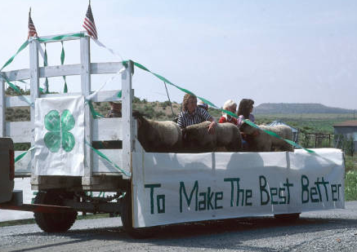
Grouse Creek Cultural Survey, 1985: Mormon Buckaroo Territory

Slide 23
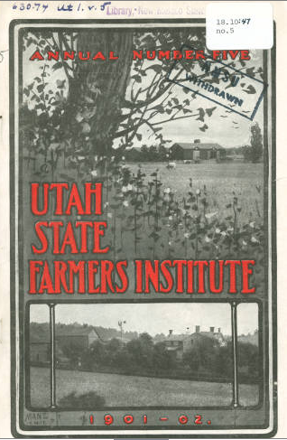
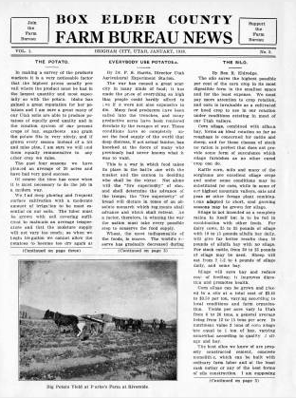
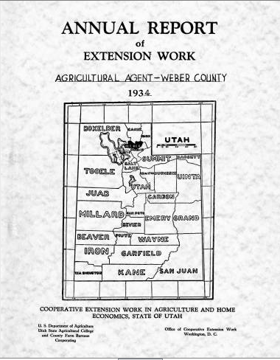
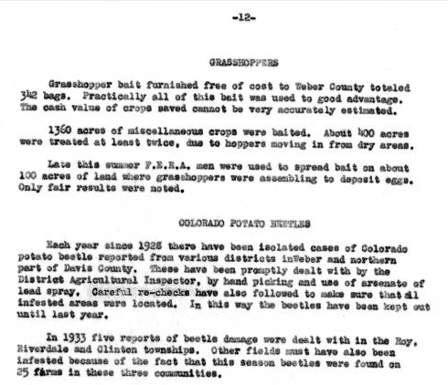
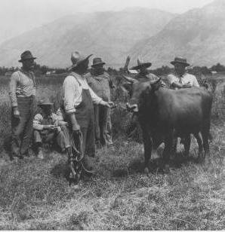
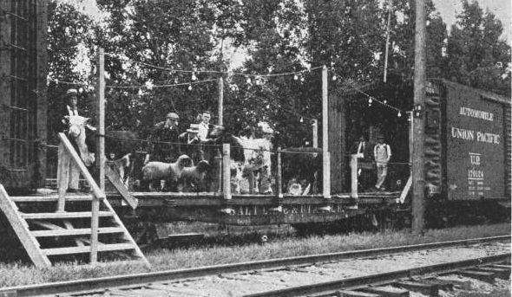
Utah Cooperatives

Slide 24
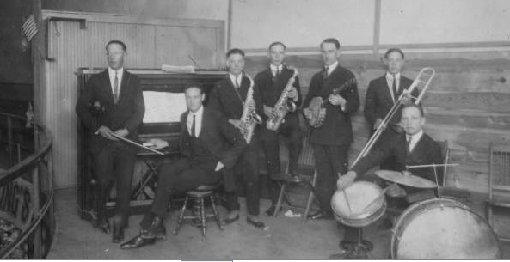
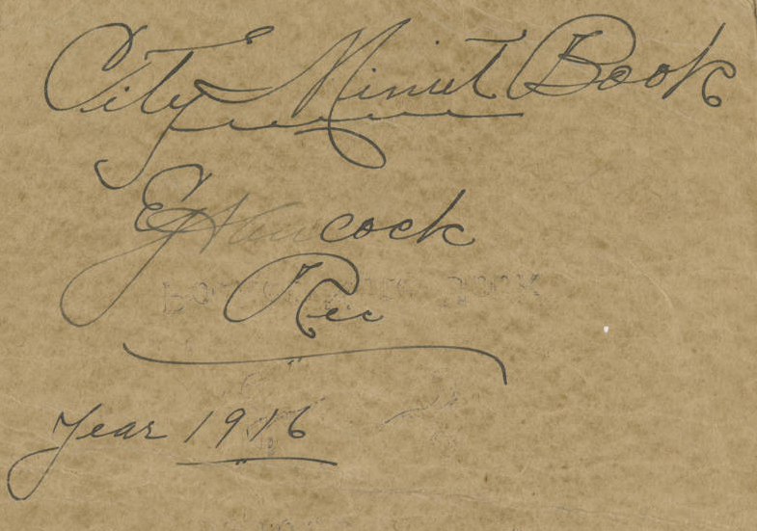
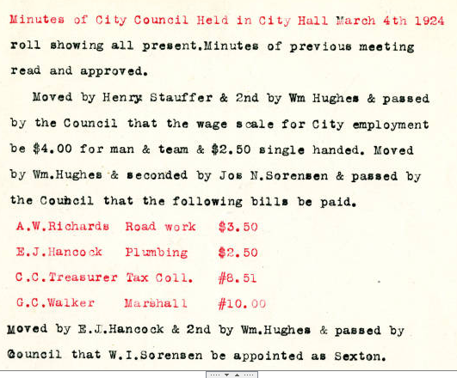
Mendon City Record

Slide 25
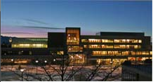
Curator Contact Information
Bradford Cole, Associate Dean, brad.cole@usu.edu, 435-797-8268
Robert Parson, University Archivist, robert.parson@usu.edu, 435-797-0894
Randy Williams, Fife Folklore Curator, randy.williams@usu.edu, 435-797-3493
Dan Davis, Photograph Curator, dan.davis@usu.edu, 435-797-0890
Ann Buttars, Curator of Western and Mormon Americana, ann.buttars@usu.edu, 435-797-2661

