Slide 1
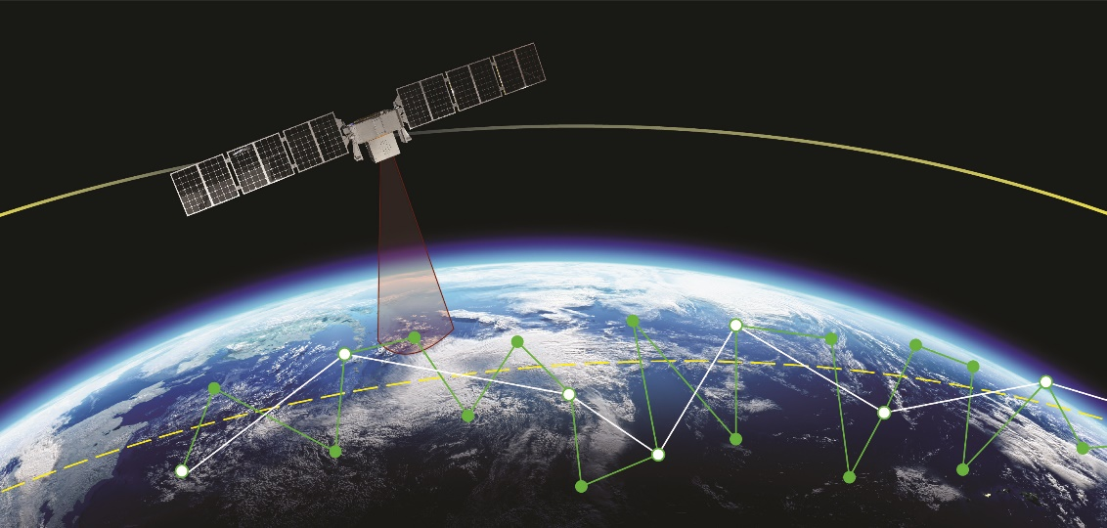
AUTONOMOUS ONBOARD OPTIMIZATION IN GNC SYSTEMS
Bryan Rogler, Matt Baumgart, Elvis Silva
August 6, 2024
Advanced optimization algorithms increase mission performance and ROI
Smallsat technology and market state enable this approach:
Substantial computing power available
Proliferation → need for autonomy
“Tech demo” posture replaced by maximization of asset capability and ROI
Example (TRL9): Optimized attitude slew maneuvers generate more remote sensing ROI per orbit
Blue Canyon Technologies - Approved for Public Disclosure This document does not contain technology or technical data controlled under either the U.S. International Traffic in Arms Regulations or the U.S. Export Administration Regulations.

Slide 2
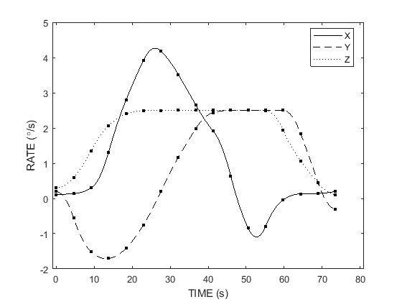
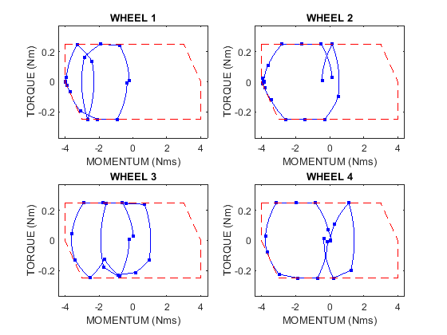
OATS: Optimal Attitude Trajectory System
Autonomously calculates and executes optimal attitude maneuver trajectories
TRL9 across multiple missions and customers:
Exists in core Blue Canyon GN&C flight software
Accommodates flexible spacecraft
Solved via proprietary black-box nonlinear optimization solver (BCTOPT) running on Blue Canyon flight processor
Example solution:
180° maneuver about Z axis (no eigenaxis solution exists)
Trajectory “rides” nontrivial RW operating envelopes
Nonzero initial/final 3-axis attitude, rate, and acceleration
Asymmetric SC inertia, spacecraft jerk limit, and more…
Blue Canyon Technologies - Approved for Public Disclosure This document does not contain technology or technical data controlled under either the U.S. International Traffic in Arms Regulations or the U.S. Export Administration Regulations.

Slide 3
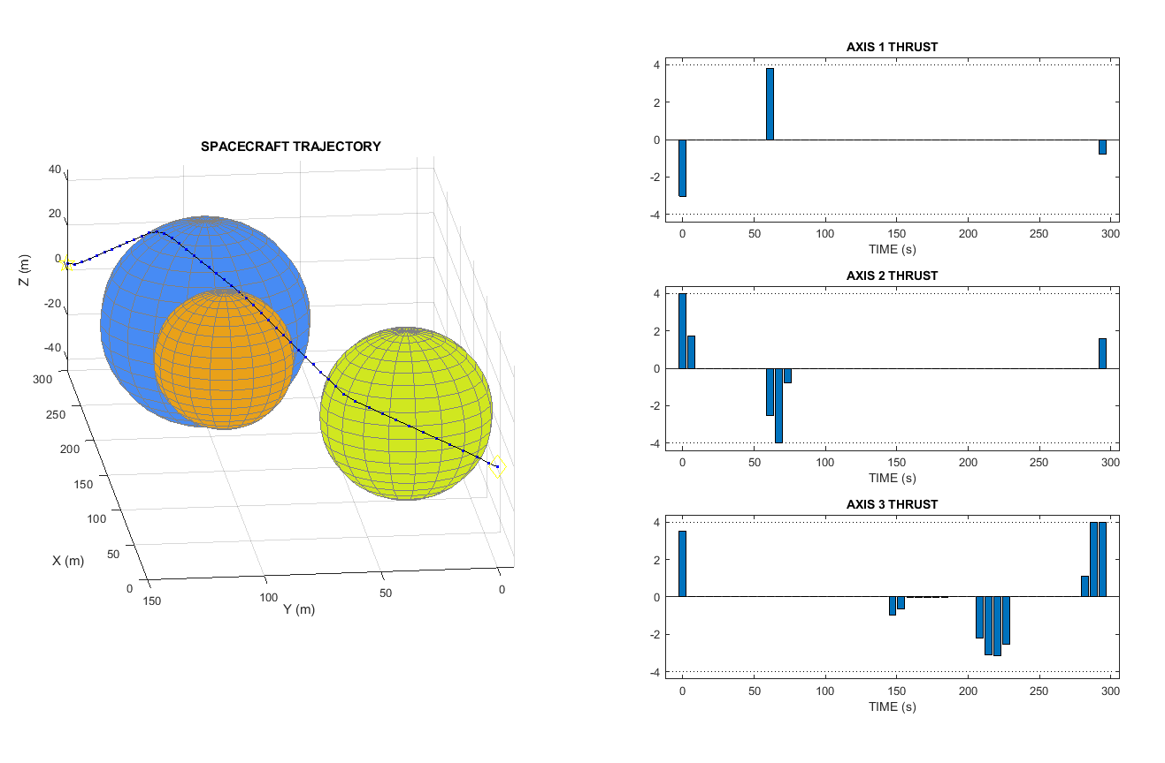
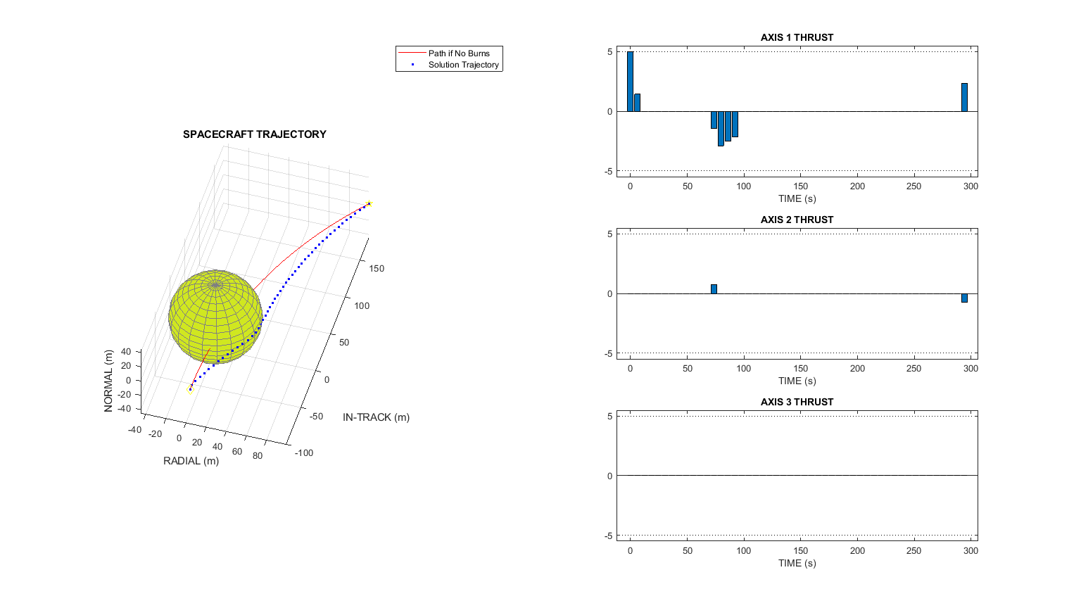
FURTHER DIRECTIONS IN WORK
OATS:
Integrate CMG dynamics and constraints
Effect of singularities on optimization process is strongly affected by mathematical formulation
Added constraint types (e.g. vector keep-out/in)
Alternative definitions of maneuver “smoothness”
Optimal Orbital Trajectory System (OOTS):
Autonomous orbital trajectory calculation with onboard propulsion
Minimizing fuel usage or other objectives
Configurable to avoid keep out regions in orbital space
Blue Canyon Technologies - Approved for Public Disclosure This document does not contain technology or technical data controlled under either the U.S. International Traffic in Arms Regulations or the U.S. Export Administration Regulations.

