Slide 1
Adaptive Antenna Elevation Masking for Smallsat Constellations
COSMIC-2 Case Study
Billy Gullotta
UCAR/COSMIC
Chris Barsoum (Aerospace), Maggie Sleziak-Sallee (UCAR COSMIC), Ronald Smilek (NOAA/NESDIS/OSPO)
6 Aug 2024

Slide 2
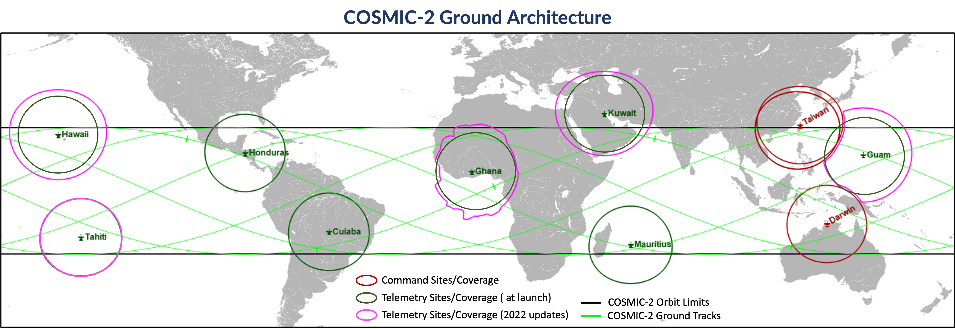
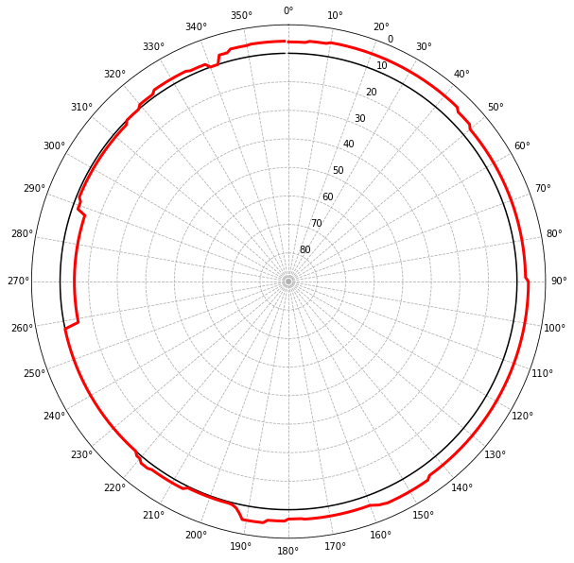
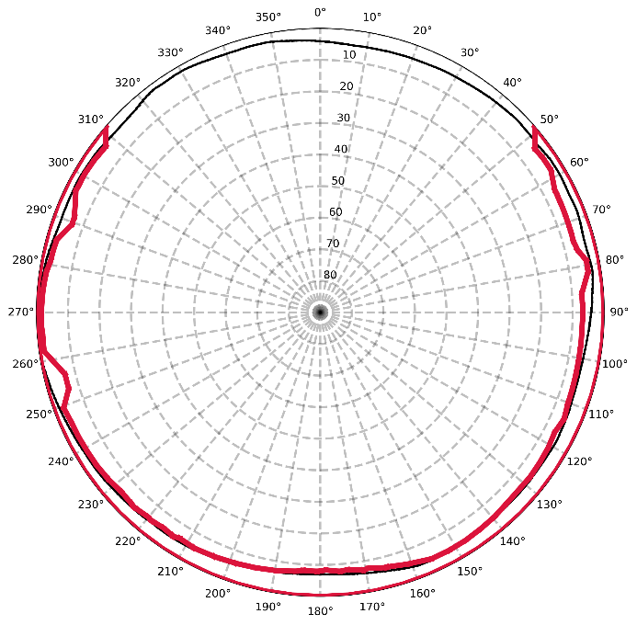
Antenna Masks & COSMIC-2
COSMIC-2 Mission
6-smallsat operational Radio Occultation (RO) mission
550-km altitude, 24° inclination
Some products were not meeting latency needs
Identified that lowering contact start elevations could improve latency by adding more contacts
Antenna Horizon Masks
Define the boundary where antennas will take contacts
Several inputs to determine:
Line-of-sight obstructions around antenna
Local RF environment
Spacecraft transmitter capability
Typically not often updated and conservative
Especially true for smallsats
COSMIC-2 Ground Tracks
Without the ability to access ground sites quickly to conduct in-situ surveys, how can antenna masks be updated quickly and effectively?
Signal-Inferred Ground Site Masks
Atlas Ghana (COSMIC-2)
NOAA Fairbanks (Sentinel-6)
Original Mask
Inferred Mask
Captured Antenna Tilt Limitations
Expanded Geographic Coverage
Mask Raised above obscura

Slide 3
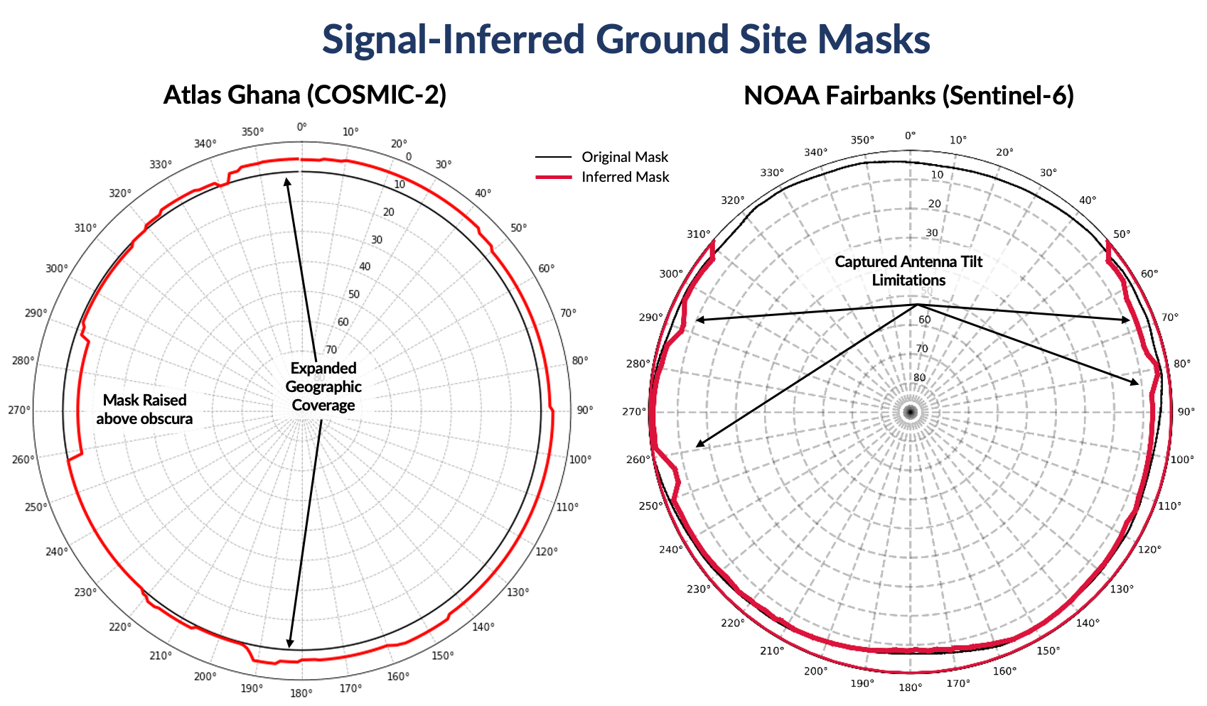
Mission-Specific Architectures
COSMIC-2 TEC Latency Before/After Masking Updates
Developed strategy to determine ground site masks using link measurements
Take measurements of signal quality throughout entire visibility
Correlate time of first “good” quality signal with antenna position
Fit a shape of the good azimuth/elevation points
Before
Latency (min)
After
Latency (min)
Real-World Implementation
Performed at a COSMIC-2 ground site and a NOAA site
COSMIC-2 mask change led to expanded coverage and a resultant improvement in data latency
NOAA tests identified limitations in the antenna tilt mechanism during passes for non-polar orbiting spacecraft
Both masks were generated through a custom ad-hoc campaign and manually generated → how to scale to larger systems?
Signal-Inferred Ground Site Masks
Atlas Ghana (COSMIC-2)
NOAA Fairbanks (Sentinel-6)
Original Mask
Inferred Mask
Captured Antenna Tilt Limitations
Expanded Geographic Coverage
Mask Raised above obscura

Slide 4
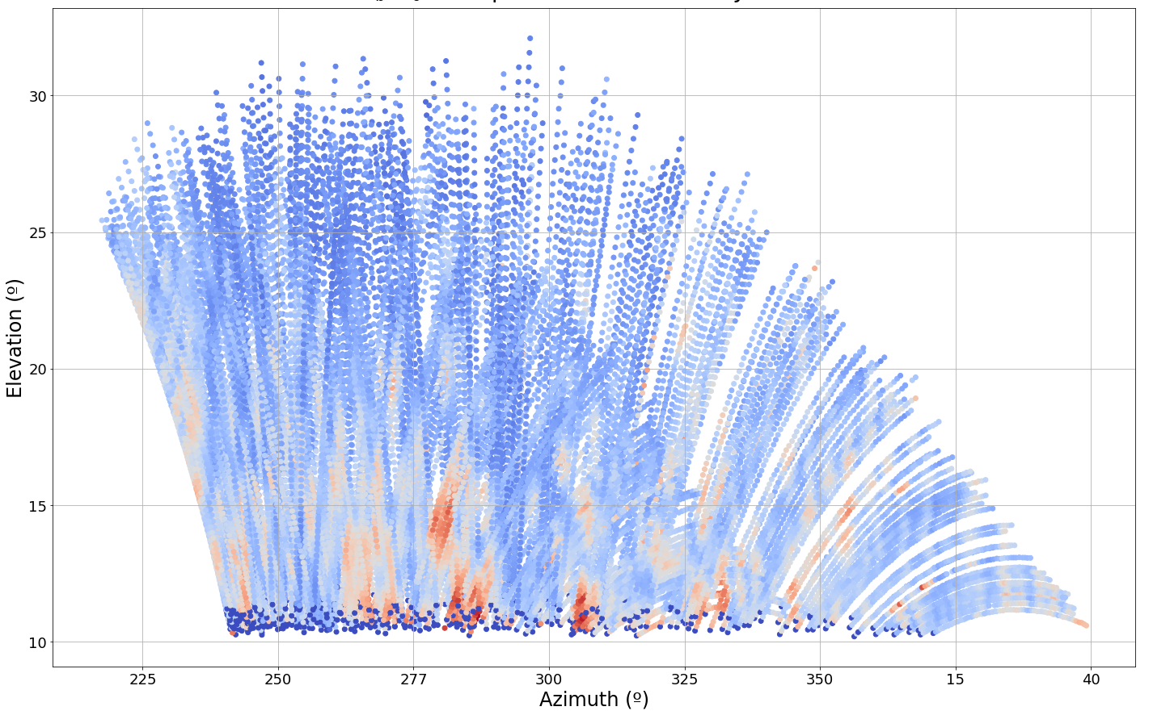
Adding Flexibility and Adaptability
Adaptive Antenna Mask Implementation
Active Mask Monitoring and Generation
Generate an initial mask using sufficient full visibility passes
Capture and store signal* quality and antenna position data during downlinks
Regularly pull signal quality data and analyze for changes
Re-fit mask to any changes and alert mission and site operators
Payload Data
Link Health (per downlink)
Link Health (periodic)
Antennas
Antenna Masks (periodic)
Benefits
Maximize downlink-able data volumes and downlink opportunities/visibilities
Remote and automated identification of antenna obstructions
Remote detection of issues with signal on both spacecraft and antenna end
Ground Site Operations
Ground Site
Data Storage
Eb/N0 of spacecraft passes at COSMIC-2 site
Mission Operations
RFI identified through mask monitoring
Users
Good
Adaptive masking for multiple COSMIC-2 ground sites currently in development
Bad
Adaptive Mask Generation

