Slide 1
Electroadhesive Attachment Technology for Improved Docking and Proximity Operations
Kalia Crowder, Simon Lee, David Smith, Victor Aguero
kalia@cambrianworks.com
Cambrian Works, Inc.
© 2024 Cambrian Works, Inc..
Notes:
Title: Electroadhesive Technology Enabled CubeSat Missions
Electroadhesive (EA) technology is well-suited for advanced CubeSat missions with constrained volume, mass, and power requirements. As a cost-effective, general attachment technology compatible with several types of surfaces, it presents unique opportunities for CubeSat-scale missions with attachment needs. EA adheres to virtually all materials that are used in space, can conform to irregular surfaces, is low power, requires no substrate preparation, has enhanced performance in vacuum, is temperature agnostic, and leaves no residue. Although EA is based on a long-understood physical phenomenon, translating this scientific principle to a technology that has been characterized and is suitable for launch and space used has required significant engineering development and test.
Cambrian Works has performed significant optimization, characterization, and testing on its electroadhesive technology in order to understand its capabilities and qualify it for space use. In this presentation, we use results from our development and test work to show new mission concepts enabled by the use of this technology.
CubeSat missions enabled by electroadhesive technology generally fall in the realm of in-space assembly, refueling, orbital debris mitigation, and payload augmentation. However EA presents multiple novel ways of addressing each of these mission areas. This presentation will discuss testing and characterization results of electroadhesion that enable specific mission concepts, to include use of EA as part of robotic end effectors, electroadhesive walls for temporary tool placement, a deployable electroadhesive unit that can surround, capture, and detumber orbital debris, and payload augmentation.
Finally, Cambrian Works will conclude with results of its EA performance testing and analysis of potential applications and quantitative capability to support CubeSat-specific missions in these fast-growing mission areas.
Presenter: Kalia Crowder

Slide 2
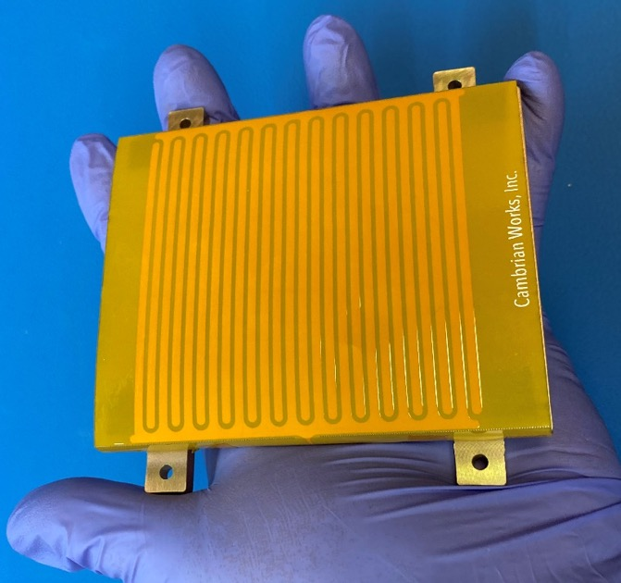
Electrical Thin Attachment Pad (eTAPTM): A General On-Orbit Attachment Technology
Electroadhesion uses an electric field to generate attractive force
Attaches near-instantaneously to wide variety of surfaces: conductive, dielectric, nonconductive
Attaches to unprepared & non-planar surfaces
Easily turned on/off & leaves no residue
Compares favorably to other in-space attachment technologies:
Mechanical grippers
Electromagnets
Laser ablation
Adhesives
Gecko-like adhesives
Cambrian Works’ Electroadhesive Pad
Demonstrated successfully with:
Aluminum Alloys
Anodized Al Steel
Titanium
Glass
Kapton
Multi-Layer Insulation
Composites
Electroadhesion discovered ca. 1920 by Danish scientists researching how to make a better telegraph
Force depends on ~20 parameters associated with the electroadhesive pad & driver alone
© 2024 Cambrian Works, Inc.
Notes:
Attaches to conductors, dielectrics, and insulators
Requires no cooperation or special preparation from attached object
Conforms to non-planar, rough, or protruding surfaces
No EMI/EMC effects and no residue left on attached object
Generated forces strong compared to typical microgravity forces
Operates better in vacuum than in air
Size and generated forces can be scaled up or down
Can be commanded ON and OFF repeatedly
Is designed with space-rated materials
Compact and uses milliWatts of power
Long shelf-life, minimal degradation over time
Rapid mission flexibility and retargeting based on real-time needs

Slide 3
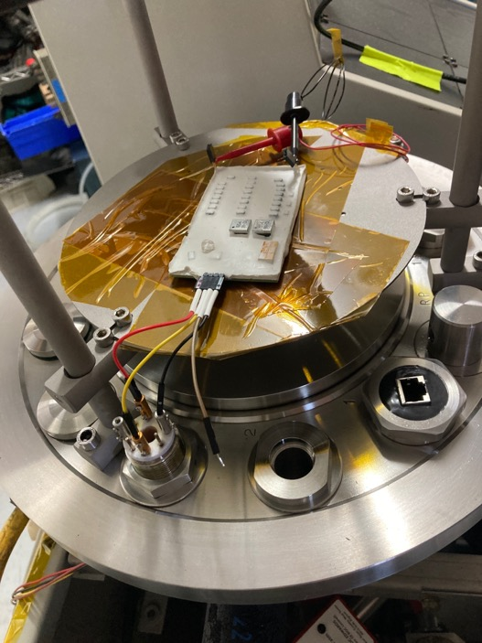
Performance & Space Qualification Testing
Normal forces are ~15 mN/cm² at ambient
Attachment 2x to 6x higher in vacuum
Shear force significantly stronger
eTAP conformability enables off-normal contact angle capture at various approach velocities
eTAP designed ground-up for space suitability
Driver circuit and pads have successfully undergone vacuum testing
Collaboration with Astroscale & AFRL ROC lab will allow us to see how electroadhesion performs in realistic dynamic conditions (next week!)
Measured Normal Force of 16 cm² eTAP Pads at Ambient Pressure
High-Voltage Driver Circuit in Vacuum Test Chamber
Significantly improved performance in vacuum makes this an ideal technology for in-space use
Materials & circuit design choices based on components and principles with long on-orbit heritage
© 2024 Cambrian Works, Inc.
Notes:
Insulator substrates have slightly higher normal attachment force than conductors
Thin non-conductive coatings on conductive material do not affect attachment force
Mechanical design and mounting of the pads has a significant impact on the maximum attachment performance
Normal force attachment is significantly higher in vacuum than at ambient pressure
Ranges from 2x to 6x higher, depending on material
Attaches near-instantaneously to wide variety of surfaces: conductive, dielectric, nonconductive
Attaches to unprepared & non-planar surfaces
Easily turned on/off & leaves no residue

Slide 4
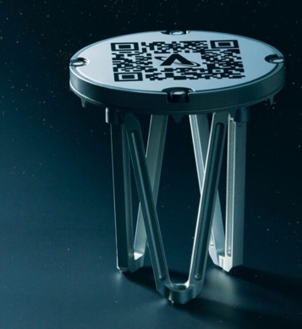
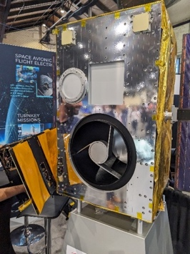
Electroadhesion for Docking & Proximity Operations
Unprepared/non-responsive docking
Soft docking/berthing
Repeatable release and re-dock
Low profile & extremely versatile topography
eTAP technology allows for arbitrarily shaped passthroughs, allowing wiring, cameras, thrusters, ports, etc.
Compatible with other types of mechanisms
Magnetics, mechanical grapplers
Mission Areas:
Orbital Debris Mitigation (SPIDEE: Space Payload for Inertial Despin Efficient Effects)
Electroadhesion-Enabled Workspaces & Deployment
In-Space Assembly Missions
Modular Payloads
Astroscale Docking Plate
eTAP-Enabled CubeSat ”Docking” with Larger Spacecraft
Electroadhesion attachment suitable for stand-alone docking or augmenting existing docking solutions
© 2024 Cambrian Works, Inc.
Notes:
ODM:
No need for prepared surfaces or attachment points
Wide variety of surfaces
Reusability
SPIDEE Space Payload for Inertial Despin Efficient Effects
Telerobotic and Servicing Assistance
Attractive “touch” – pull objects in, and absorb incoming momentum
Augment existing mechanical graspers for in-space assembly
In-Space Assembly Line
Easily controllable “stickiness”
In-orbit assembly debris capture
Double-sided “Oreo filling” between items
Easily enables modular assembly approach
Attach a fully functional modular payload to existing satellites
eTAP compatible with power, data, and heat transfer
CubeSat payload deliverable via mothership, e.g. Space Logistics’ Mission Robotic Vehicle
Add capability: space domain awareness, computational payloads, imaging payloads
Add comms and/or other services: comms terminal, PNT payload, propulsion module
Someday…
Satellites designed for upgradeability will enable evolving missions
Intra-satellite wireless comms and modular power supplies will allow for deep integration of new capabilities
Key Design Parameters
Understand mission parameters:
Likely attachment surface(s)
Required shear and/or normal forces
Approach angles, speeds, and relative masses
Tune for desired attractive force:
Attracts to all surfaces, but difference in quality
Scales with attached area and voltage applied
Best to design for a minimum required force
Design mission CONOPs to play to electroadhesion strengths:
Shear force many times stronger than normal
Flexibility & pad conformance useful to minimize elastic collisions

