Slide 1




Math is Instrumental: An Analysis of Multi-Decade Space Flight Science Instrument Cost Performance
2024 Small Satellite Conference
Utah State University
Rachel Sholder, Johns Hopkins Applied Physics Lab (JHU/APL)
Eric Plumer, NASA Headquarters (NASA HQ)
Joseph Mrozinski, Jet Propulsion Laboratory (JPL)
Notes:
Things to say:
If you were at SmallSat last year, you saw my Math is EZIE Swifty (cost growth analysis study both at the mission and SC level looking at factors that could potentially impact cost growth such as contractor experience)
EZIE: Since spacecraft costs are a significant portion of total mission costs, we also focused on cost growth specifically experienced in the SC WBS
NOW: For the same reason, now looking at instrument costs

Slide 2

Cost Growth of 106 Domestic Remote Sensing Instruments
Instrument Type
Instrument Cost
Instrument Mass
Instrument Mass Growth
Mission Acquisition Strategy
Mission Class
Destination
Science Mission Directorate Division
Policy Era
Mission Class
Average = 46%
Notes:
Will say some of this out loud:
Historically, one of the most significant contributors to cost growth of NASA’s science missions has been instrument development cost growth
There is a strong correlation between instrument cost growth and total mission cost growth where instrument cost growth influences mission cost growth at a 2-to-1 factor
Cost growth at the instrument level tends to snowball up to the mission level by causing changes needed to the mission or spacecraft itself or by simply causing delays in the instrument integration, leading to “marching army” costs for the mission
106 domestic remote-sensing science instruments, launch dates from 2004 to 2023
Cost growth can come both from unforeseen technical challenges as well as simply under-estimating the scope of the work necessary. We hypothesized potential factors that might influence instrument cost growth.
Instrument Type (Level 1)
Total Instrument Cost
Instrument Mass
Instrument Mass Growth
Mission Acquisition Strategy
Mission Class
Destination
Science Mission Directorate (SMD) Division
Policy Era

Slide 3
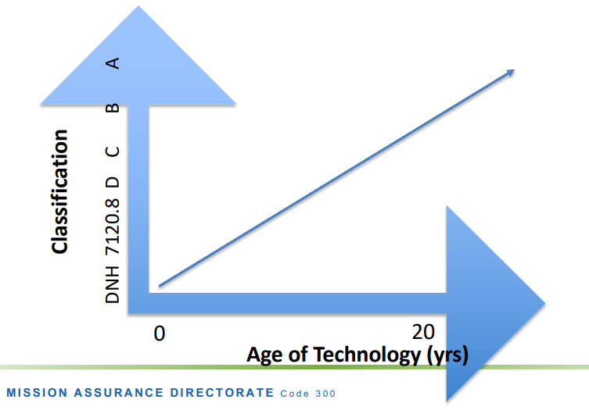
Cost Growth of A/B versus C/D Domestic Remote
Sensing Instruments
C/D Average = 54%
A/B Average = 37%
Source: Risk Classification
Notes:
Things to say out loud:
A/B: lower risk, more mature technology
C/D: higher risk, newer technologies
Initially looked at all 4 classes separately → happy to explain why we grouped them into these 2 groupings when I have more than 3 minutes. Find me later.
The difference is statistically significant supporting the assertion that Class C/D instruments experience more cost growth than Class A/B instruments. We hypothesized that this difference would be due to lower cost Class C/D instruments resulting in misleadingly higher growth percentages
Notes for myself:
Only 2 class A instruments
9 class D
modernizing-risk-classification-aerospace-030123 (nasa.gov)
The difference is statistically significant supporting the assertion that Class C/D instruments experience more cost growth than Class A/B instruments. We hypothesized that this difference would be due to lower cost Class C/D instruments resulting in misleadingly higher growth percentages
modernizing-risk-classification-aerospace-030123 (nasa.gov)
- We speculate that this may be due to higher risk tolerance of Class C/D missions
- Higher risk tolerance also means projects are accepting lower cost/schedule reserves levels (often well below 50% confidence) whereas the more expensive Class A/B instruments typically undergo JCL analysis boosting cost reserves to achieve the policy threshold of 70% (or higher) confidence level, thus reducing the likelihood of cost/schedule overrun

Slide 4
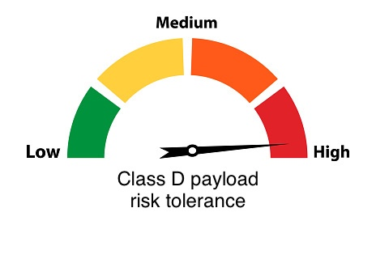
SmallSat Realm
Higher risk tolerance for C/D missions
SmallSat missions have been pretty consistently binned in Class D due to the level of technical risks
However, many Class D mission requirements do not match the needs of SmallSat missions
  Tailored mission assurance profiles are often produced
Source: “Class D” Payloads
Notes:
Things to say out loud:
Class A, B, C, D was developed in 1986 by the DoD for one-of-a-kind space equipment (first SmallSat Conference was held one year later in 87)
In the last 35 years, lots has changed about space and space missions
The A-D mission assurance/risk levels are increasingly difficult to apply to today’s smaller constraints-driven missions, many of which are not one-of-a-kind
Class D is the closest “bin” for SmallSats
Notes for myself:
Class C/D instruments average more dollars spent than Class A/B instruments
We speculate that this may be due to higher risk tolerance of Class C/D missions
Higher risk tolerance also means projects are accepting lower cost/schedule reserves levels (often well below 50% confidence) whereas the more expensive Class A/B instruments typically undergo JCL analysis boosting cost reserves to achieve the policy threshold of 70% (or higher) confidence level, thus reducing the likelihood of cost/schedule overrun
The Good, The Bad, and The Ugly… “Class D” Payload Explained | New Space Economy
Defining a New Mission Assurance Philosophy for Small Satellites (usu.edu)
How Satellites are Moving Beyond the Class System: Class Agnostic Development and Operations Approaches for Constraints-Driven Missions (usu.edu)

Slide 5



SHOULDER

