Slide 1
Maximizing Ground Network Efficiency in the Ground Segment as a Service (GSaaS) Context via Stochastic Model-Driven Capacity Demand Prediction
Stefan-Vlad Tudor
38th Annual Small Satellite Conference | Logan, UT, USA, 8th August 2024

Slide 2
GSaaS scaling up problem
3D problem for model uncertainty:
Space Segment
Ground Segment
Time
Stochastic Model for GS optimal expansion
SCENARIOS based on single GS/SS KPI coupling
Fixing demand – supply
Sets CASES of SS/GS with different configuration
Validates demand – supply is achieved
How Many GSs?
Where?
When?
The Ground Segment is the response of the Space Segment Capacity Demand
Space/Ground expansion discrepancy timeline

Slide 3
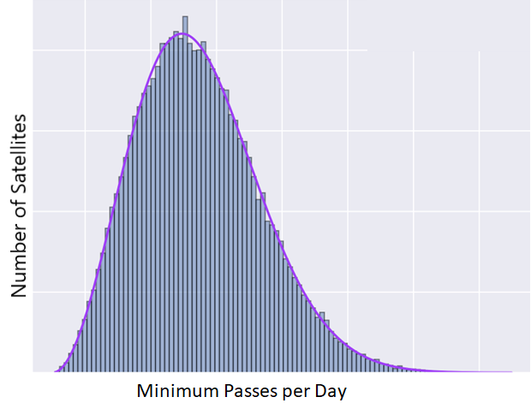
Problem Modelling
Space Segment
Defining size and orbital distribution
CONOPS
Total Demand
Ground Segment
Random Sat – GS allocation
Starting point: Leaf Line
Locations feasibility
Time:
Uncertainty modelling
Sets model boundaries
Active
End-24
End-25

Slide 4
Stochastic Model Results
Once the number of CASES meeting the demand surpasses a predefined threshold, the SCENARIO is considered successful
The optimal solutions are at the transition between failed to successful SCENARIOS
How many GSs, Where and When?
Statistics on successful cases (RISK)
This problem can be solved ONLY by using autonomous scheduling techniques for capacity allocation and visibility conflict solving – Leaf Line Scheduler
Successful SCENARIOS
Failed SCENARIOS

Slide 5
38th Annual Small Satellite Conference | Logan, UT, USA, 8 August 2024
Thank you for your attention!
See you at our booth Fieldhouse #208

