Slide 1
Two-Dimensional Electron Gases at the Surface of Potassium Tantalate
Ben Pound
Electron Physics Group
SURF Colloquium, August 8, 2014

Slide 2
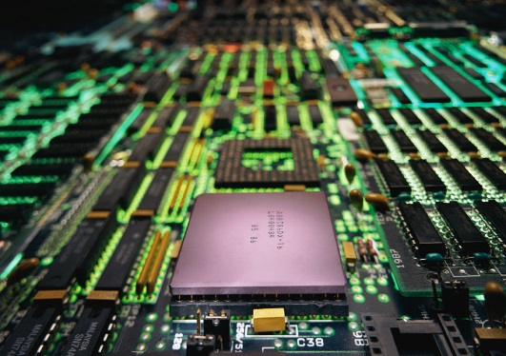
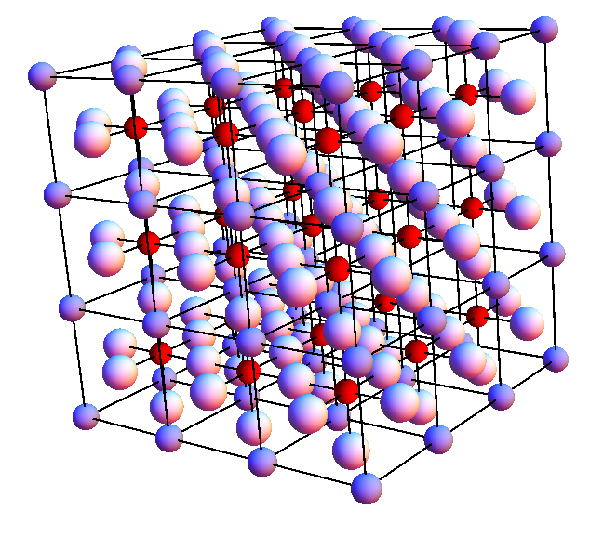
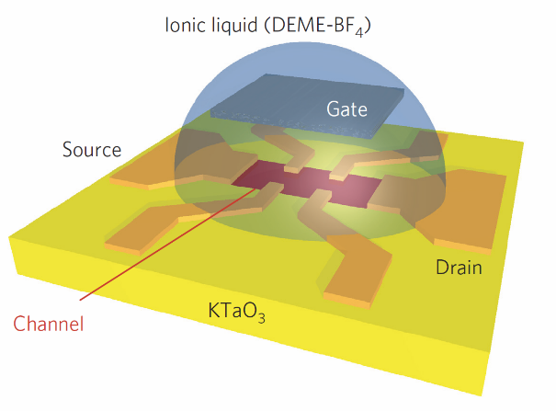
Outline
Semiconductor technology
Properties of perovskites
Some properties of KTaO₃
Notes:
Semiconductor technology: its progress and limits to progress.
Properties of perovskites: how they might be an answer to the need for new semiconducting technology.
Some properties of KTaO3, and why it is a material worth studying.

Slide 3
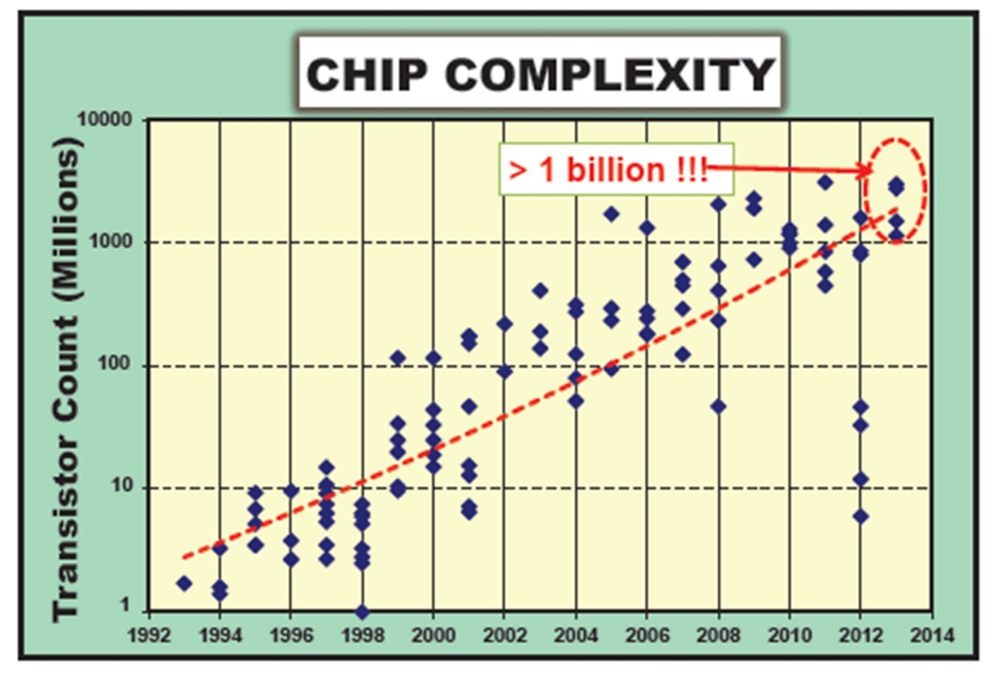
Transistor size is approaching its limit
Approximate
feature size:
32 nm
90 nm
1970’s: 10,000 nm
Wikipedia, “Moore’s Law”
Notes:
TAKEAWAY: THE LIMITS ON SILICON ARE BEING REACHED. NEW TECHNOLOGY NEEDS TO BE DEVELOPED.
In the 1970’s, the “top of the line” manufacturing feature size was 10,000 nm. By the 1990’s, that had shrunk to 90 nm. Currently, the standard is 32 nm. The goal is to make things even smaller so that they don’t take up as much space and use energy more efficiently. Considering that atoms are on the order of .1 nm in size, we are quickly approaching the point where technology will have to significantly change in order to continue progression.

Slide 4
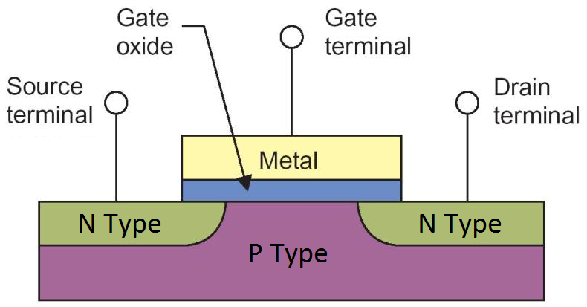
Two-dimensional electron gases give functionality to field-effect transistors
Wikipedia, “Lateral MOSFET”
Notes:
TAKEAWAY: SILICON TRANSISTORS FUNCTION BY THE CREATION OF 2DEGS. ARE THERE OTHER MATERIALS THAT MAKE 2DEGS, THAT COULD POSSIBLY REPLACE SILICON?
In MOSFETs (so called because of the metal-oxide substrate configuration of the gate), there are three main parts – the drain, gate, and source. Basically, a current wants to pass between the source terminal and the drain terminal, but can’t (at least in appreciable quantities) because neither the N-type substrate nor gate oxide is a good conductor. When a voltage is applied at the gate, however, something called a depletion layer forms. In this MOSFET, the voltage drives the electrons in the N-type substrate downward, freeing up space near the oxide for current to pass between the drain and source. This depletion layer, in some transistors, is actually a 2 dimensional electron gas.
A 2 dimensional electron gas is a layer of electrons just beneath the oxide (slashed lines) that is free to move on the surface – and so is highly conductive - but is tightly confined in the z-direction, meaning that the electrons can’t travel into the oxide or n-type substrate. This electron gas is the mechanism by which MOSFETs operate. There are, however, other types of materials that can support such two dimensional electron gases, and they are called perovskites

Slide 5
A two-dimensional electron gas forms at the surface of KTaO₃ by applying an electric field
Gate
+ + + + + + + + + + + + + + +
Ionic
Liquid
- - - - - - - - - - - - - -
+ + + + + + + + + + + + + + +
- - - - - - - - - - - - - -
KTaO₃
Charge Separation < 1 nm!
Huge electric fields!
K. Ueno, Nature Nanotechnology 6, 408–412 (2011)
Notes:
- YES. 2DEG HAS BEEN OBSERVED IN KTAO3
-SOLUTION TO THE TRANSISTOR PROBLEM, WHERE SILICON IS REPLACED BY ANOTHER MATERIAL.
-THIS IS THE SYSTEM THAT WE WANT TO MODEL.
Now I’m going to talk a little bit about the system that we eventually want to model.
Bulk superconductivity of KTaO3 has not been found, although studies have been conducted down to 10 mK.
However, when KTaO3 is gated (meaning that an electric field is applied), it shows 2 dimensional superconductivity – that is, only the surface of the KTaO3 crystal superconducts.
This only happens at very high electric fields that can only be obtained by ionic liquid gating. The ionic liquid acts as a capacitor.

Slide 6
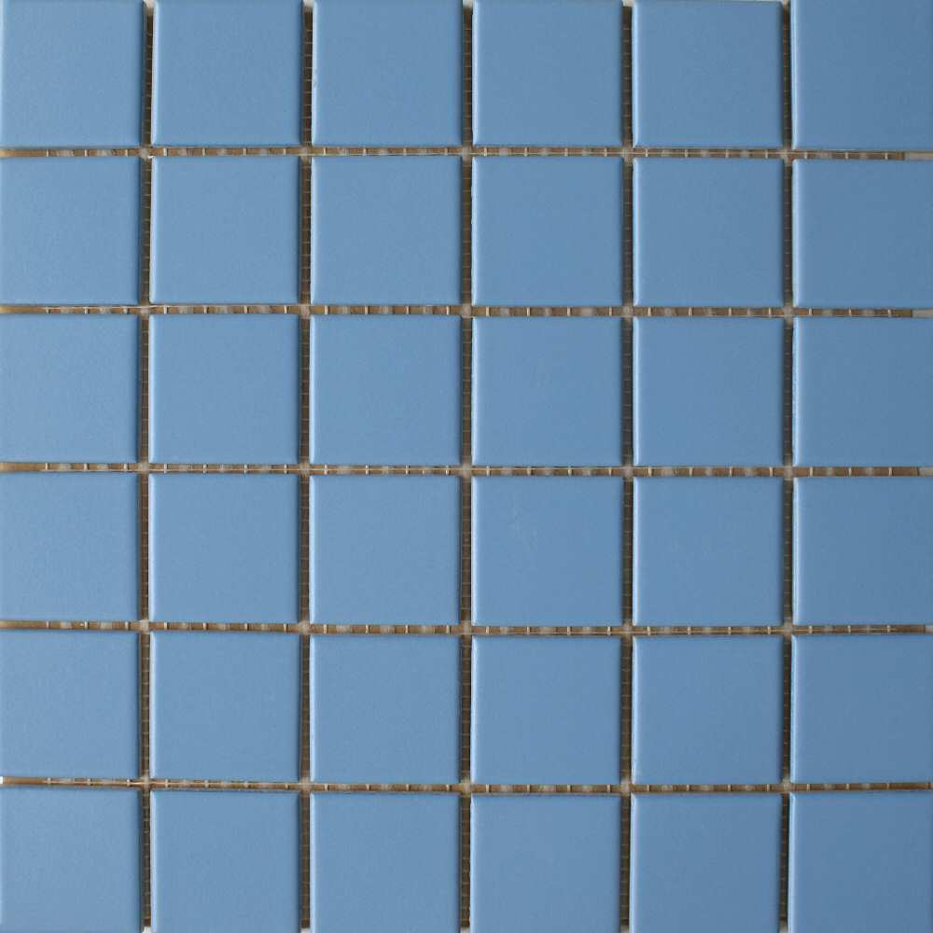
“2 Dimensional” Crystal Structure
Notes:
INFINITELY REPEATING STRUCTURE.
TILE IS SMALLEST UNIT THAT CAN BE REPEATED.
This tile is a repeating structure. Each tile is exactly the same as the one next to it, and they are arranged very neatly in a pattern. In fact, you could reproduce the whole picture through various translations of one square.

Slide 7
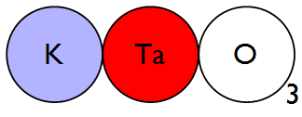
Perovskite crystal structure is periodic in three dimensions
Notes:
THE ‘TILE’ OF PEROVSKITES IS 3D, AND CRYSTALS ARE IN 3D.
THIS IS THE UNIT CELL OF PEROVSKITE.

Slide 8
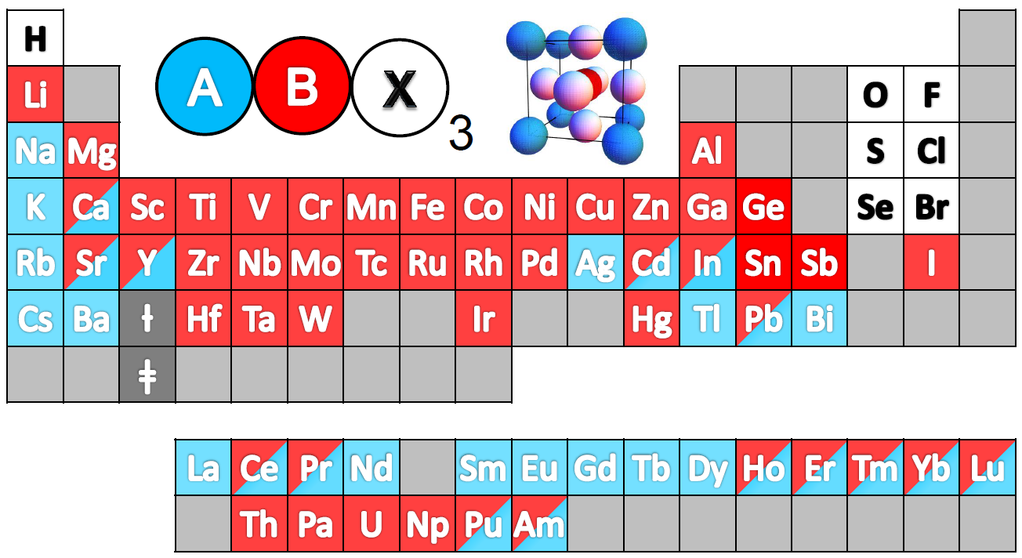
There are many different perovskites
Adapted by G. Khalsa from ,Schlom, D.G. et al., J. Am. Ceram. Soc. 91, 2429 (2008).
Notes:
TAKEAWAY: THERE ARE SO MANY COMBINATIONS OF PEROVSKITES THAT DO INTERESTING THINGS THAT ONE OF THEM IS BOUND TO BE USEFUL, AND WE SHOULD HAVE A GOOD UNDERSTANDING OF IT.
Perovskites contain three elements in a cubic structure. They are extremely versatile, with many different possible combinations of elements. Combined, the perovskite class of materials hosts a wide range of interesting phenomenon that may help with the transistor issues already discussed, but also many other possible applications (for instance, there is a lot of research going into perovskite solar cells right now – they are doing very well there).
The cubic ball-and-stick structure is the perovskite unit cell. What is a unit cell? It is the smallest group of atoms that can be translated in a predetermined way “into itself” – that is, moved so that it sits on an identical structure. Since the number of unit cells is defined as infinite in a crystal, we can use the properties of the unit cell throughout the whole solid, simplifying the problem considerably.

Slide 9
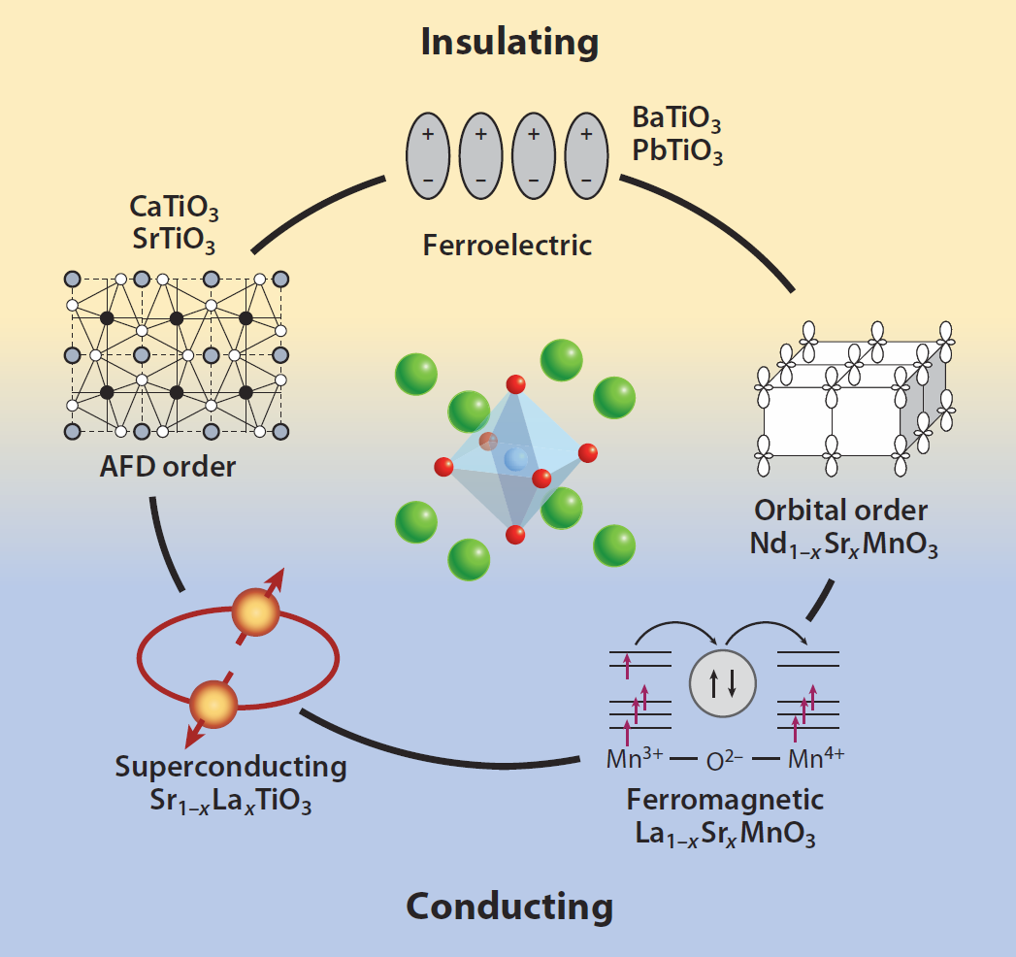
Perovskites have many diverse properties
P. Zubko, et al. Annu. Rev. Condens. Matter Phys. 2011. 2:141–65
Notes:
TAKEAWAY: TONS OF INTERESTING STUFF. WORTH STUDYING.
Lead zerconate titanate – it’s a piezoelectric perovskite.
Anomalous magnetic … they have found perovskite that can be ferromagnets and superconductors simultaneously
Perovskites are being heavily researched for solar cell usage
Multiferroics – use electric fields in one material to influence the magnetic fields in another
Sketched oxide single-electron transistor – using a perovskite substrate, they could “draw” (and erase) conducting wires of about 1-2 nm width on the surface of the perovskite.

Slide 10
Theoretical Model
Lattice “spring constants”
Dielectric Screening
Bonding parameters
Electric Potential by layer
Lattice Displacements
Layer Charge Density
Black Box
Notes:
The lattice “spring constants” were found from inelastic neutron scattering data.
Got bonding parameters from ARPES data
Got the electric field dependence of the dielectric constant from capacitative measurements.
The temperature is implicitly contained in all the above measurements.
The size of the unit cell is a relatively well-known quantity in the field – but the number of layers of unit cells also needs to be input into the program.
The variable is the electric field.

Slide 11
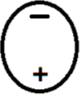
Screening reduces external electric fields in the interior of the material
When external electric fields are applied, electron clouds and nuclei move to reduce electric fields inside the material.
Gate
+ + + + + + + + + +
- - - - - - - - - -
Ionic
Liquid
+ + + + + + + + + +
- - - - - - - - - -
KTaO₃
Notes:
SILICON SHIELDS THIS WAY
When you apply an electric field on one atom, the nucleus goes one way because of the electric field, and the electron cloud goes the other.
In a crystal, however, “screening” occurs. Charge builds up to cancel the electric field in the crystal.
The effect

Slide 12
Screening in KTaO₃ is enhanced by atomic movement
High dielectric constant = high polarization
-
-
-
-
+
+
+
+
-
-
-
Oxygen
+
Tantalum
+
Potassium
Notes:
TAKEAWAY: IN KTAO3, NOT ONLY THE ELECTRON CLOUDS MOVE, BUT THE WHOLE ATOMS. THIS IS WHY THE DIELECTRIC CONSTANT IS SO HIGH.
The dielectric constant tells you how much the material can polarize – that is, how much the charge can move. The dielectric constant for silicon is ~12. For KTaO3, the dielectric constant is ~4000 – about 300 times larger. Even at room temperature, KTaO3 has a dielectric constant of about 600. This means that the polarization, how far the atoms move under an electric field, is much greater for KTaO3 than silicon. The only polarization mechanism for silicon is the one I showed in the last slide, where the electron clouds get displaced. In KTaO3, not only do the electron clouds get displaced, but the atoms actually move a little bit. This greatly enhances the polarizability of KTaO3.
- In KTaO3, one example atoms moving in different directions is this one. This is actually the lowest energy configuration for KTaO3, not where all the atoms displace in the same direction.

Slide 13
Screening in layered KTaO₃
-
-
-
-
+
+
-
-
+
+
Gate
+ + + + + + + + + + + + + + +
- - - - - - - - - - - - - - -
-
-
-
-
Ionic
Liquid
+
+
-
-
+ + + + + + + + + + + + + + +
- - - - - - - - - - - - - - -
+
+
KTaO₃
-
-
-
-
+
+
-
-
+
+

Slide 14
Inelastic neutron scattering provides “spring constants” of the lattice
$$U_{s}=\frac{1}{2}Kx^{2}+\frac{1}{4}αx^{4}+\frac{1}{6}βx^{6}+QEx$$
Phonon energy can be converted to a frequency
K depends on frequency, and on layer
Energy (meV)
0
q_{x}
$$\frac{\text{π}}{a}$$
C. H. Perry, et al. Phys. Rev. B 39, 8666 (1989)
Notes:
momentum vs real space
One over length scale
Infinite length scale
Lattice constant length scale
Leads to differences in dielectric respons on different length scales

Slide 15
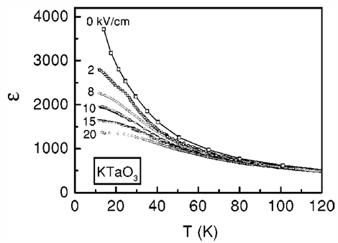
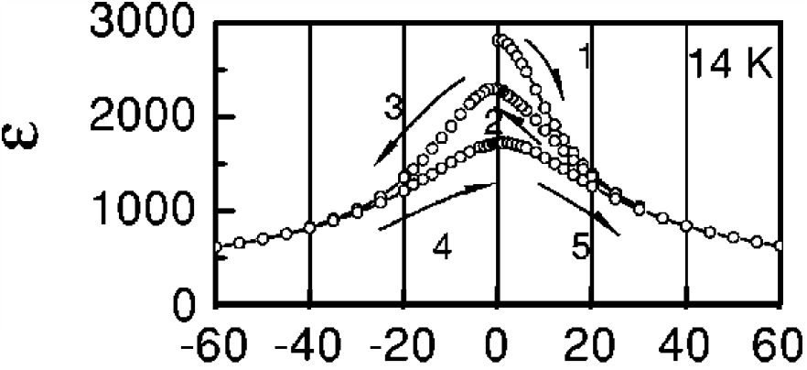
Capacitance measurements show how well KTaO₃ screens electric field
$$U_{s}=\frac{1}{2}Kx^{2}+\frac{1}{4}αx^{4}+\frac{1}{6}βx^{6}+QEx$$
Dielectric constant changes with applied electric field
C. Ang, et al. Phys. Rev. B 64, 184104 (2001)
Notes:
Additionally, capacitive measurements show …
Ignoring hysteresis in our analysis
This decrease in dielectr …
Atomic potential.. Nonlinearity

Slide 16
Combining inelastic neutron scattering and capacitance measurements gives Q
$$U_{s}=\frac{1}{2}Kx^{2}+\frac{1}{4}αx^{4}+\frac{1}{6}βx^{6}+QEx$$
Q is the Born Effective Charge
Function of screening and displacement
$Q=\sqrt{K V (ε−εo)}$
Energy
Displacement
Notes:
Add temperature dependence
We are interested in low temp – experiments have been done there (at that temp)
With a simple electrostatic model we can relate the spring contant and the dielectric constant to a quantity called the born effective charge…
This is what couples to the electric field ….

Slide 17
Theoretical Model
Lattice “spring constants”
Bonding parameters
Dielectric Screening
Electric Potential by layer
Lattice Displacements
Layer Charge Density
Black Box
Notes:
The lattice “spring constants” were found from inelastic neutron scattering data.
Got bonding parameters from ARPES data
Got the electric field dependence of the dielectric constant from capacitative measurements.
The temperature is implicitly contained in all the above measurements.
The size of the unit cell is a relatively well-known quantity in the field – but the number of layers of unit cells also needs to be input into the program.
The variable is the electric field.

Slide 18
Conclusions
Field-effect transistors made from perovskite materials are different than traditional silicon transistors
Lattice screening is very different – adds significant complication
Extracted information from literature about KTaO₃ to be inputs for a simple electrostatic model
Bonding parameters and “spring constants”
Dependence of dielectric constant on electric field
Born effective charge
Notes:
FETs made of perovskites are different
Lattice screening – added complication
Currently testing the code

Slide 19
Acknowledgements
SURF Program and SURF Directors
Mark Stiles (advisor)
Guru Khalsa (postdoctoral researcher)

